Slide 1
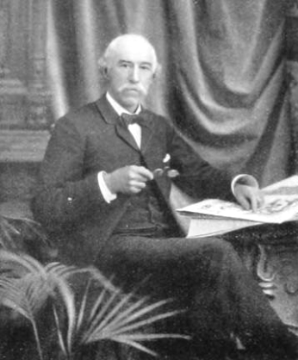
Robert Spear Dunning American Artist
1829-1905

Slide 2
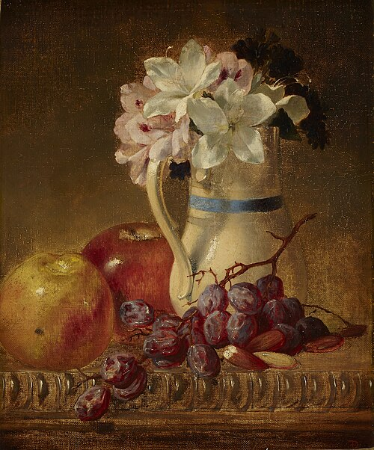
Still Life, 1862, oil on canvas, 33x25.4 cm, Indianapolis Museum of Art, USA https://commons.wikimedia.org/wiki/File:Robert_Spear_Dunning_-_Still_Life_-_79.338_-_Indianapolis_Museum_of_Art.jpg

Slide 3
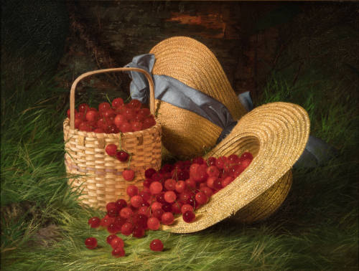
Harvest of Cherries, 1866, oil on canvas, 50.8 x 67.3 cm, Terra Foundation for American Art, Chicago, USA https://collection.terraamericanart.org/objects/573/harvest-of-cherries;jsessionid=6E95B6A1589D9AB792AE95D30953BDDE?ctx=b69c620fd362e3526fd1b8dce2d4304e91b9d21a&idx=0

Slide 4
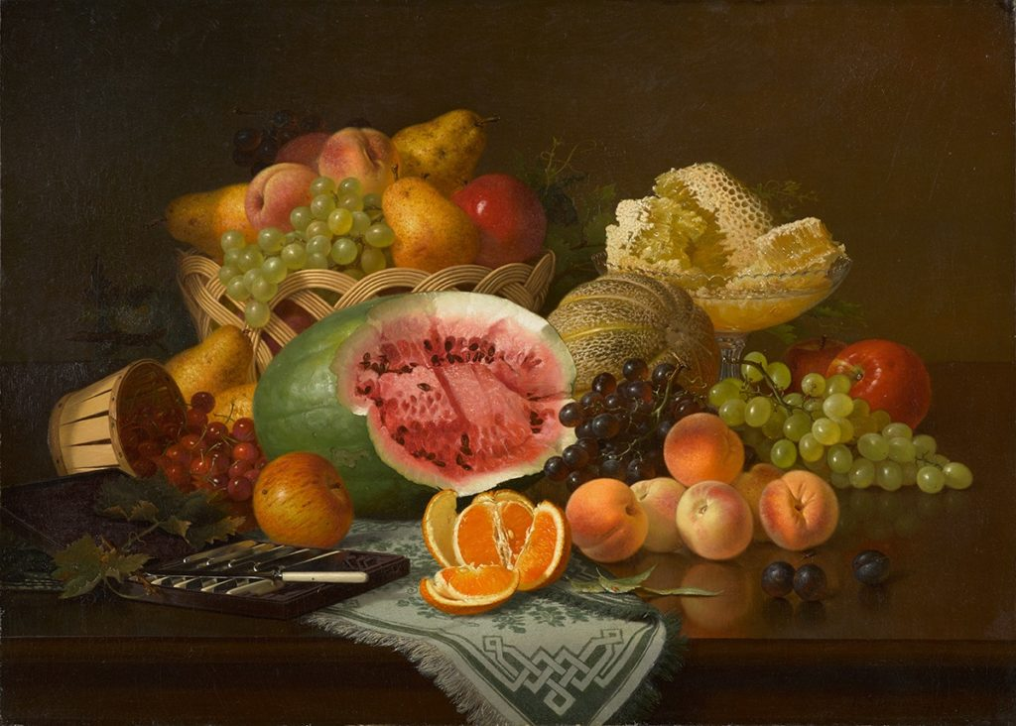
Still Life of Fruit, Honeycomb and Knives, 1867, oil on canvas, 66x92.7 cm, the North Carolina Museum of Art, USA https://learn.ncartmuseum.org/artwork/still-life-of-fruit-honeycomb-and-knives/

Slide 5
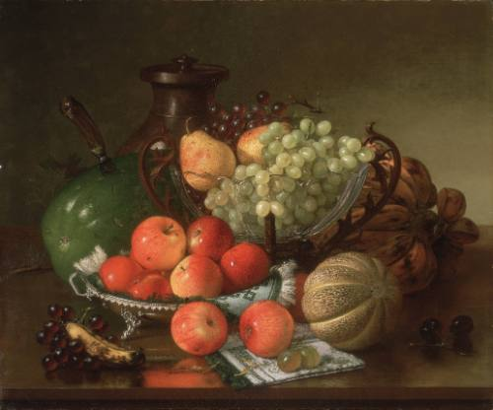
Still Life with Fruit, 1868, oil on canvas, 63.5 x 76.8 cm, Terra Foundation for American Art, Chicago, USA https://collection.terraamericanart.org/objects/527/still-life-with-fruit

Slide 6
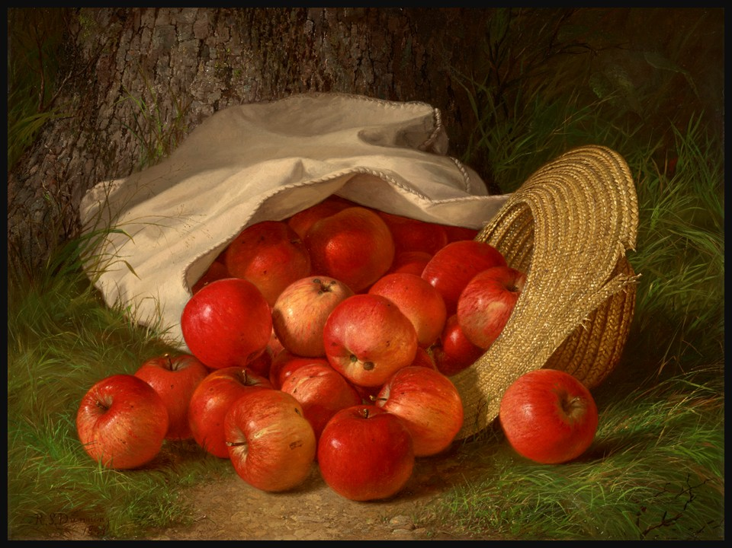
Apples, 1869, Oil on Canvas, 50.2 x 64.1 cm, Private Collection https://www.christies.com/en/lot/lot-6519615?ldp_breadcrumb=back

Slide 7
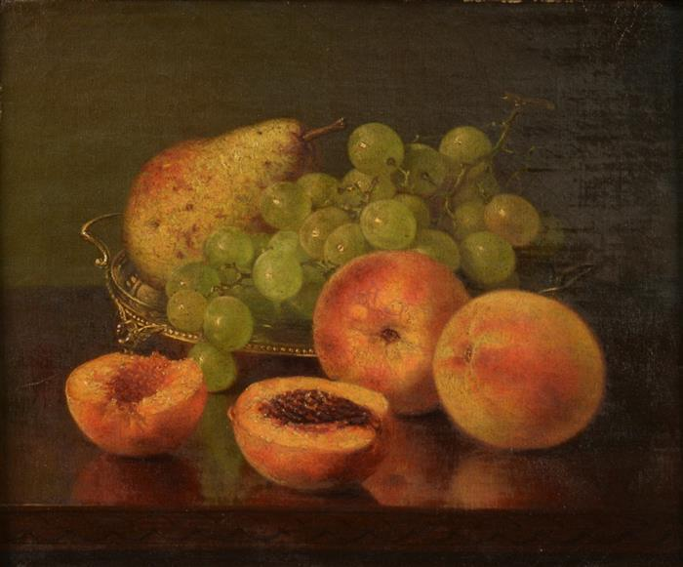
Still Life of Fruit, 1873, oil on canvas, 31.1 × 20.3 cm, Private Collection https://commons.wikimedia.org/wiki/File:Robert_Spear_Dunning_-_Still_Life_of_Fruit_(1873).jpg

Slide 8
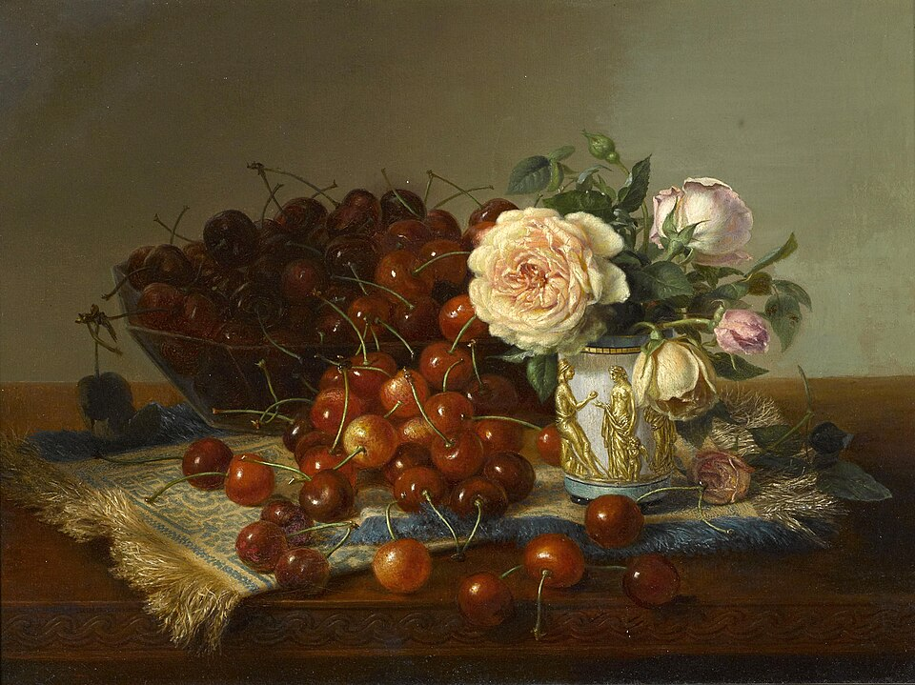
Still Life with Roses and Cherries, 1875, oil on canvas, 30.4x40.6 c, Private Collections https://commons.wikimedia.org/wiki/File:Robert_Spear_Dunning_-_Still_life_with_roses_and_cherries.jpg

Slide 9
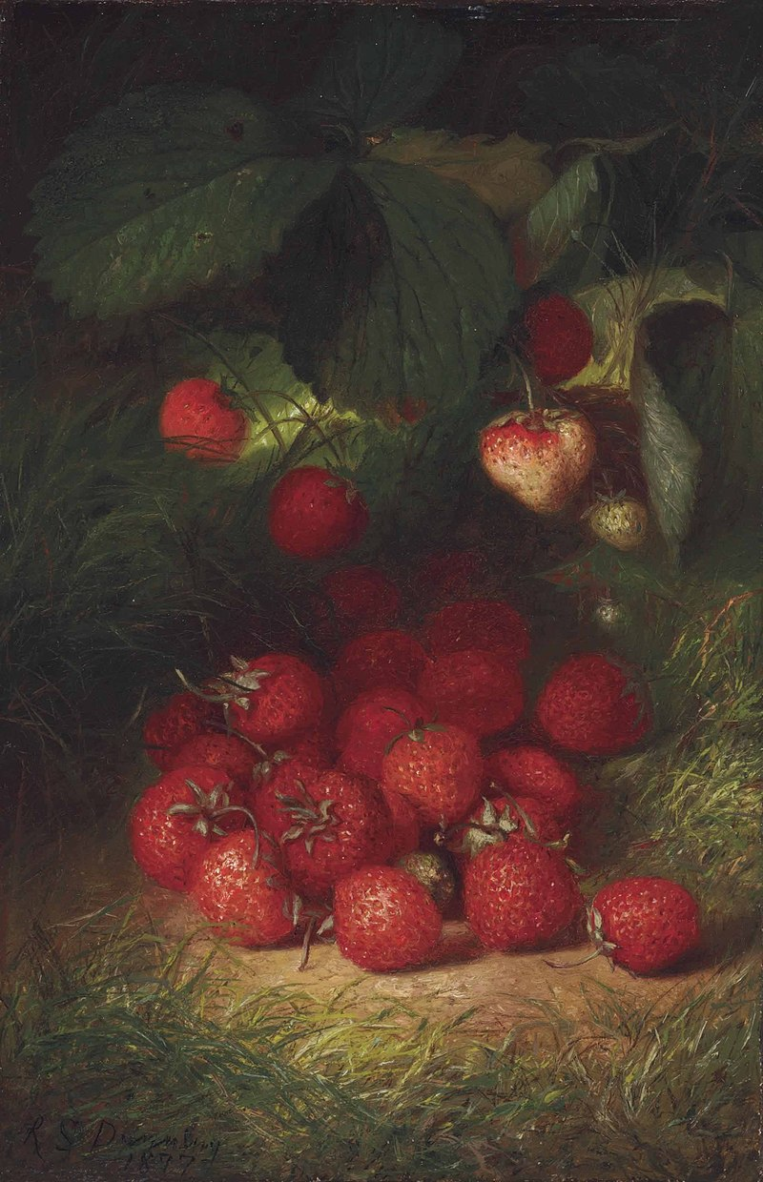
Strawberries, 1877, oil on canvas, 31.1x20.3 cm, Private Collection https://commons.wikimedia.org/wiki/File:Robert_Spear_Dunning_-_Strawberries_(1877).jpg

Slide 10
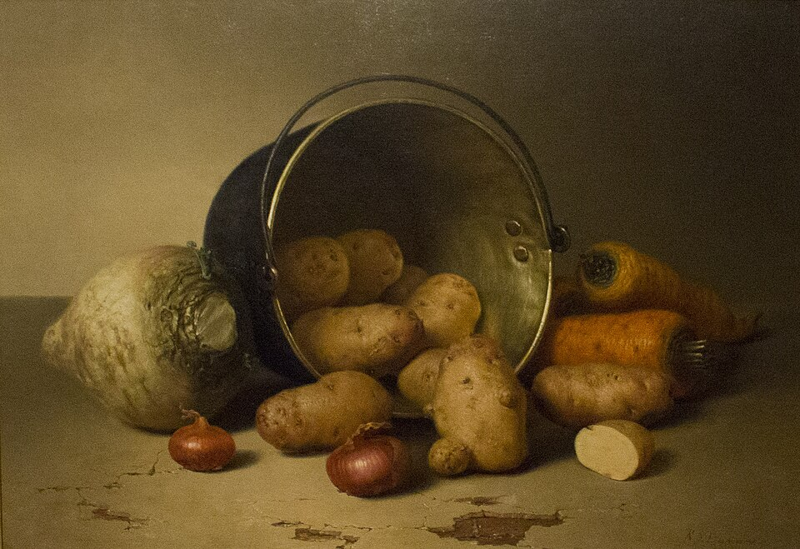
Still Life with Root Vegetables, 1879. oil on canvas, 43.8x61.9 cm, New Britain Museum of American Art https://commons.wikimedia.org/wiki/File:Robert_Spear_Dunning_-_Still_Life_with_Root_Vegetables_(New_Britain_Museum_of_American_Art).jpg

Slide 11
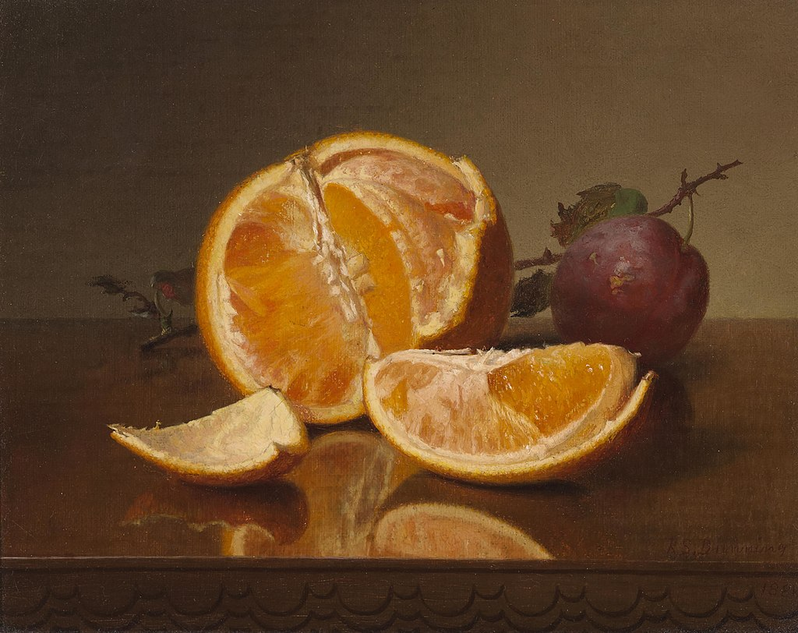
Still Life with Orange and Plum, 1881, oil on canvas, 20.3x25.4 cm, Private Collection https://commons.wikimedia.org/wiki/File:Robert_Spear_Dunning_-_Still_life_with_orange_and_plum.jpg

Slide 12
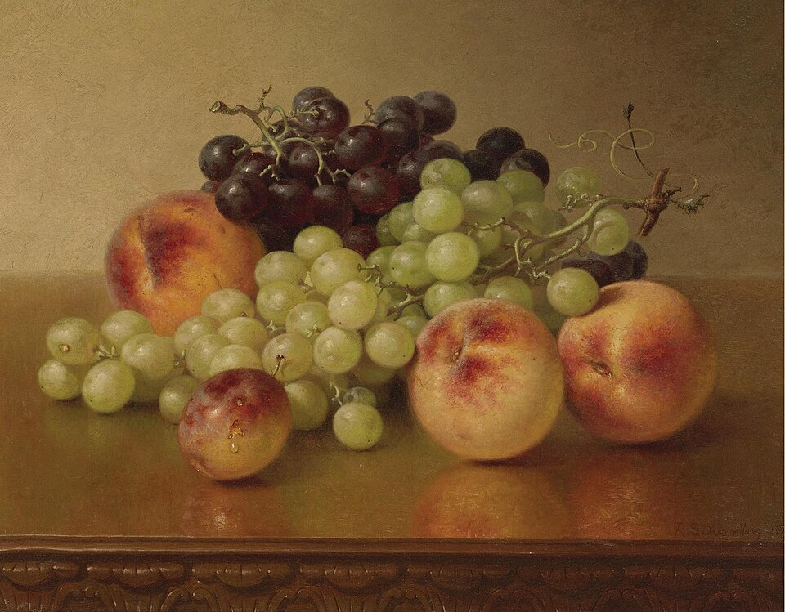
Peaches and grapes, 1886, oil on canvas, 30.5x38.7 cm, Private Collection https://commons.wikimedia.org/wiki/File:Robert_Spear_Dunning_-_Peaches_and_grapes.jpg

Slide 13
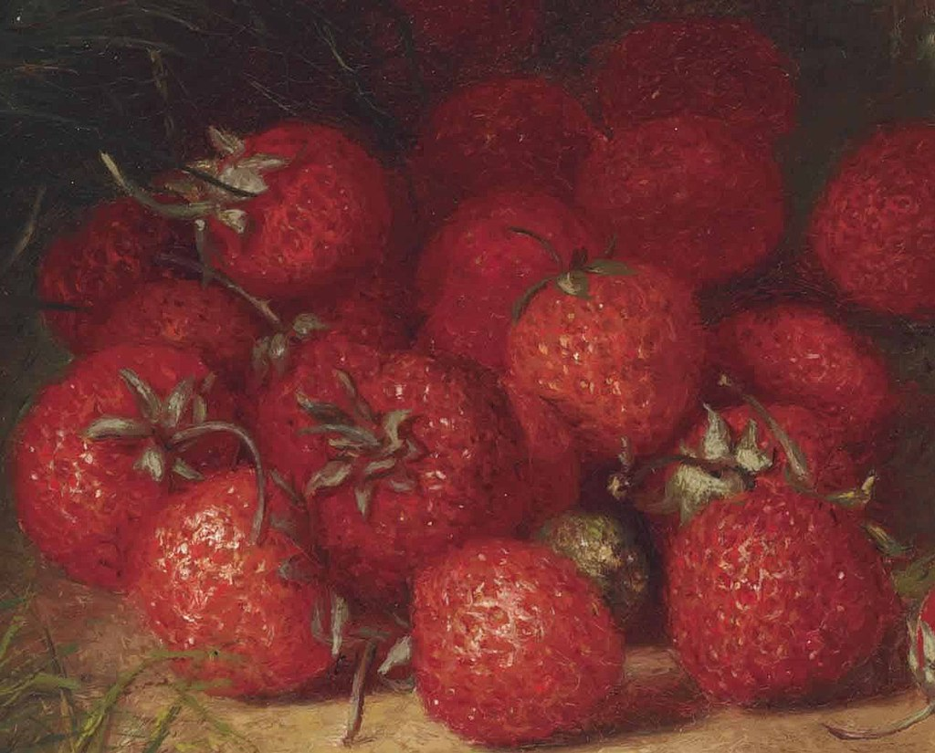
Strawberries, 1877, oil on canvas, 31.1x20.3 cm,
Private Collection https://commons.wikimedia.org/wiki/Category:Robert_Spear_Dunning#/media/File:Strawberry_details,_from-_Robert_Spear_Dunning_-_Strawberries_(1877)_(cropped).jpg

