Slide 1
Portraits of
Peter Paul Rubens
1577-1640
Isabella Brant
1591-1626
and their Children

Slide 2
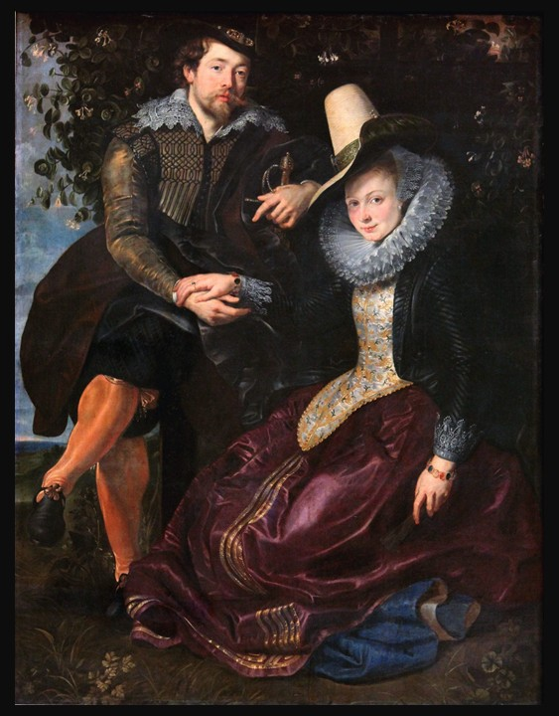
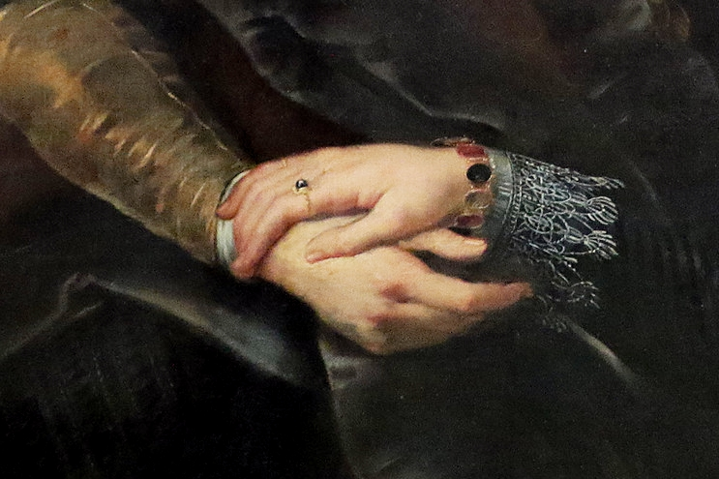
Rubens and Isabella Brant in the Honeysuckle Bower, c. 1609–10, Oil on Canvas, 178 x 136.5 cm, Alte Pinakothek, Munich, Germany https://smarthistory.org/peter-paul-rubens-and-isabella-brant-in-the-honeysuckle-bower/

Slide 3
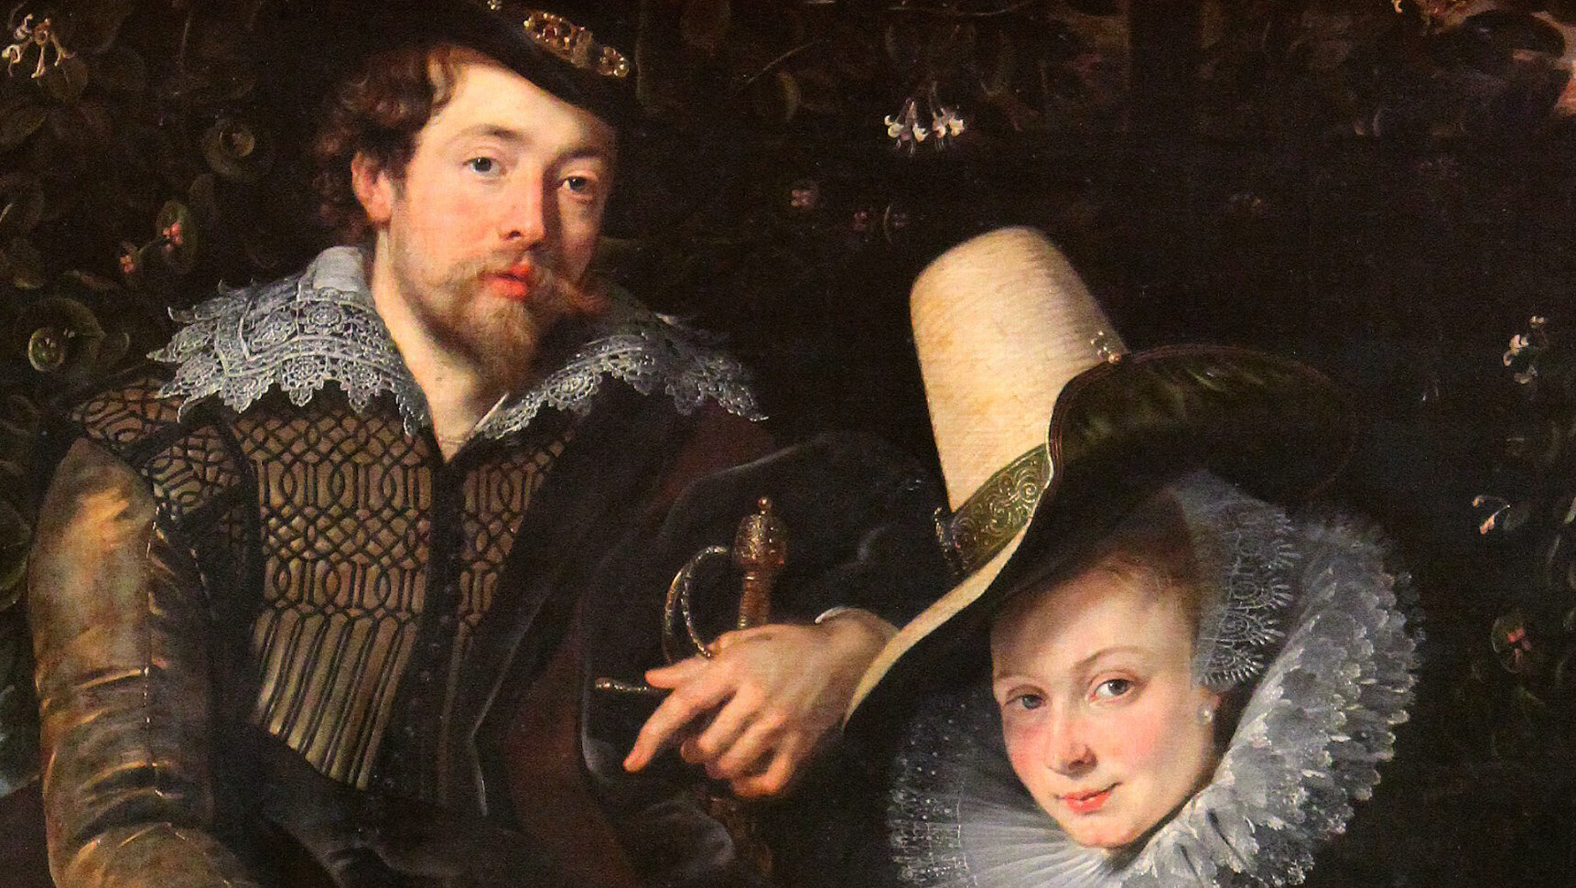
https://wendylovesjesus.wordpress.com/wp-content/uploads/2016/05/peter-paul-rubens.jpg

Slide 4
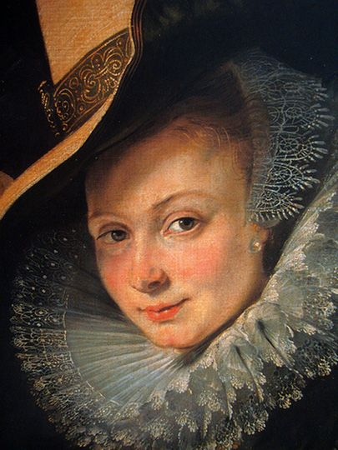
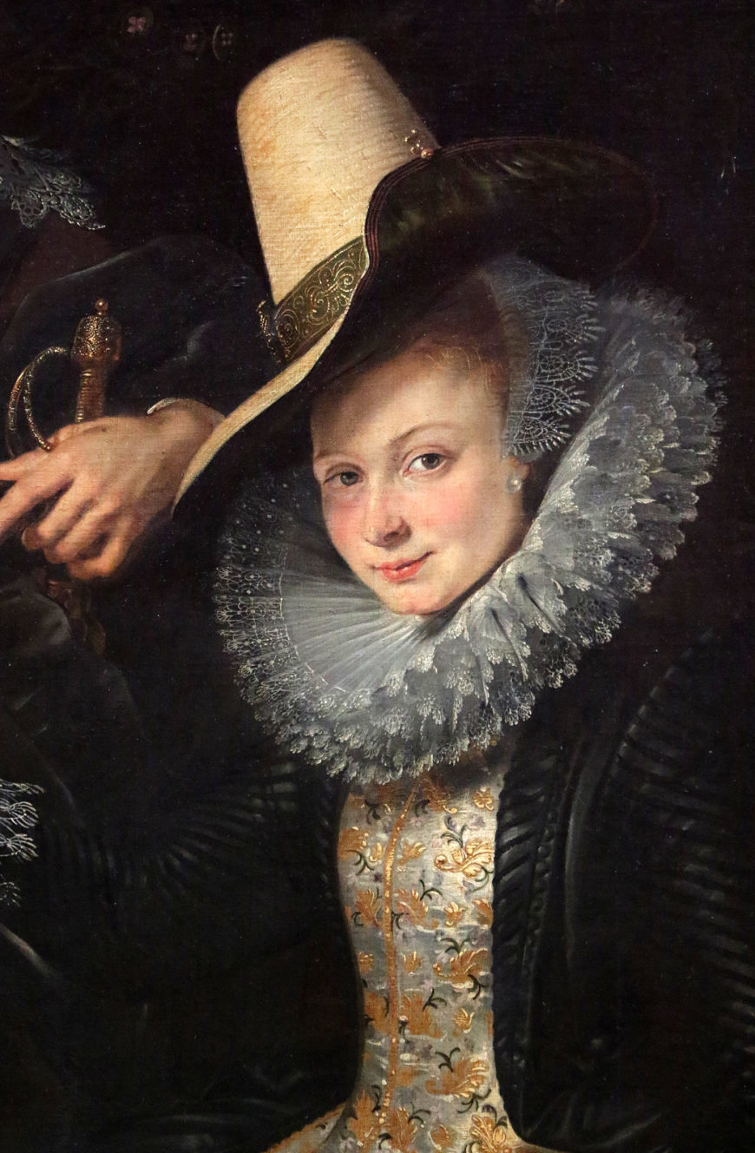
https://gr.pinterest.com/pin/561261172290943285/ and https://smarthistory.org/peter-paul-rubens-and-isabella-brant-in-the-honeysuckle-bower/

Slide 5
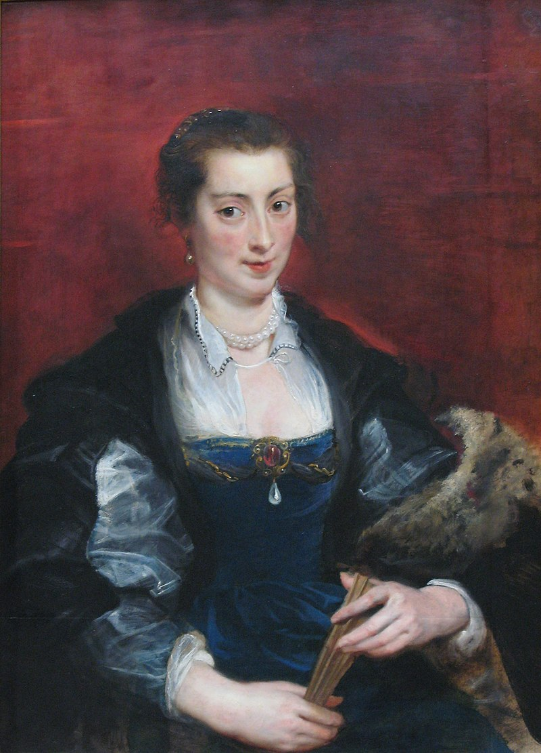
Isabella Brant (?), c. 1626, Oil on Oak, 98 x 72 cm, Staatliche Museen, Berlin, Germany https://commons.wikimedia.org/wiki/Category:Portrait_of_a_woman,_possibly_Isabella_Brant_(Rubens)#/media/File:Portrait_of_a_Woman_by_Rubens_(1637).jpg

Slide 6
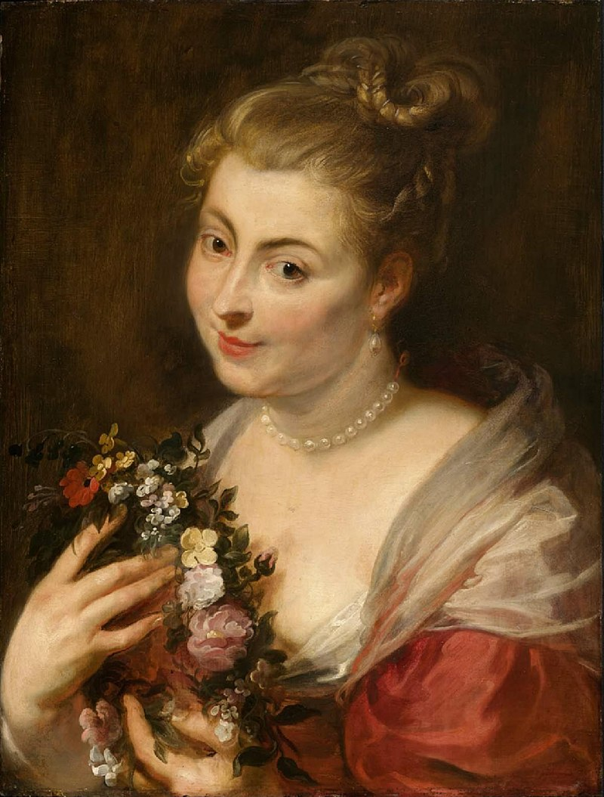
Isabella Brant as Glycera, 1616?, Oil on Panel, 64.2 x 49.2 cm, MFA, Boston, USA https://collections.mfa.org/objects/32661

Slide 7
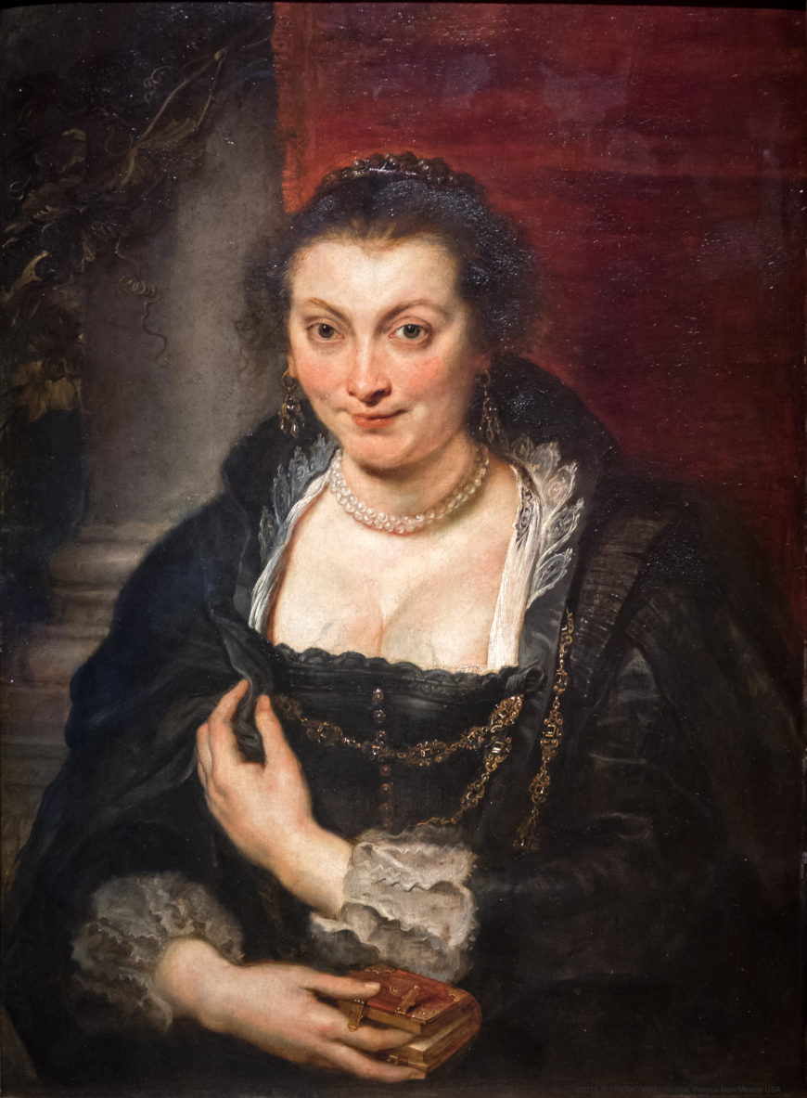
Isabella Brant, c. 1626, Oil on Canvas, 86 x 62 cm, Galleria degli Uffizi, Florence, Italy https://smarthistory.org/peter-paul-rubens-and-isabella-brant-in-the-honeysuckle-bower/

Slide 8
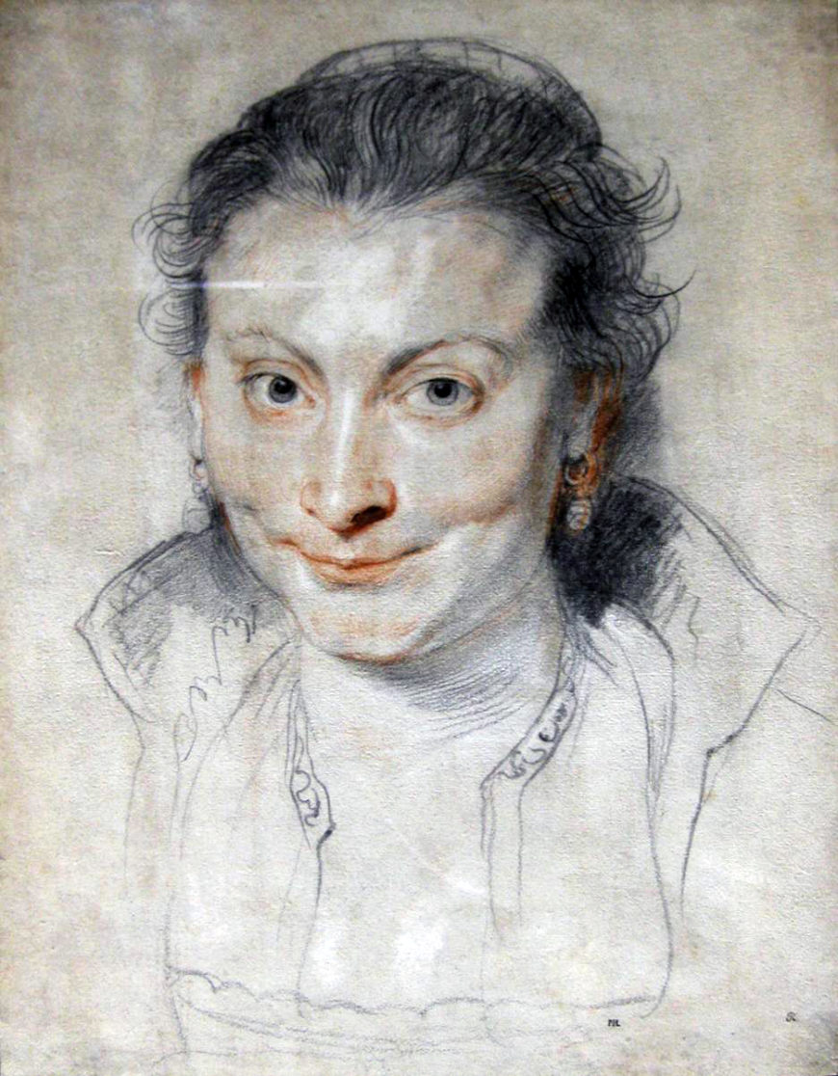
Isabella Brant, c. 1621, Black Chalk, Pen and Brown Ink on Blue Paper, 38.1 x 29.4 cm, British Museum, London, UK https://smarthistory.org/peter-paul-rubens-and-isabella-brant-in-the-honeysuckle-bower/

Slide 9
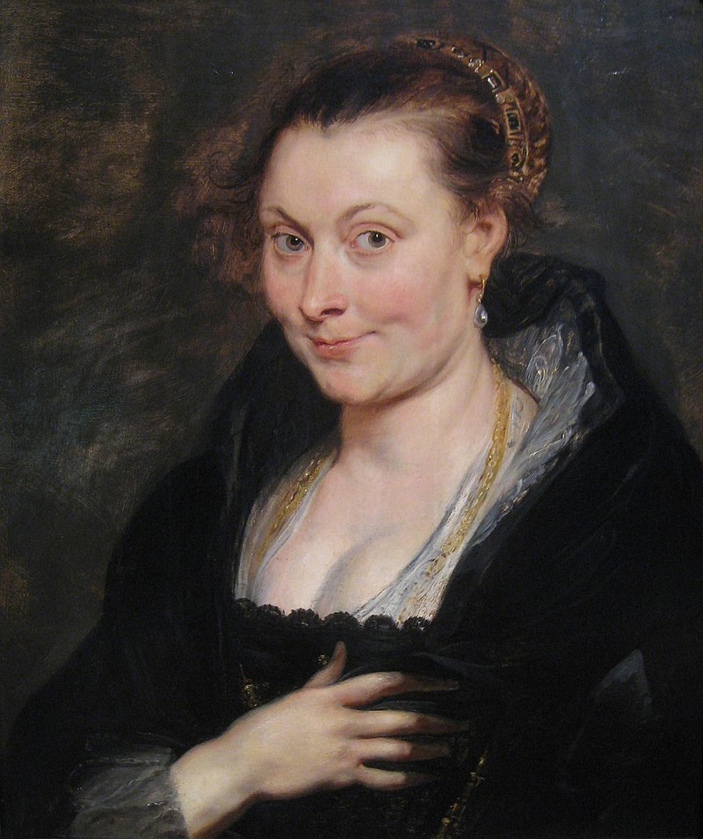
Portrait of Isabella Brant, c. 1620–25, Oil on Wood, 53 x 46 cm, The Cleveland Museum of Art, USA https://commons.wikimedia.org/wiki/File:Portrait_of_Isabella_Brant_by_Peter_Paul_Rubens.jpg#/media/File:Peter_Paul_Rubens_-_Portrait_of_Isabella_Brant_-_1947.207_-_Cleveland_Museum_of_Art.tif

Slide 10
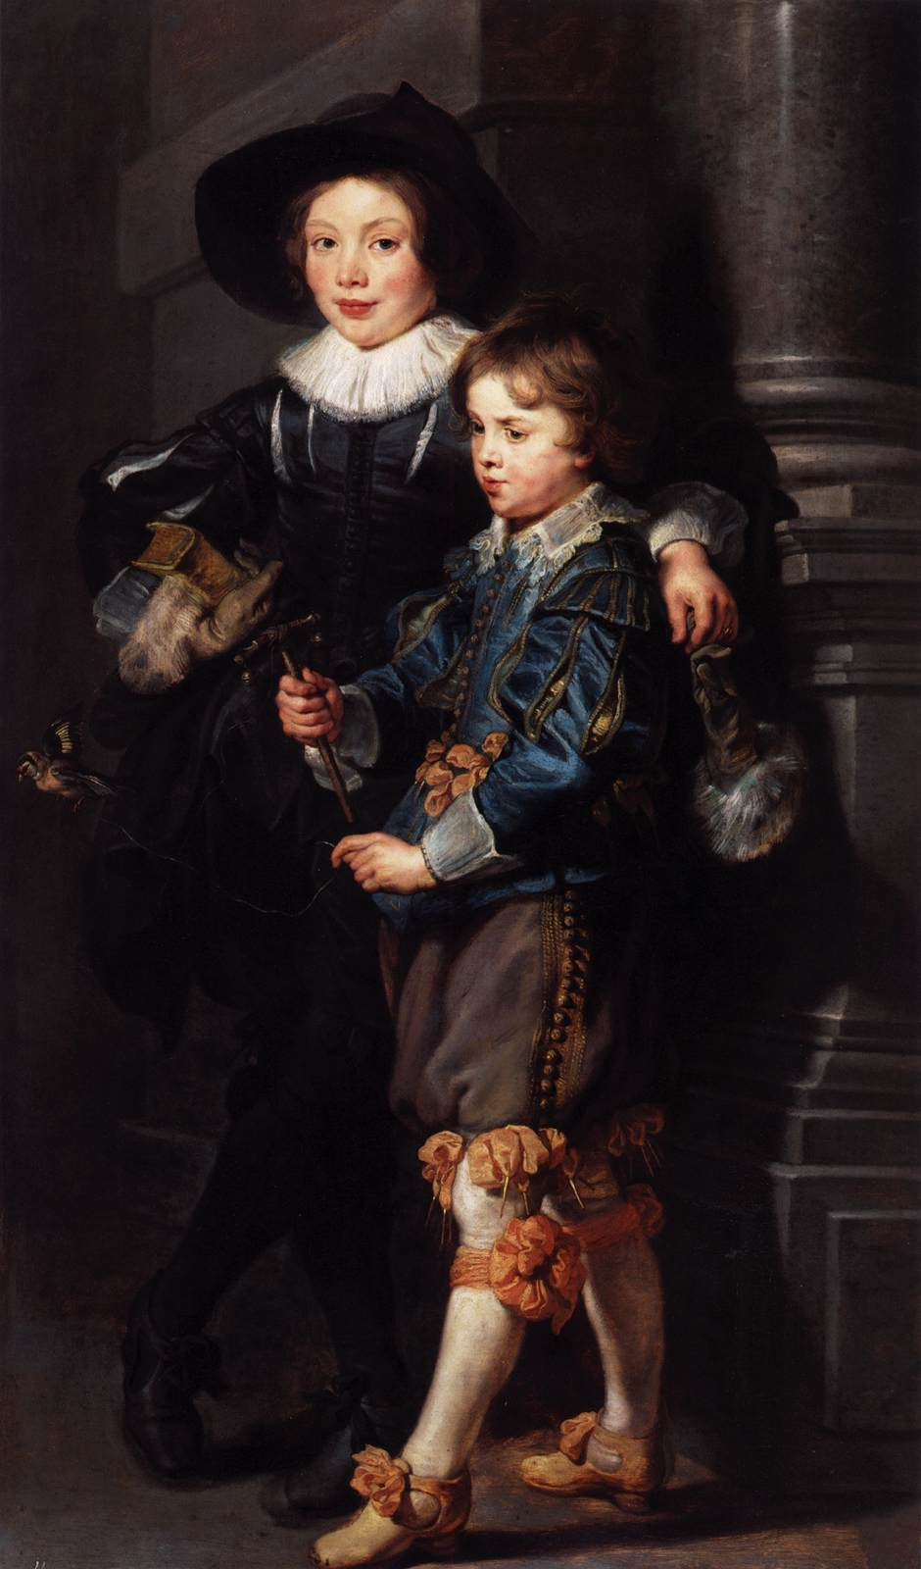
Albert and Nicolaas Rubens (the couple’s sons), , 1626-27, Oil on Wood, 157 x 93 cm, LIECHTENSTEIN, The Princely Collections, Vaduz–Vienna, Austria https://www.wga.hu/frames-e.html?/html/r/rubens/index.html

Slide 11
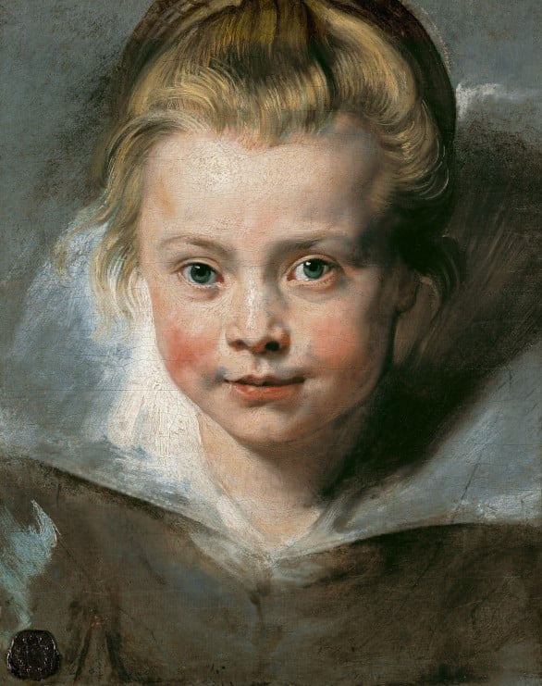
Portrait of a Young Girl (the couple’s daughter Clara Serena), 1615-16, Oil on Canvas, 37 x 27 cm,
LIECHTENSTEIN, The Princely Collections, Vaduz–Vienna, Austria https://www.liechtensteincollections.at/en/collections-online/portrait-of-clara-serena-rubens-the-artist-s-daughter-1611-1623

Slide 12
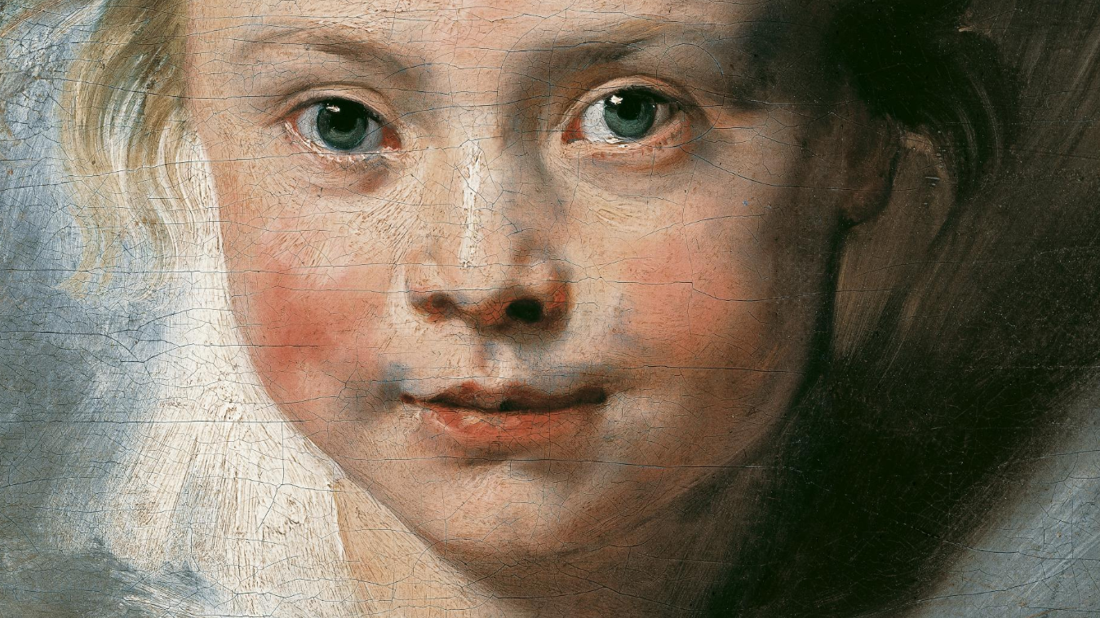
https://www.liechtensteincollections.at/en/collections-online/portrait-of-clara-serena-rubens-the-artist-s-daughter-1611-1623

Slide 13
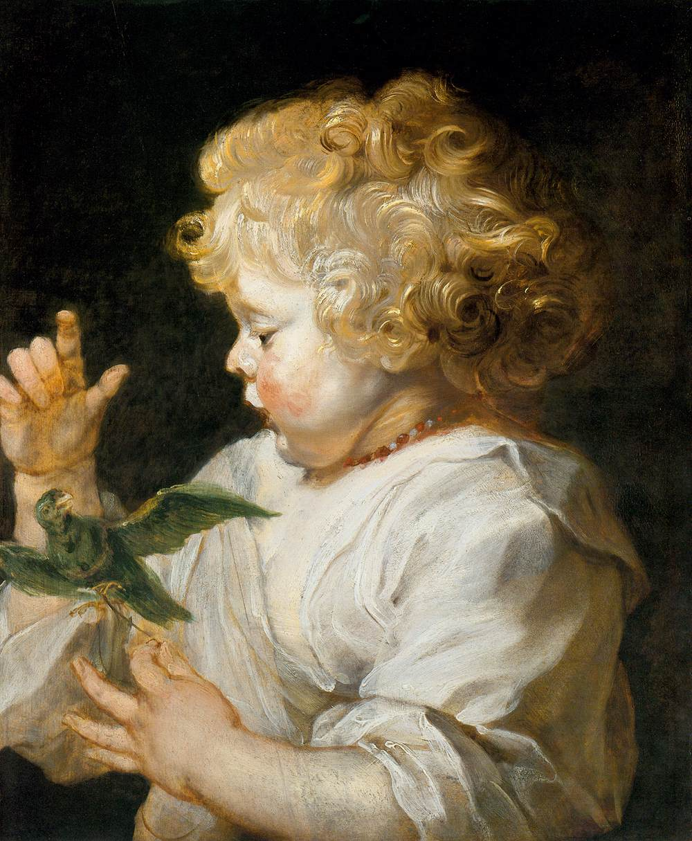
Boy with Bird (in all probability the couple’s first son Albert, c. 1616, Oil on Panel, 49 x 40 cm, Staatliche Museen, Berlin, Germany https://www.wga.hu/frames-e.html?/html/r/rubens/index.html

Slide 14
The End

