Slide 1
The Ancient City of Hephaistia
on the island of Lemnos

Slide 2
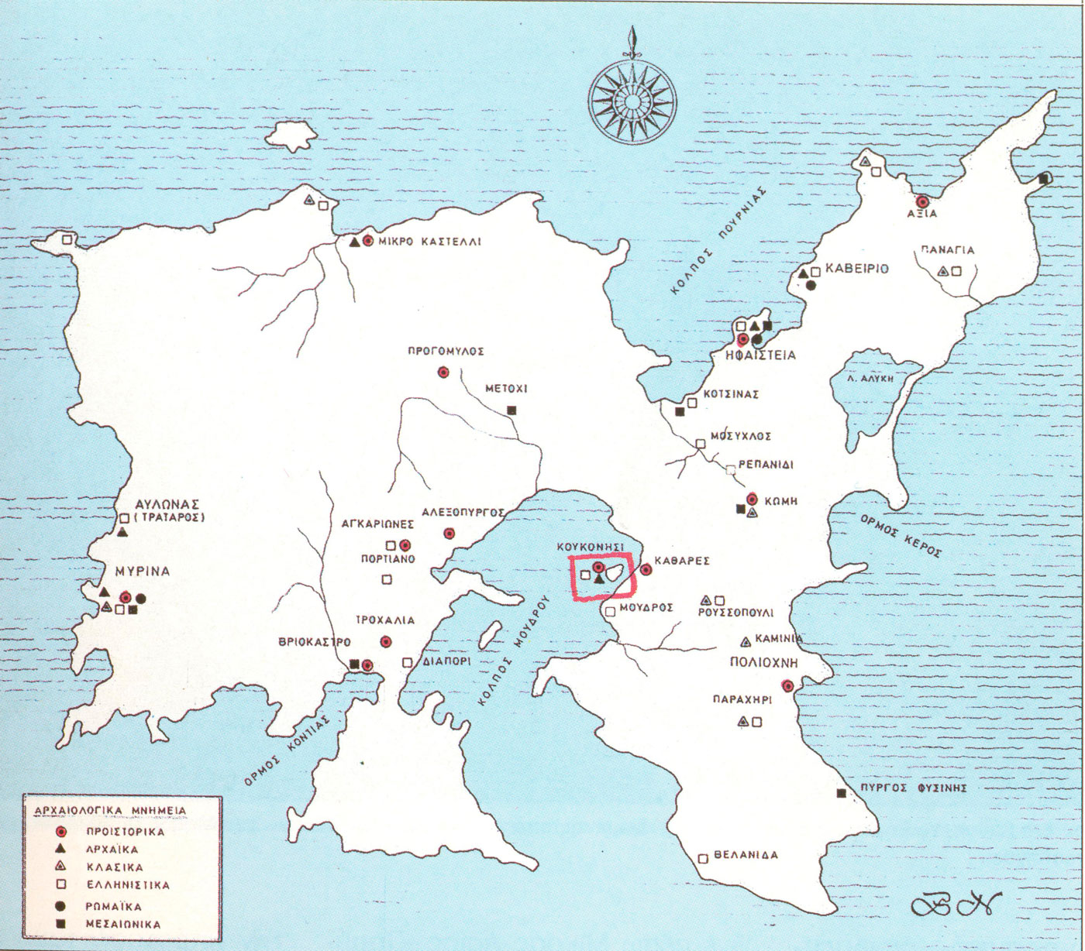
https://www.aegeantravel.eu/en/%CE%B7-%CE%BB%CE%AE%CE%BC%CE%BD%CE%BF%CF%82/%CE%B7-%CE%B9%CF%83%CF%84%CE%BF%CF%81%CE%AF%CE%B1-%CF%84%CE%B7%CF%82-%CE%BB%CE%AE%CE%BC%CE%BD%CE%BF%CF%85/

Slide 3
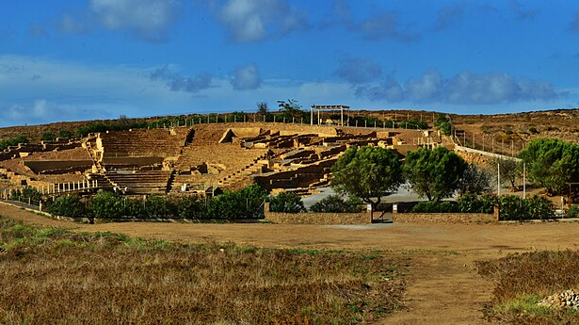
https://el.wikipedia.org/wiki/%CE%91%CF%81%CF%87%CE%B5%CE%AF%CE%BF:Ancient_Hephaistia_Lemnos_theatre.jpg

Slide 4
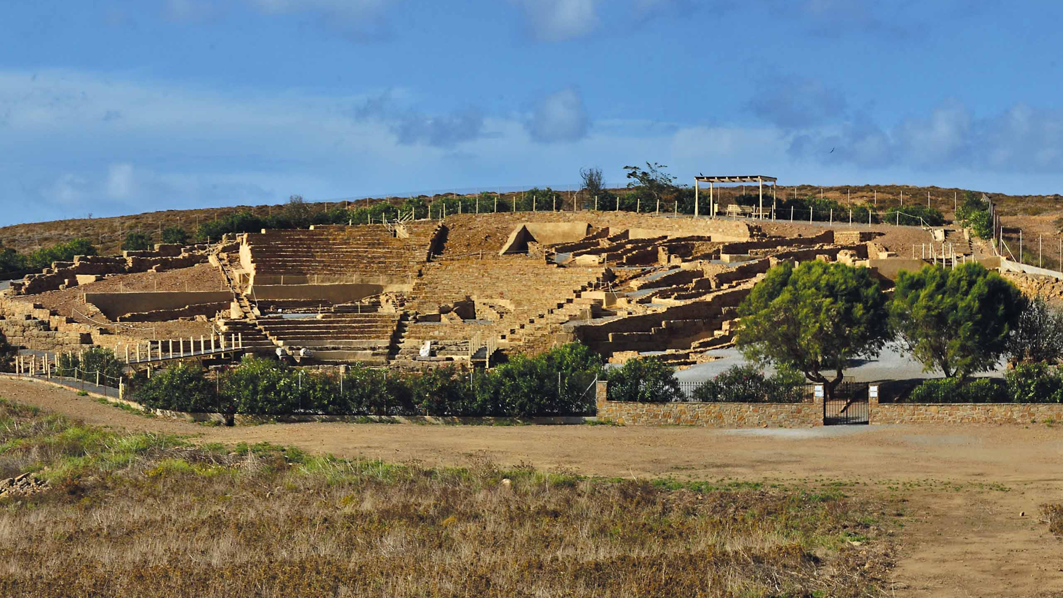
https://greekdestinations.gr/places-and-attractio/lemnos/

Slide 5
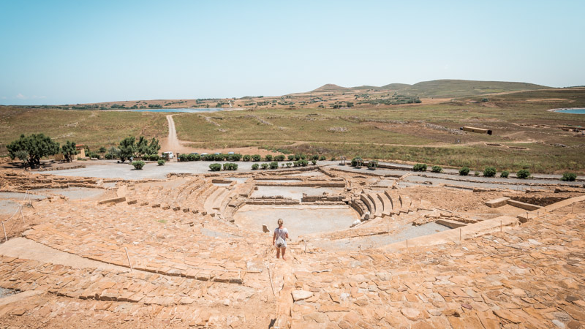
https://www.aegeantravel.eu/en/%CE%B7-%CE%BB%CE%AE%CE%BC%CE%BD%CE%BF%CF%82/%CE%B7-%CE%B9%CF%83%CF%84%CE%BF%CF%81%CE%AF%CE%B1-%CF%84%CE%B7%CF%82-%CE%BB%CE%AE%CE%BC%CE%BD%CE%BF%CF%85/

Slide 6
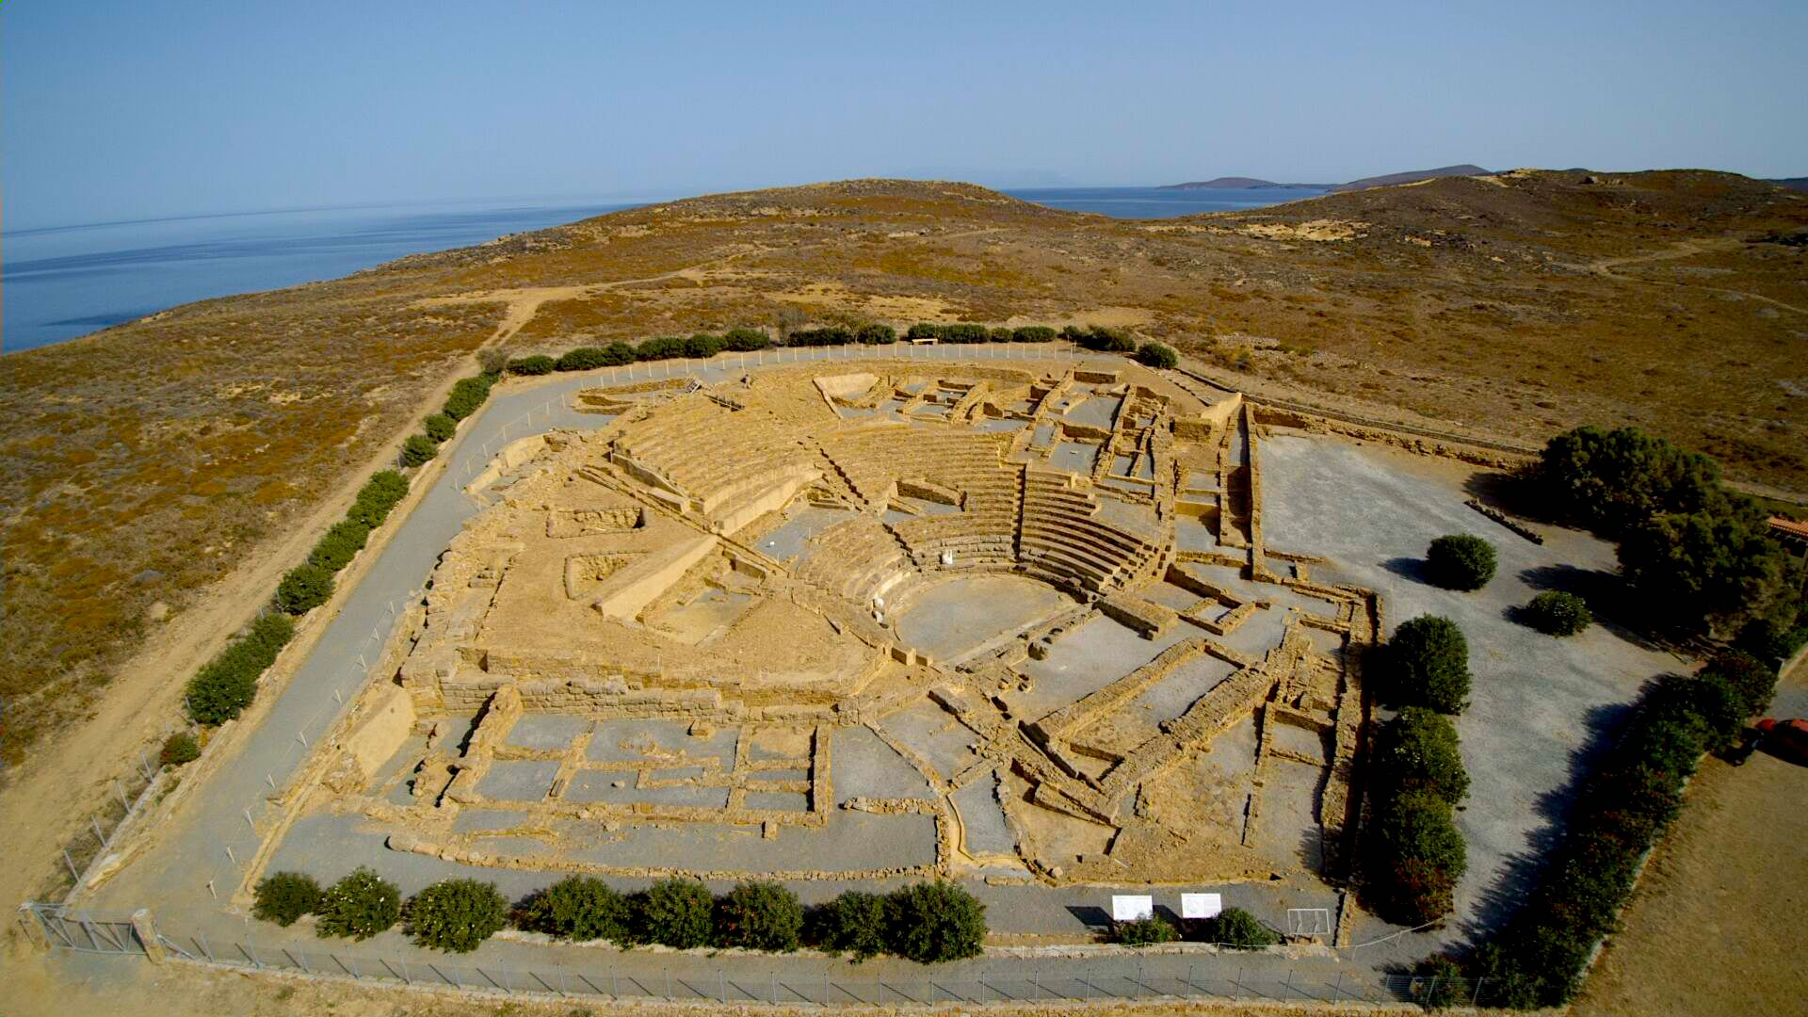
https://commons.wikimedia.org/wiki/File:%CE%91%CF%81%CF%87%CE%B1%CE%AF%CE%BF_%CE%B8%CE%AD%CE%B1%CF%84%CF%81%CE%BF_%CE%97%CF%86%CE%B1%CE%B9%CF%83%CF%84%CE%AF%CE%B1%CF%82._4.jpg

Slide 7
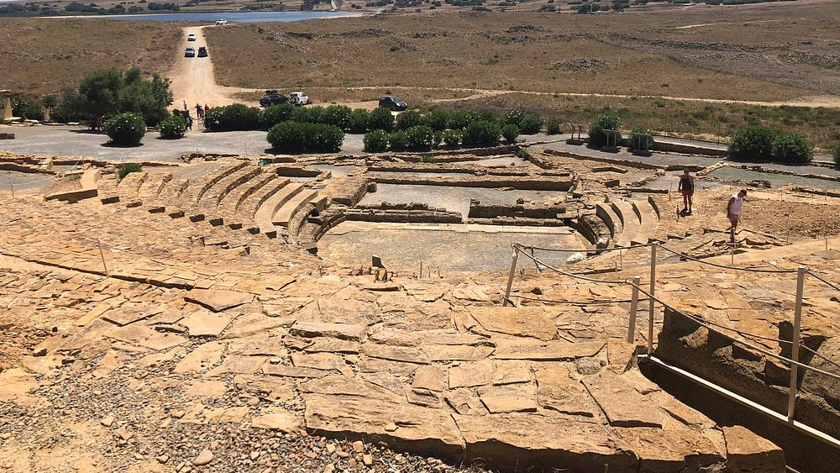
https://www.tripadvisor.com/Attraction_Review-g189478-d7062992-Reviews-or10-Ancient_Theater-Lemnos_Northeast_Aegean_Islands.html#/media/7062992/?albumid=-160&type=ALL_INCLUDING_RESTRICTED&category=-160

Slide 8
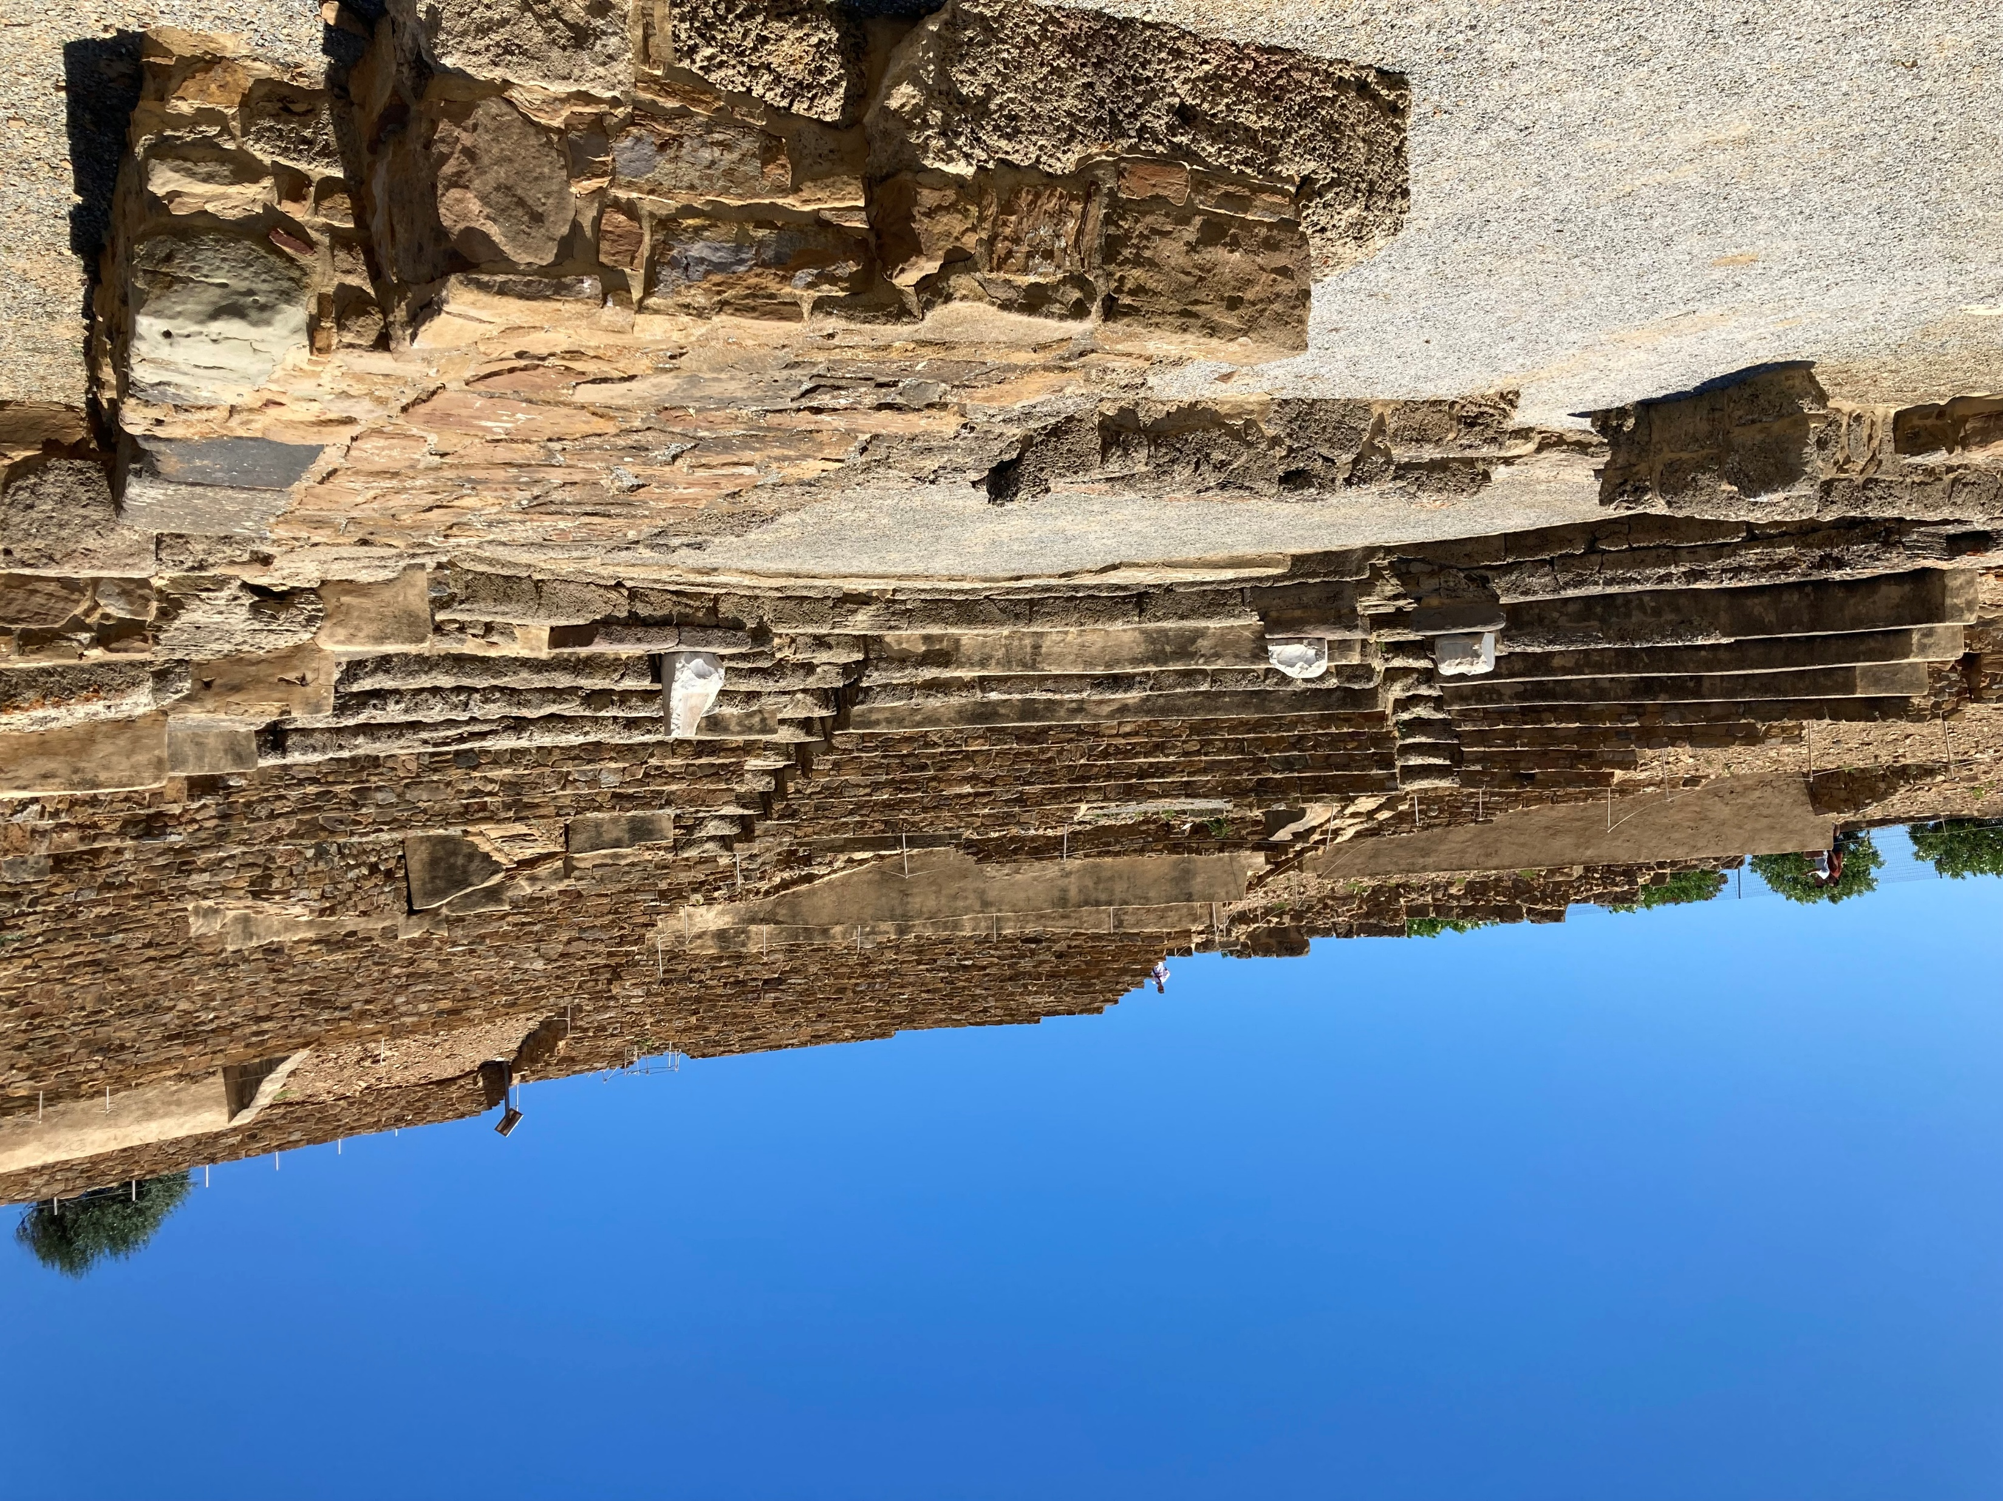
Photo Credit: Amalia Spiliakou, July 2025

Slide 9
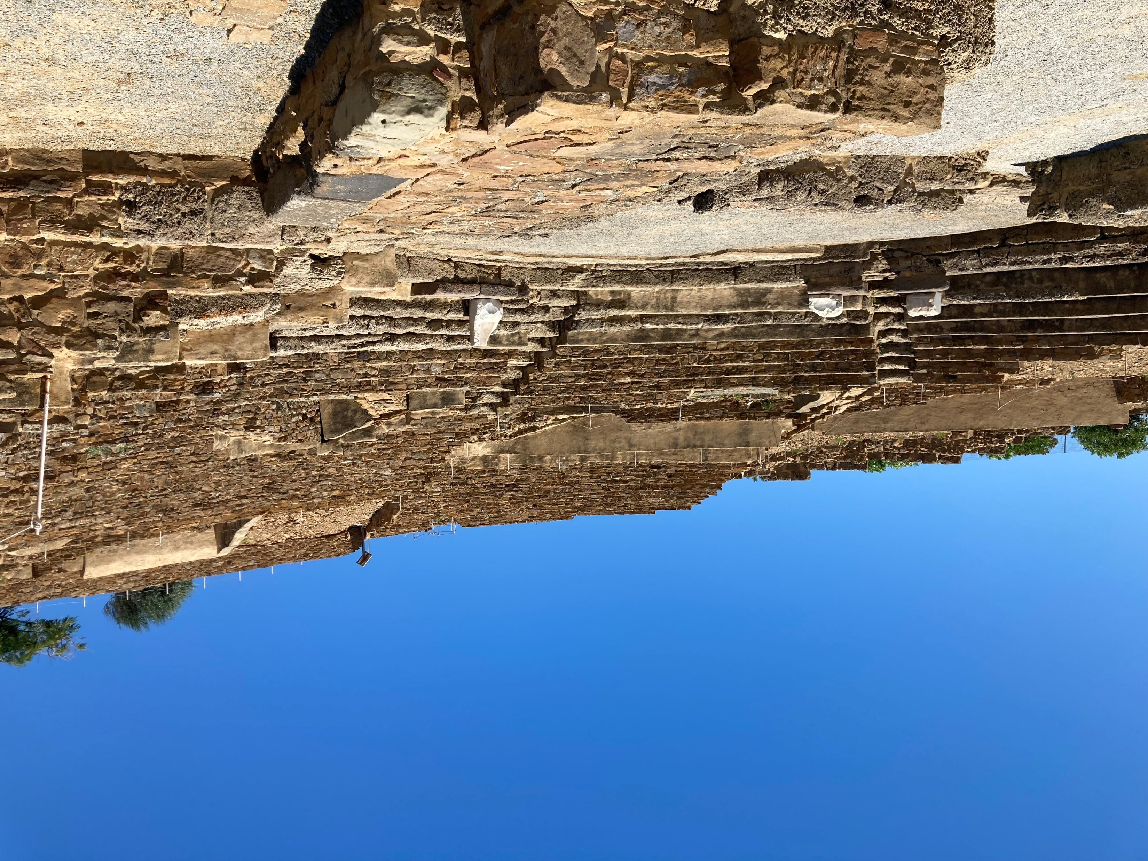
Photo Credit: Amalia Spiliakou, July 2025

Slide 10
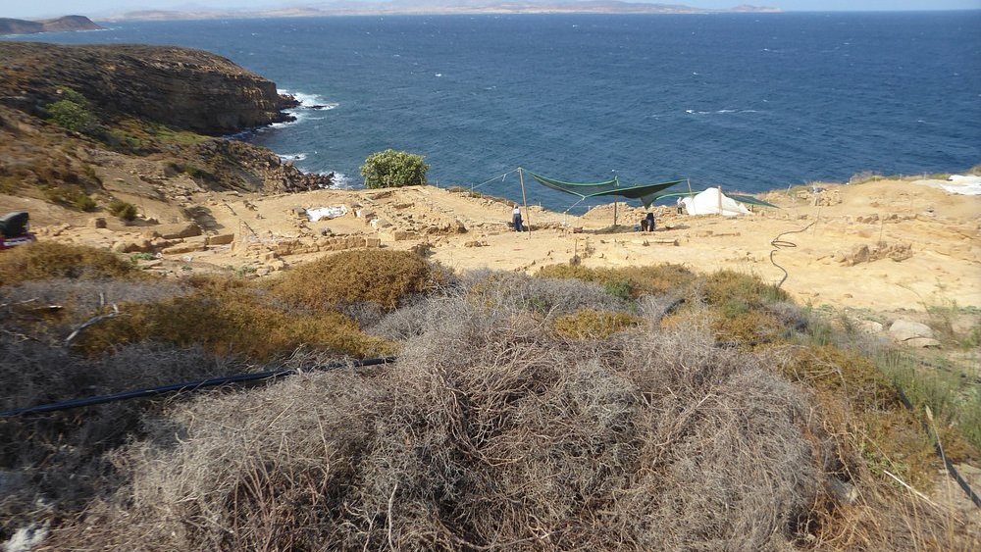
https://www.tripadvisor.com/Attraction_Review-g189478-d7062992-Reviews-or10-Ancient_Theater-Lemnos_Northeast_Aegean_Islands.html#/media/7062992/?albumid=-160&type=ALL_INCLUDING_RESTRICTED&category=-160

Slide 11
The End

