Slide 1
Loreno di Credi
1456/59-1537
10 Paintings

Slide 2
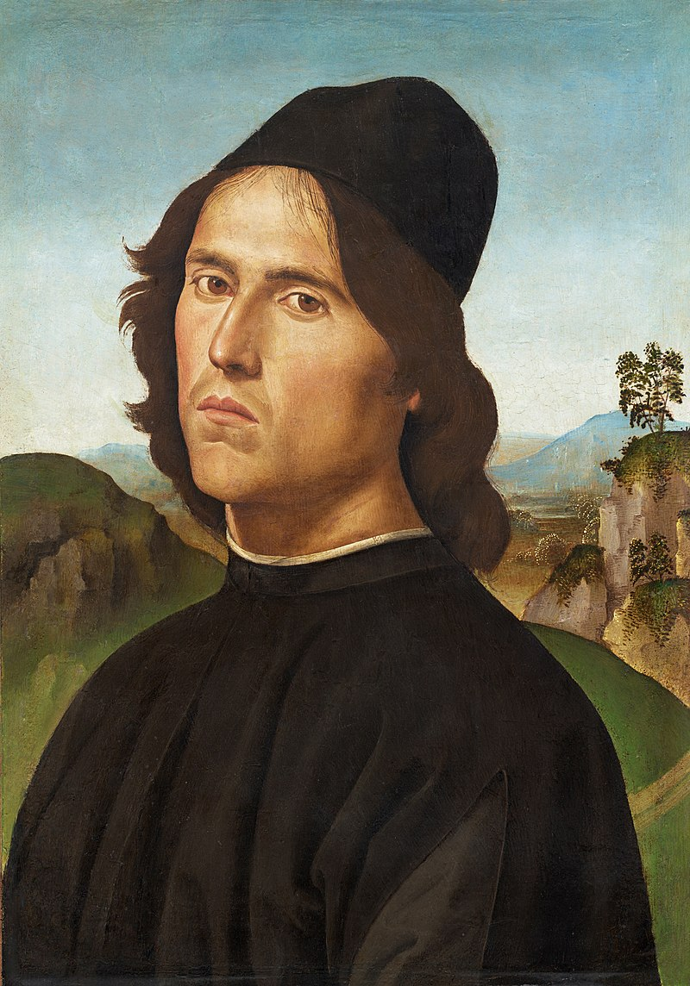
Pietro Perugino, 1448-1523
Portrait of Lorenzo di Credi, 1488, Oil transferred on canvas, on panel, 44 x 30.5 cm, National Gallery, Washington DC, USA https://commons.wikimedia.org/wiki/File:Lorenzo_di_Credi_by_Perugino.jpg#/media/File:Lorenzo_di_Credi_by_Perugino.jpg/2

Slide 3
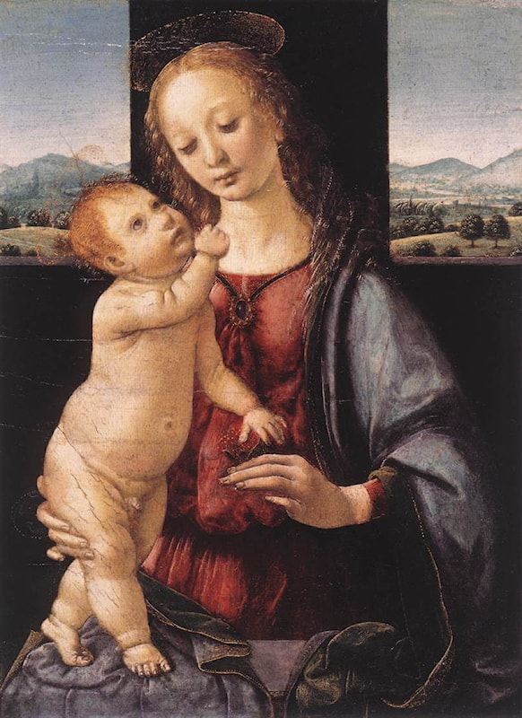
Madonna and Child with a Pomegranate, 1475-80, Oil on Panel, 16,5 x 13,4 cm, National Gallery of Art, Washington DC, USA https://www.artrenewal.org/artworks/madonna-and-child-with-a-pomegranate/leonardo-da-vinci/12932

Slide 4
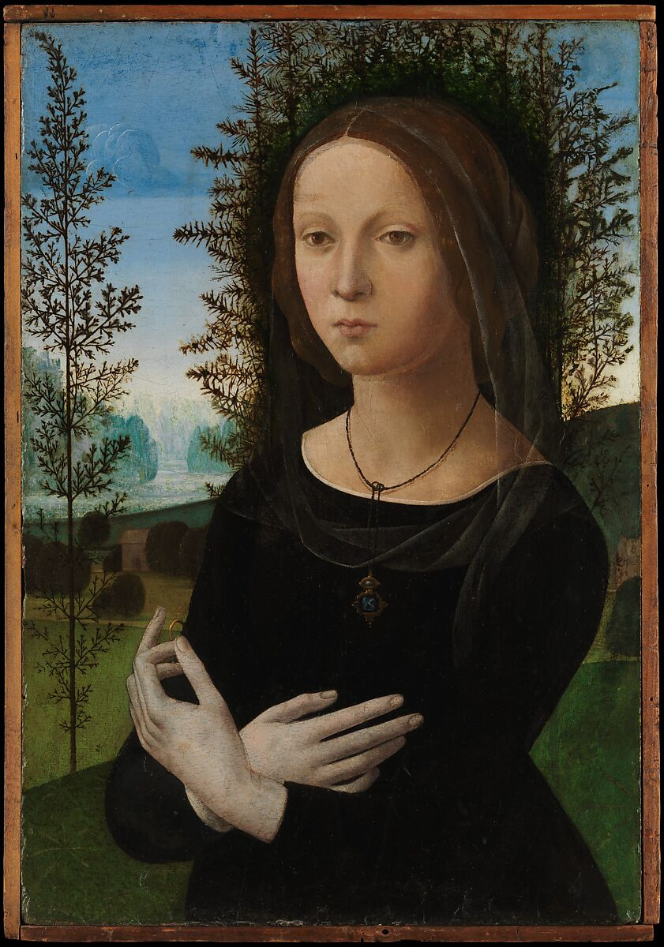
Portrait of a Young Woman, 1475-80, Tempera and oil on wood, 59 x 40 cm, Metropolitan Museum of Art, New York, USA https://www.metmuseum.org/art/collection/search/436910

Slide 5
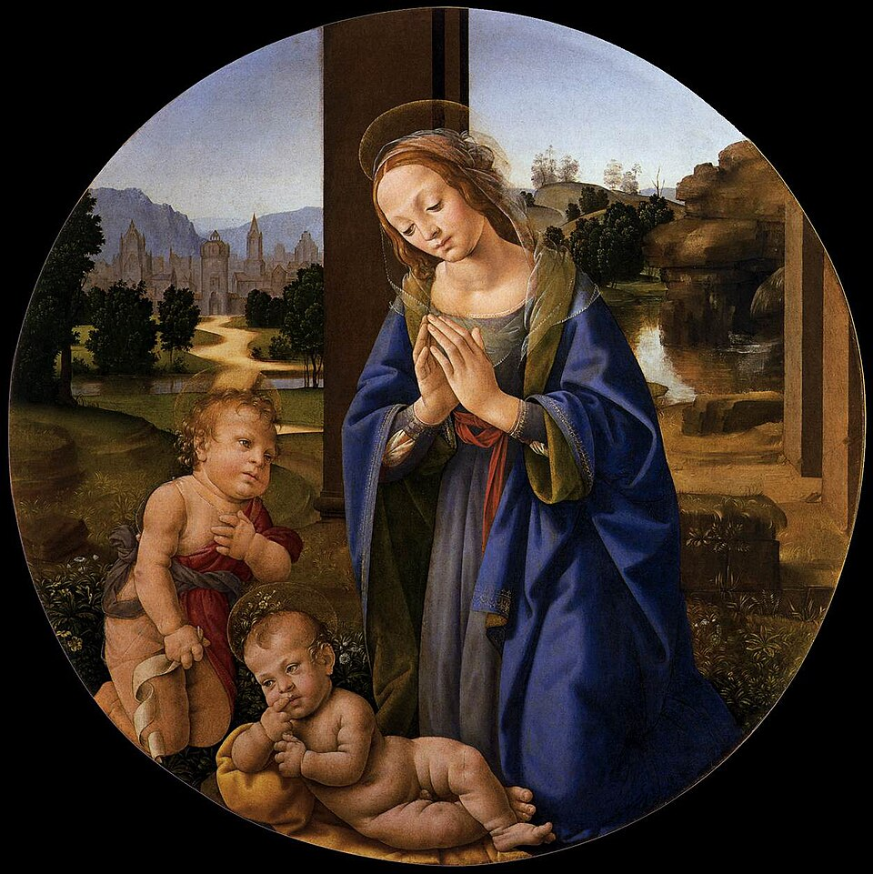
Adoration of the Child, c. 1480, Panel, diameter 27 cm, Fondazione Querini Stampalia, Venice, Italy https://commons.wikimedia.org/wiki/File:Lorenzo_di_credi,_adorazione_del_bambino.jpg

Slide 6
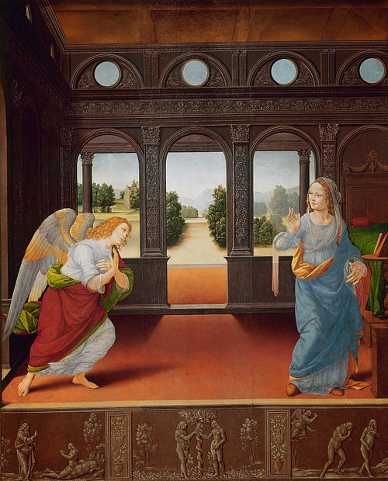
Annunciation, 1480-85, Tempera on panel, 88 x 71 cm, Galleria degli Uffizi, Florence, Italy https://it.m.wikipedia.org/wiki/File:Lorenzo_di_credi,_annunciazione_1480_01.jpg

Slide 7
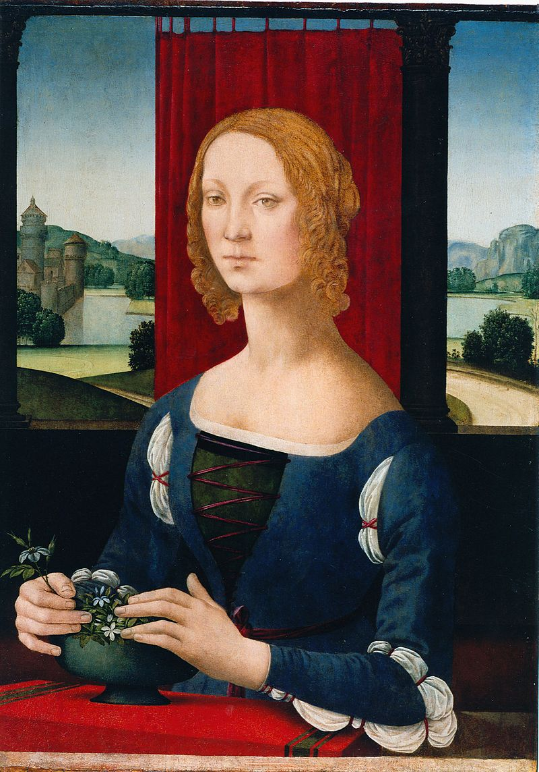
Lady of the Jasmin, circa 1483, Oil on canvas, 75 x 54 cm, Forlì Municipal Art Gallery, Italy https://commons.wikimedia.org/wiki/File:Caterina_Sforza_incut.jpg#/media/File:Caterina_Sforza_incut.jpg/2

Slide 8
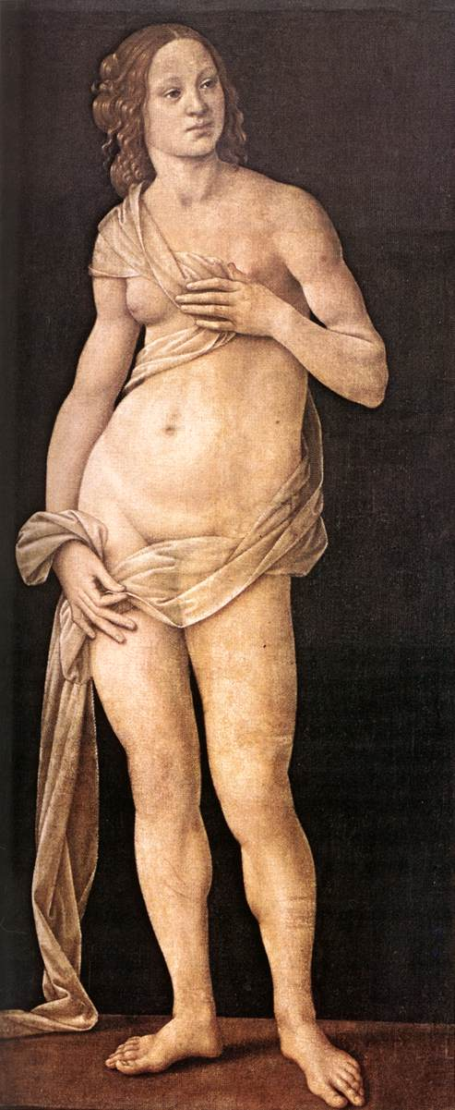
Venus, c. 1490, Oil on canvas, 151 x 69 cm, Galleria degli Uffizi, Florence, Italy https://www.wga.hu/frames-e.html?/html/l/lorenzo/credi/index.html

Slide 9
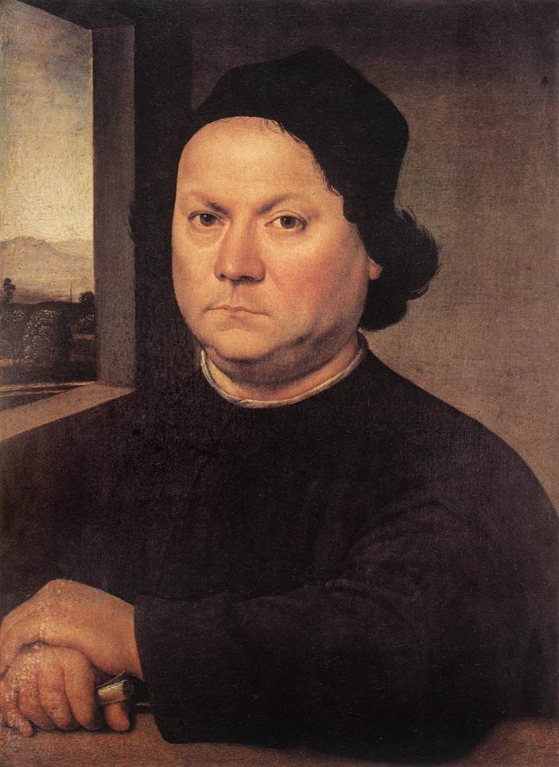
Portrait of a Man, c. 1504, Oil on wood, 51 x 37 cm, Galleria degli Uffizi, Florence, Italy https://www.wga.hu/frames-e.html?/html/l/lorenzo/credi/index.html

Slide 10
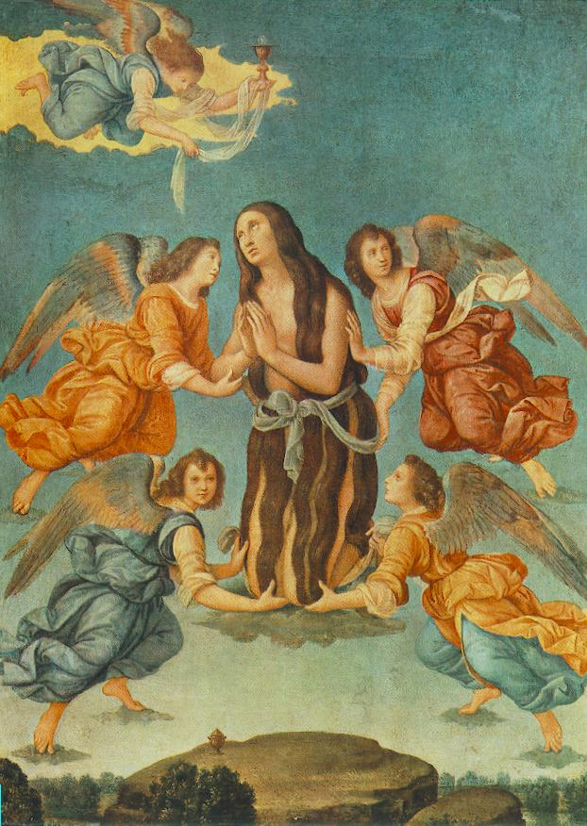
An Angel Brings the Holy Communion to Mary Magdalen, about 1510, Tempera on wood, 51 x 38 cm, Christian Museum, Esztergom, Hungary https://www.wga.hu/frames-e.html?/html/l/lorenzo/credi/index.html

Slide 11
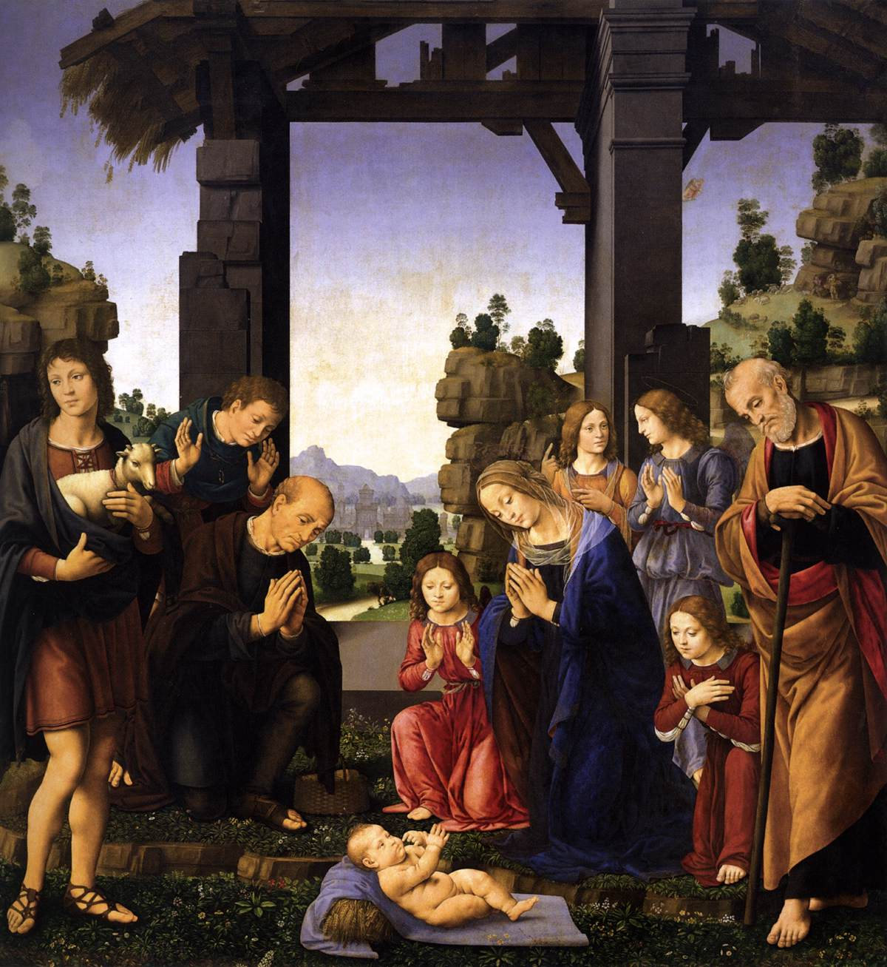
Adoration of the Shepherds, c. 1510, Oil on wood, 224 x 196 cm, Galleria degli Uffizi, Florence, Italy https://www.wga.hu/frames-e.html?/html/l/lorenzo/credi/index.html

Slide 12
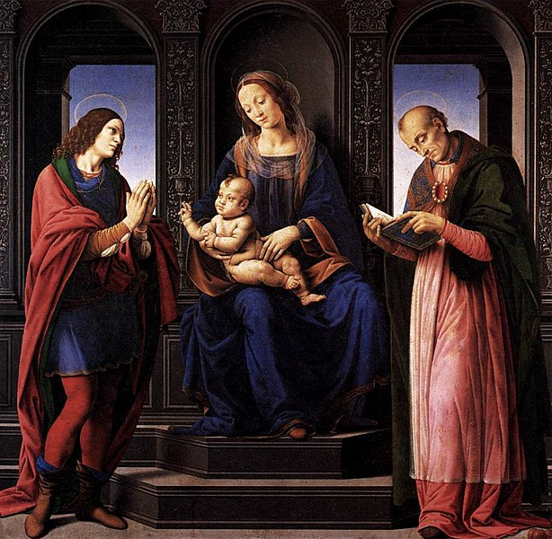
The Virgin and Child with St Julian and St Nicholas of Myra, 1490-92, Wood, 163 x 164 cm, Musée du Louvre, Paris, France https://commons.wikimedia.org/wiki/File:Lorenzo_di_credi,_The_Virgin_and_Child_with_St_Julian_and_St_Nicholas_of_Myra.jpg

Slide 13
The End

