Slide 1
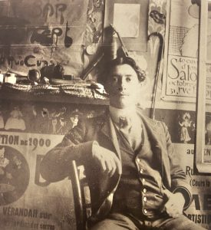
Gabriel
Argy-Rousseau
1885-1953
Argy Rousseau 17 years old in the studio of his future brother in law, Platon Argyriadès in Sèvres https://www.diamantiques.com/gabriel-argy-rousseau-artiste-technicien-de-la-pate-de-verre/

Slide 2
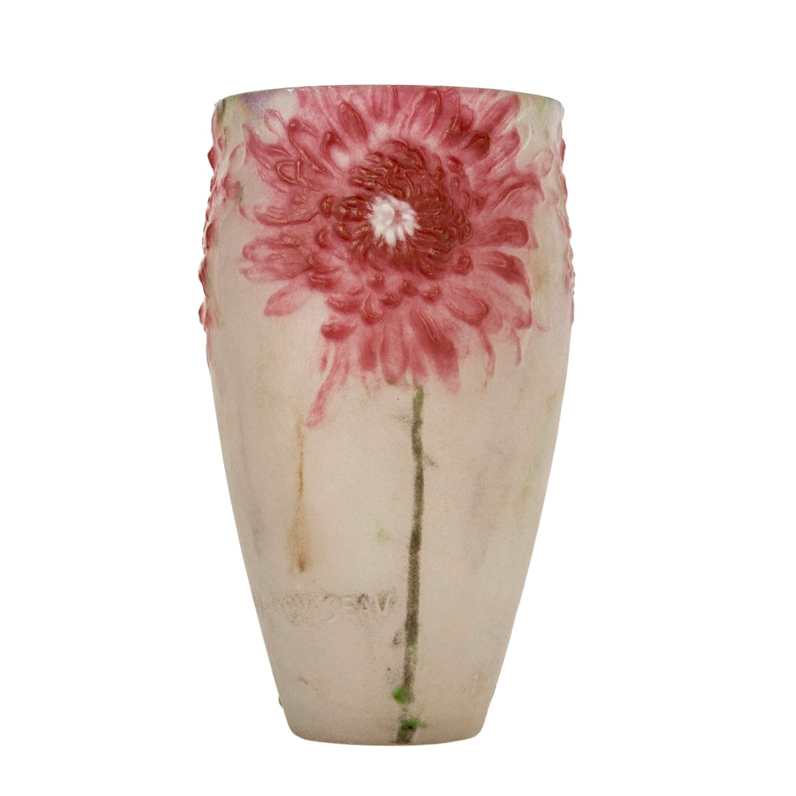
Chrysanthemum, 1919, Pâte de Verre, Height: 14,5 cm, Private Collection https://www.anticstore.art/114491P

Slide 3
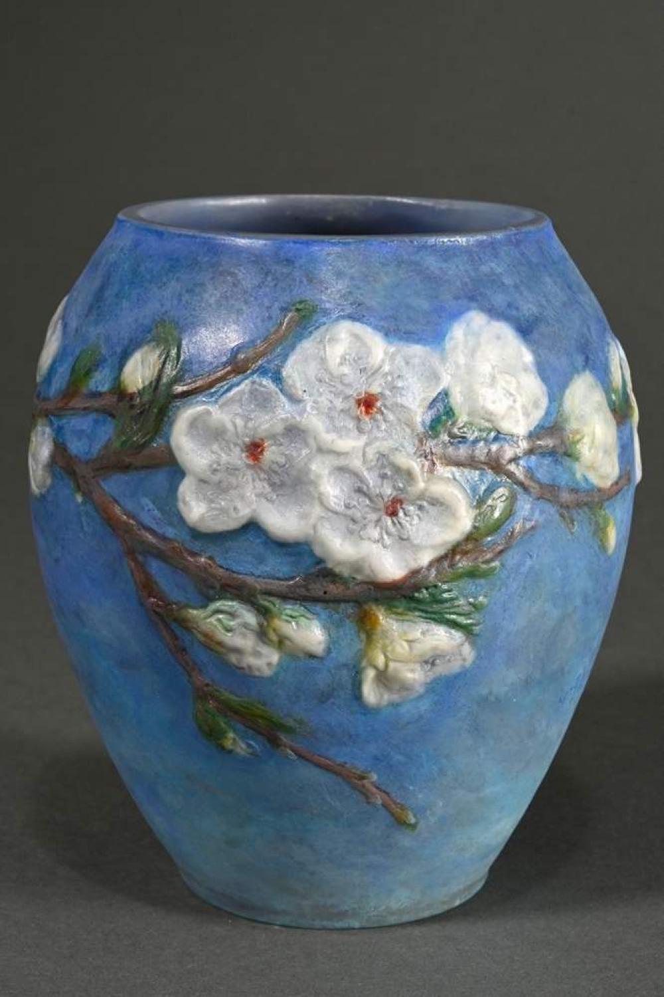
‘Fleurs de Pêcher, 1920, Pâte de Verre, Height: 14 cm, Private Collection https://www.invaluable.com/auction-lot/-7A246718AB

Slide 4
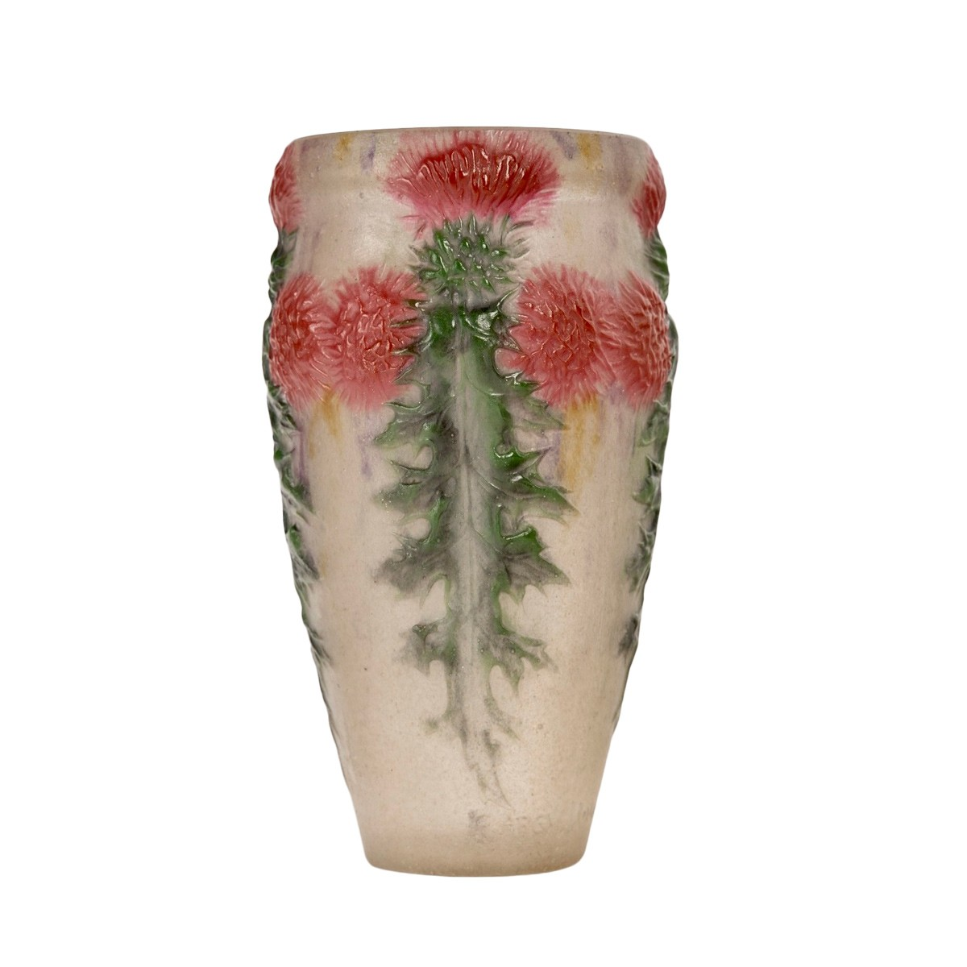
Red Thistles, 1920, Pâte de Verre, Height: 15.3 cm, Private Collection https://www.anticstore.art/115312P

Slide 5
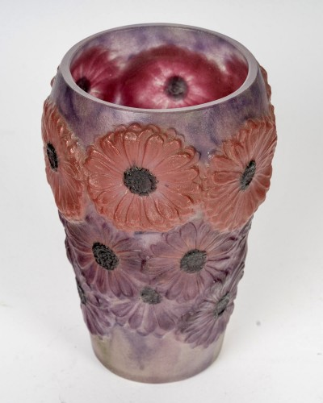
Vase Soucis, 1920, Pâte de Verre, Height: 15 cm, Private Collection https://www.anticstore.art/119749P

Slide 6
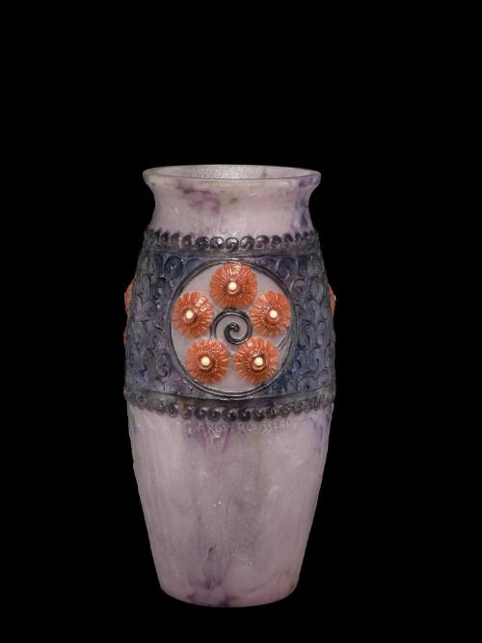
Vase with Flower Medallions, 1929, Pâte de Verre, Height: 25,9 cm, Corning Museum of Glass, USA https://glasscollection.cmog.org/objects/3481/vase?ctx=646edc683c1ce1aef75a8250e8fd3d5c1c27e47b&idx=2

Slide 7
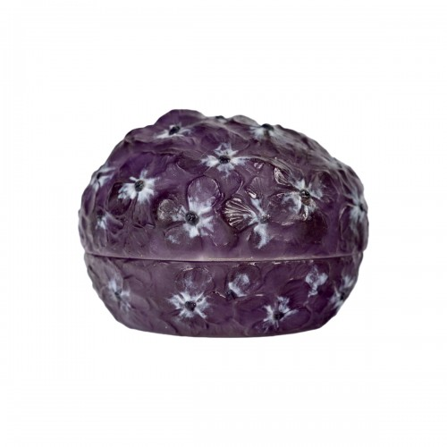
Hortansias Hydrangea, 1921, Pâte de Verre, Height: 6,5 cm, Diameter: 9,5 cm, Private Collection https://www.anticstore.art/112782P

Slide 8
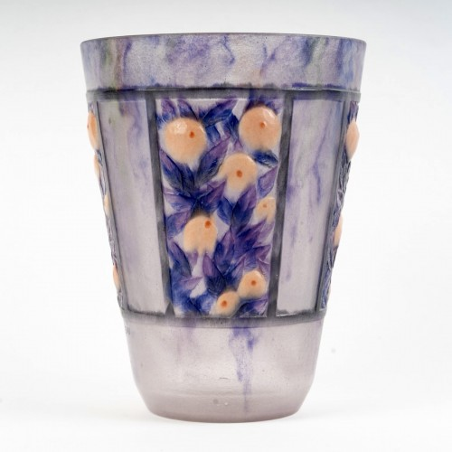
Fruits et Feuillages, 1922, Pâte de Verre, Height: 21,5 cm, Private Collection https://www.anticstore.art/120271P

Slide 9
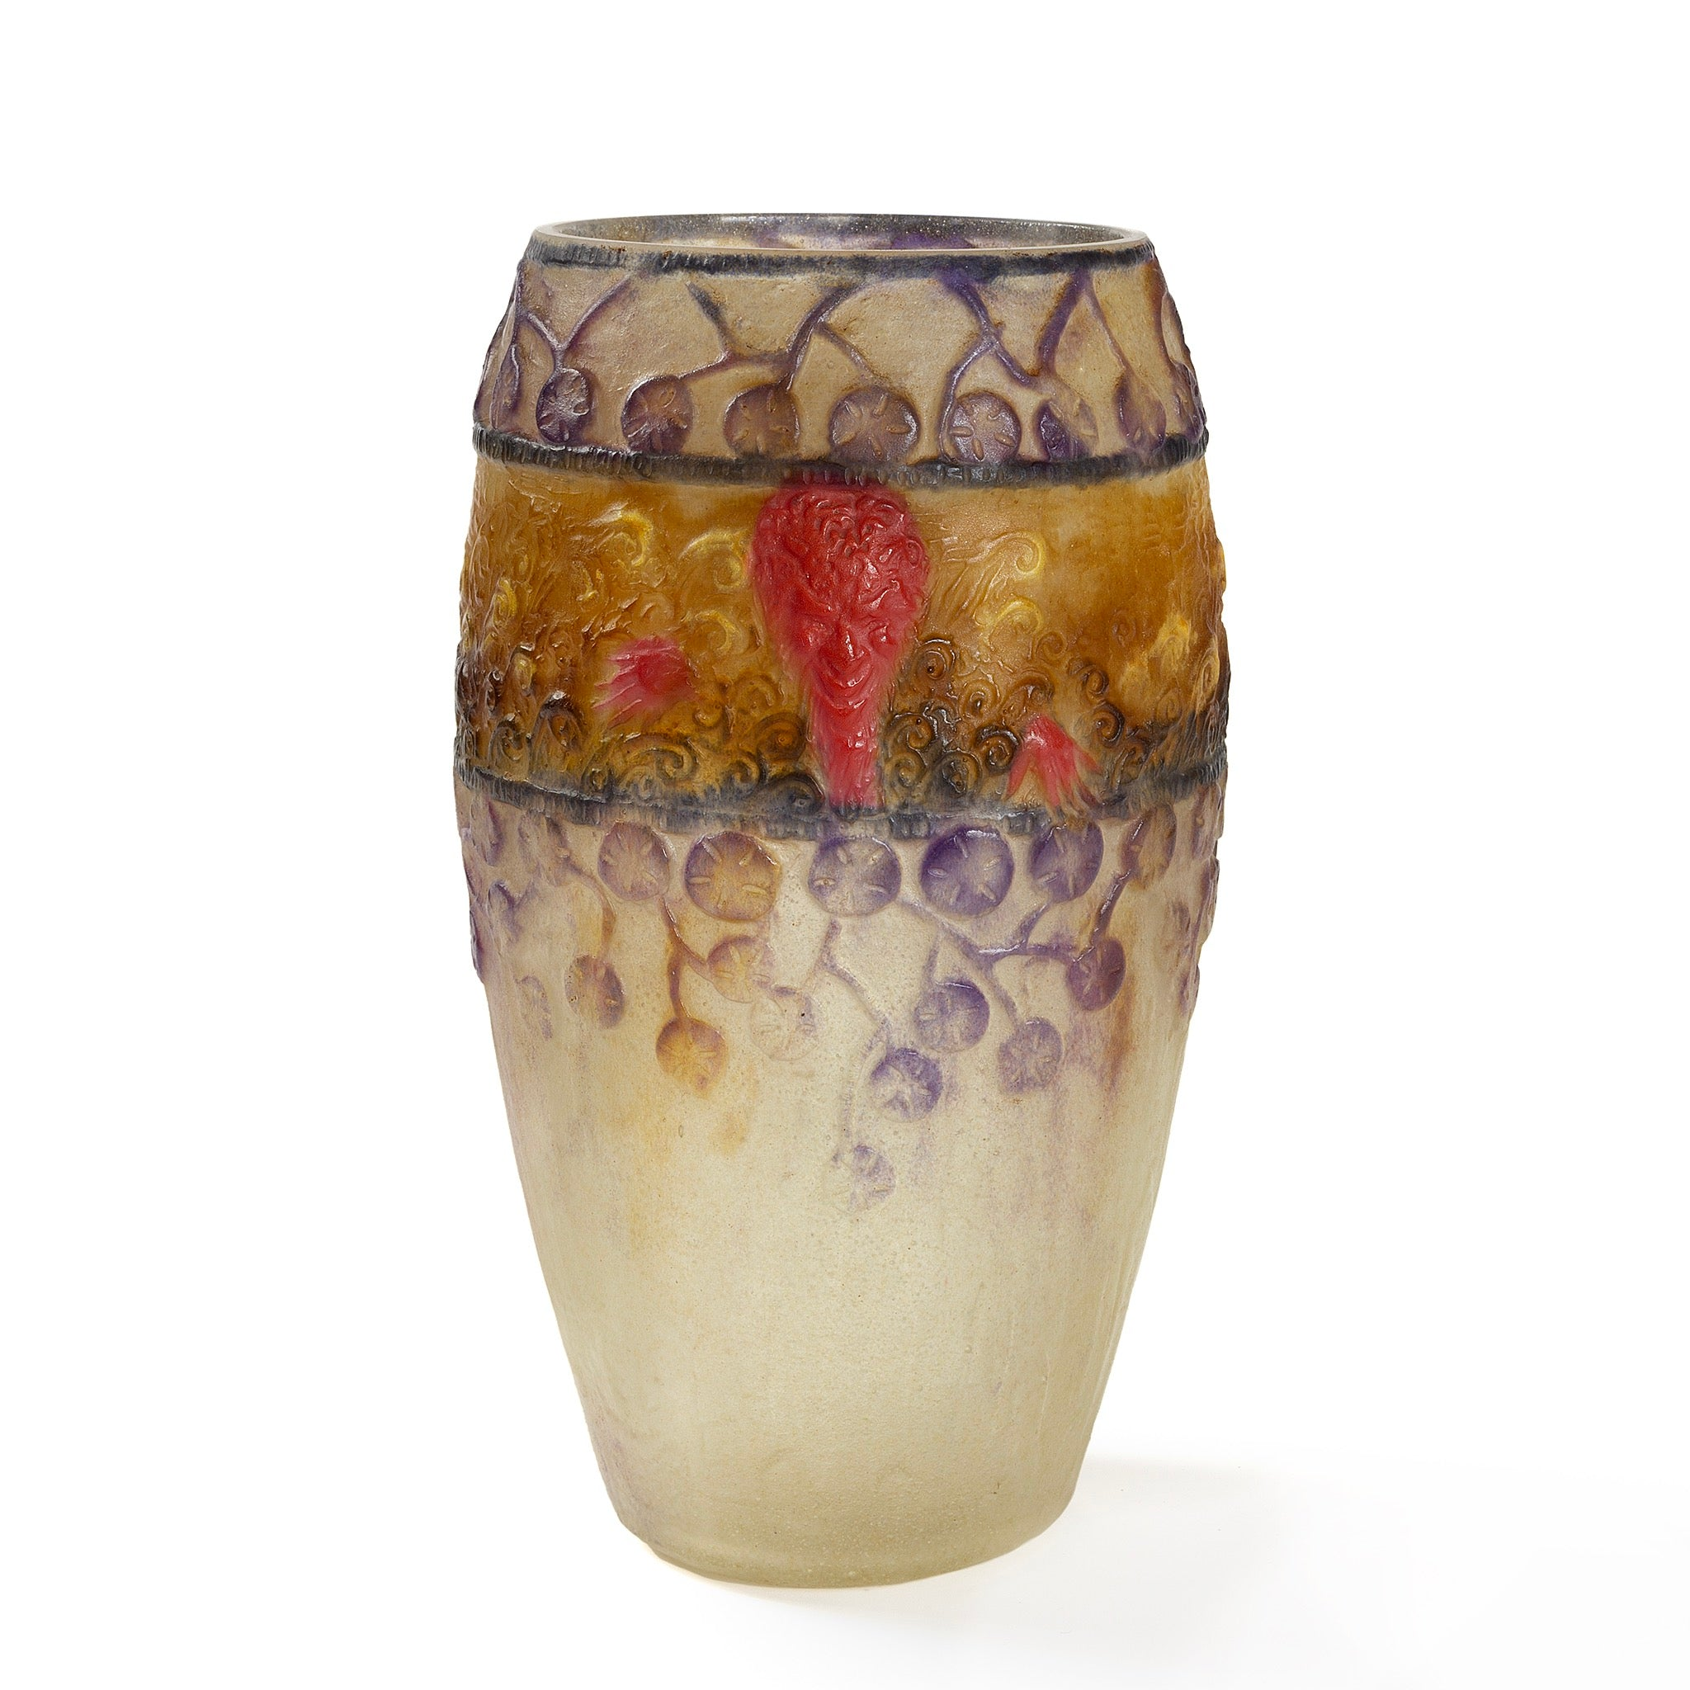
Faunes et Nymphes, 1923, Pâte de Verre, Height: 228.6 millimeters, Macklowe Gallery, NY, USA https://www.macklowegallery.com/products/gabriel-argy-rousseau-faunes-et-nymphes-vase?srsltid=AfmBOopKxGmyqExhZPYt1k09KlJyMVWPBho07_E2ezxS92hBfw6dMDiu

Slide 10
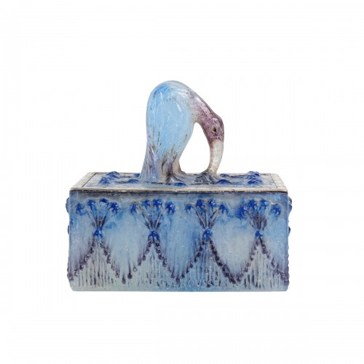
Ibis Box, 1923, Pâte de Verre, Height: 6,5 cm, Diameter: 13 cm, Private Collection https://www.anticstore.art/103458P

Slide 11
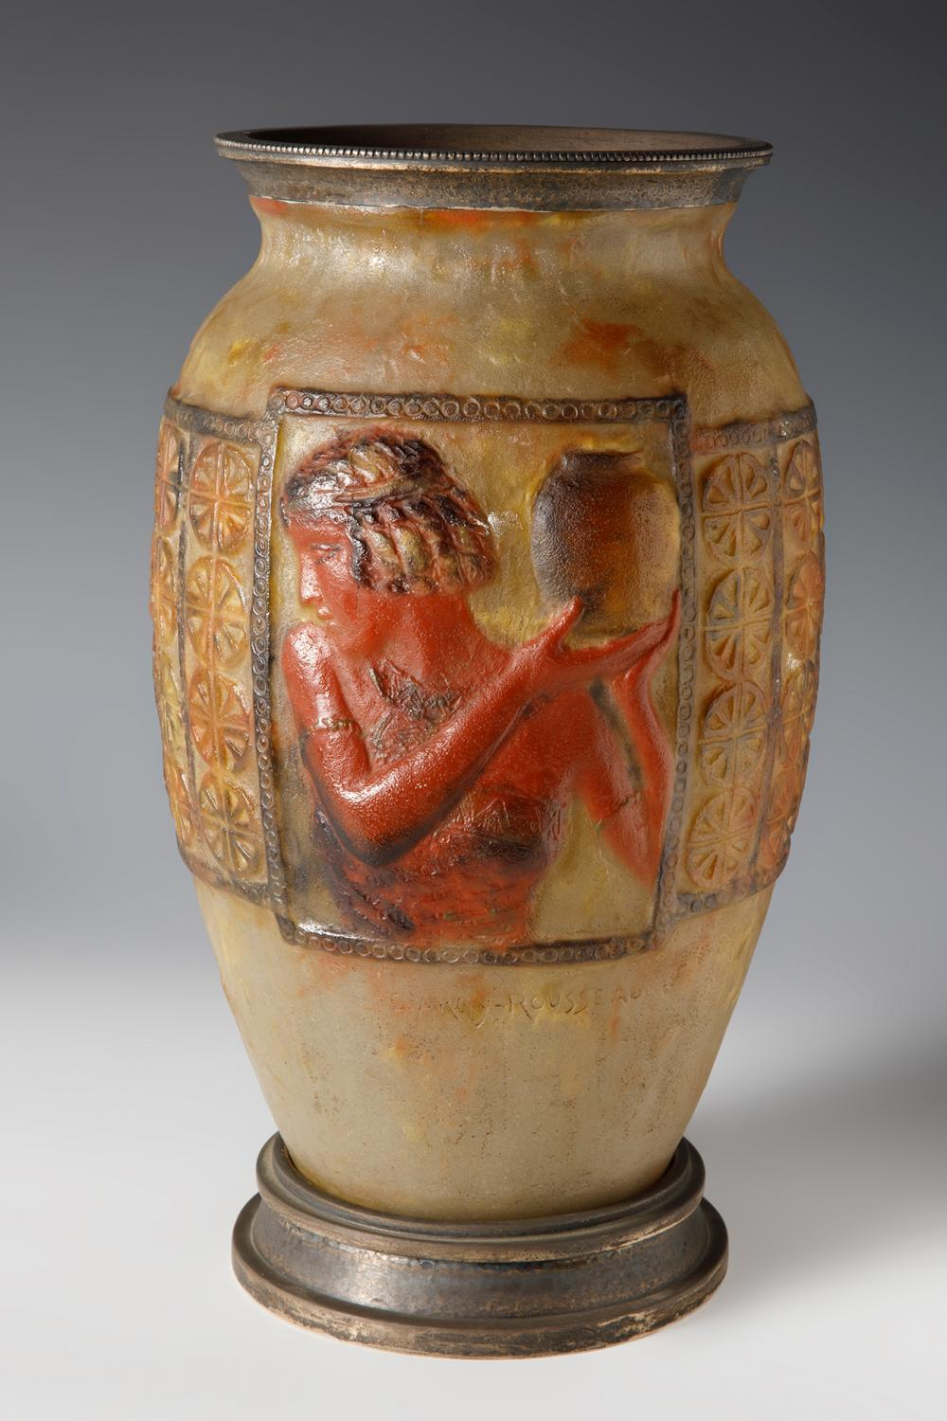
‘Libation’, 1924. Pâte de Verre, height: 30 cm, Private Collection https://www.invaluable.com/auction-lot/gabriel-argy-rousseau-france-1885-1953-libations--165-c-bfe49fea21?srsltid=AfmBOopjwtXjGuDsL1sqrwzqiNJb5rBIePTPkvisSmxvdvCjVSI1w75a

Slide 12
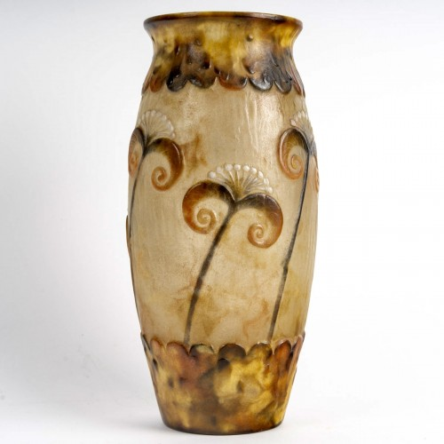
Papyrus, 1924, Pâte de Verre, Height: 26 cm, Private Collection https://www.anticstore.art/116388P

Slide 13
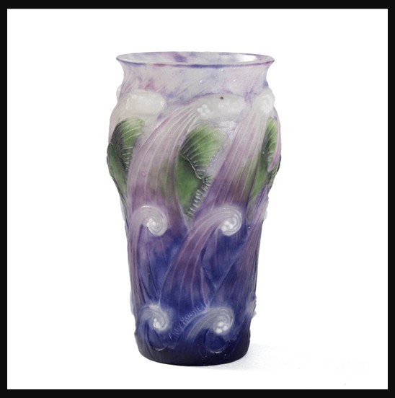
Poissons Dans Les Vagues, 1925, Pâte de Verre, Height: 152.4 millimeters, Macklowe Gallery, NY, USA https://www.macklowegallery.com/products/gabriel-argy-rousseau-poissons-dans-les-vagues-pate-de-verre-glass-vase?srsltid=AfmBOoovAA26CWovwdBaAjyXP-8bW_rwkBfZTu_V4XvvOPyQAMLEyb-2

Slide 14
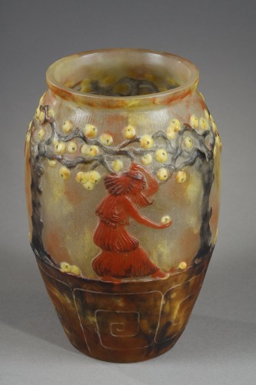
Garden of Hesperides, 1925, Pâte de Verre, Height: 24,3 cm, Private Collection https://www.invaluable.com/auction-lot/gabriel-argy-rousseau-le-jardin-des-hesperides-va-9-c-d314f038d5

Slide 15
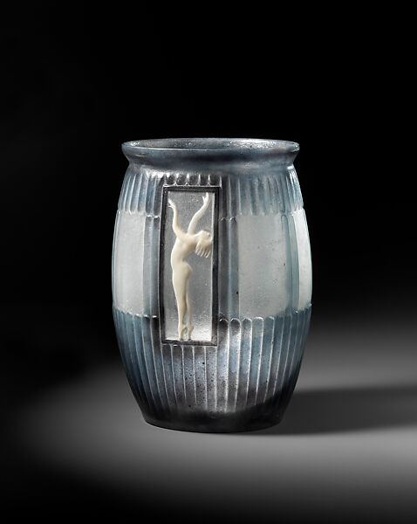
‘Eurythmics’ Vase, 1932, Pâte de Verre, Height: 19.7 cm, the MET, NY, USA https://www.metmuseum.org/art/collection/search/480714

Slide 16
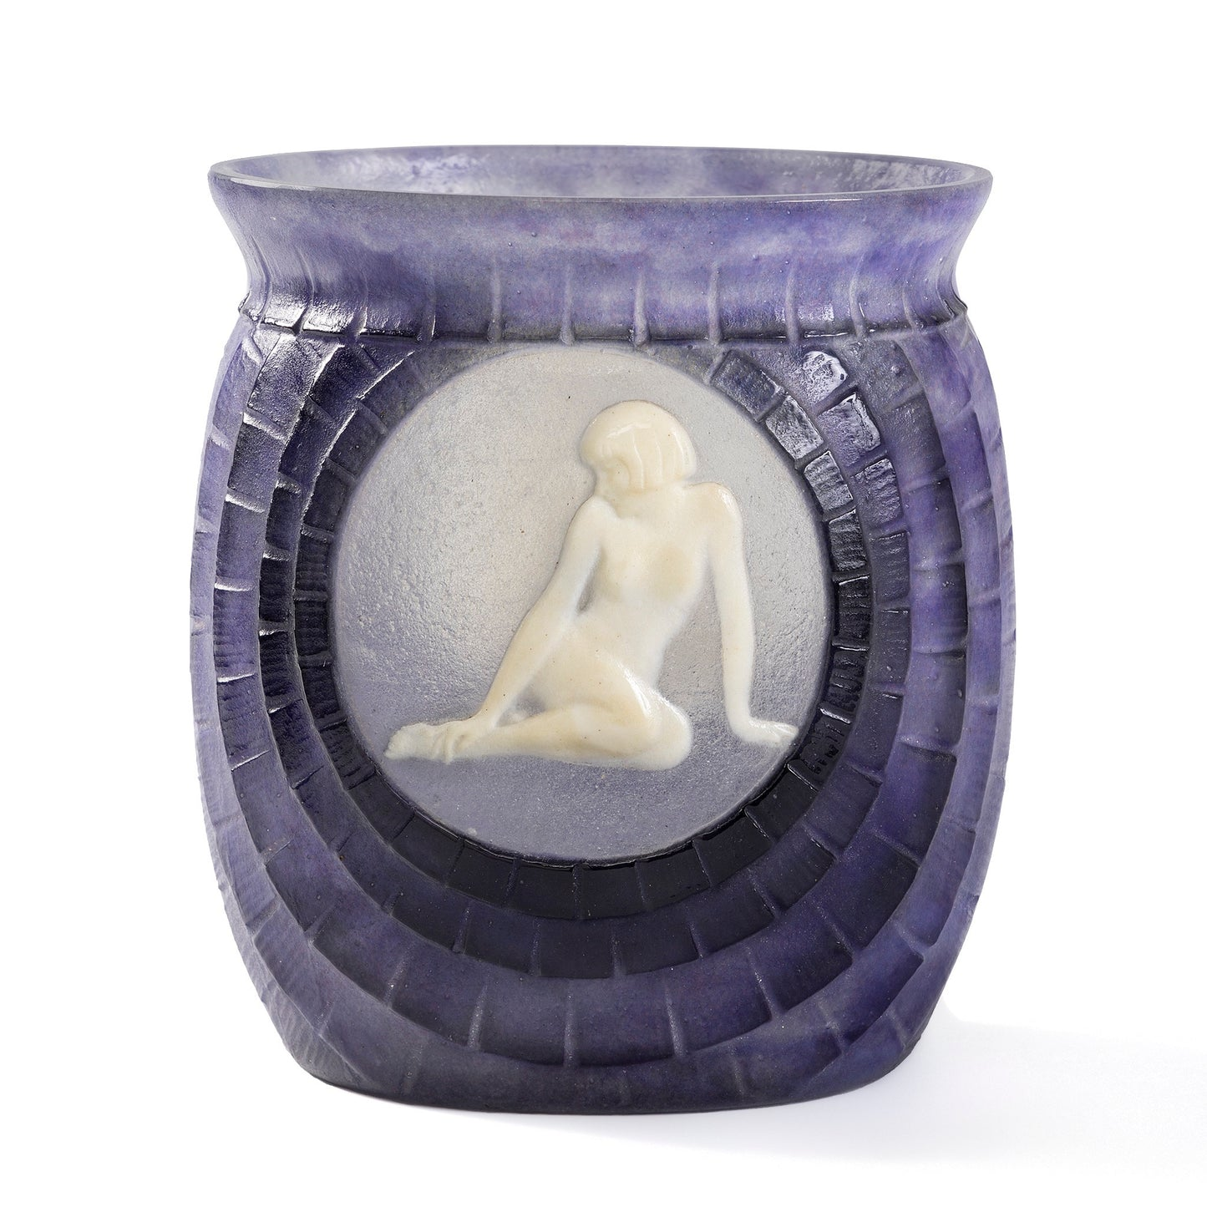
Jeunesse,, 1932, Pâte de Verre, Height: 14.6 cm, Macklowe Gallery, NY, USA https://www.macklowegallery.com/collections/argy-rousseau/products/gabriel-argy-rousseau-jeunesse-pate-de-verre-glass-vase

