Slide 1
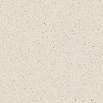
Rhyl Sands
by
David Cox, 1783–1859

Slide 2
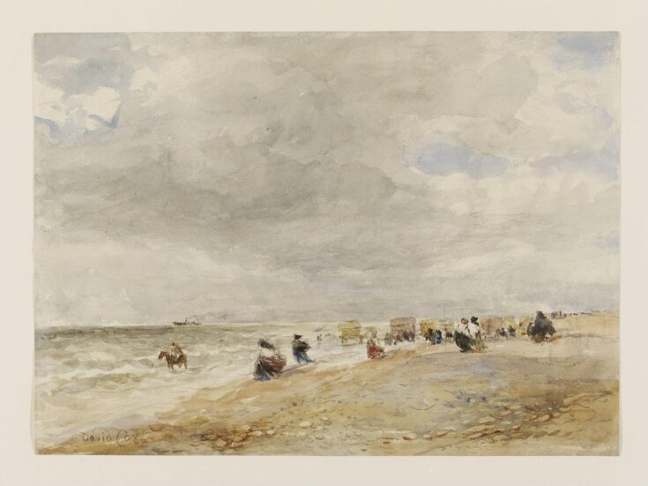
Rhyl Sands, 1854, c. 1850, Watercolour, V&A Museum, London, UK https://collections.vam.ac.uk/item/O1070711/rhyl-sands-watercolour-cox-david-the/

Slide 3
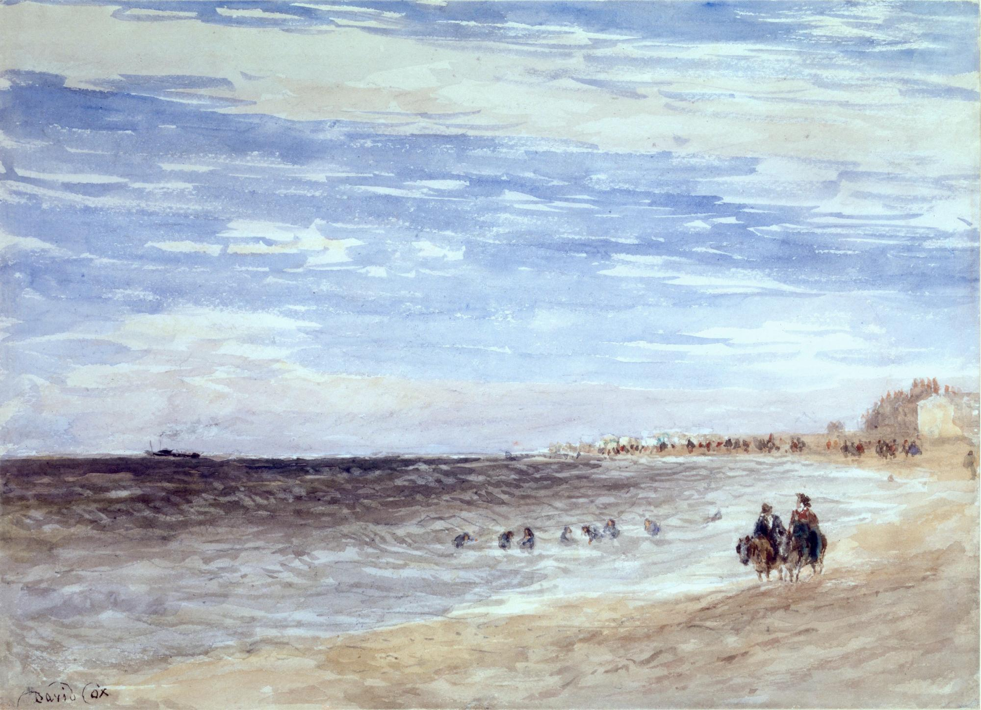
Rhyl Sands, 1854, Pencil and Watercolour,
27 x 36.8 cm, Private Collection https://www.clayton-payne.com/artworks/9452/

Slide 4
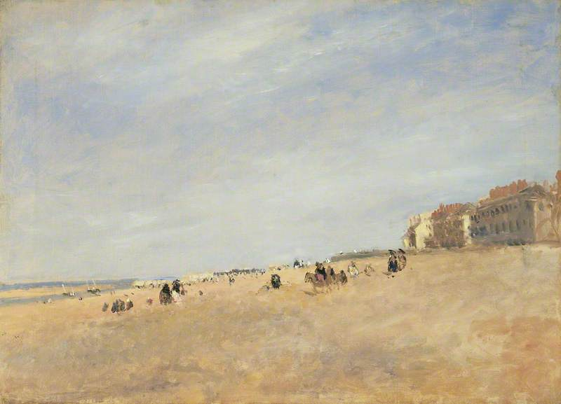
Rhyl Sands, 1853–1855, Oil on Canvas, 45.8 x 63.5 cm, Manchester Art Gallery, UK https://artuk.org/discover/artworks/rhyl-sands-204757

Slide 5
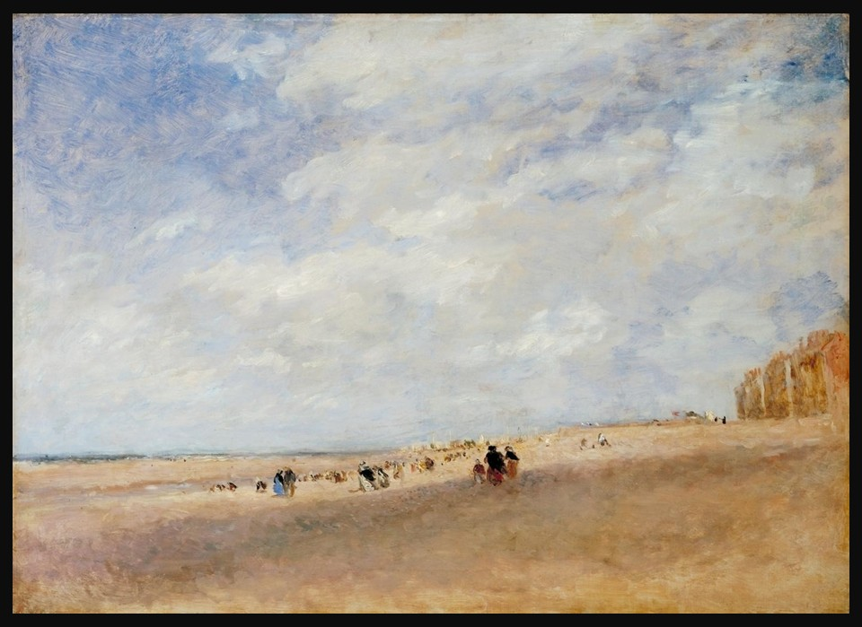
Rhyl Sands, c.1854, Oil on Canvas, 454 x 630 mm, the TATE, London, UK https://www.tate.org.uk/art/artworks/cox-rhyl-sands-t04130

Slide 6
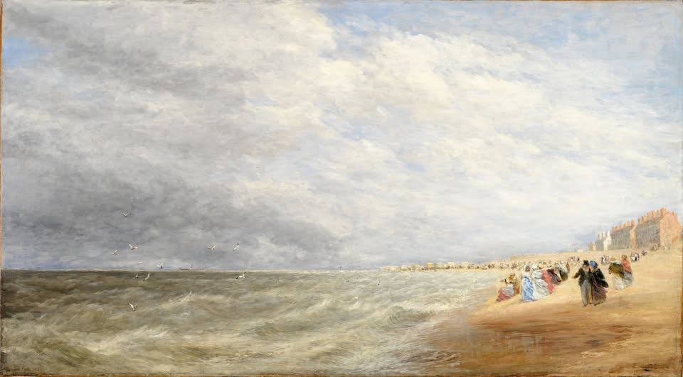
Rhyl Sands, 1854-1855, Oil on Canvas, 1353 x 743 mm, Birmingham Museum and Art Gallery, UK https://www.facebook.com/BirminghamMuseumandArtGallery/posts/birmingham-artist-david-cox-was-born-on-this-day-29-april-in-1783-hes-considered/1081113800725589/

Slide 7
THE END

