Slide 1
Paul Cézanne
1839-1906
Paintings of Bathers

Slide 2
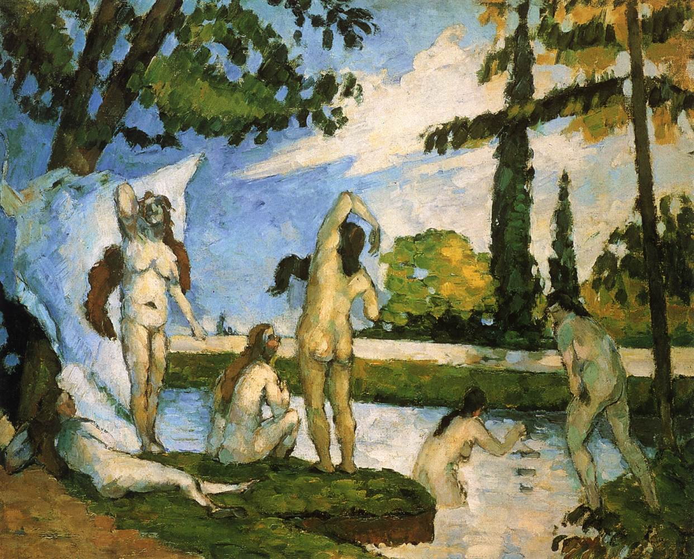
Bathers, 1874-75, Oil on canvas, 38 x 46 cm, Metropolitan Museum of Art, New York, USA

Slide 3
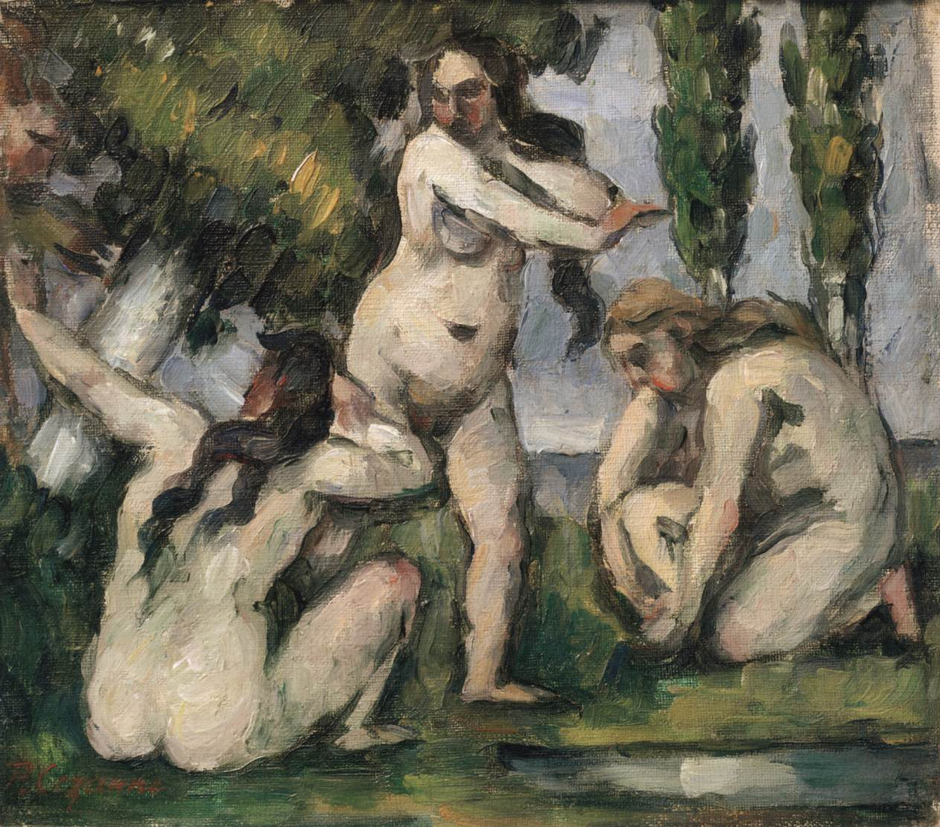
Three Bathers, 1874-75, Oil on canvas, 19 x 22 cm, Musée d’Orsay, Paris, France

Slide 4
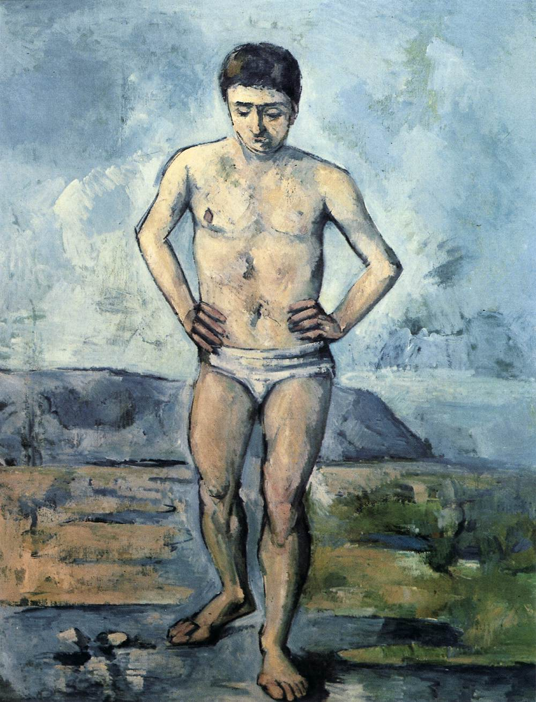
Bather, 1885-87, Oil on canvas, 127 x 97 cm, Museum of Modern Art, New York, USA

Slide 5
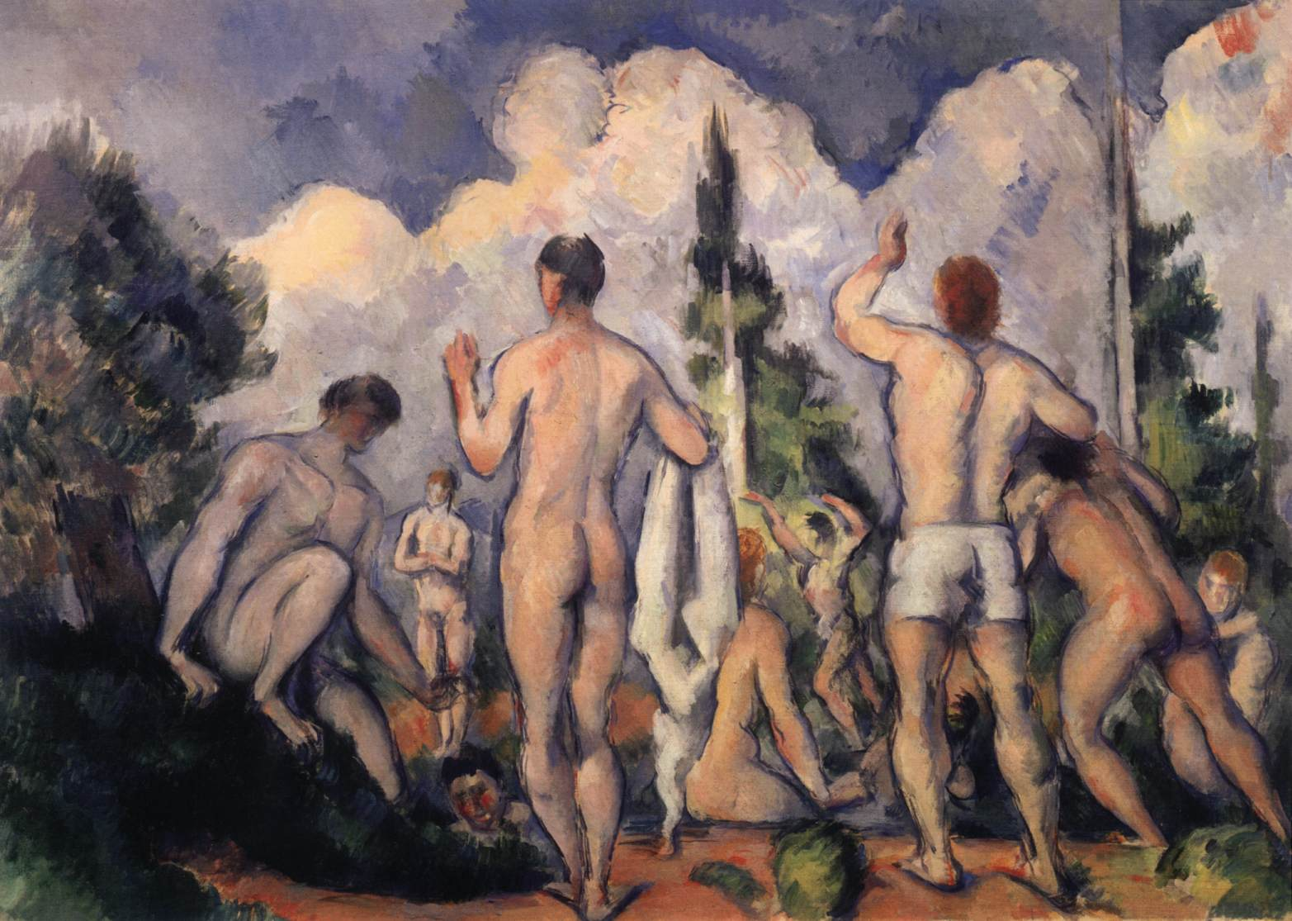
Bathers, 1890-92, Oil on canvas, 60 x 82 cm, Musée d'Orsay, Paris, France

Slide 6
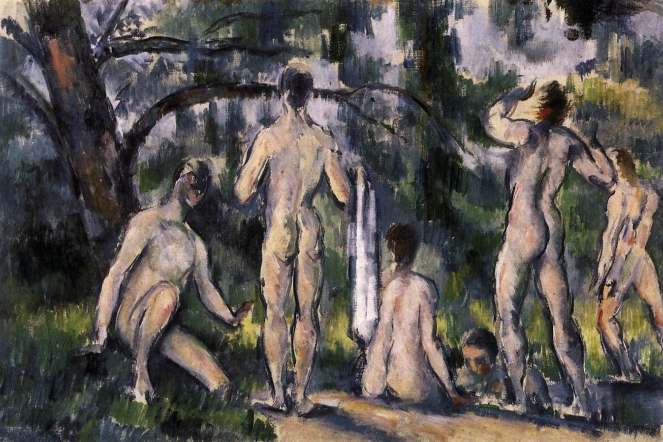
Bathers, 1892-94, Oil on canvas, 27 x 41 cm, Pushkin Museum, Moscow, Russia

Slide 7
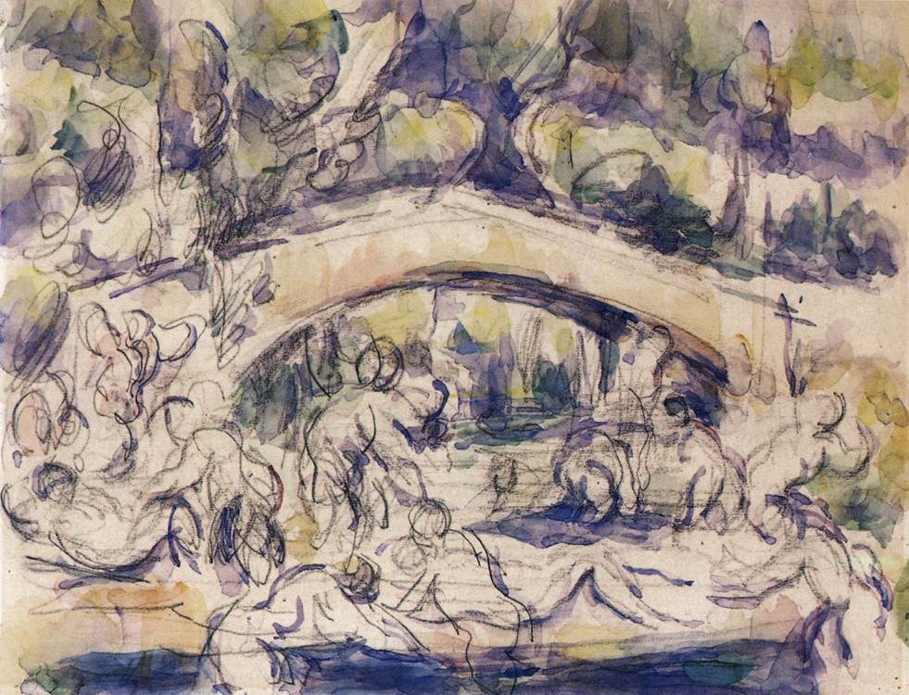
Bathers Beneath a Bridge, c. 1895, Pencil and watercolour, 210 x 270 mm, Metropolitan Museum of Art, New York, USA

Slide 8
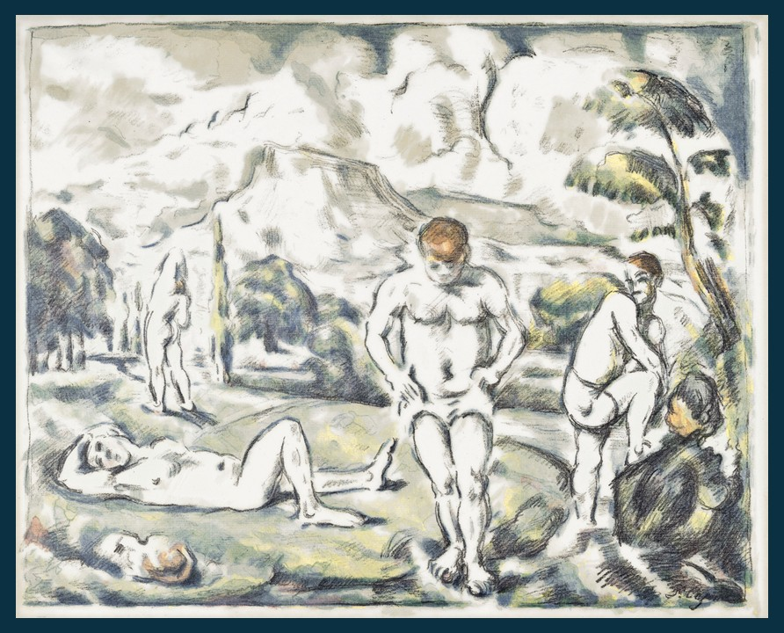
Les Baigneurs (Large Plate), 1896-1897, lithograph in colors, 419 x 521 mm, Private Collection

Slide 9
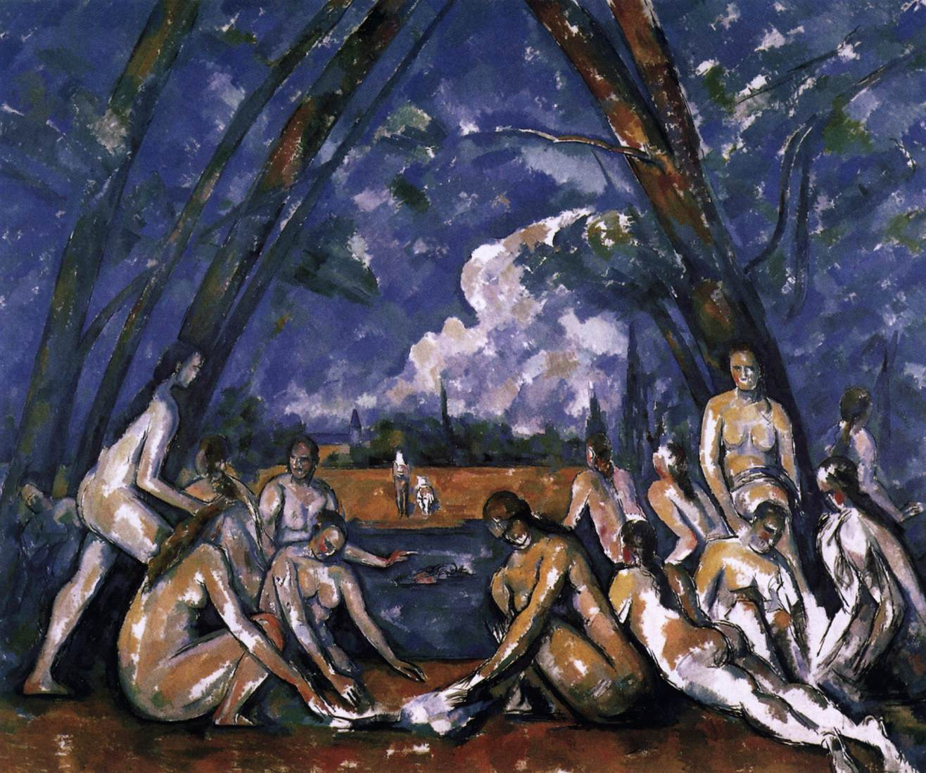
The Large Bathers, 1898-1905, Oil on canvas, 208 x 249 cm, Museum of Art, Philadelphia, USA

Slide 10
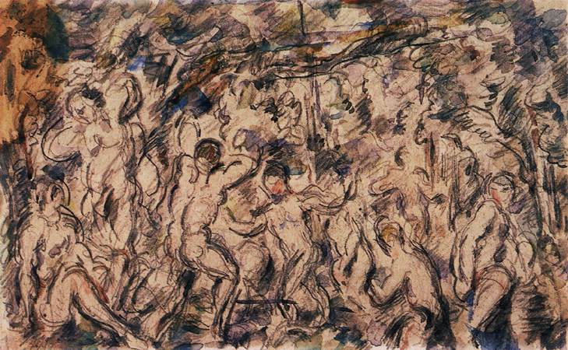
Bathers, c. 1900, Watercolour and pencil, 130 x 210 mm, Bridgestone Museum of Art, Tokyo, Japan

Slide 11
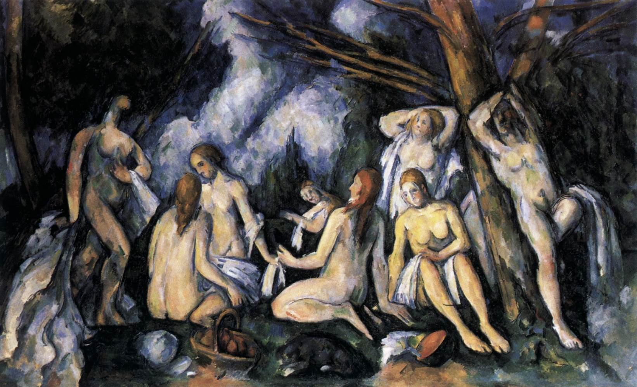
The Large Bathers, 1900-05, Oil on canvas, 133 x 207 cm, The Barnes Foundation, Merion, USA

Slide 12
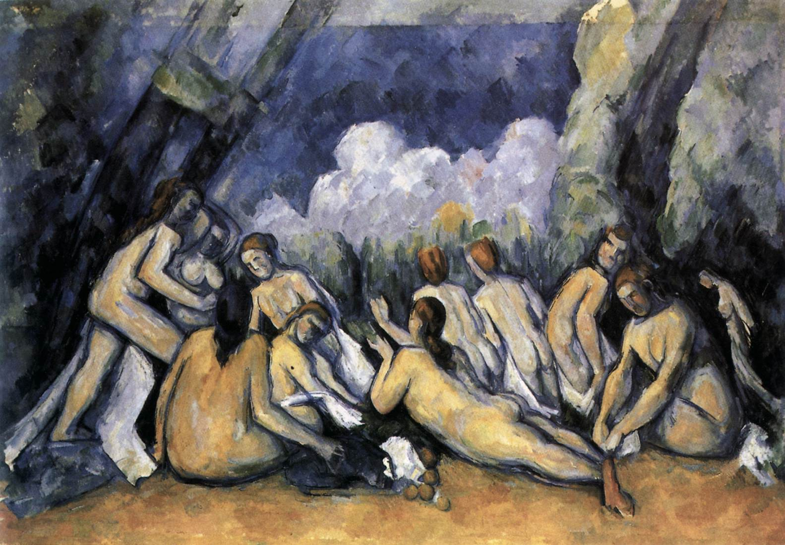
The Large Bathers, 1900-05, Oil on canvas, 130 x 195 cm, National Gallery, London, UK

Slide 13
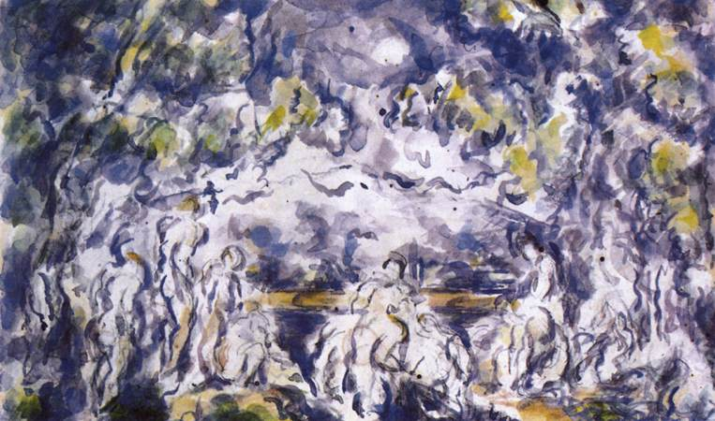
Bathers, 1900-06, Watercolour and pencil, 130 x 210 mm, Private collection

Slide 14
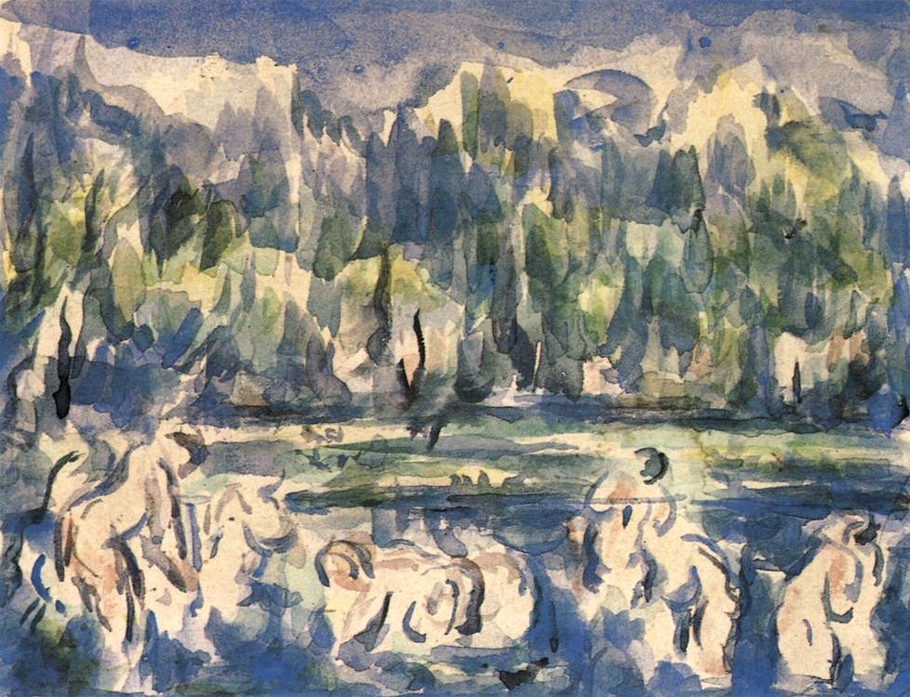
Bathers, 1900-06, Watercolour, 210 x 270 mm, Private collection

Slide 15
Photo Credit: https://www.wga.hu/frames-e.html?/html/c/cezanne/index.html

Slide 16
The End

