Slide 1
Dante Gabriel Rossetti
1828 - 1882

Slide 2
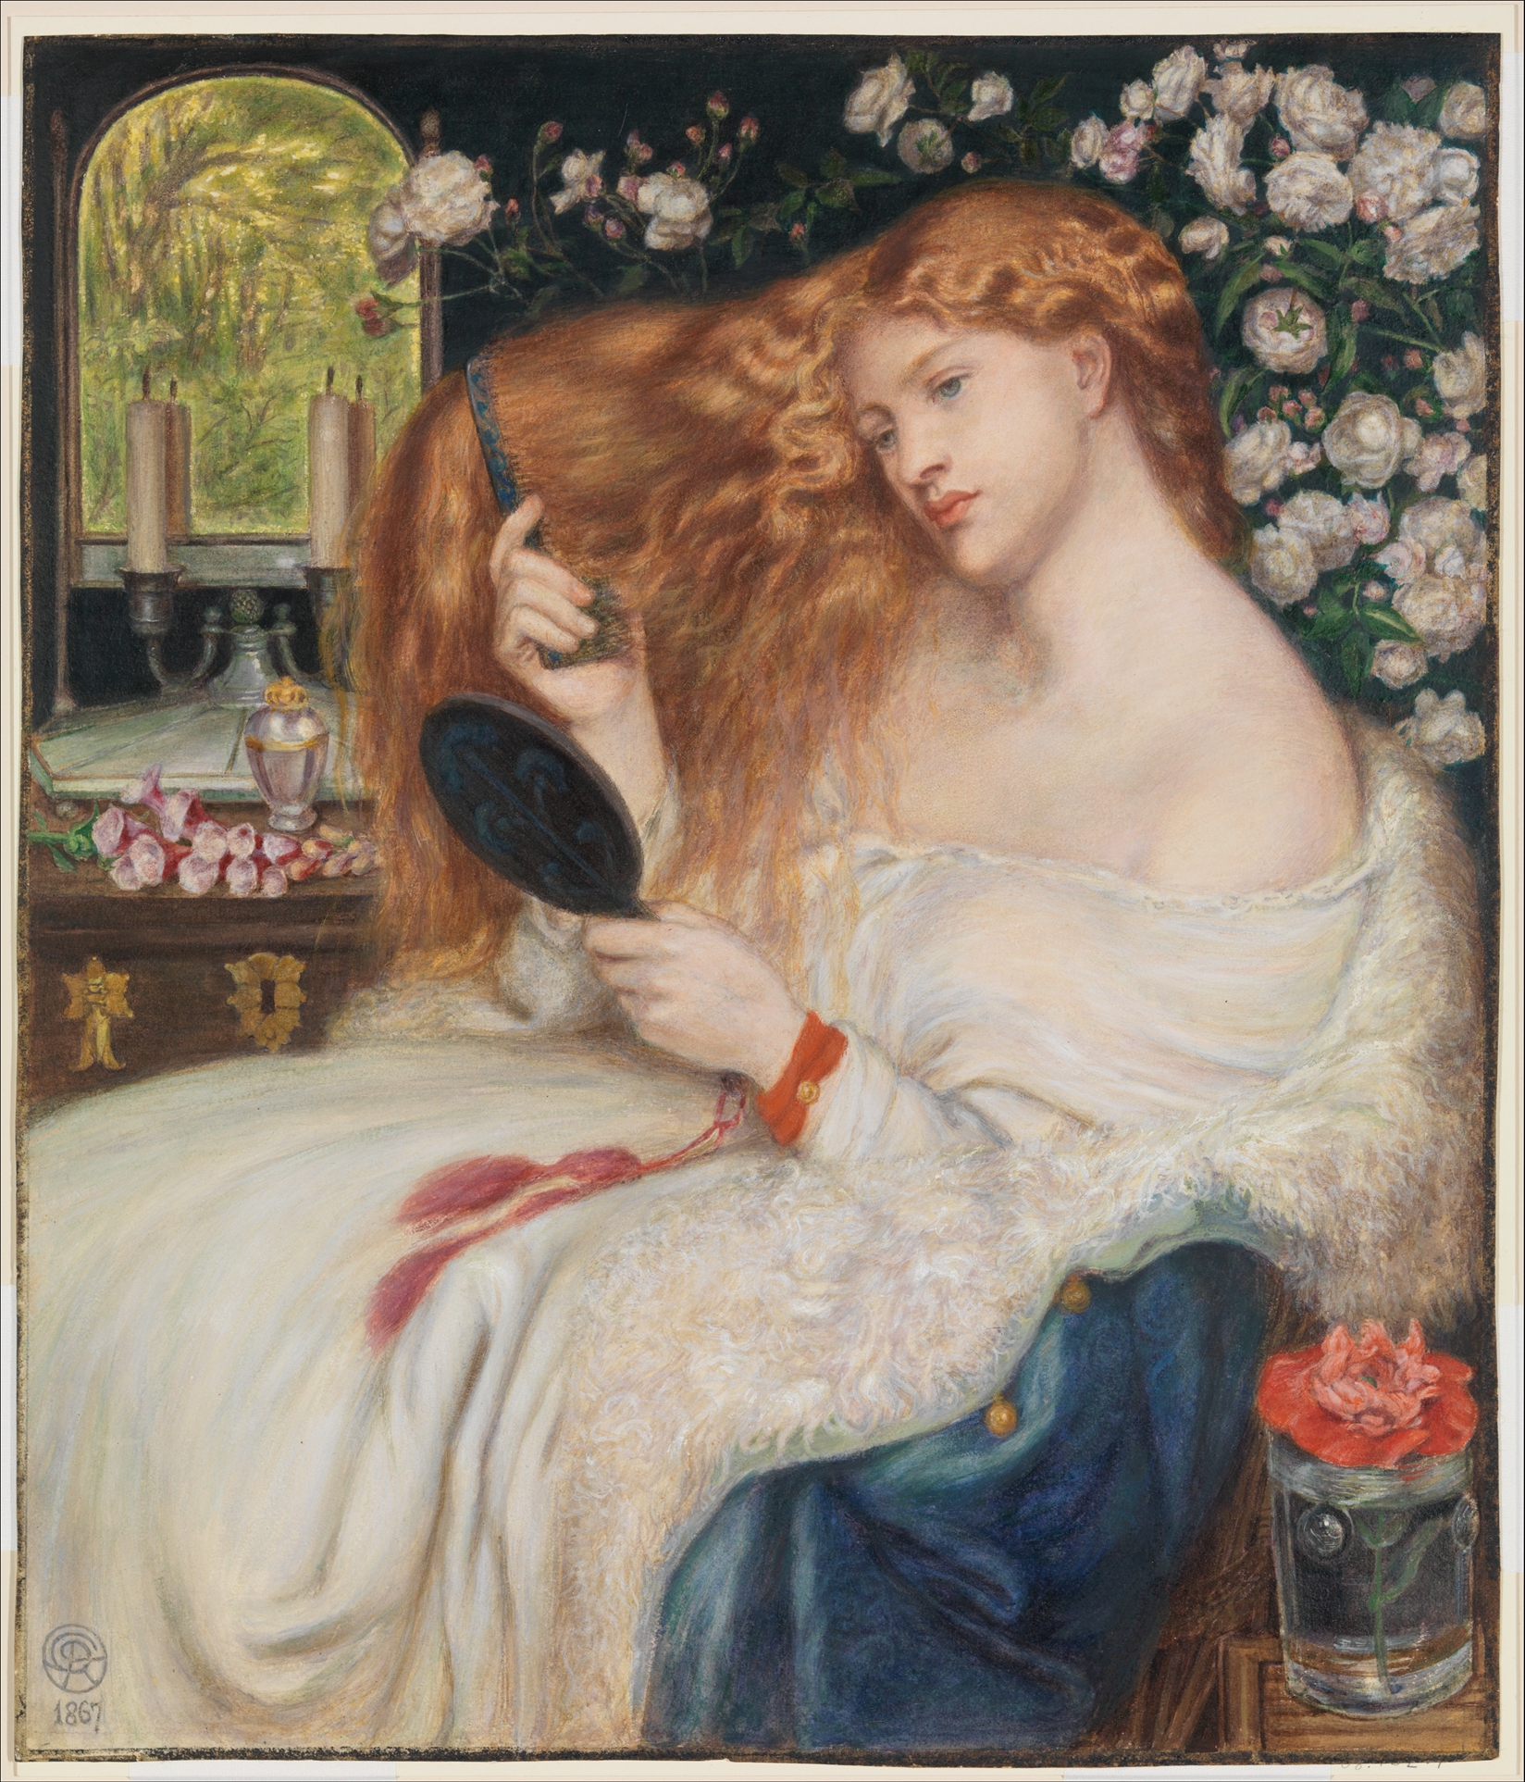
Lady Lilith, 1867, Oil on Canvas, 97.8 × 85.1 cm, The Metropolitan Museum of Art, NY, USA https://www.metmuseum.org/art/collection/search/337500?_gl=1*qsobpc*_ga*MTQxNjM2OTE3OC4xNzU1NTgxNTMw*_ga_REZYBMF9C3*czE3NTYzOTI1ODgkbzMkZzEkdDE3NTYzOTMzMTQkajE1JGwwJGgw

Slide 3
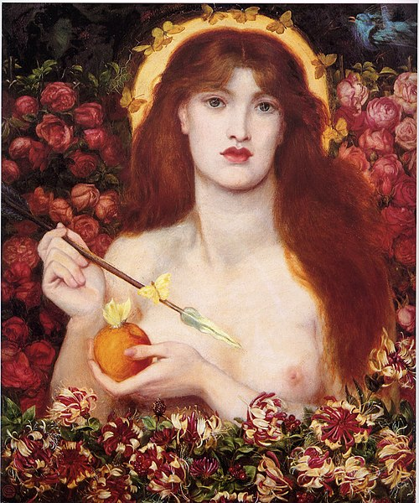
Venus Verticordia, 1868, Oil on Canvas, 81.3 × 68 cm, Russell-Cotes Museum, Bournemouth, UK https://commons.wikimedia.org/wiki/File:Dante_Gabriel_Rossetti_-_Venus_Verticordia.jpg

Slide 4
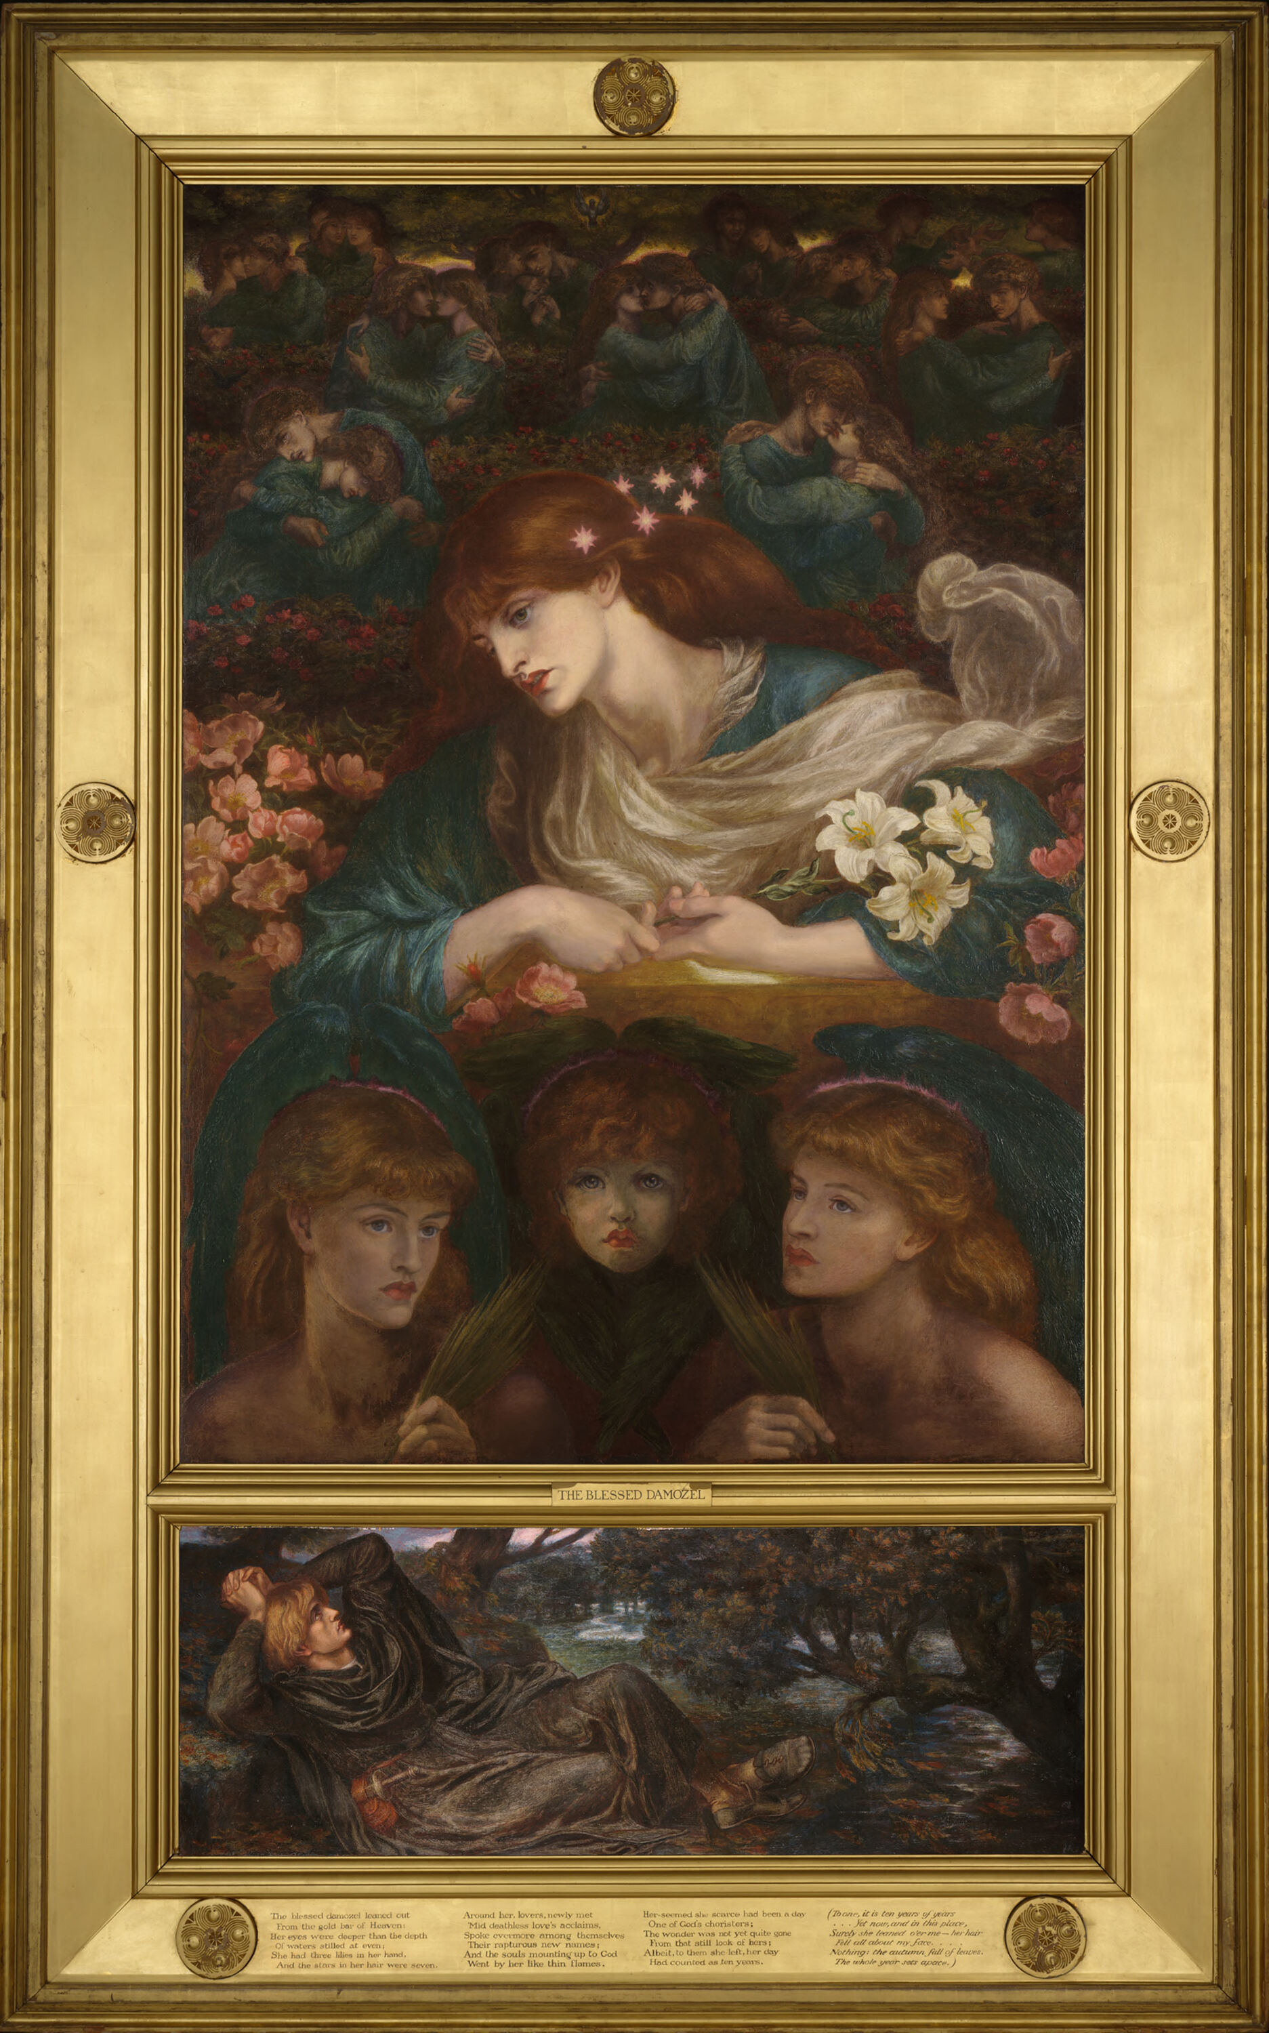
The Blessed Damozel, 1871-1878, Oil on Canvas, 136.8 x 96.5 cm, Harvard Art Museums https://harvardartmuseums.org/collections/object/299805

Slide 5
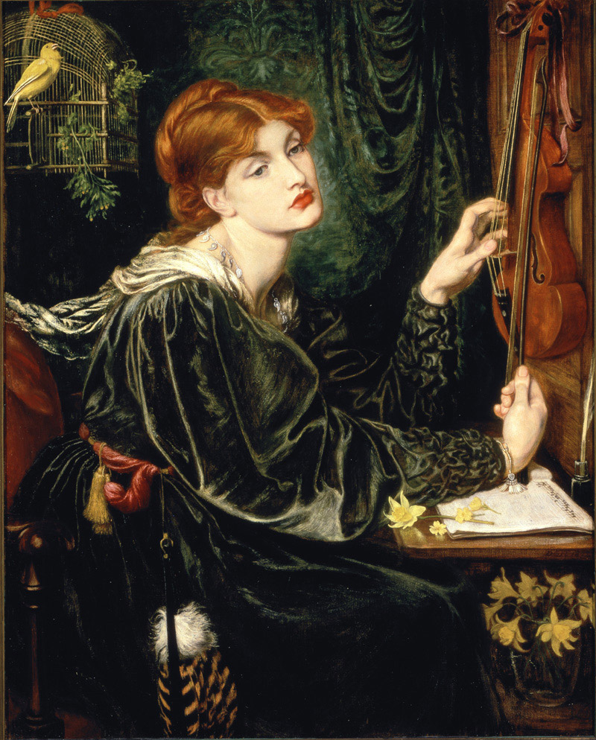
Veronica Veronese, 1872, Oil on Canvas, 107.9x86.3 cm, Delaware Art Museum, USA https://en.wikipedia.org/wiki/Veronica_Veronese#/media/File:Veronica_Veronese_DAM.jpg

Slide 6
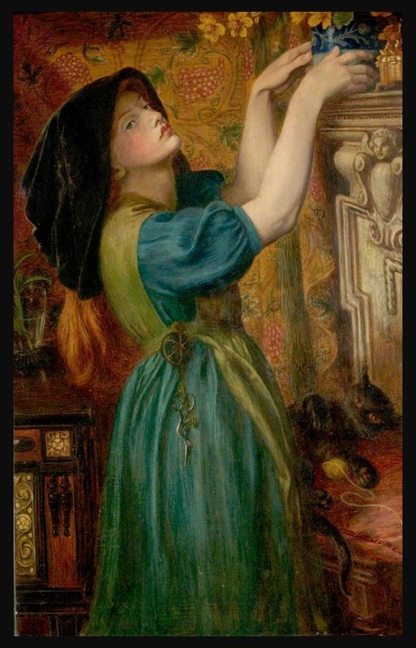
Marigolds or Bower Maiden, 1873, Oil on Canvas, 114.3 x 73.66 cm, Nottingham Castle Museum and Art Gallery, UK https://useum.org/artist/Dante-Gabriel-Rossetti

Slide 7
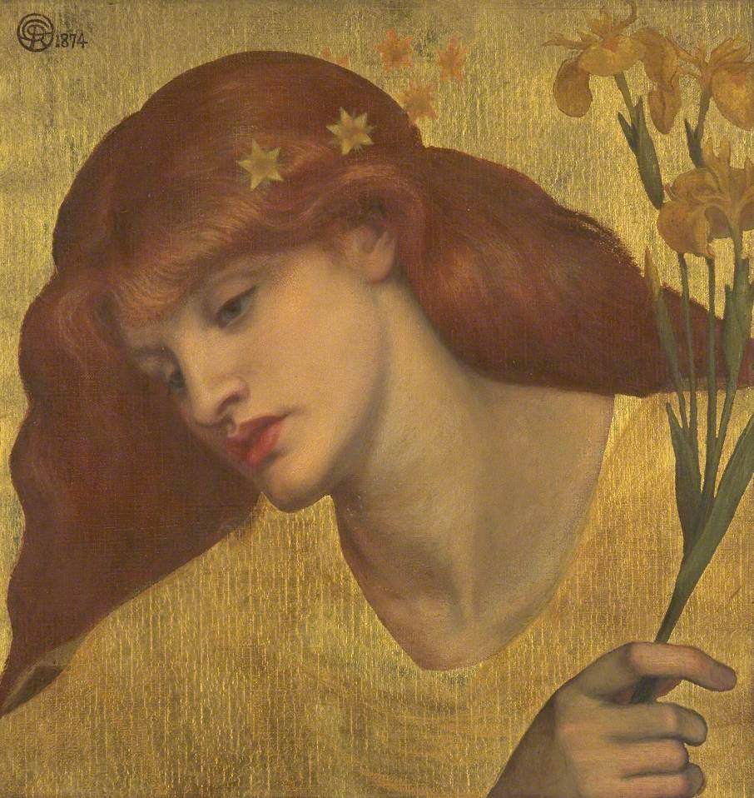
Sancta Lilias, 1874, Oil on Canvas, 48.3 x W 45.7 cm, TATE Britain, UK https://artuk.org/discover/artworks/sancta-lilias-201561

Slide 8
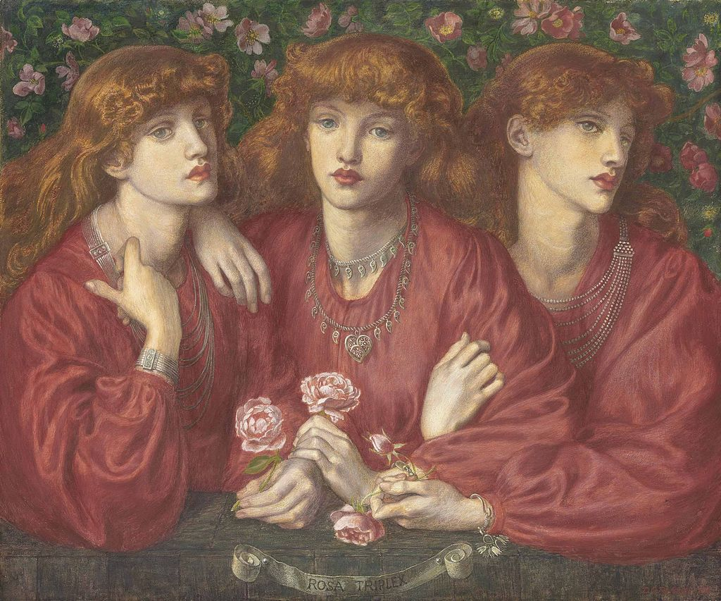
Rosa Triplex, 1874, Pencil, Watercolor, Gouache paint and gum arabic on Paper, 77.5Χ88.3 cm, Private collection https://commons.wikimedia.org/wiki/File:Dante_Gabriel_Rossetti_-_Rosa_Triplex_(1874).jpg

Slide 9
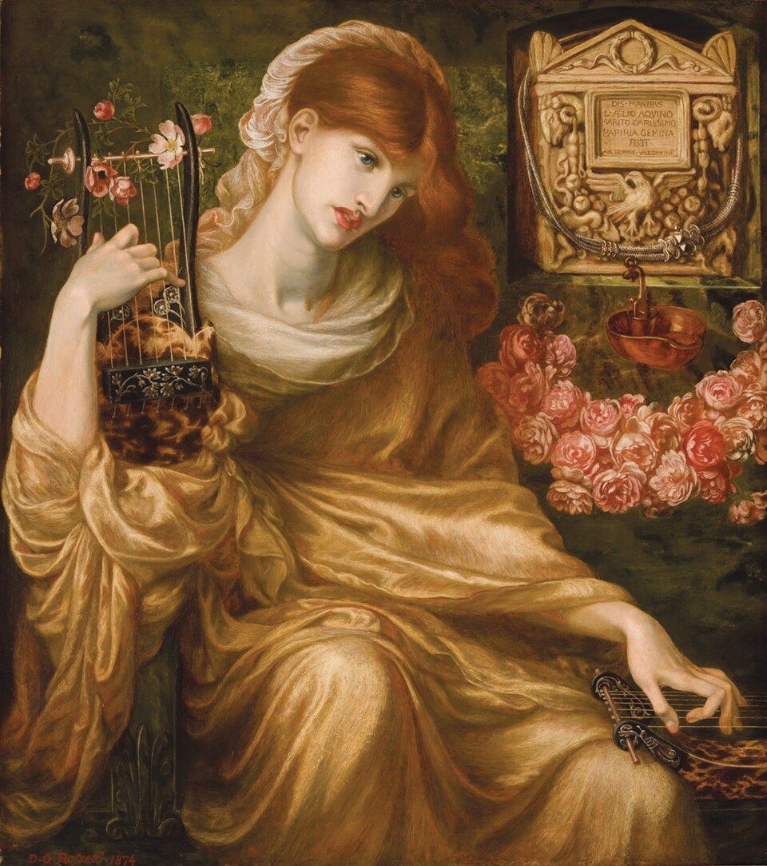
Roman Widow, 1874, Oil on Canvas, 104.8 × 93.3 cm, Museo de Arte de Ponce, Puerto Rico https://www.useum.org/artwork/Roman-Widow-Dante-Gabriel-Rossetti

Slide 10
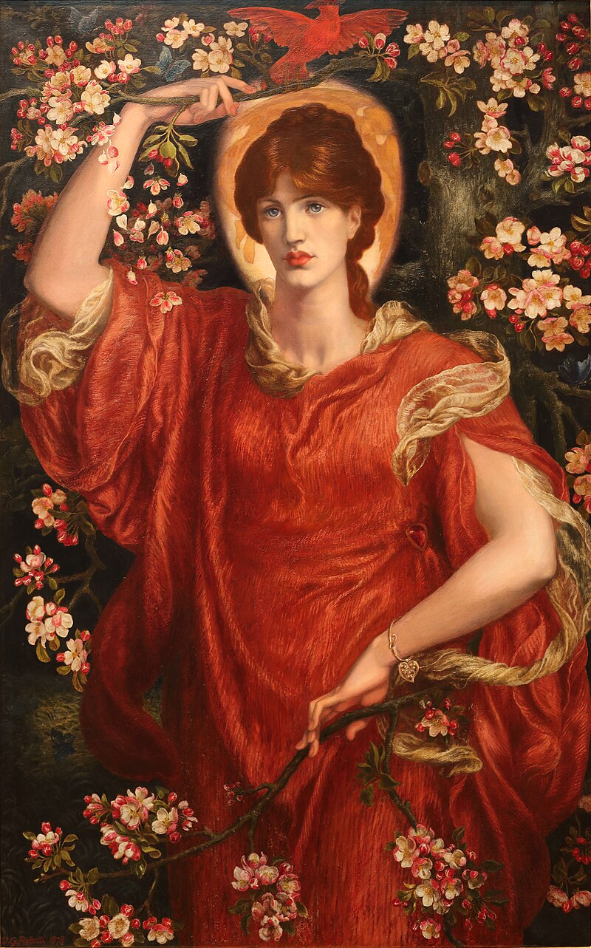
A Vision of Fiammetta, 1878, Oil on Canvas, 140 cm × 91 cm, Private Collection of Andrew Lloyd Webber https://en.wikipedia.org/wiki/A_Vision_of_Fiammetta#/media/File:A_Vision_of_Fiammetta_by_Dante_Gabriel_Rossetti.jpg

Slide 11
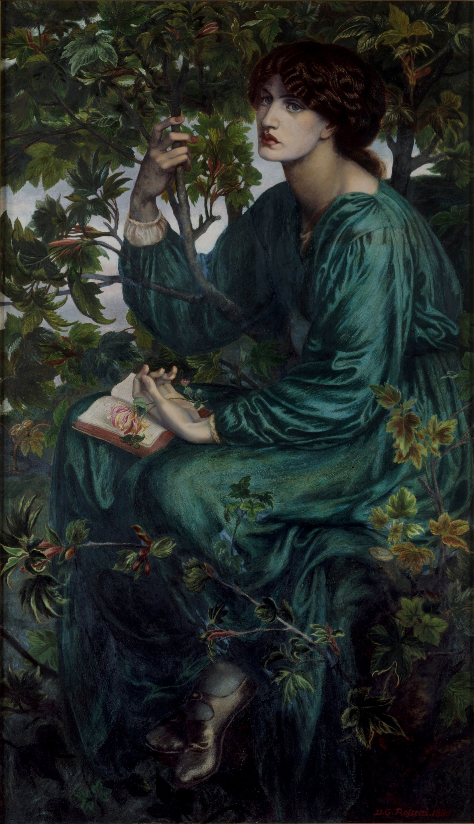
The Day Dream, 1880, Oil on Canvas, 157.5X92.7 cm, Victoria and Albert Museum, London, UK https://commons.wikimedia.org/wiki/File:Dante_Gabriel_Rossetti_-_The_Day_Dream_-_Google_Art_Project.jpg

Slide 12
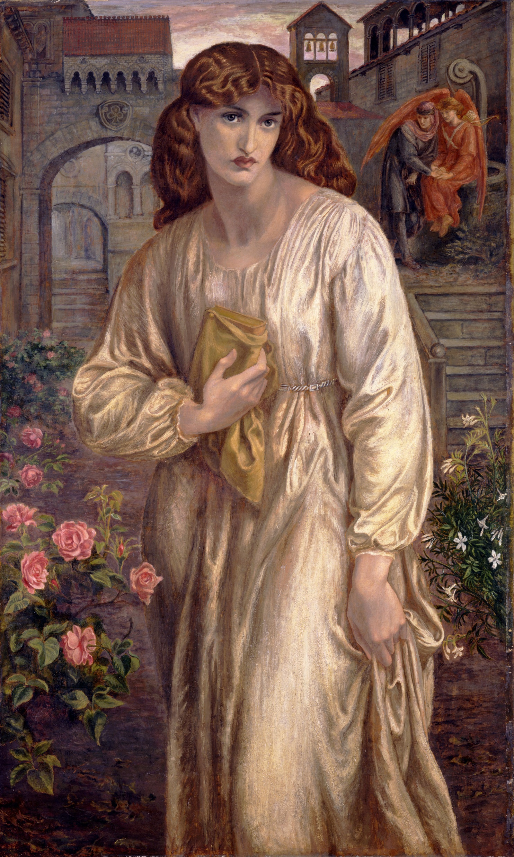
Salutation of Beatrice, 1880 – 1882, Oil on Canvas, 1,543x914 mm, Toledo Museum of Art, OH, USA https://www.useum.org/artwork/The-Salutation-of-Beatrice-Dante-Gabriel-Rossetti

Slide 13
The End

