Slide 1
Thomas Moran
and Venice
American Artist, 1837 - 1926

Slide 2
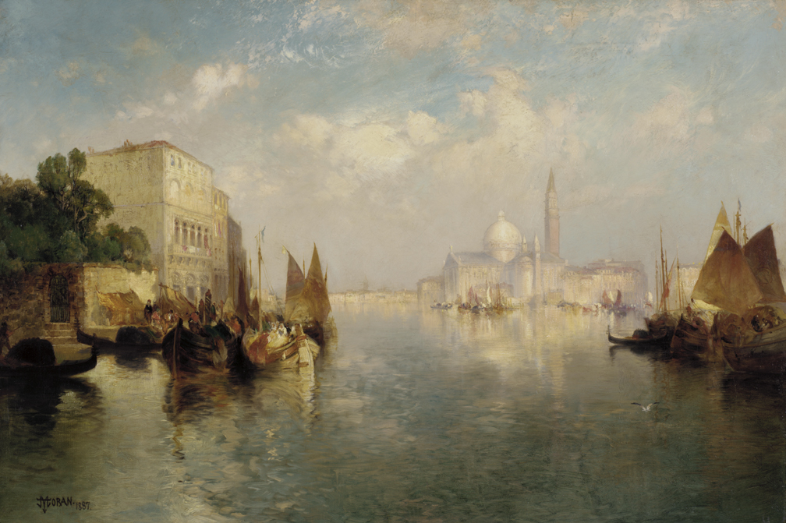
Venice, 1887, Oil on Canvas, 51.6 x 76.4 cm, Pennsylvania Academy of the Fine Arts, Philadelphia, USA https://www.pafa.org/museum/collection/item/venice-5

Slide 3
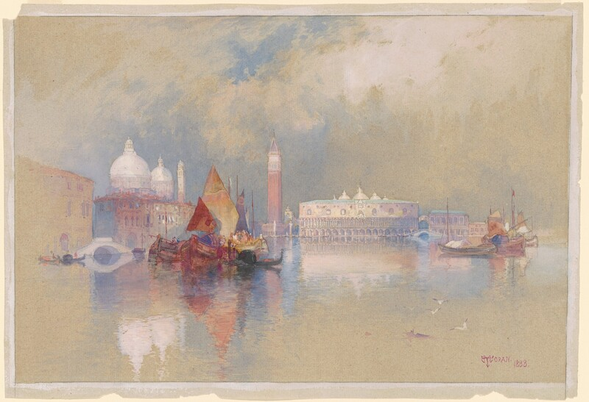
View of Venice, 1888, Watercolor and Gouache on laid paper, image: 26.35 × 40.01 cm, National Gallery of Art, Washington DC, USA https://www.nga.gov/artworks/98404-view-venice

Slide 4
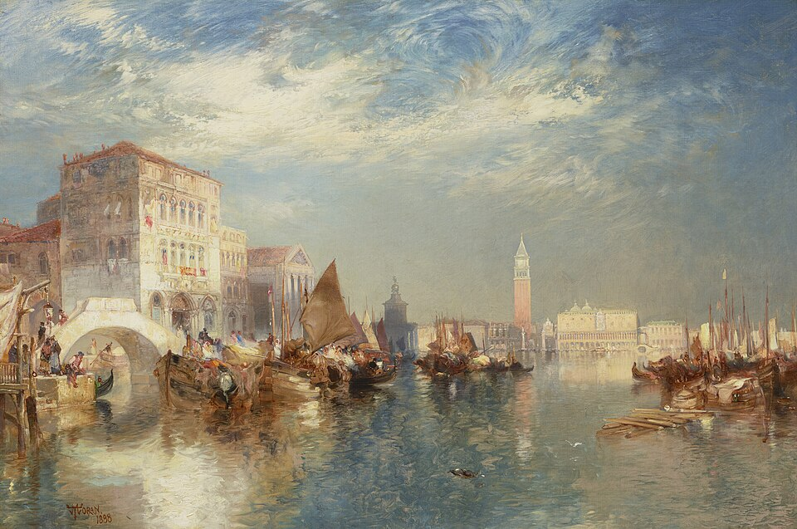
Glorious Venice, 1888, Oil on Canvas, 50.8 x 76.2 cm, Private Collection https://fr.m.wikipedia.org/wiki/Fichier:Thomas_moran_glorious_venice021111%29.jpg

Slide 5
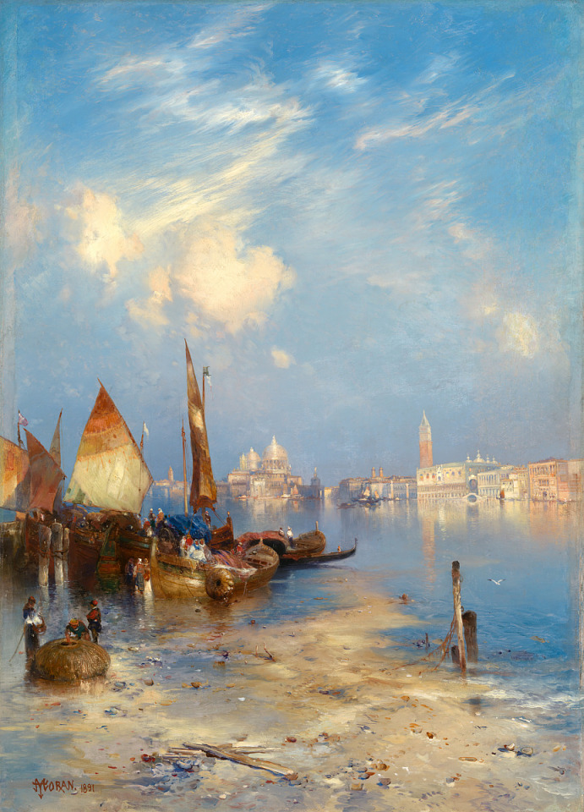
A View of Venice, 1891, Oil on Canvas, 35 1⁄8 x 25 1⁄4 in. (89.2 x 64.1 cm.), Smithsonian American Art Museum, Washington DC, USA https://americanart.si.edu/artwork/view-venice-17881

Slide 6
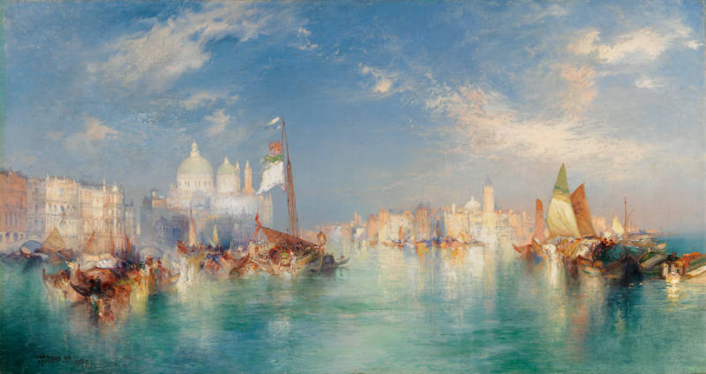
Venice, 1898, Oil in Canvas, 40.6 × 81.3 cm, Chrysler Museum of Art, VA, USA https://chrysler.emuseum.com/objects/63736/venice

Slide 7
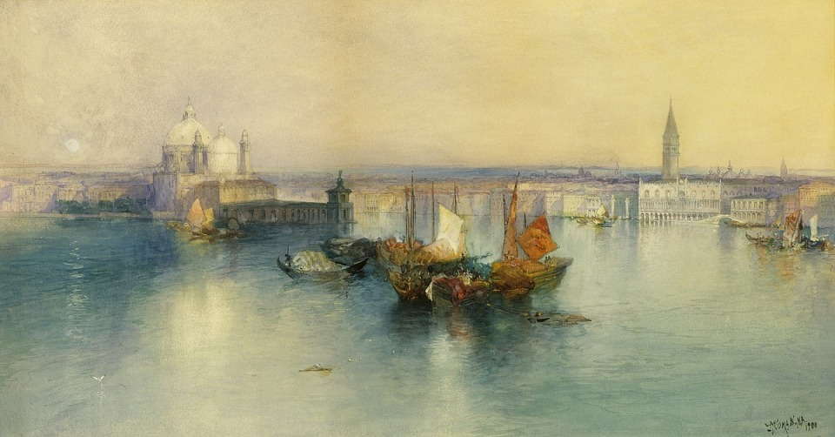
Venice from the Tower of San Giorgio, 1900, Watercolor on Paper mounted on paperboard, 38.1 x 66.7 cm, Smithsonian American Art Museum, Washington DC, USA https://americanart.si.edu/artwork/venice-tower-san-giorgio-17880

Slide 8
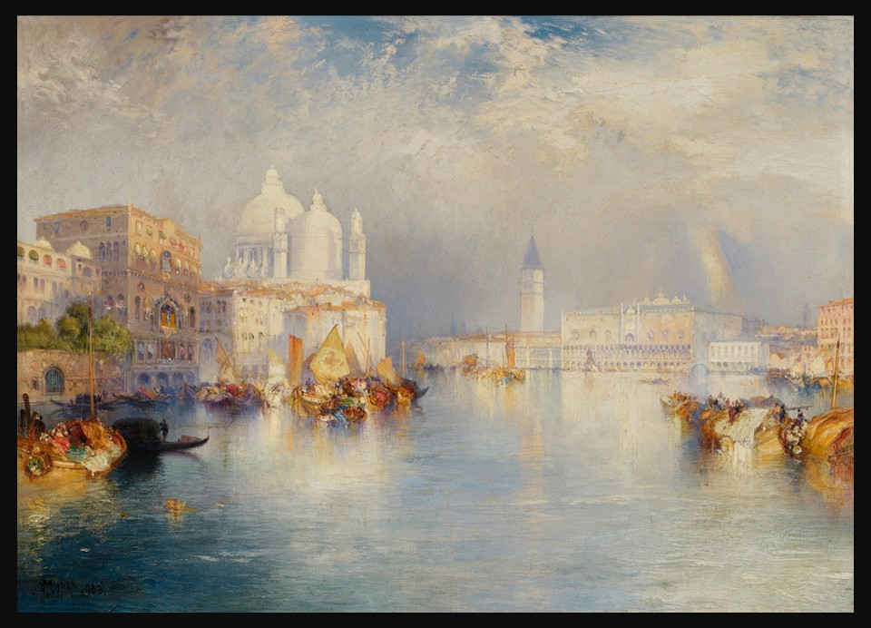
Grand Canal, Venice, 1903, Oil on Canvas, 35.6x51.4 cm, Private Collection https://www.sothebys.com/en/buy/auction/2025/art-of-the-americas-featuring-the-american-west/grand-canal-venice

Slide 9
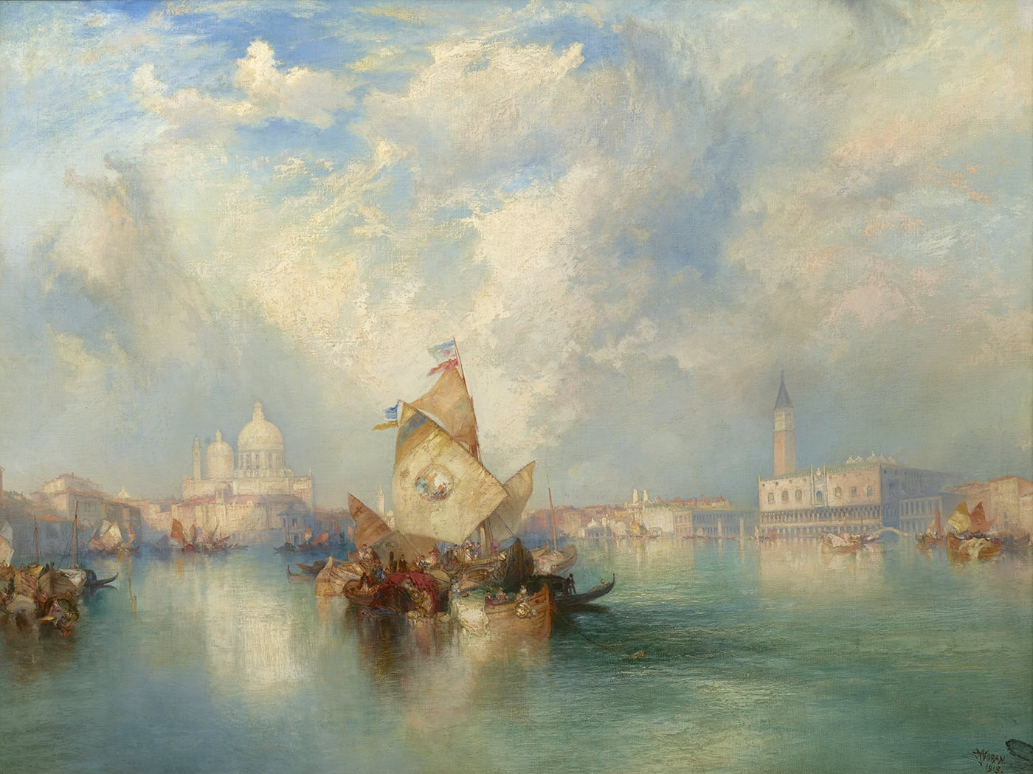
Santa Maria della Salute, Venice, 1915, Oil onCanvas,
76.20x101.60 cm, Private Collection https://www.questroyalfineart.com/artwork/santa-maria-della-salute-venice/

Slide 10
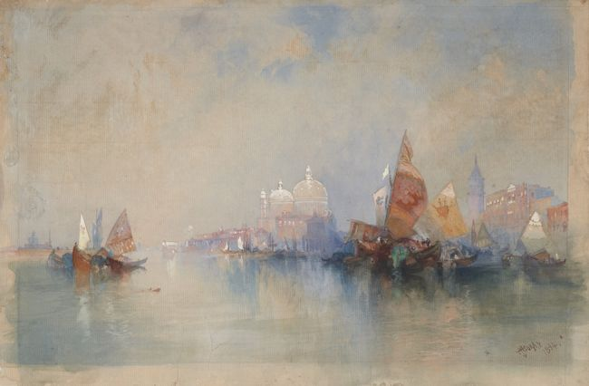
Venice: The Lagoon Looking toward Santa Maria della Salute, 1894, Watercolor and Gouache over graphite, 27.3 x 41.2 cm, Princeton University Art Museum, NJ, USA https://artmuseum.princeton.edu/collections/objects/11406

Slide 11
The End

