Slide 1
John Ottis Adams,
1851-1927

Slide 2
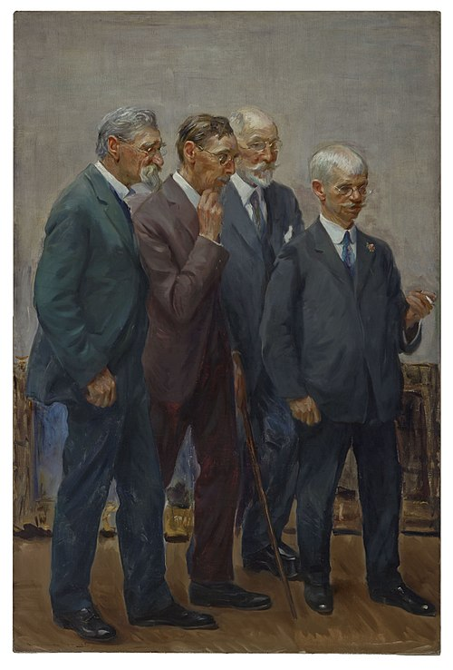
John Ottis Adams, depicted third from the left
Wayman Elbridge Adams, American Artist, 1883–1959
The Art Jury, 1921, oil on canvas, 208.9x137.7 cm, Indianapolis Museum of Art, USA https://commons.wikimedia.org/wiki/File:The_Art_Jury,_Wayman_Elbridge_Adams,_1921.jpg

Slide 3
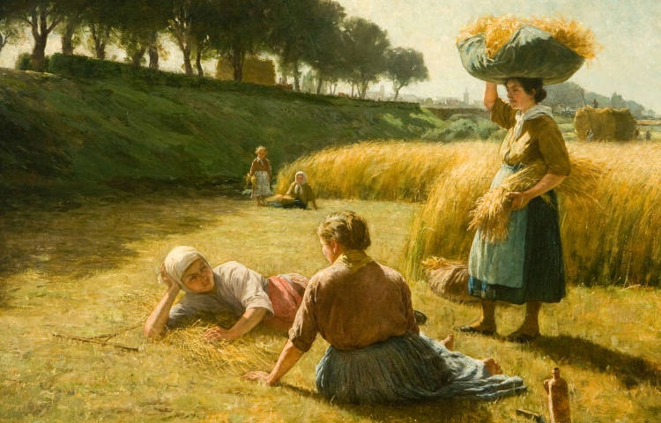
Nooning (The Gleaners), 1886, Oil on Canvas, 72.39x99.36 cm, David Owsley Museum of Art, Ball State University Art Museum, IN, USA

Slide 4
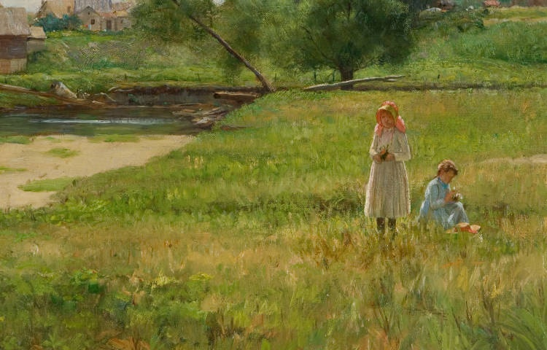
Summertime, 1890, Oil on Canvas, 36.04x50.95 cm, David Owsley Museum of Art, Ball State University Art Museum, IN, USA

Slide 5
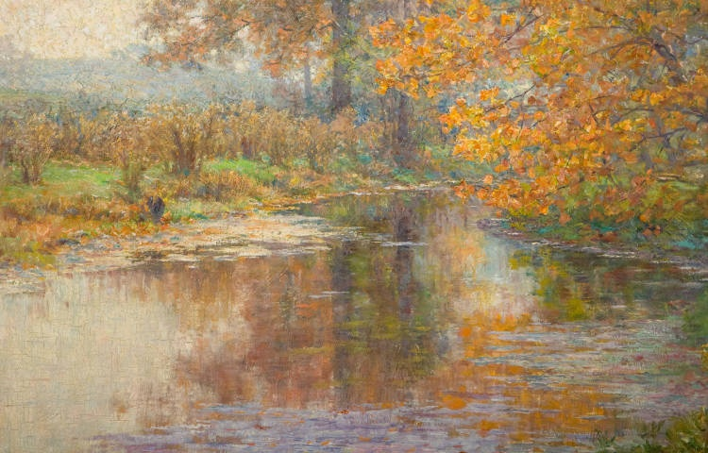
Glimmer Glass, 1895, Oil on Canvas, 50.49x76.04 cm, David Owsley Museum of Art, Ball State University Art Museum, IN, USA

Slide 6
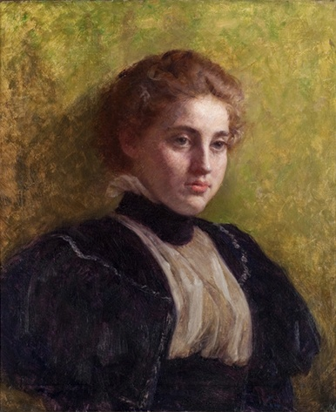
Madge, 1900-1905, Oil on Canvas, 72x61 cm, David Owsley Museum of Art, Ball State University Art Museum, IN, USA

Slide 7
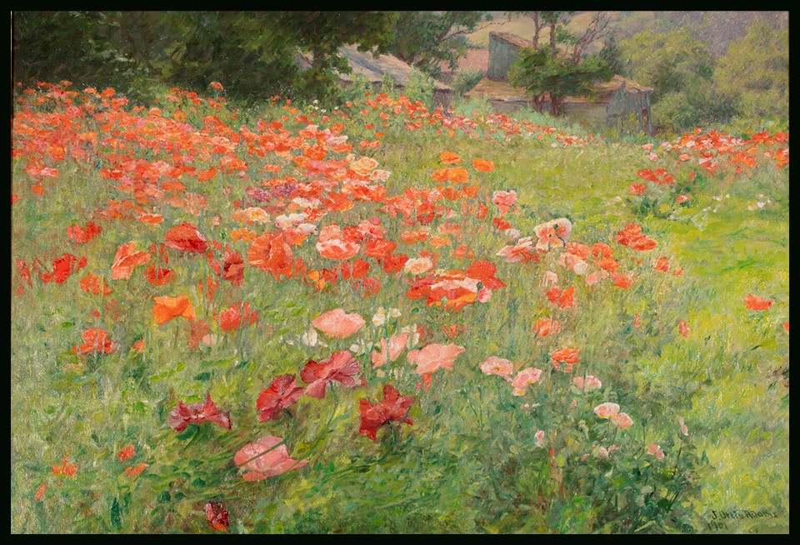
In Poppyland, 1901, Oil on Canvas, 55.9 x 81.3 cm, David Owsley Museum of Art, Ball State University Art Museum, IN, USA https://www.bsu.edu/web/museumofart/exhibitions/past#accordion_impressionsoflove

Slide 8
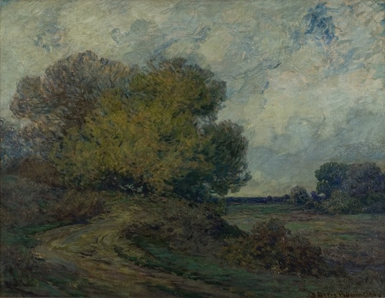
A Winding Road, Brookville, 1904, Oil on Canvas, 71x91 cm, Location: Unknown

Slide 9
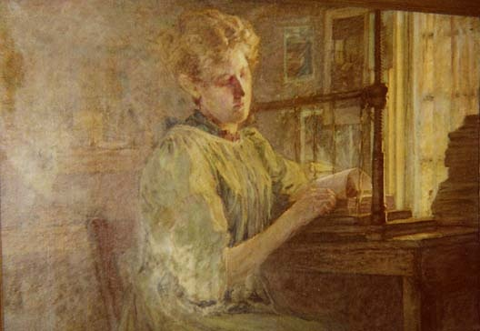
Binding Books, ca. 1904, Oil on Canvas, 71.12x 106.68 cm, Private Collection

Slide 10
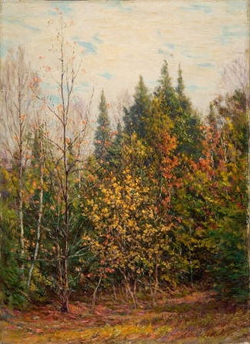
Spires of the Woods, 1910/1920, Oil on Canvas, 40.64x55.88 cm, David Owsley Museum of Art, Ball State University Art Museum, IN, USA

Slide 11
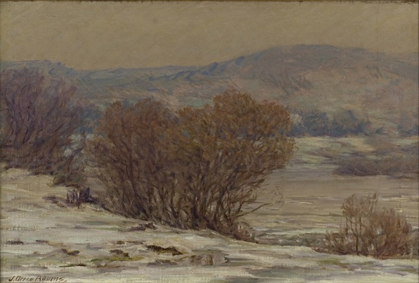
A Winter Day, Brookville, 1910-1912, Oil on Canvas, 72.39x99.06 cm, David Owsley Museum of Art, Ball State University Art Museum, IN, USA

Slide 12
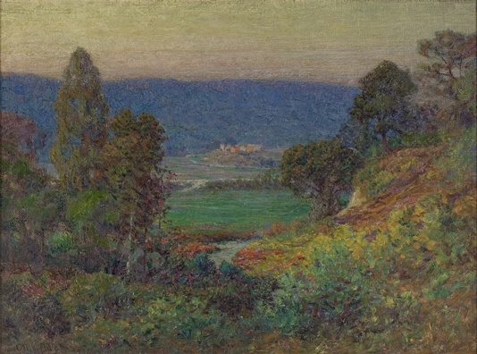
Blue Hills, Brookville, 1910, Oil on Canvas, 66.04x 88.9 cm, Location: Unknown

Slide 13
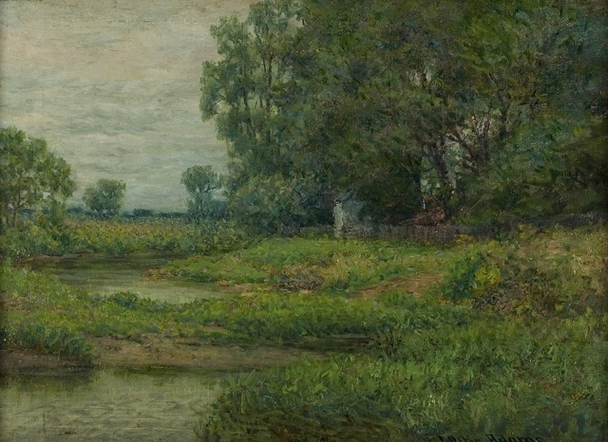
Gray Summer Day, 1911, Oil on Canvas, 76x61 cm, David Owsley Museum of Art, Location: Unknown

Slide 14
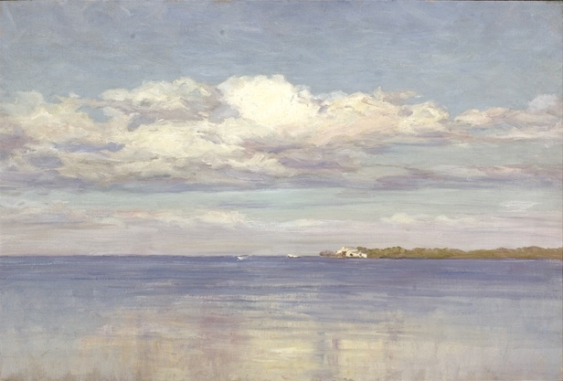
Big Bayou, St. Petersburg, Florida, 1920, Oil on Canvas, 55.88x81.28 cm, Location: Unknown

Slide 15
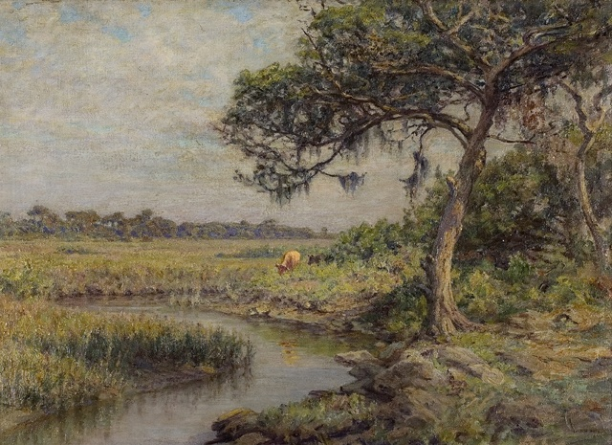
Along Indian River (Florida Cow, New Smyrna), 1923-1926, Oil on Canvas, 45.72x62.23, Location: Unknown

Slide 16
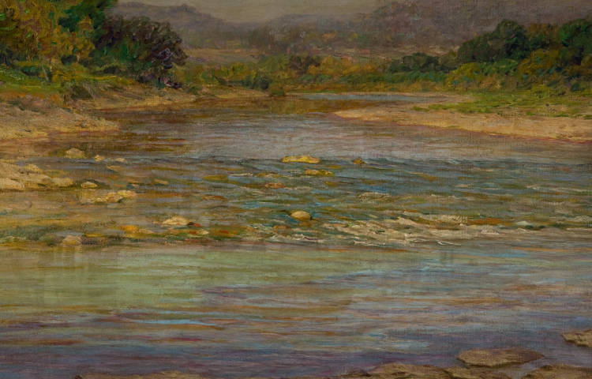
The Iridescent Stream, about 1900, Oil on Canvas, 55.88x81.28 cm, David Owsley Museum of Art, Ball State University Art Museum, IN, USA

Slide 17
Photo Credits: http://americanartgallery.org/artist/home/id/910

