Slide 1
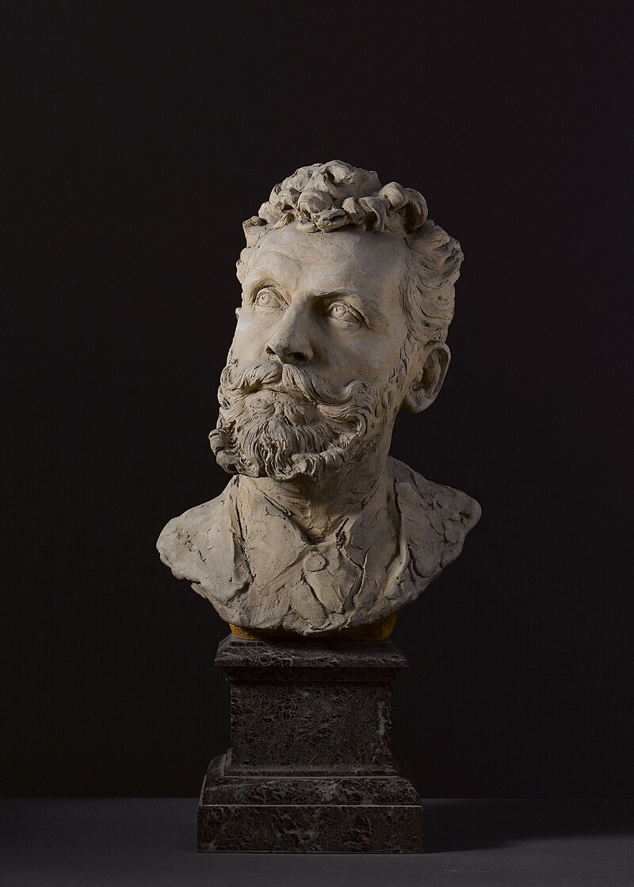
Alfred-Philippe Roll,
1846-1919
Aimé-Jules Dalou, 1838-1902
Buste de l'artiste Alfred-Philippe Roll, Terracotta, Marble, Height: 58 cm, Petit Palais, Musée des Beaux-arts de la Ville de Paris, France https://commons.wikimedia.org/wiki/File:Buste_d%27Alfred_Roll,_PPS1191(1).jpg

Slide 2
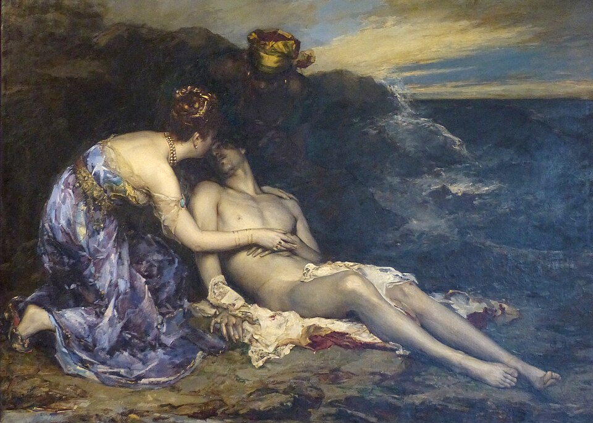
Don Juan and Haïdee, 1874, Oil on Canvas, Calvet Museum, Avignon, France

Slide 3
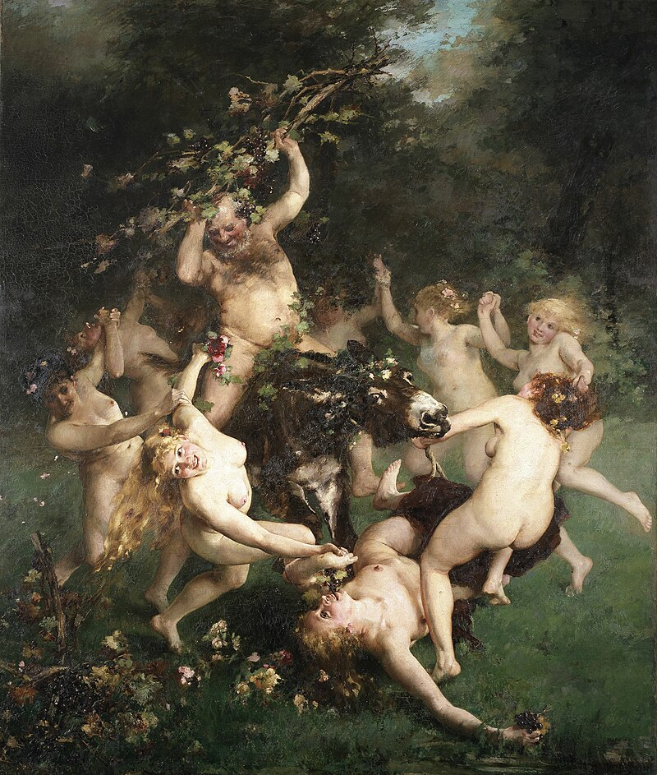
The Feast of Silenus, 1880, Oil on Canvas, 362-305 cm, Museum of Fine Arts Ghent, Belgium

Slide 4
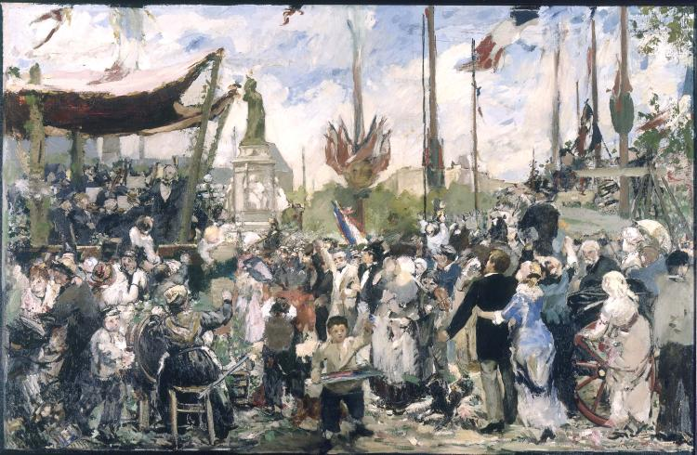
Bastille Day, 1880-1882, Oil on Canvas, 175 x 269 cm, Petit Palais, Paris, France https://www.petitpalais.paris.fr/en/oeuvre/bastille-day-1880-inauguration-monument-republic

Slide 5
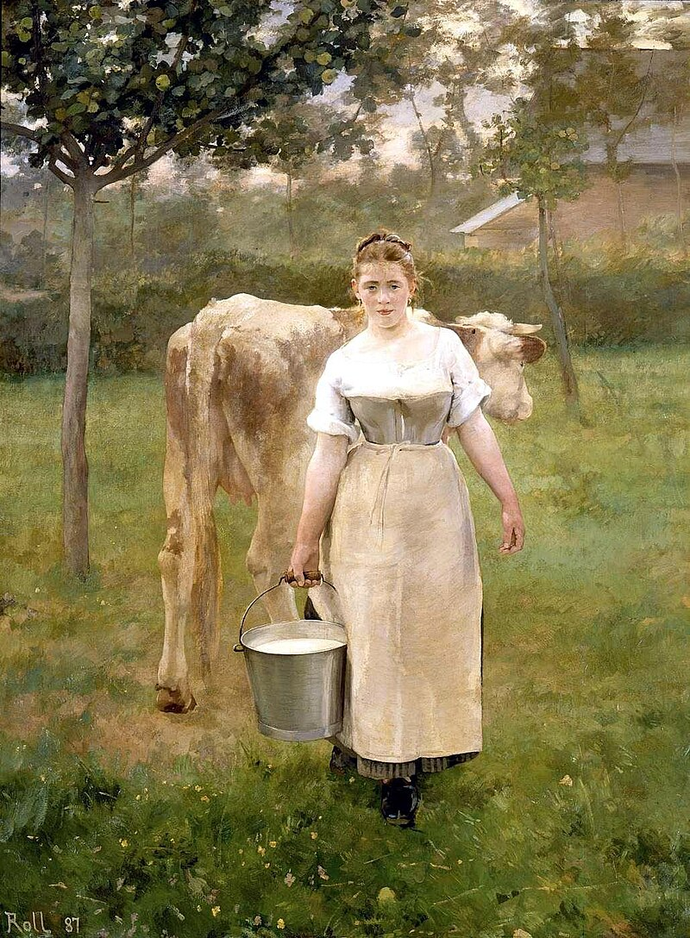
Manda Lamétrie, farmer, 1887, Oil on Canvas, 2.1x1.6 m, Musée d'Orsay, Paris, France

Slide 6
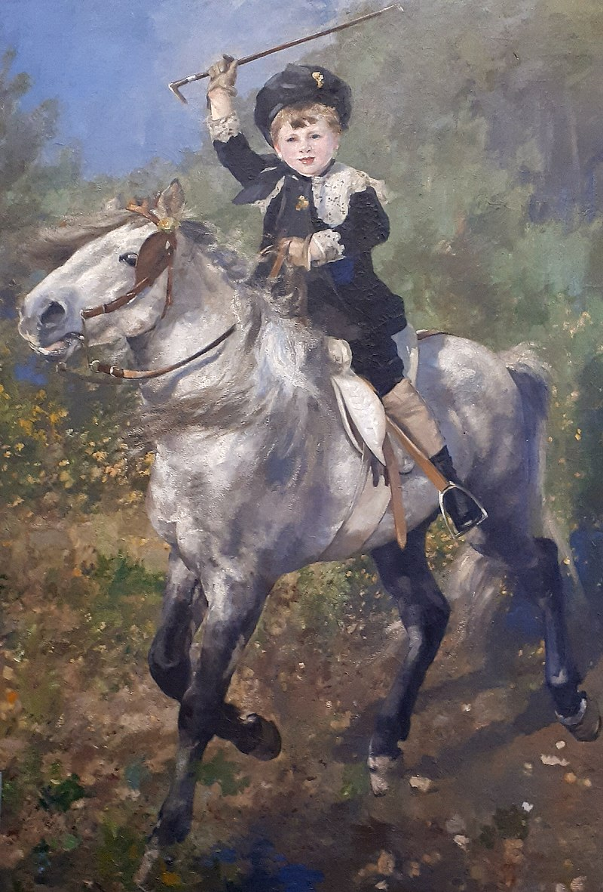
Au trot, 1888, Oil on Canvas, 197x286 cm, Municipal Museum of Saverne, France

Slide 7
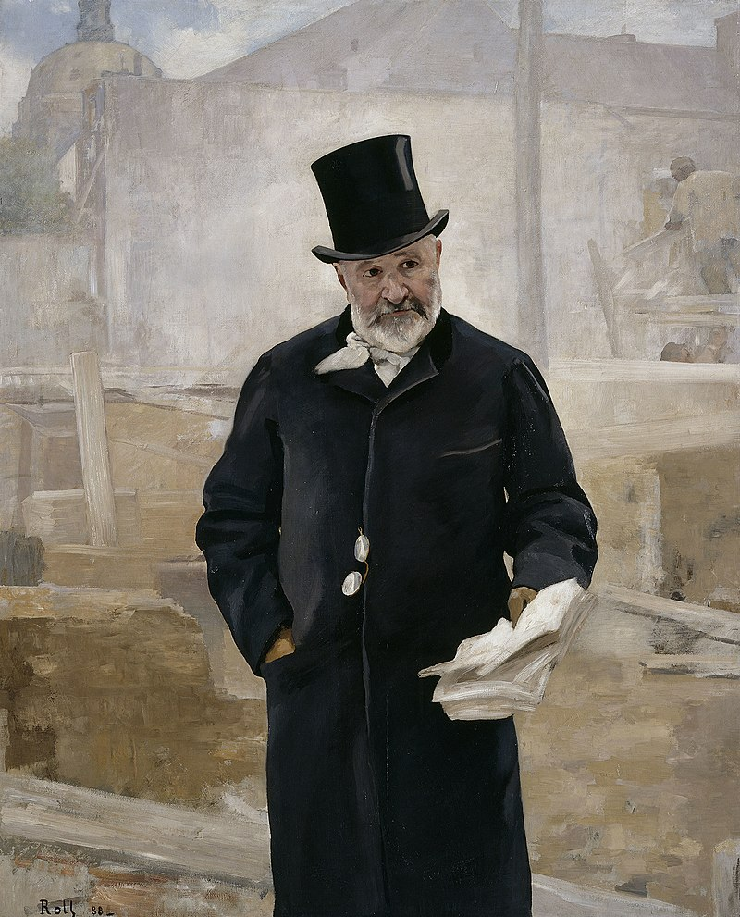
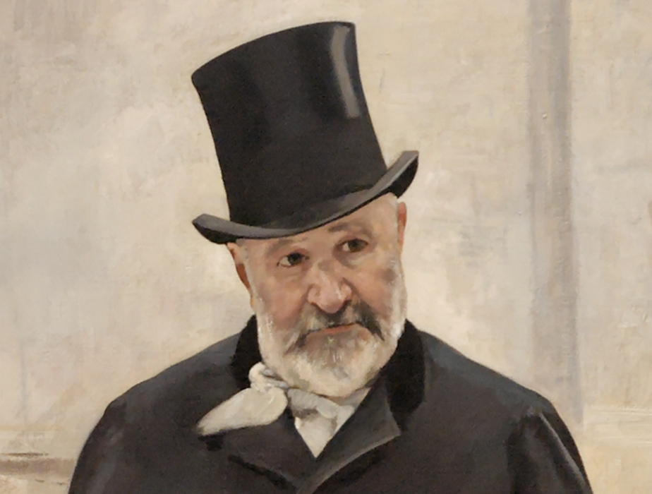
Portrait d'Adolph Alphand, 1888, Oil on Canvas, 202x173 cm, Musée des Beaux-Arts de la ville de Paris, France

Slide 8
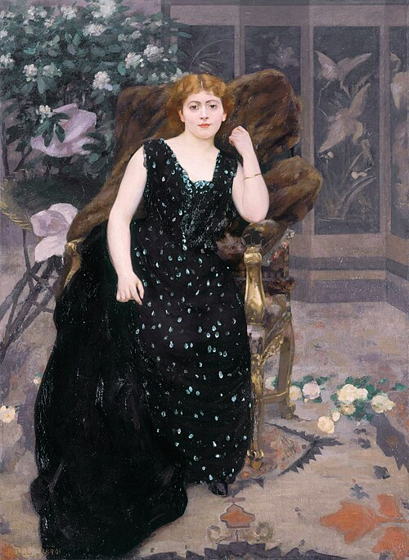
Portrait of Jane Hading, 1890, Oil on Canvas, 192 x 140 cm, Le Petit Palais, Paris, France

Slide 9
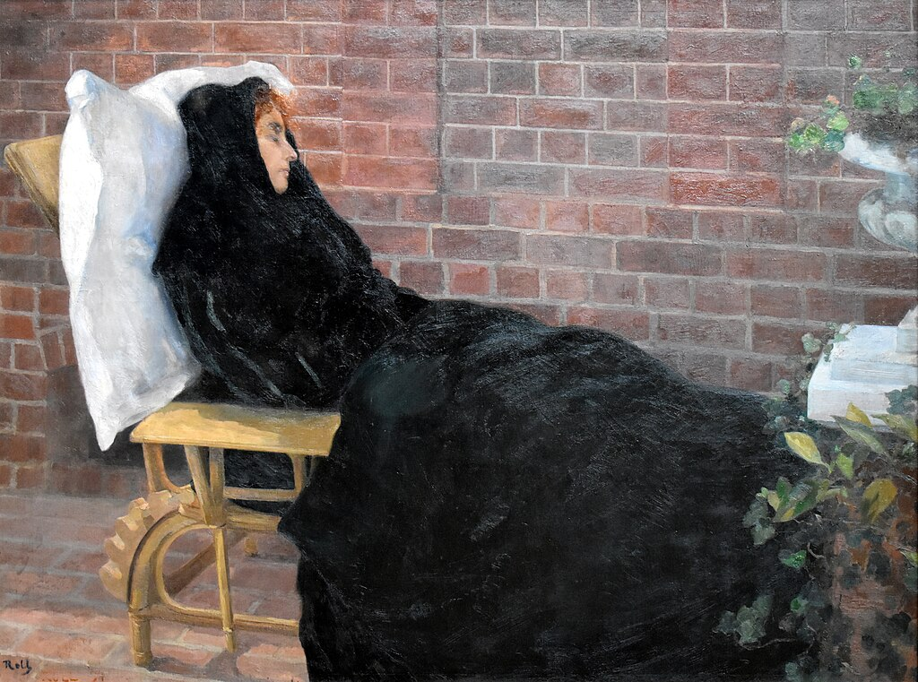
La Malade, 1897, Oil on Canvas,
110x147 cm, Musée des Beaux-Arts de Bordeaux, France

Slide 10
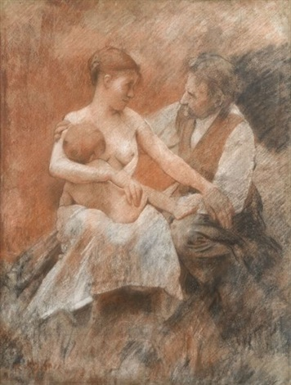
Maternity, 1911, Pastel, 64 x 49,5 cm, Private Collection

Slide 11
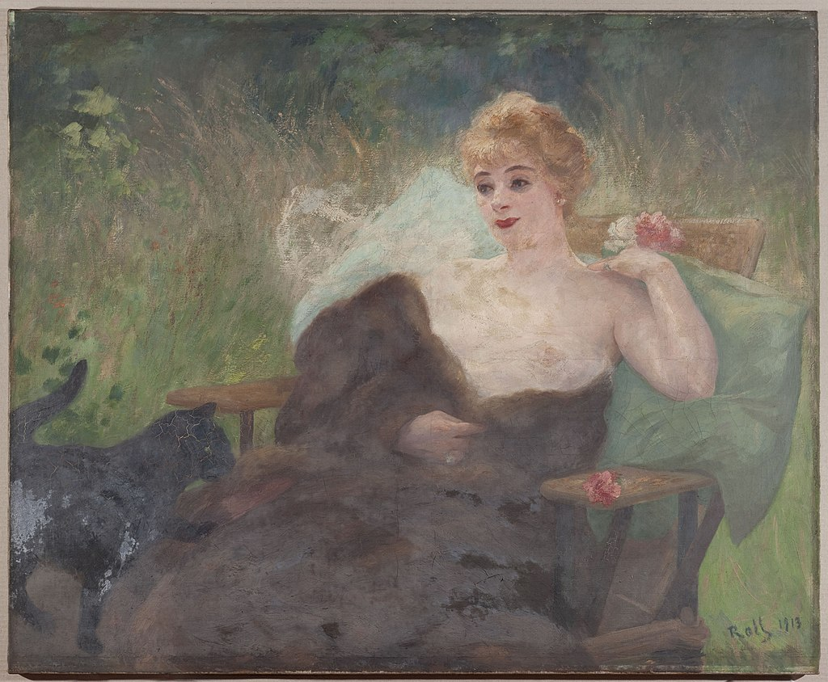
Portrait of Amélie Diéterle, 1813, Oil on Canvas, 106x130 cm, Petit Palais, Paris, France

Slide 12
Photo Credit: https://commons.wikimedia.org/wiki/Category:Alfred_Philippe_Roll

