Slide 1

Thomas Pollock Anshutz
1851-1912
10 Paintings

Slide 2
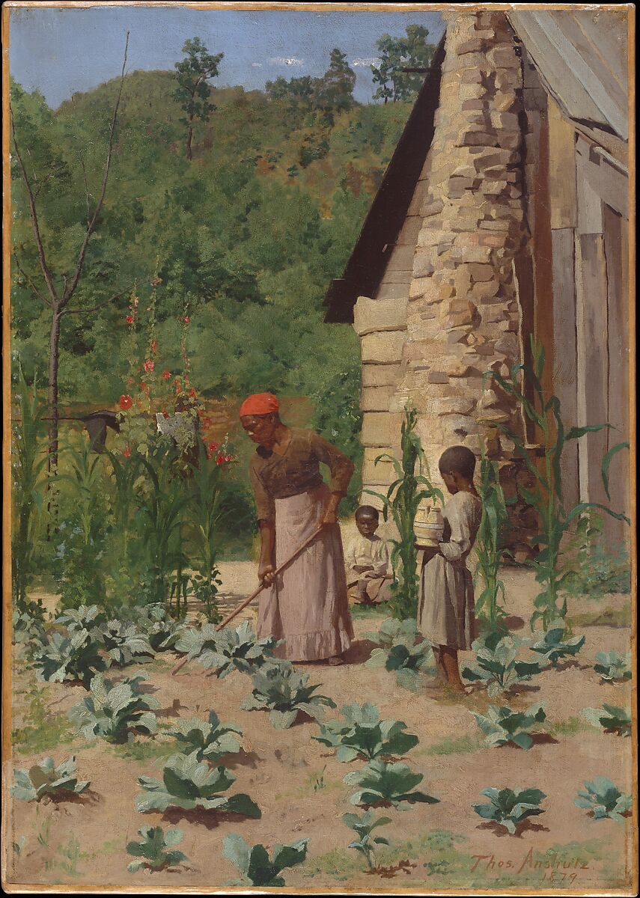
The Way they Lived, 1879, Oil on canvas, 61 x 43.2 cm, the MET, NY, USA https://www.metmuseum.org/art/collection/search/10080

Slide 3
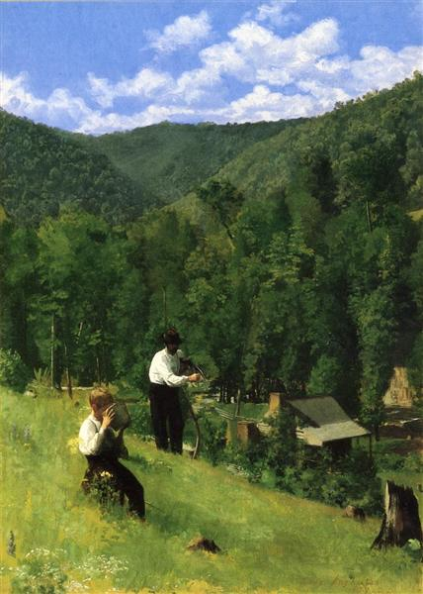
The Farmer and His Son at Harvesting, c. 1879. Oil on canvas,
61.6 x 43.8 cm, Private Collection https://www.wikiart.org/en/thomas-pollock-anshutz/the-farmer-and-his-son-at-harvesting-1879

Slide 4
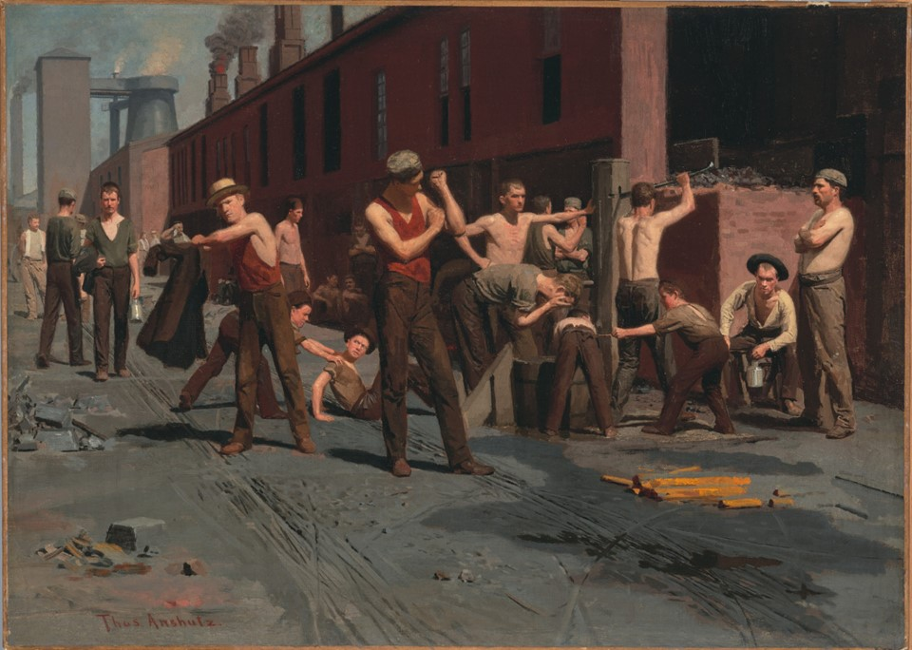
The Ironworkers' Noontime, 1880, Oil on Canvas, 43.2 x 60.6 cm, de Young/Legion of Honor Fine Arts Museums of San Francisco, CA, USA https://www.famsf.org/artworks/the-ironworkers-noontime

Slide 5
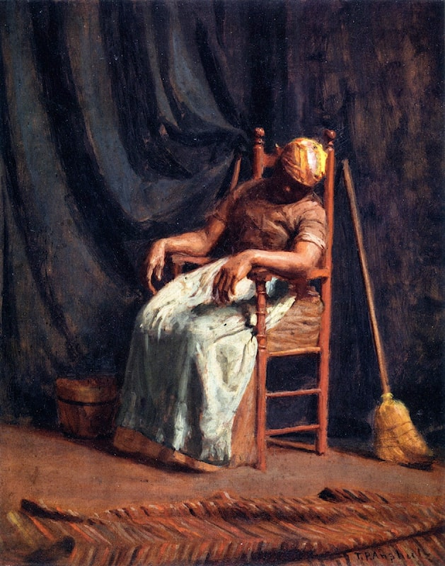
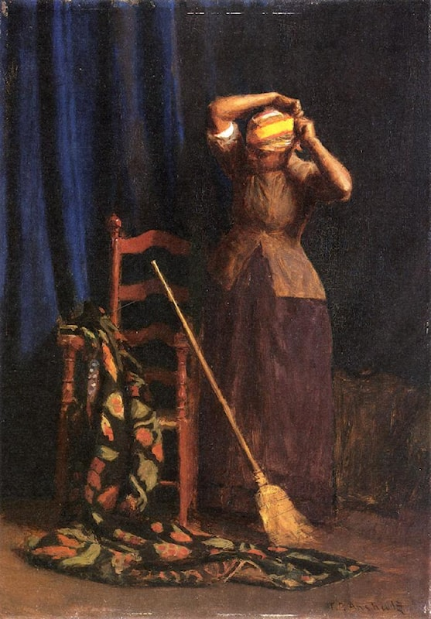
Aunt Hannah, c. 1880, 30.8 x 25.1 cm, Oil on panel, Detroit Institute of Art, USA https://www.artrenewal.org/artworks/thomas-pollock-anschutz/aunt-hannah/60474
The Chore, 1888, Oil on canvas, 35.7 x 25.1 cm, Allentown Art Museum, USA https://www.artrenewal.org/artworks/thomas-pollock-anschutz/the-chore/28185

Slide 6
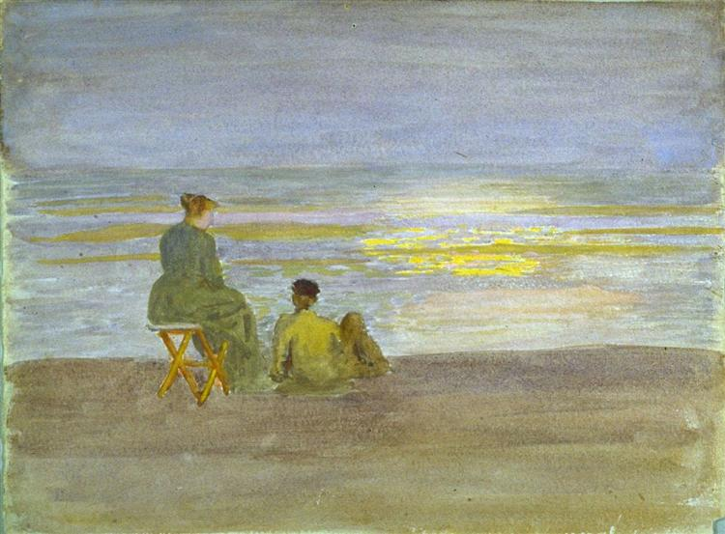
Man and Woman on the Beach, circa 1893, Watercolor on paper, 25.4x33 cm, Fine Arts Museums of San Francisco, USA https://commons.wikimedia.org/wiki/File:Thomas_P._Anshutz_-_Man_and_Woman_on_the_Beach.jpg

Slide 7
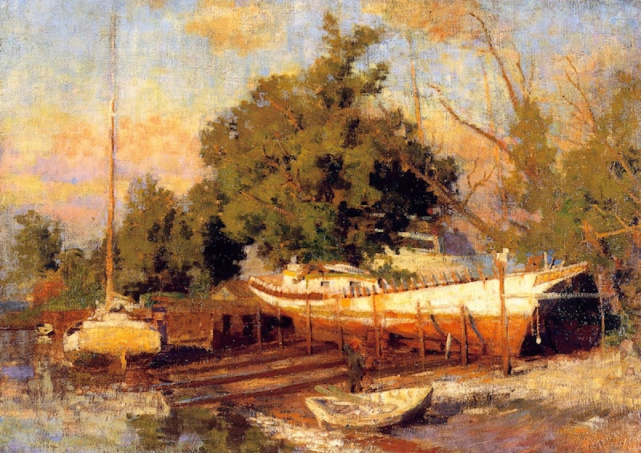
Down the Delaware Bay, c. 1897, Oil on canvas, 66.7 x 94.6 cm, Montgomery Museum of Fine Arts, USA https://www.artrenewal.org/artworks/thomas-pollock-anschutz/down-the-delaware-bay/60485

Slide 8
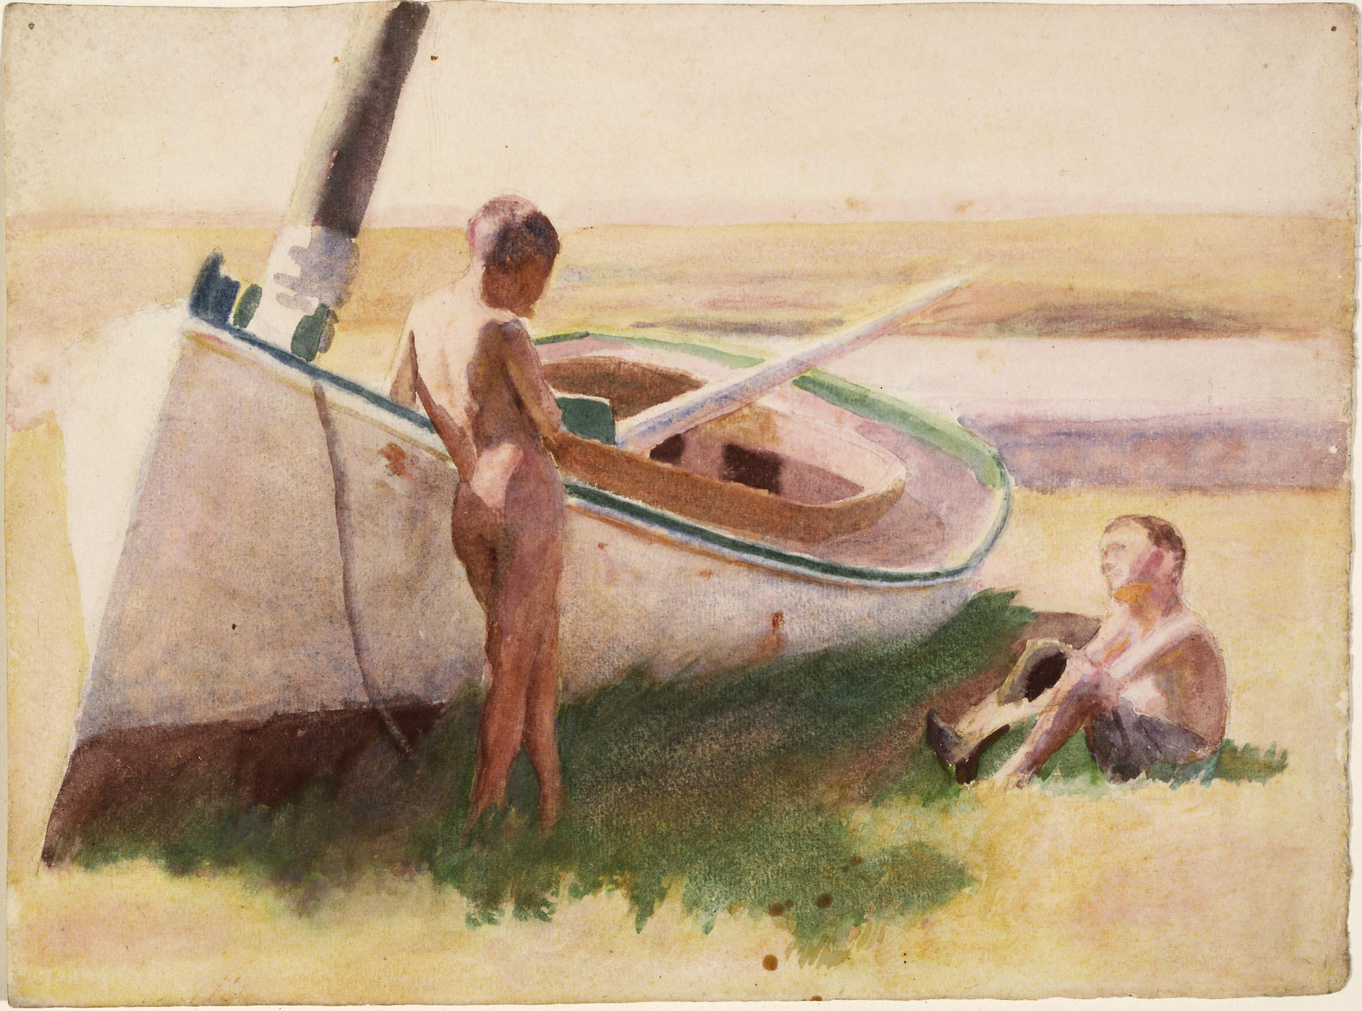
Two Boys by a Boat, 1895, Watercolour and Graphite on paper, 25,40x33,97 cm, Carnegie Museum of Art, Pittsburgh, USA https://collection.carnegieart.org/objects/e8d2974f-e957-4944-a3f1-afc4720e2b0d

Slide 9
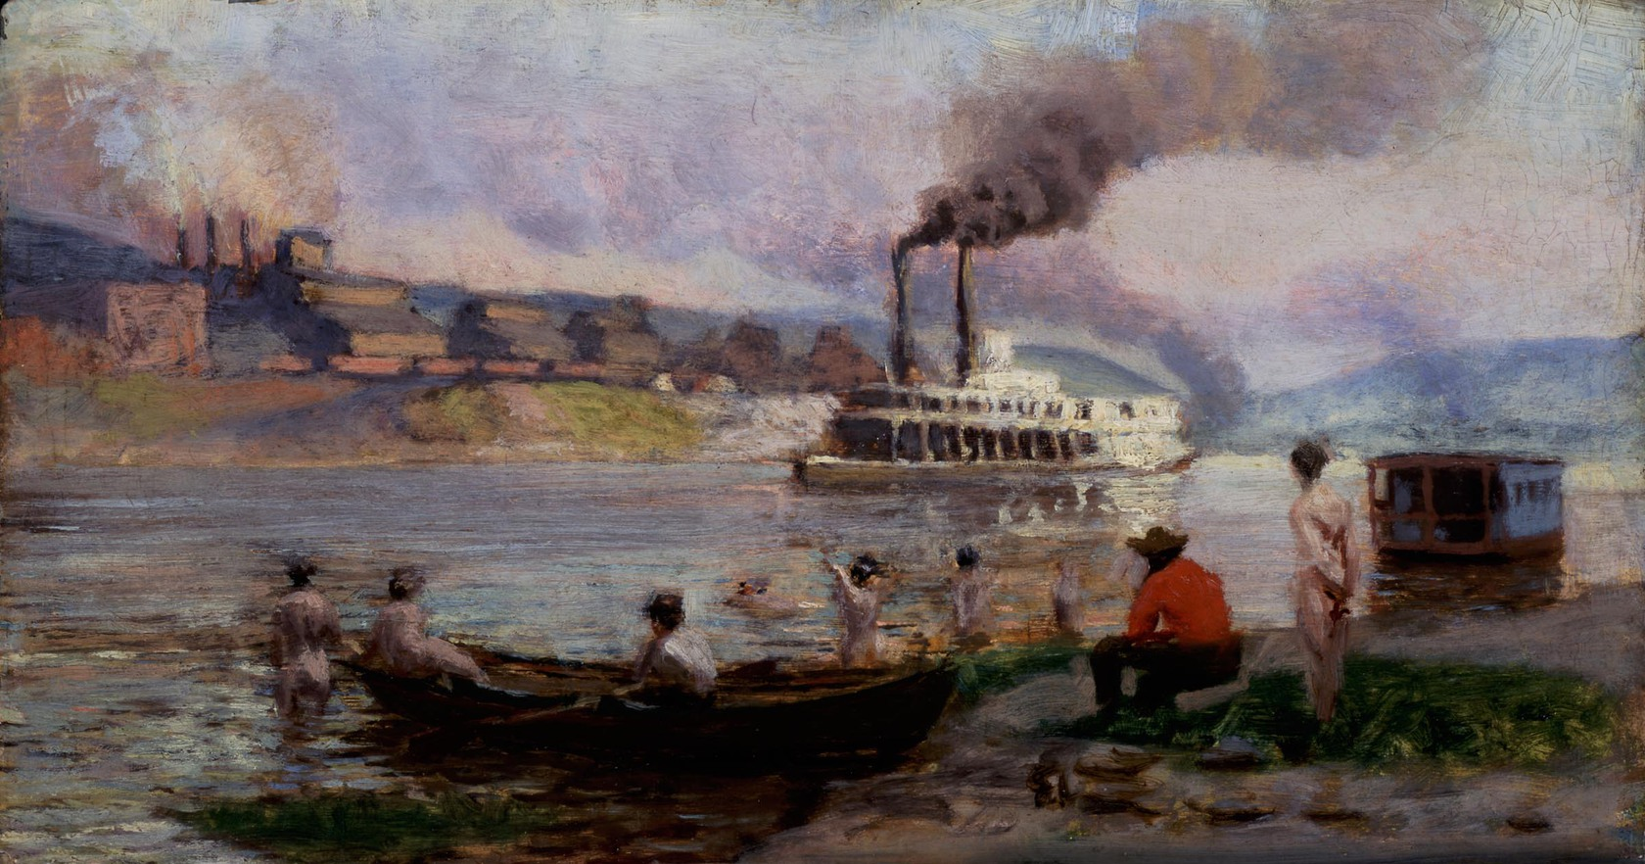
Steamboat on the Ohio, c. 1900- 1908, Oil on canvas, 69.2 x 122.6 cm, Carnegie Museum of Art, Pittsburgh, USA https://collection.carnegieart.org/objects/64ef35fc-d1d8-404f-b137-e39e8576e14e

Slide 10
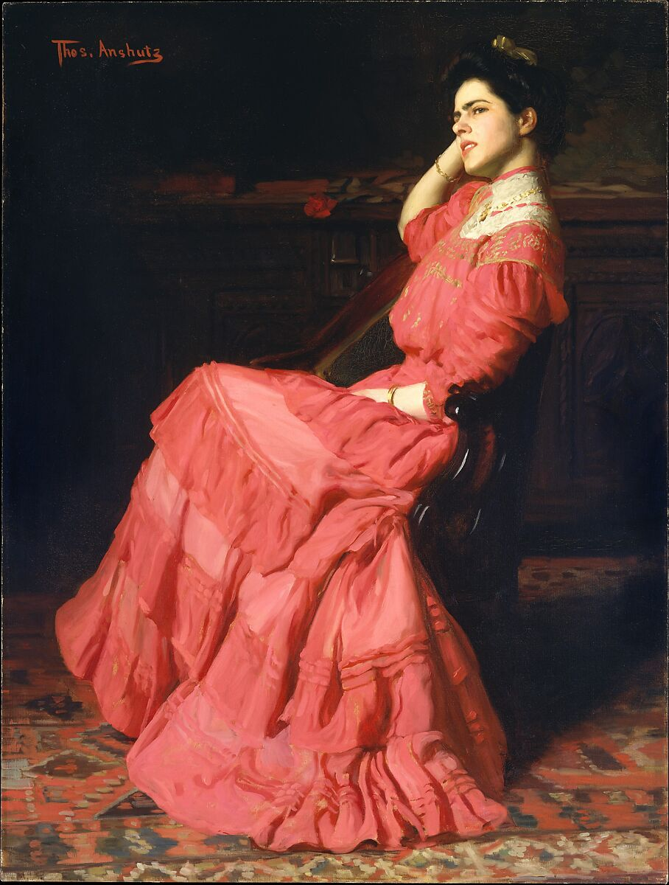
A Rose, 1907, Oil on canvas, 147.3 x 111.4 cm, the MET, NY, USA https://www.metmuseum.org/art/collection/search/14931

Slide 11
Thomas Pollock Anshutz
1851-1912
10 Paintings

