Slide 1

Sosannah and the Elders through the Ages

Slide 2
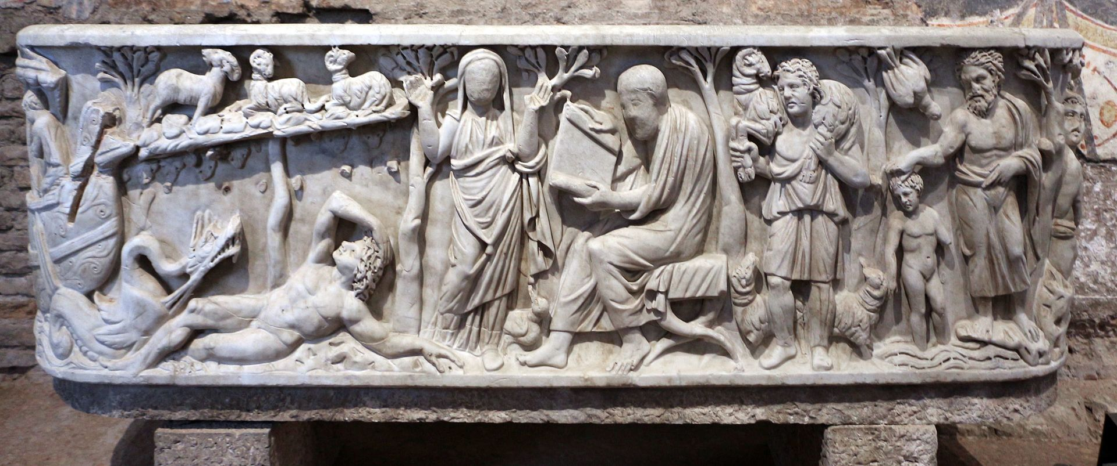
Sarcophagus – The praying woman flanked by two trees is identified as Sosannah, late 3rd century, Marble, Santa Maria Antiqua, Rome, Italy https://commons.wikimedia.org/wiki/File:Sarcofago_a_vasca_con_le_storie_di_giona,_detto_di_s.m._antiqua,_275_dc_ca.,_01.jpg

Slide 3
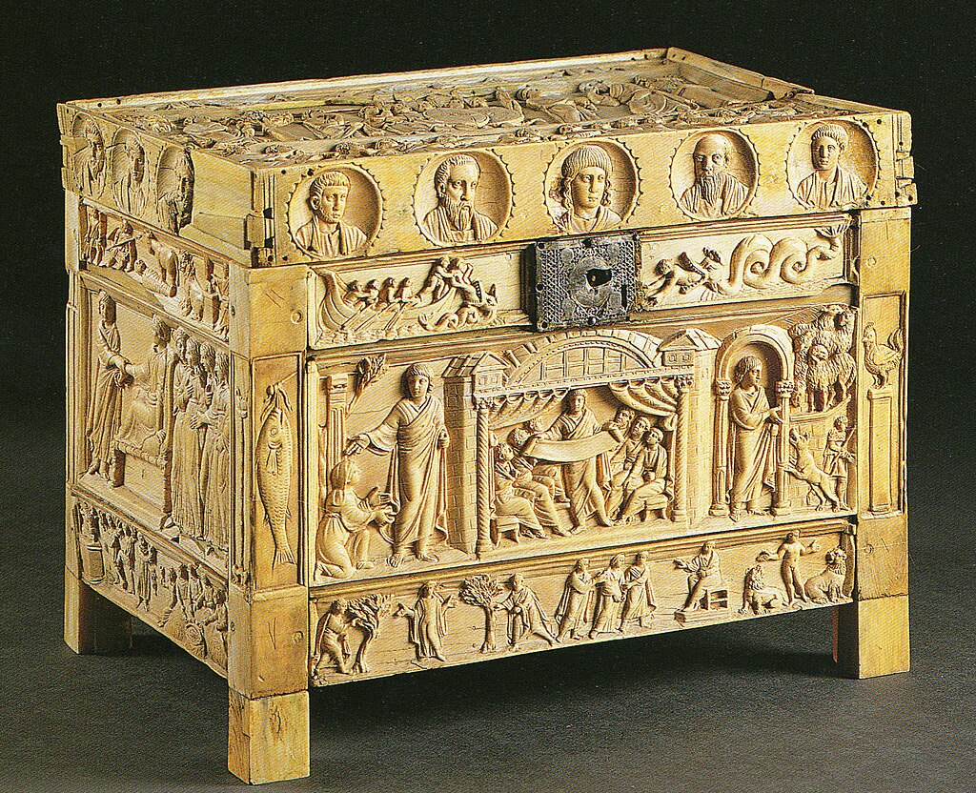
Brescia Casket – the scene of Sosannah and the Elders is depicted in the lower, left plaque, late 4th century, Ivory, 22×32×25 cm, Museum of Santa Giulia , Brescia, Italy https://it.wikipedia.org/wiki/Lipsanoteca_di_Brescia

Slide 4
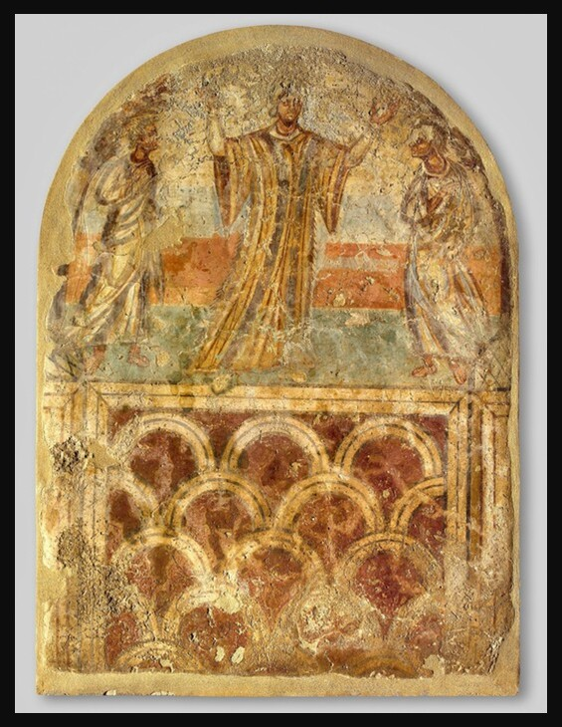
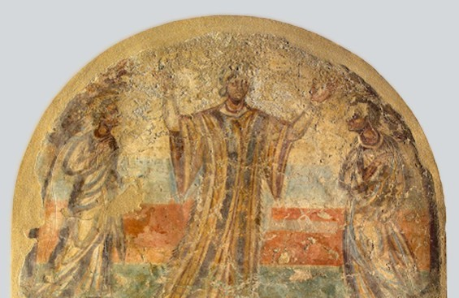
Funerary Wall Painting with Sosannah and the Elders, early 5th century, Fresco, 170 x 127 cm, Museum of Byzantine Culture, Thessaloniki, Greece https://www.lifo.gr/culture/arxaiologia/oi-toihografies-sta-tafika-mnimeia-sto-moyseio-byzantinoy-politismoy-tis

Slide 5
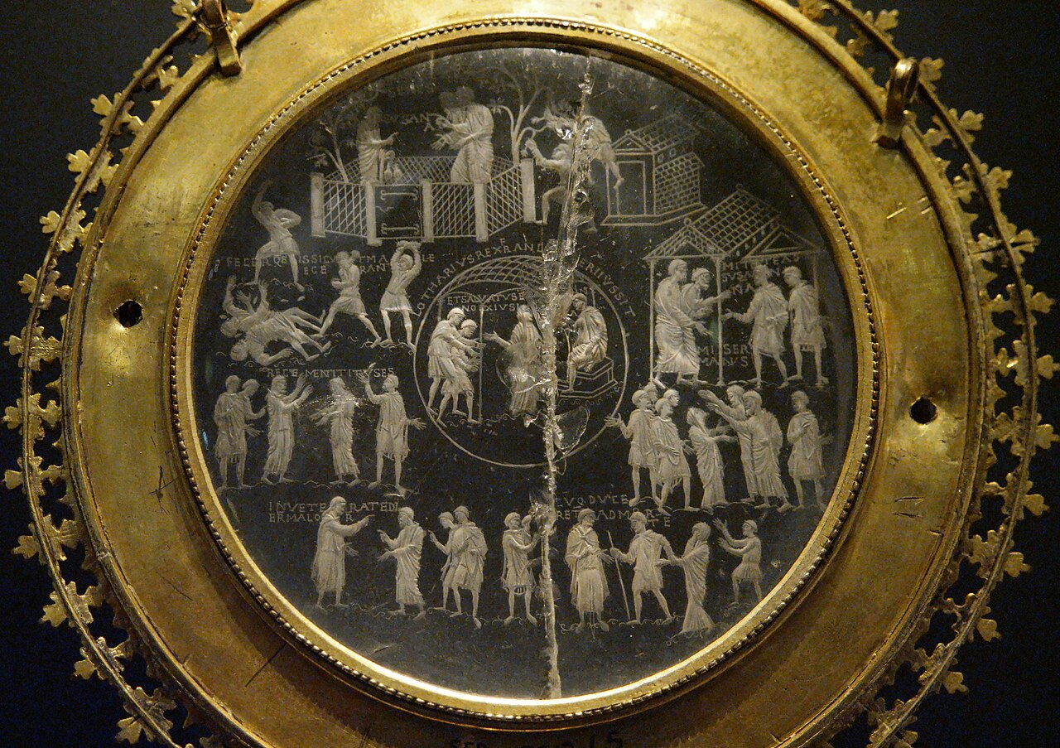
The Lothair Crystal - The Biblical story of Susanna and the Elders, 9th century (crystal) – 15th century (frame), Rock Crystal, Gold, Copper, Diameter: 83 millimetres (incl frame), British Museum, London, UK https://en.wikipedia.org/wiki/Lothair_Crystal

Slide 6
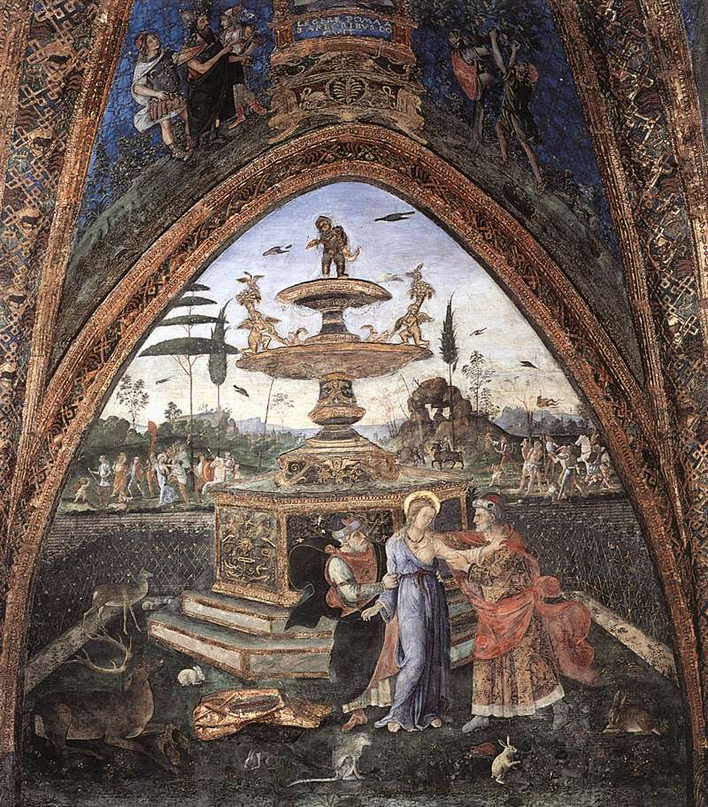
Pinturicchio, 1454–1513
Susanna and the Elders, circa 1492-1494, Fresco, Palazzi Pontifici, Borgia Apartment, The Vatican https://upload.wikimedia.org/wikipedia/commons/7/73/Appartamento_borgia%2C_susanna_e_i_vecchioni.jpg

Slide 7
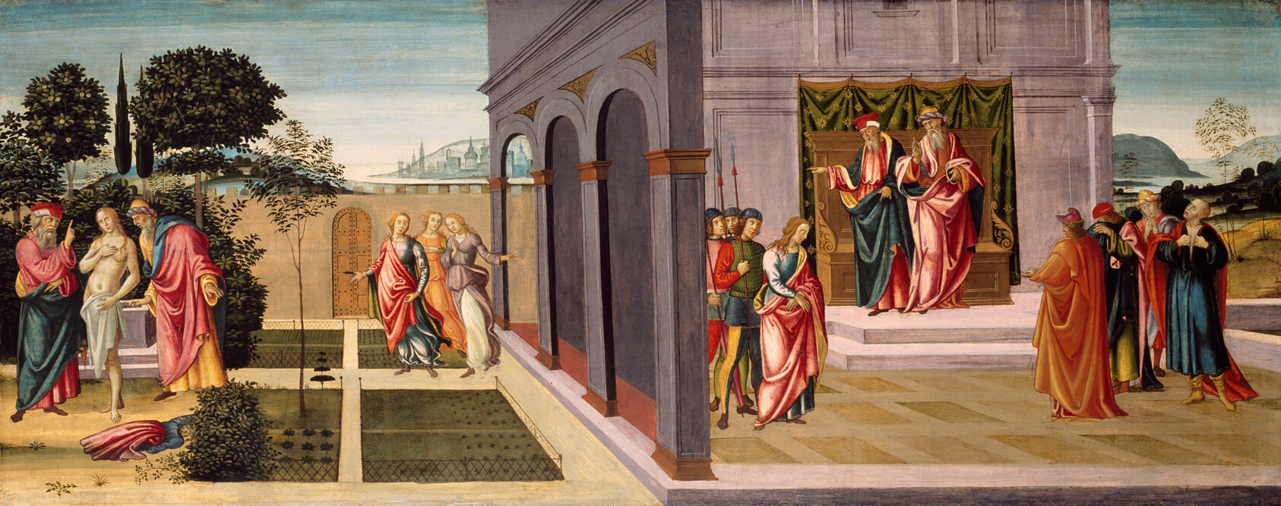
Master of the Apollo and Daphne Legend, Italian, active c. 1480–1510
Susanna and the Elders in the Garden, and the Trial of Susanna before the Elders, circa 1500, 64x159 cm, Art Institute of Chicago, USA https://www.artic.edu/artworks/16218/susanna-and-the-elders-in-the-garden-and-the-trial-of-susanna-before-the-elders

Slide 8
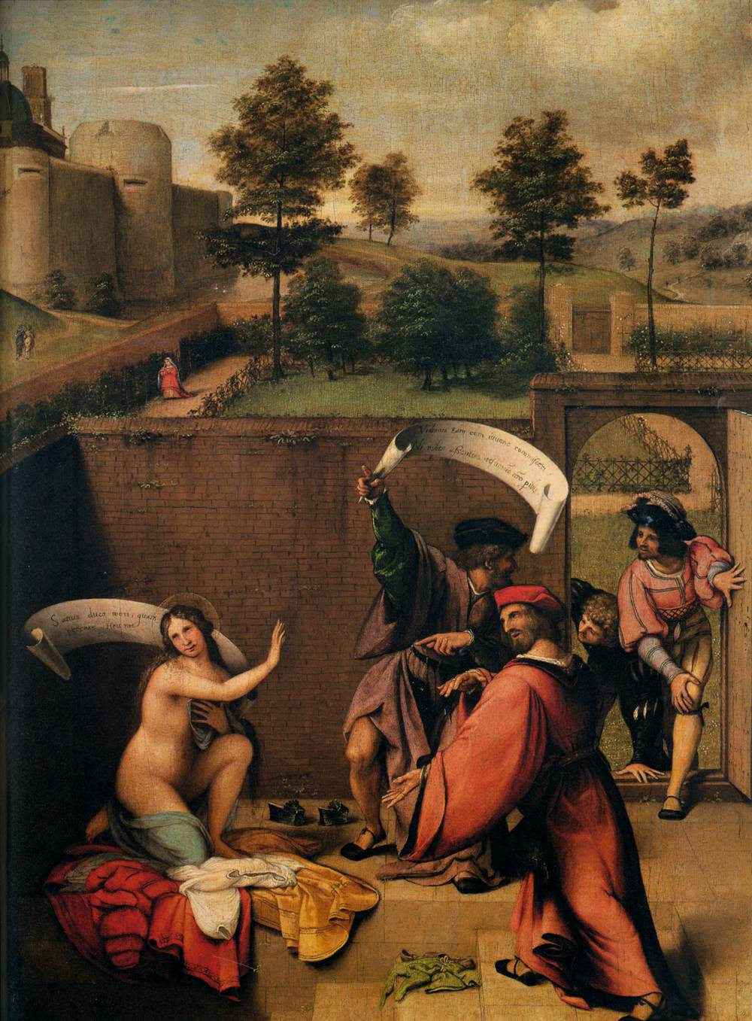
Lorenzo Lotto, 1480–1556
Sosannah and the Elders, 1517, Oil on Panel, 50X60 cm, Contini Bonacossi Collection, Uffizi Gallery, Florence, Italy https://commons.wikimedia.org/wiki/File:Lotto,_susanna_e_i_vecchioni.jpg

Slide 9
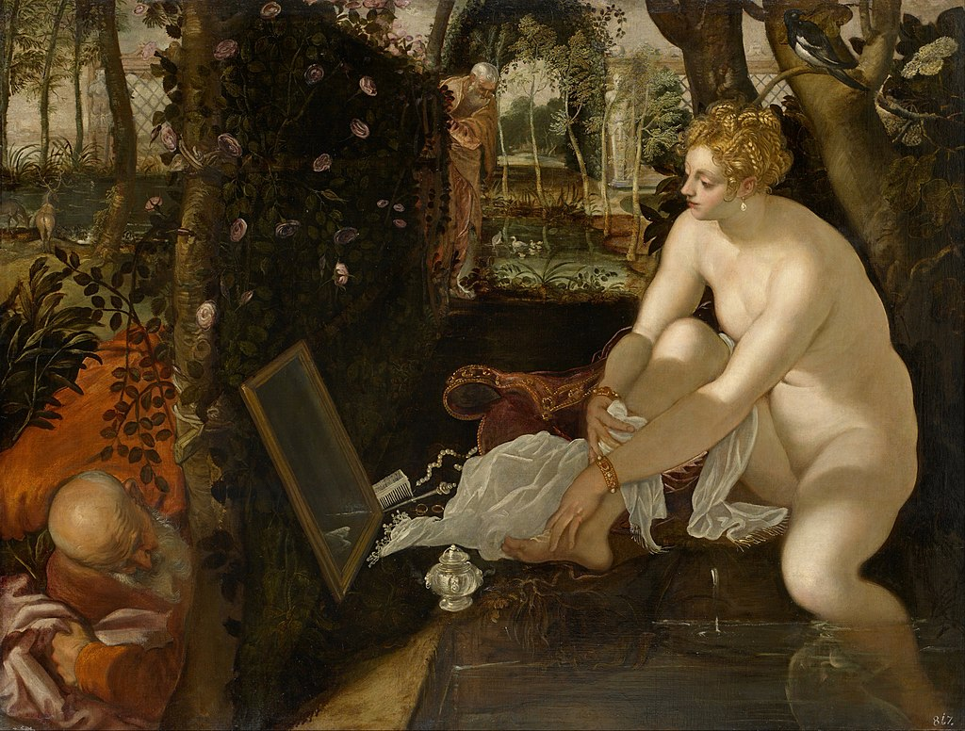
Jacopo Tintoretto, 1519–1594
Sosannah and the Elders, 1555 – 1556, Oil on Canvas, 1,460x1,936 mm,
Kunsthistorisches Museum, Vienna, Austria https://commons.wikimedia.org/wiki/File:Jacopo_Robusti,_called_Tintoretto_-_Susanna_and_the_Elders_-_Google_Art_Project.jpg

Slide 10
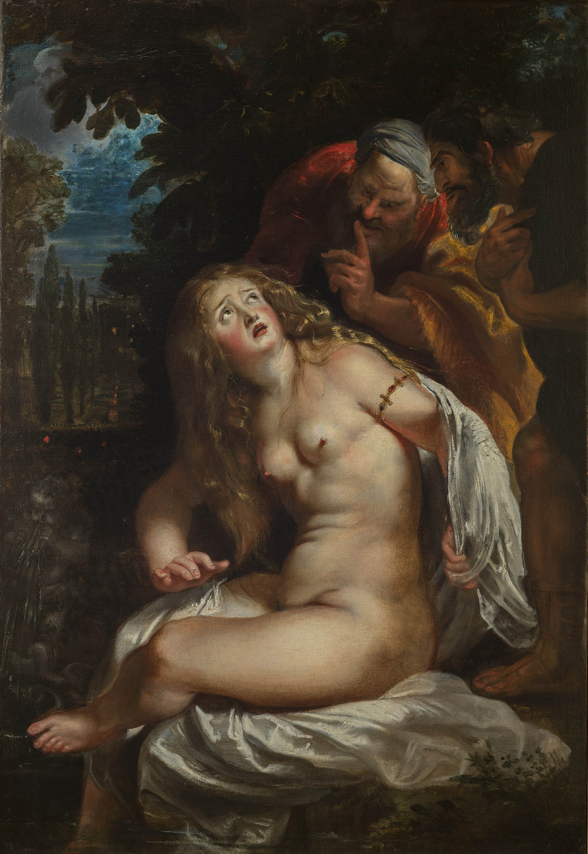
Pieter Paul Rubens, 1577-1640
Sosannah and the Elders, c. 1606-1607, Oil on Canvas, Galleria Borghese, Rome, Italy https://www.collezionegalleriaborghese.it/en/opere/susanna-and-the-elders

Slide 11
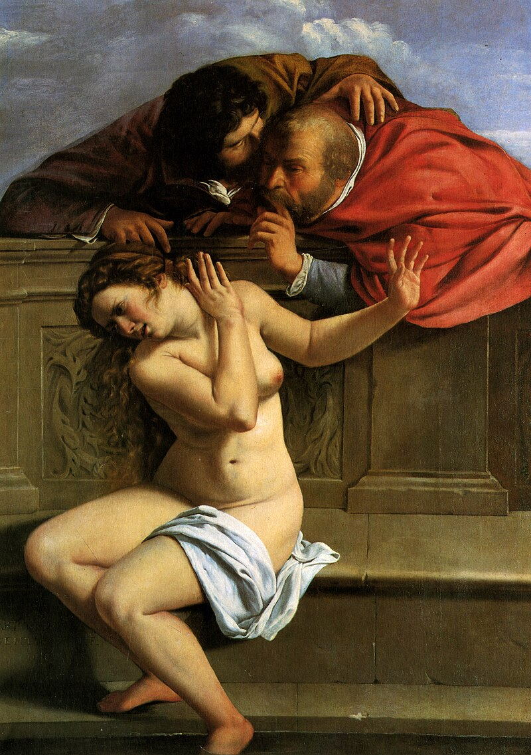
Artemisia Gentileschi 1593–1653
Sosannah and the Elders, circa 1610, Oil on Canvas, 170x119 cm, Schloss Weißenstein, Pommersfelden, Germany https://commons.wikimedia.org/wiki/File:Susanna_and_the_Elders_(1610),_Artemisia_Gentileschi.jpg

Slide 12
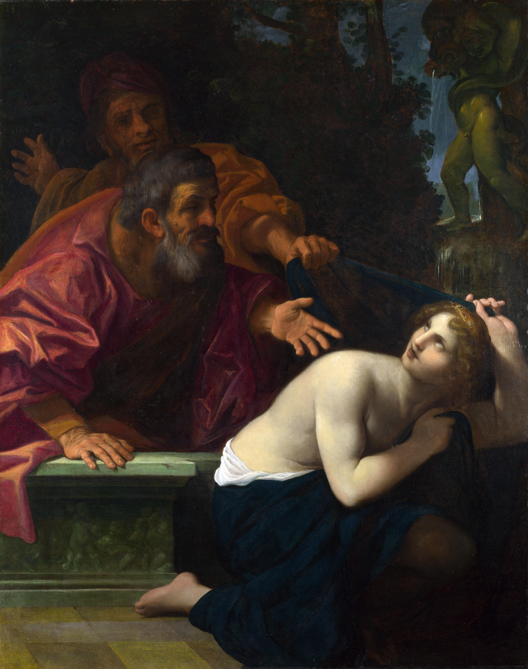
Ludovico Carracci, 1555 - 1619
Susannah and the Elders, 1616, Oil on Canvas, 146.6 × 116.5 cm, National Gallery, London, UK https://www.nationalgallery.org.uk/paintings/ludovico-carracci-susannah-and-the-elders

Slide 13
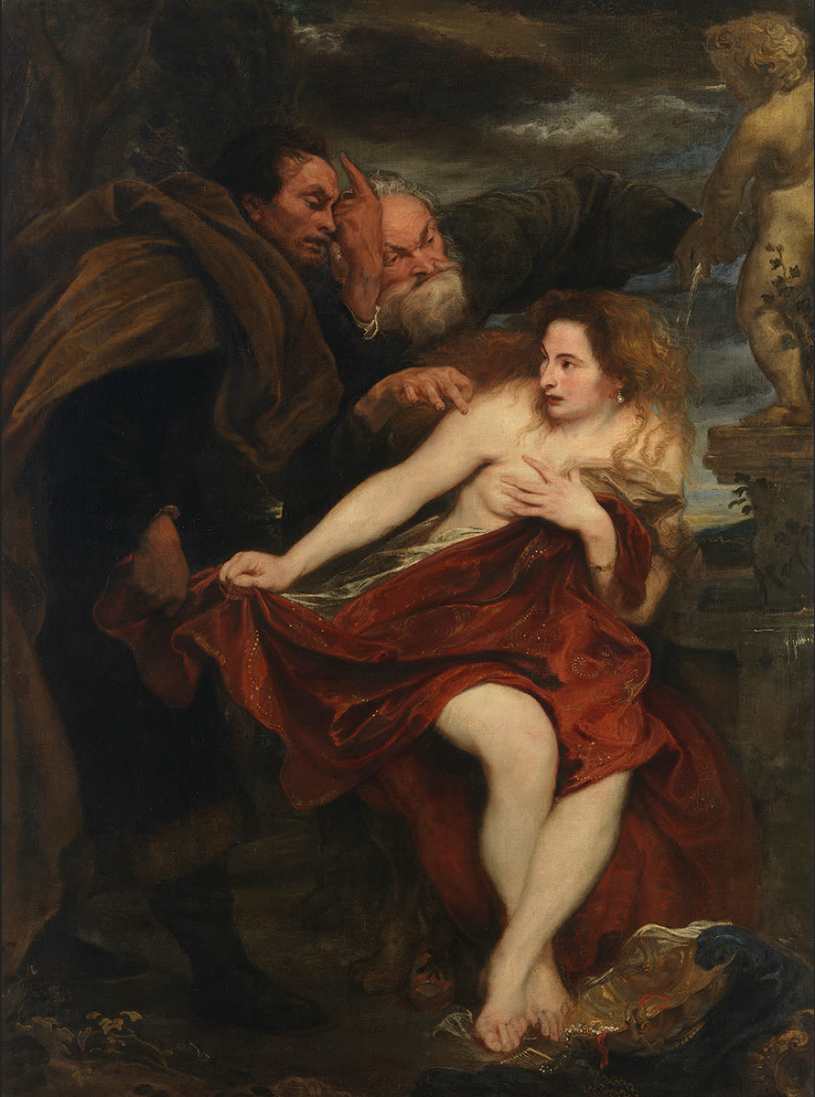
Anthony van Dyck, 1599–1641
Sosannah and the Elders, c. 1621-1622, Oil on Canvas, 194 × 144 cm, Alte Pinakothek, Munich, Germany https://en.wikipedia.org/wiki/Susanna_and_the_Elders_(van_Dyck)

Slide 14
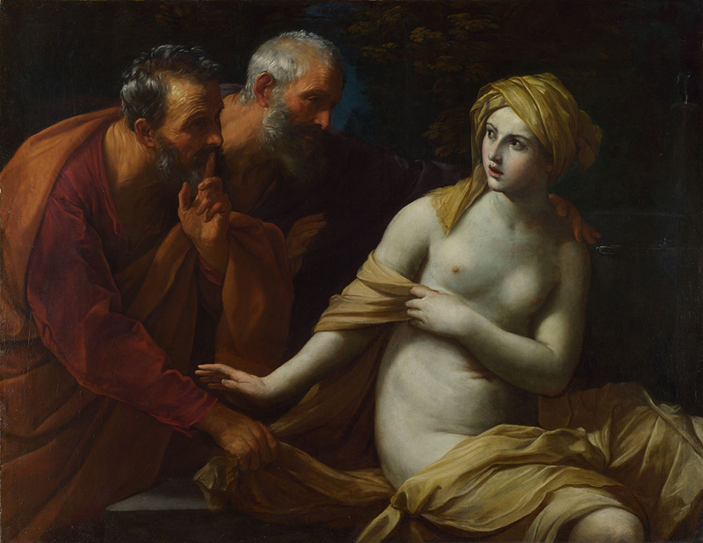
Guido Reni, 1575 - 1642
Susannah and the Elders, about 1622-3,
Oil on Canvas, 116.6x150.5 cm, from Palazzo Lancellotti, National Gallery, London, UK https://www.nationalgallery.org.uk/paintings/guido-reni-susannah-and-the-elders

Slide 15
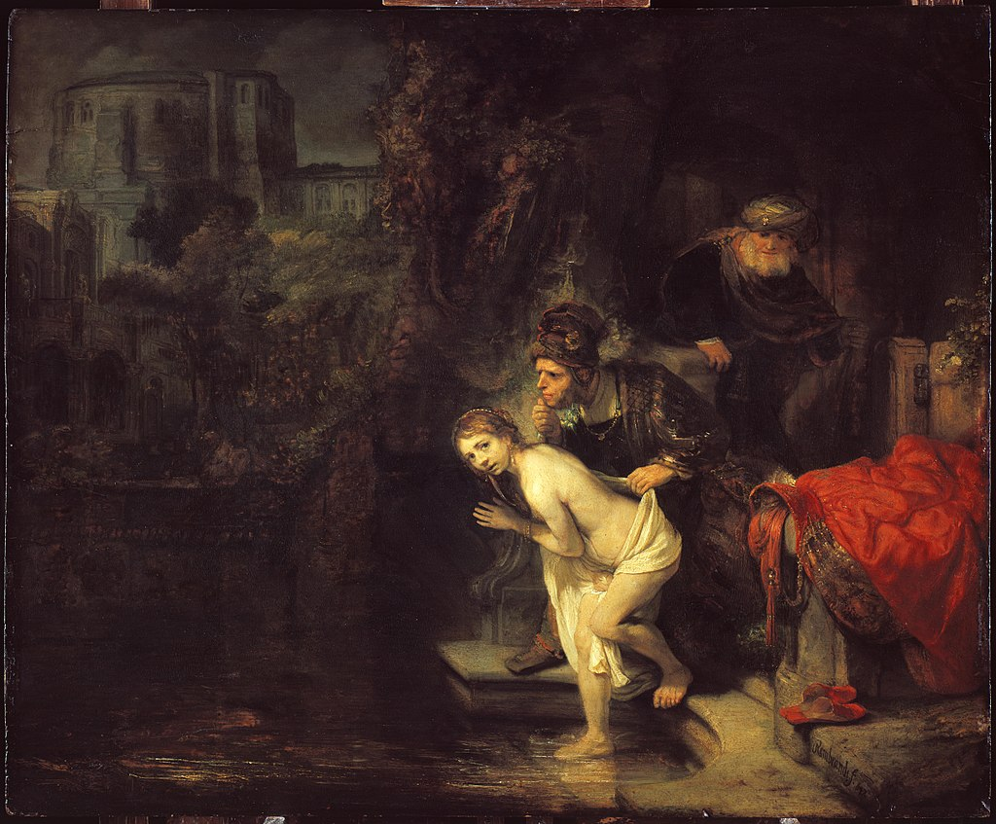
Rembrandt Harmenszoon van Rijn, 1606-1669
Sosannah and the Elders, 1647, Oil on Canvas, 76.6x92.8 cm, Gemäldegalerie, Berlin, Germany https://en.wikipedia.org/wiki/Susanna_and_the_Elders_(Rembrandt)#/media/File:Rembrandt_-_Susanna_and_the_Elders.jpg

Slide 16
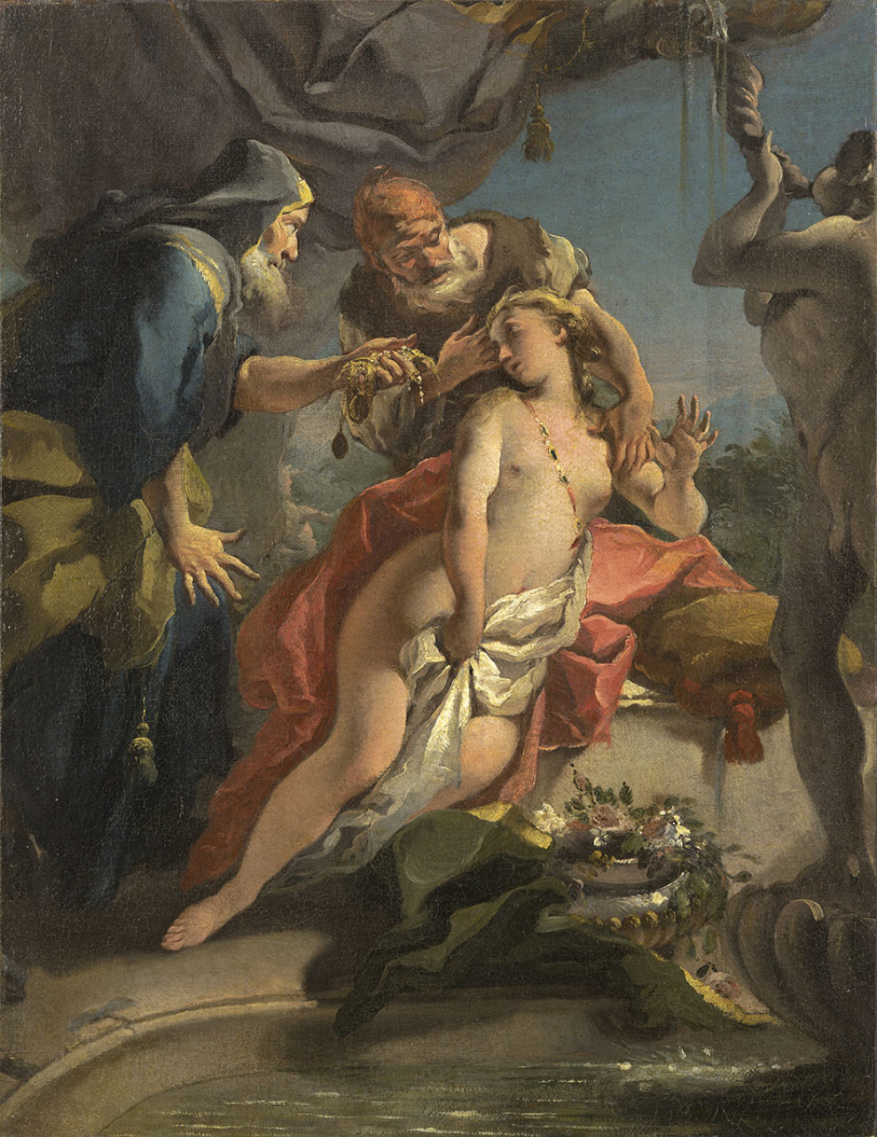
Giovanni Battista Tiepolo, 1696 – 1770
Sosannah and the Elders, 1720-22, Oil on Canvas, 67 × 54 cm, Wadsworth Atheneum, CT, USA https://www.artbible.info/art/large/467.html

Slide 17
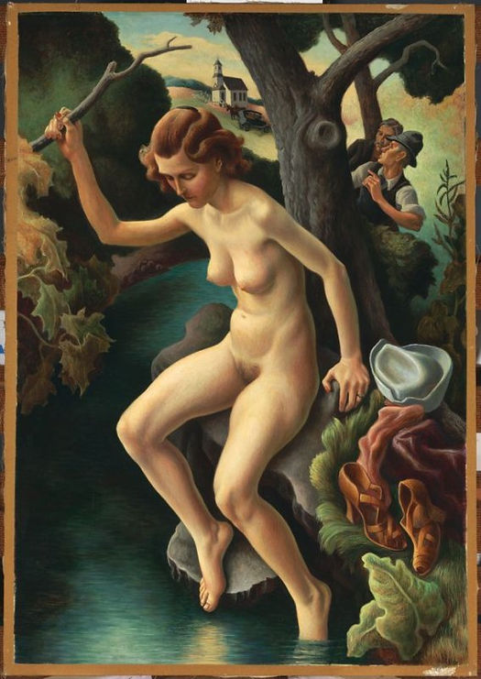
Thomas Hart Benton, 1889-1975
Susanna and the Elders, 1938, Oil and Tempera on Canvas mounted on wood Panel, 152.4 x 106.68 cm, Fine Arts Museums of San Francisco. USA https://www.famsf.org/artworks/susanna-and-the-elders

Slide 18
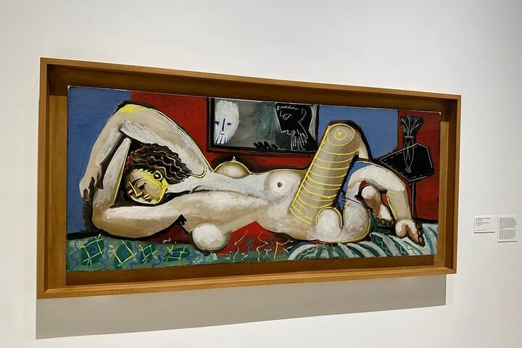
Pablo Picasso, 1881 – 1973
Sosannah and the Elders, 1955, Oil on Canvas,
80x190cm
Picasso Museum, Málaga, Spain https://www.facebook.com/groups/1748037352167720/posts/3408675172770588/?_rdr

Slide 19
The End

