Slide 1
NEOCLAssIcIsM
Hubert Robert 1733–1808
15 paintings

Slide 2
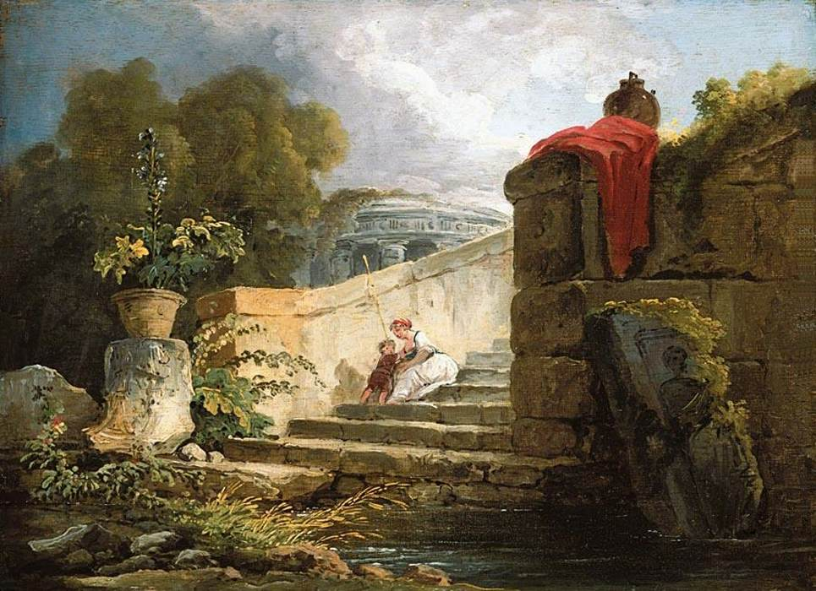
A Scene in the Grounds of the Villa Farnese, Rome, c. 1765, Oil on panel,
25 x 35 cm, Private collection

Slide 3
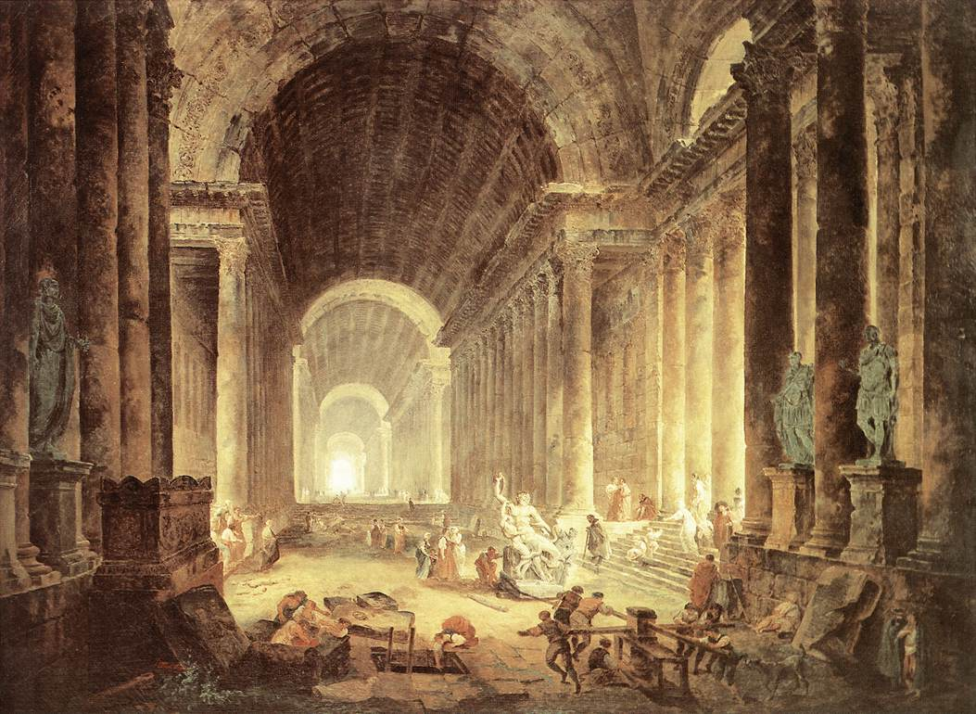
The Finding of the Laocoön, 1773, Oil on canvas,
119 x 163 cm, Virginia Museum of Fine Arts, Richmond, USA

Slide 4
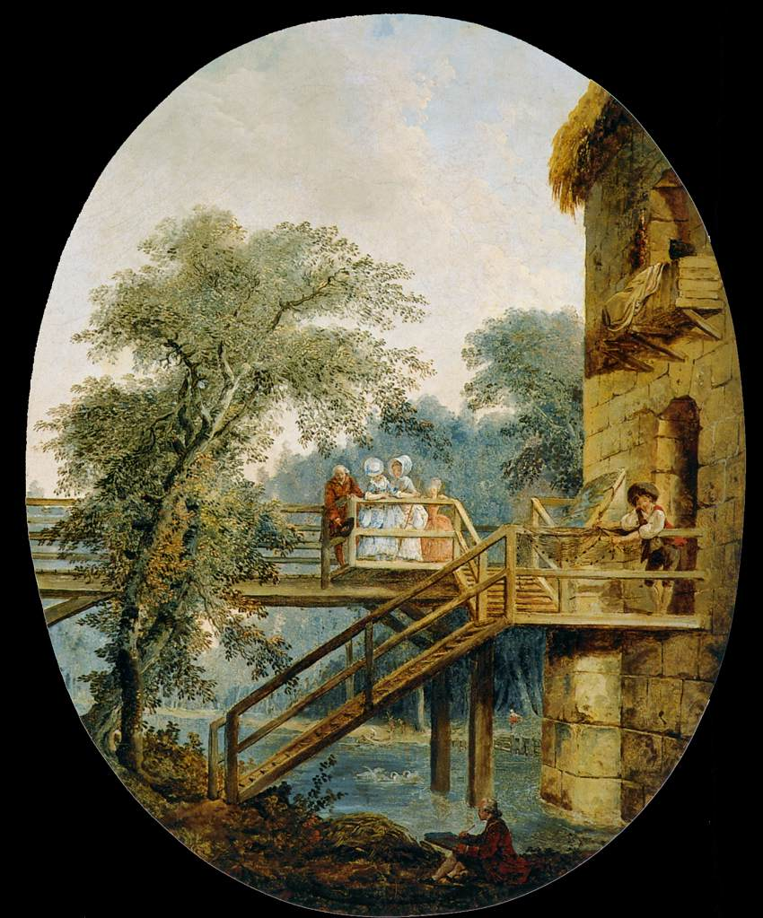
The Footbridge, c. 1775, Oil on canvas, 59 x 47 cm, Museo Thyssen-Bornemisza, Madrid, Spain

Slide 5
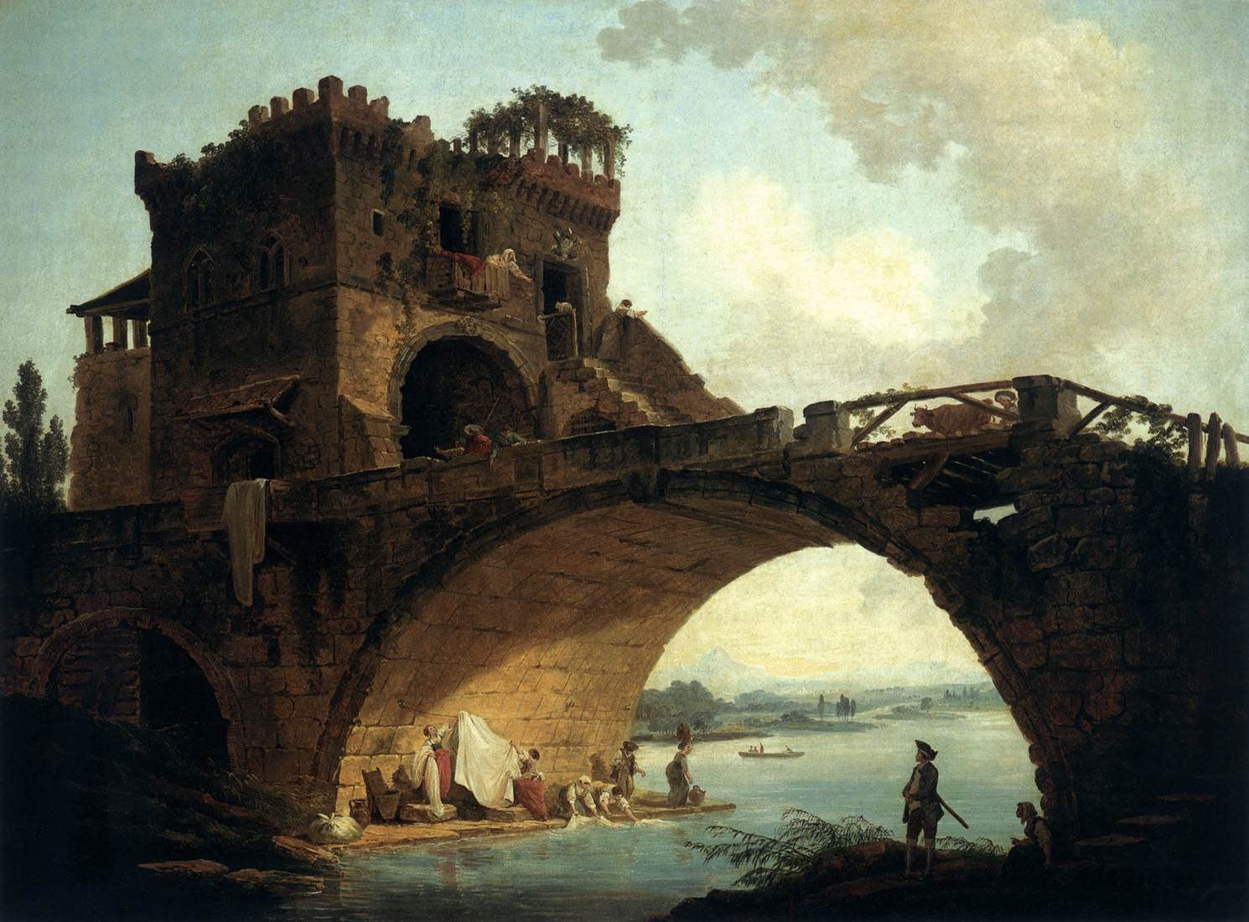
The Ponte Solario, c. 1775, Oil on canvas,
91 x 121 cm, National Gallery of Art, Washington DC, USA

Slide 6
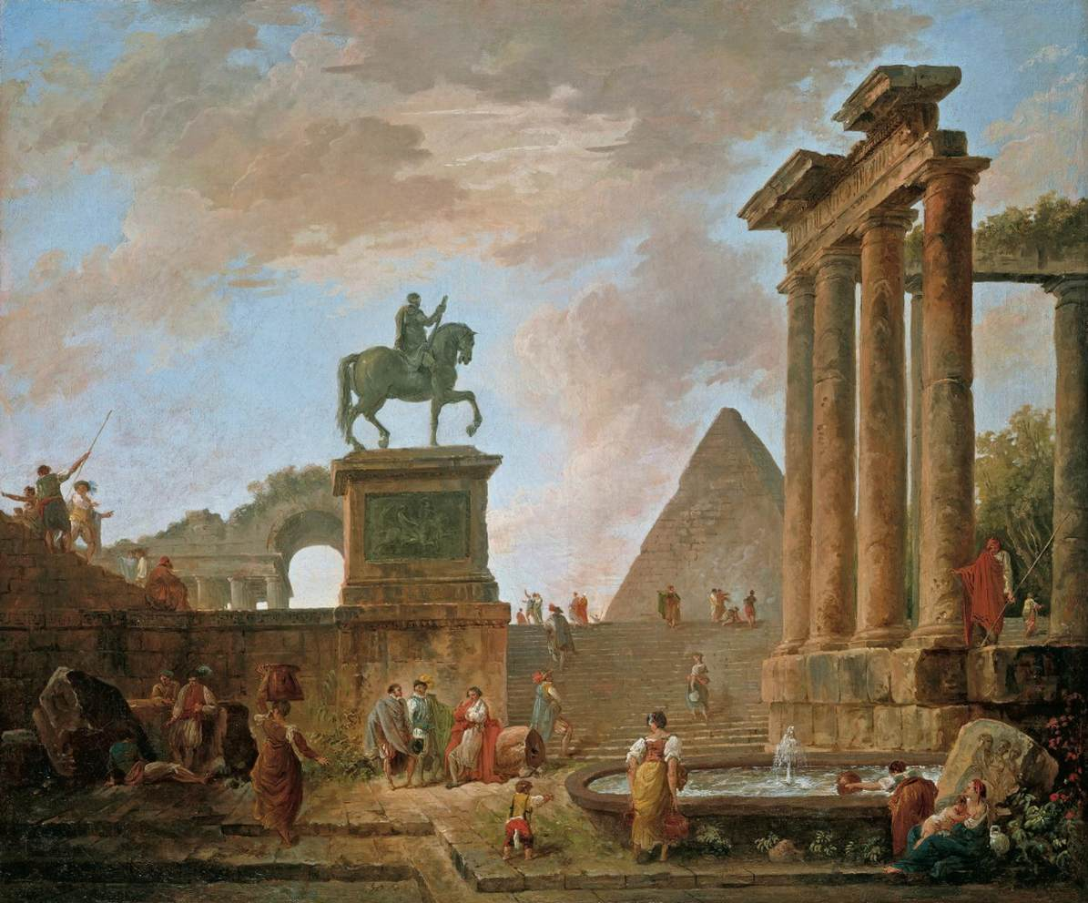
Architectural Capriccio, c. 1780, Oil on canvas, 67 x 81 cm, Private collection

Slide 7
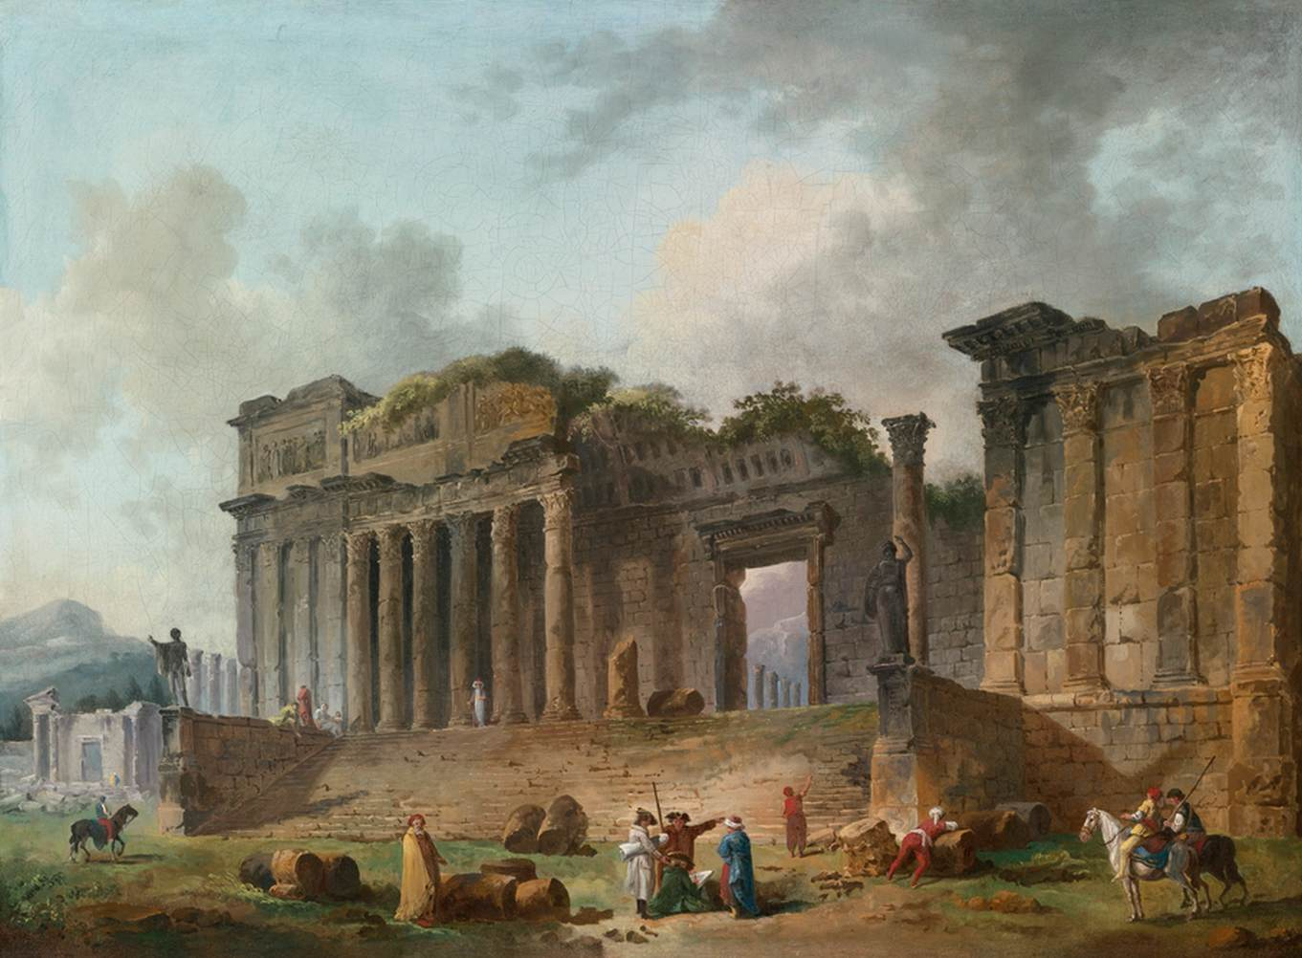
An Architectural Capriccio, 1782, Oil on canvas, 50 x 67 cm, Private collection

Slide 8
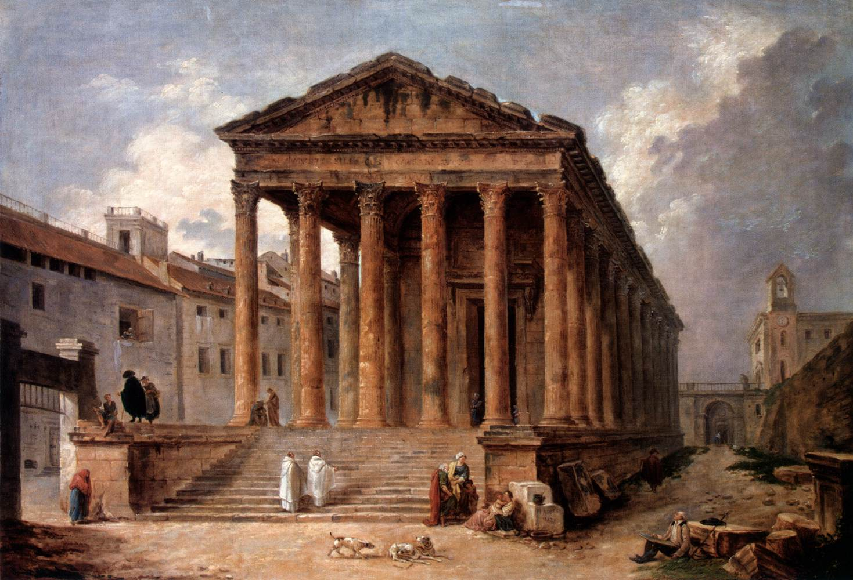
The Maison Carée in Nimes, 1783, Oil on canvas,
102 x 143 cm, The Hermitage, St. Petersburg, Russia

Slide 9
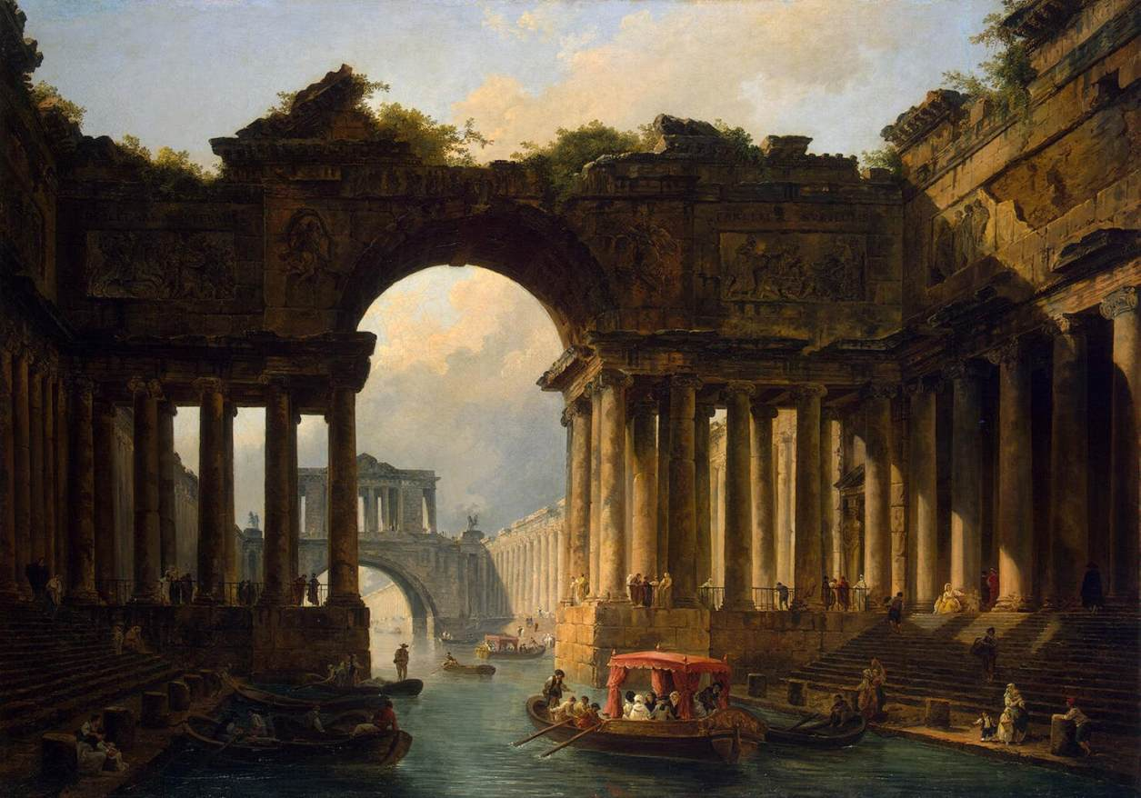
Architectural Landscape with a Canal, 1783, Oil on canvas, 129 x 183 cm, The Hermitage, St. Petersburg, Russia

Slide 10
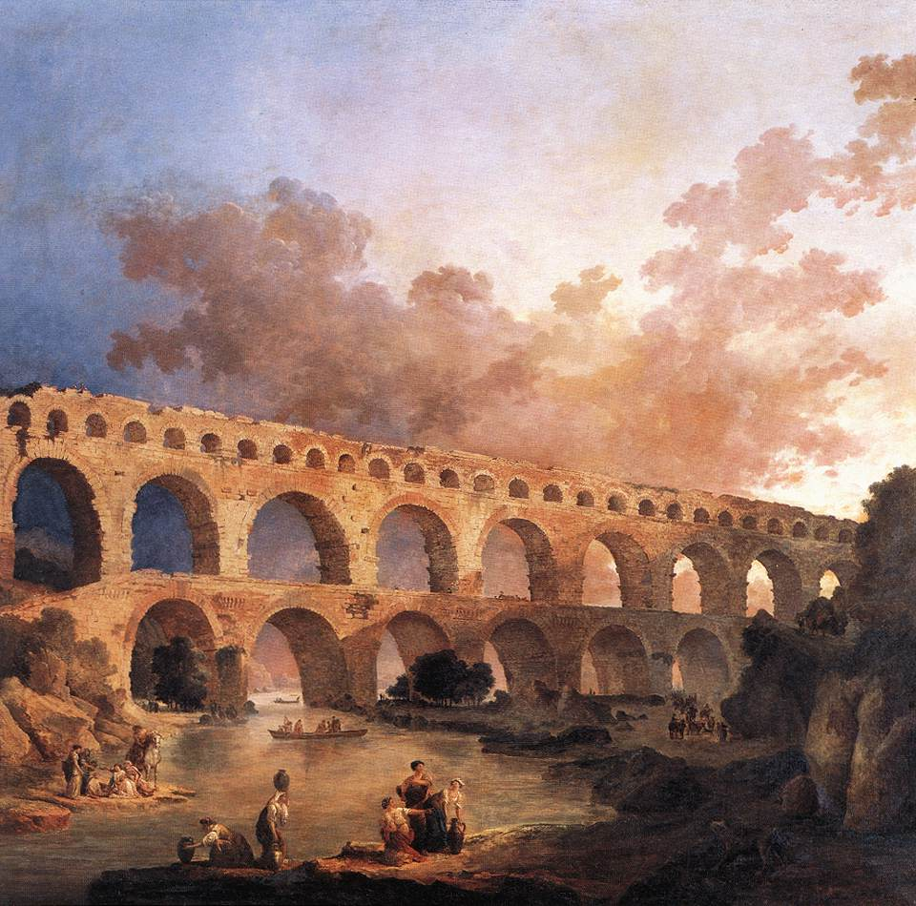
The Pont du Gard, 1787, Oil on canvas, 242 x 242 cm, Musée du Louvre, Paris, France

Slide 11
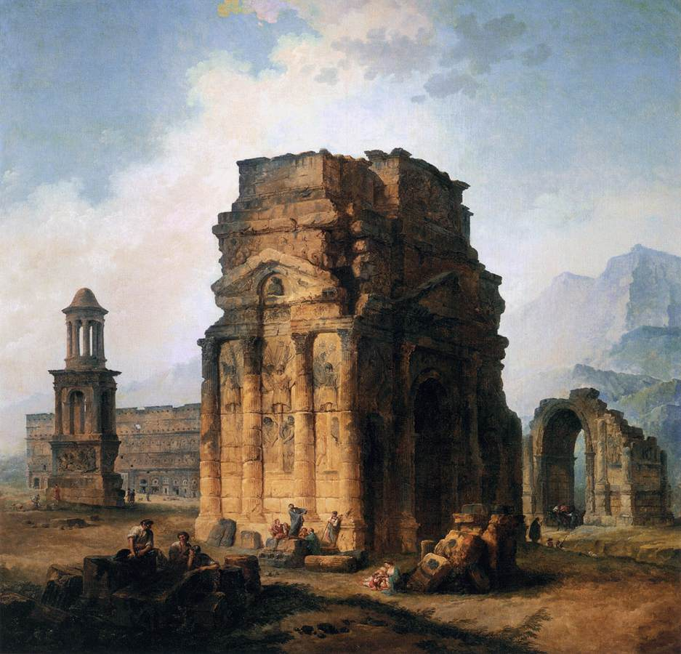
The Arc de Triomphe and the Theatre of Orange, 1787, Oil on canvas, 242 x 242 cm, Musée du Louvre, Paris, France

Slide 12
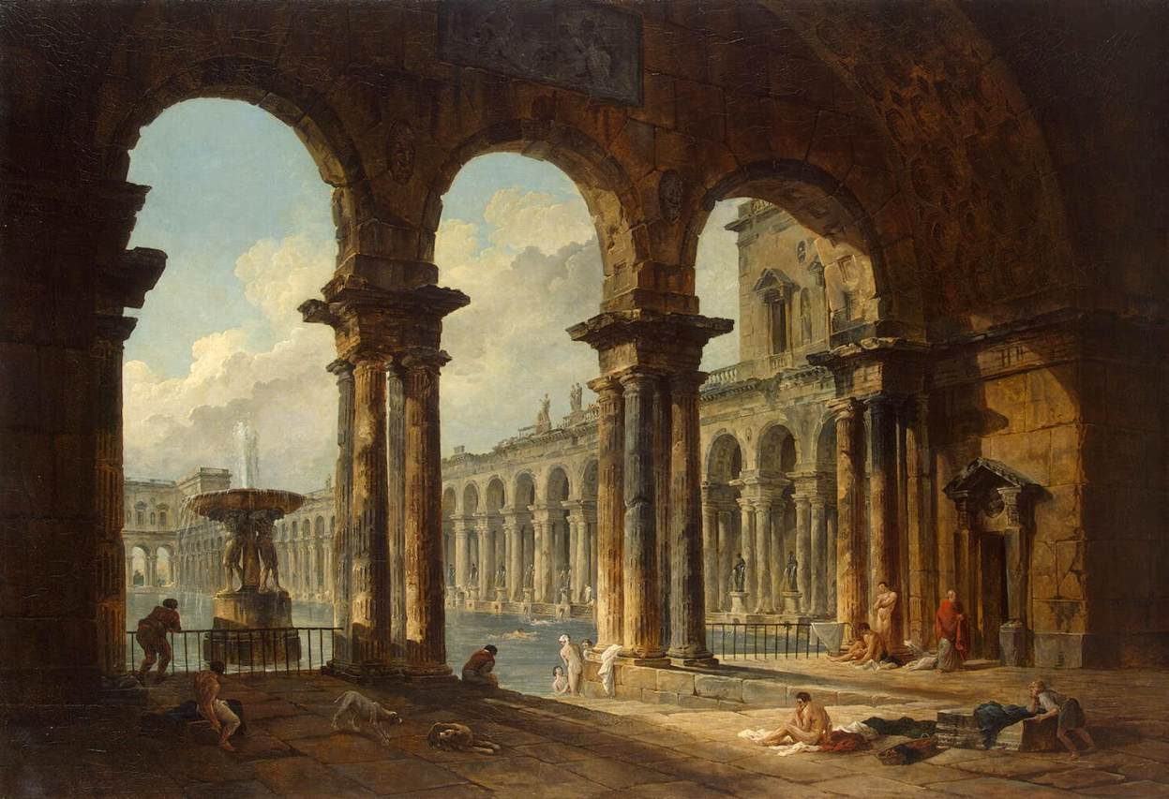
Ancient Ruins Used as Public Baths, 1798, Oil on canvas, 133 x 194 cm, The Hermitage, St. Petersburg, Russia

Slide 13
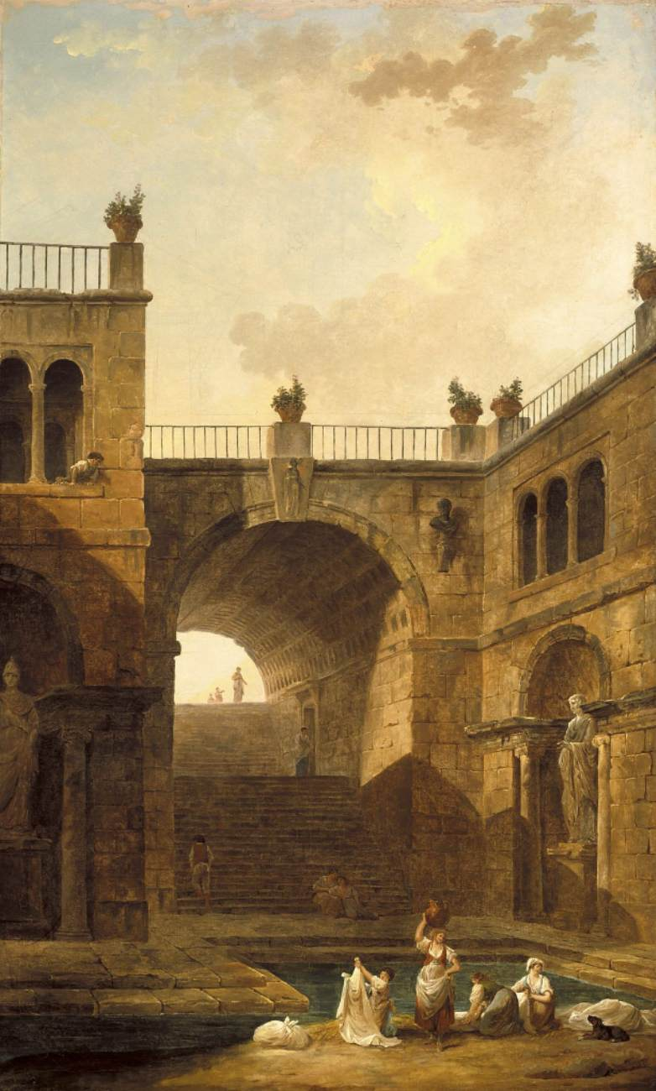
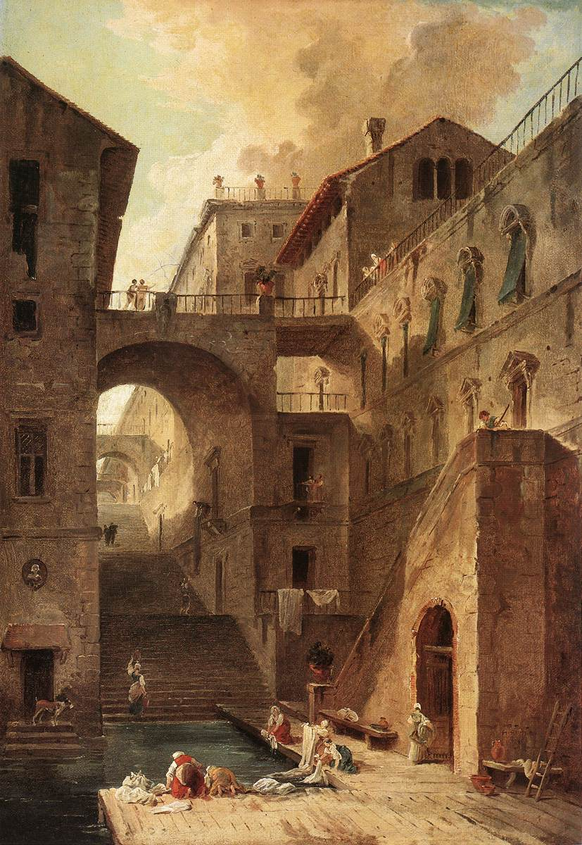
Architectural Scene of Women Washing Clothes at a Pool, 1799, Oil on canvas, 178 x 109 cm, Museum of Art, Indianapolis, USA
Washerwomen, 1796, Oil on canvas, 60,3 x 41,6 cm, Museum of Fine Arts, Boston, USA

Slide 14
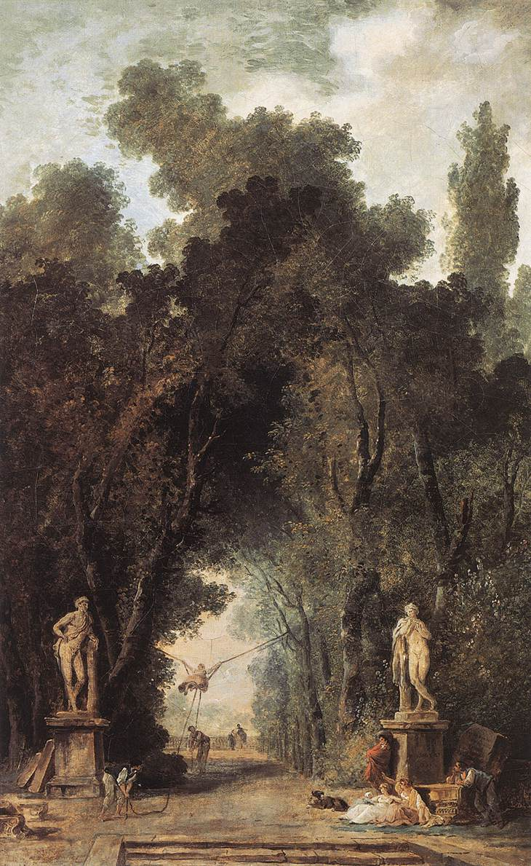
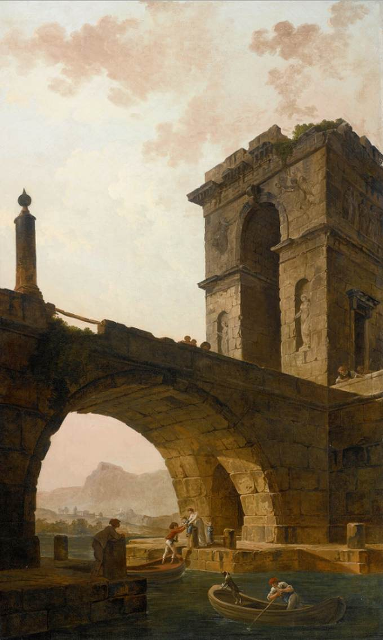
Avenue in a Park, 1799, Oil on canvas, 59 x 39 cm, Musées Royaux des Beaux-Arts, Brussels, Belgium
Figures under a Bridge c. 1798
Oil on canvas, 178 x 109 cm
Private collection

Slide 15
The End
Photo Credits: https://www.wga.hu/frames-e.html?/html/r/robert/

