Slide 1

Ancient Greek
Mesomphalos Phiale

Slide 2
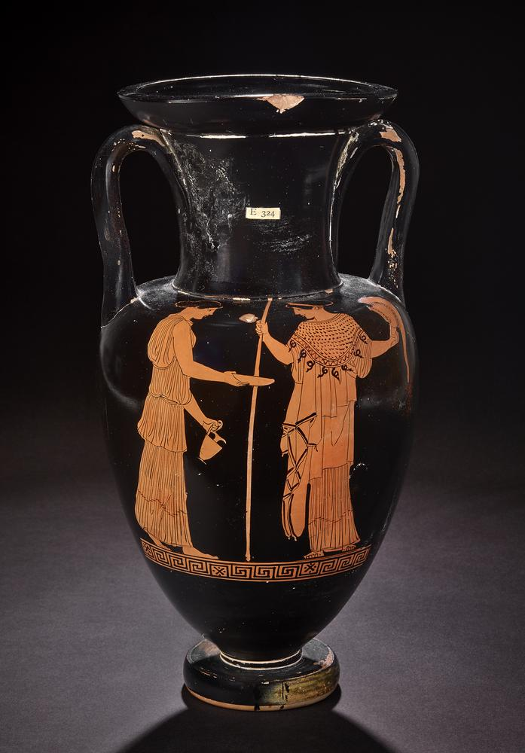
Woman holding out a phiale and a jug approaching Athena, Attic red-figure neck amphora, attributed to the Sabouroff Painter, c. 460–450 BC, Height: 33.65 cm, British Museum, London UK
Photo: © Trustees of the British Museum https://www.britishmuseum.org/collection/object/G_1867-0508-1059

Slide 3
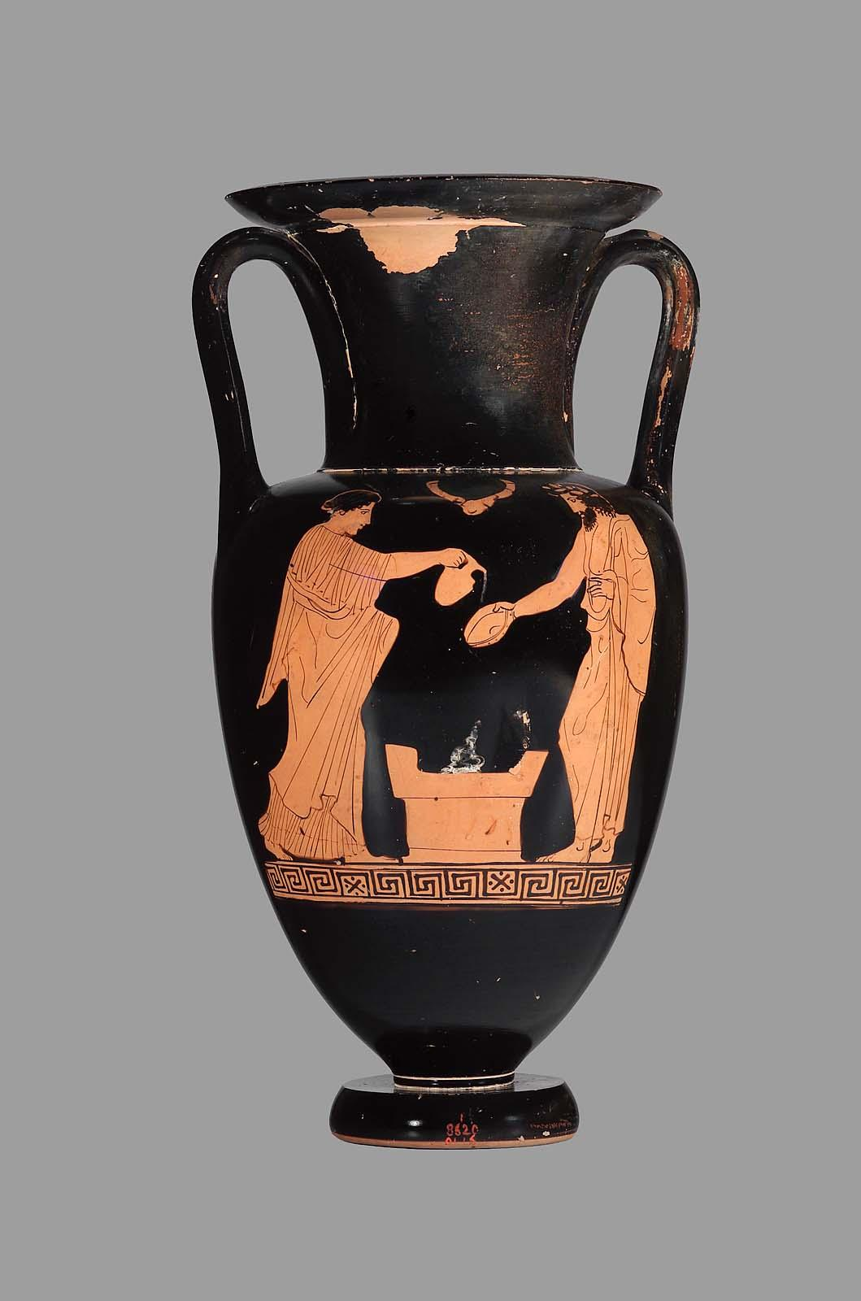
Man and woman making a libation at an altar, Attic red figure amphora, attributed to the Phiale Painter (also known as the Boston Phiale Painter), c. 430 BC, Height: 33.2 cm, Museum of Fine Arts, Boston, USA https://collections.mfa.org/objects/153607/twohandled-jar-amphora-depicting-a-man-and-a-woman-sacrif?ctx=6a1469a6-e2fb-4d8b-9351-f8a6ec59b183&idx=0

Slide 4
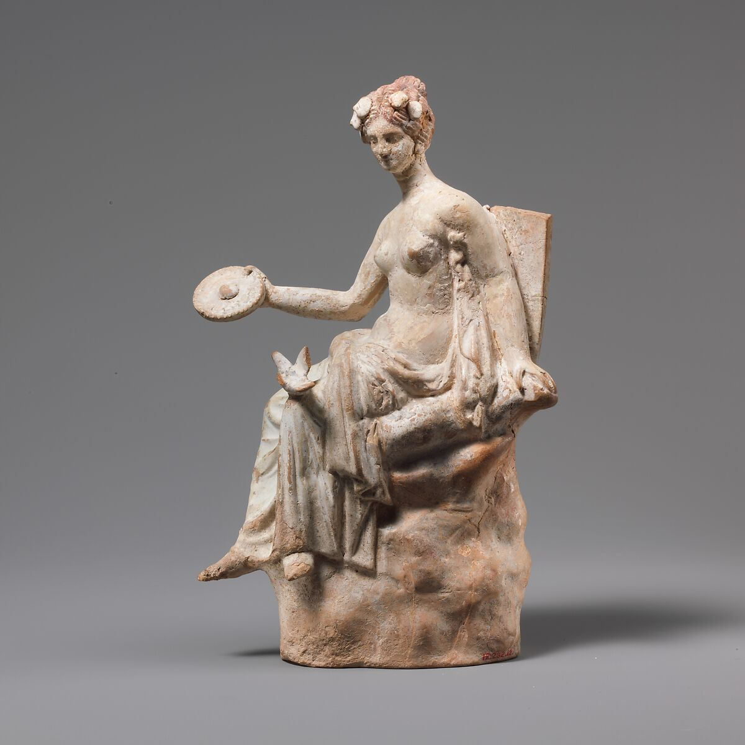
Terracotta figurine of Aphrodite holding a Phiale, said to be from Taranto, 3rd century BC, Height: 20.3 cm, Metropolitan Museum of Art, NY, USA https://www.metmuseum.org/art/collection/search/248711

Slide 5
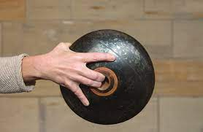
Attic black-figure phiale held, and seen from the back
Photo: Jessica Smolinski chrome-extension://efaidnbmnnnibpcajpcglclefindmkaj/https://classics.osu.edu/sites/default/files/2022-09/Gaifman_Libation%20Bowl%20as%20Embodied%20Object.pdf

Slide 6
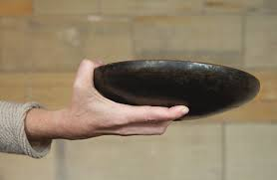

Slide 7
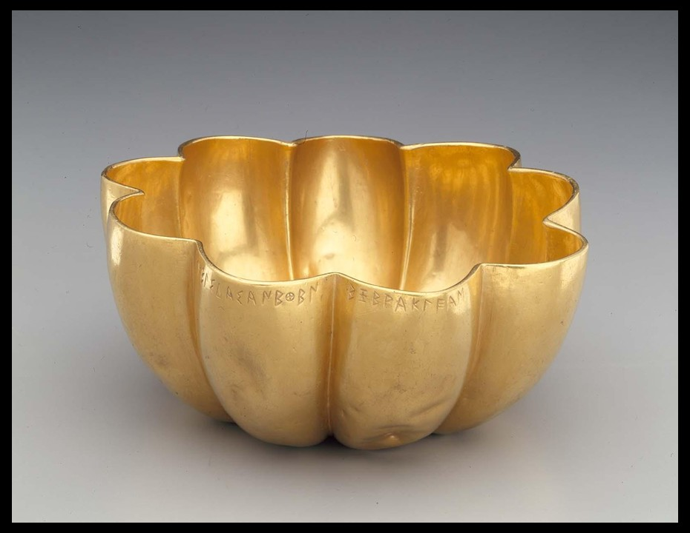
Libation Bowl (phiale mesomphalos), Greek, Late Orientalizing Period, about 625 BC, Gold, Diameter: 15 cm, MFA Boston, USA https://collections.mfa.org/objects/238352/libation-bowl-phiale-mesomphalos?ctx=7a1910d2-cc14-430a-99b9-d503c1d5b7f3&idx=6

Slide 8
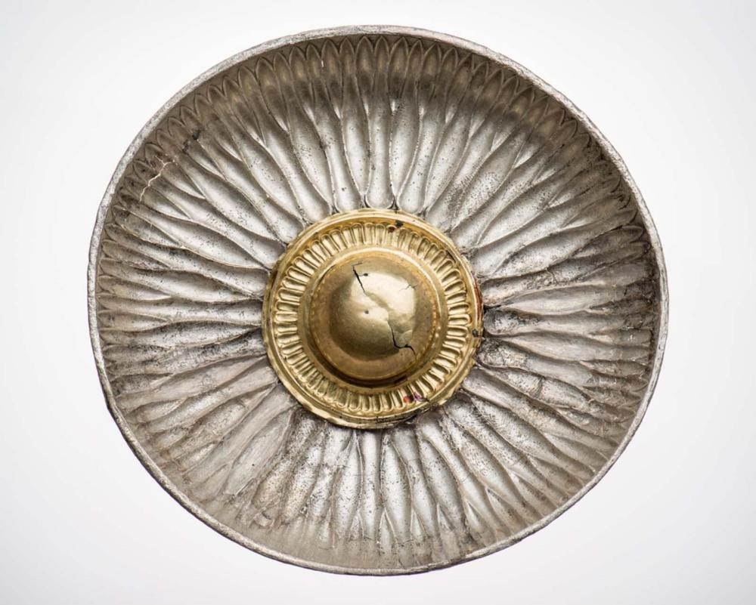
Silver Gilt Phiale Mesomphalos, Greek, Archaic Period, 6th century BC, Diameter: 17.1 cm, Museum of Fine Arts, Boston USA https://collections.mfa.org/objects/198378/phiale-mesomphalos?ctx=4a8c73b7-4cbb-44a2-9e32-bc8ca0989ae1&idx=7

Slide 9
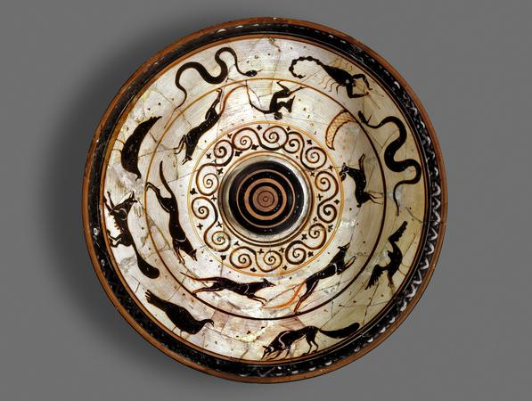
Terracotta Mesompalos Phiale depicting , Greek, attributed to the Nicosthenes(?), c. 500–470 BC, Diameter: 21.59 cm, British Museum, London UK https://www.britishmuseum.org/collection/object/G_1873-0820-388

Slide 10
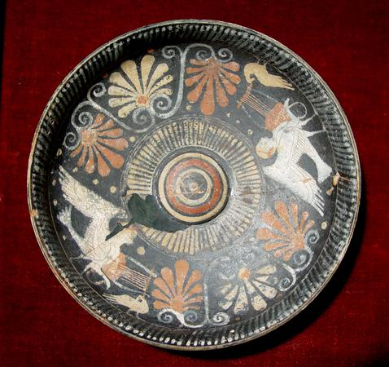
Terracotta Phiale Mesomphalos depicting two Sirens and Palmettes, Attic, Greek, c. 500–480 BC, Diameter: 19.8 cm, British Museum, London, UK https://www.britishmuseum.org/collection/object/G_1864-1007-269

Slide 11
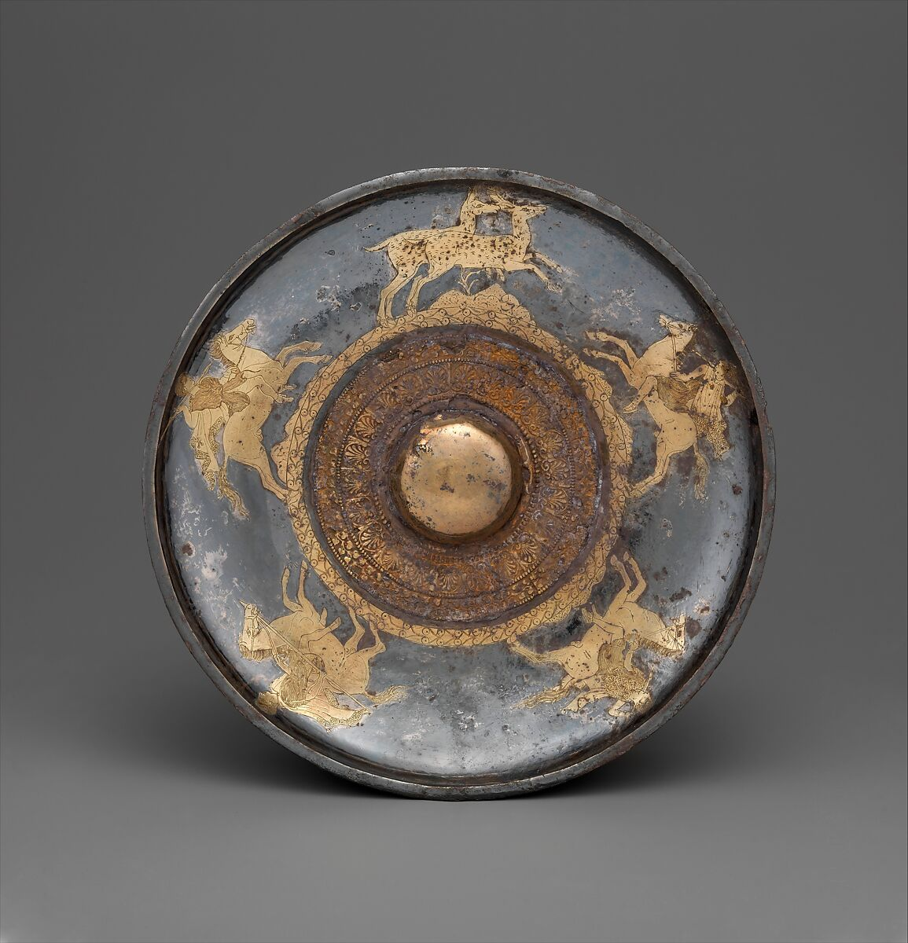
Gilt silver Phiale Mesomphalos, late 5th century BC, Diameter: 20.3 cm, the MET, NY, USA https://www.metmuseum.org/art/collection/search/646264

Slide 12
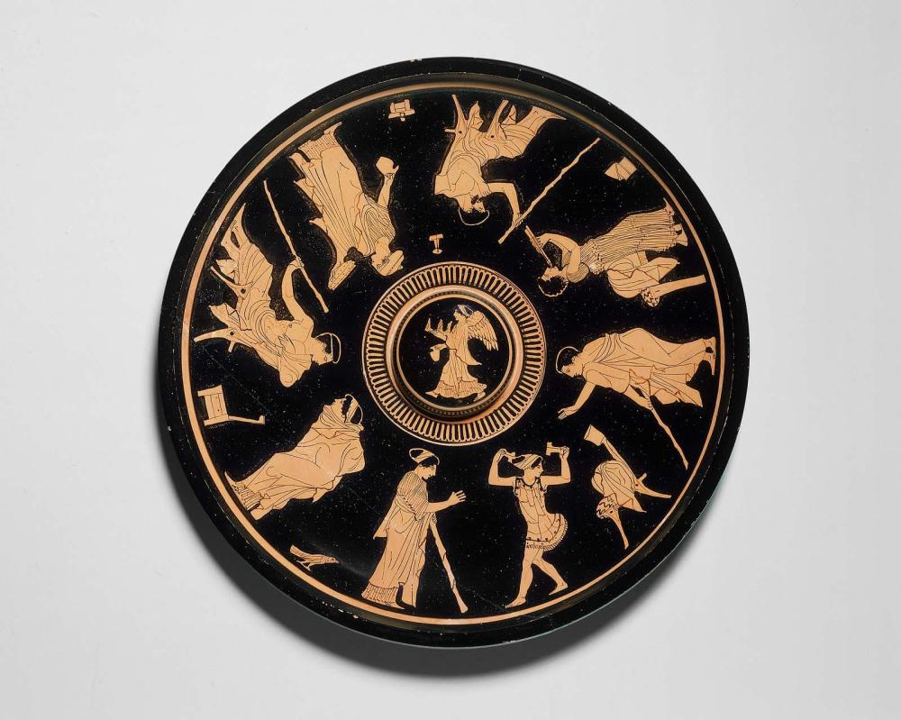
Terracotta Phiale Mesomphalos depicting men being entertained, Attic red-figure phiale, attributed to the Sabouroff Painter, c. 460–450 BC, Diameter: 24.8 cm, MFA Boston, USA https://collections.mfa.org/objects/153850

Slide 13
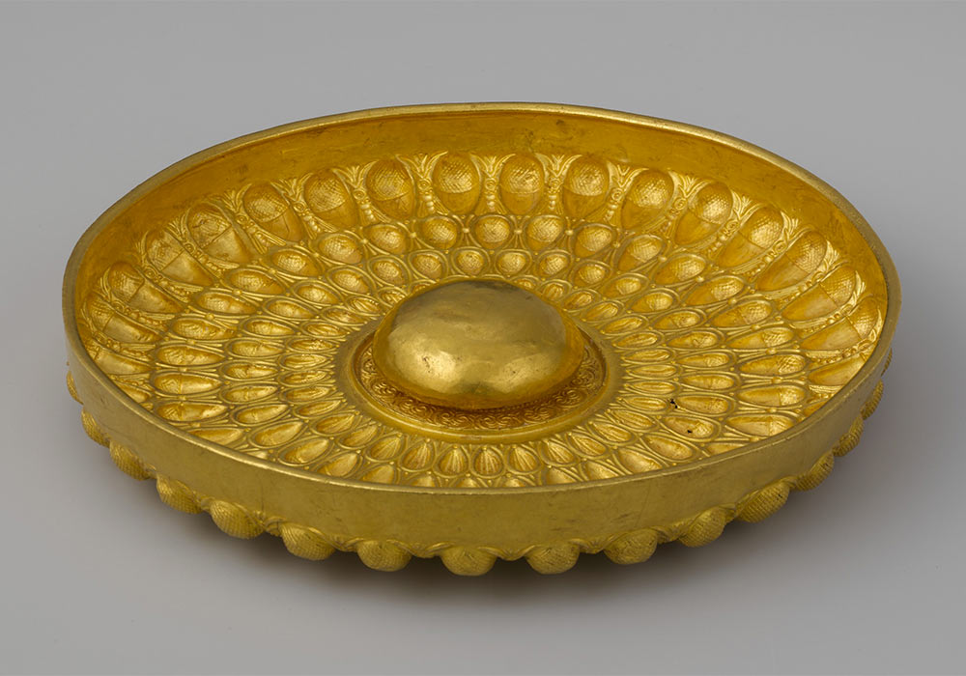
Gold Mesomphalos Phiale, Greek, late 4th–early 3rd century BC, Diameter: 23.5 cm, the MET, NY, USA https://www.wondersofsicily.com/sicily-greeks.htm

Slide 14
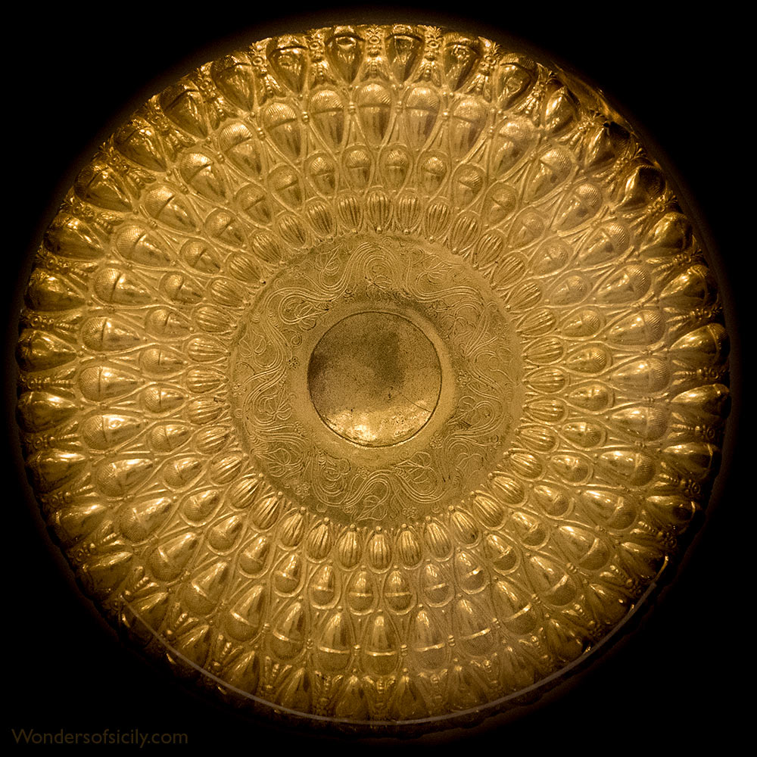
Gold Mesomphalos Phiale from near Himera, Greek, late 4th–early 3rd century BC, Diameter: 22.8 cm, Palermo Archaeological Museum, Italy https://www.wondersofsicily.com/sicily-greeks.htm

Slide 15
The End

