Slide 1
Giambologna
1529-1608

Slide 2
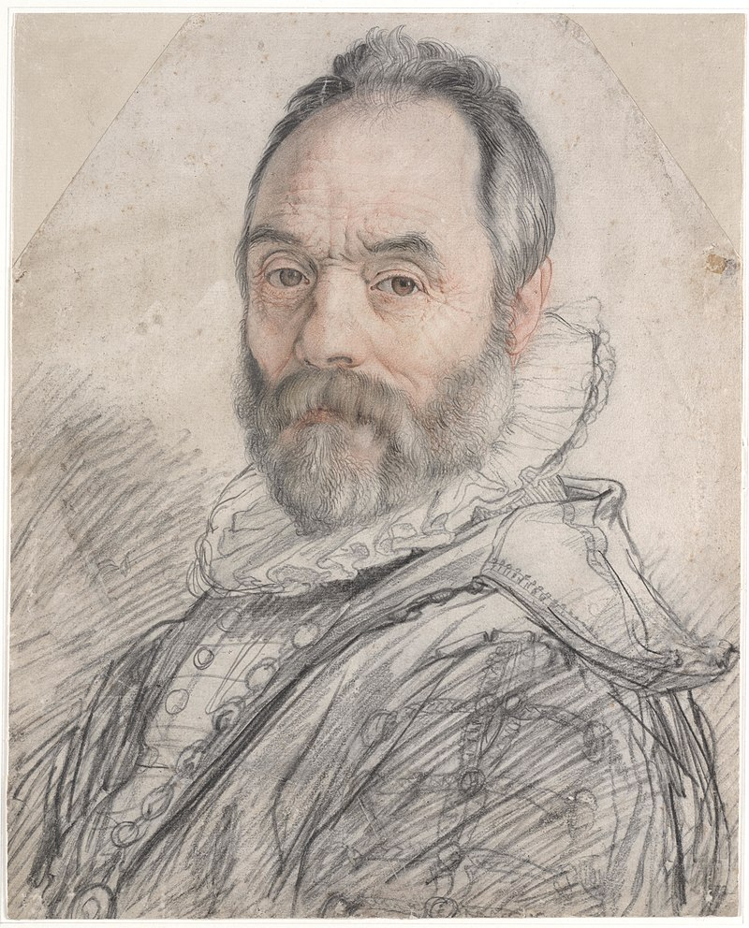
Hendrik Goltzius, 1558–1617
Portrait of Giovanni da Bologna, 1591, Chalk, 37x30 cm, Teylers Museum, Haarlem, Netherlands https://commons.wikimedia.org/wiki/File:Portrait_of_Giambologna.jpg

Slide 3
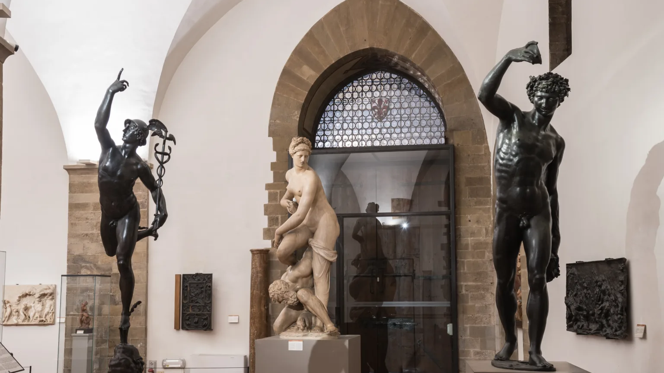
Museo Nazionale del Bargello: Giambologna's sculptures https://bargellomusei.it/en/museum/museo-nazionale-del-bargello/

Slide 4
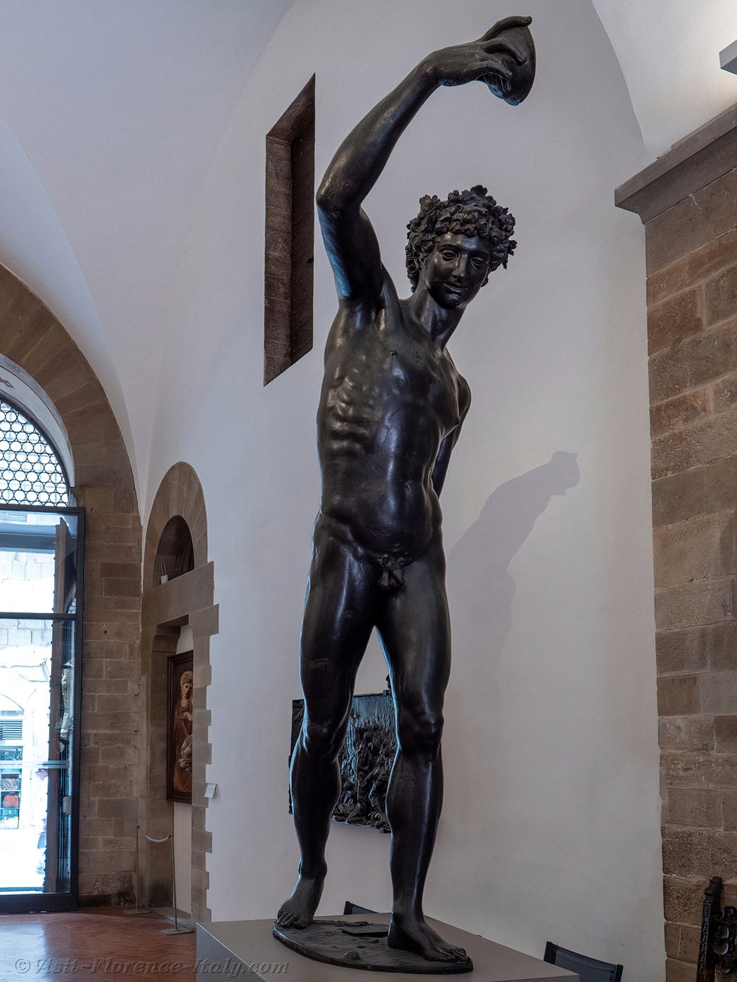
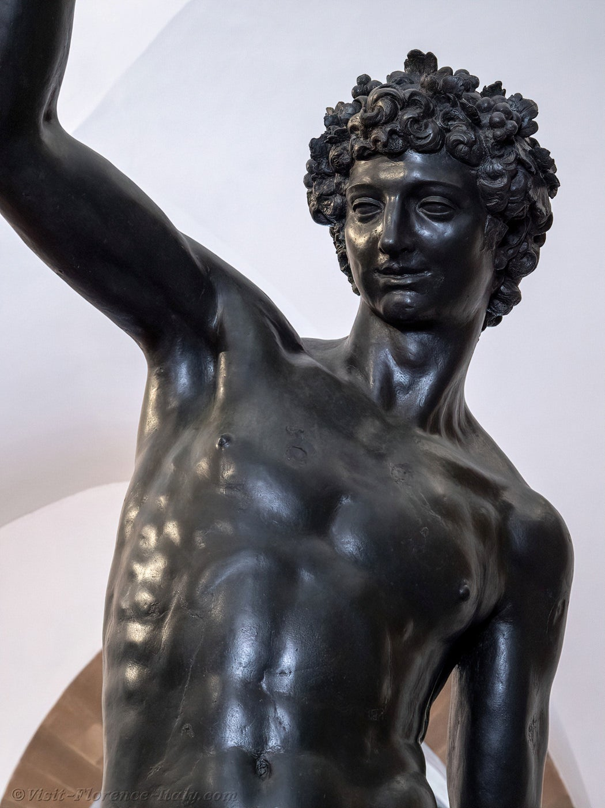
Bacchus, 1560-61, Bronze, Museo Nazionale del Bargello, Florence, Italy https://www.visit-florence-italy.com/museums/bargello/giambologna-bargello-florence-italy.html

Slide 5
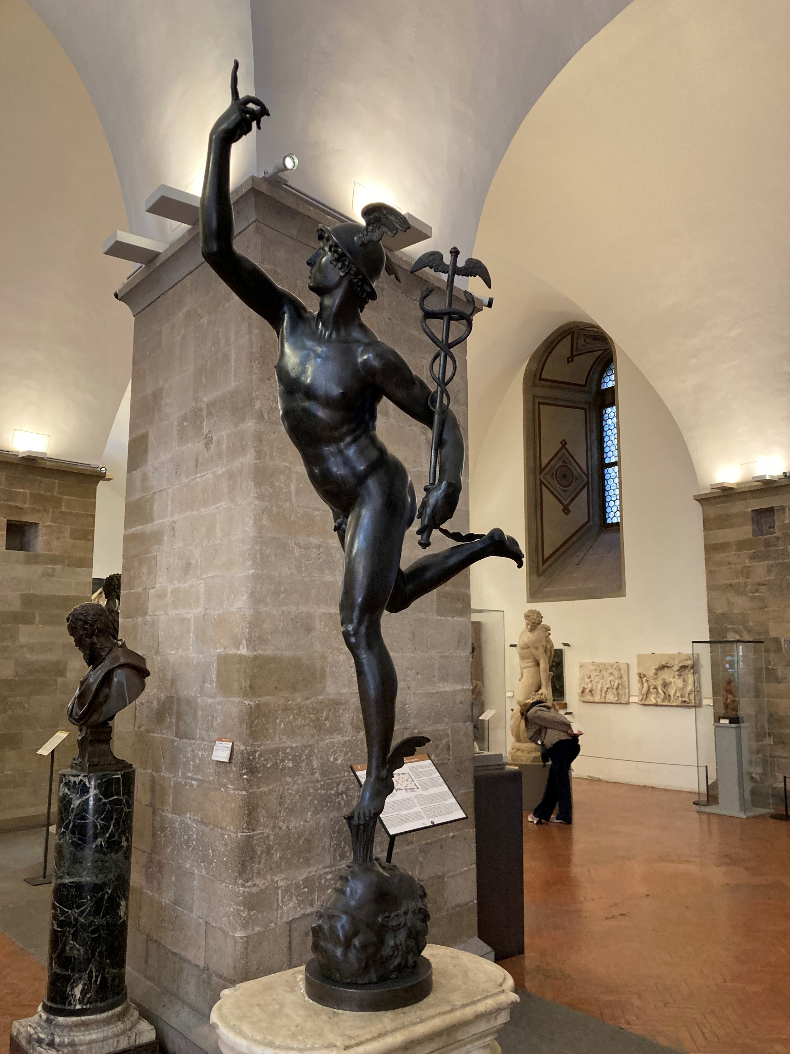
Mercury, 1564-65, Bronze, Height: 1.87 m, Museo Nazionale del Bargello, Florence, Italy
Photo Credit: Amalia Spiliakou, April 2025

Slide 6
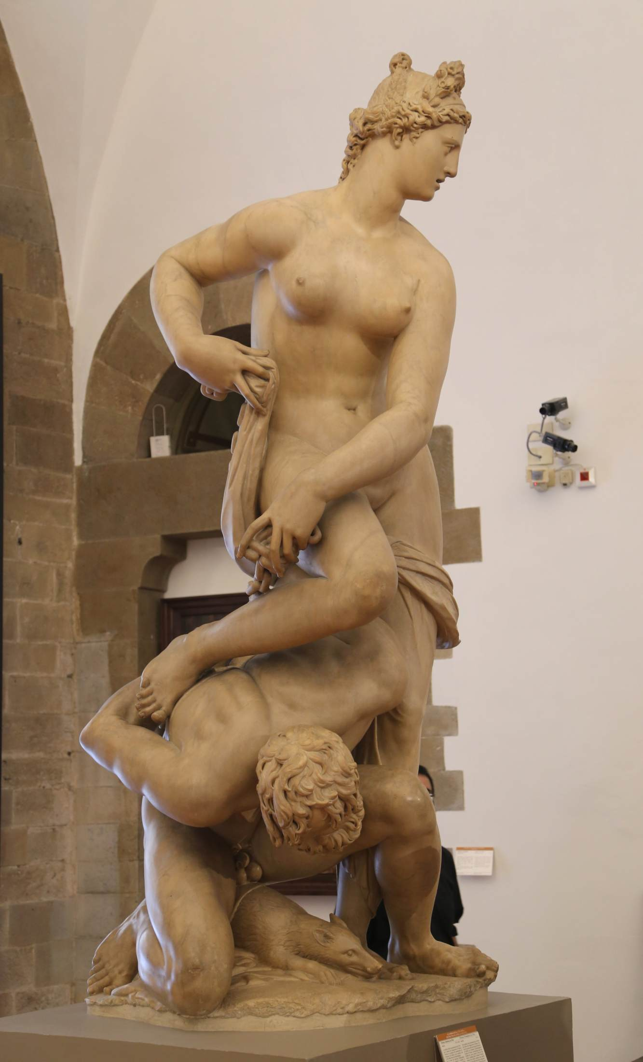
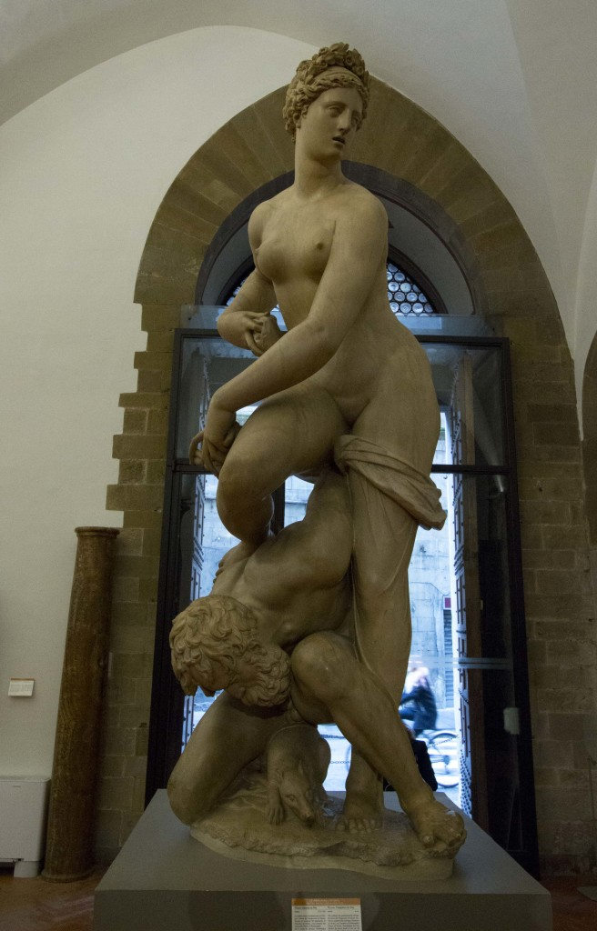
Florence Triumphant over Pisa, 1575, Marble, Height: 260 cm,
Museo Nazionale del Bargello, Florence, Italy https://www.wga.hu/frames-e.html?/html/g/giambolo/index.html https://www.wayfarerdaves.com/bargello-a-medieval-frame-for-renaissance-art/

Slide 7
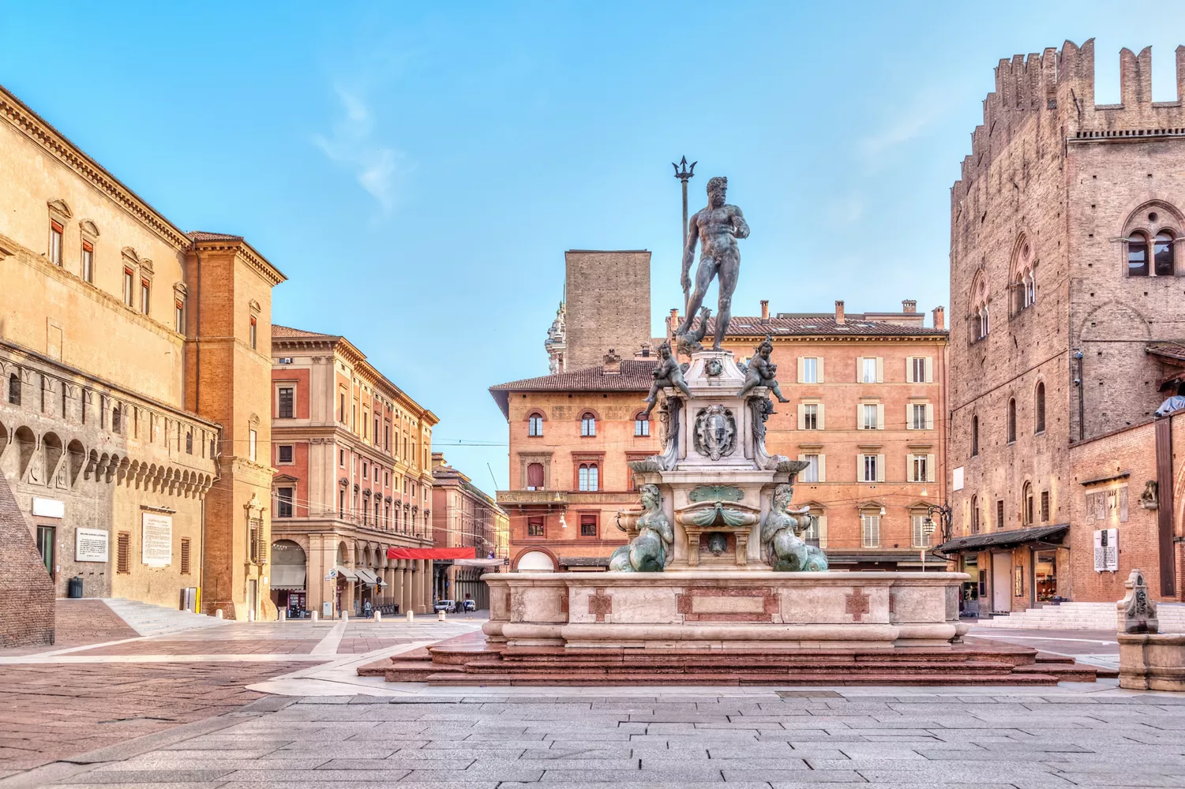
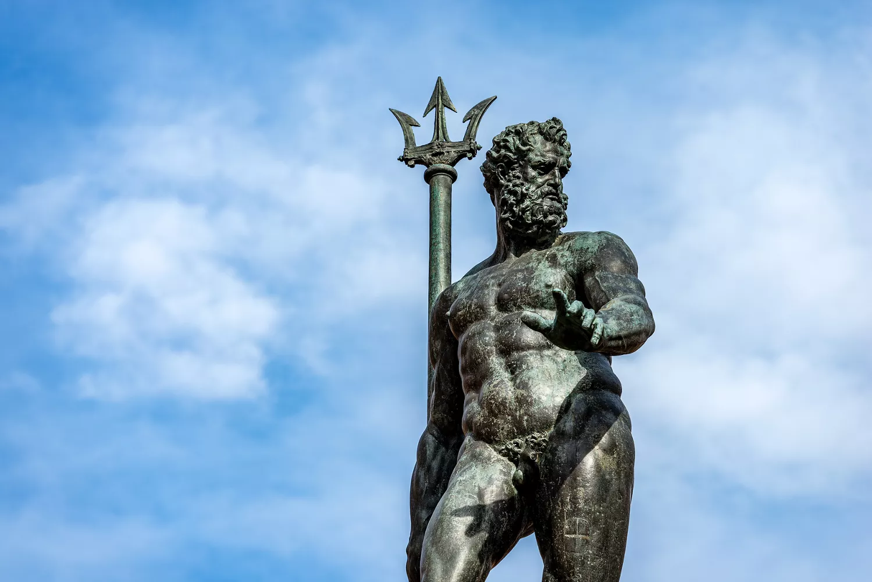
Fountain of Neptune, 1563-66, Bronze and marble, Height: 335 cm (central figure), Piazza Maggiore, Bologna, Italy https://www.italia.it/en/emilia-romagna/bologna/fountain-neptune

Slide 8
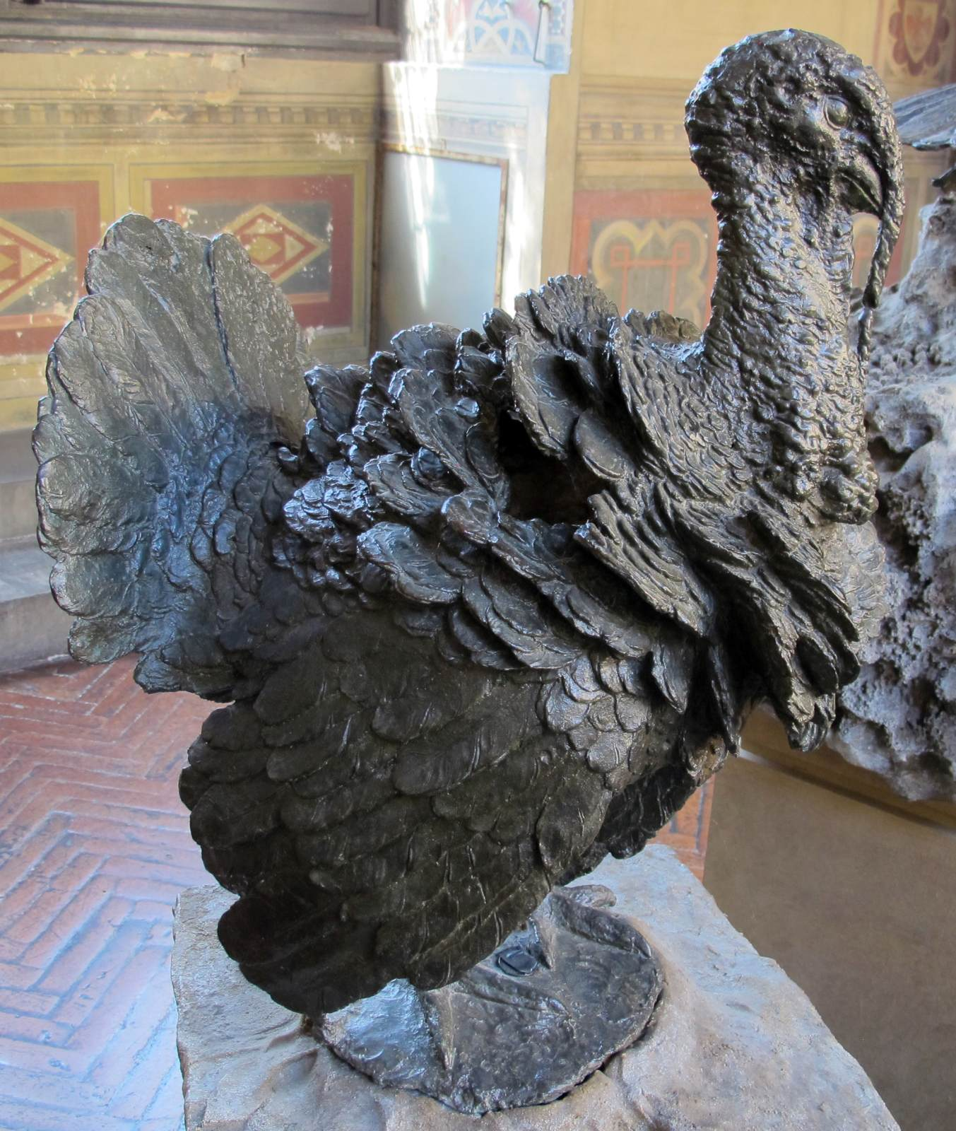
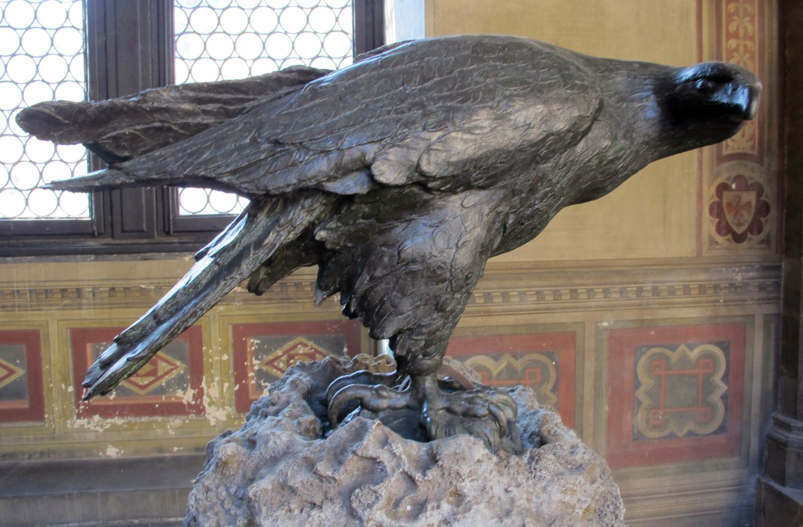
Turkey, 1567, Bronze, Height: 62 cm
Eagle, 1567, Bronze, Life-size
Museo Nazionale del Bargello, Florence, Italy https://www.wga.hu/frames-e.html?/html/g/giambolo/index.html

Slide 9
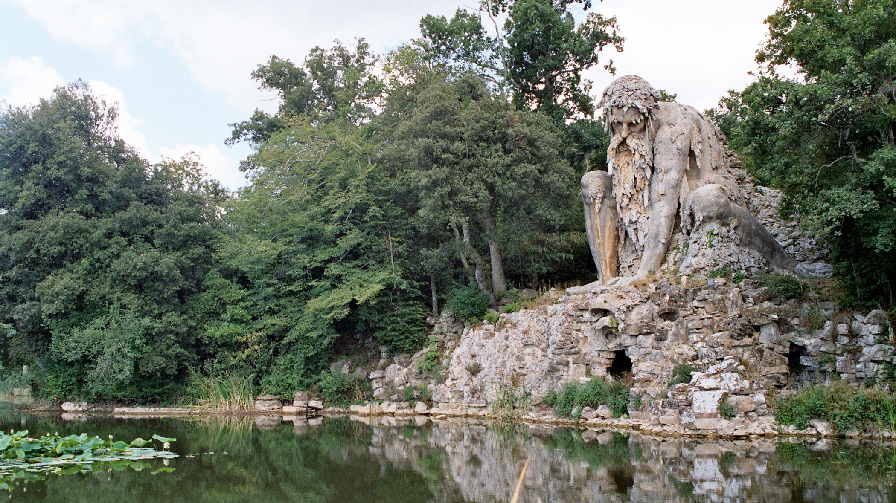
Colosso del’Appenino, 1570s, Rock, lava, brick, etc., H. 10 m, Garden of the Villa Medici, Pratolino, Italy https://commons.wikimedia.org/wiki/File:Demidoff_01.jpg

Slide 10
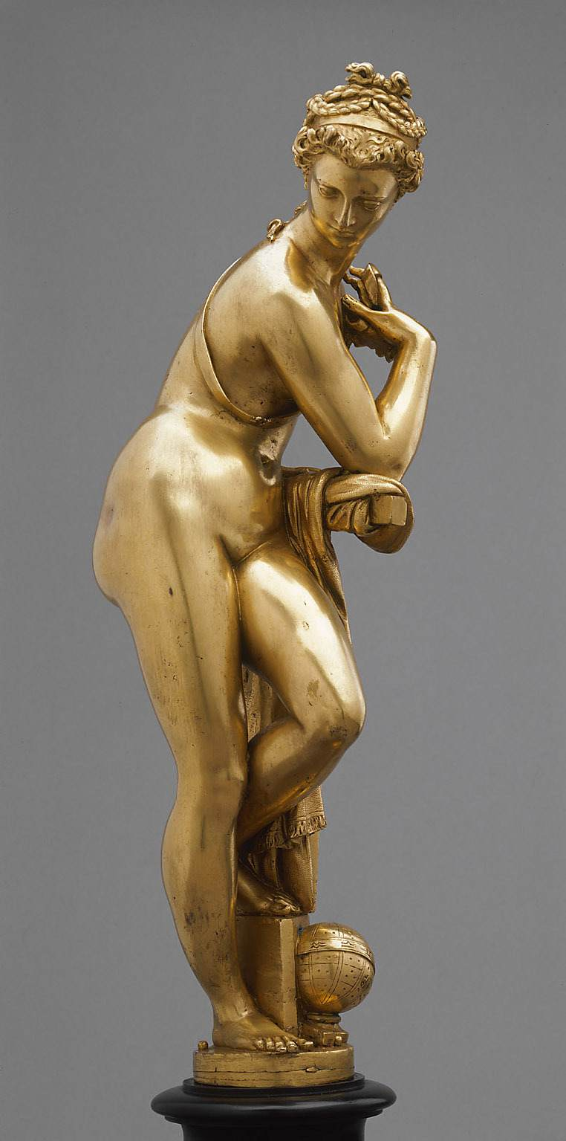
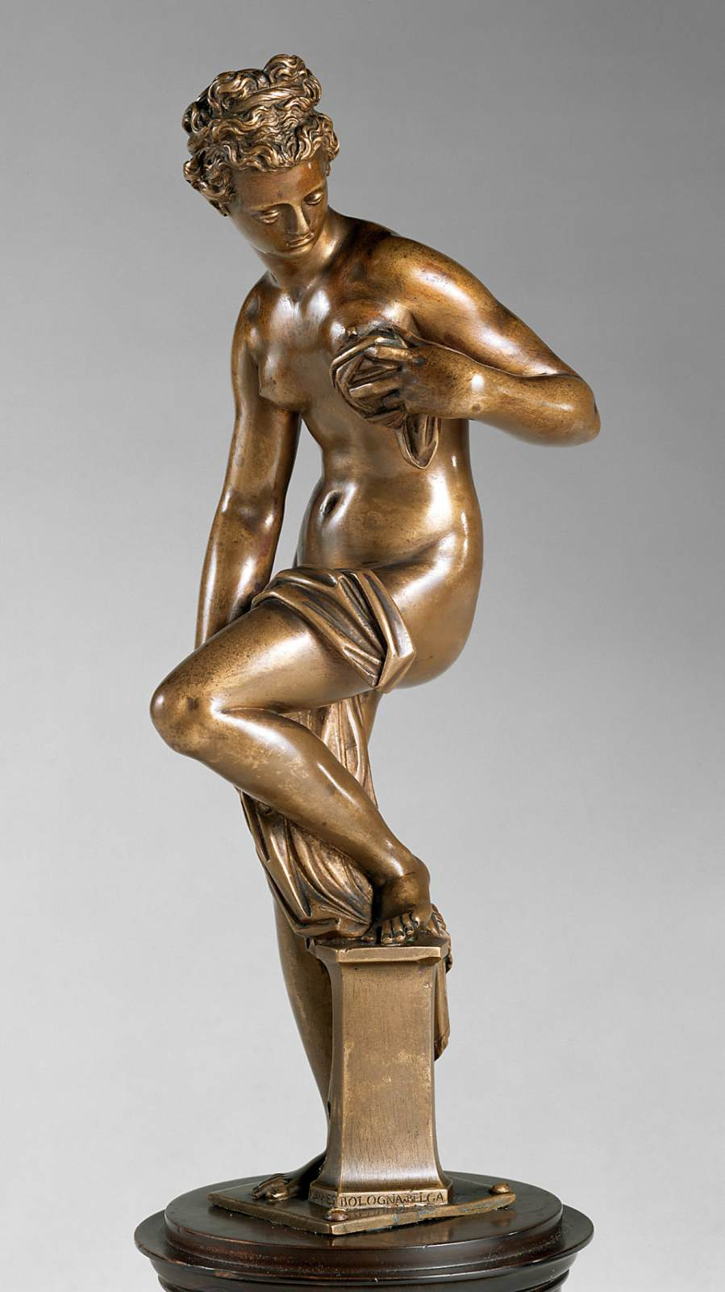
Allegory of Astronomy, c. 1573, Gilt bronze, Height: 39 cm,
Kunsthistorisches Museum, Vienna, Austria
Bather, 1565, Bronze, Height: 25 cm,
Kunsthistorisches Museum, Vienna, Austria https://www.wga.hu/frames-e.html?/html/g/giambolo/index.html

Slide 11
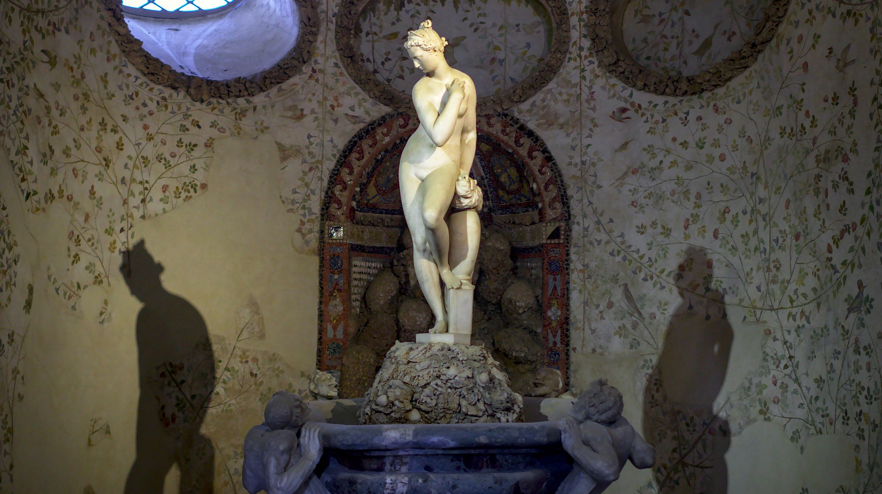
Venus, 1573, Marble, Grotto Buontalenti, Boboli Gardens, Florence, Italy https://commons.wikimedia.org/wiki/Category:Bathing_Venus_by_Giambologna#/media/File:Bathing_Venus_statue_in_Buontalenti_Grotto,_Boboli_Gardens,_Florence.jpg

Slide 12
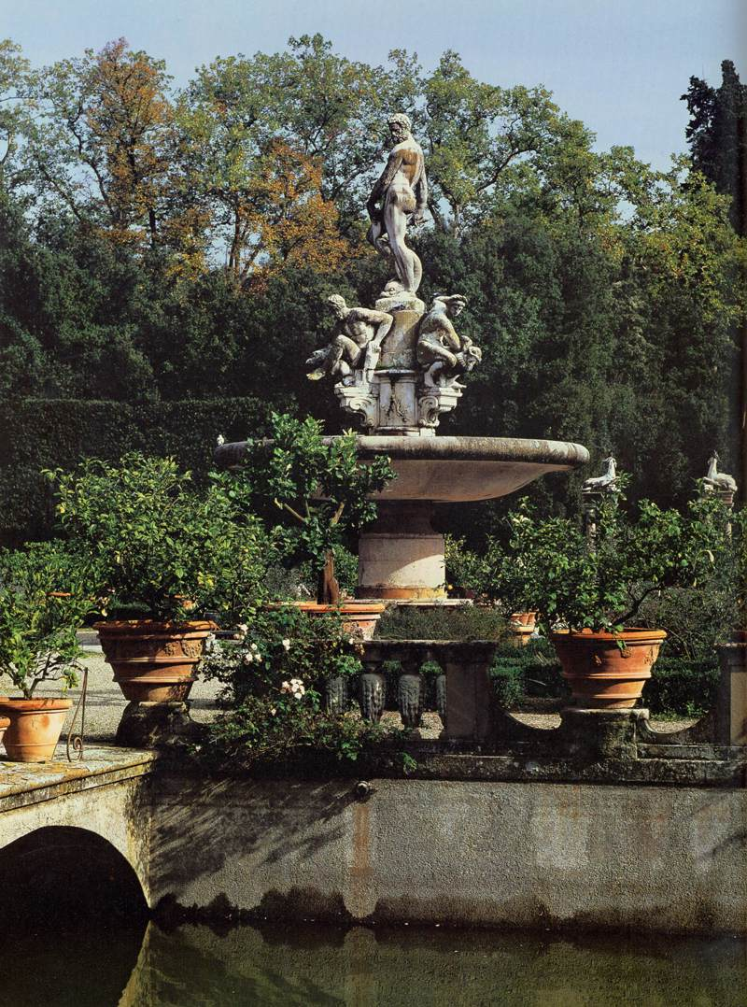
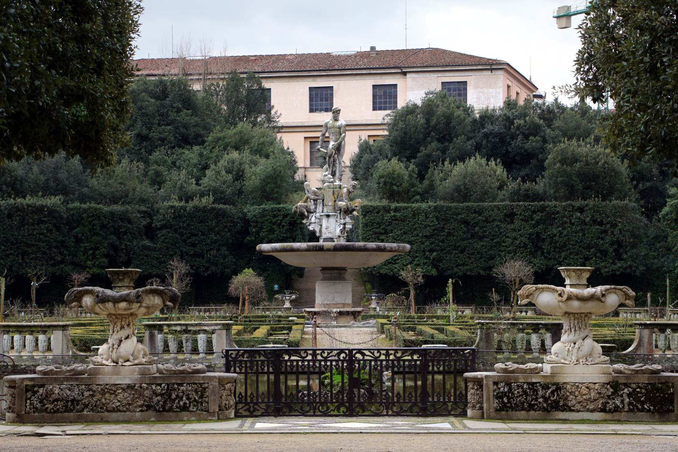
The Fountain of Oceanus, 1576
Marble, Boboli Gardens, Florence, Italy https://www.wga.hu/frames-e.html?/html/g/giambolo/index.html

Slide 13
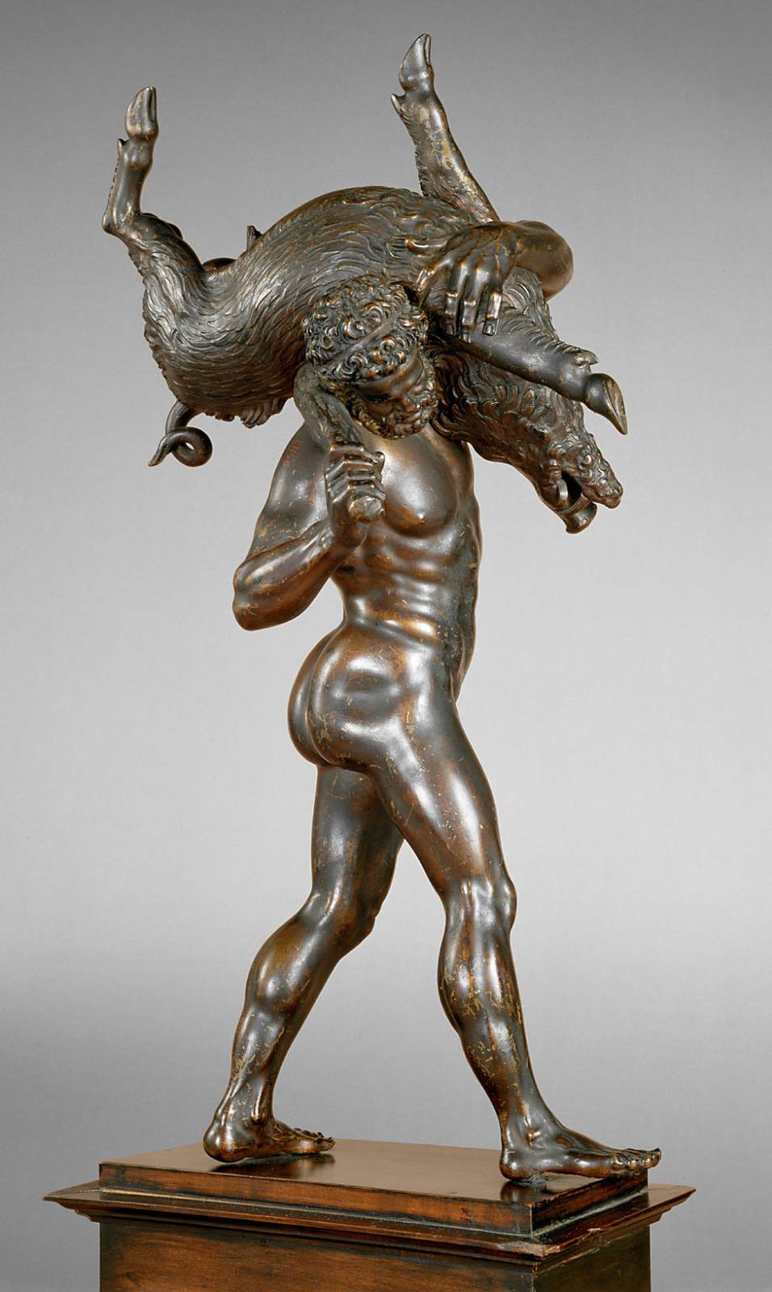
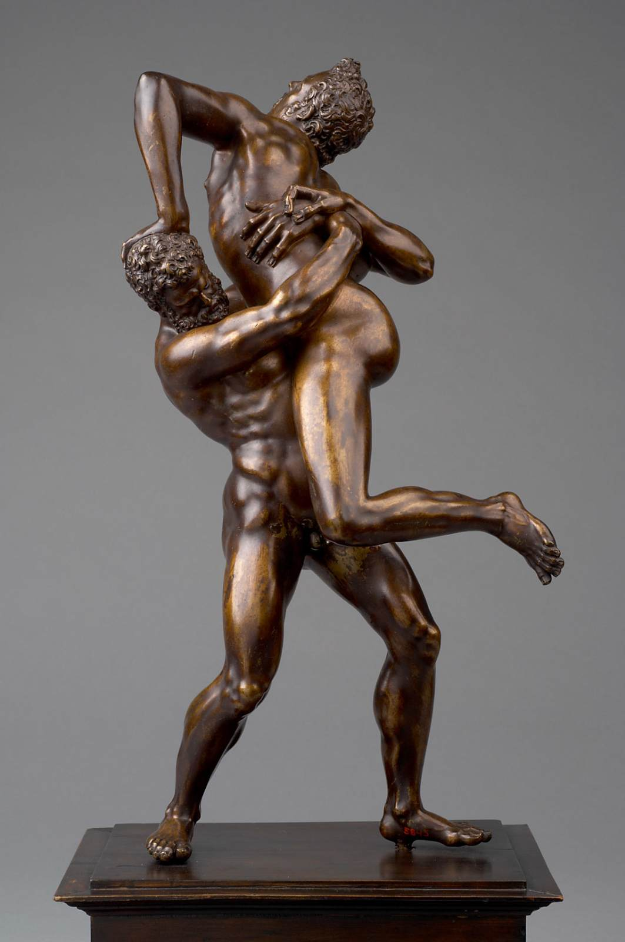
Hercules with the Erymanthian Boar, 1575-80, Bronze, Height: 47 cm
Hercules and Antaeus, 1578-80,
Bronze, Height: 51 cm
Kunsthistorisches Museum, Vienna, Austria https://www.wga.hu/frames-e.html?/html/g/giambolo/index.html

Slide 14
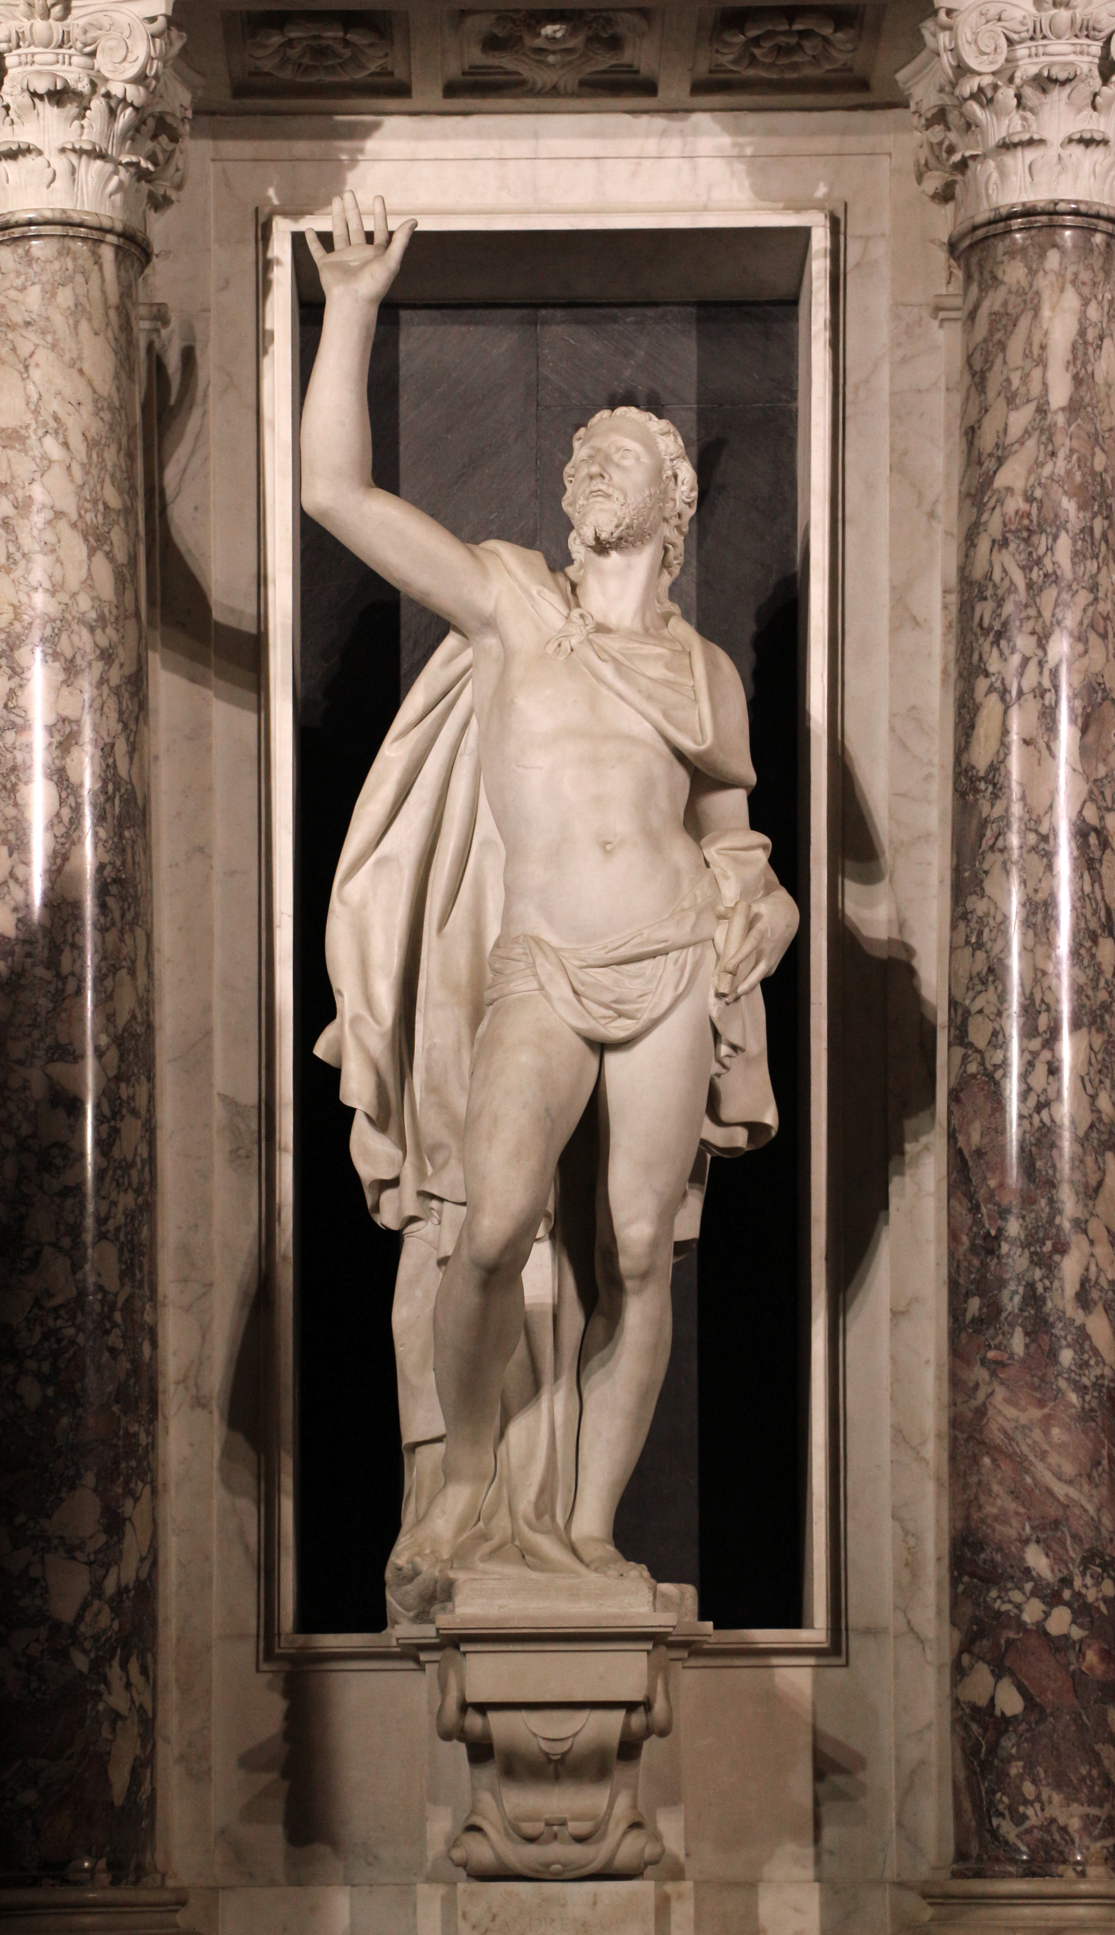
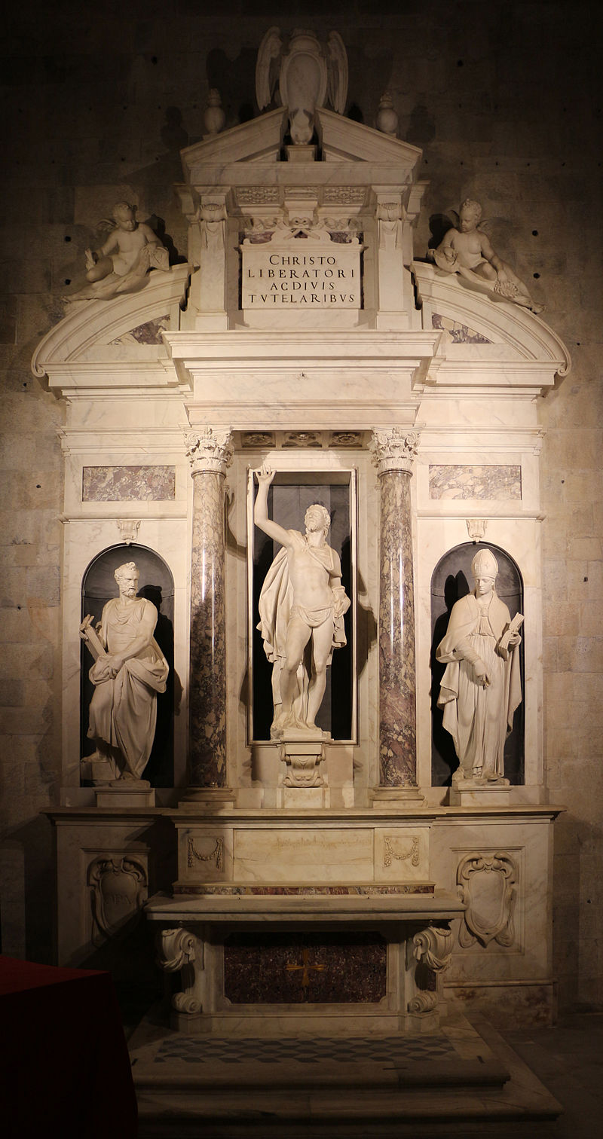
Altar of Liberty, 1579, Marble, Cathedral of San Martino, Lucca, Italy
Photo Credits: https://upload.wikimedia.org/wikipedia/commons/6/62/Giambologna%2C_altare_della_libert%C3%A0%2C_1579%2C_05_cristo_salvatore.JPG https://commons.wikimedia.org/wiki/Category:Altar_of_Freedom#/media/File:Giambologna,_altare_della_libert%C3%A0,_1579,_01.JPG

Slide 15
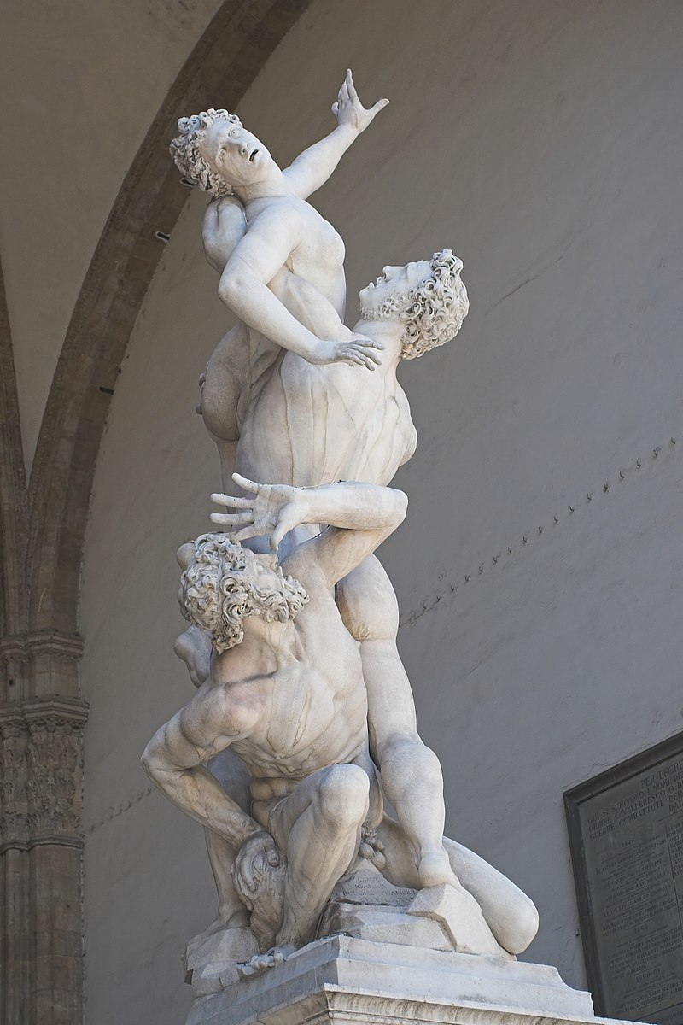
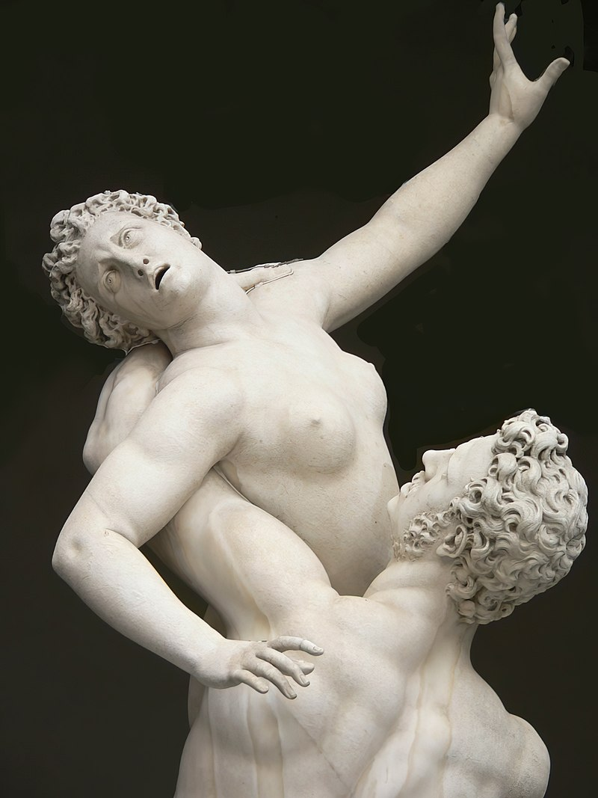
Abduction of a Sabine, 1581-83, Marble, Height: 410 cm, Loggia dei Lanzi, Florence, Italy https://en.wikipedia.org/wiki/Abduction_of_a_Sabine_Woman

Slide 16
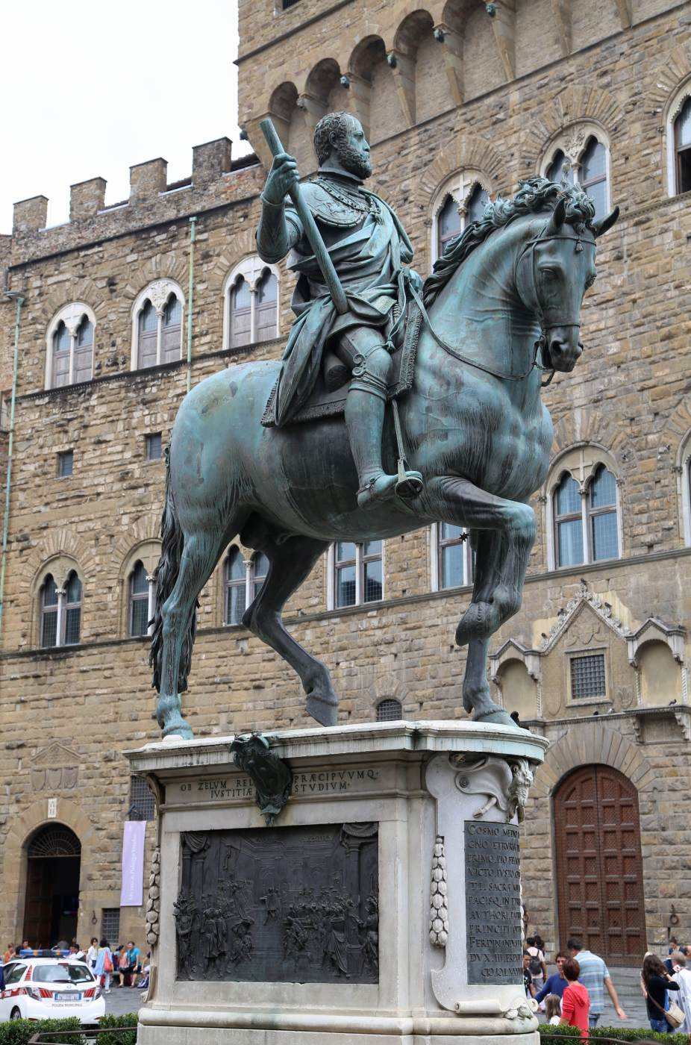
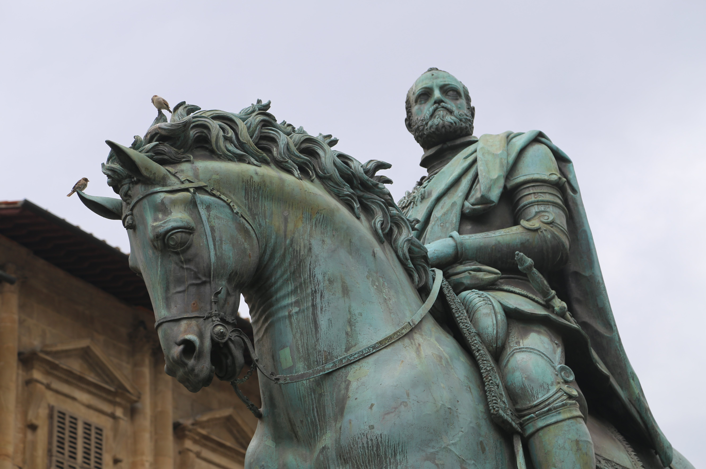
Equestrian Portrait of Cosimo I, 1587-94, Bronze, Height: 450 cm, Piazza della Signoria, Florence, Italy https://www.wga.hu/frames-e.html?/html/g/giambolo/index.html

Slide 17
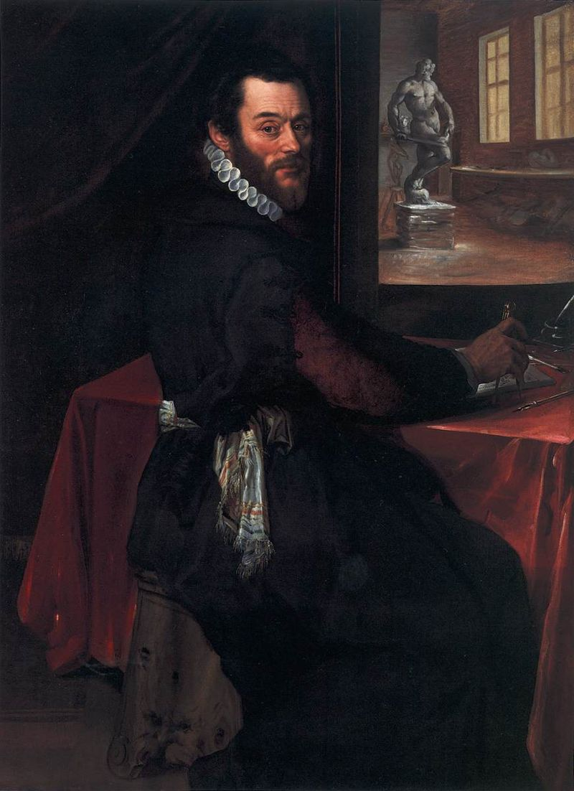
The End
Unknown Flemish Master, late 16th century
Portrait of Giambologna in his Studio, 1570s, oil on panel, 89x66 cm, Scottish National Gallery, UK https://commons.wikimedia.org/wiki/File:16th-century_unknown_painters_-_Portrait_of_Giambologna_in_his_Studio_-_WGA23628.jpg

Slide 18
The End

