Slide 1
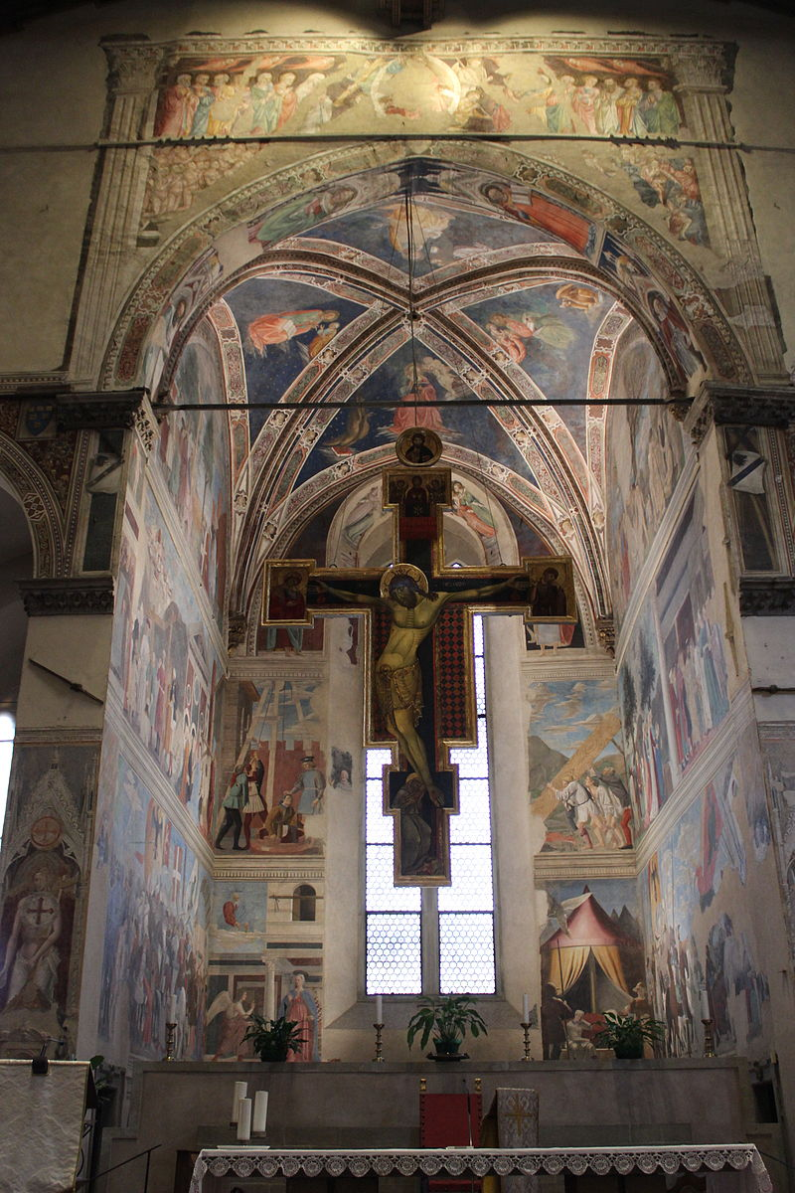
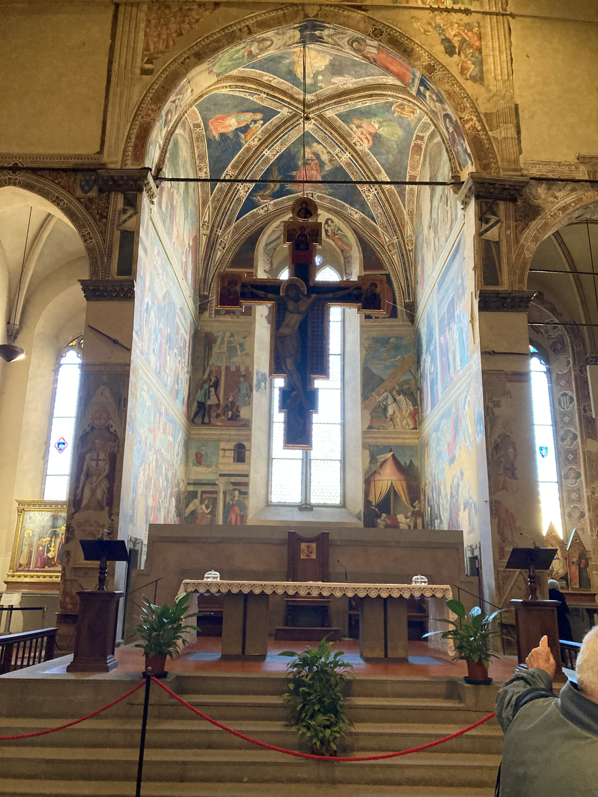
Piero della Francesca, 1416-1492
View of the Cappella Maggiore, 1452-66, Fresco, San Francesco, Arezzo, Italy https://www.wga.hu/tours/arezzo/index4.html

Slide 2
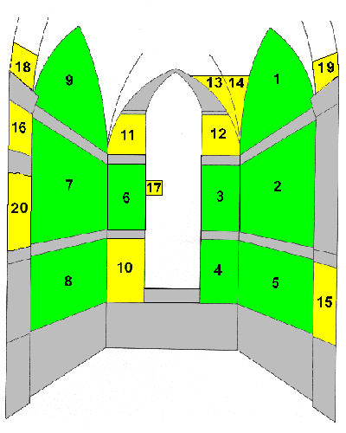
Legend of the True Cross
1. Death of Adam
2. Procession of the Queen of Sheba;
Meeting between the Queen and King Solomon
3. Burial of the Holy Wood
4. Vision of Constantine
5. Constantine's Victory over Maxentius
6. Torture of the Jew
7. Finding and Recognition of the True Cross
8. Battle between Heraclius and Chosroes
9. Exaltation of the Cross
Other frescoes by Piero and his assistants
10. Annunciation
11. Prophet Isaiah by Giovanni di Piamonte
12. Prophet Jeremiah
13. Head of an Angel
14. Head of an Angel by Giovanni di Piamonte
15. Angel
16. Cupid Blindfolded
17. St Bernardino of Siena by Lorentino d'Arezzo
18. St Augustine by Giovanni di Piamonte
19. St Ambrose by Giovanni di Piamonte
20. St Louis of Toulouse by Lorentino d'Arezzo

Slide 3
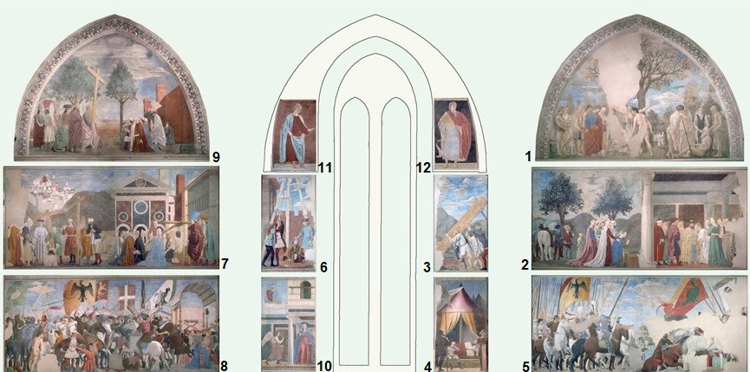

Slide 4
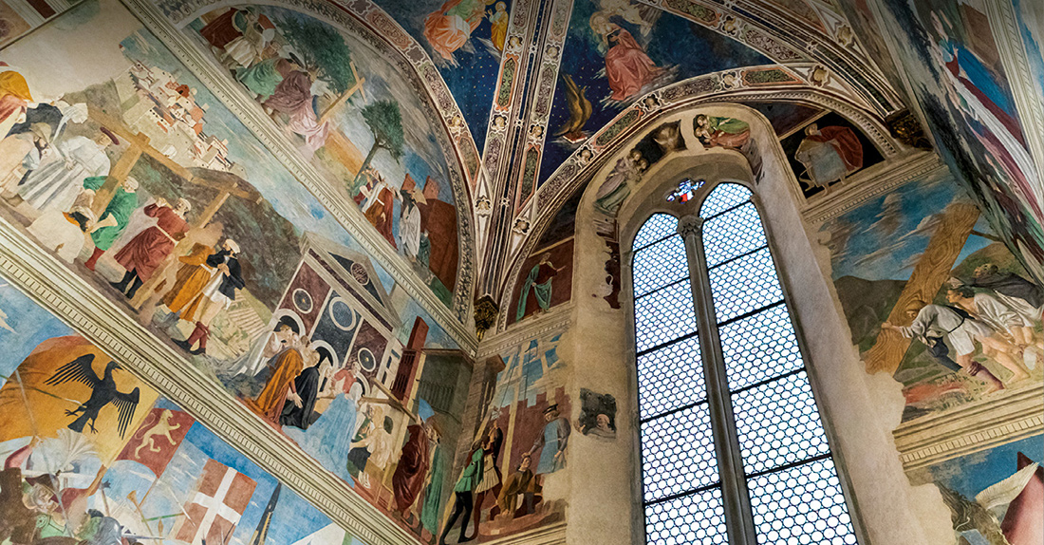
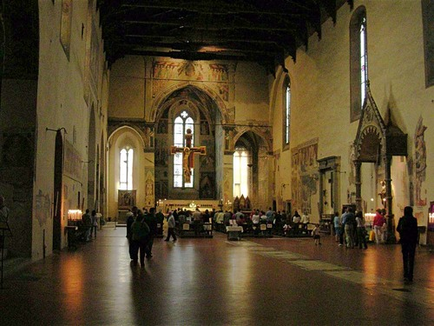

Slide 5
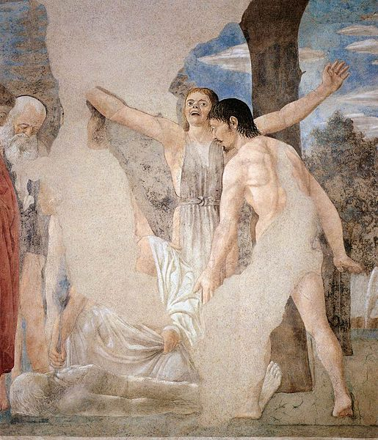
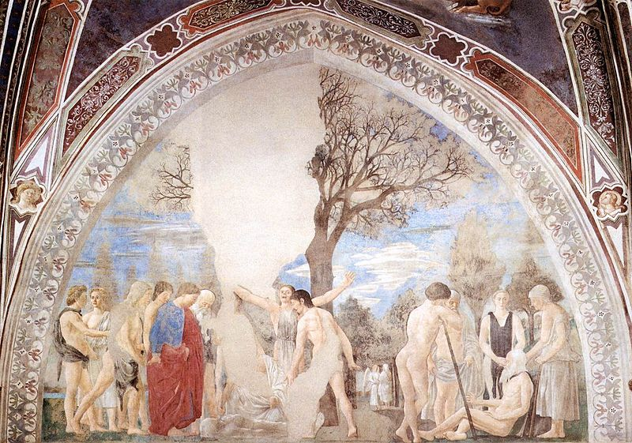
Death of Adam, 1452-66, Fresco,
390 x 747 cm,
San Francesco, Arezzo

Slide 6
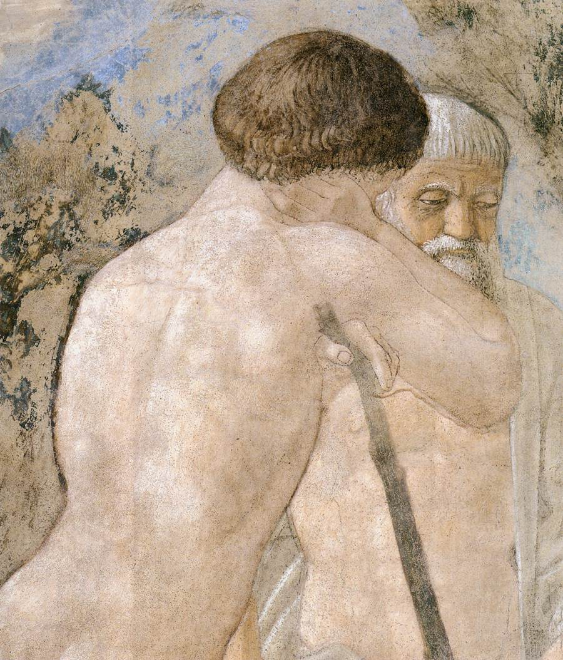
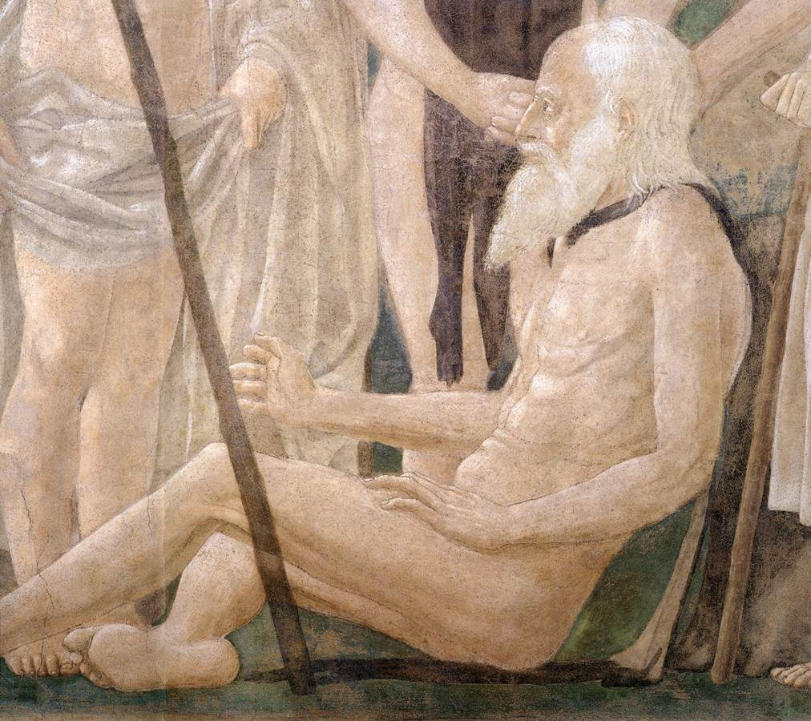

Slide 7
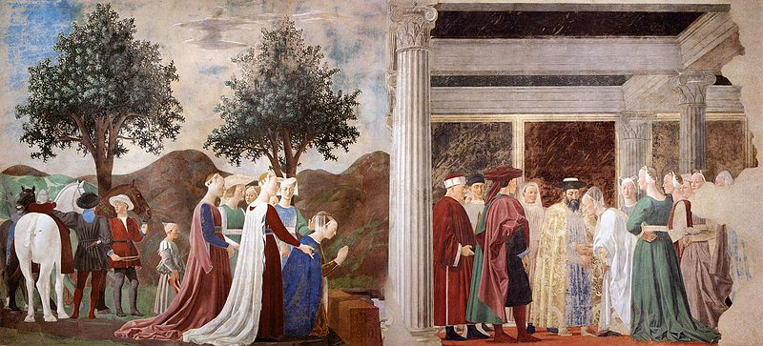
Procession of the Queen of Sheba; Meeting between the Queen of Sheba and King Solomon, 1452-66, Fresco, 336 x 747 cm, San Francesco, Arezzo

Slide 8
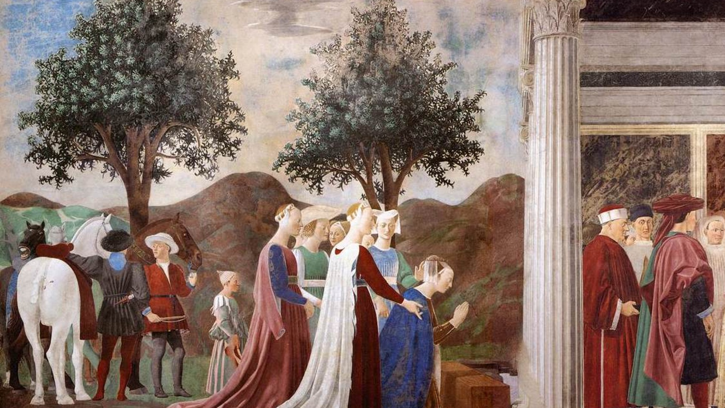
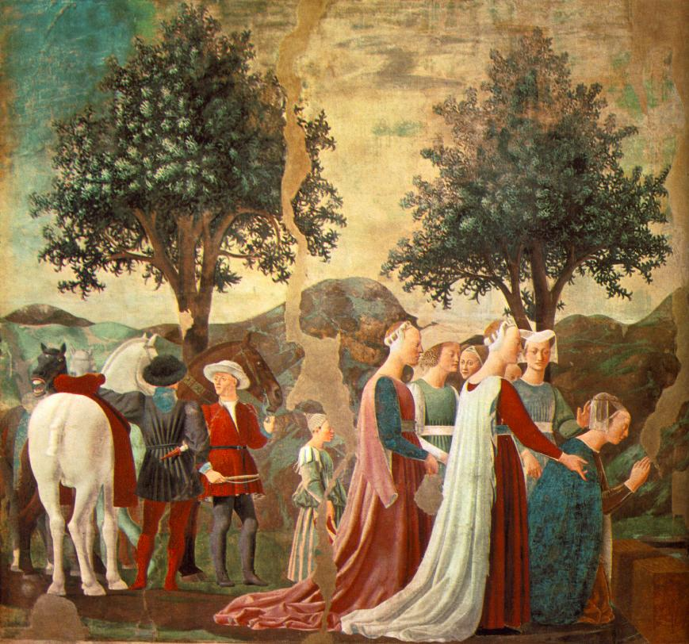
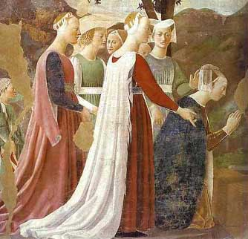

Slide 9
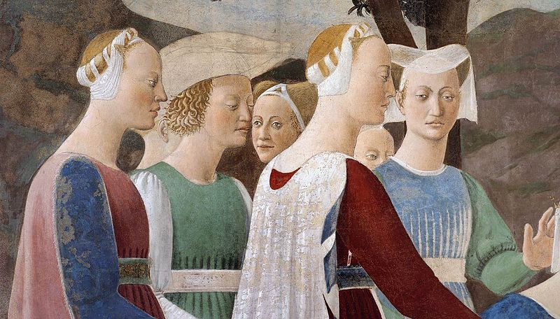

Slide 10
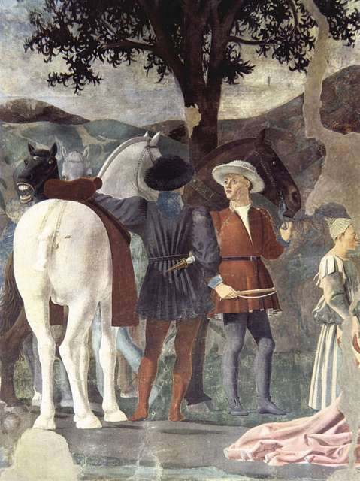
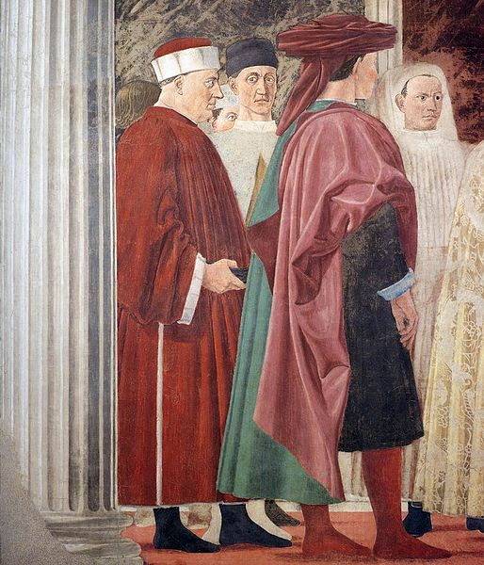

Slide 11
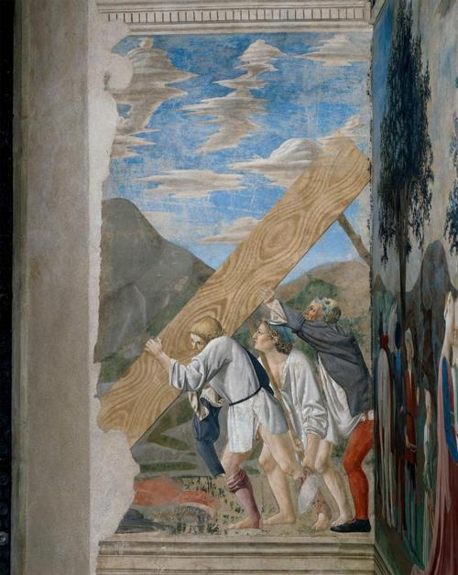
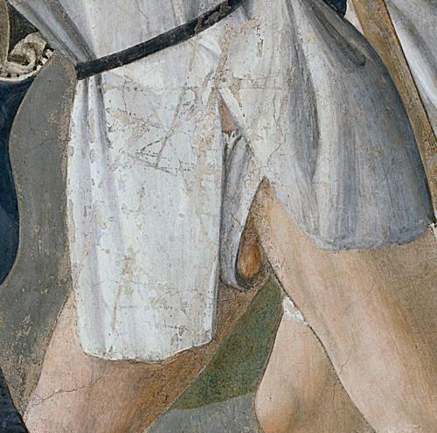
Burial of the Sacred Wood, 1452-66, Fresco, 356 x 190 cm
San Francesco, Arezzo

Slide 12
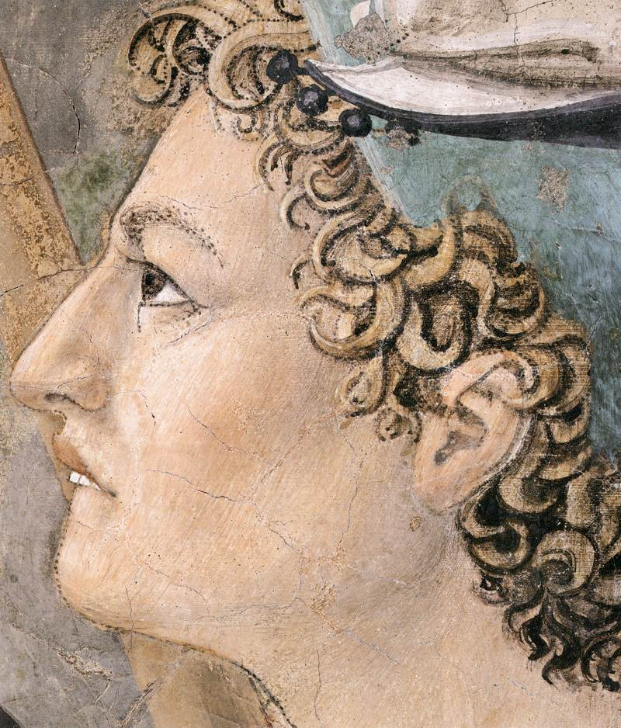
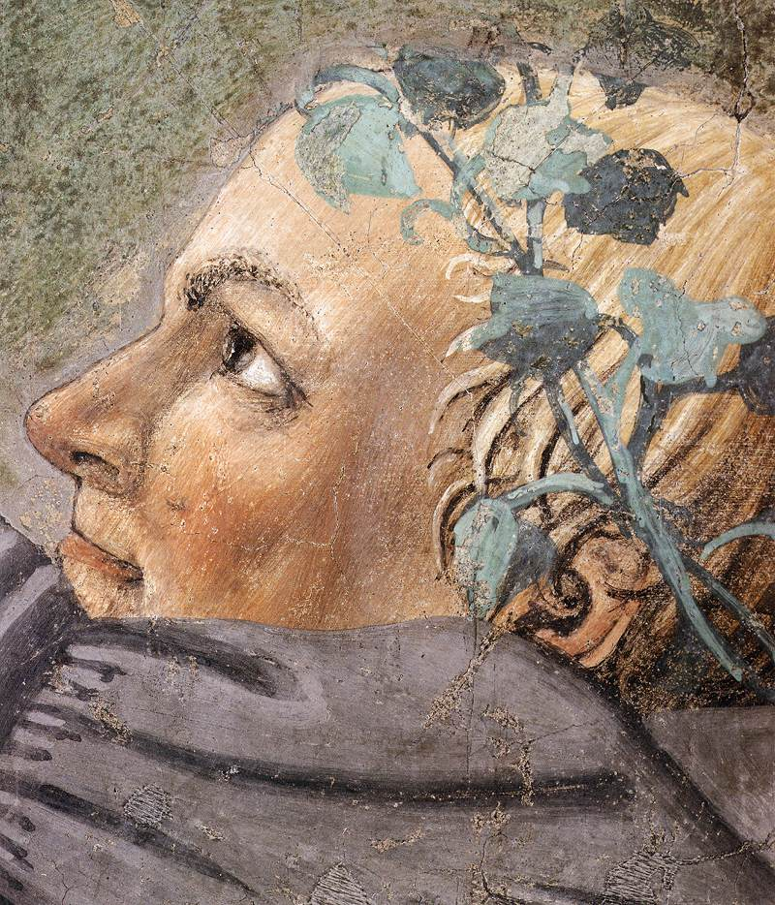

Slide 13
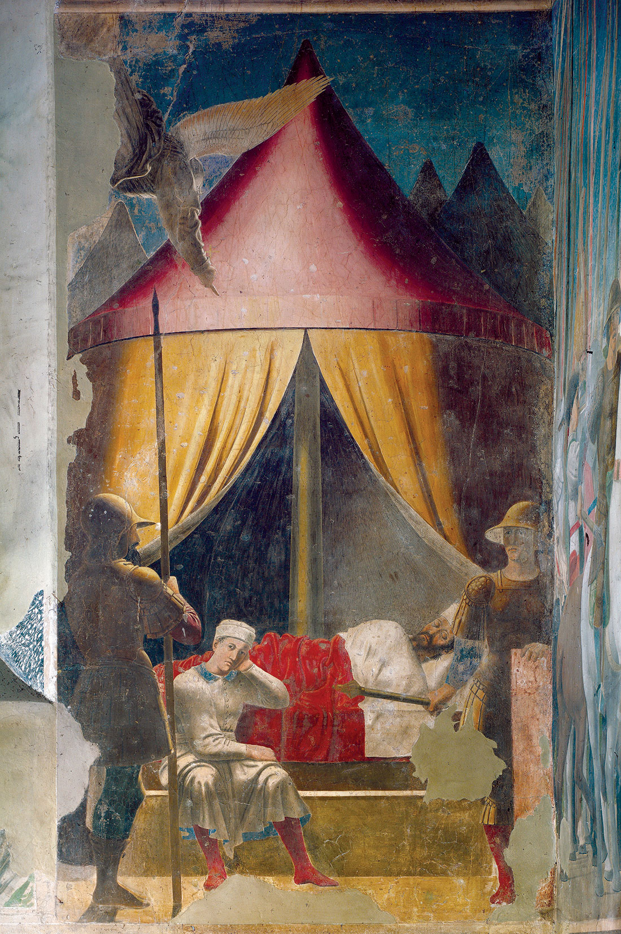
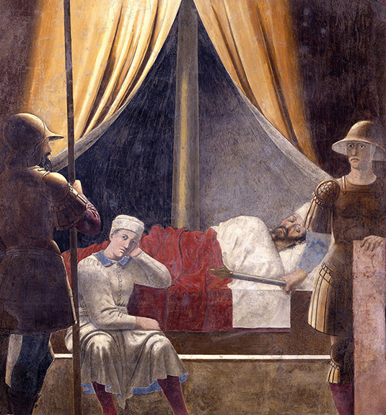
Vision of Constantine, 1452-66, Fresco, 329 x 190 cm, San Francesco, Arezzo

Slide 14
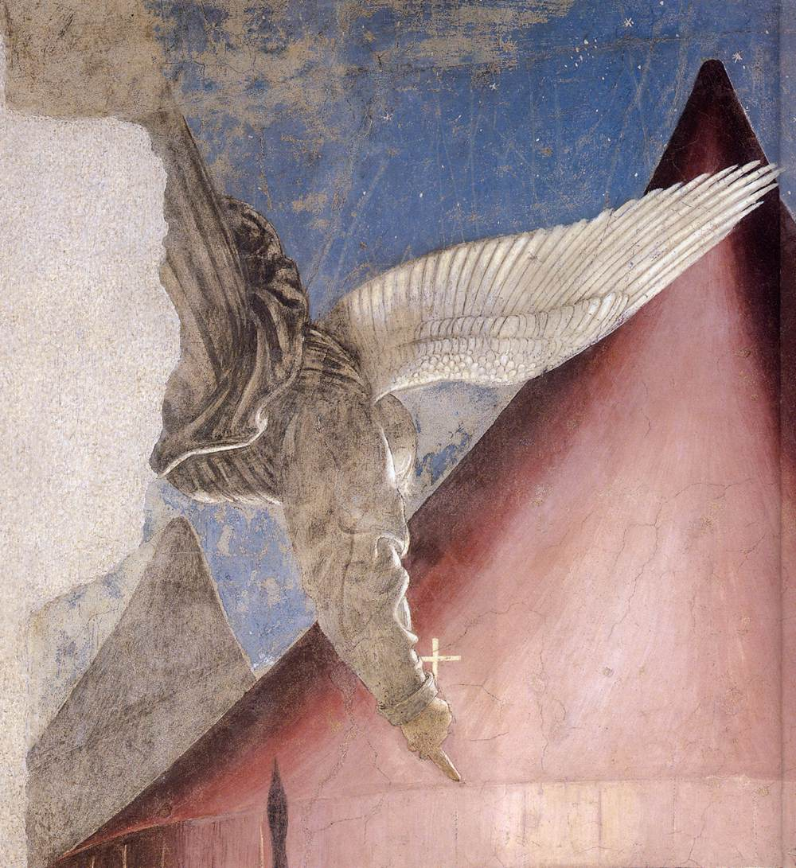
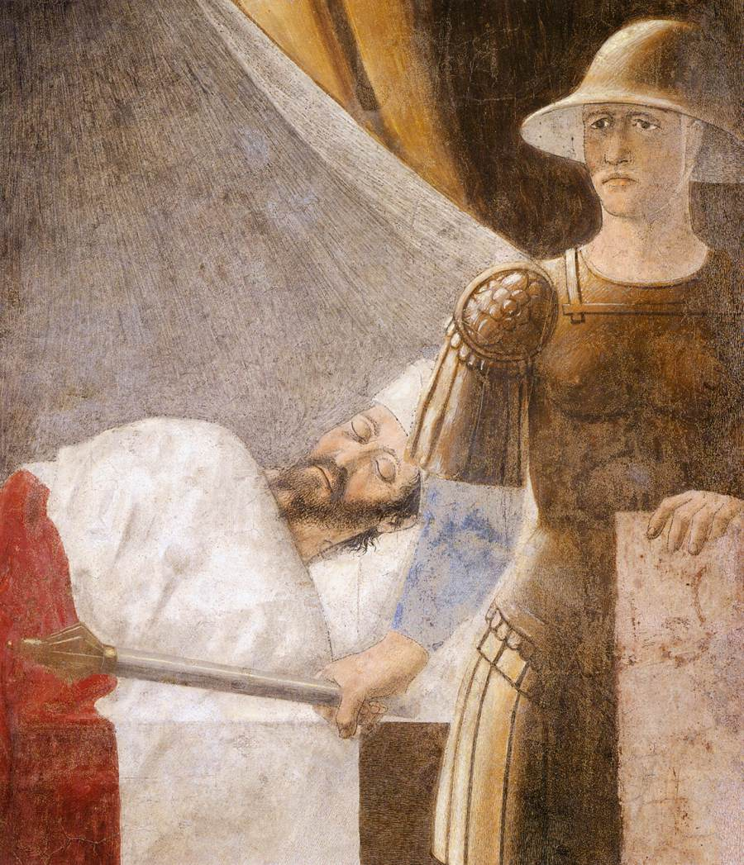

Slide 15
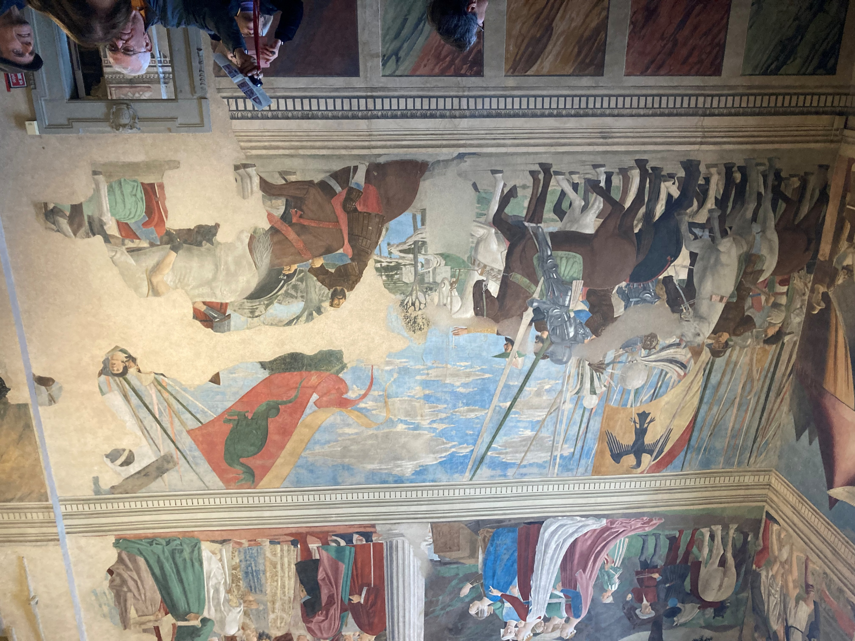
Constantine's Victory over Maxentius, 1452-66, Fresco, 322 x 764 cm, San Francesco, Arezzo

Slide 16
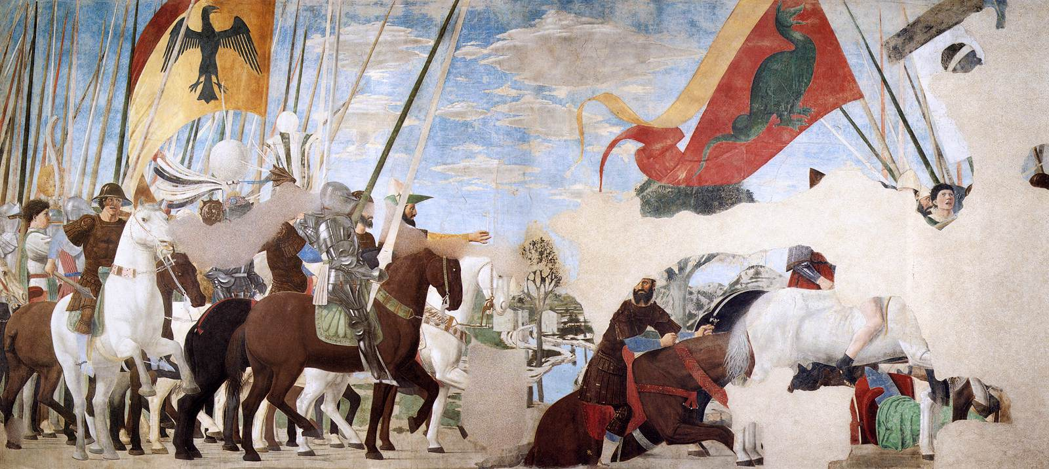

Slide 17
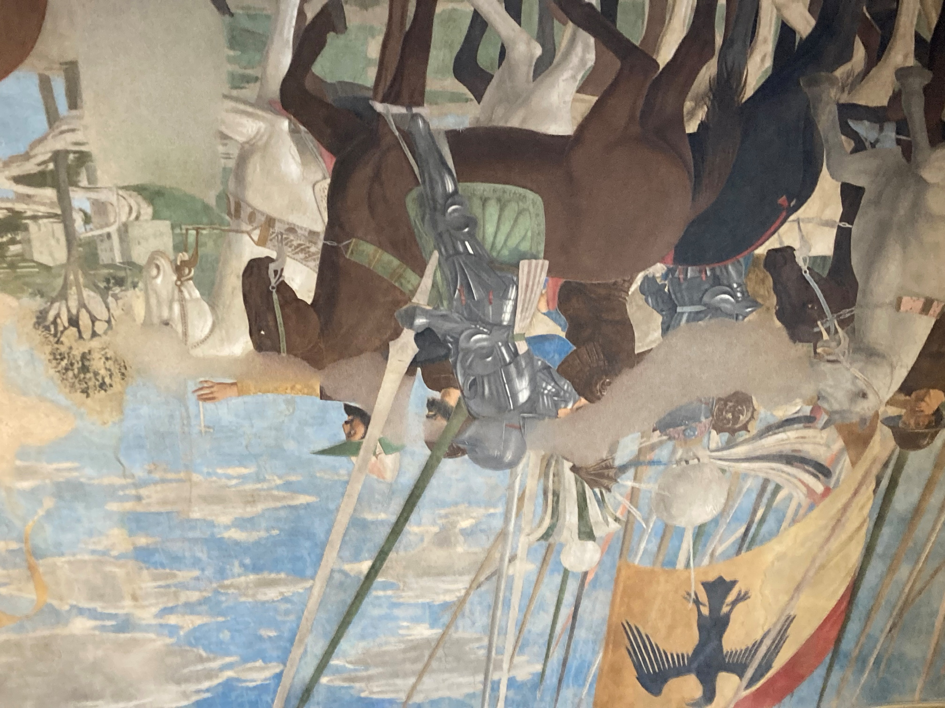

Slide 18
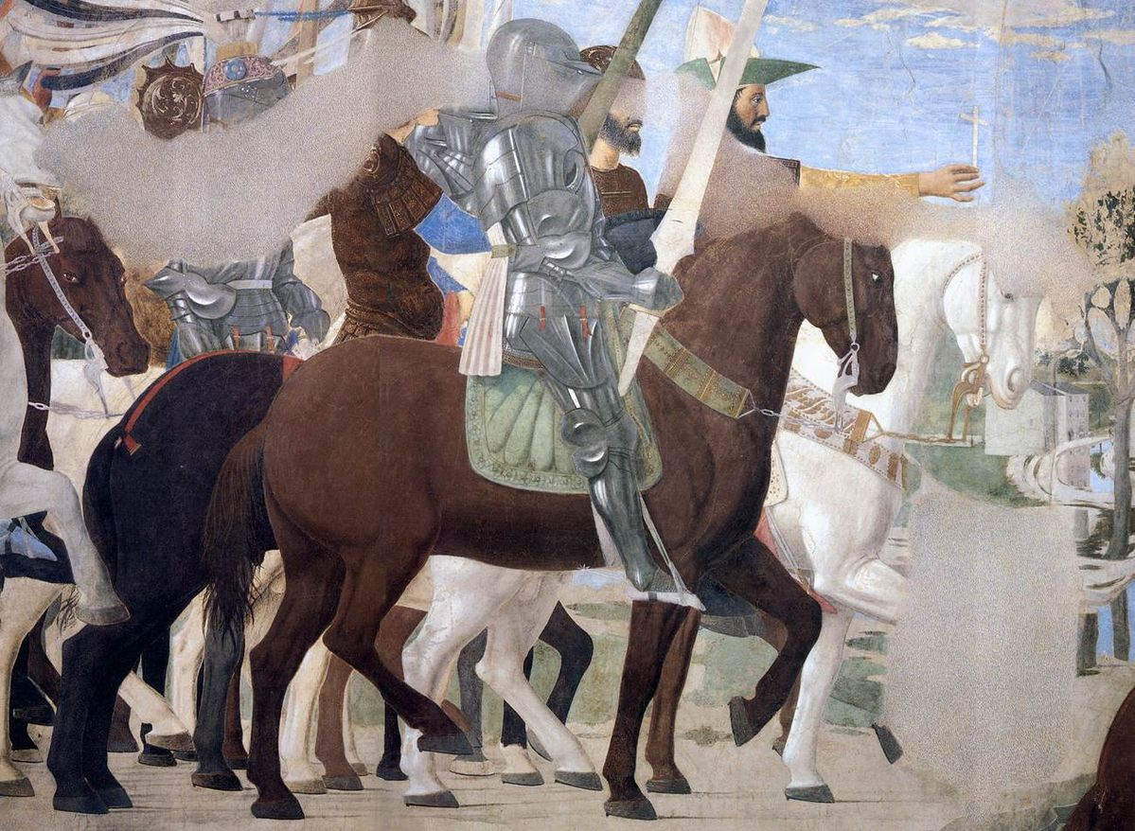
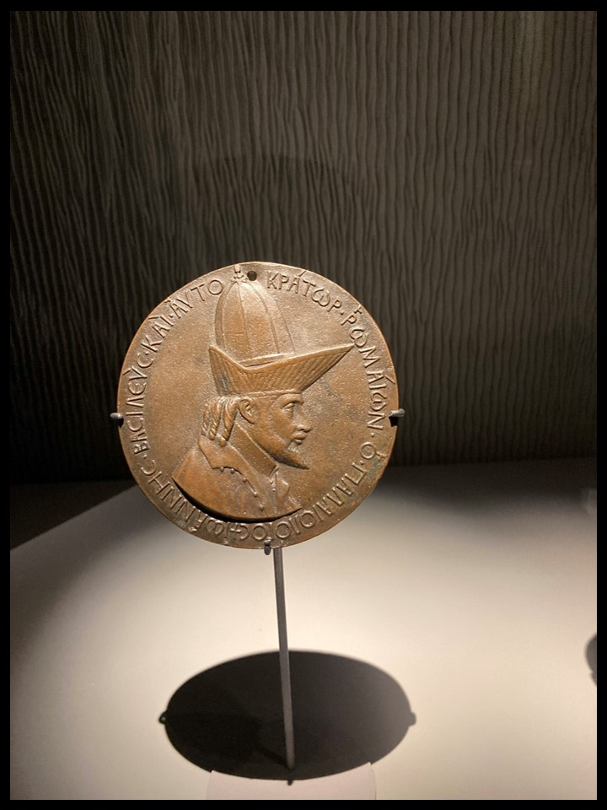

Slide 19
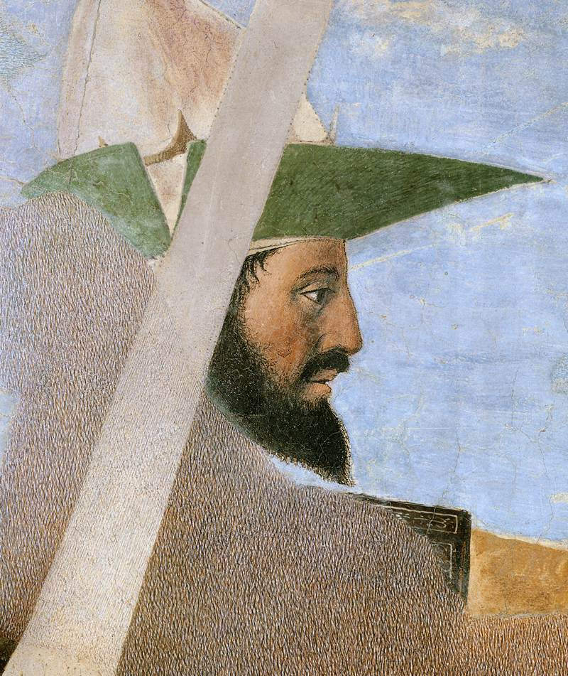
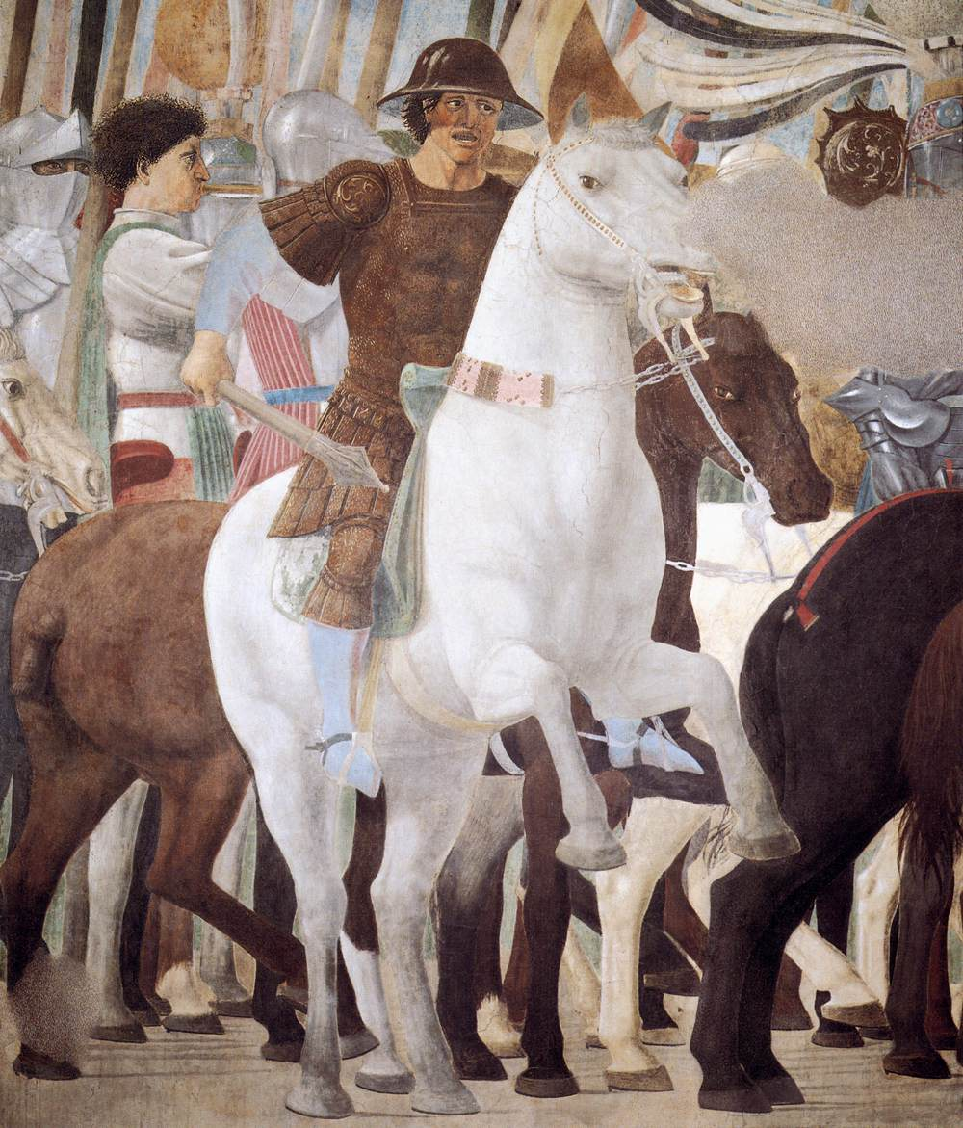

Slide 20
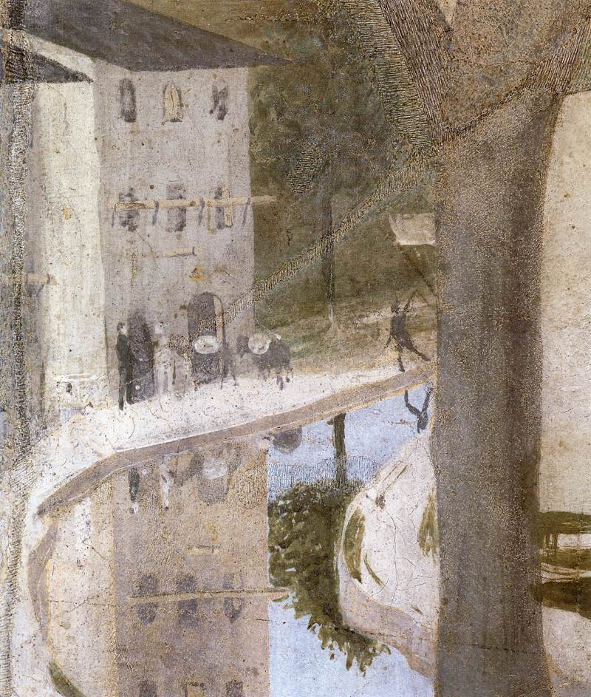
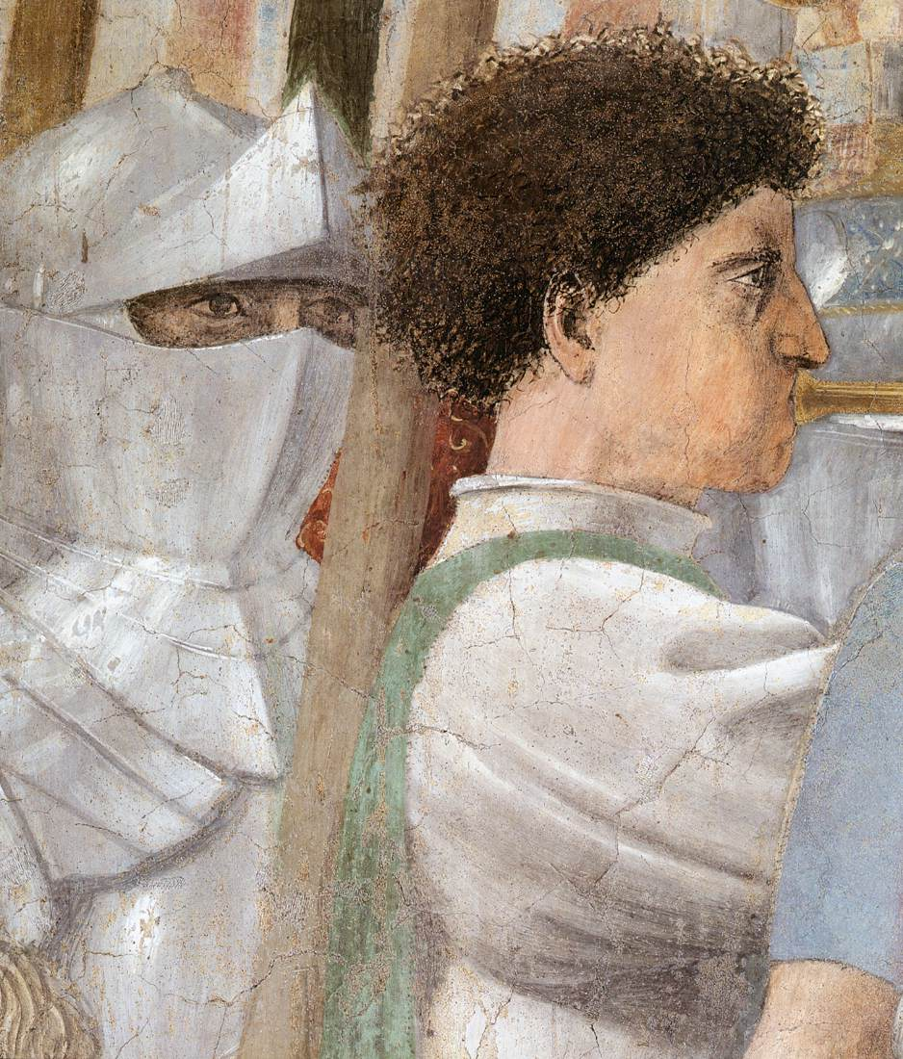

Slide 21
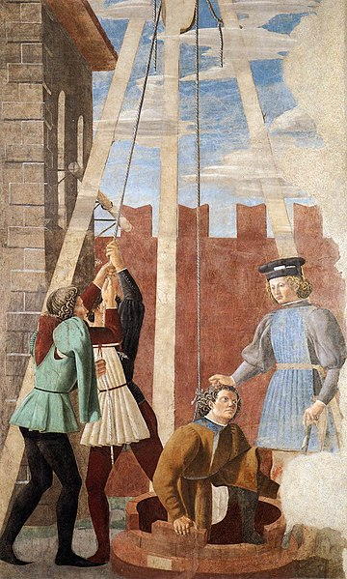
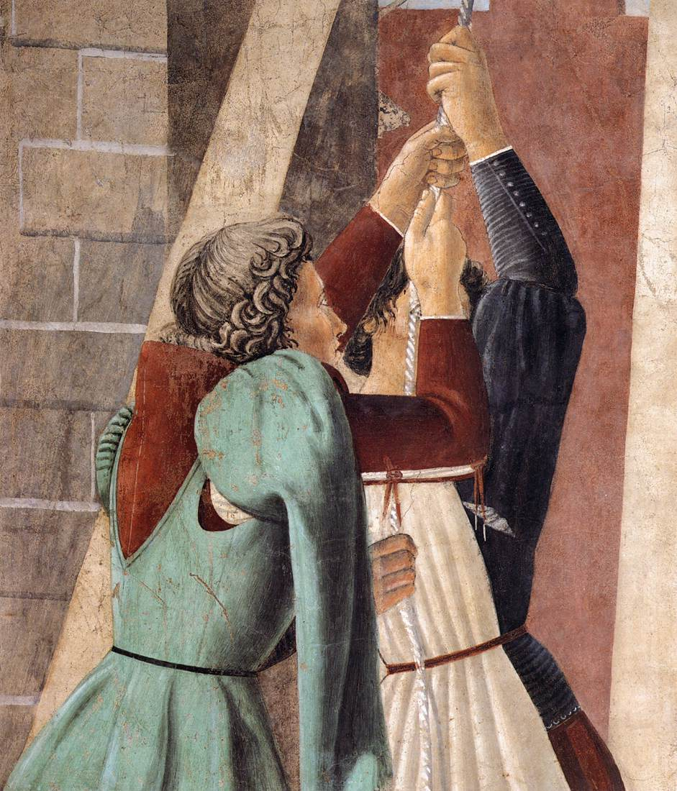
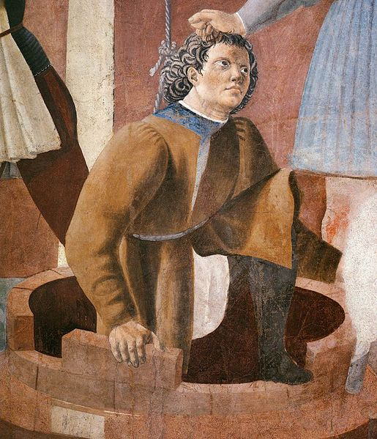
Torture of the Jew, 1452-66, Fresco, 356 x 193 cm, San Francesco, Arezzo

Slide 22
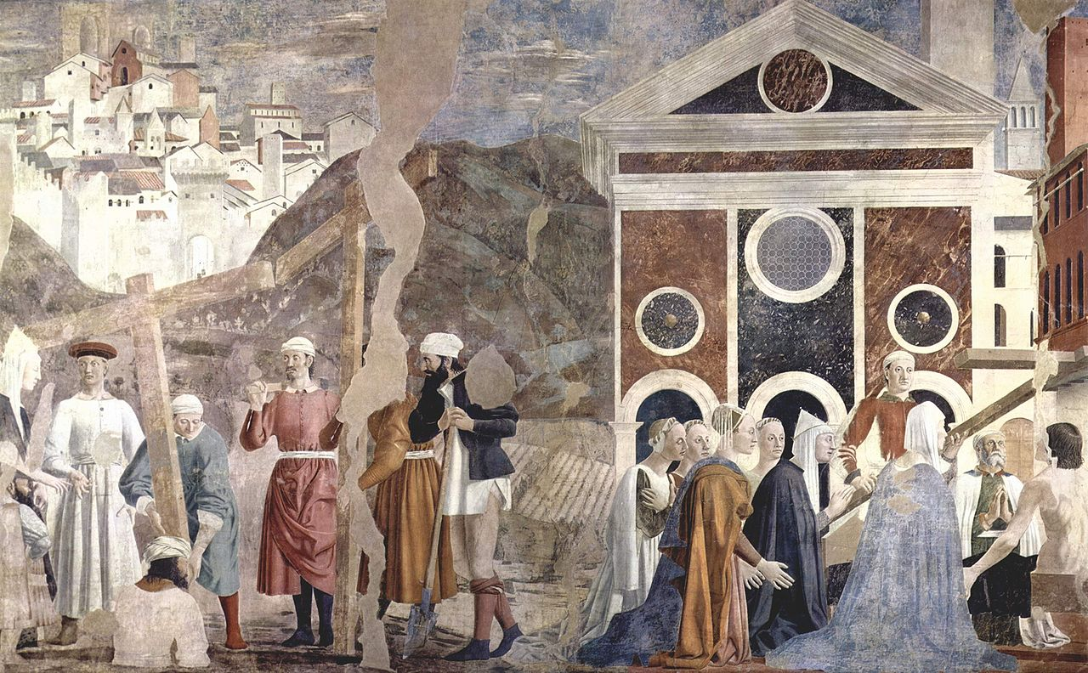
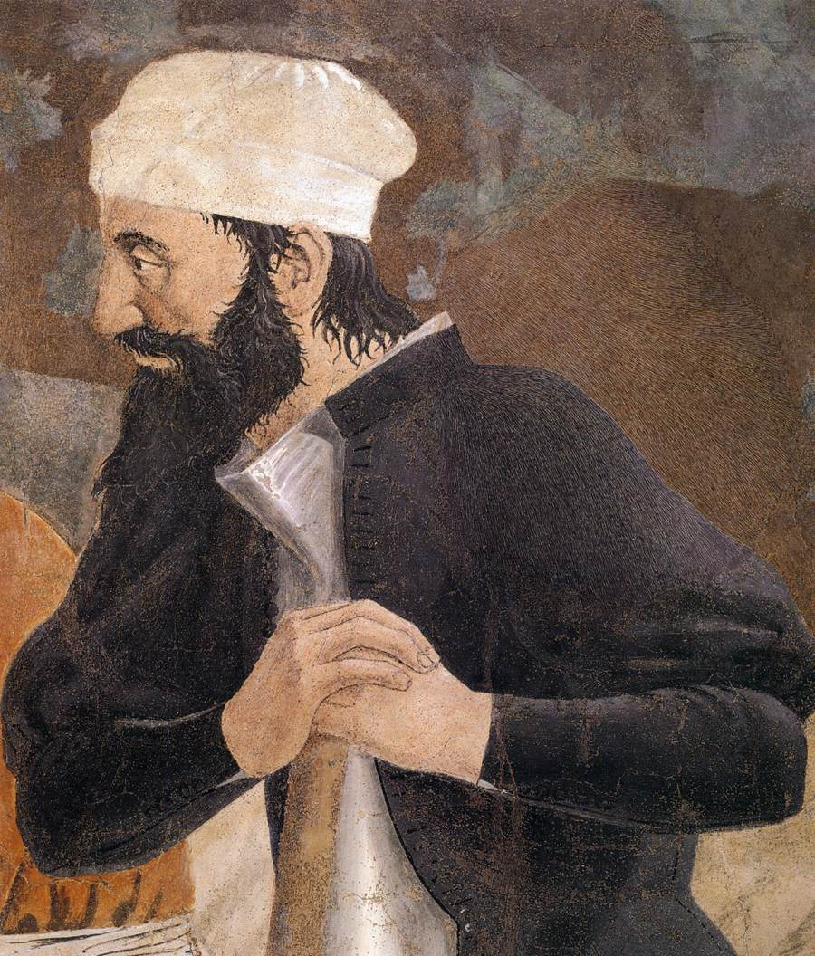
Finding and Recognition, of the True Cross, 1452-66, Fresco, 356 x 747 cm, San Francesco, Arezzo

Slide 23
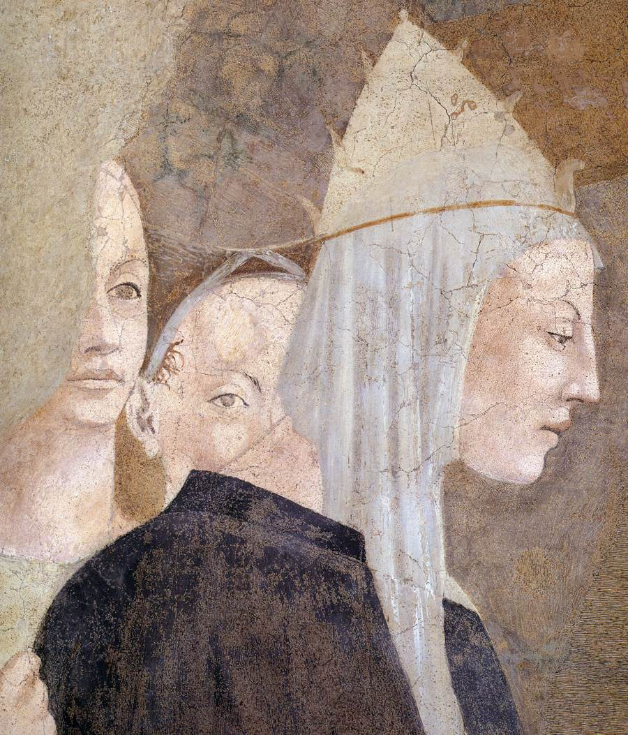
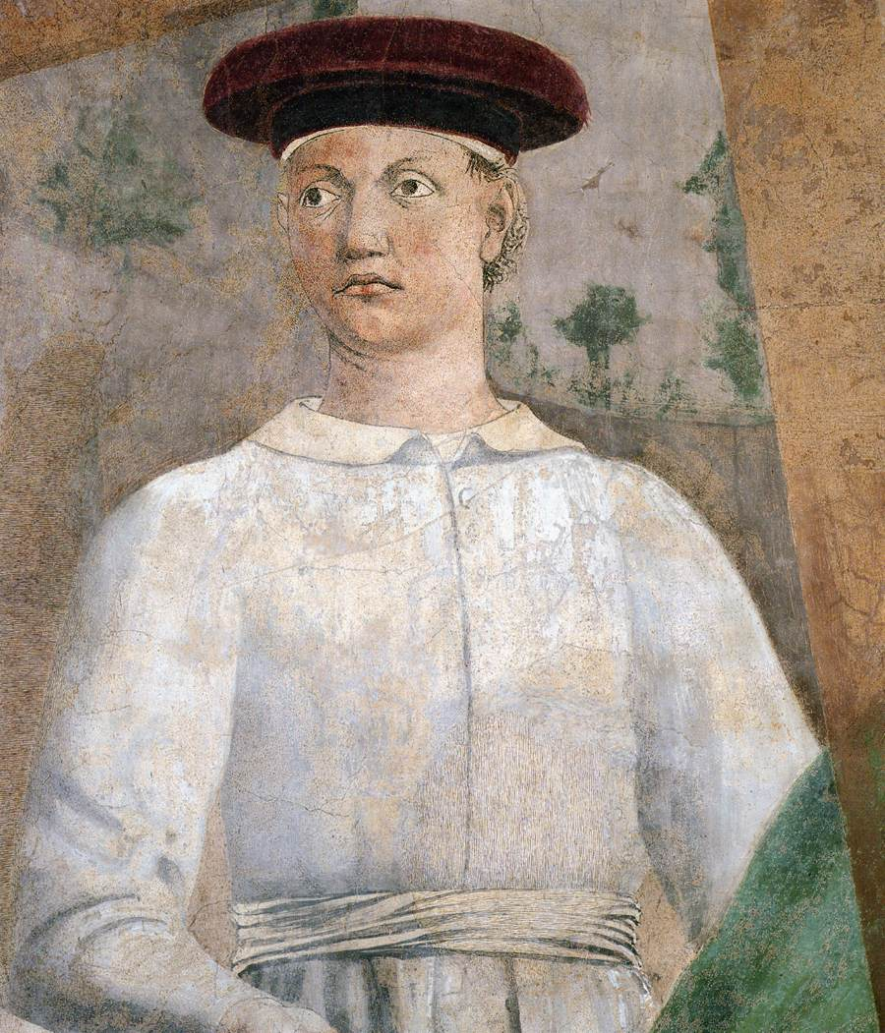

Slide 24
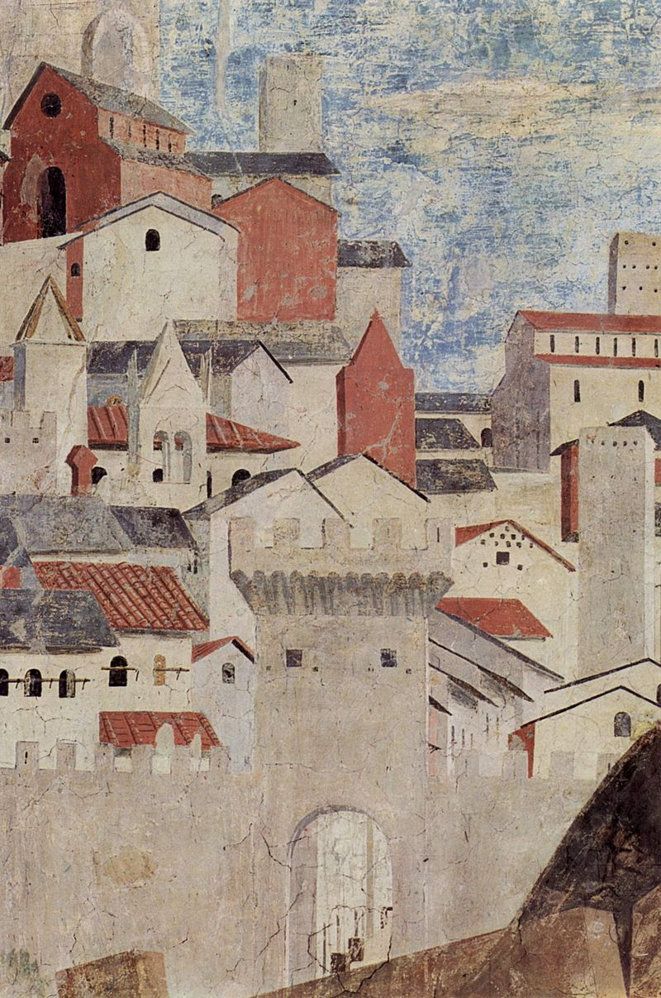
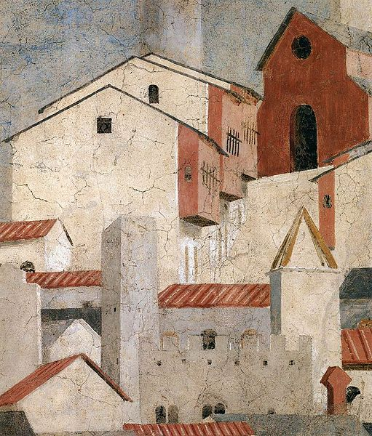

Slide 25
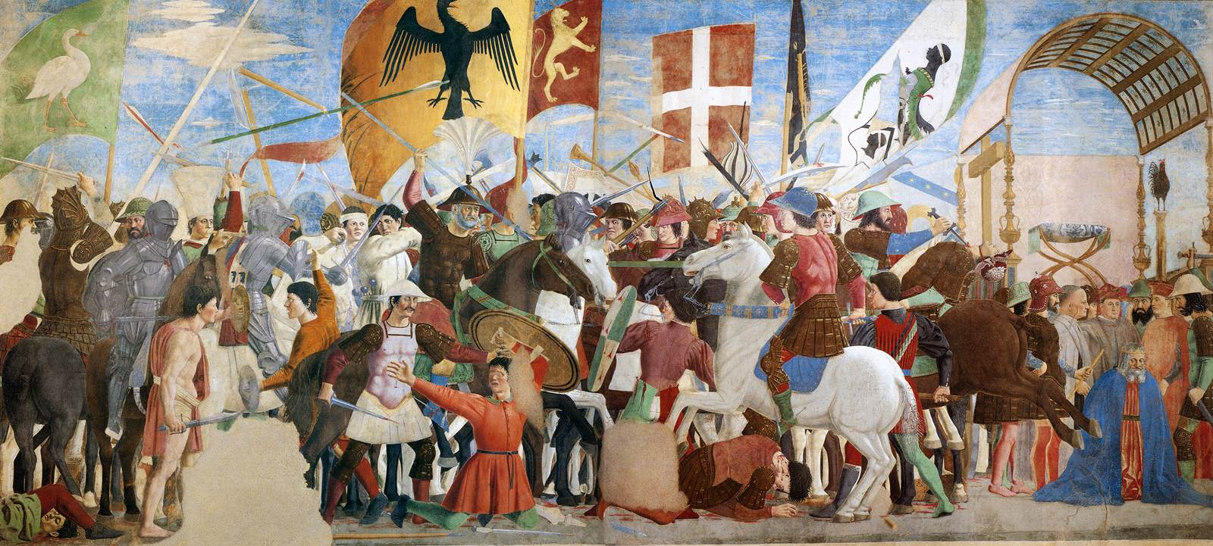
Battle between Heraclius, and Chosroes, 1452-66, Fresco, 329 x 747 cm, San Francesco, Arezzo

Slide 26
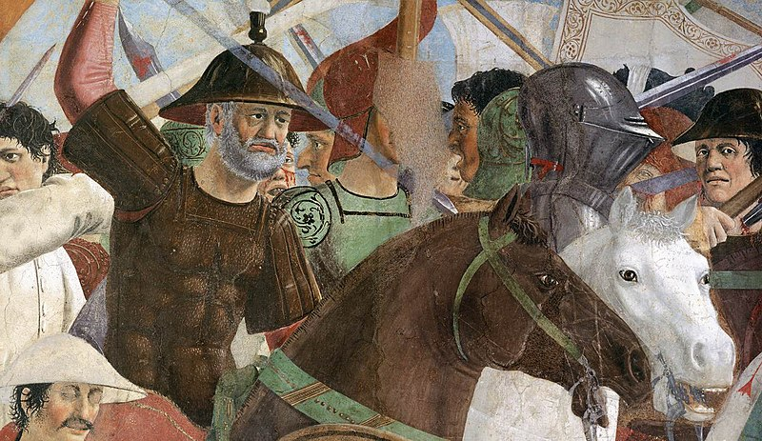

Slide 27
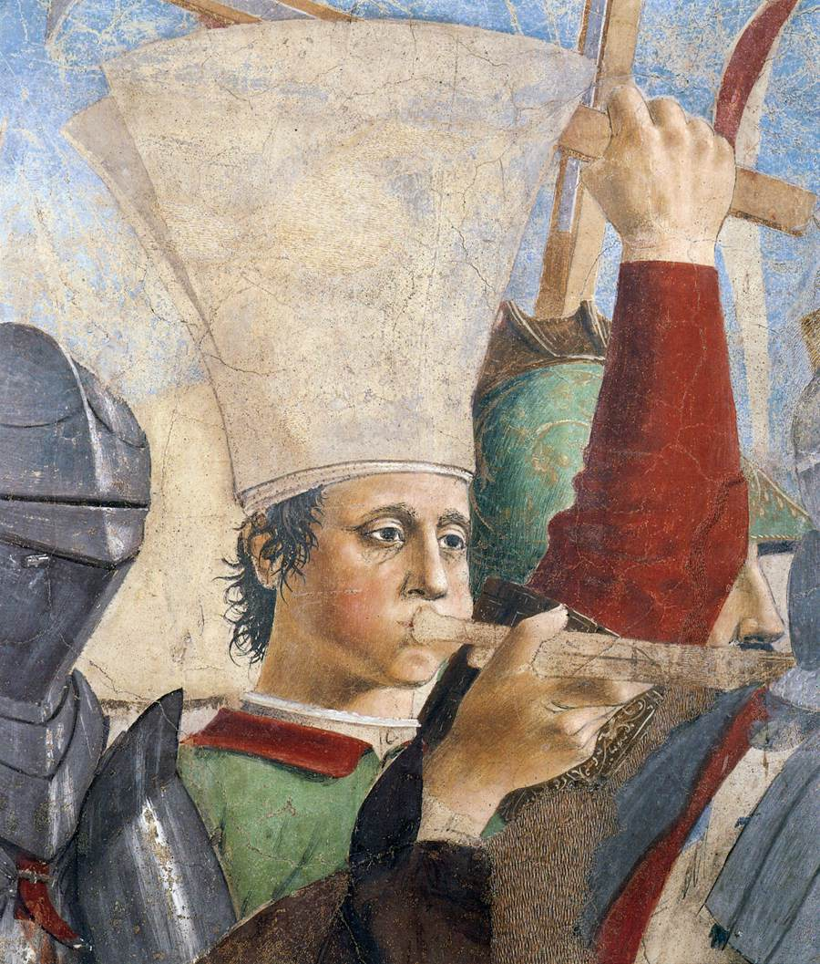
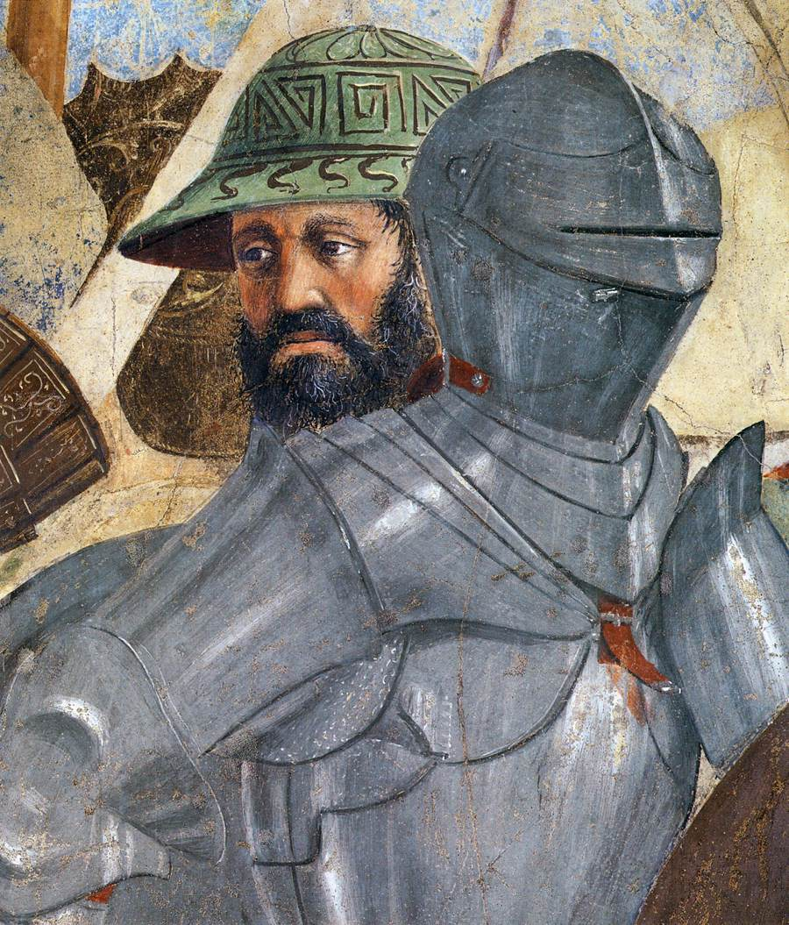

Slide 28
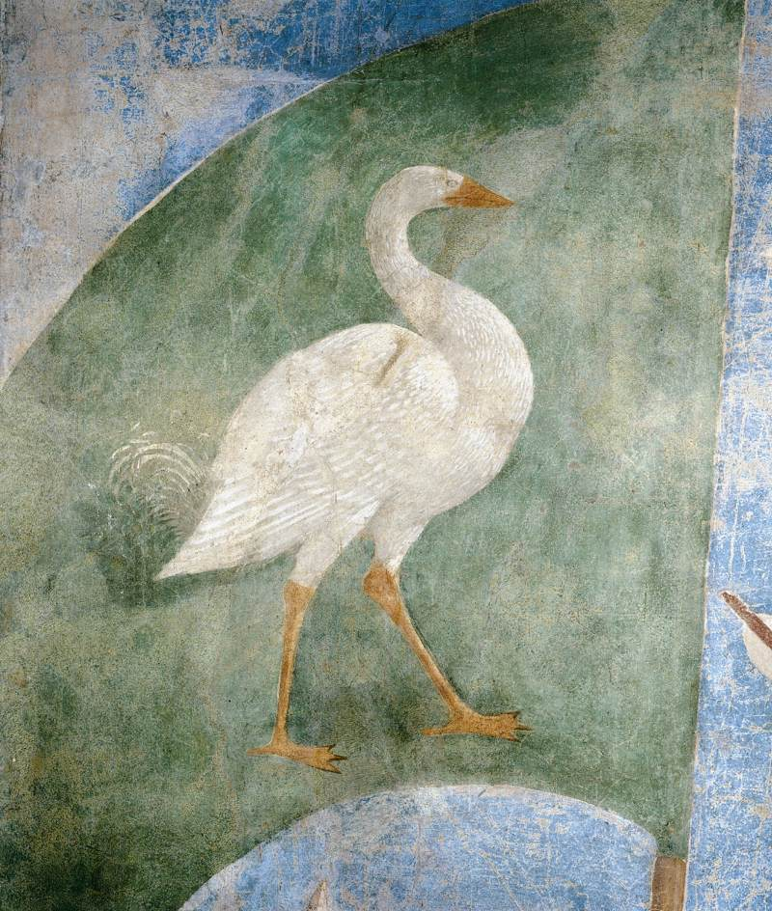
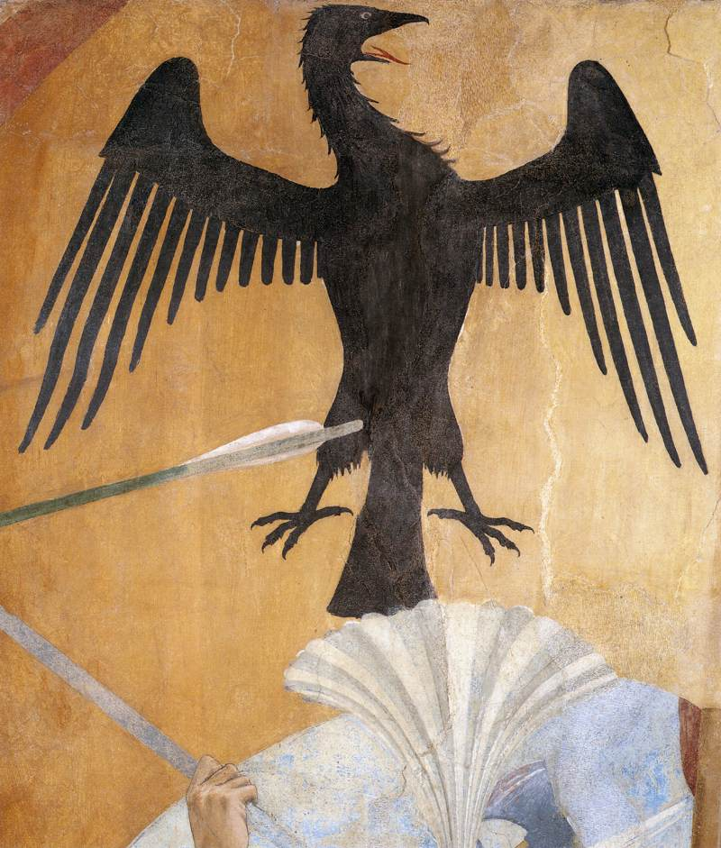

Slide 29
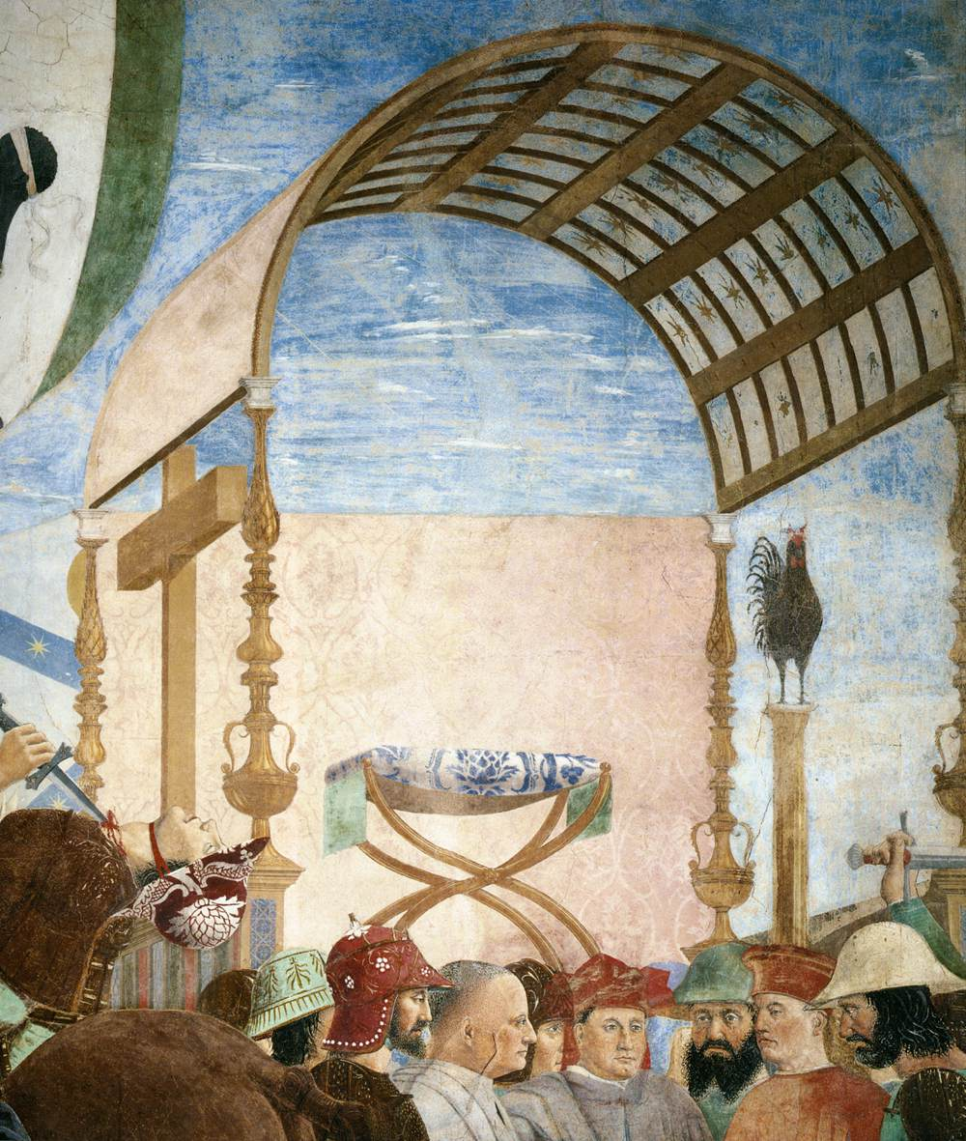


Slide 30


Exaltation of the Cross, 1452-66
Fresco,
390 x 747 cm,
San Francesco, Arezzo

Slide 31



Slide 32



The Annunciation, 1452-66,
Fresco, 329 x 193 cm,
San Francesco, Arezzo

