Slide 1
The House
of
Carl Fabergé
in the MET

Slide 2
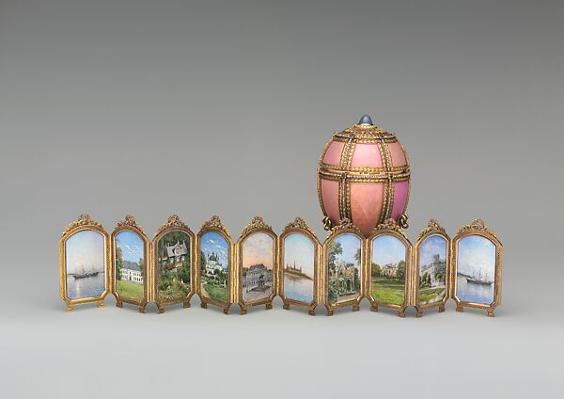
Maker: House of Carl Fabergé
Workmaster: Mikhail Evlampievich Perkhin
Artist:
Miniatures by Konstantin Yakovlevich Krijitski
Danish Palaces Egg, 1890, Green, rose, and quatre-couleur gold, guilloché enamel, star sapphire, cabochon emerald, rose-cut diamond nacre, crystal crimson silk velvet, 10.2 x 6.7 x 6.7 cm

Slide 3
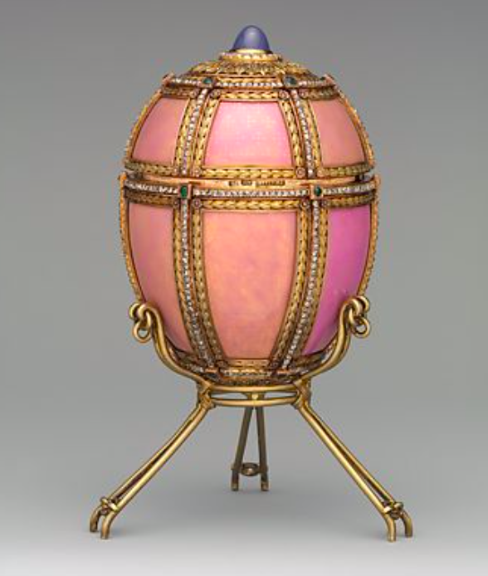
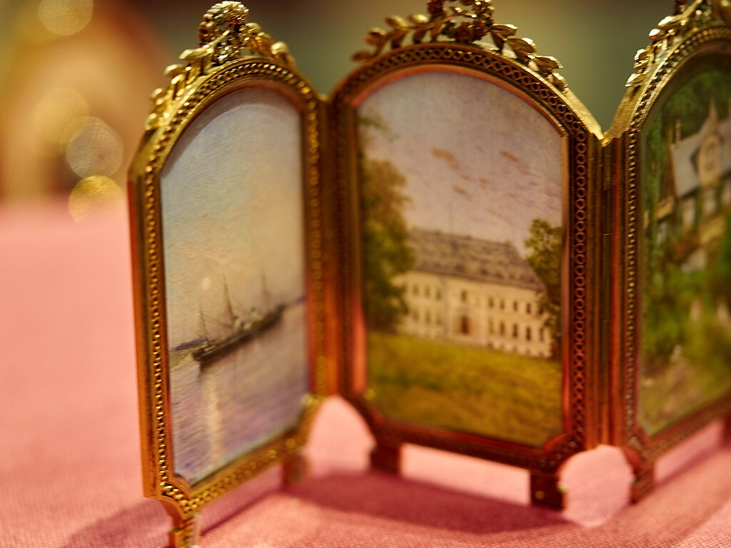

Slide 4
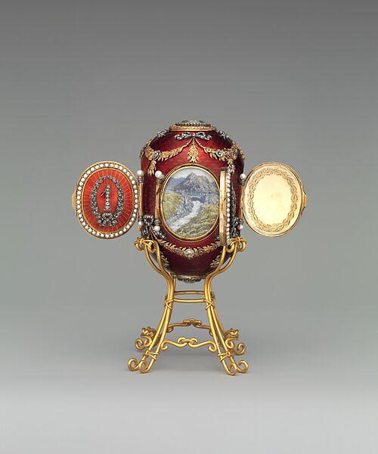
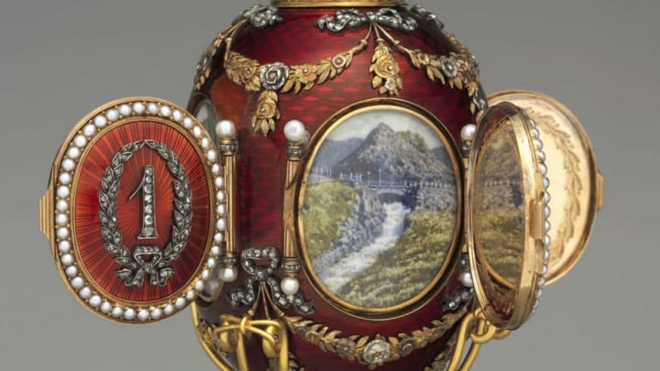
Maker: House of Carl Fabergé Maker: Workmaster: Mikhail Evlampievich Perkhin Artist: Miniatures by Konstantin Yakovlevich Krijitski
Imperial Caucasus Egg, 1893, Yellow and quatre-couleur gold, silver, platinum, guilloché enamel, rose- and table-cut diamond, pearl, crystal, ivory, watercolor, 9.2 x 7.3 cm

Slide 5
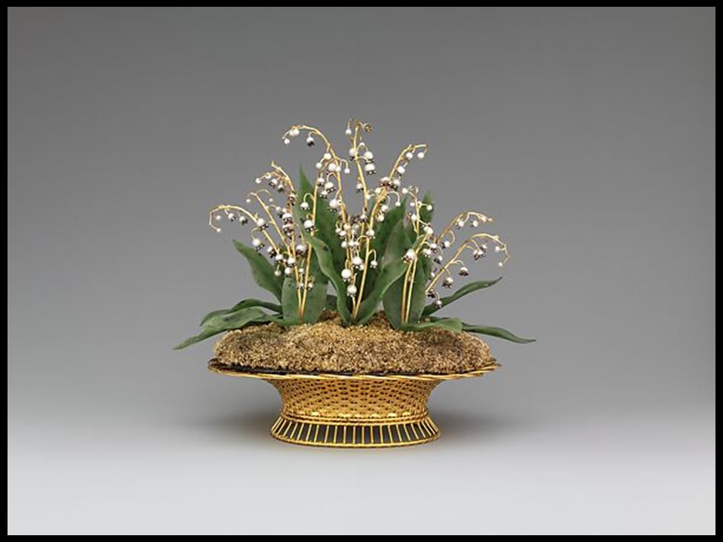
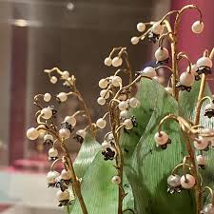
Maker: House of Carl Fabergé Workmaster: August Wilhelm Holmström
Imperial Lilies-of-the-Valley Basket, 1896, Yellow and green gold, silver, nephrite, pearl, rose-cut diamond, 19.1 x 21.6 x 14.9 cm

Slide 6
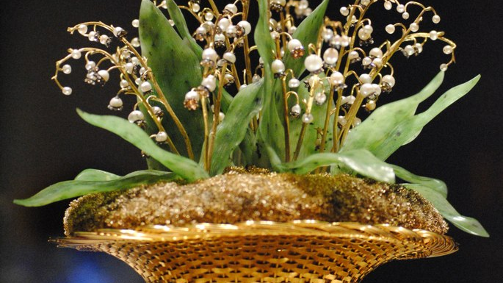

Slide 7
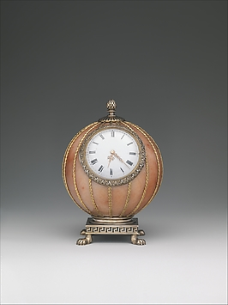
Maker: House of Carl Fabergé Workmaster: Mikhail Evlampievich Perkhin Spherical Clock, before 1899, Rose jasper, silver, silver gilt, gold, enamel, glass, Diam. 9.8 x 7 cm

Slide 8
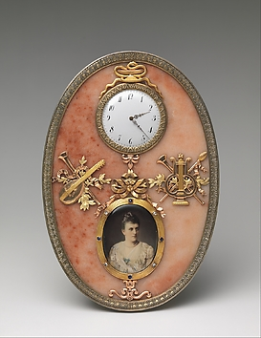
Maker: House of Carl Fabergé
Workmaster: Mikhail Evlampievich Perkhin
Artist: Painting by Johannes Zehngraf
Imperial Frame and Clock, before 1899, Rose jasper, silver gilt, trois-couleur gold, diamond, sapphire, ivory, oil paint, glass, 19.4 x 14 x 1.3 cm

Slide 9
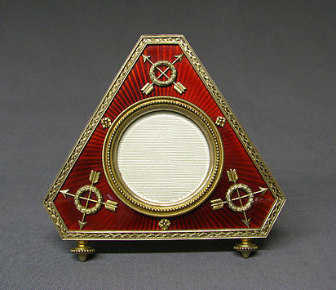
Maker: House of Carl Fabergé
Picture frame, before 1899, Silver-gilt, enamel, 13.8 x 14.3 cm

Slide 10
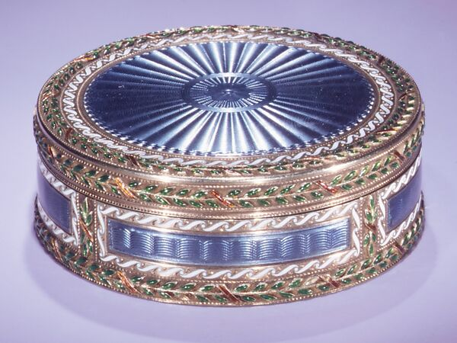
Maker: House of Carl Fabergé
Workmaster: Henrik Emanuel Wigström
Bonbonnière, 1896–1903, Gold, enamel, Diam. 5.2 cm

Slide 11
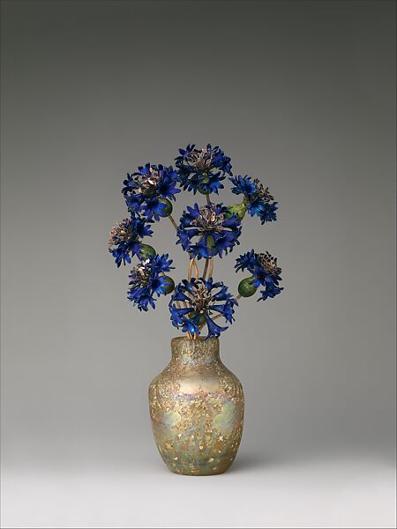
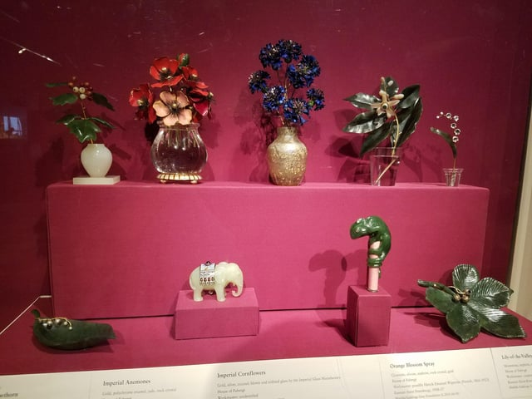
Maker: House of Carl Fabergé
Imperial Cornflowers, ca. 1900–1905, Gold, silver, enamel; blown and iridized glass, 21 x 9.8 x 5.7 cm
Fabergé items that belonged to the Romanov Family, 1870's-1900’s, the Metropolitan Museum of Art, New York

Slide 12
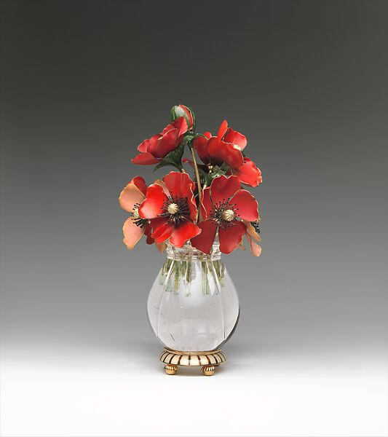
Maker: House of Carl Fabergé
Imperial Anemones, probably 1899–1908, Gold, polychrome enamel, jade, rock crystal, 12.7 x 12.7 x 10.2 cm

Slide 13
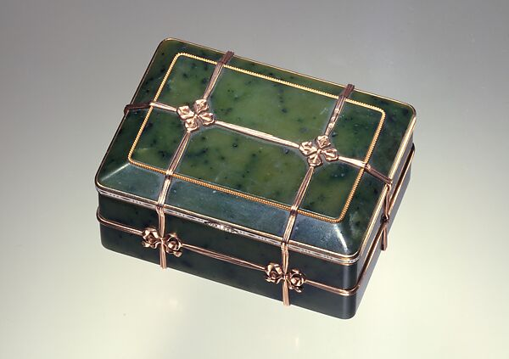
Factory: House of Carl Fabergé
Box in the form of a banded trunk, Date: 1899–1908, Nephrite, gold, ename, diamonds, 4.4 x 8.6 x 6.4 cm

Slide 14
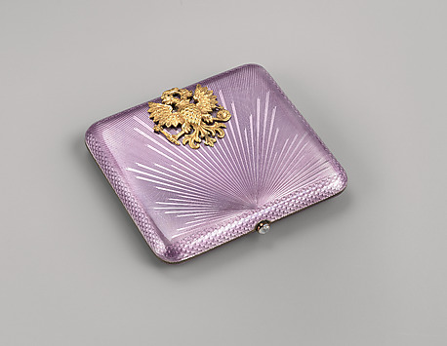
Maker: House of Carl Fabergé Workmaster: August Wilhelm Holmström (1829–1903)
Mauve Cigarette Case, 1899–1908, Silver gilt, gold, guilloché rayonnant enamel, cabochon moonstone, 1.3 x 8.9 x 7.9 cm

Slide 15
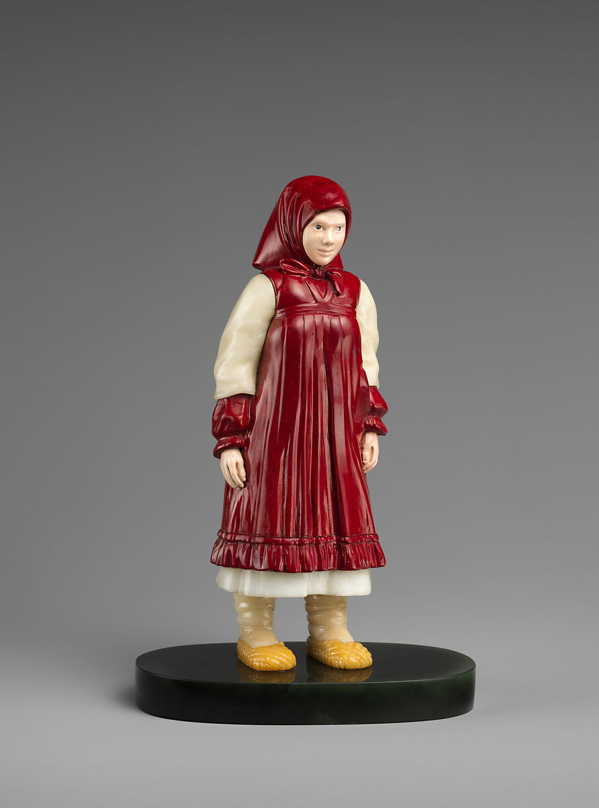
Artist: Peter Carl Fabergé, 1846–1920
Russian peasant girl, ca. 1910, Jasper, sapphire, purpurine, nephrite, jade, Height: 15.9 cm

Slide 16
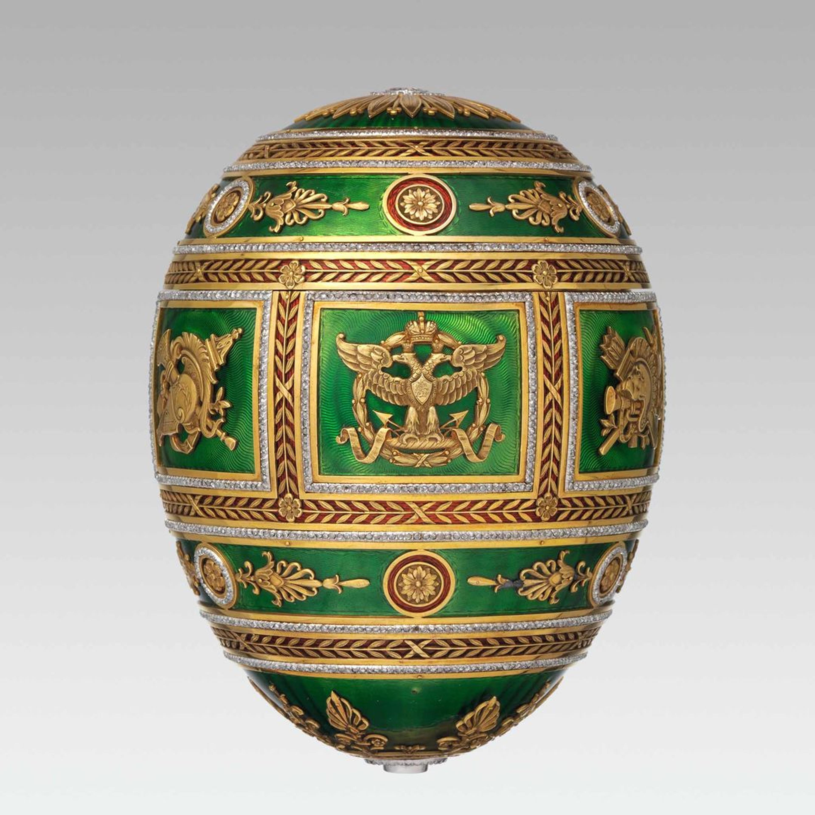
Maker: House of Carl Fabergé Maker: Workmaster: Henrik Emanuel Wigström
Artist: Miniatures by Vassily Ivanovich Zuiev
Imperial Napoleonic Egg, 1912, Gold, guilloché enamel, rose-cut diamond, platinum, gold, ivory, gouache, velvet, silk, 11.7 x 8.9 cm

Slide 17
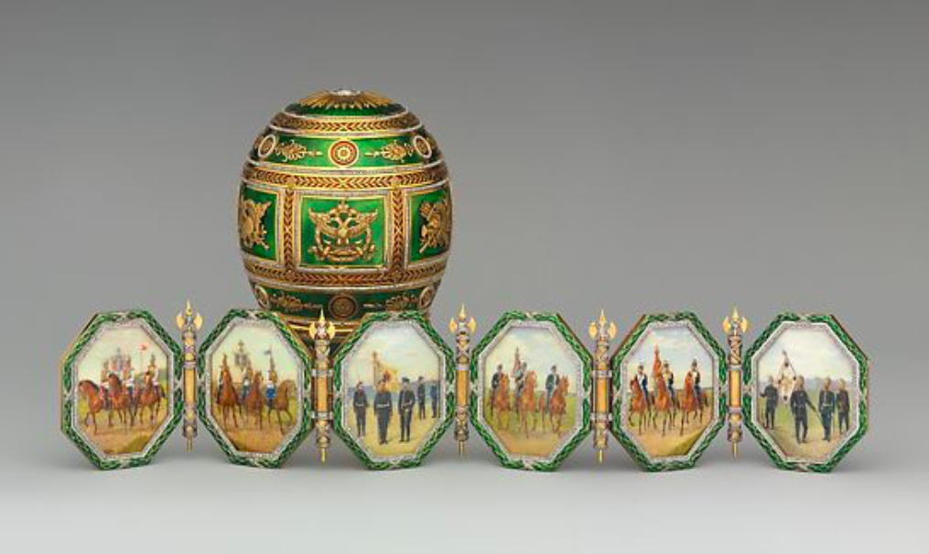

Slide 18
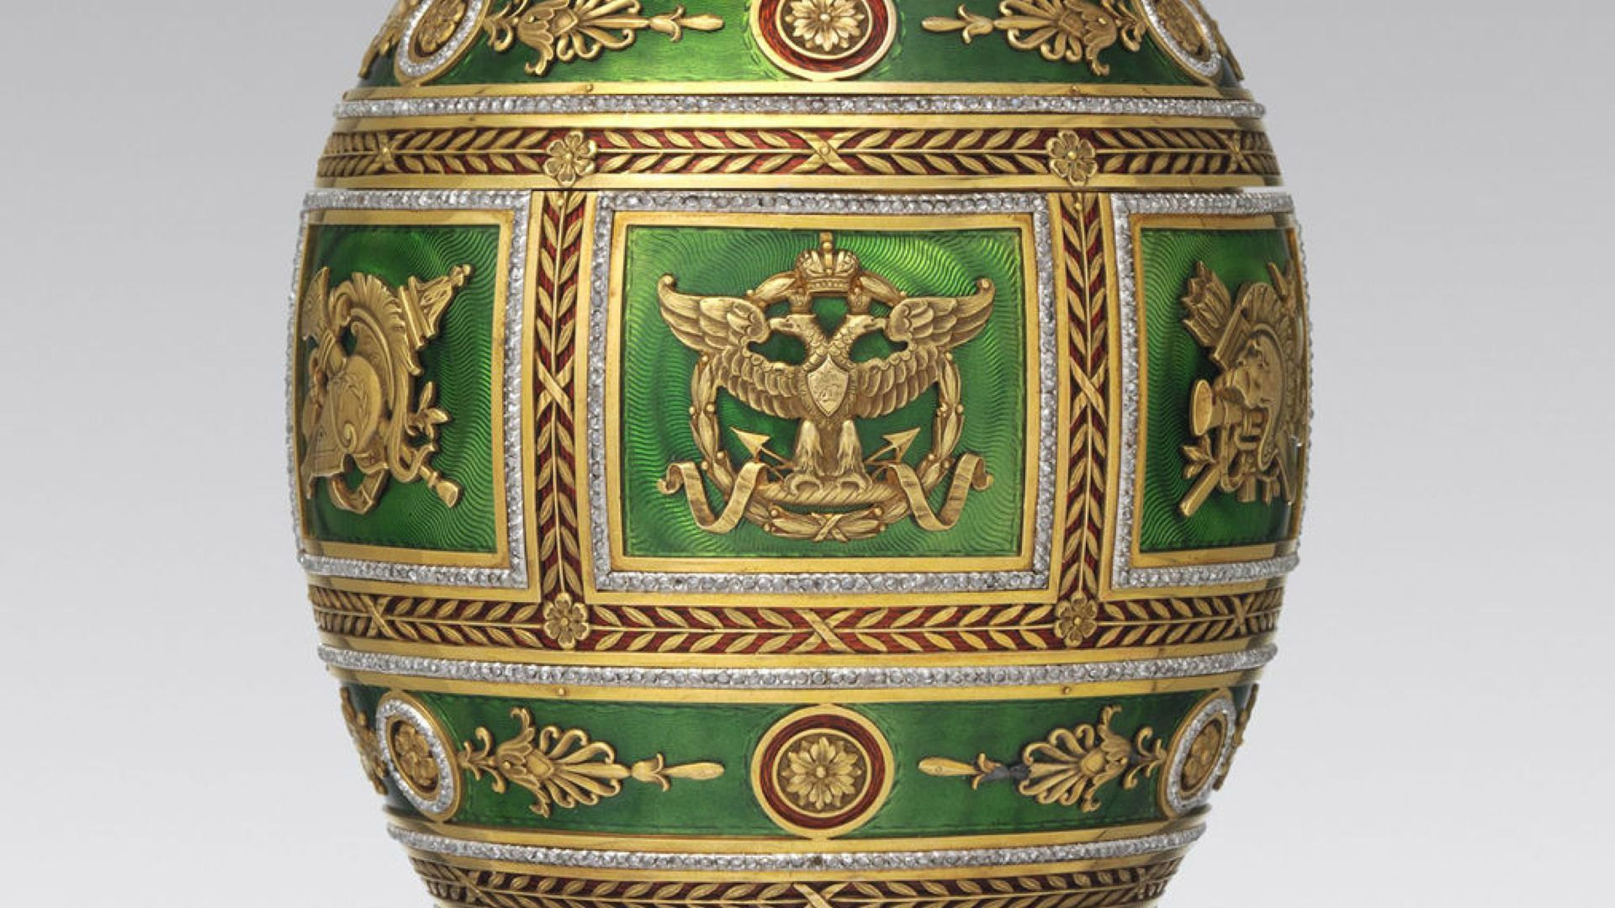

Slide 19
The MET, NY: https://www.metmuseum.org/art/collection/search?q=Peter+Carl+Faberg%C3%A9&sortBy=Relevance

