Slide 1
Gabriele Münter
1877–1962

Slide 2
Gabriele Münter
Princeton University
Art Museum
https://artmuseum.princeton.edu/search/collections?mainSearch=%22Gabriele+M%C3%BCnter%22

Slide 3
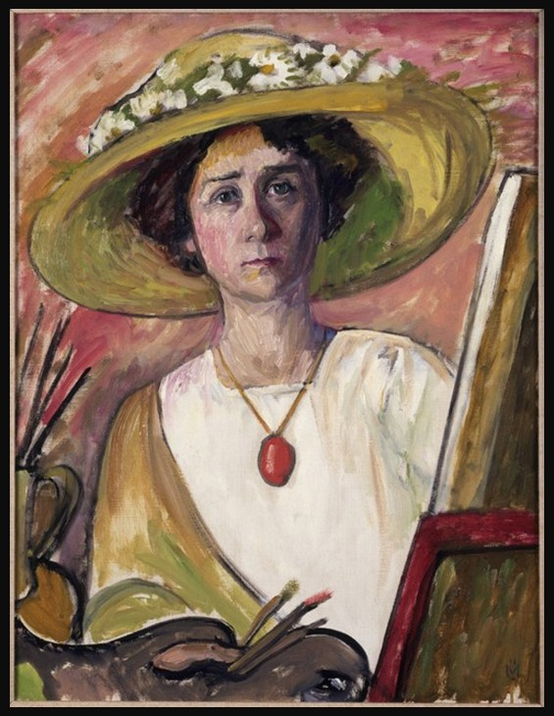
Self-Portrait in front of an easel, ca. 1908–09, Oil on canvas, 78 × 60.5 cm

Slide 4
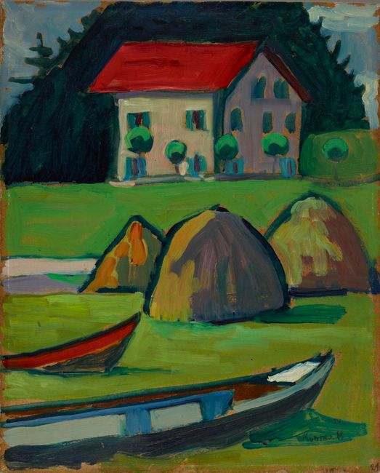
Fisherman's House (Fischerhaus), 1908, Oil on board, 39.4 × 31.1 cm

Slide 5
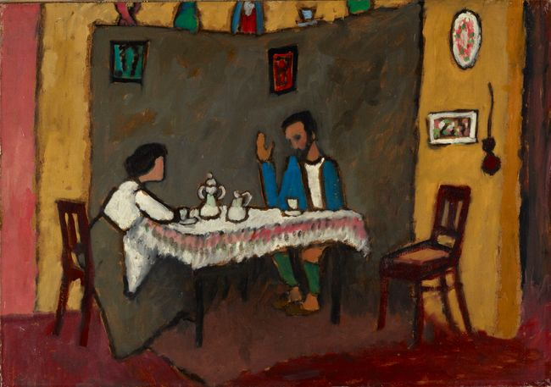
Kandinsky and Erma Bossi, 1910, Oil on board, 48.9 × 70.5 cm

Slide 6
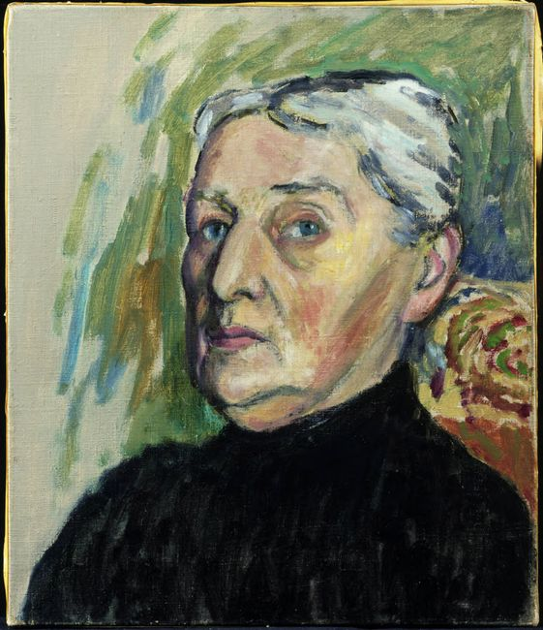
Mother of Kandinsky, 1913, Oil on canvas, 45.2 x 38 cm

Slide 7
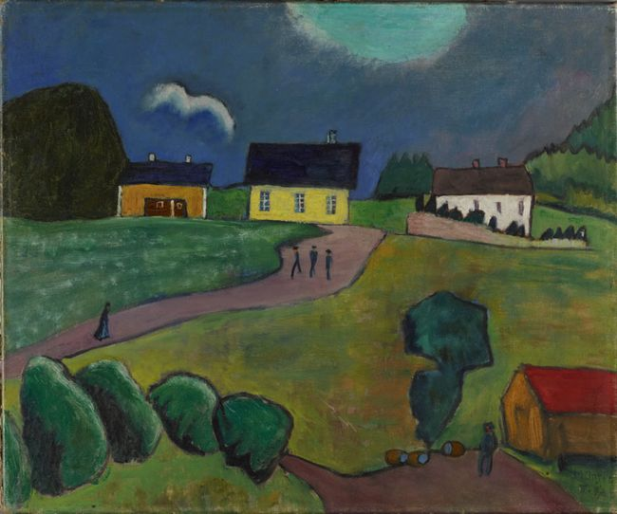
From Norway (Tjellebotten), 1917, Oil on canvas, 52.1 x 62.9 cm

Slide 8
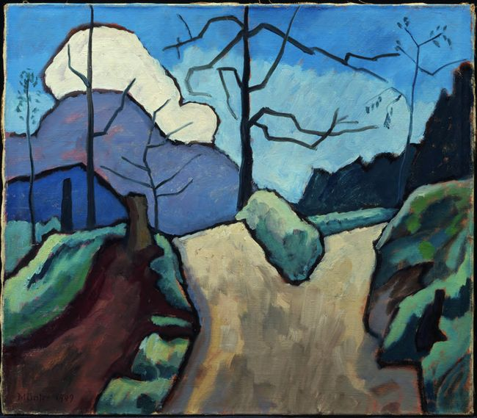
Kahl (Barren Landscape), 1949, Oil on canvas, 49 x 56.5 cm

Slide 9
Gabriele Münter
National Museum
of Women in the Arts
https://nmwa.org/art/artists/gabriele-munter/

Slide 10
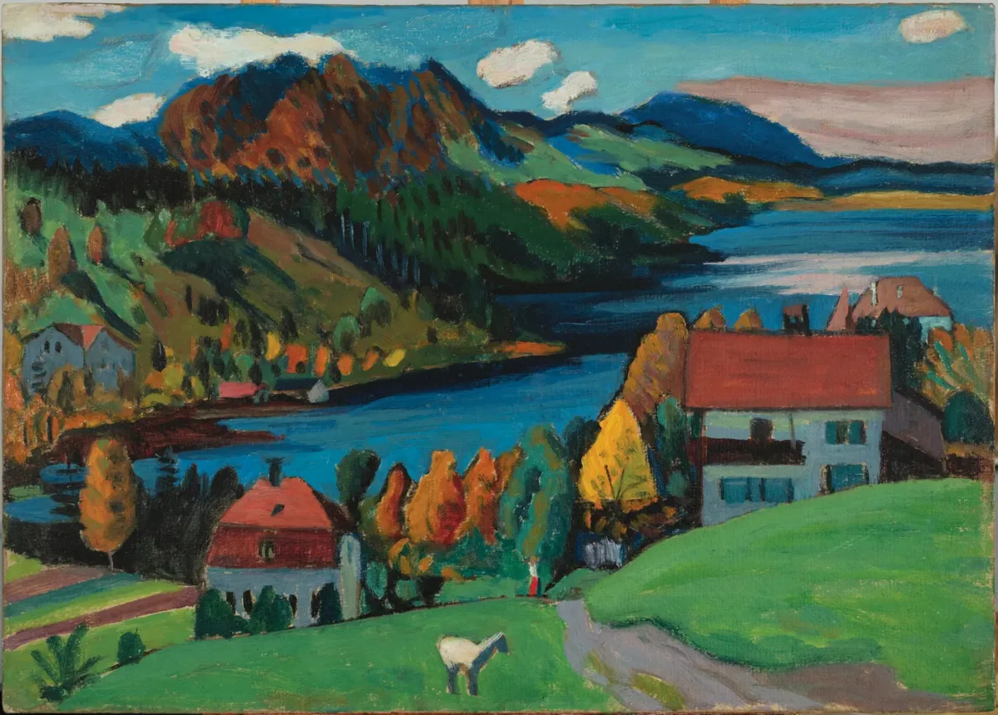
Staffelsee in Autumn, 1923, Oil on board,
84 x 48 cm

Slide 11
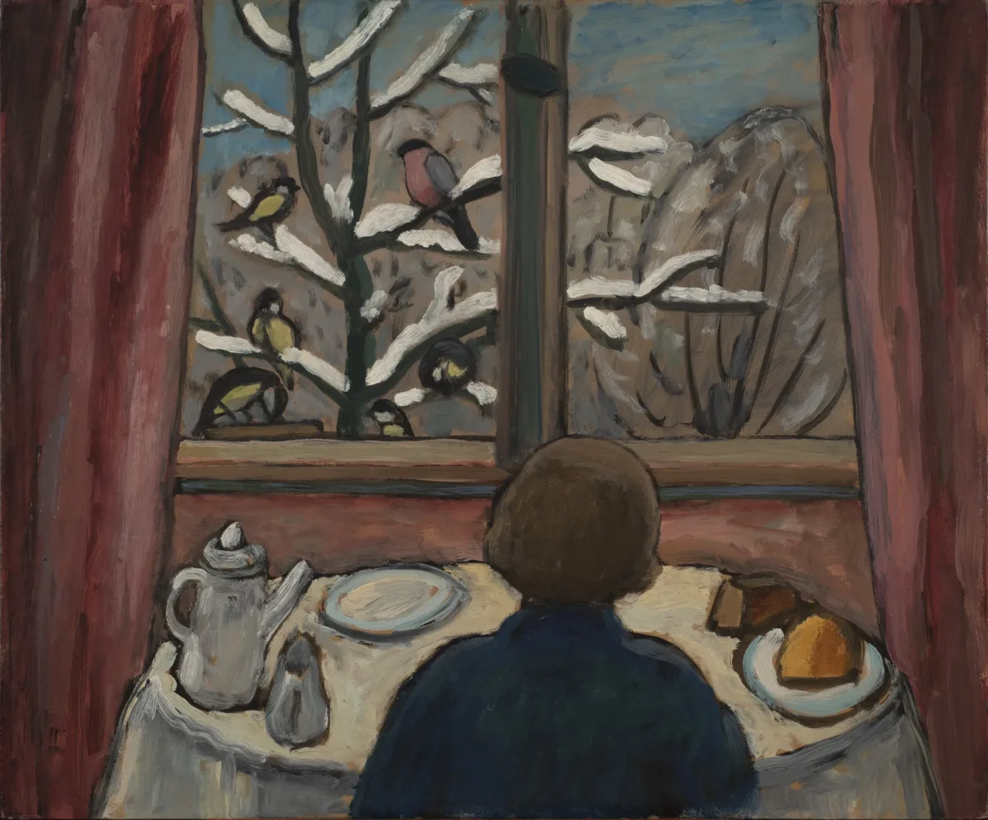
Breakfast of the Birds, 1934, Oil on board,
45.82 x 53.34

Slide 12
Gabriele Münter
Carmen Thyssen Collection
https://www.museothyssen.org/en/collection/artists/munter-gabriele

Slide 13
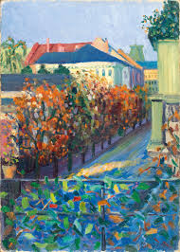
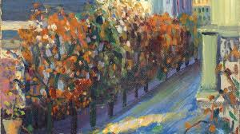
View from her Brother´s House in Bonn, 1908, Oil on cardboard. 47.2 x 33.6 cm

Slide 14
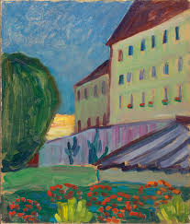
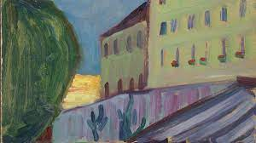
School House, Murnau, 1908, Oil on cardboard. 40.6 x 32.7 cm

Slide 15
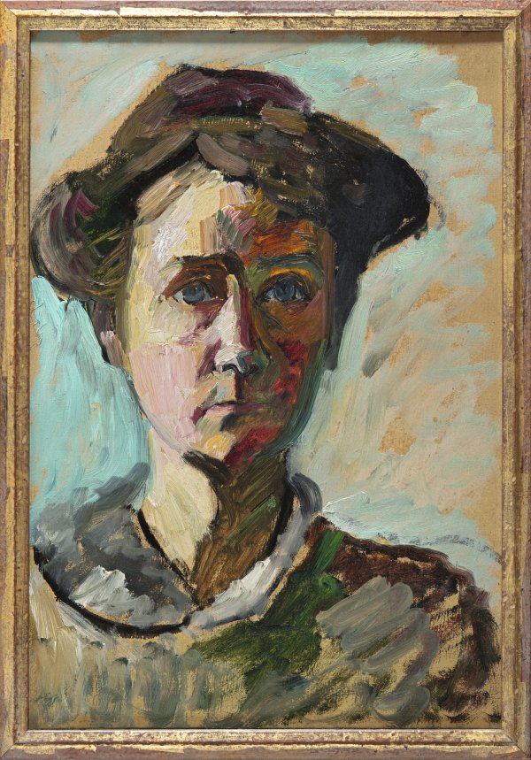
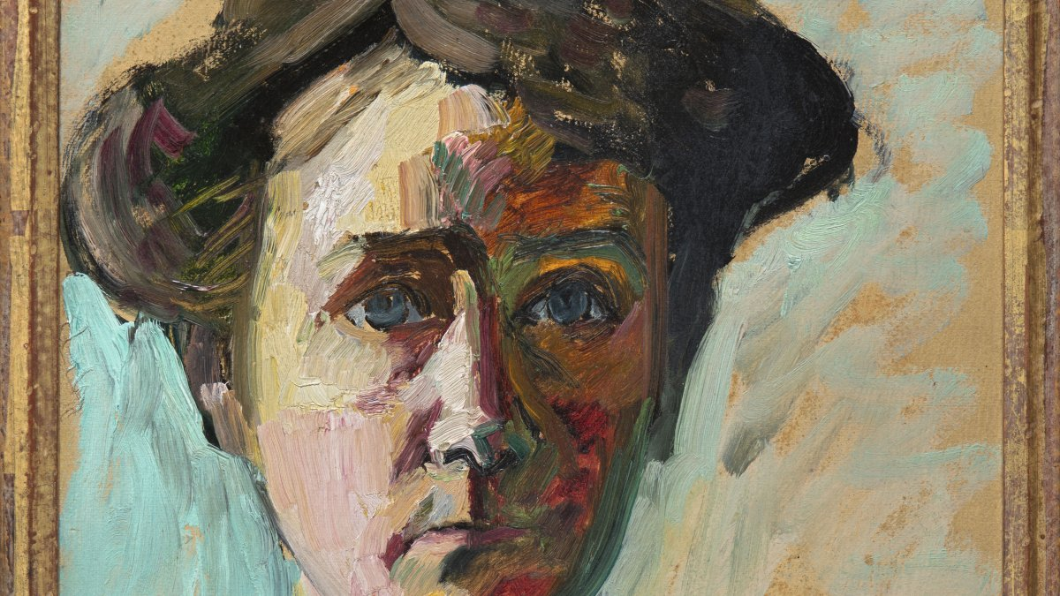
Self-portrait, ca. 1909-1910, Oil on cardboard, 49 x 33.6 cm

Slide 16
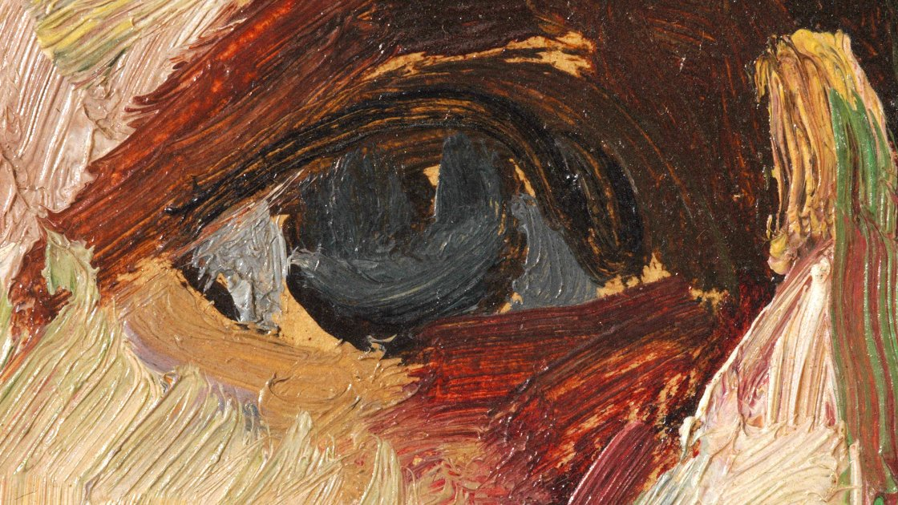
https://nmwa.org/art/artists/gabriele-munter/

Slide 17
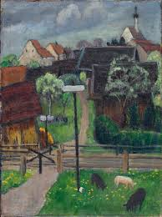
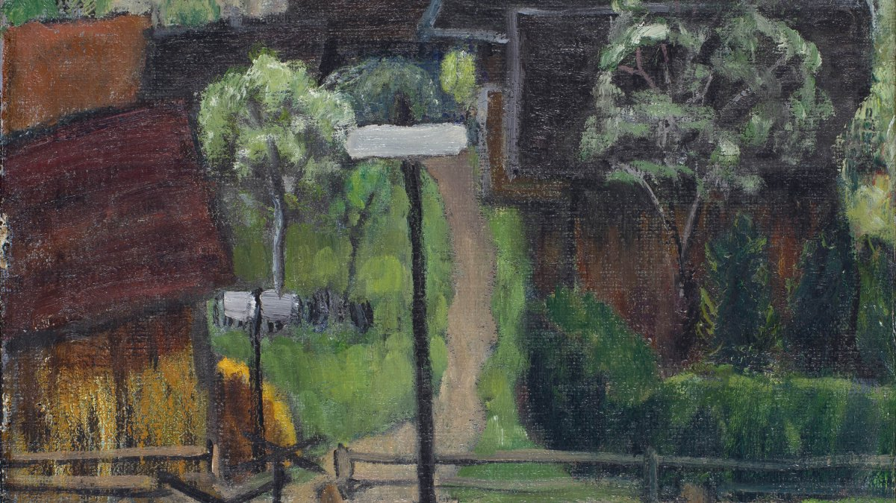
Murnau (Murnau on May), 1924, Oil on canvas,
51 x 38 cm

Slide 18
The End

