Slide 1
13th - 14th century Italian Renaissance Art
Pietro Lornzetti
ca. 1280-1348

Slide 2
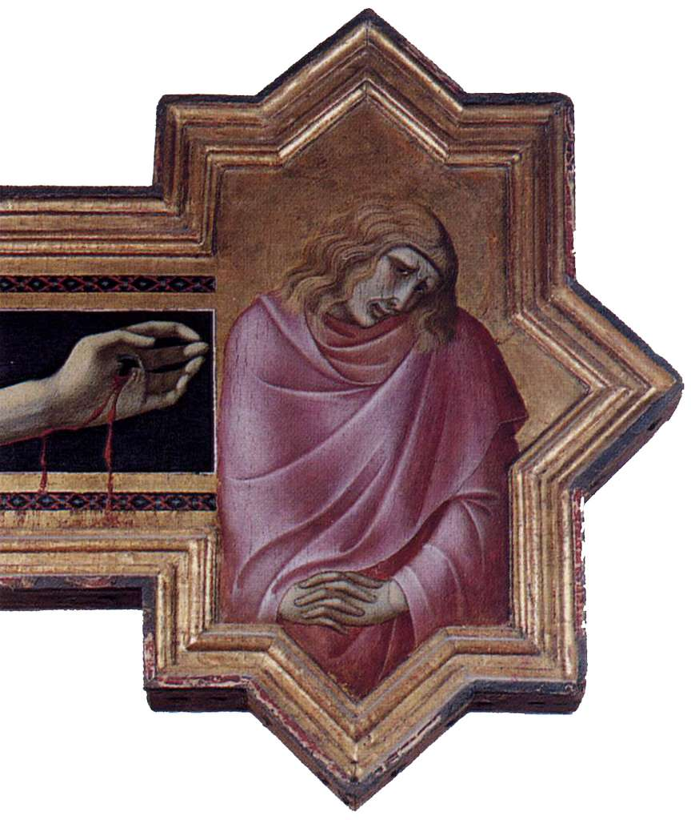
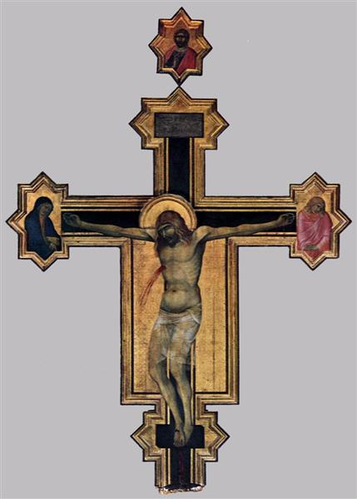
Crucifix, circa 1320, Tempera on Wood, 380x 274 cm, Diocesan Museum, Cortona, Italy https://www.wikiart.org/en/pietro-lorenzetti/crucifix

Slide 3
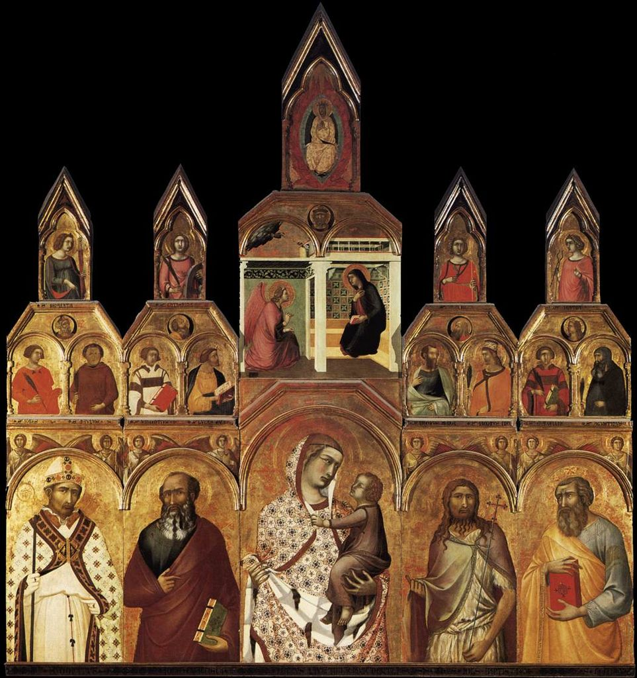
Tarlaty Polyptych, 1320, Tempera on Wood, 298x309 mm, Santa Maria della Pieve, Arezzo, Italy https://el.m.wikipedia.org/wiki/%CE%91%CF%81%CF%87%CE%B5%CE%AF%CE%BF:Tarlati-polyptych-Pietro_Lorenzetti_Pieve_di_santa_Maria_Arezzo.jpg#/media/File%3APietro_Lorenzetti_-_Polyptych_-_WGA13536.jpg

Slide 4
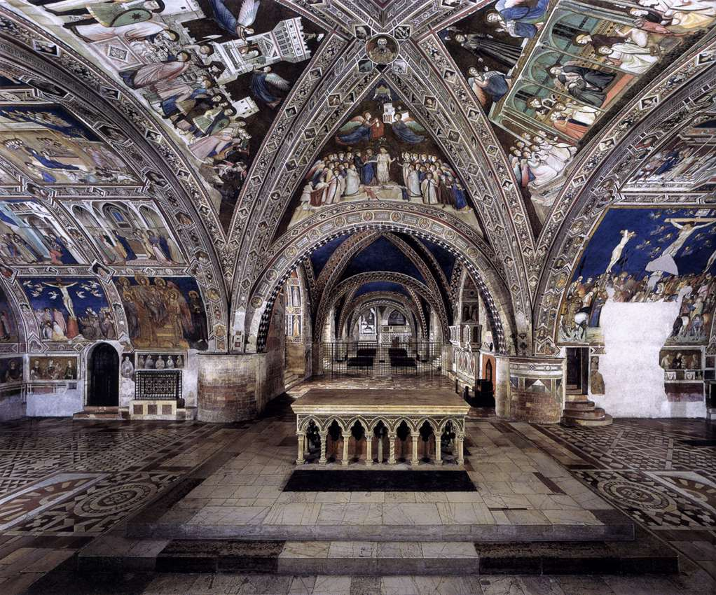
Pietro Lornzetti, ca. 1280-1348
Panoramic view of the frescoes, 1320-40, Fresco, Lower Church, San Francesco, Assisi, Italy https://www.wga.hu/frames-e.html?/html/l/lorenzet/pietro/index.html

Slide 5
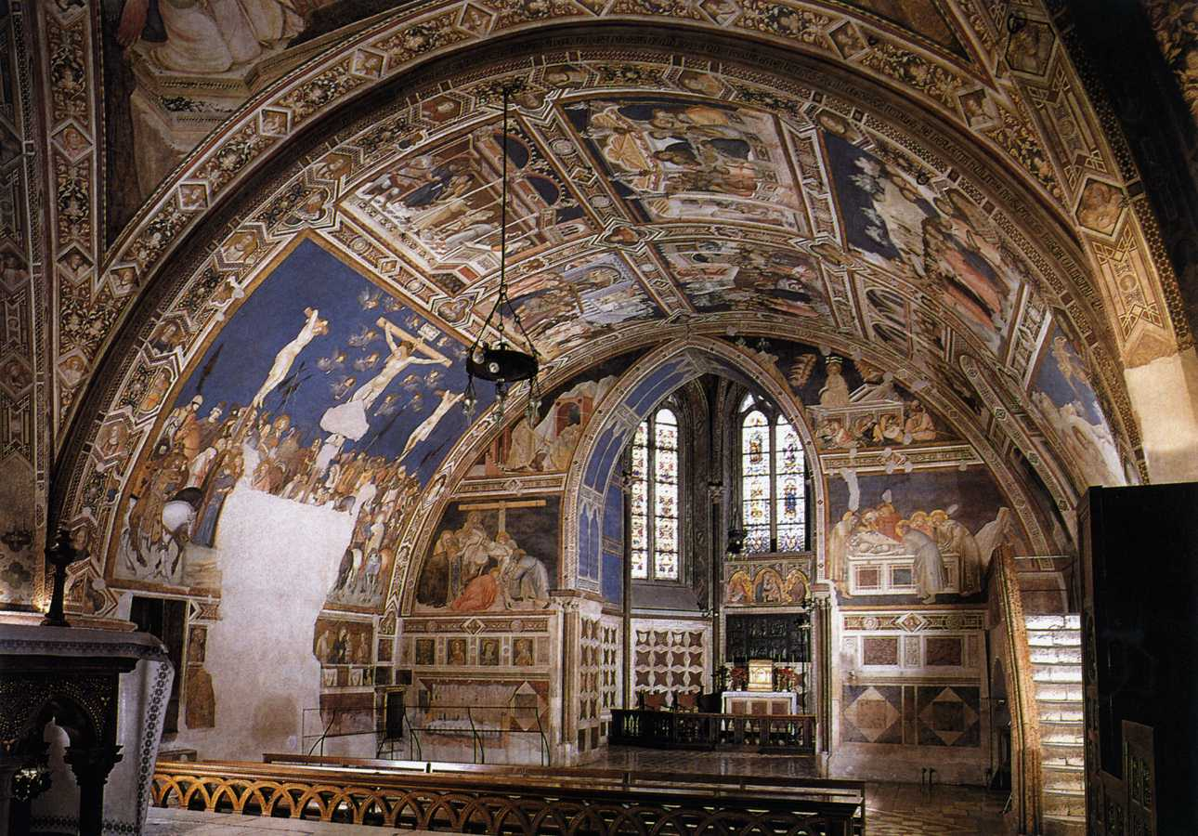
View of the south arm of the western transept, c. 1320, Fresco, Lower Church, Left Transept, San Francesco, Assisi, Italy

Slide 6
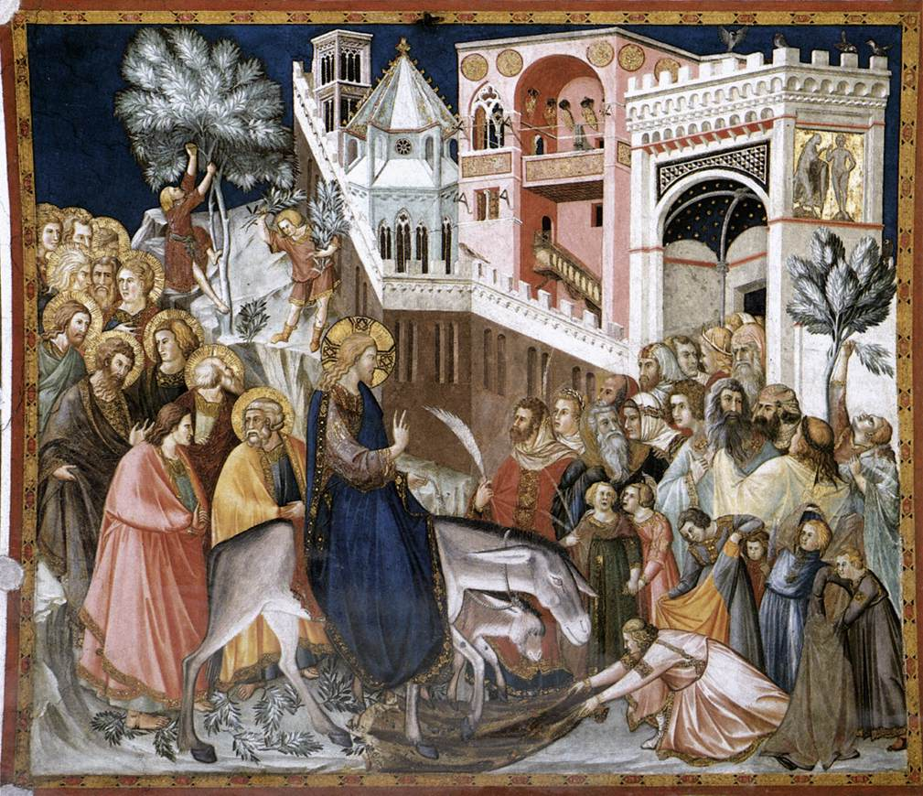
Entry of Christ into Jerusalem, c. 1320, Fresco, Left Transept,
Lower Church, San Francesco, Assisi, Italy https://arsartisticadventureofmankind.wordpress.com/tag/basilica-of-saint-francis-of-assisi/

Slide 7
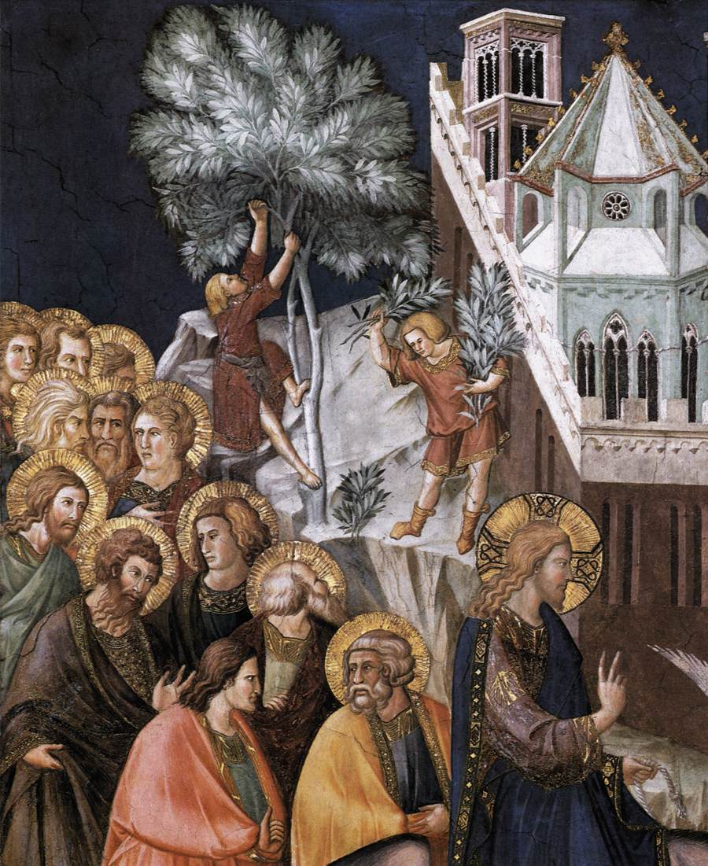
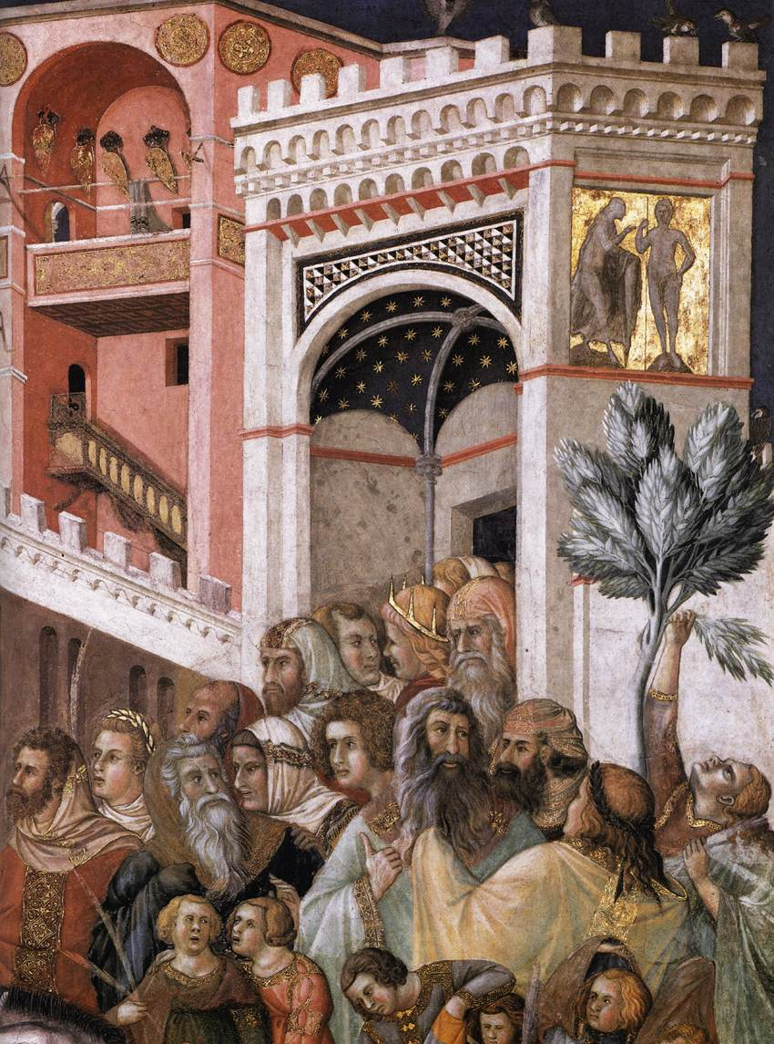

Slide 8
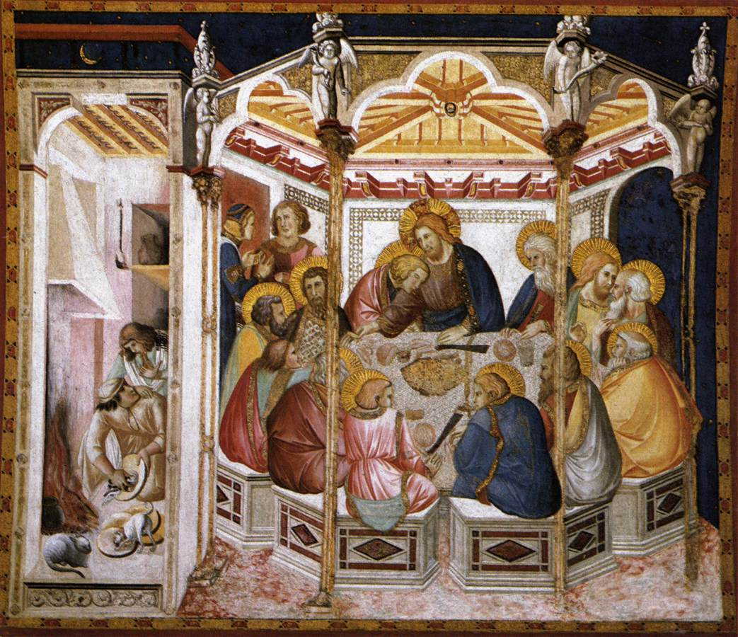
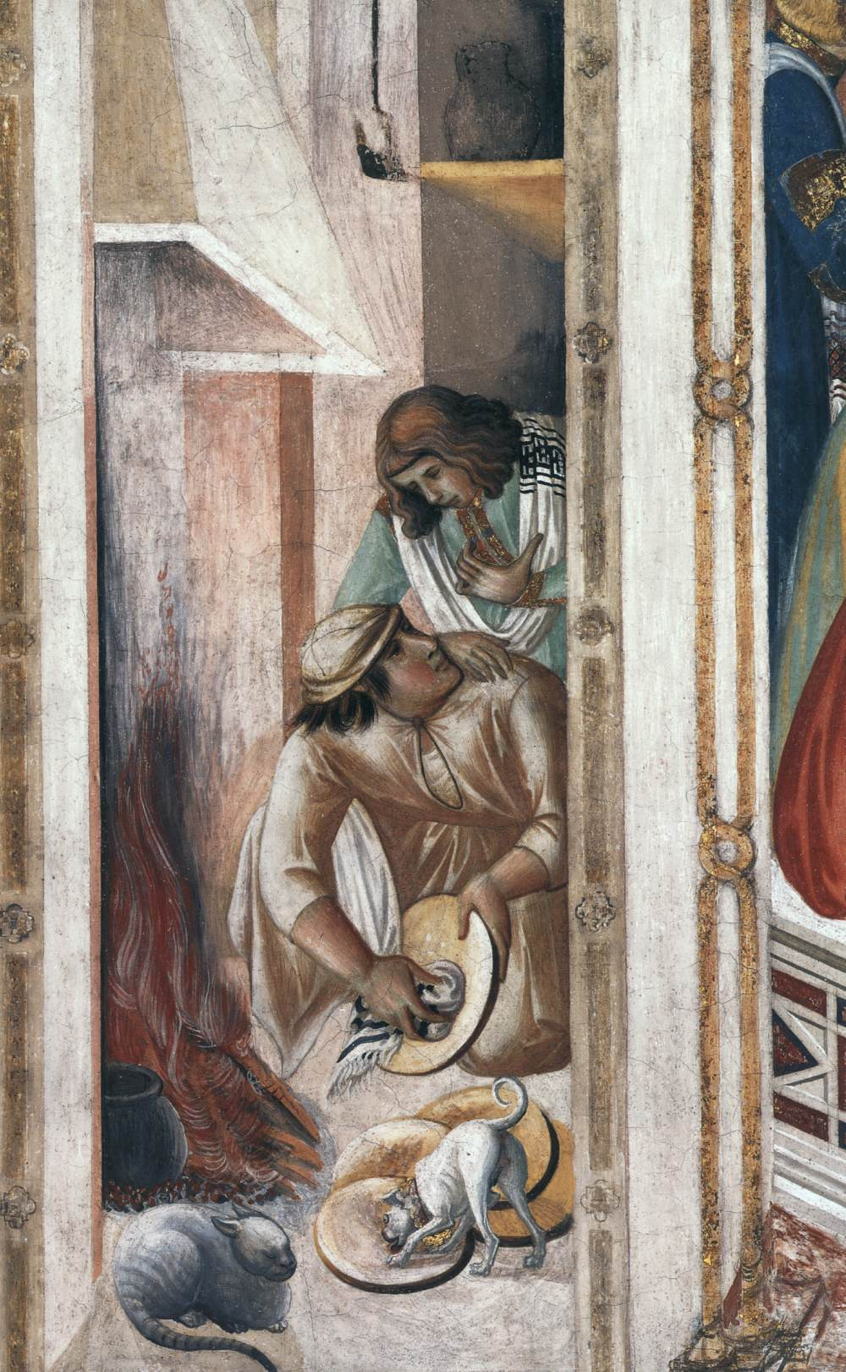

Slide 9
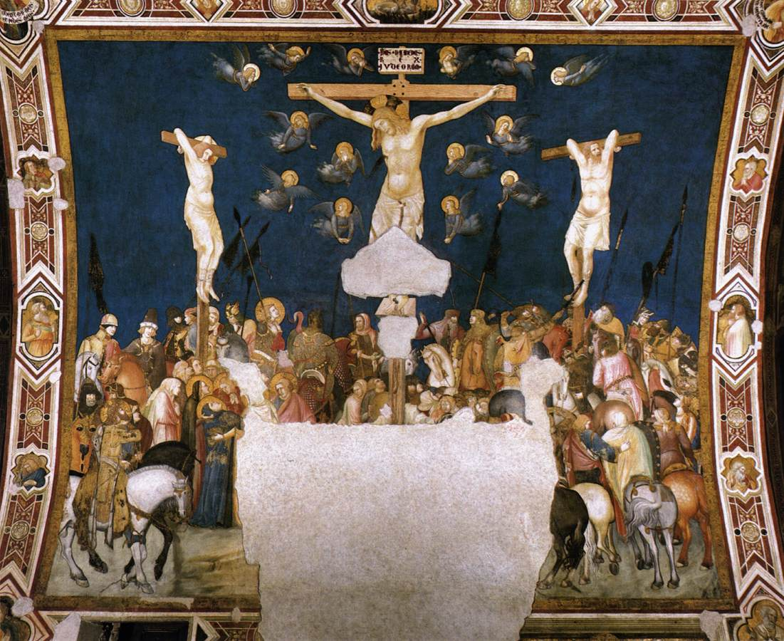
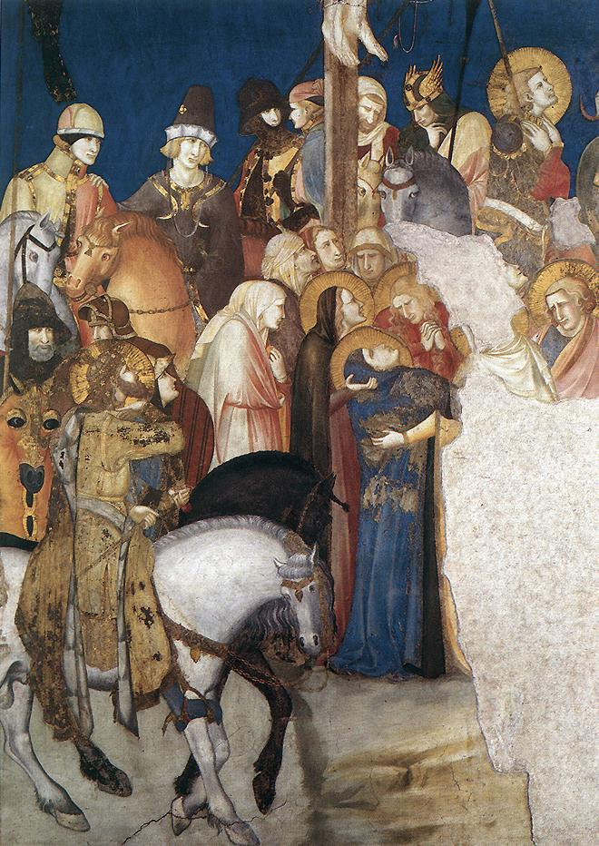
The Crucifixion, c. 1320, Fresco, Lower Church, Left Transept,
San Francesco, Assisi, Italy https://arsartisticadventureofmankind.wordpress.com/tag/basilica-of-saint-francis-of-assisi/

Slide 10
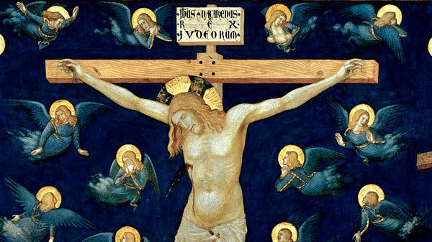

Slide 11
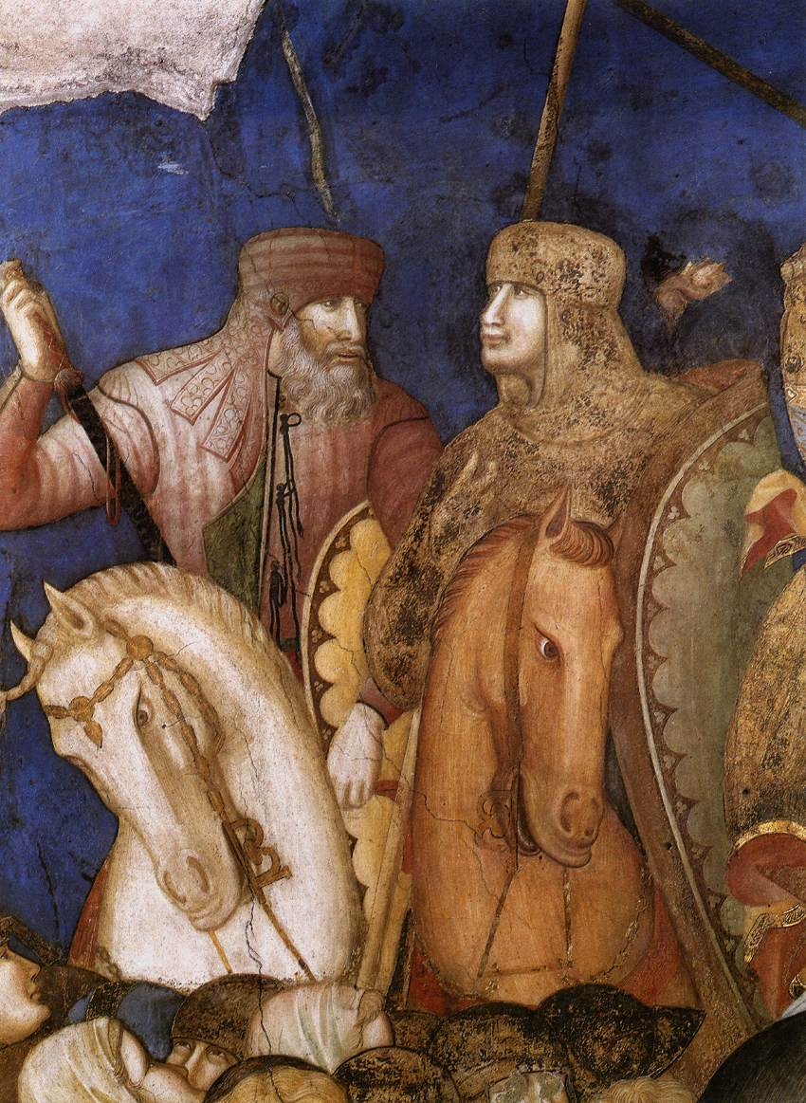
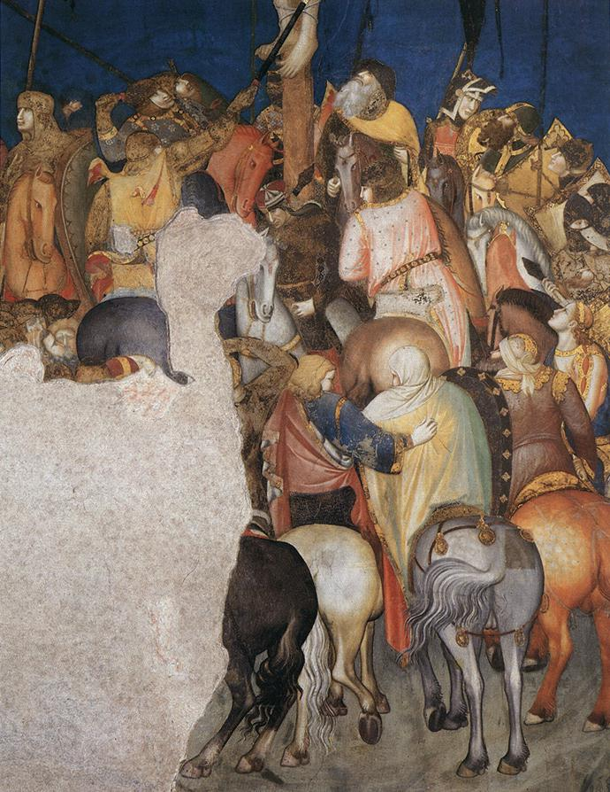

Slide 12
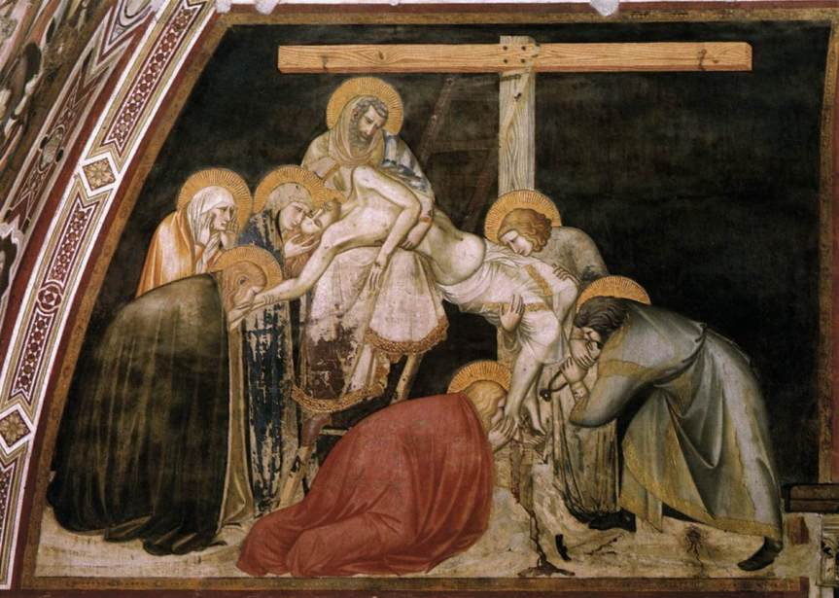
Deposition, c. 1320, Fresco
Lower Church, Left Transept,
San Francesco, Assisi, Italy https://arsartisticadventureofmankind.wordpress.com/tag/basilica-of-saint-francis-of-assisi/

Slide 13
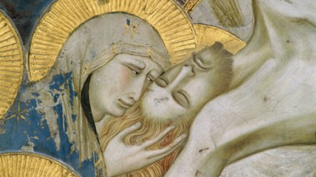

Slide 14
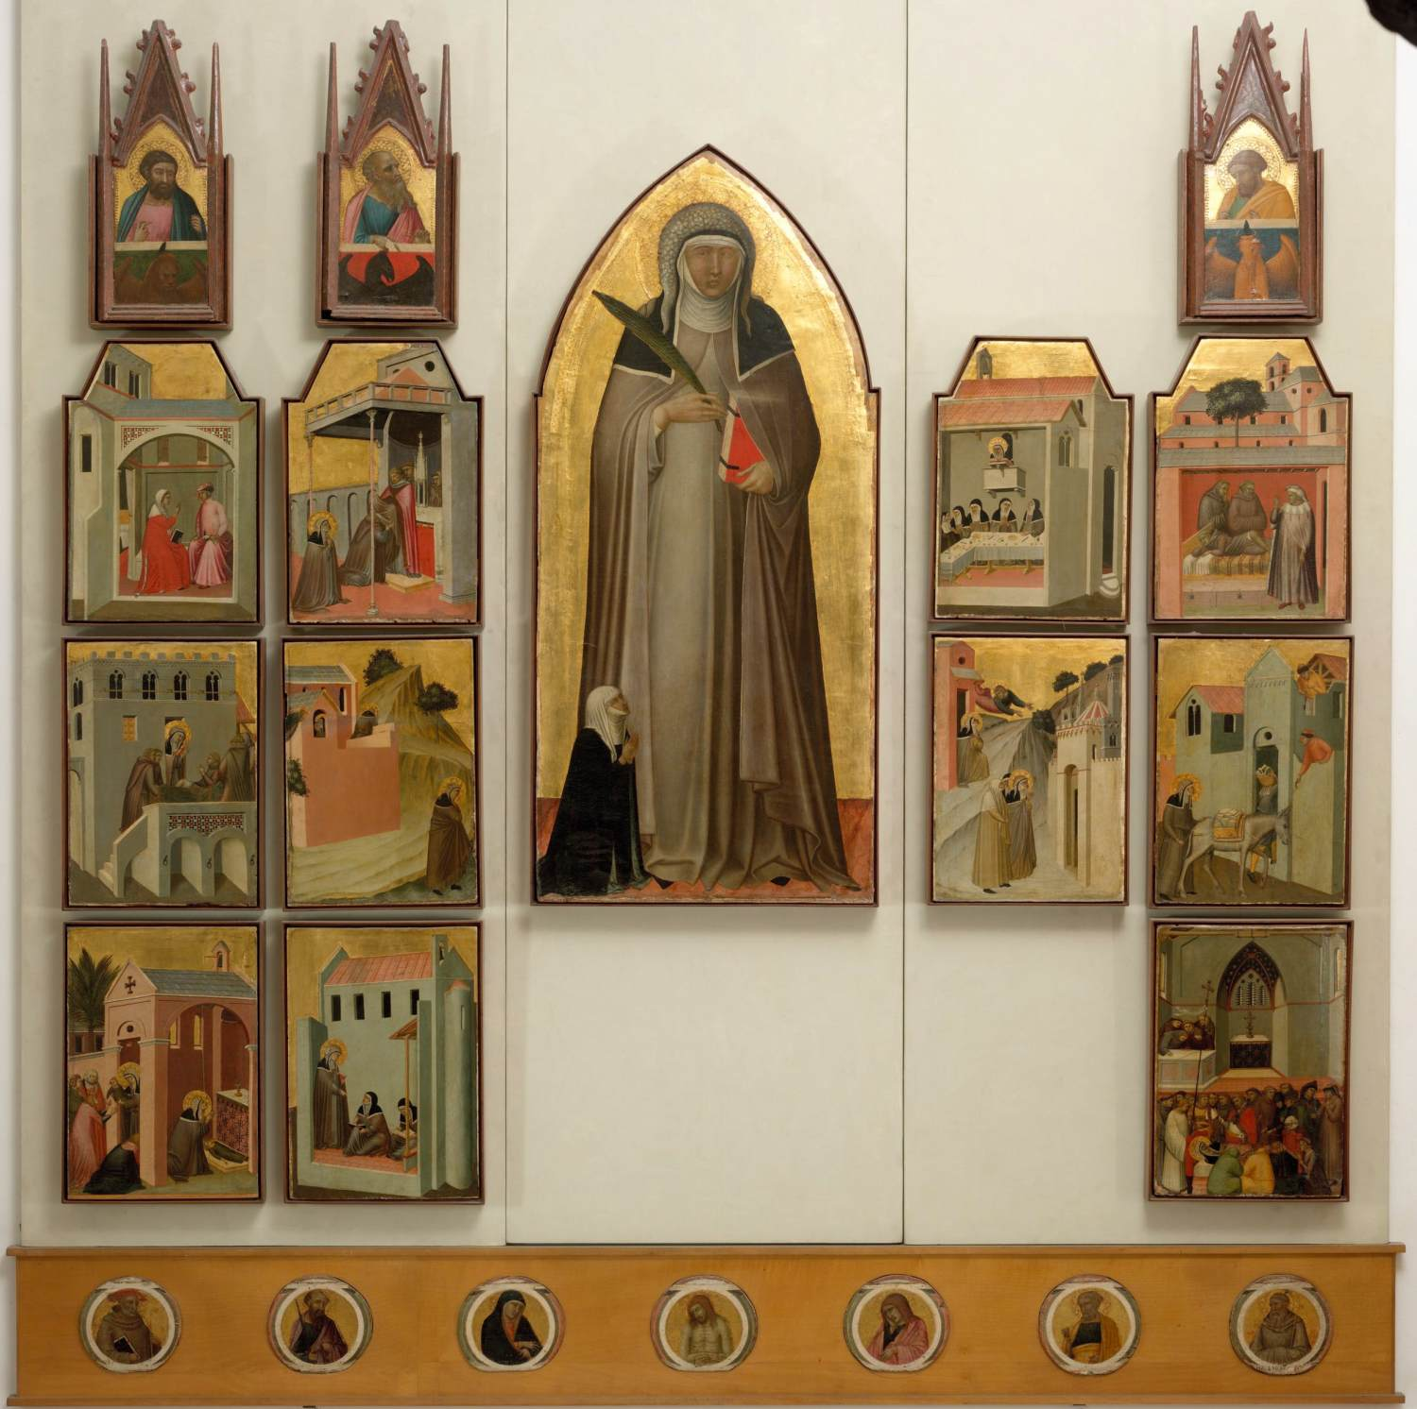
Pietro Lornzetti, ca. 1280-1348
St Humility and Scenes from her Life, 1335-40, Tempera on wood, gold background, 257 x 168 cm, Galleria degli Uffizi, Florence, Italy https://www.wga.hu/frames-e.html?/html/l/lorenzet/pietro/index.html

Slide 15
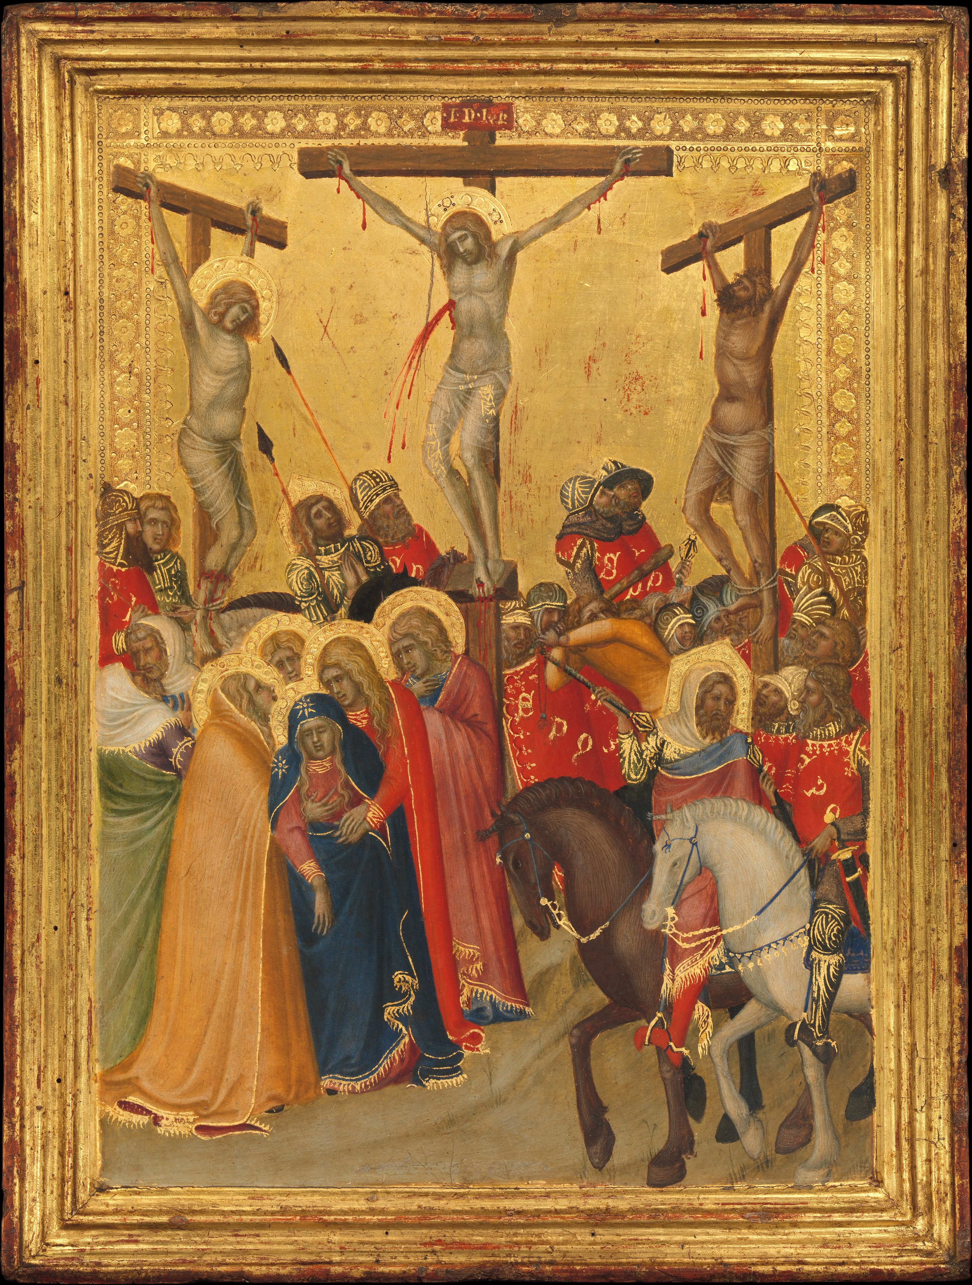
The Crucifixion, 1340s, Tempera on Wood, 41.9 x 31.8 cm, the MET, NY, USA https://www.metmuseum.org/art/collection/search/438605

Slide 16
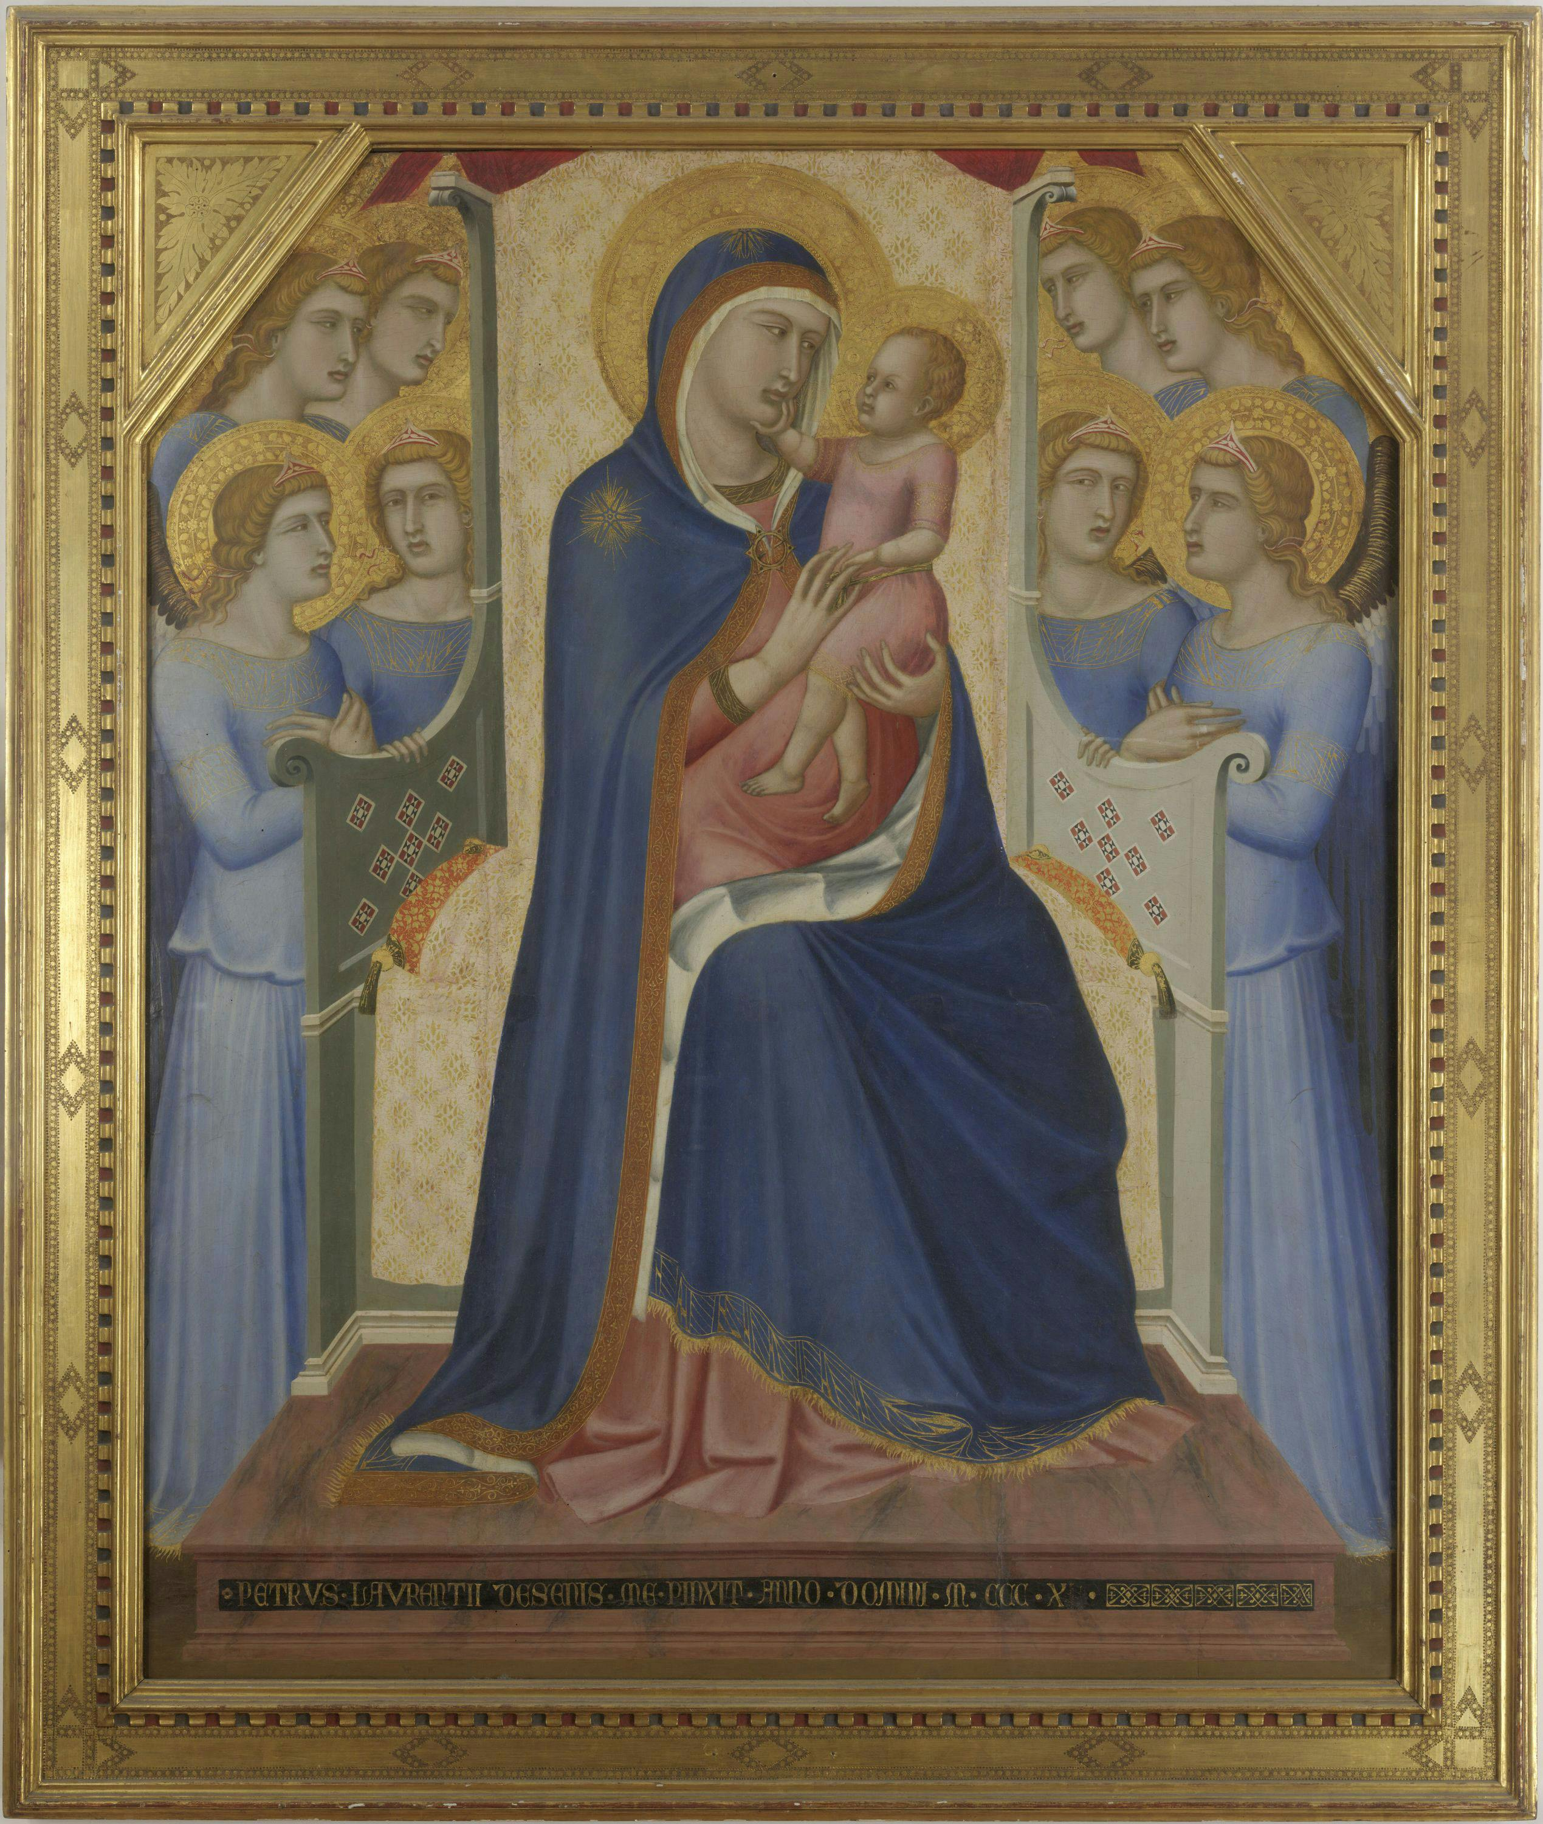
Madonna and Child Enthroned with Angels, 1340, Tempera on Panel, 1220 x 1450 mm, Uffizi Gallery, Florence, Italy https://www.uffizi.it/en/artworks/lorenzetti-madonna-majesty

Slide 17
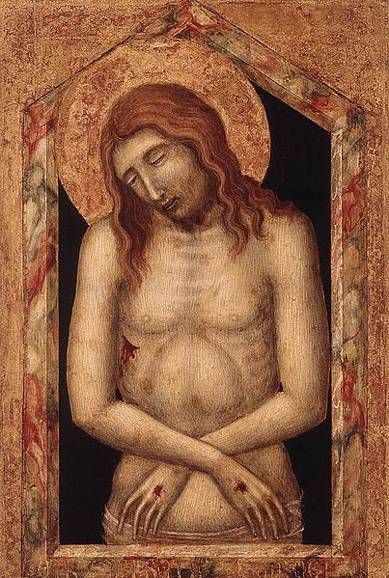
Man of Sorrow, between 1340 and 1345, Tempera on Wood, 29x20 cm, Lindenau-Museum, Altenburg, Thuringia, Germany https://commons.wikimedia.org/wiki/File:Pietro_Lorenzetti_-_Man_of_Sorrow_-_WGA13546.jpg

Slide 18
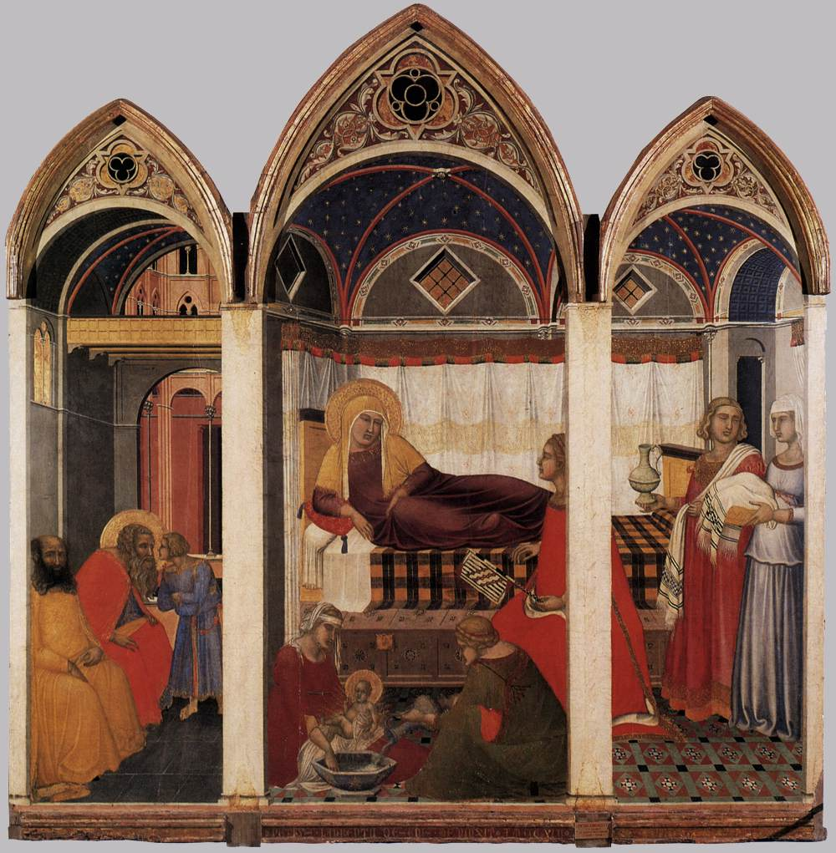
Pietro Lornzetti, ca. 1280-1348
Ambrogio Lorenzetti, ca. 1290-1348
The Birth of Mary, 1342, Tempera on wood, Museo dell'Opera del Duomo, Siena

Slide 19
The End

