Slide 1
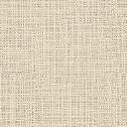
The Tomb of Philosophers, c. 300 BC, Pella, Greece
Texts: https://www.mdpi.com/2571-9408/6/8/296
Photo Credit: Christos Simatos © Ephorate of Antiquities of Pella, Ministry of Culture and Sports https://www.mdpi.com/2571-9408/6/8/296

Slide 2
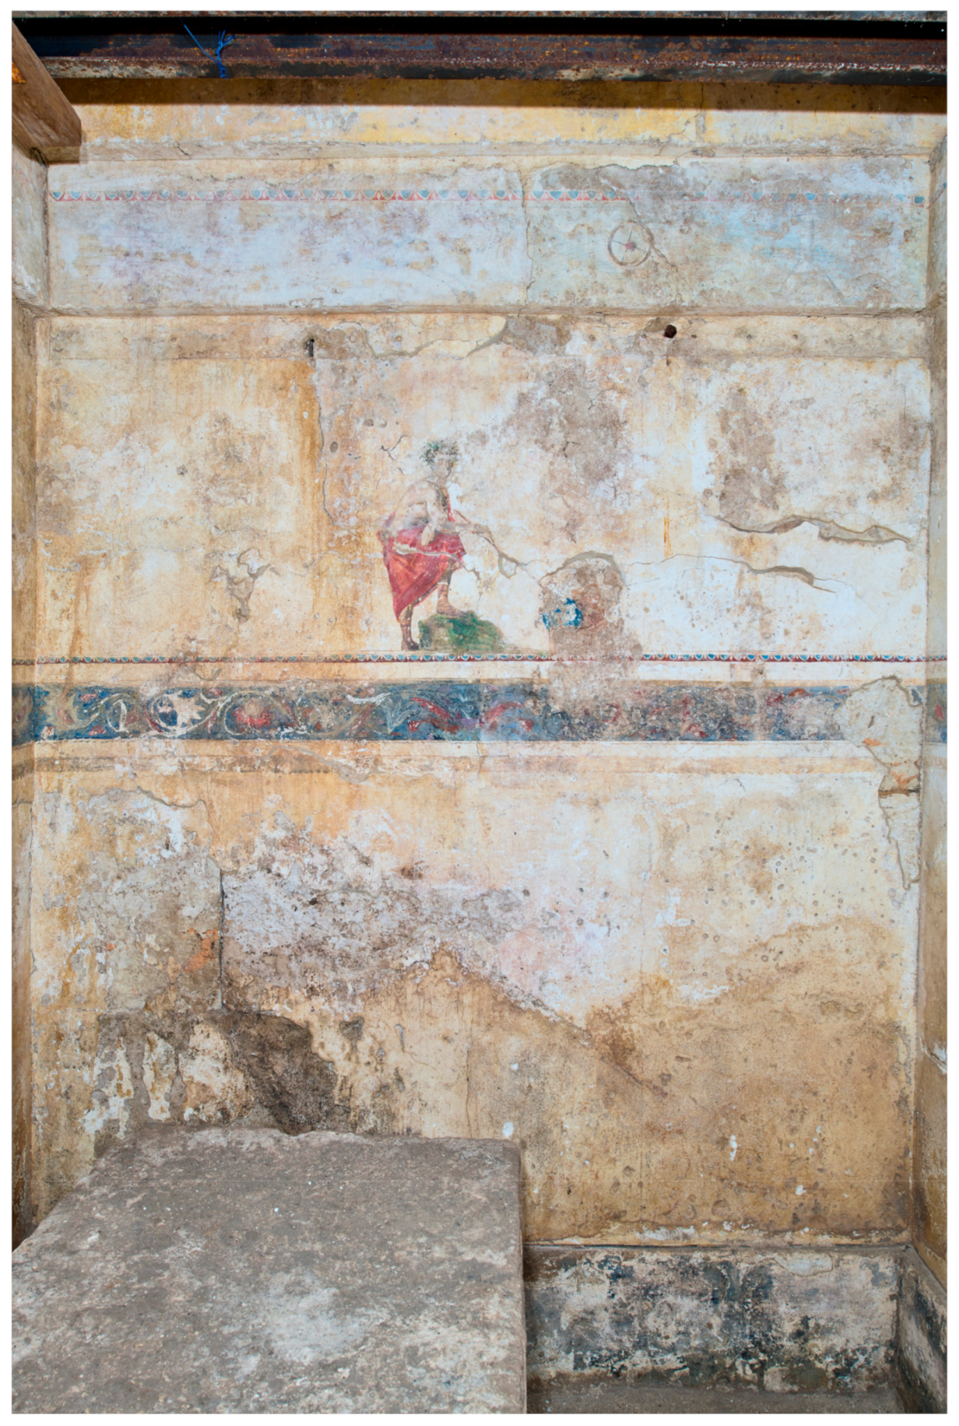
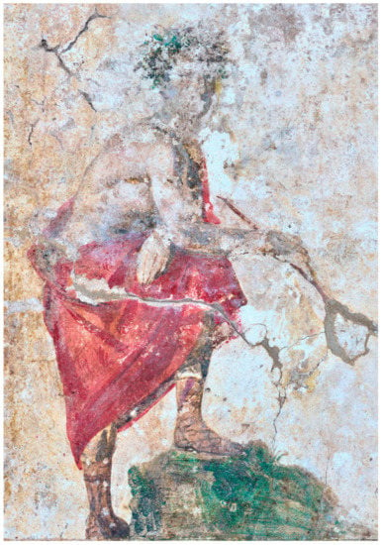
West wall, main figural frieze showing a man in red himation with wooden rod pointing at a blue globe.
A young man stands alone against the unpainted plaster. With short brown hair, he wears a bright red himation, leather sandals (krepides) and a wreath with green leaves. With his left leg leaning on a mossy green rock, the man points with a wooden rod at a blue globe in a box. This figure has been identified as an ‘astronomer’ .

Slide 3
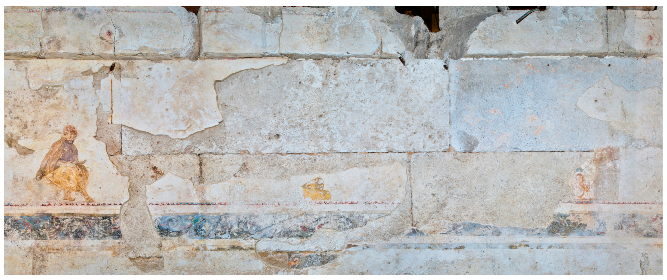
North wall, main figural frieze with man sitting on a rock (west side), yellow papyri in the center, and remains of a second figure (east side), floral frieze and frieze with horse race.
A bearded man, absorbed in reading a papyrus roll, sits on a rock on the west side of the north wall. With short hair, he wears a chiton, a himation and a wreath. Two rolled papyri are represented to the east of the man. One more figure of a wreathed man was shown seated in the partially collapsed area, dressed in a chiton, himation and krepides.

Slide 4
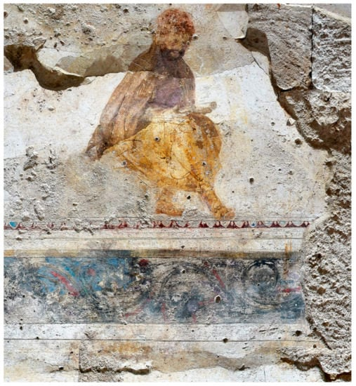
North wall, main figural frieze: man sitting on a rock (west side) in raking light.

Slide 5
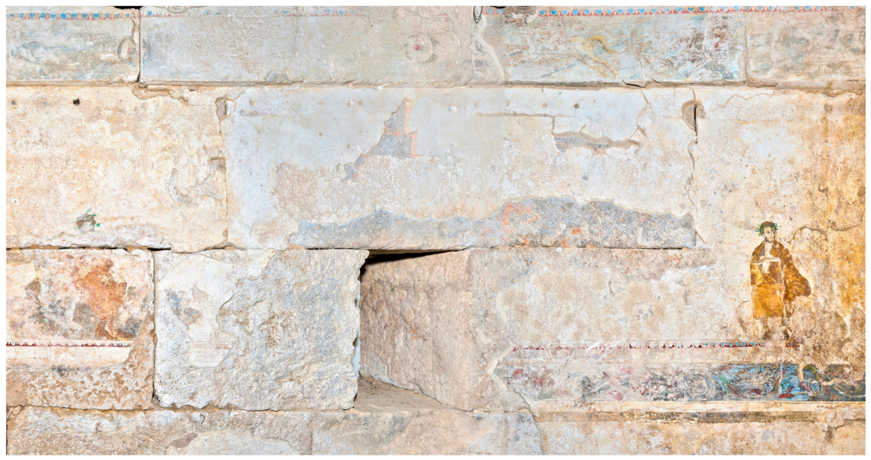
South wall, main figural frieze with two seated men, floral frieze and frieze with horse race.
Two figures are represented on the south wall. On the west side, a bearded man with short hair and a wreath sits on a rock, wearing a himation and krepides; he looks to his left and supports his head with his right arm, elbow pressed against his leg. On the east side, another man was seated on a rock, wearing a himation, wreath and krepides, and held a bent arm across the torso.

Slide 6
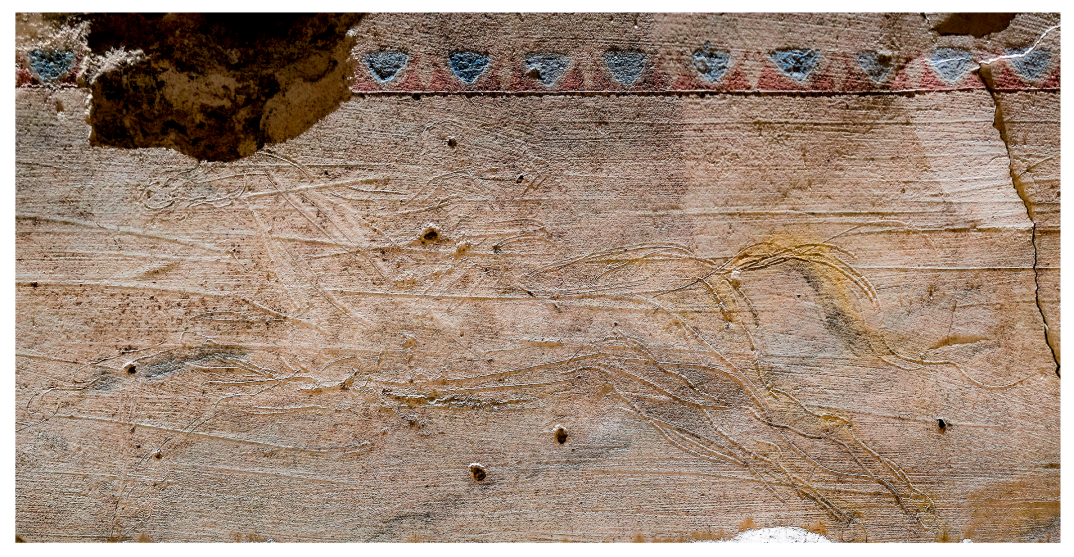
South wall, detail of the horse frieze in raking light

Slide 7
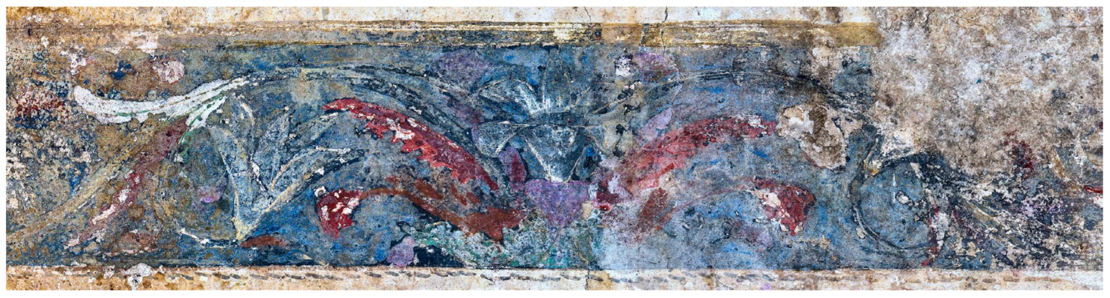
West wall, detail of the scroll frieze in normal light

Slide 8
The End

