Slide 1

René Lalique
French Artist
1860-1945

Slide 2
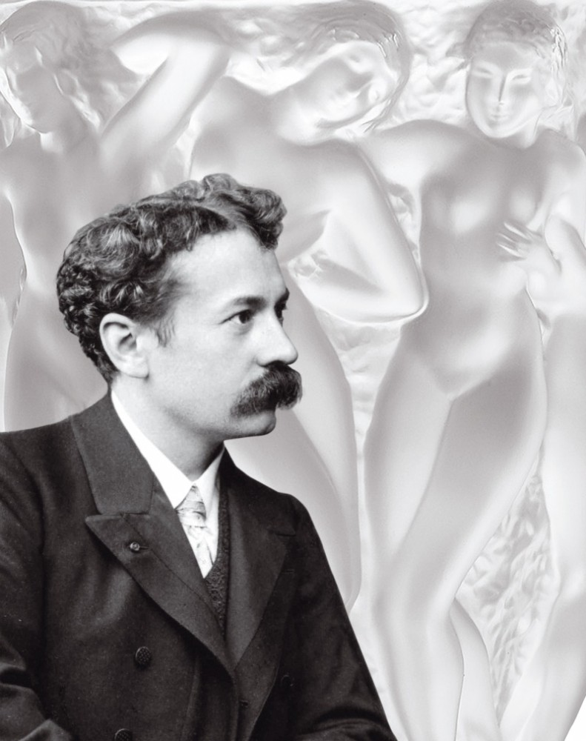
https://artdecostyle.ca/art-deco-style-blog/art-deco-artist-rene-lalique

Slide 3
Perfume Bottles
‘Let yourself be seduced by the 230 perfume bottles and powder boxes presented. Thanks to the loan from the Silvio Denz Foundation, discover exceptional works of rare diversity. It was after his meeting with the perfumer François Coty that René Lalique embarked on the adventure of mass-produced glass.
He subsequently created for the greatest names of his time: Houbigant, Molinard, d'Orsay, Roger&Gallet, Worth... The artist gives substance to olfactory essences and lends them an image.’
https://www.musee-lalique.com/decouvrir/collections/les-flacons-de-parfum/

Slide 4
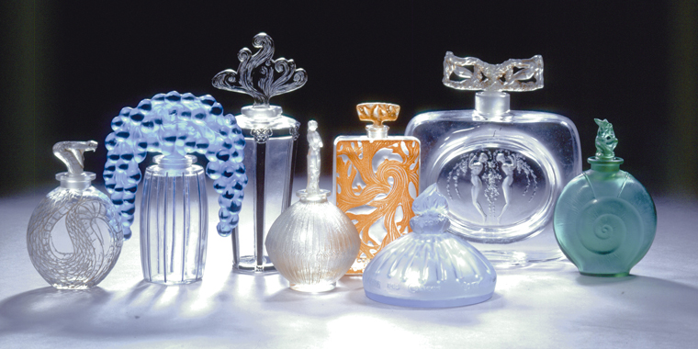
Musée Lalique, Wingen-sur-Moder, France https://www.europeanwaterways.com/blog/discover-wonderful-world-rene-lalique/

Slide 5
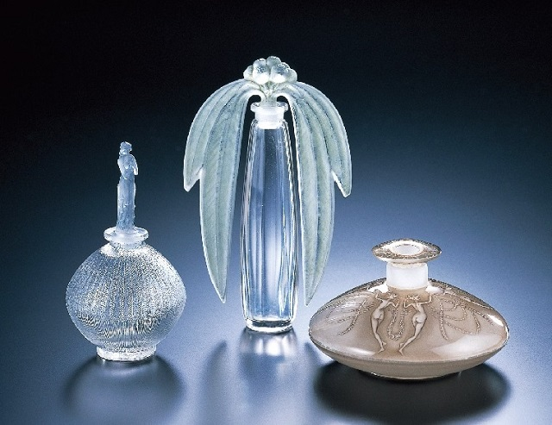
"Rose" perfume bottle (1914), "Eucalyptus" perfume bottle (1919), "Three dancing pairs" perfume bottle (1912), Kitazawa Museum, Japan https://www.tokyoartbeat.com/en/events/-/2017%2FB34E

Slide 6
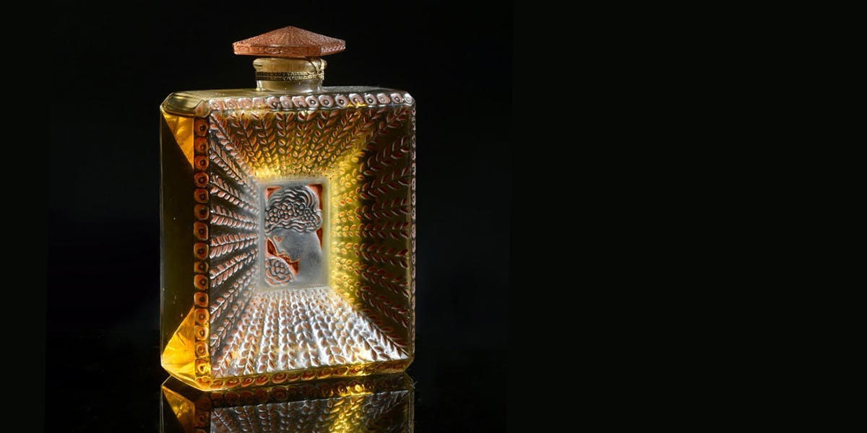
"La Belle Saison" bottle, 1925, pressed colorless glass
Photo © Coutau-Bégarie https://www.barnebys.com/blog/rene-lalique-perfume-bottles-into-artworks

Slide 7
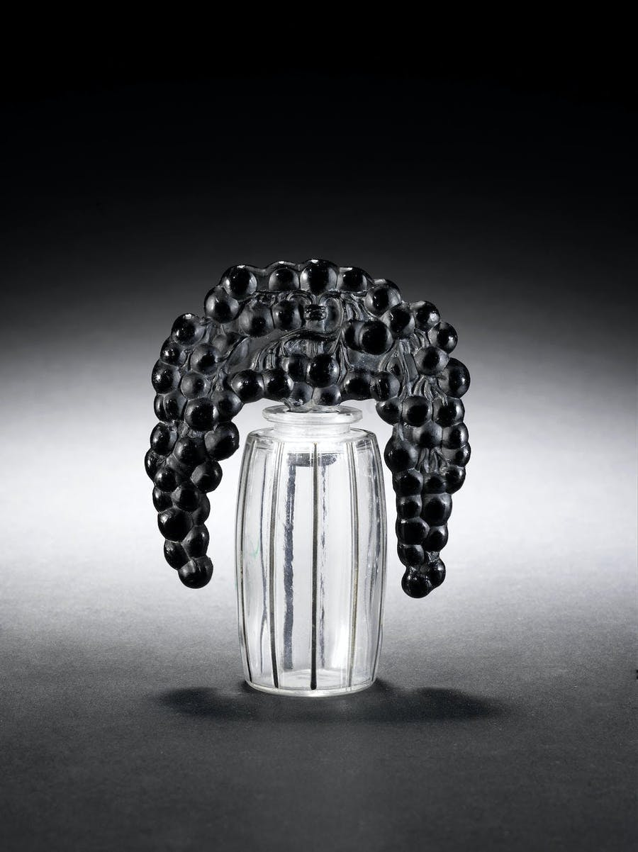
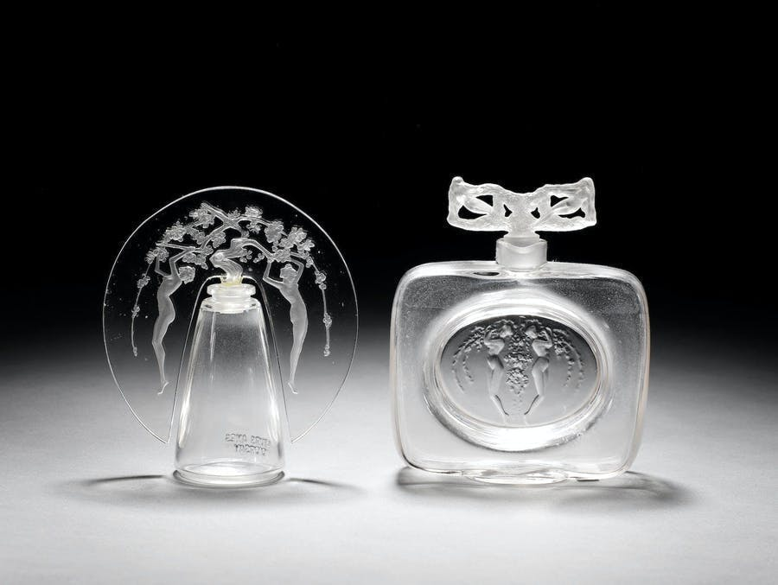
"Bouchon Cassis" bottle, 1920, clear and black enamelled glass. Photo © Bonhams
"Deux Figurines" bottle made of clear and frosted glass, 1912, and another bottle for D'Orsay. Photo © Bonhams https://www.barnebys.com/blog/rene-lalique-perfume-bottles-into-artworks

Slide 8
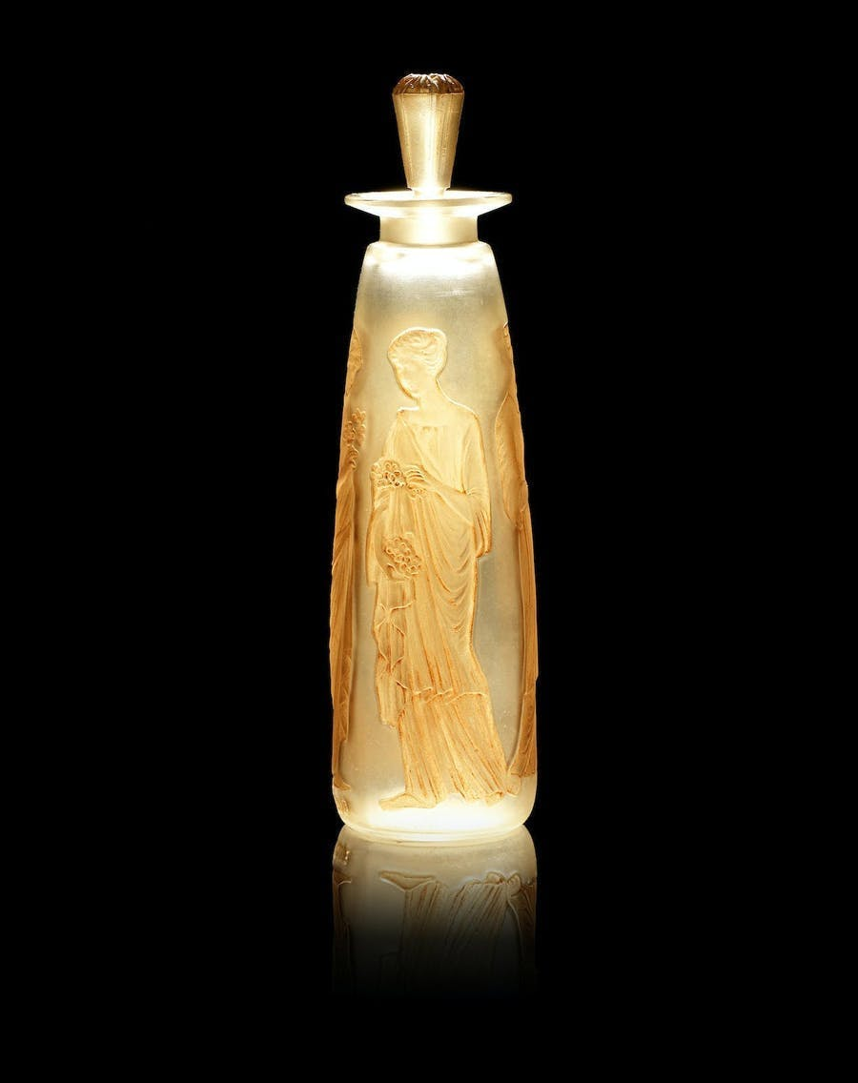
René Lalique for François Coty, "Ambre Antique" bottle, 1910
Photo © Bonhams https://www.barnebys.com/blog/rene-lalique-perfume-bottles-into-artworks

Slide 9
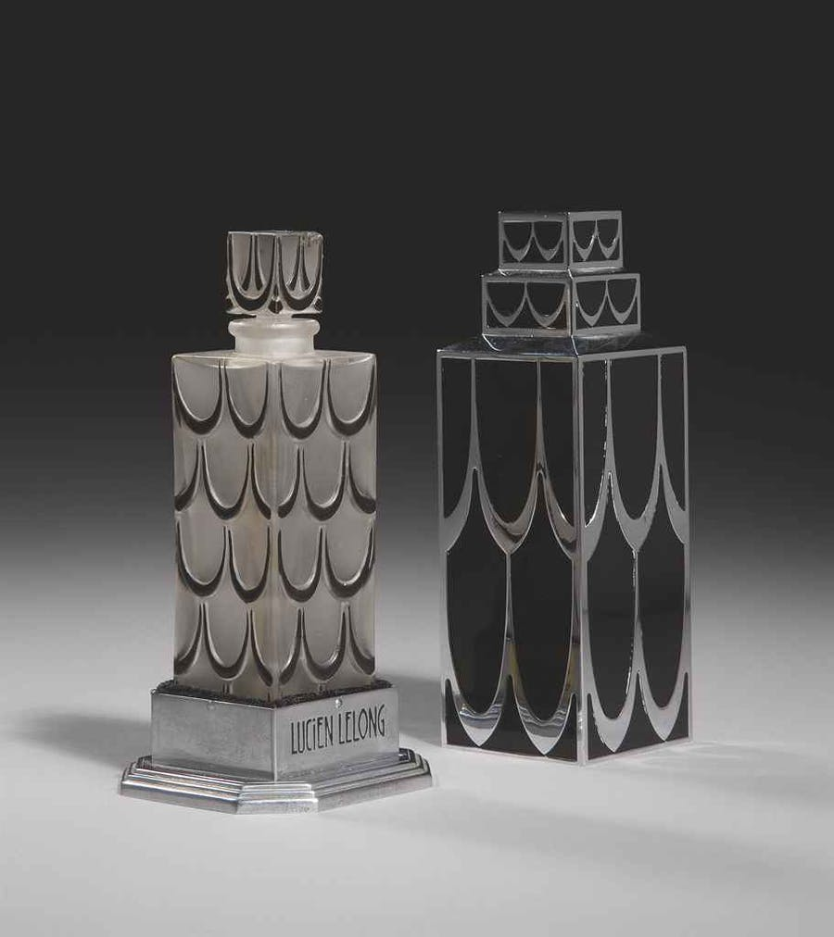
René Lalique for Lucien Lelong, 1929, bottle inspired by the Chrysler Building in New York Photo © Christie’s https://www.barnebys.com/blog/rene-lalique-perfume-bottles-into-artworks

Slide 10
Glass
René Lalique, wanting to make beauty accessible to the greatest number, often produced in series using molds. In addition to perfume bottles, glass is then used in different themes in the museum: tableware, architecture, and decorative objects.
The artist brought glass into all areas of life. He worked on vases like the Moissac Vase but also on light fixtures, statues, clocks, radiator caps for cars from the Roaring Twenties, inkwells, mirrors, recreated jewelry, etc.
https://www.musee-lalique.com/decouvrir/collections/le-verre/

Slide 11
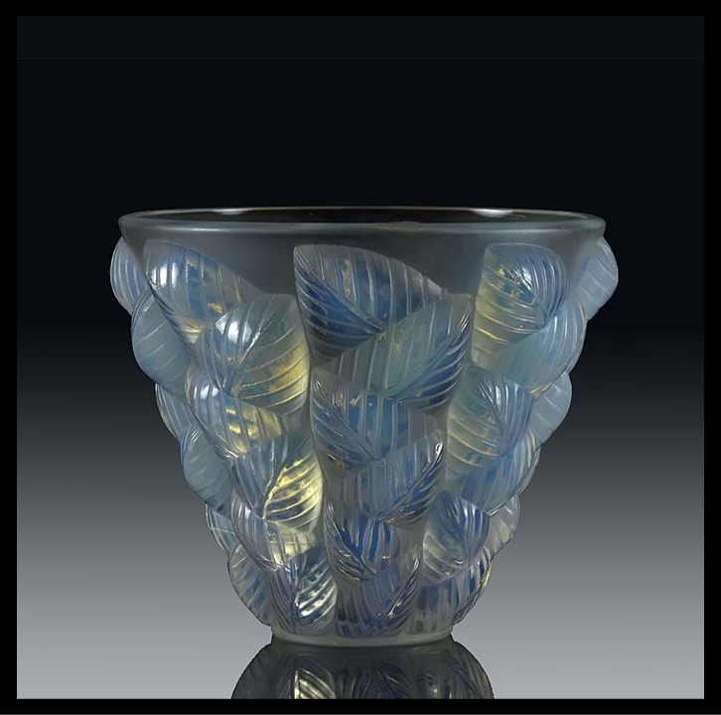
Moissac Vase, c. 1930, Opalescent Glass, Height: 13 cm, Private Collection https://hickmet.com/products/rene-lalique-moissac-vase?srsltid=AfmBOopKGBdoz2qgOWYJy5s3FAq5xmPJq2A1jCN-QQW4gMqEHjEXwrhK

Slide 12
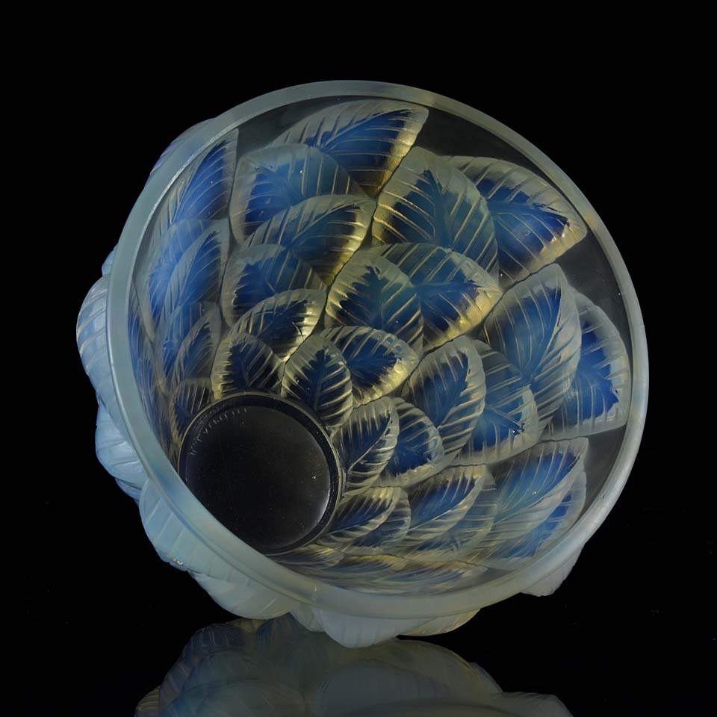
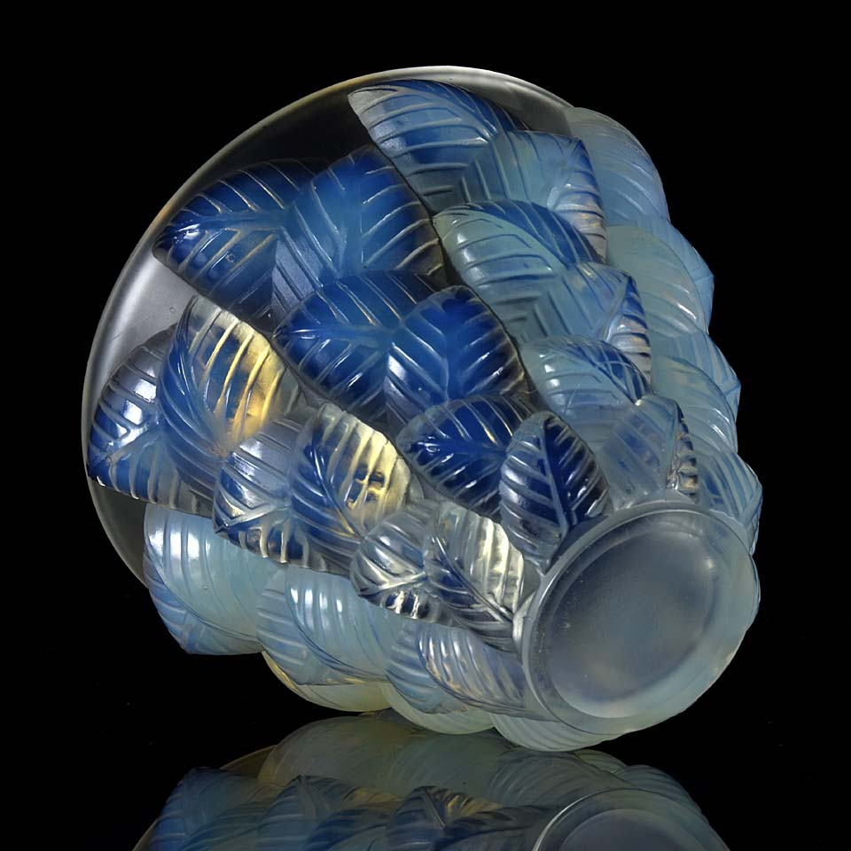

Slide 13
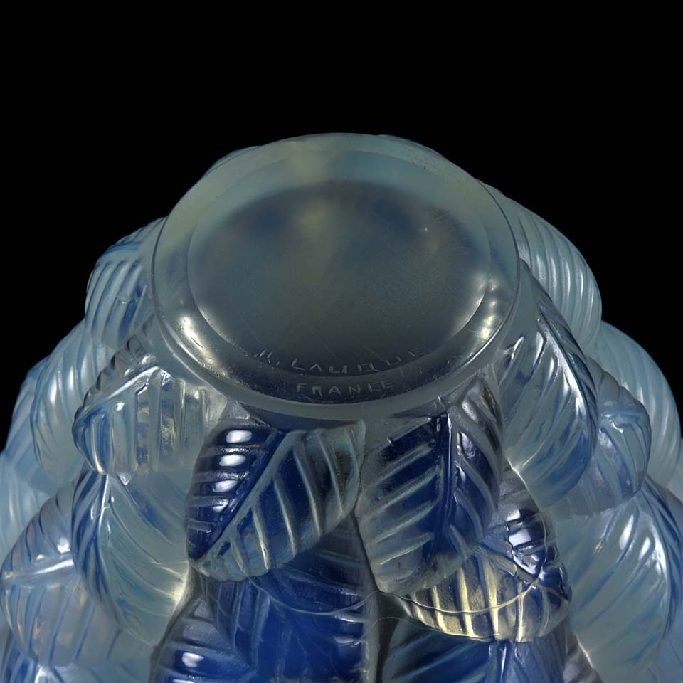

Slide 14
René Lalique and the art of travelling by Train!
Decorative panel created by René Lalique in 1928 were used to adorn the cars of the famous Orient Express train which led travelers from the banks of the Seine to the shores of the Bosphorus. René Lalique stands alongside René Prou as one of the most admired artists who have contributed to the decoration of this train. Originally made in white molded pressed glass, the panels, inspired by the Art Deco style, were embedded on a silver background in Cuban mahogany paneling.

Slide 15
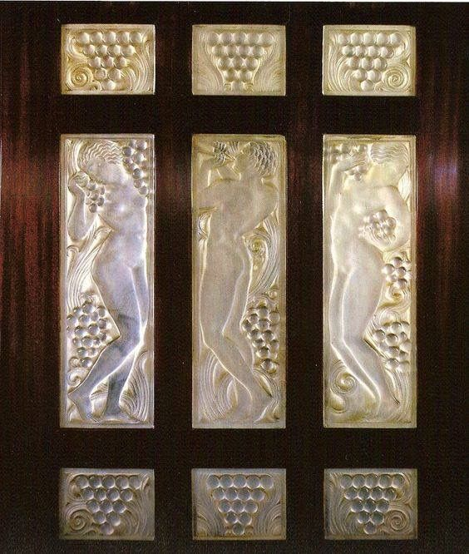
Glass panel by René Lalique in the Golden Arrow car n°4159 of the Orient Express.
This Pullman saloon car was built in 1929 and restored in 1987. https://www.flickr.com/photos/dalbera/14560681841/in/photostream/

Slide 16
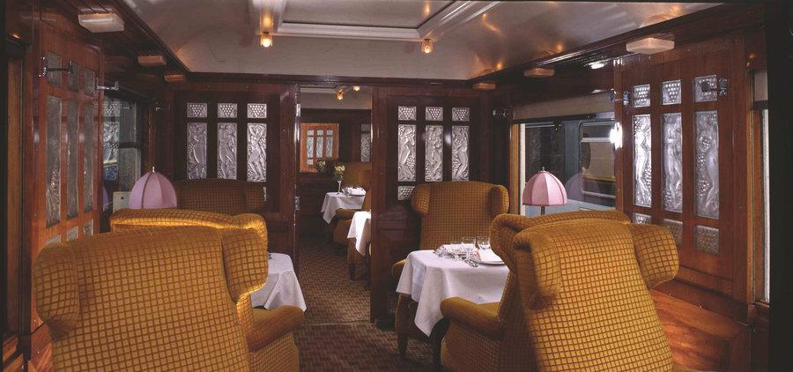
https://www.chinadaily.com.cn/a/202111/24/WS619d9d34a310cdd39bc7735e_7.html

Slide 17
René Lalique and St Matthew's Church
St Matthew’s Church, is an Anglican church in Millbrook, in the parish of Saint Lawrence, Jersey, in the Channel Islands. Built in 1840, the church is known for its glass-work by René Lalique.
In 1934, Florence Boot commissioned an extensive renovation of the church by architect A. B. Grayson and French glass designer René Lalique. According to BBC News, this is the only remaining and complete example of ... Lalique's heavy, clouded glass.
https://en.wikipedia.org/wiki/St_Matthew%27s_Church,_Jersey and https://www.facebook.com/photo/?fbid=625877146273199&set=pcb.625877229606524

Slide 18
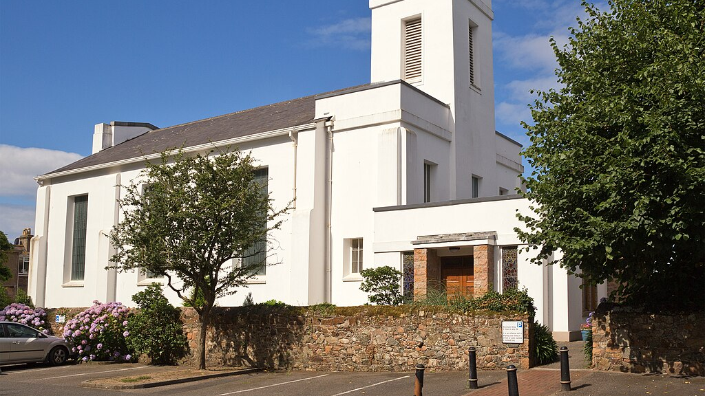

Slide 19
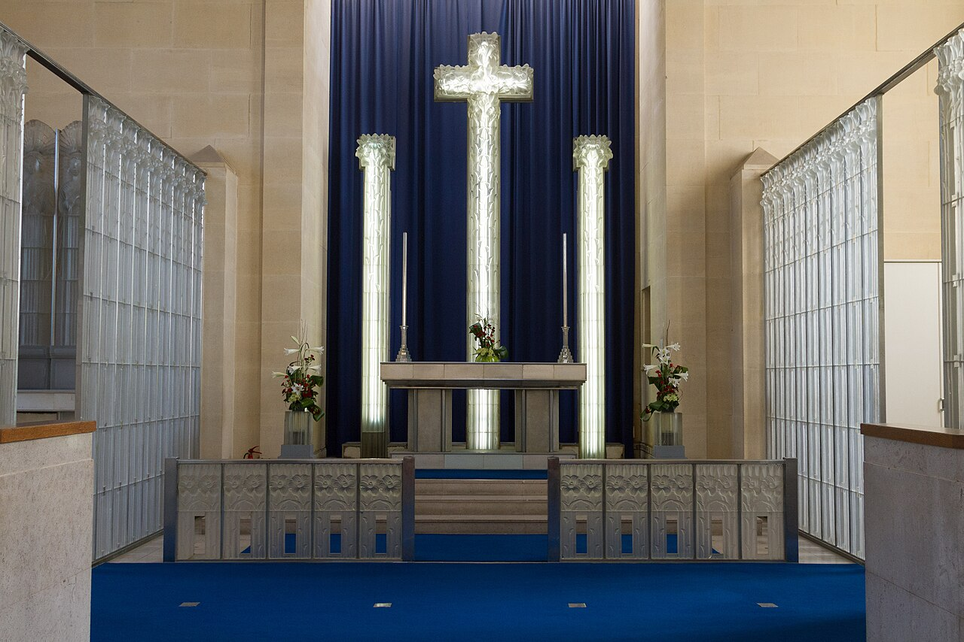

Slide 20
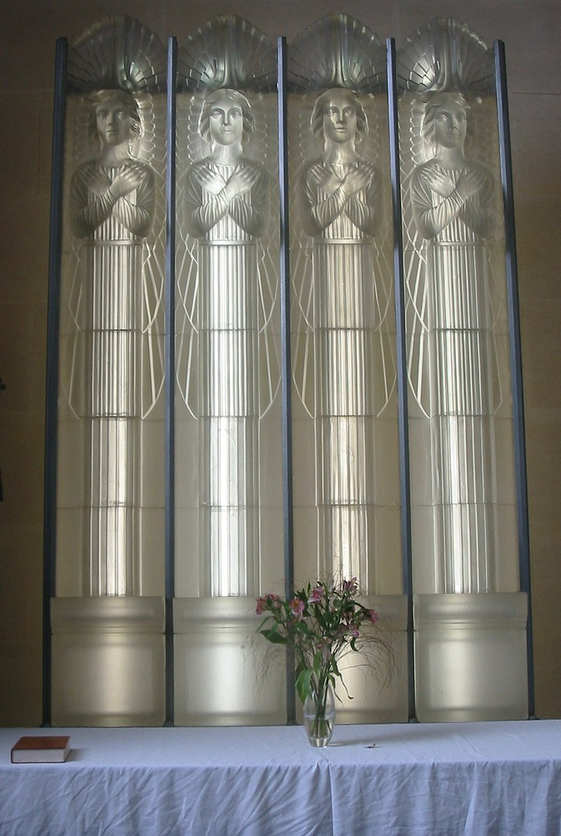
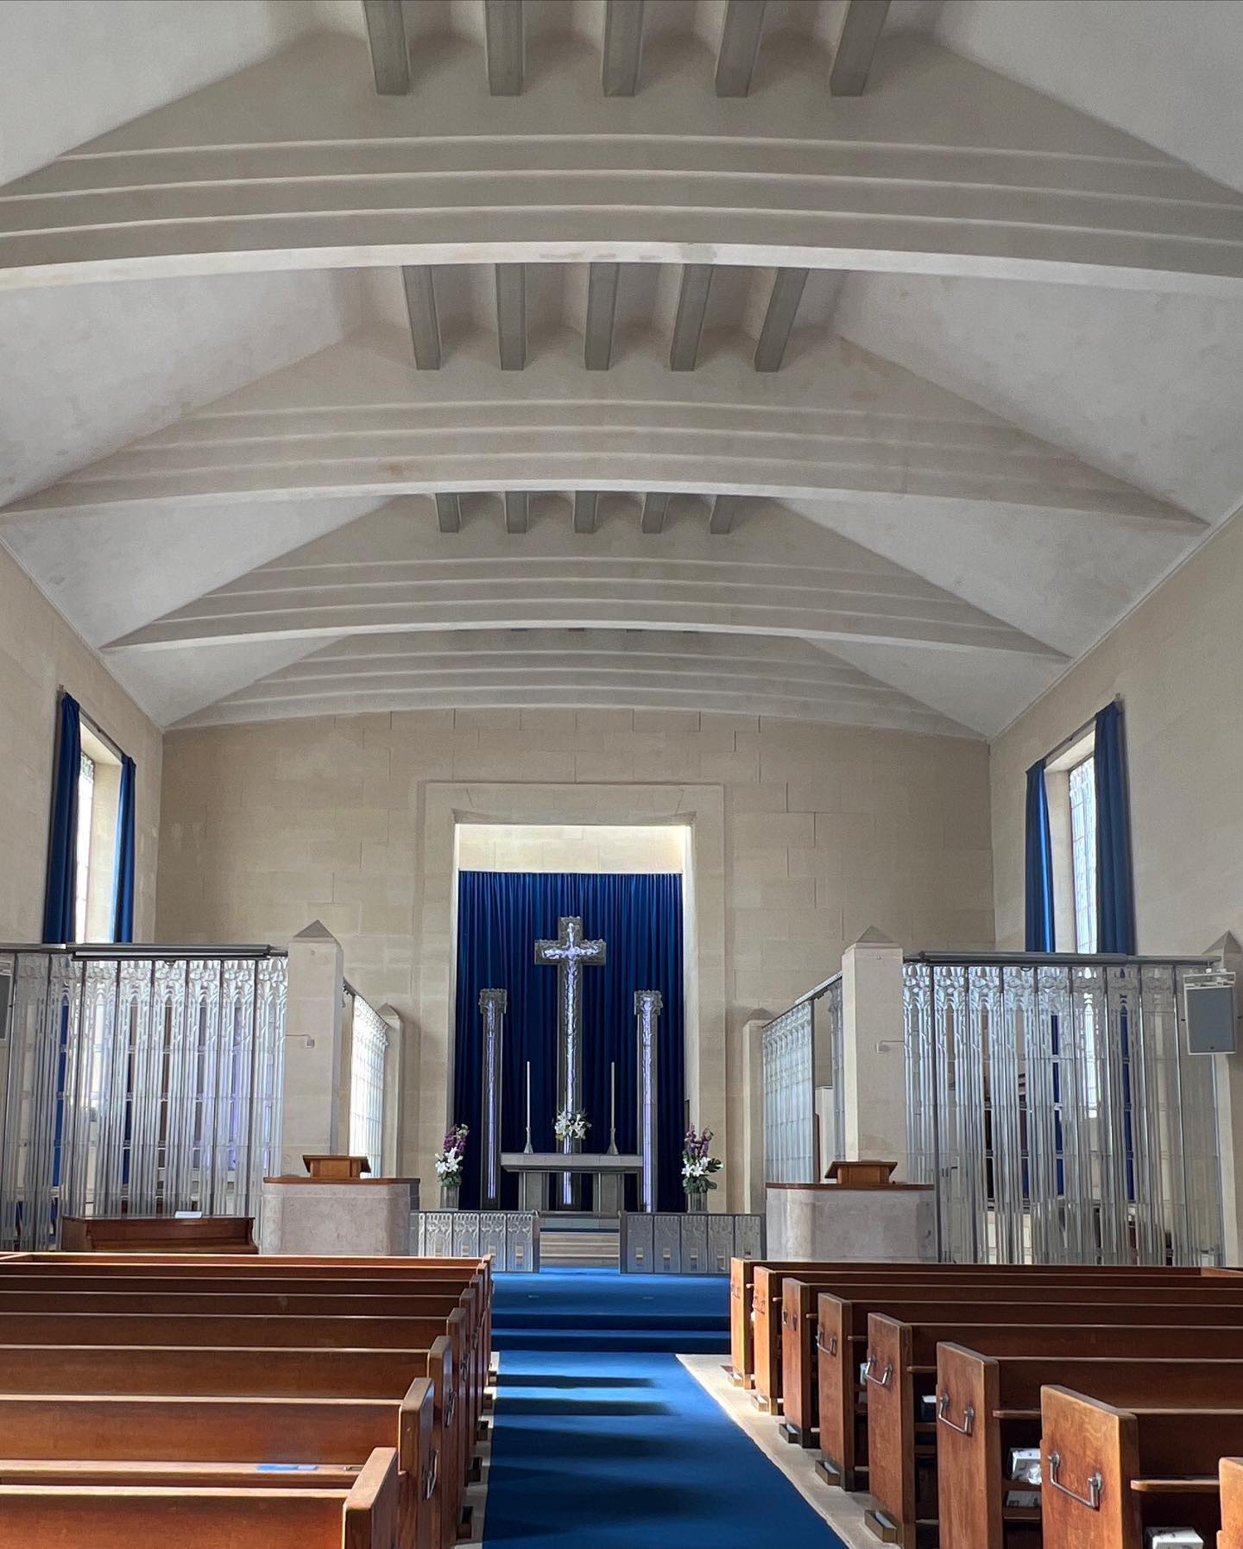

Slide 21
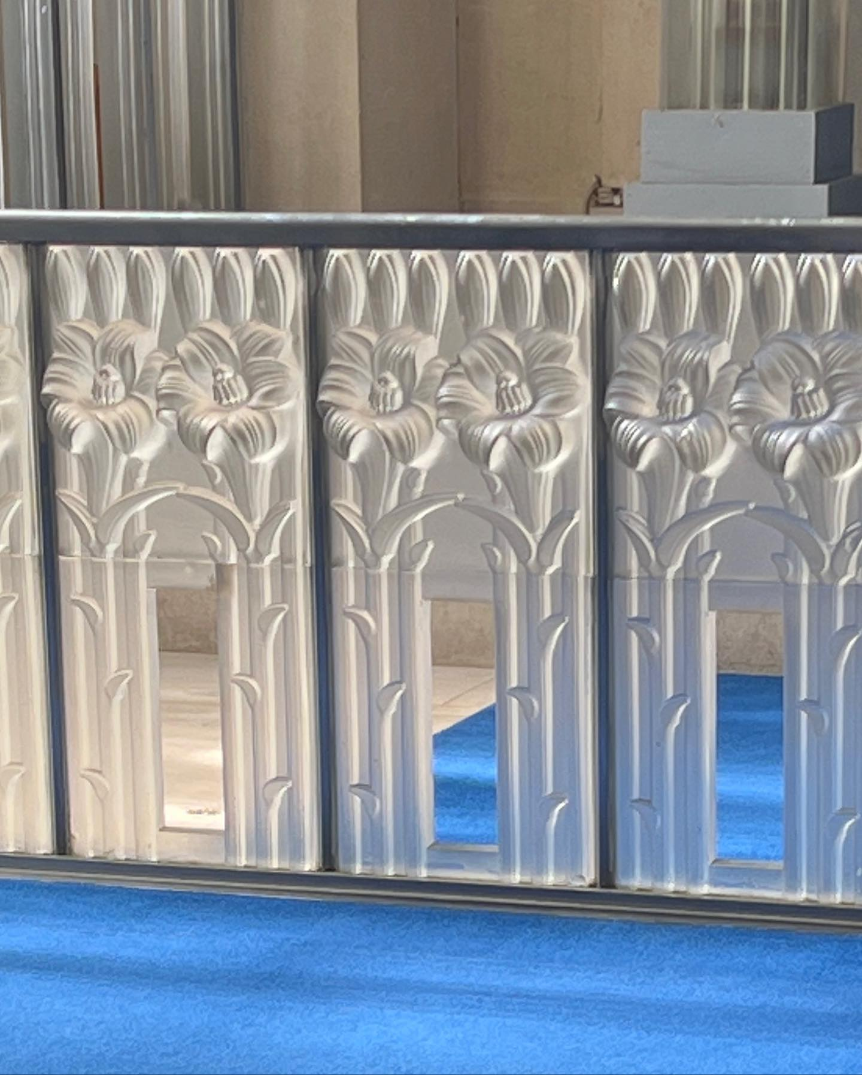
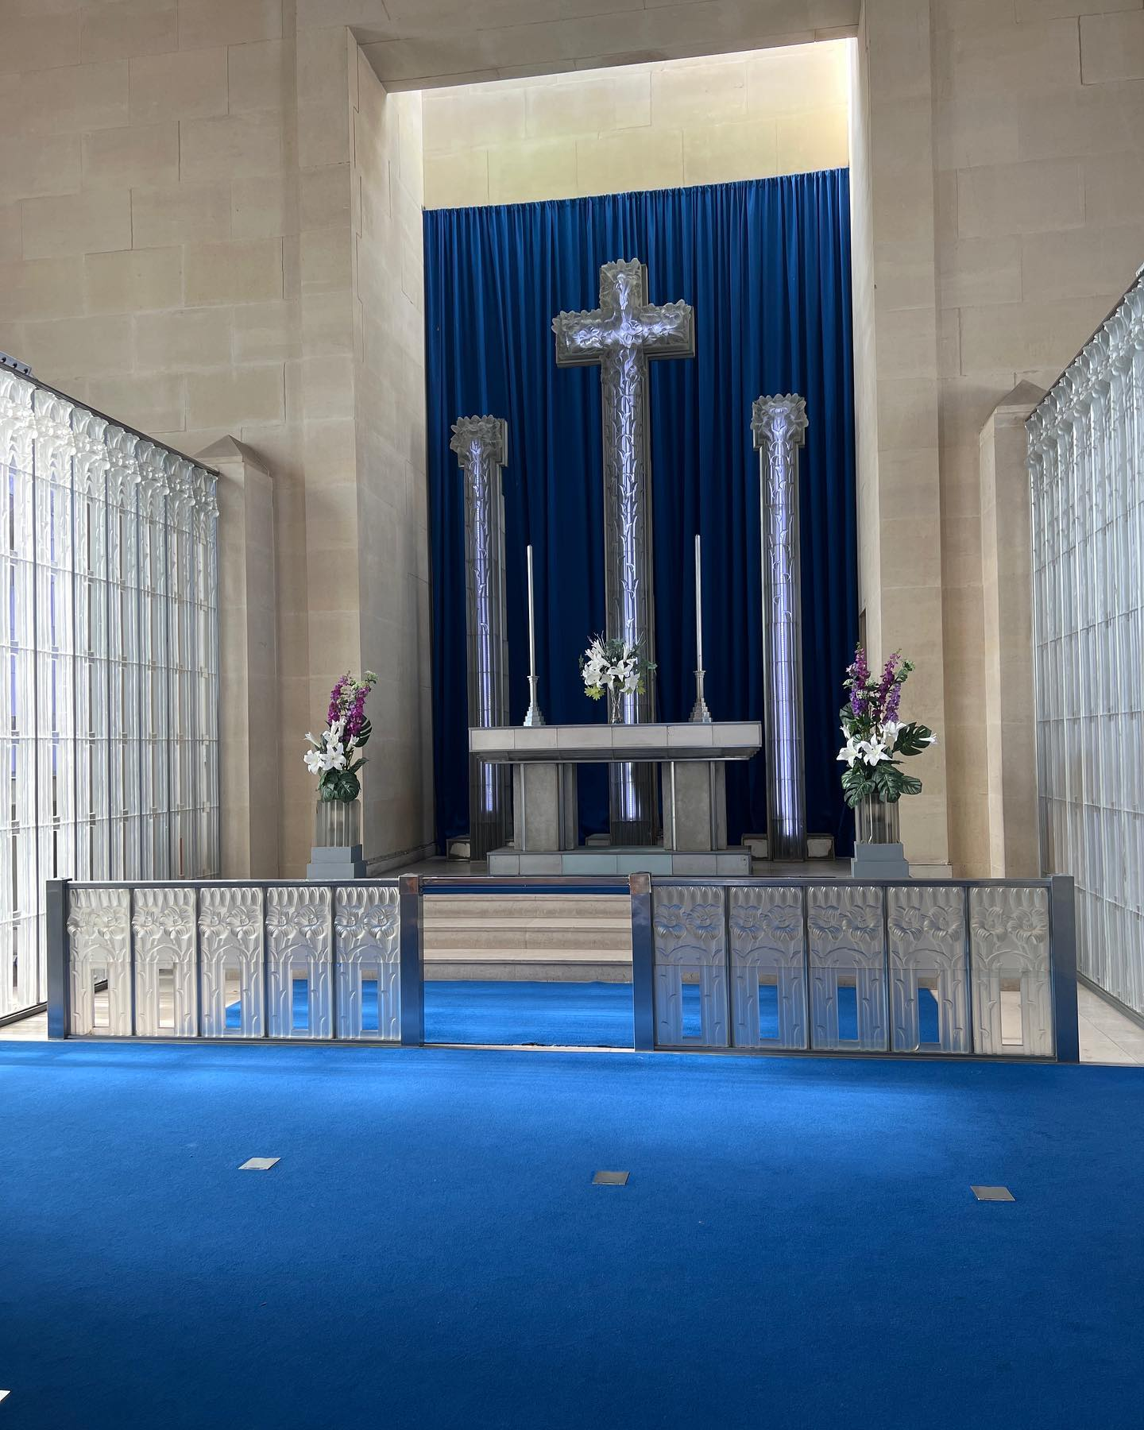

Slide 22
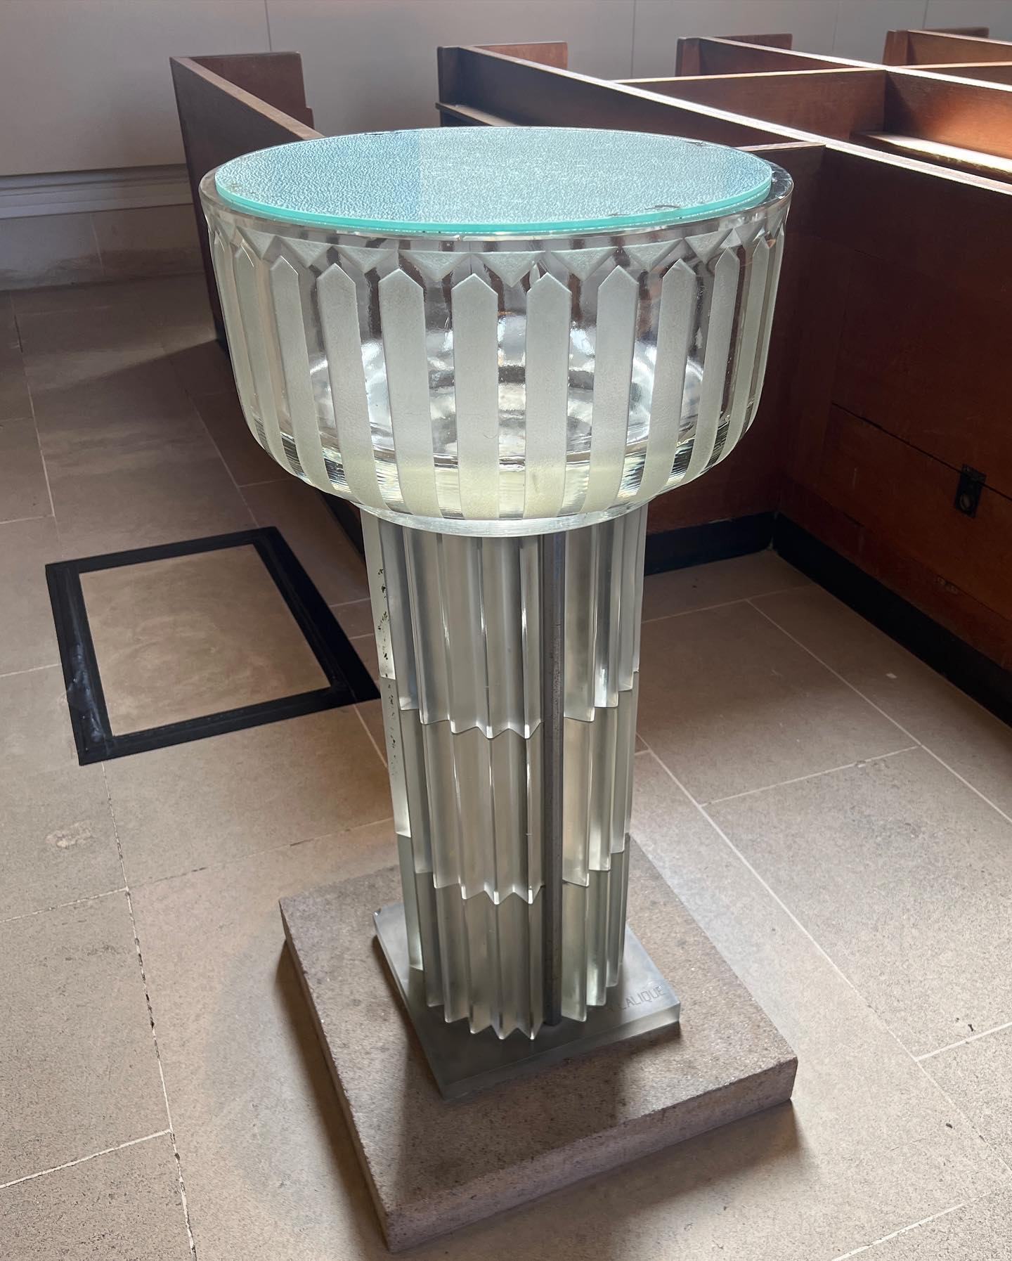

Slide 23
The End

