Slide 1

Pompeii
House of the Ancient Hunt
Late 2nd century BC to 79 AD

Slide 2
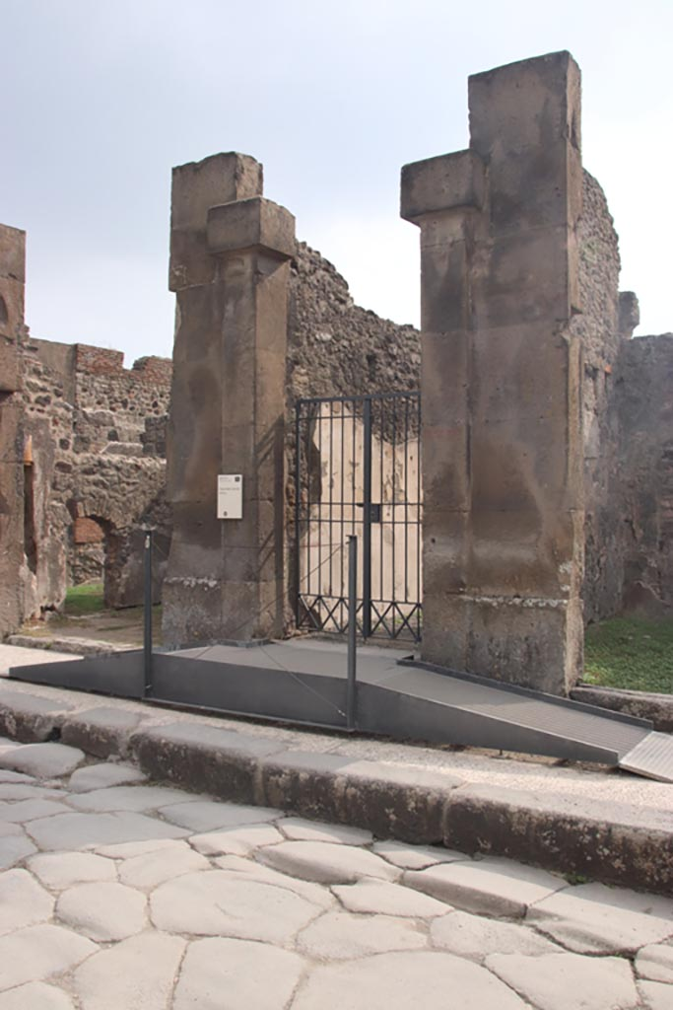
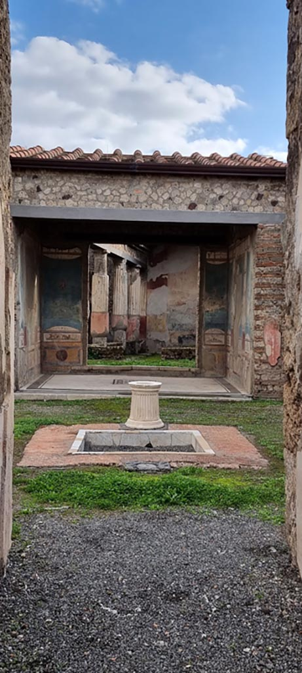
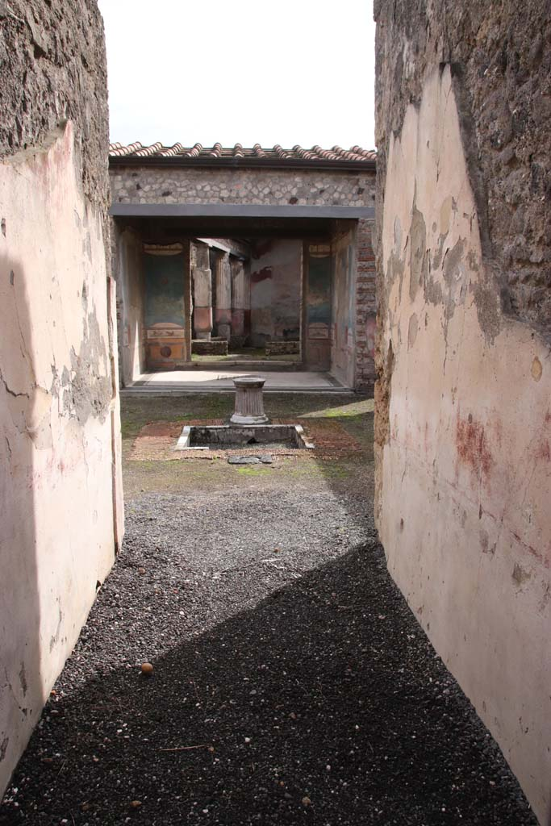
Entrance doorway on Via della Fortuna
Photo: Klaus Heese
Looking south across atrium towards tablinum from entrance corridor
Photo: Miriam Colomer https://pompeiiinpictures.com/pompeiiinpictures/R7/7%2004%2048%20p1.htm

Slide 3
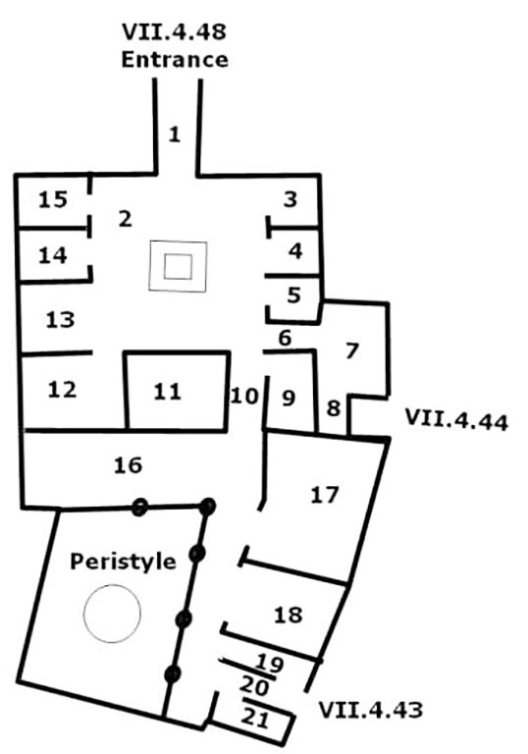
Casa della Caccia Antica or House of the Ancient Hunt Room Plan https://pompeiiinpictures.com/pompeiiinpictures/R7/7%2004%2048%20plan.htm

Slide 4
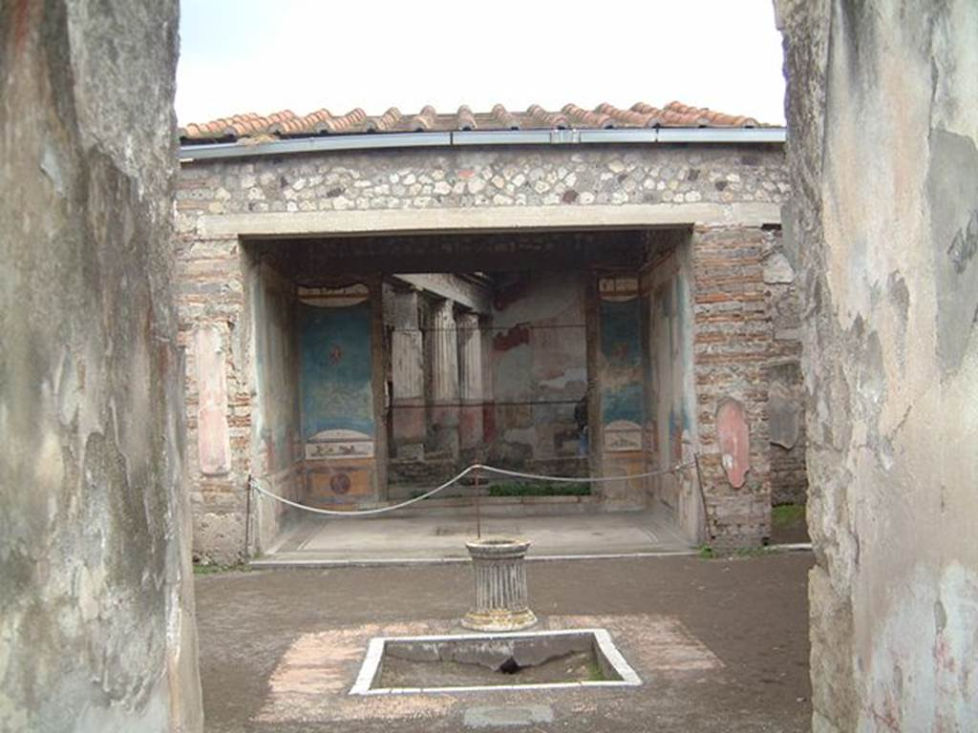
Atrium and Τablinum as seen from entrance corridor Photograph: Current Archaeology https://pompeiiinpictures.com/pompeiiinpictures/R7/7%2004%2048%20p1.htm

Slide 5
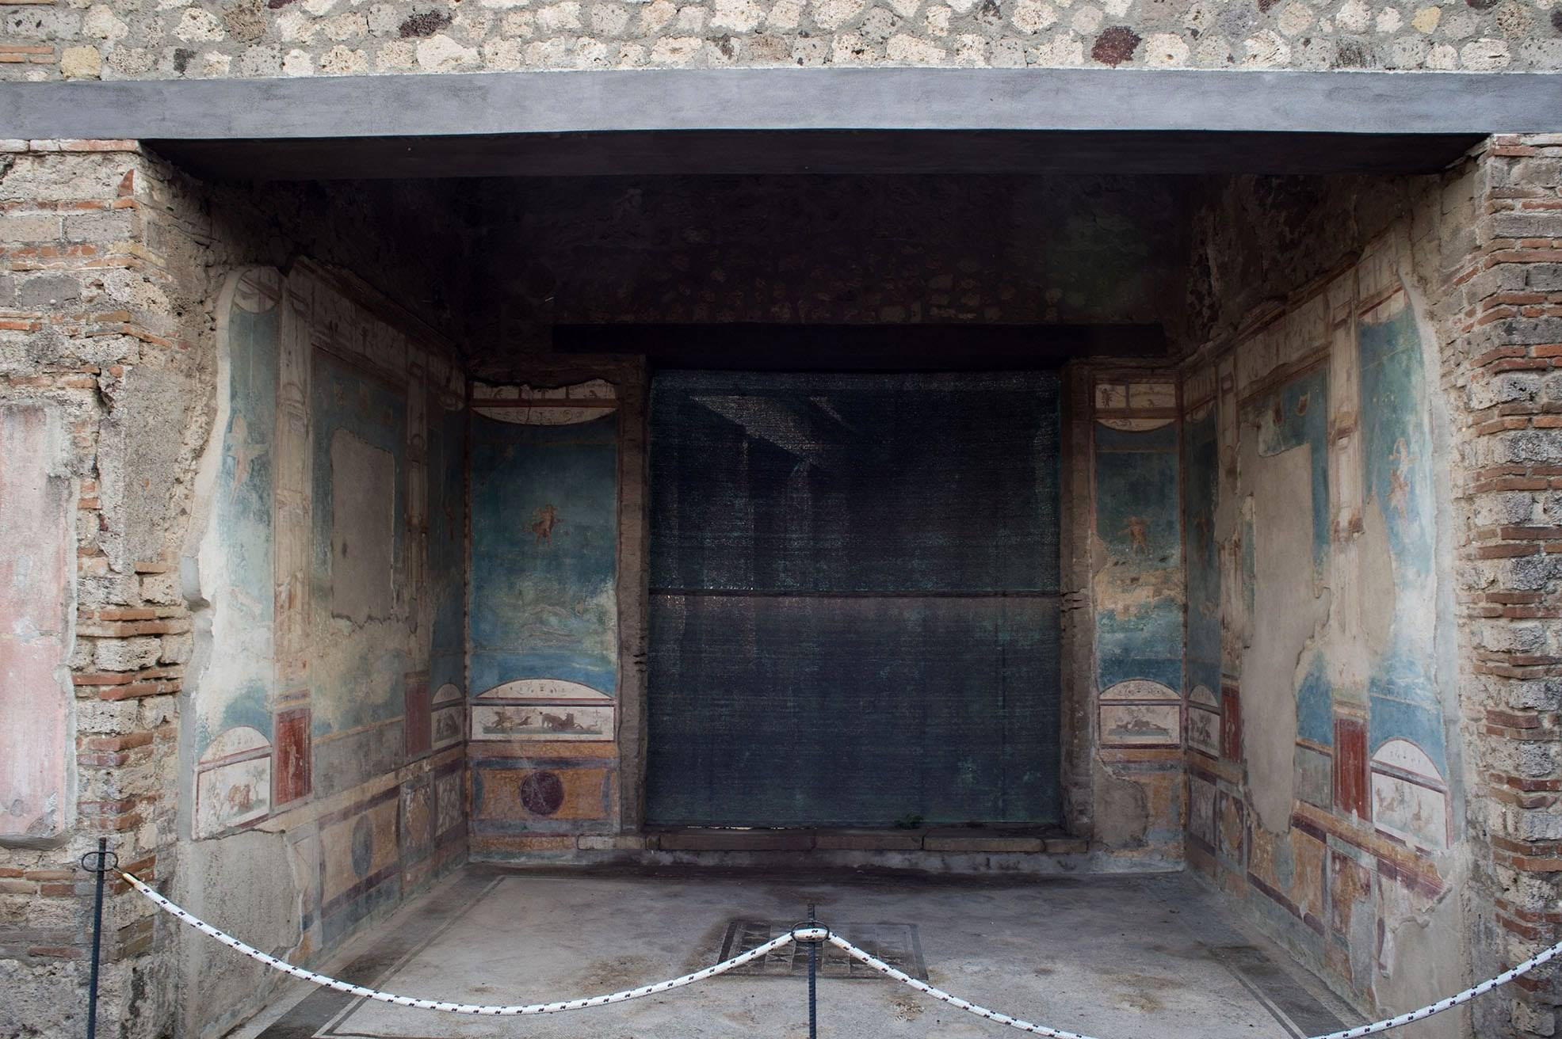
Tablinum https://pompeiiinpictures.com/pompeiiinpictures/R7/7%2004%2048%20p1.htm

Slide 6
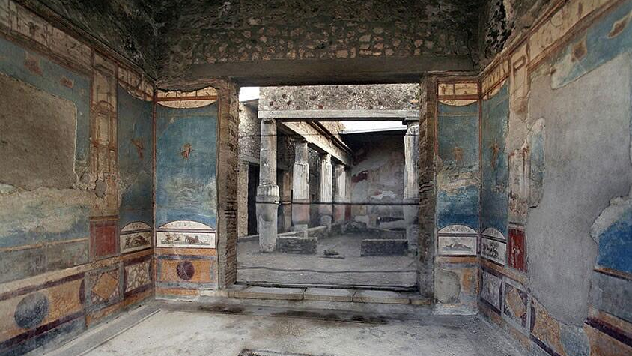
https://www.planetpompeii.com/it/map/casa-della-caccia-antica.html

Slide 7
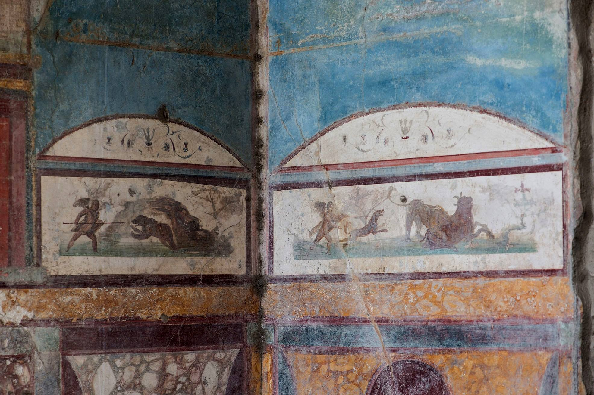
https://www.facebook.com/photo/?fbid=2140356092993471&set=pcb.7712381922141230

Slide 8
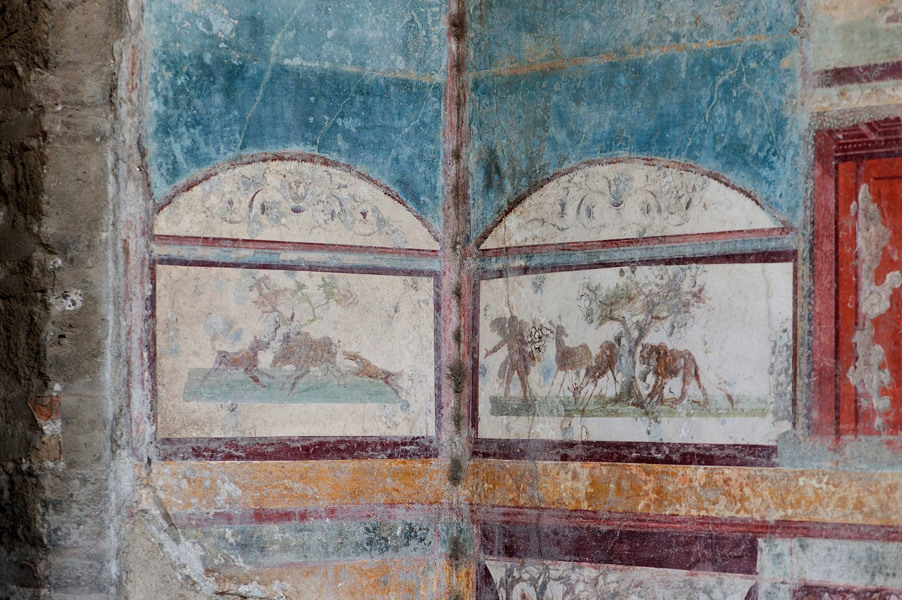
https://www.facebook.com/photo/?fbid=2140356092993471&set=pcb.7712381922141230

Slide 9
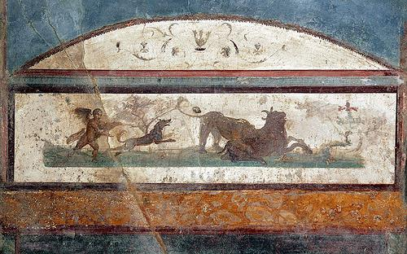
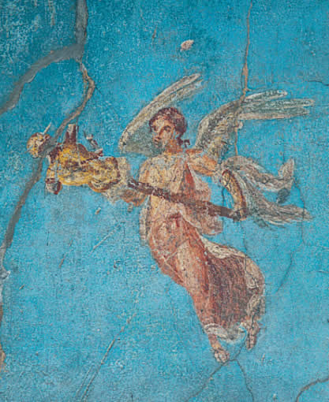
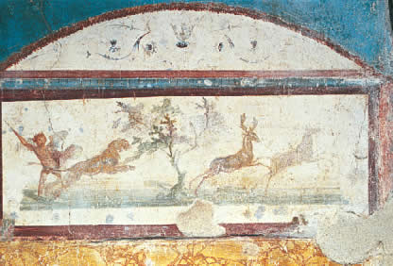
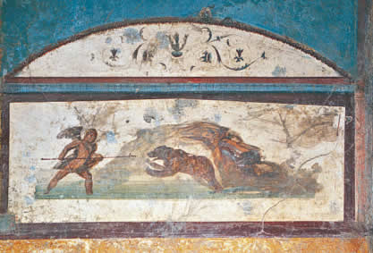
https://www.planetpompeii.com/en/map/the-house-of-ancient-hunt/112-detail-of-a-winged-figure.html

Slide 10
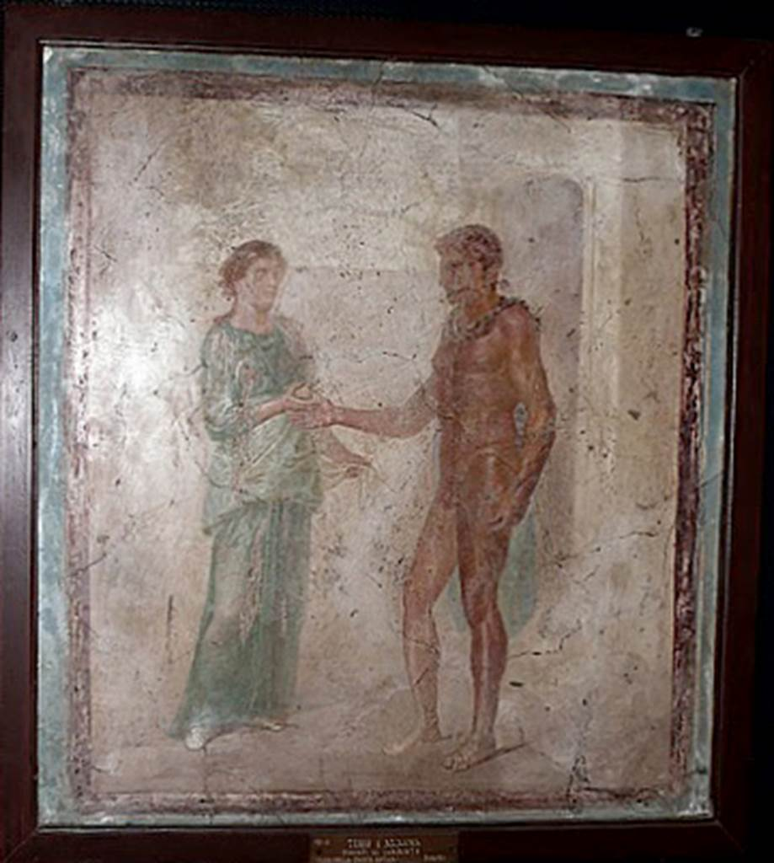
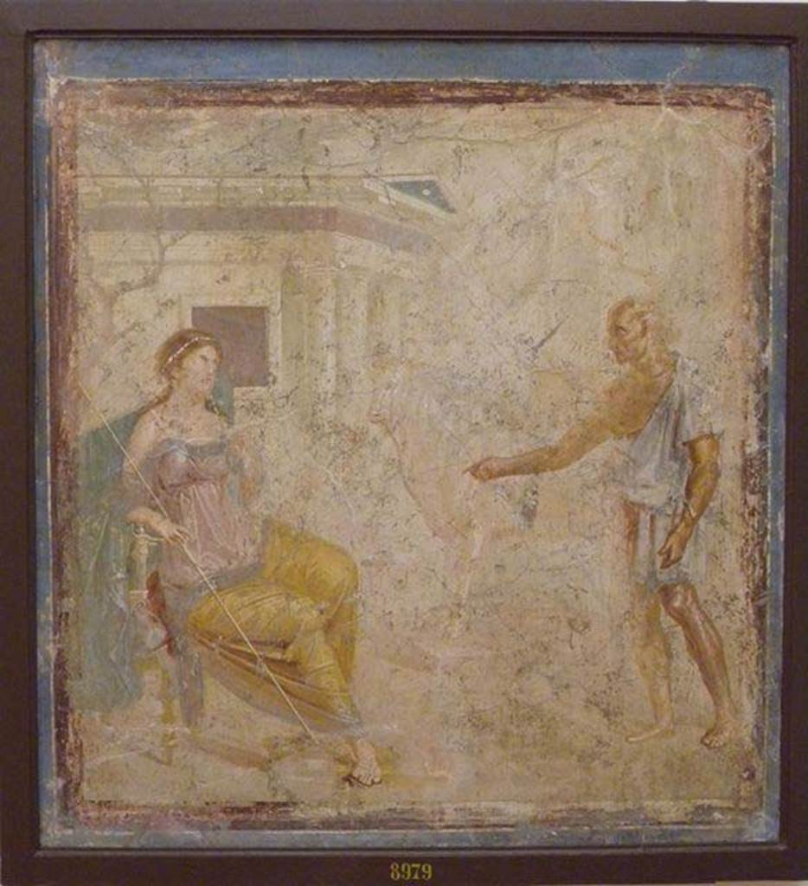
Theseus and Ariadne
Daedalus and Pasiphae and the Wooden Cow
National Archaeological Museum of Naples, Italy https://pompeiiinpictures.com/pompeiiinpictures/R7/7%2004%2048%20p3.htm and https://pompeiiinpictures.com/pompeiiinpictures/R7/7%2004%2048%20p2.htm

Slide 11
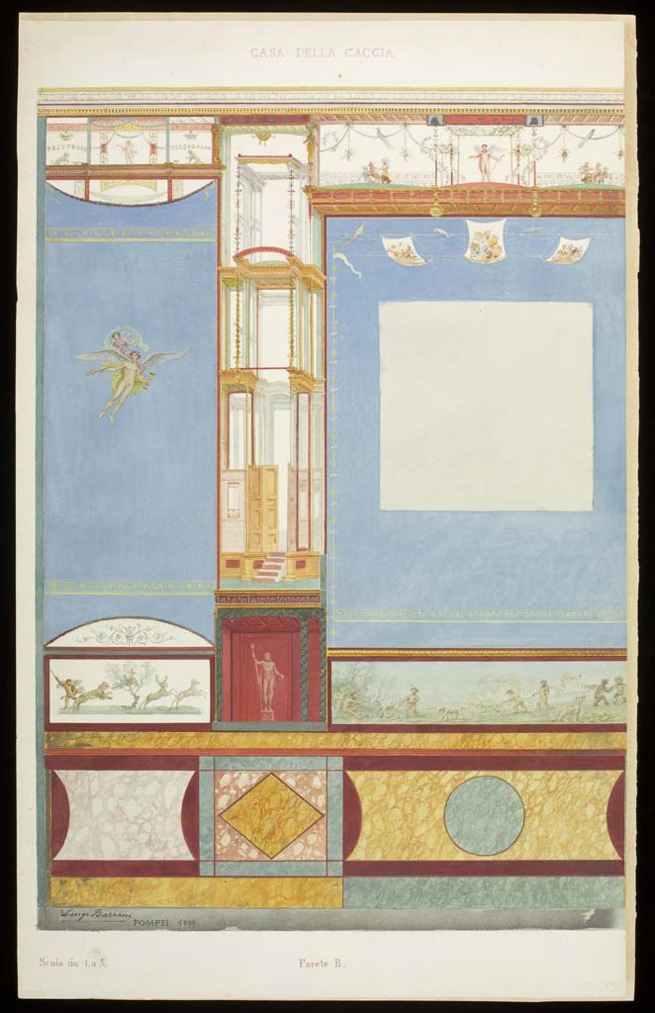
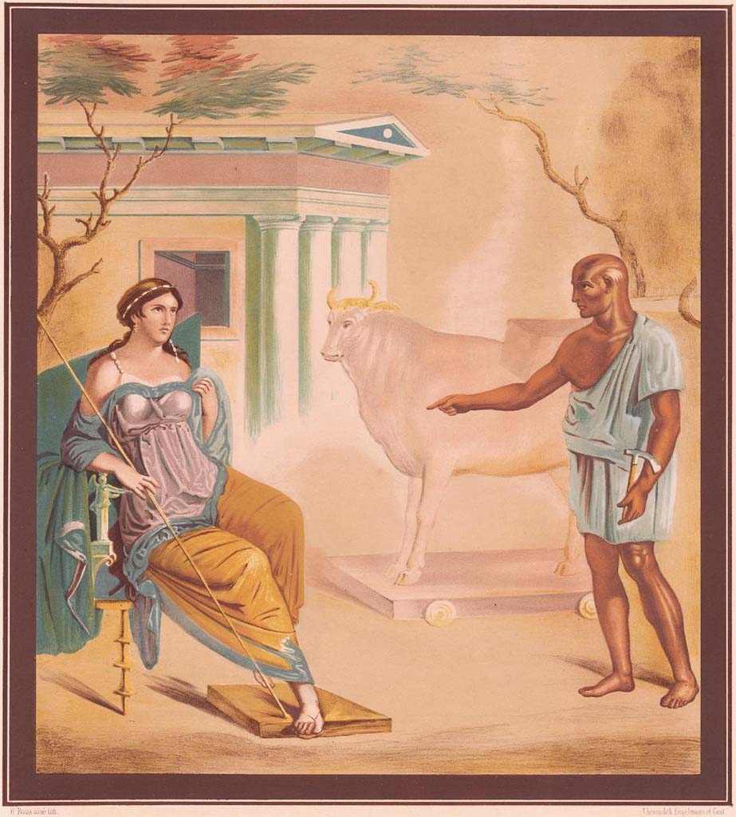
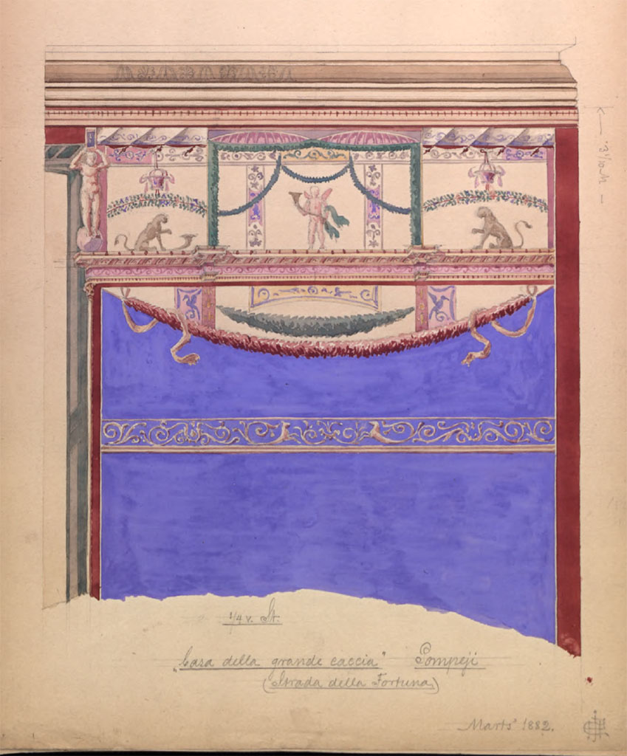
More info: https://pompeiiinpictures.com/pompeiiinpictures/R7/7%2004%2048%20p3.htm

Slide 12
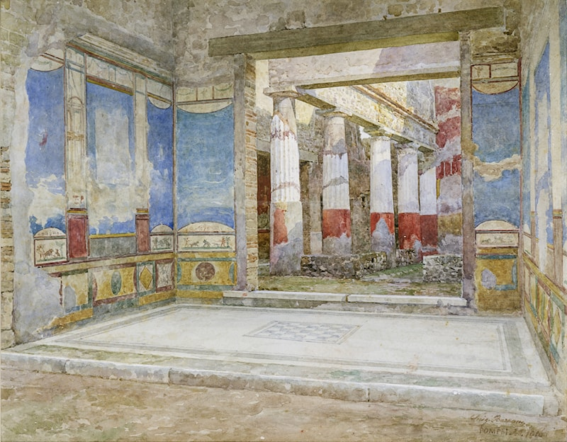
Luigi Bazzani, Italian Artist, 1836-1927
Atrium of the House of the Ancient Hunt in Pompeii, 1886, Watercolour on Paper, 34.92x 47.94, Victoria and Albert Museum, London UK https://www.artrenewal.org/artworks/atrium-a-pompei-nella-domus-della-caccia-antica/luigi-bazzani/92235

Slide 13
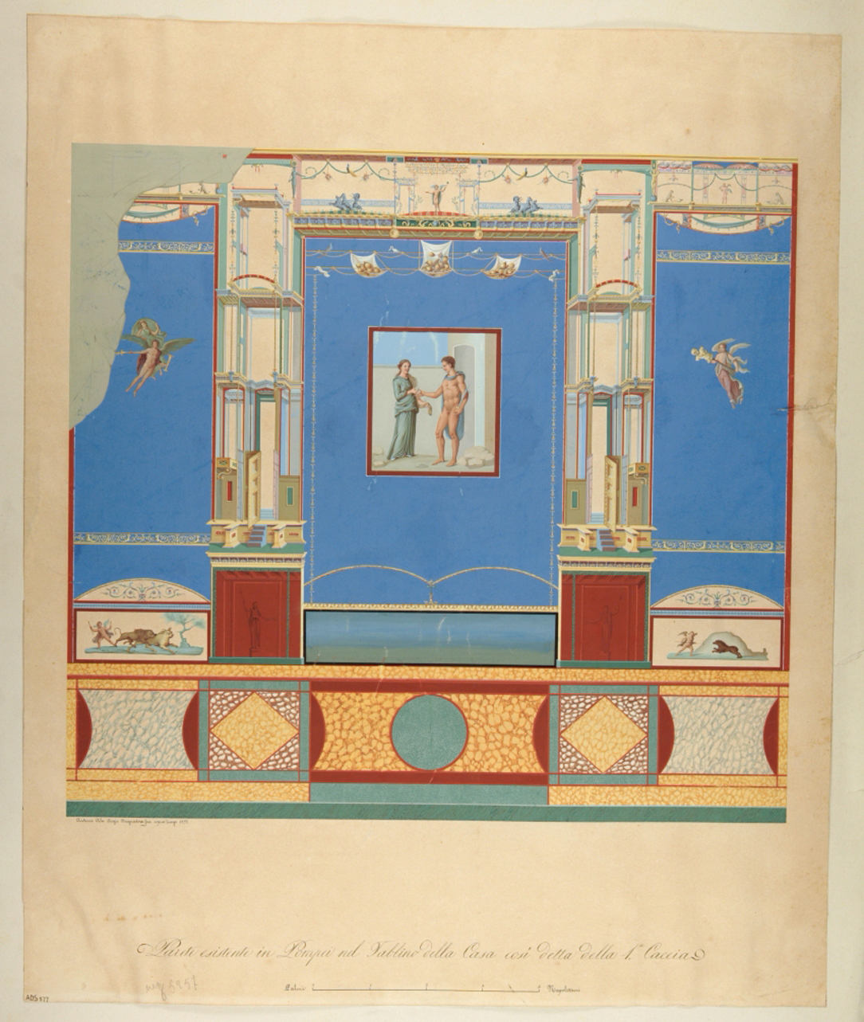
Wall of IV style (drawing) by Ala Antonio (third quarter of the 19th century)
Terms of use: Standard Cultural Heritage (BCS) https://www.catalogo.beniculturali.it/detail/HistoricOrArtisticProperty/1500573080#lg=1&slide=0

Slide 14
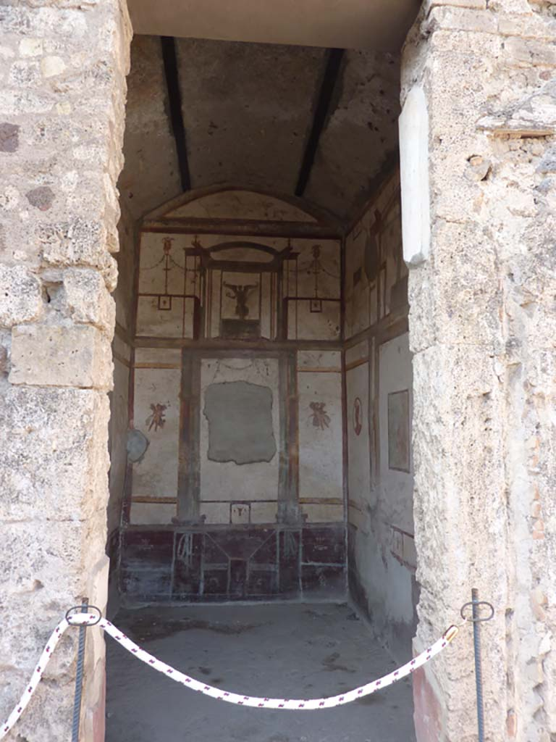
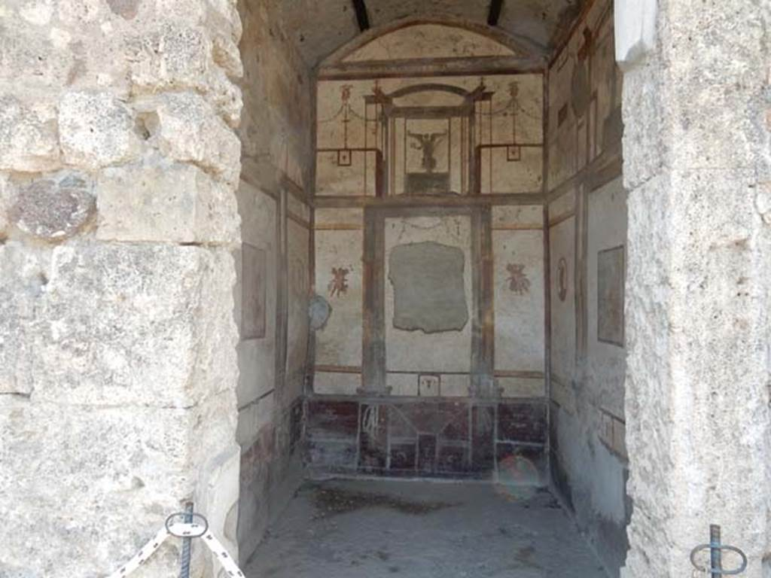
Room 14, doorway to cubiculum
Photo: Buzz Ferebee https://pompeiiinpictures.com/pompeiiinpictures/R7/7%2004%2048%20p5.htm

Slide 15
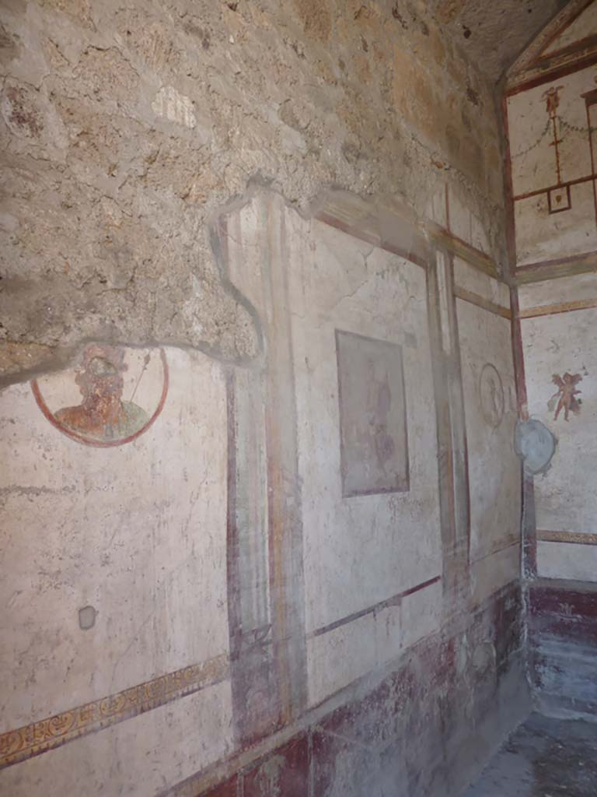
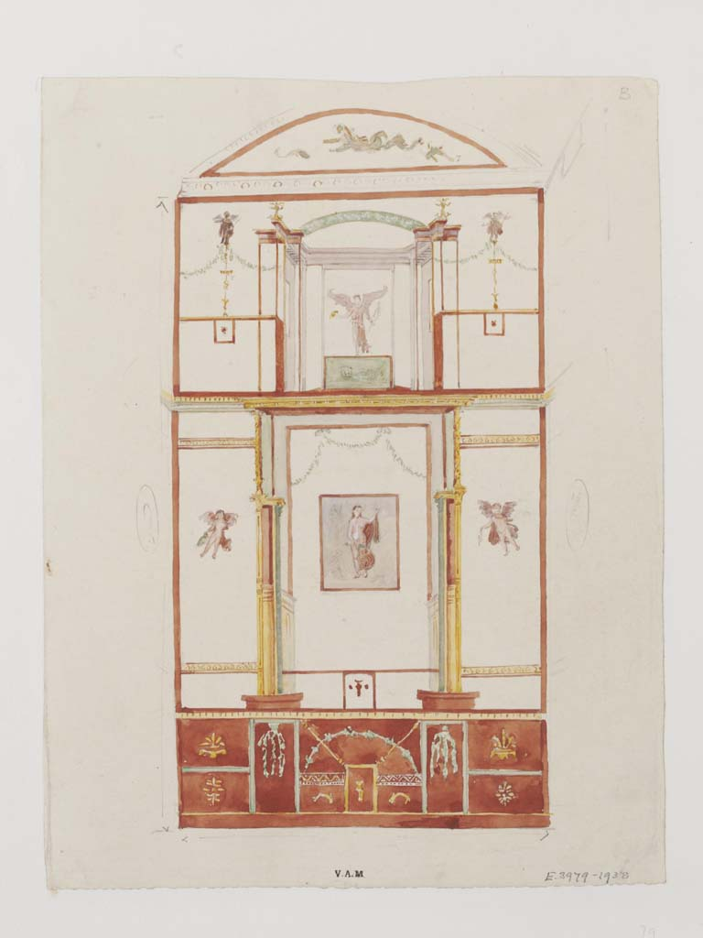
https://pompeiiinpictures.com/pompeiiinpictures/R7/7%2004%2048%20p5.htm

Slide 16
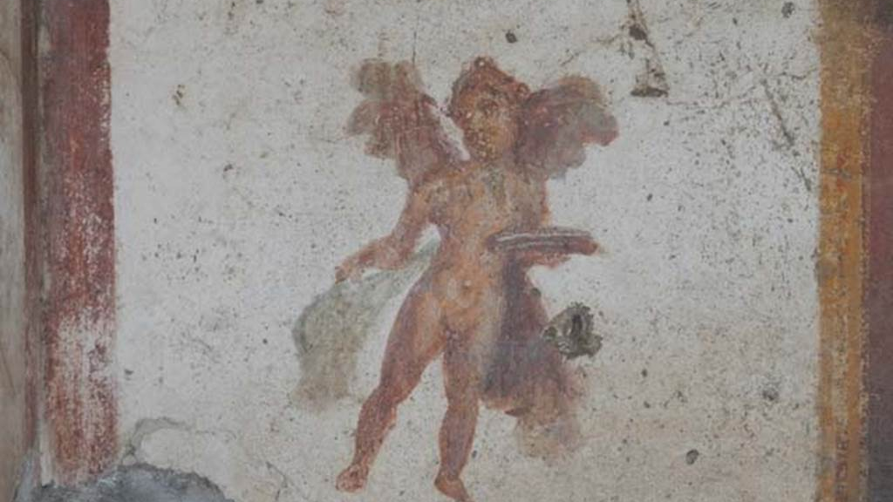
https://pompeiiinpictures.com/pompeiiinpictures/R7/7%2004%2048%20p5.htm

Slide 17
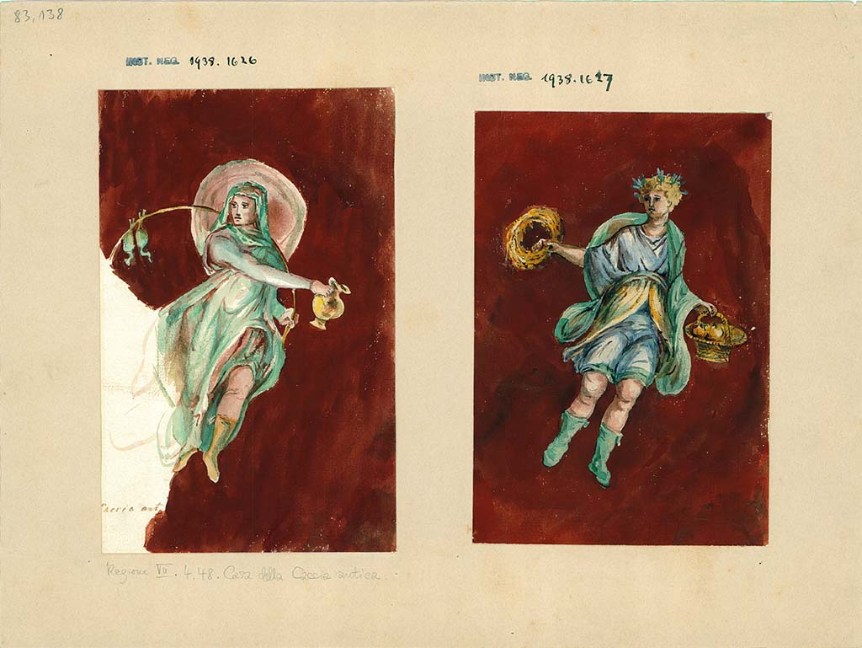
Paintings from the Atrium Walls showing winter 9North Wall0 and Autumn9West Wall
Photo: Deutsches Archäologisches Institut, Abteilung Rom, Arkiv. https://pompeiiinpictures.com/pompeiiinpictures/R7/7%2004%2048%20p5.htm

Slide 18
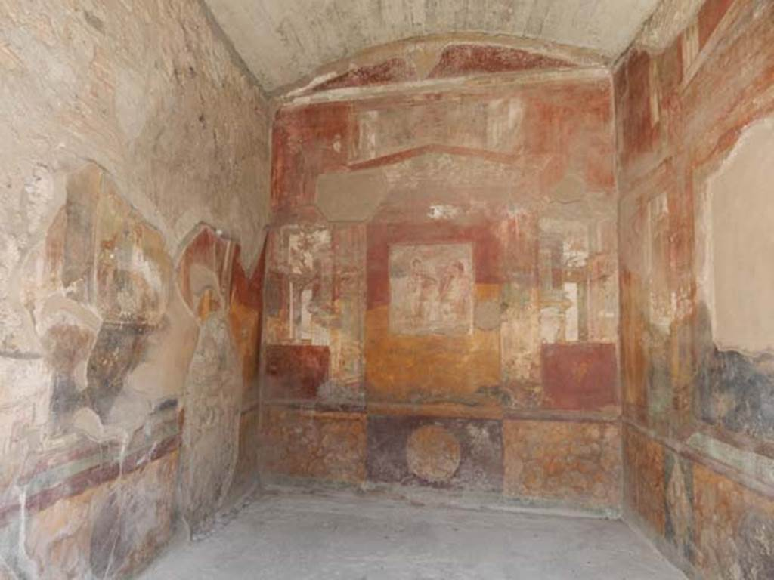
Exedra - Room 18,
Photo: Buzz Ferebee https://pompeiiinpictures.com/pompeiiinpictures/R7/7%2004%2048%20p7.htm

Slide 19
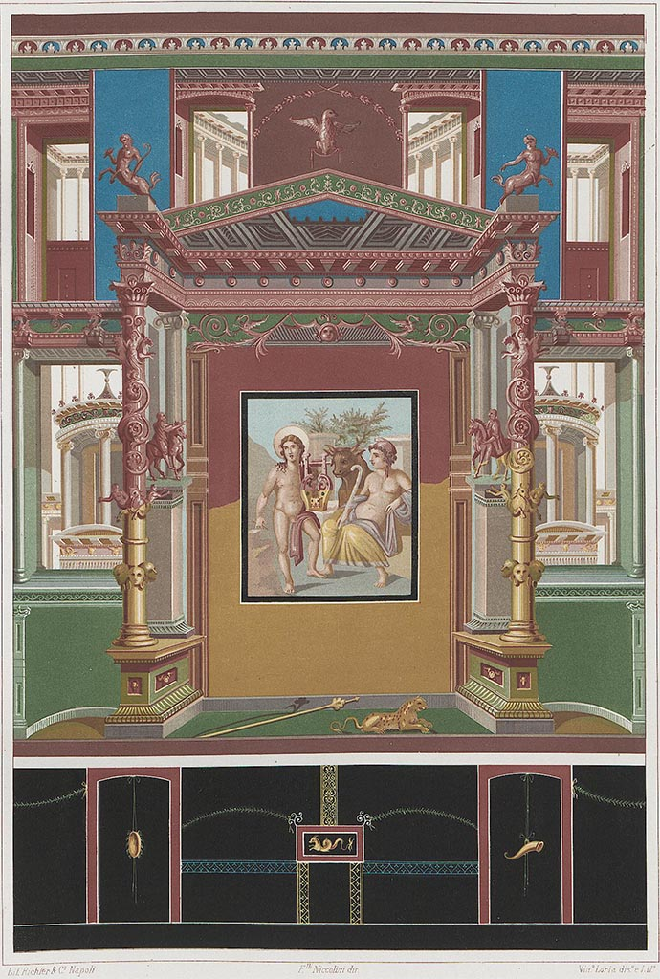
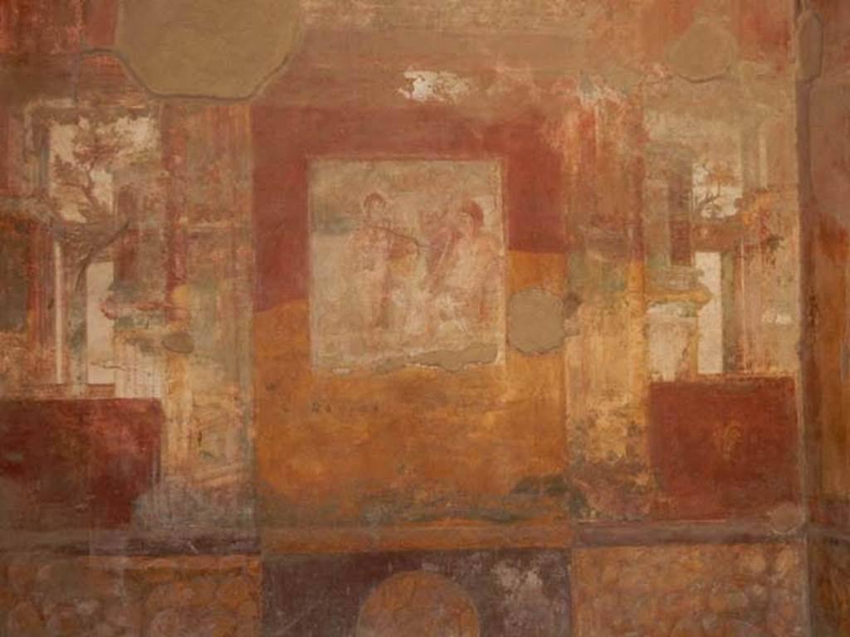
More info: https://pompeiiinpictures.com/pompeiiinpictures/R7/7%2004%2048%20p7.htm

Slide 20
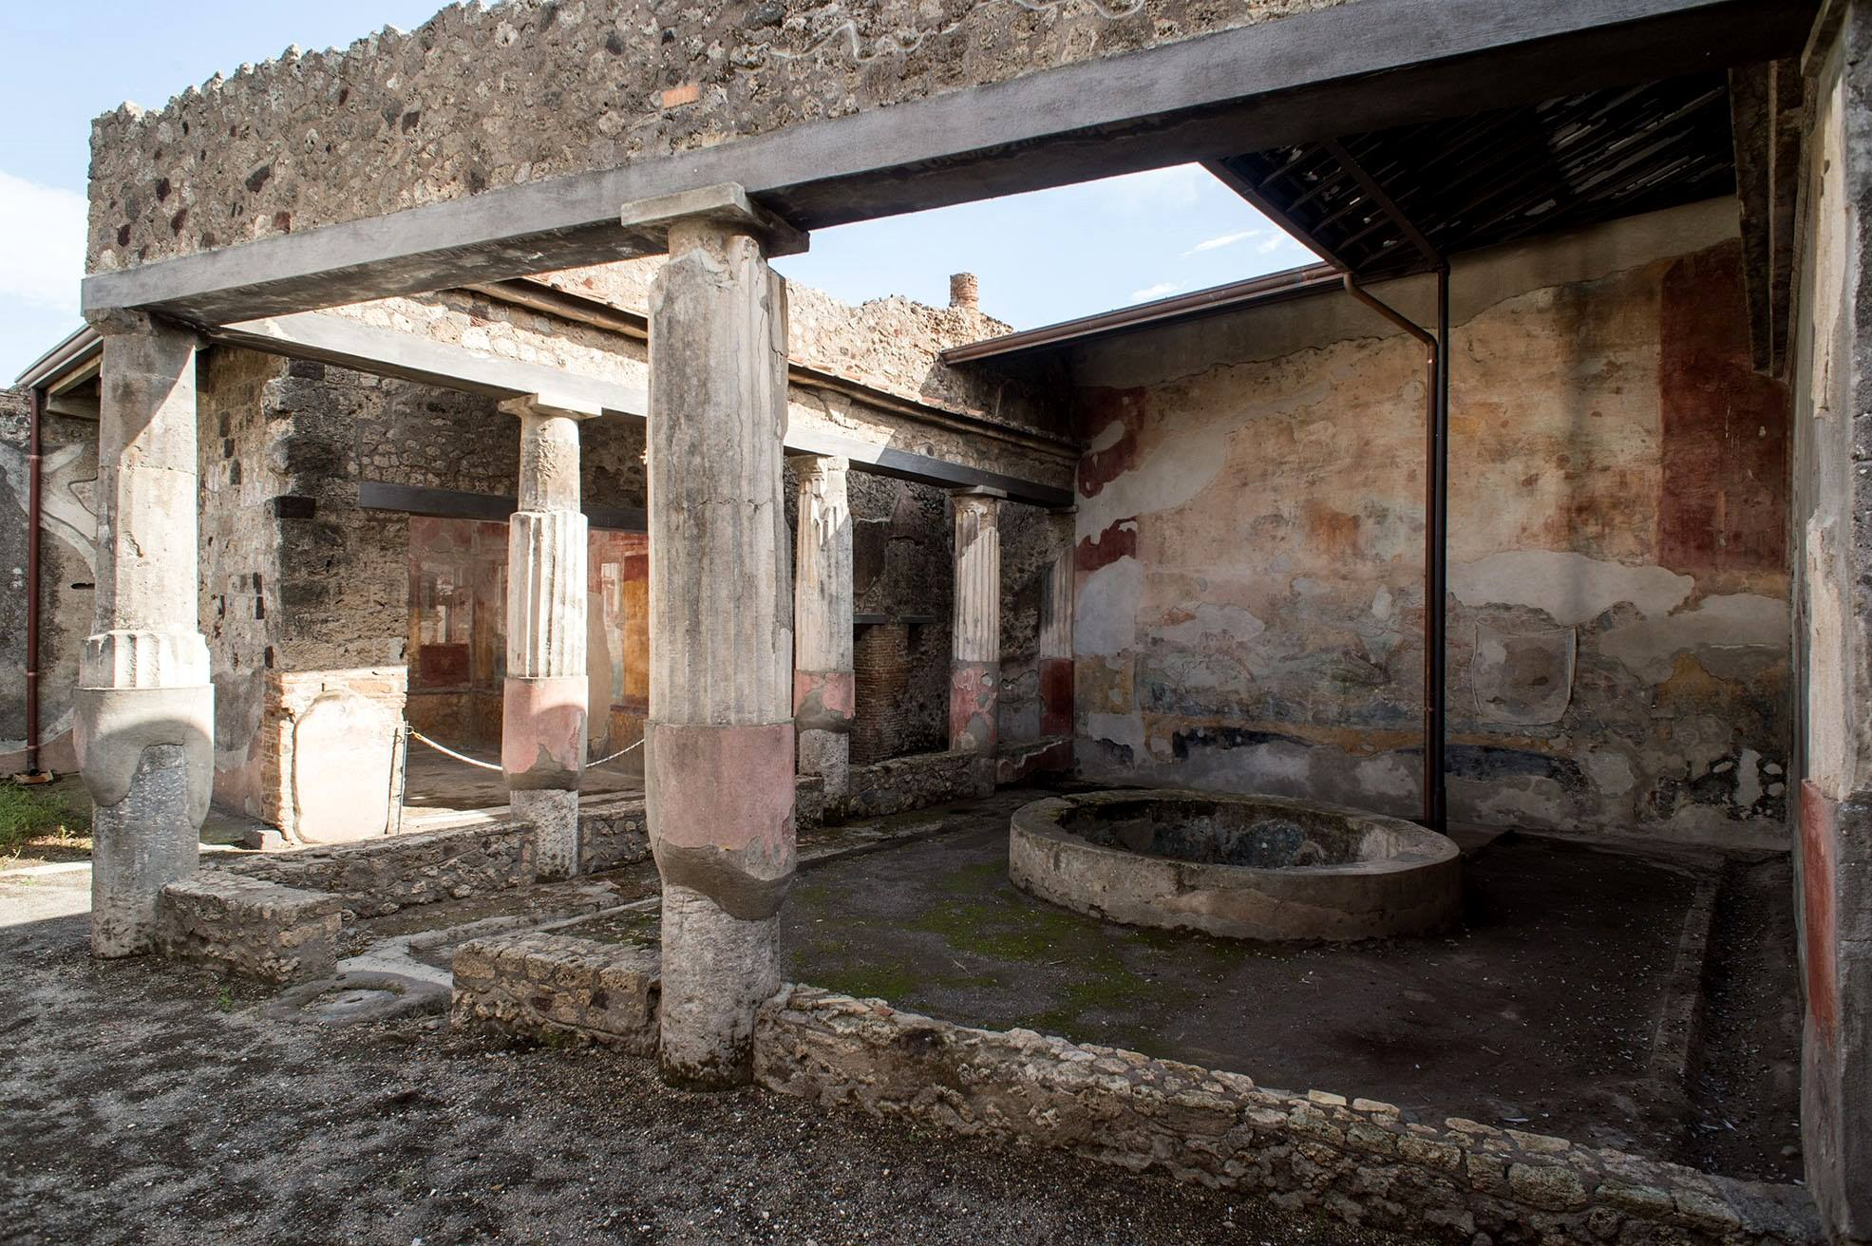
Peristyle in the House of the Ancient Hunt in Pompeii, Regio VII Insula 4.48, Pompeii, Italy https://www.artrenewal.org/artworks/atrium-a-pompei-nella-domus-della-caccia-antica/luigi-bazzani/92235

Slide 21
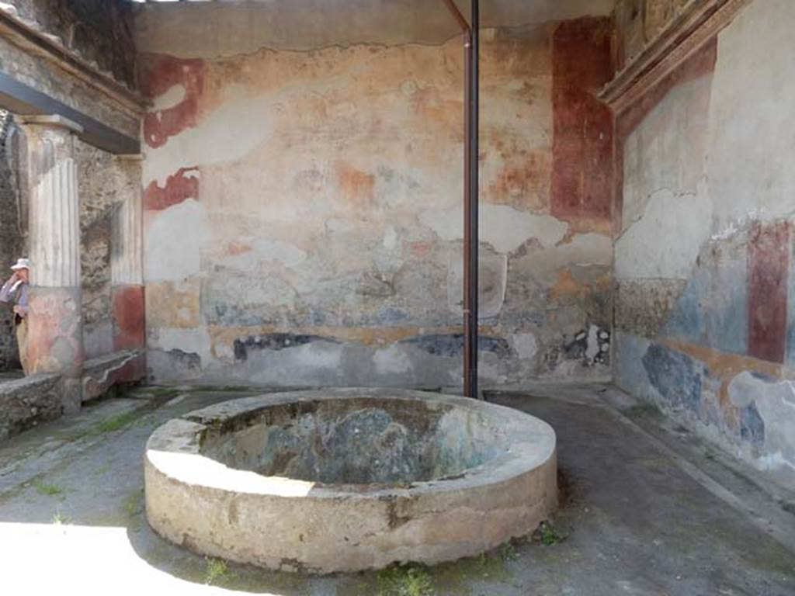
https://pompeiiinpictures.com/pompeiiinpictures/R7/7%2004%2048%20p8.htm

Slide 22
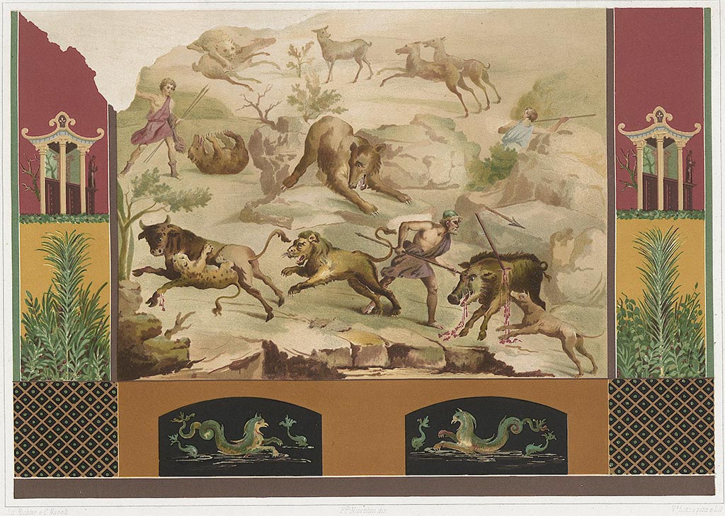
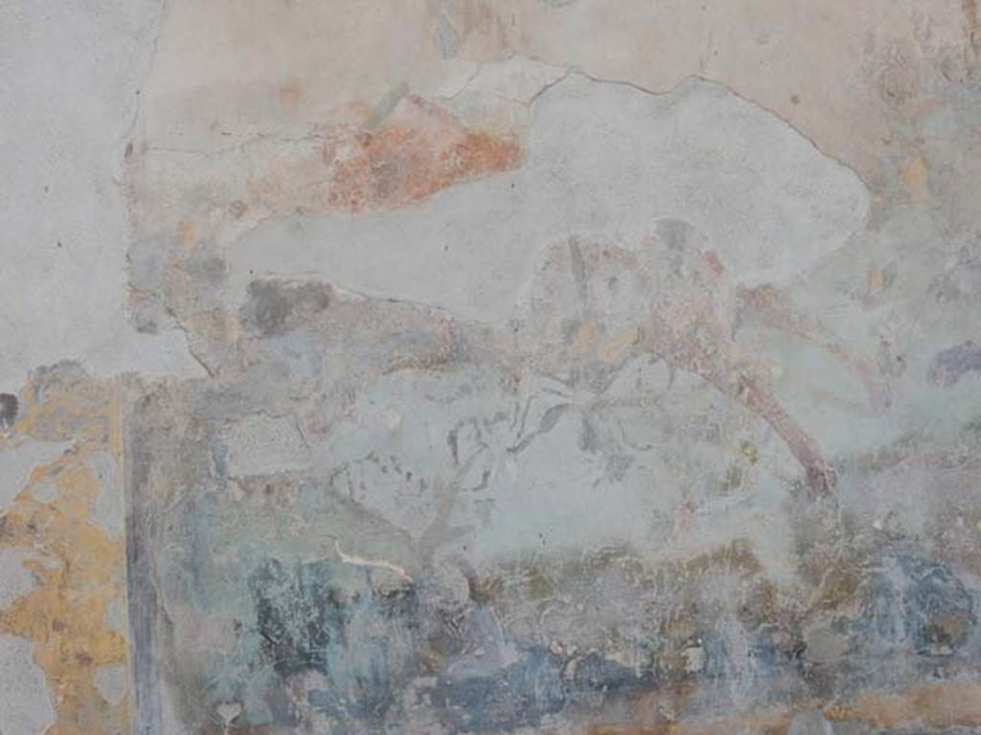
Painting by F. Niccolini showing hunt scene on the South Wall of the Peristyle, and current situation
Niccolini F, 1862. The houses and monuments of Pompeii: Volume Two. Naples, General Description, Plate LXXXII https://pompeiiinpictures.com/pompeiiinpictures/R7/7%2004%2048%20p8.htm

Slide 23
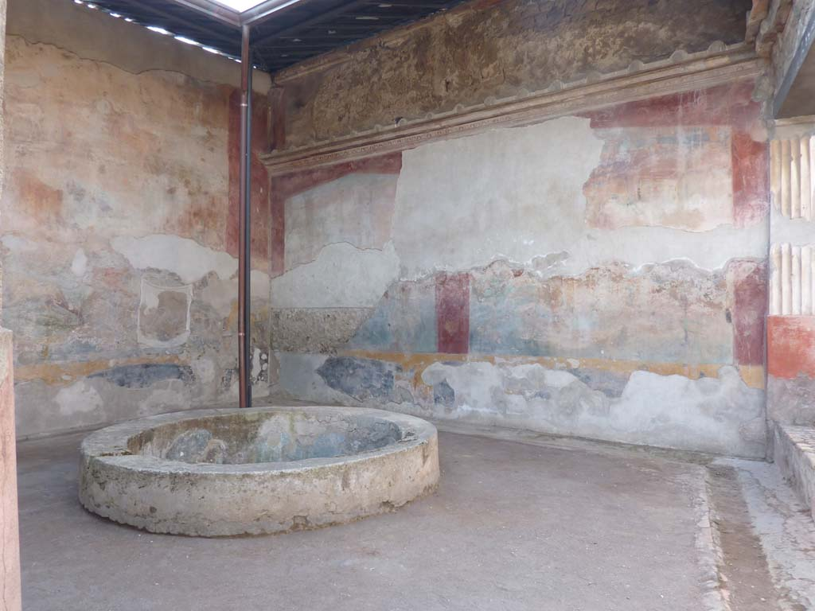
Looking towards the South-West corner of the Peristyle
Photo: Annette Haug https://pompeiiinpictures.com/pompeiiinpictures/R7/7%2004%2048%20p8.htm

Slide 24
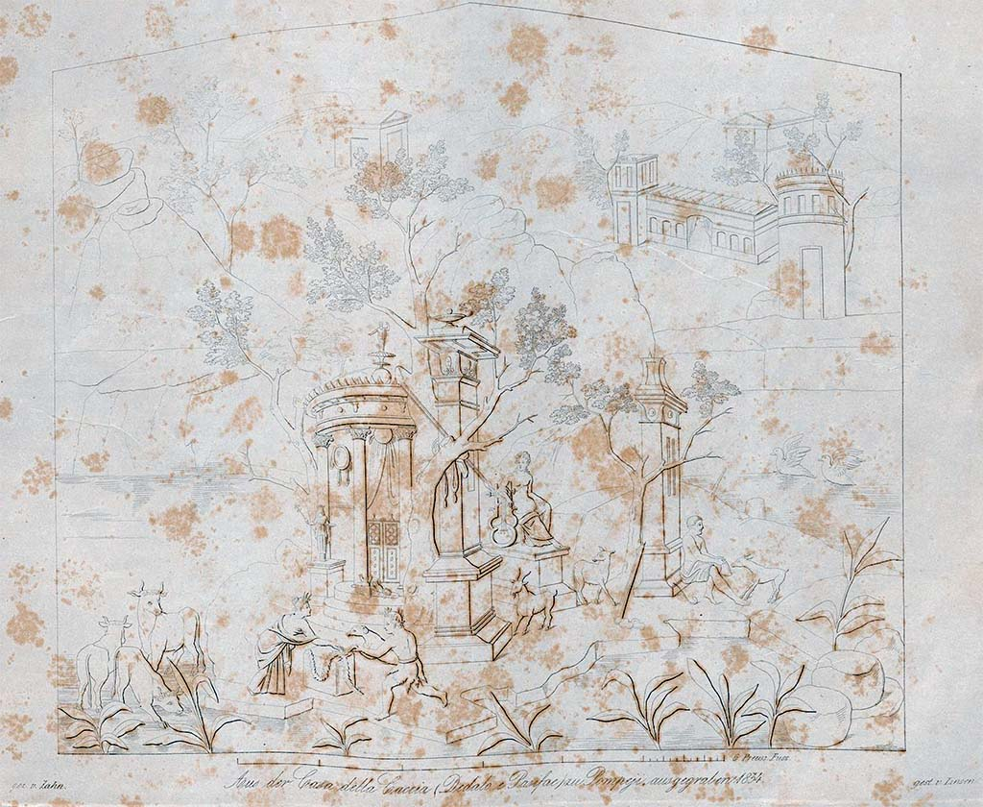
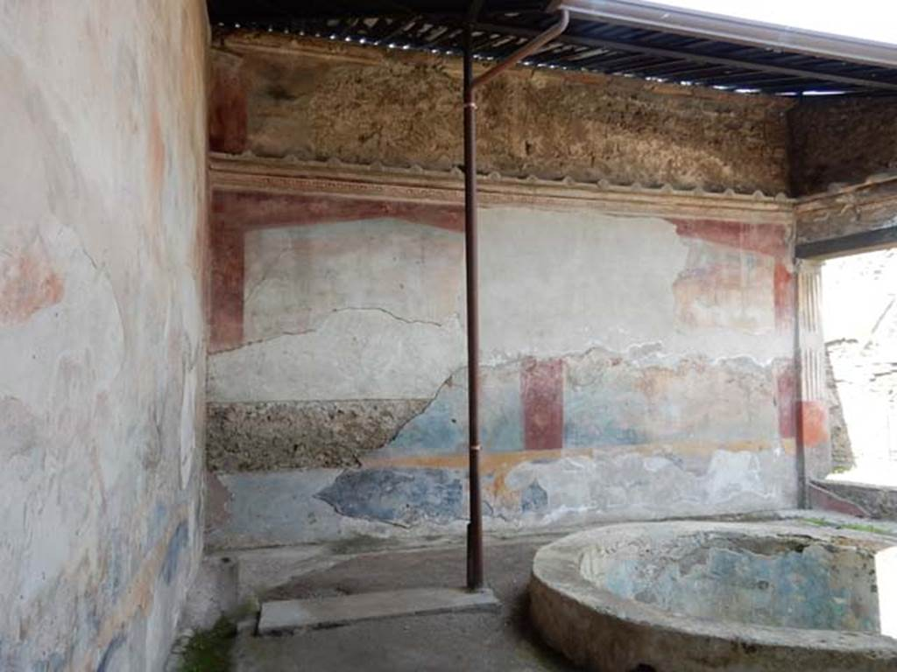
Drawing by W. Zahn of a scene in the painting found on the West Wall of the Peristyle and the current situation https://pompeiiinpictures.com/pompeiiinpictures/R7/7%2004%2048%20p9.htm

Slide 25
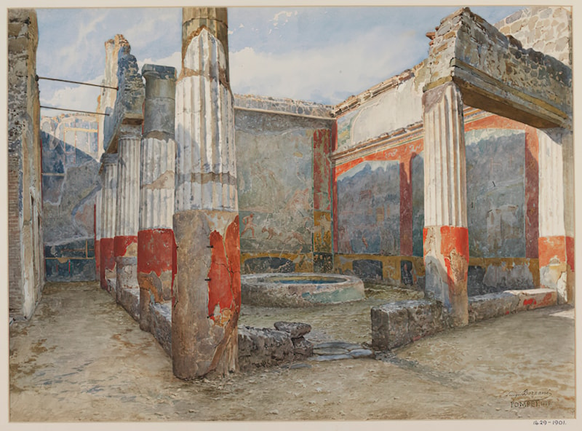
Luigi Bazzani, Italian Artist, 1836-1927
Peristyle in the House of the Ancient Hunt in Pompeii, 1886, Watercolour on Paper, 34.92x 47.94, Victoria and Albert Museum, London UK https://www.artrenewal.org/artworks/atrium-a-pompei-nella-domus-della-caccia-antica/luigi-bazzani/92235

Slide 26
The End

