Slide 1
Portraits of
Sofonisba Anguissola
1532 – 1625

Slide 2
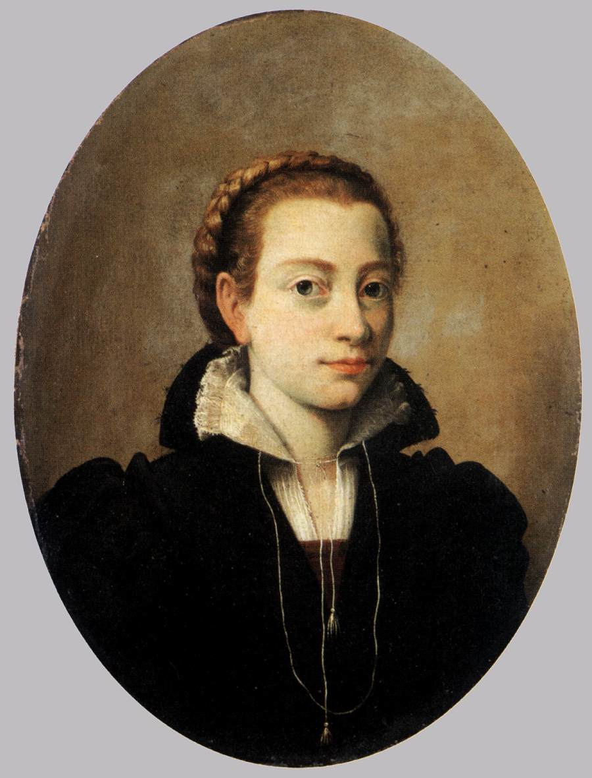
Self-Portrait, 1550s, Oil on canvas, 45 x 34 cm, Museo Poldi Pezzoli, Milan, Italy https://www.wga.hu/html_m/a/anguisso/sofonisb/s_portra.html

Slide 3
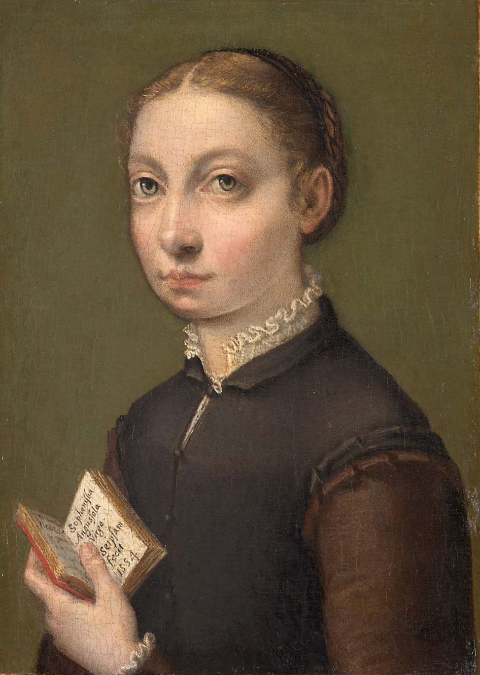
Sofonisba Anguissola, c. 1532 – 1625
Self-Portrait, 1554, Oil on panel, 20 x 13 cm, Kunsthistorisches Museum, Vienna, Austria https://www.khm.at/en/objectdb/detail/66/

Slide 4
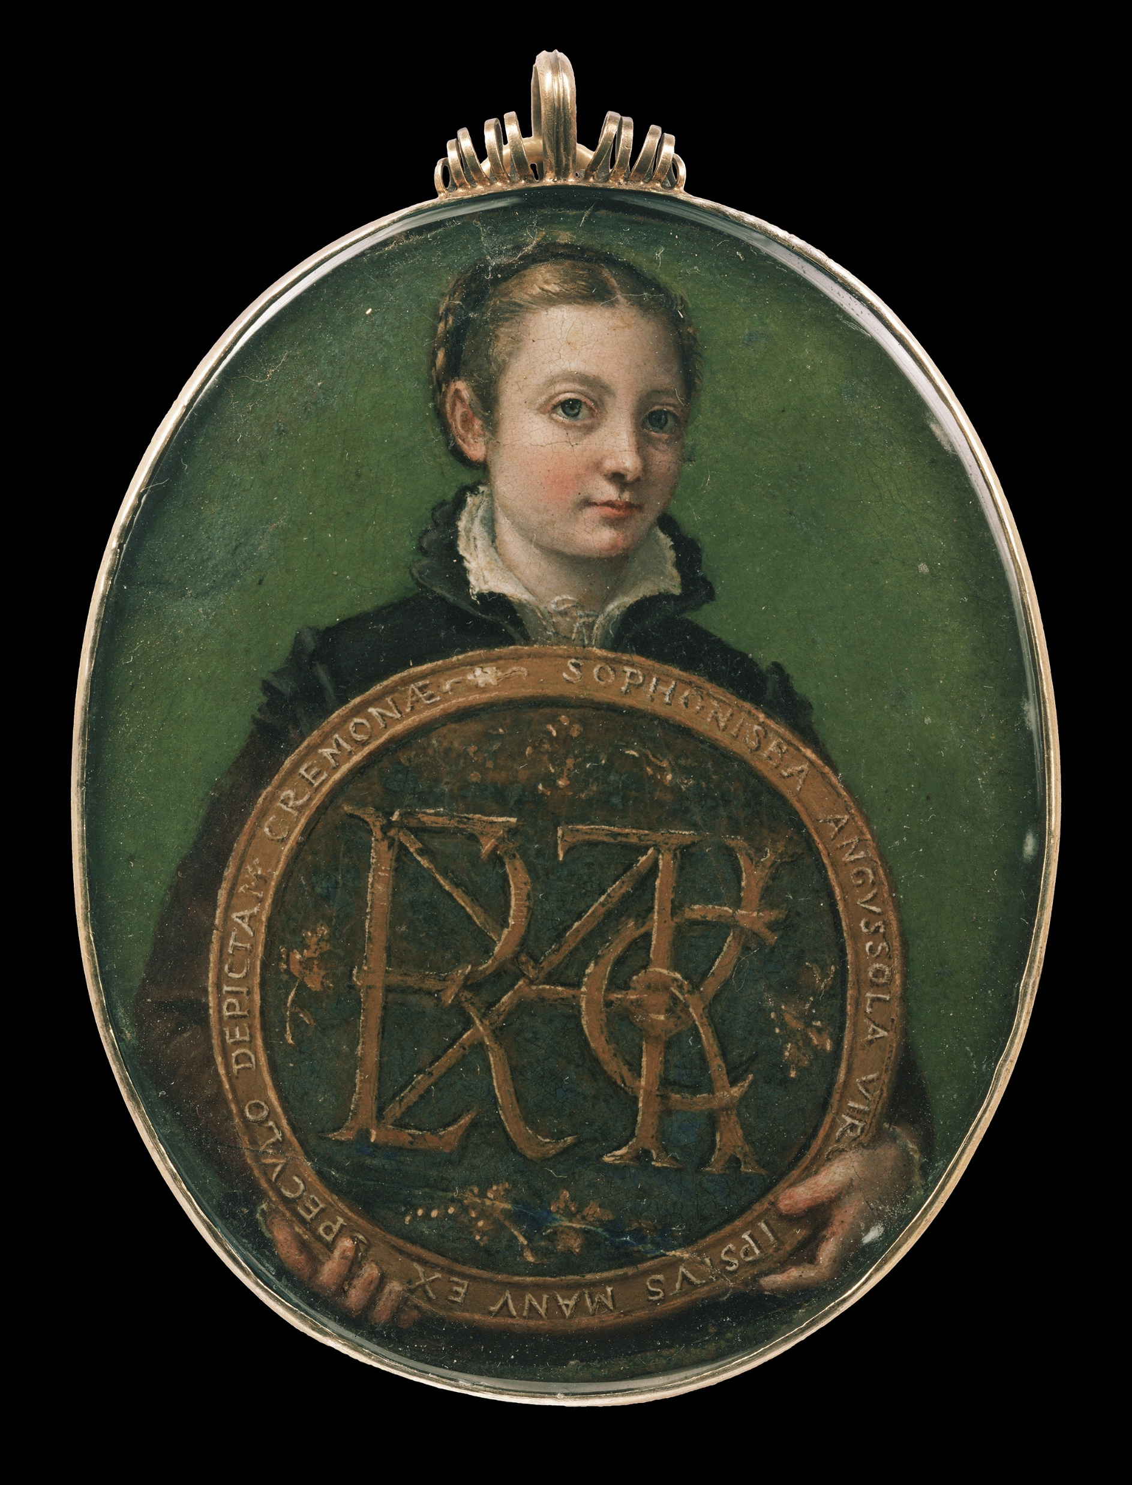
Sofonisba Anguissola, c. 1532 – 1625 Self-Portrait, c. 1556, Oil on parchment, 8,3 x 6,4 cm, Museum of Fine Arts, Boston, USA https://upload.wikimedia.org/wikipedia/commons/8/88/Sofonisba_Anguissola_-_Self-Portrait_-_c._1556.jpg

Slide 5
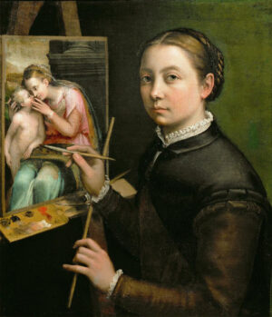
Sofonisba Anguissola, c. 1532 – 1625
Self-Portrait at the Easel, 1556, Oil on Canvas, 66x57 cm, Łańcut Castle, Poland https://smarthistory.org/sofonisba-anguissola/

Slide 6
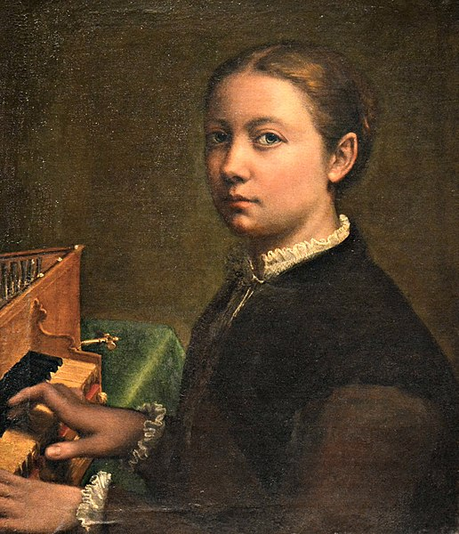
Sofonisba Anguissola, c. 1532 – 1625
Self-Portrait Playing the Spinet
1556-57
Oil on canvas, 57 x 48 cm
Museo Nazionale di Capodimonte, Naples, Italy https://commons.wikimedia.org/wiki/File:Autoritratto_alla_spinetta,_Sofonisba_Anguissola_001.JPG

Slide 7
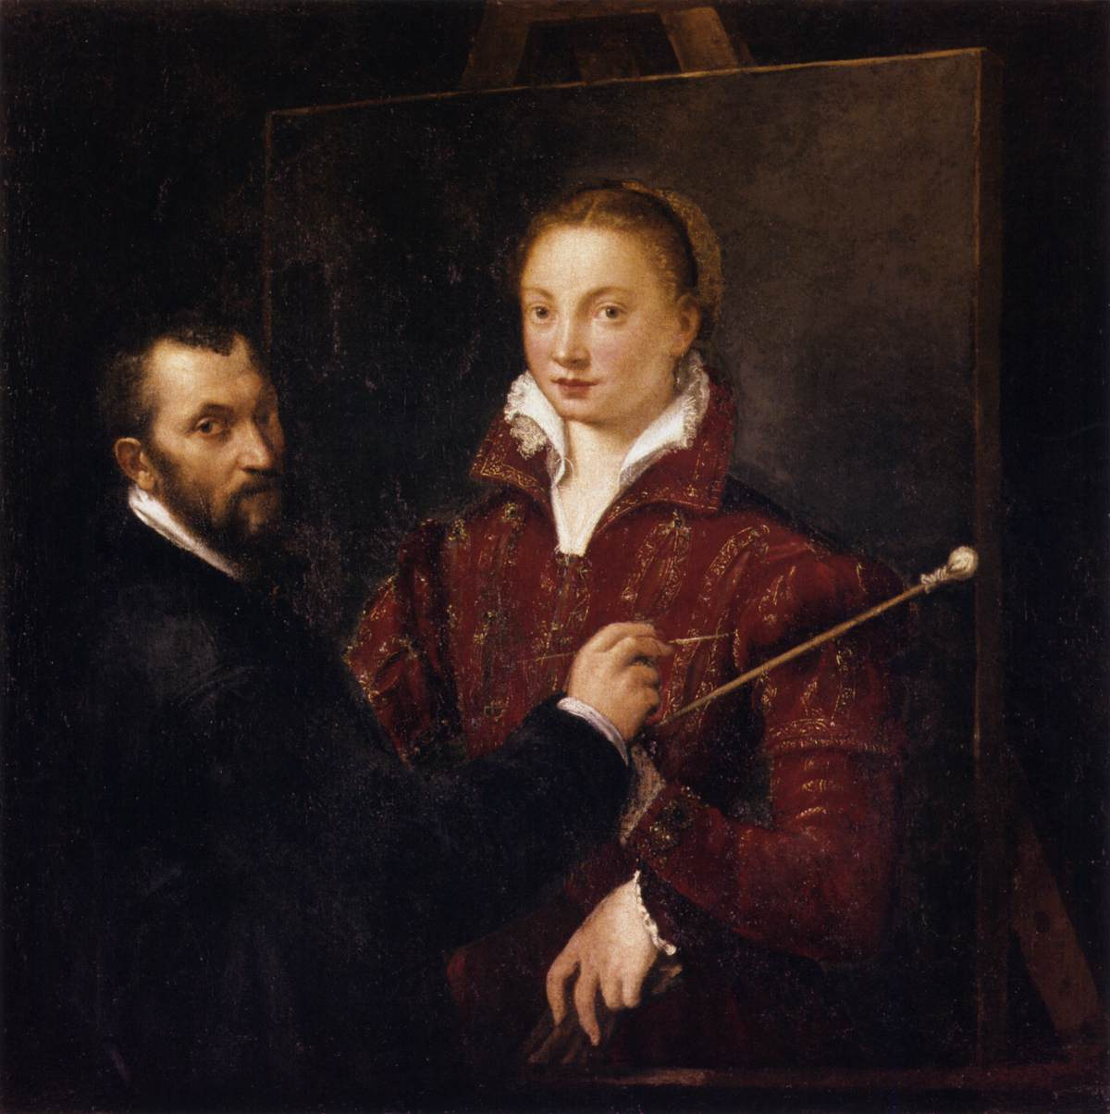
Bernadino Campi,
1522–1591
Bernardino Campi Painting Sofonisba Anguissola c. 1559
Oil on canvas, 111 x 110 cm
Pinacoteca Nazionale, Siena, Italy https://www.wga.hu/frames-e.html?/html/a/anguisso/sofonisb/index.html

Slide 8
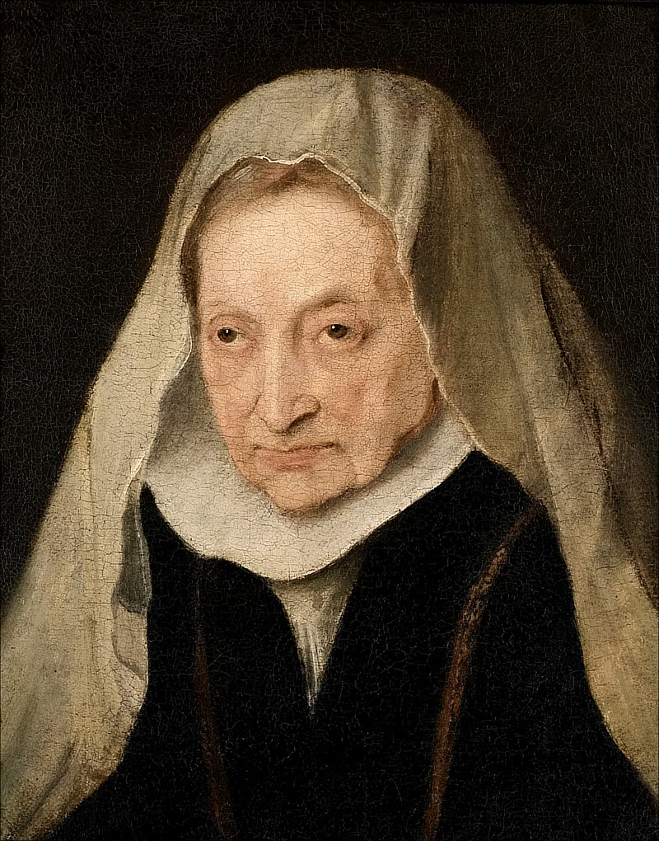
Anthony van Dyck, 1599–1641
Portrait of Sofonisba Anguissola, 1624, Oil on panel, 41.6x33.7 cm, Knole House, National Trust, National Trust Collections, UK https://www.wikidata.org/wiki/Property:P4373

