Slide 1
Nikolaos Gyzis
1842–1901
14 Paintings
National Gallery
Alexandros Soutsos Museum
https://www.nationalgallery.gr/en/artist/gyzis-nikolaos/

Slide 2
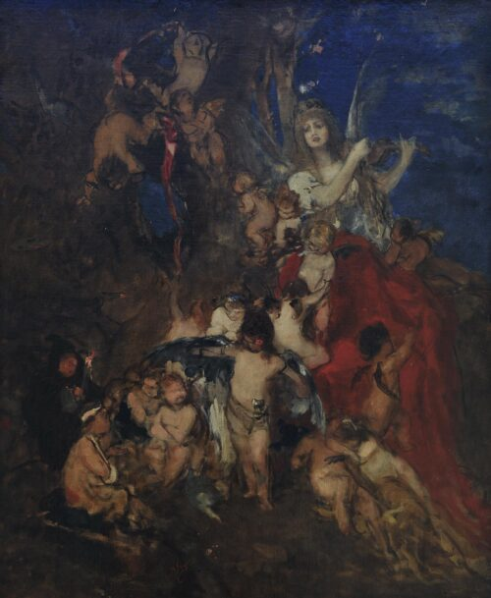
Art and its Spirits, 1876,
Oil on Canvas,
67 x 55 cm

Slide 3
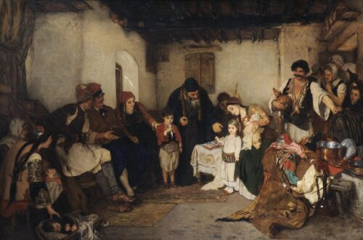
The Betrothal of the Children, 1877
Oil on Canvas, 103 x 155 cm, Apostolos Chatziargyris Bequest

Slide 4
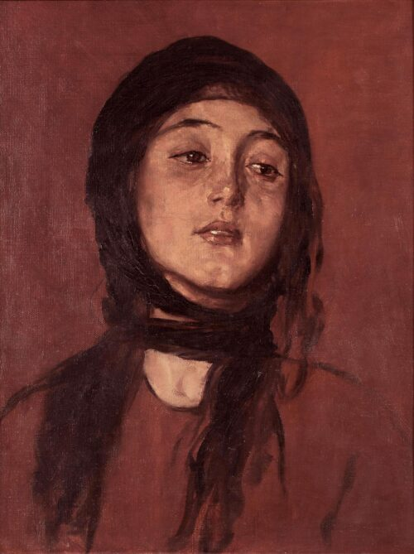
Wishbone, 1878, Oil on Canvas, 46 x 37 cm,
Apostolos Chatziargyris Bequest

Slide 5
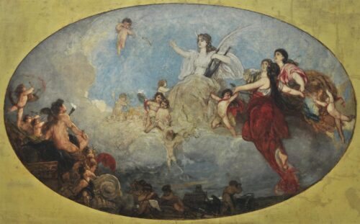
The Liberal Arts and their Spirits, 1878 - 1880
Oil on Canvas, 99 x 152 cm,
Ε. Koutlidis Foundation Collection

Slide 6
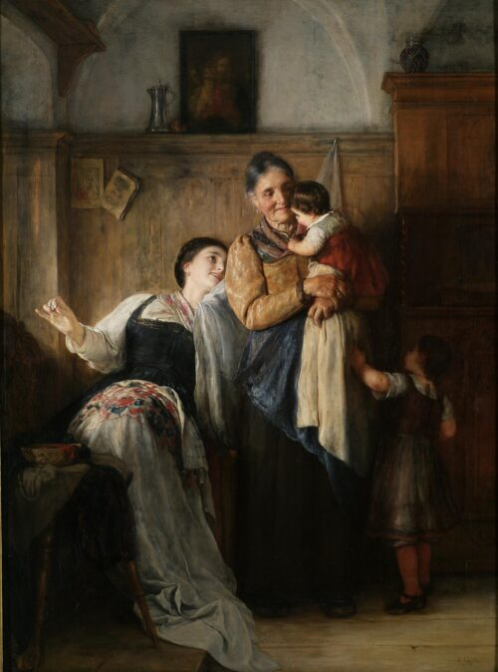
Peak-a-Boo, 1882
Oil on Canvas, 100 x 75 cm
Anonymous donation in memory of
D. Tzirakopoulos

Slide 7
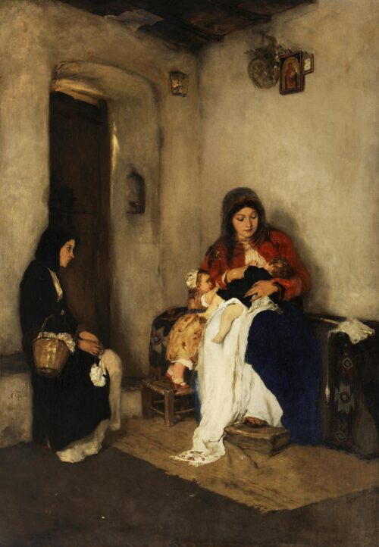
Foster Mother,
1882-1883, Oil on Canvas, 105 x 73 cm,
Ε. Koutlidis Foundation Collection

Slide 8
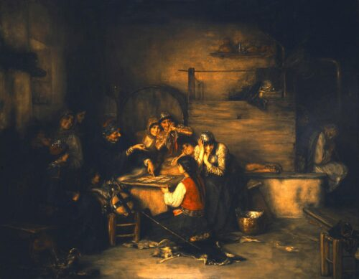
The Fortune Teller, 1885, Oil on Canvas, 72,5 x 92,5 cm, Antonios Benakis Bequest

Slide 9
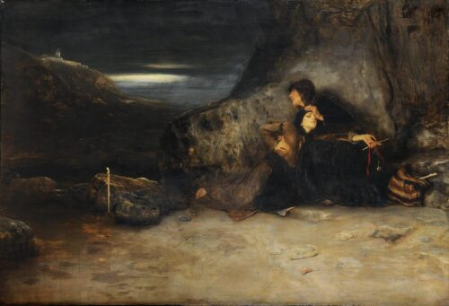
The Vow, 1886, Oil on Canvas, 107 x 158 cm

Slide 10
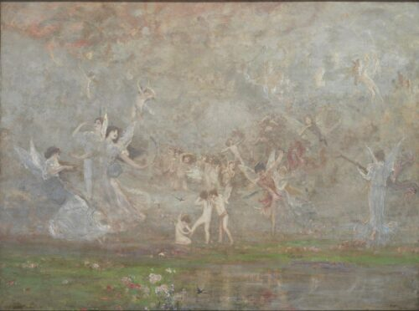
Spring Symphony, 1886, Oil on Canvas, 102 x 139 cm
Donated by Antonios Benakis

Slide 11
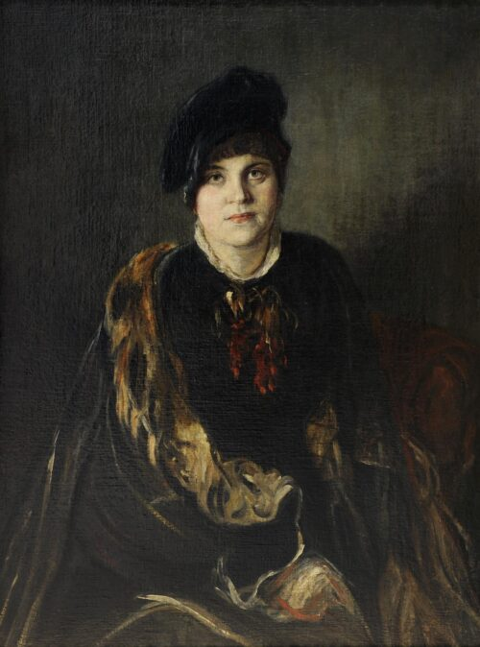
Artemis Gyzi, 1890, Oil on Canvas,
100 x 75 cm,
Ε. Koutlidis Foundation Collection

Slide 12
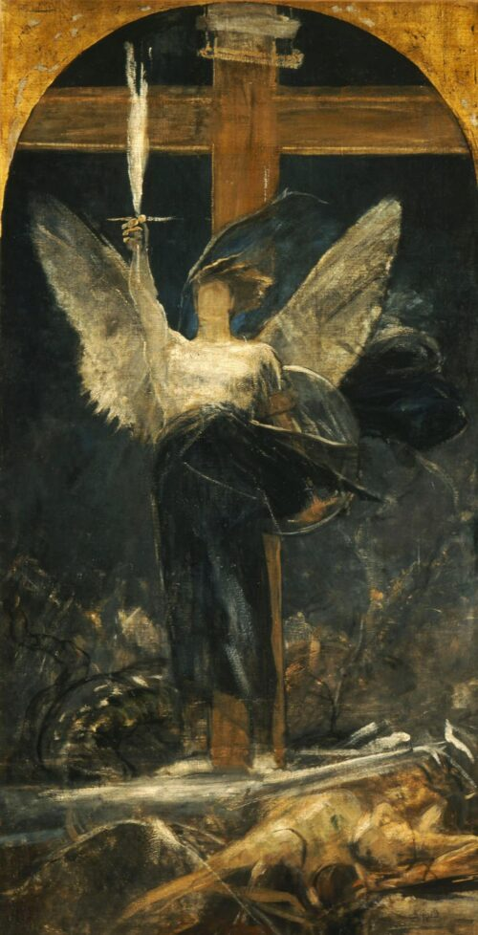
The Archangel, study for the Grounding of Faith, 1894-1895,
Oil on Canvas, 145 x 73 cm,
Ε. Koutlidis Foundation Collection

Slide 13
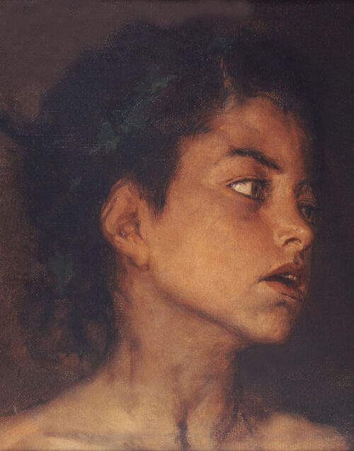
The Little Satyr, ca 1895, Oil on Canvas, 32 x 26 cm,
E. Koutlidis Foundation Collection

Slide 14
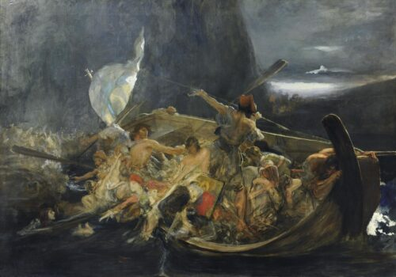
After the Destruction of Psara, ca 1896-1898
Oil on Canvas, 133 x 188 cm

Slide 15
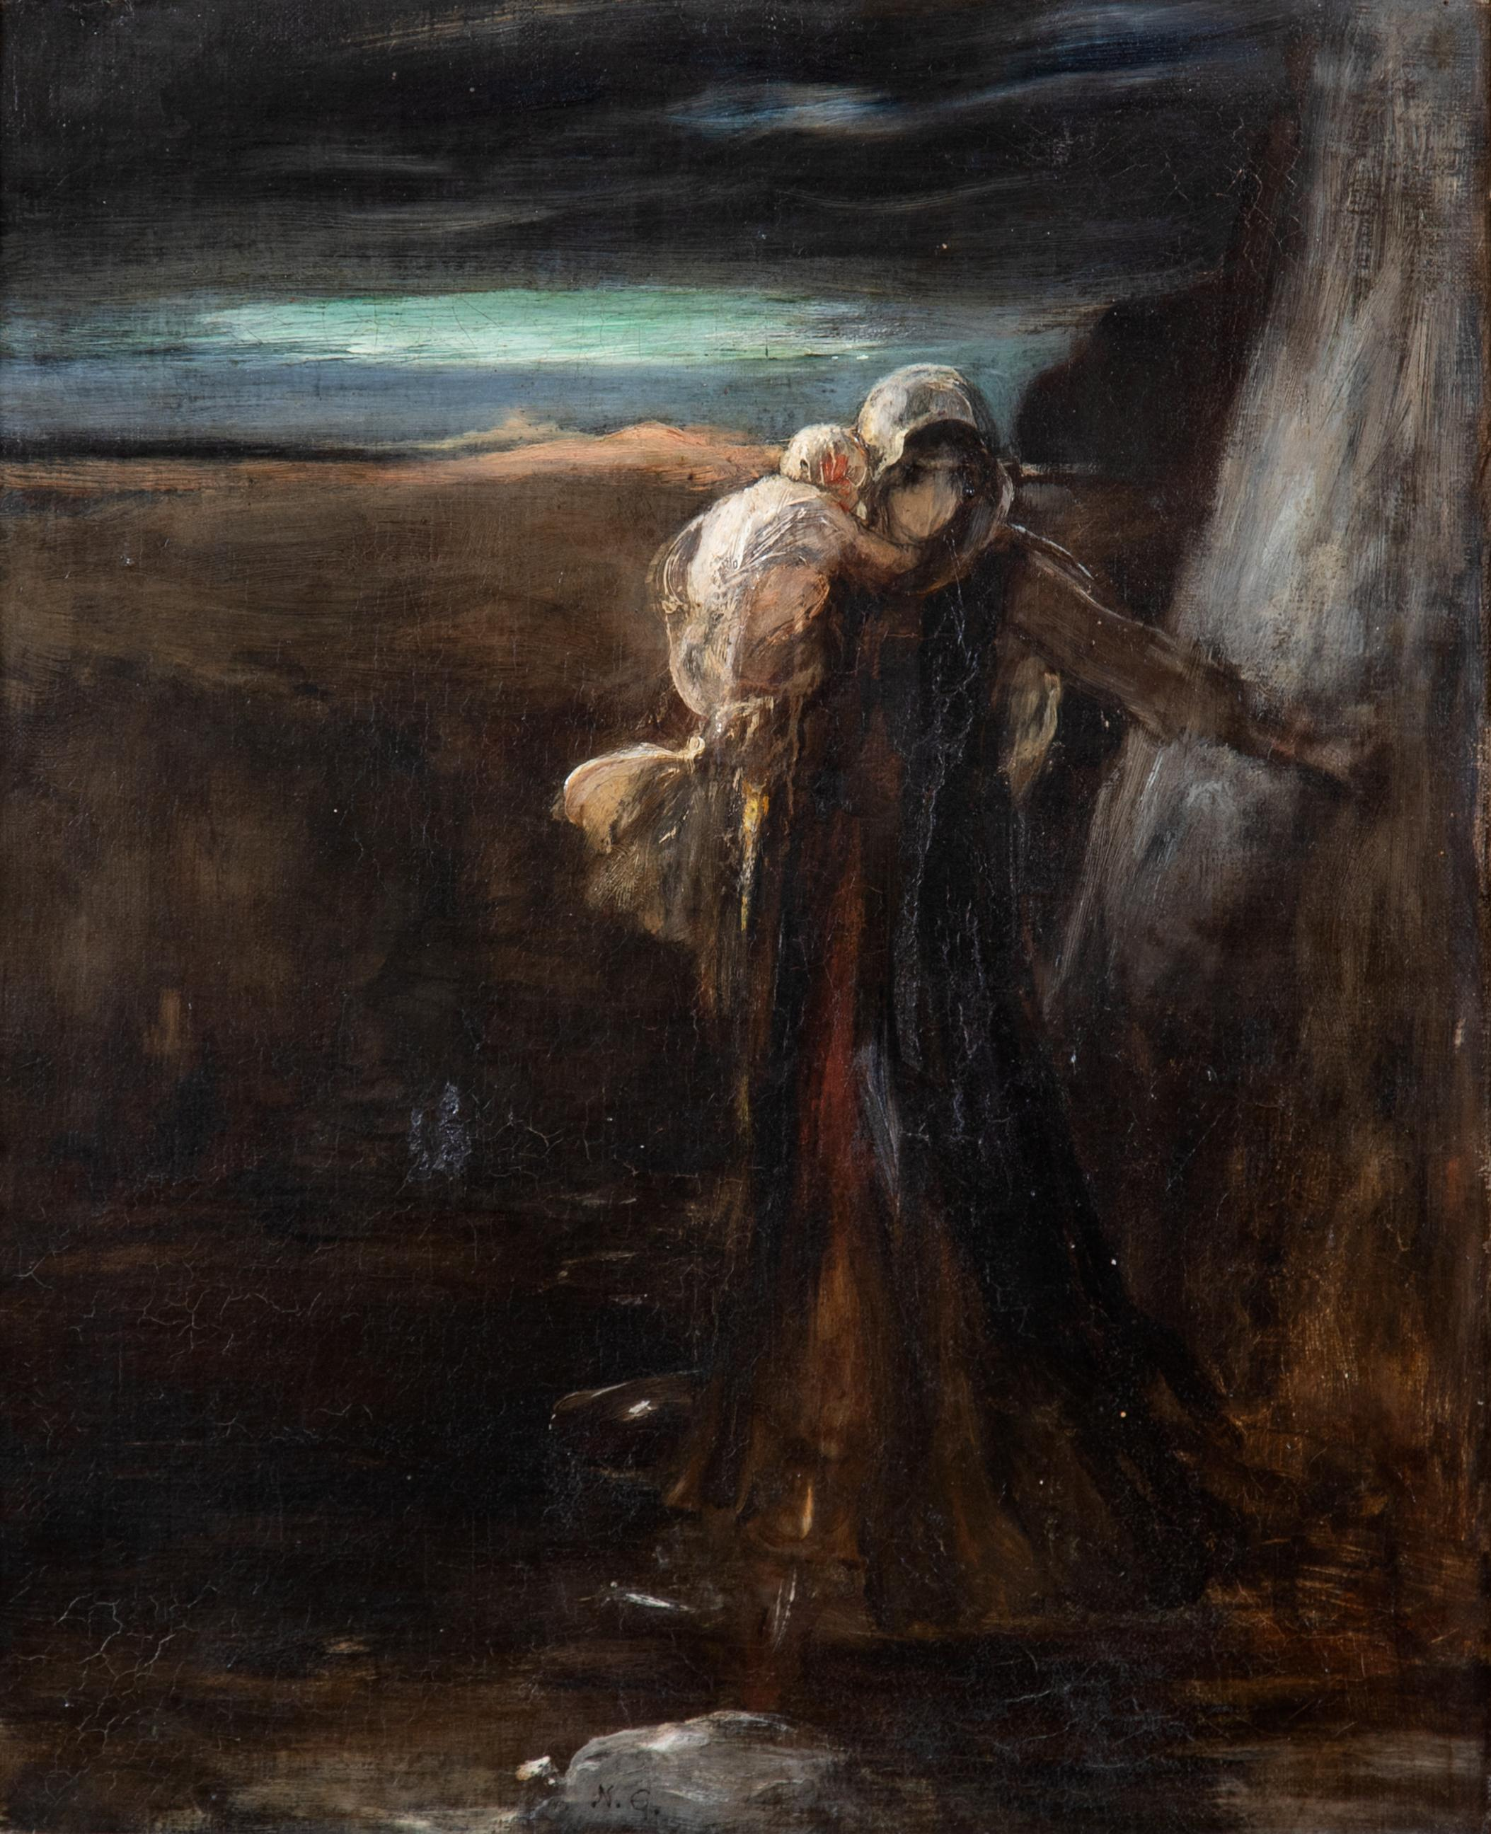
Fuite après le massacre de Psara (Flight after the Massacre of Psara), c. 1896, Oil on Canvas, 37,5 x 30,5 cm, Private Collection https://www.bonhams.com/auction/29818/lot/4/nicholaos-gysis-1842-1901-fuite-apres-le-massacre-de-psara/

Slide 16
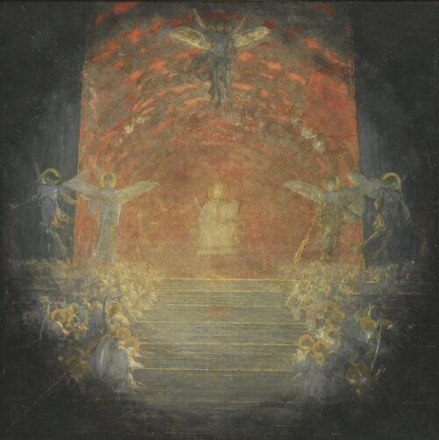
Behold the Bridegroom Arriving, 1899-1900, Oil on Canvas, 200 x 200 cm

