Slide 1
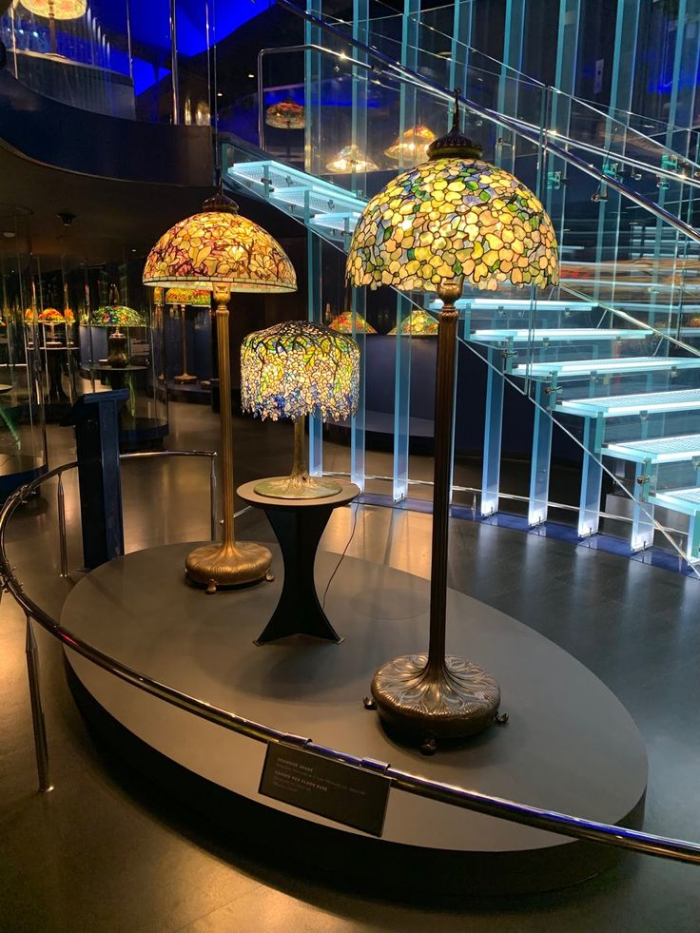
Tiffany Lamps https://attemptedbloggery.blogspot.com/2019/03/tiffany-lamps-at-new-york-historical.html?utm_content=buffer5dd7d&utm_medium=social&utm_source=twitter.com&utm_campaign=buffer&m=1

Slide 2
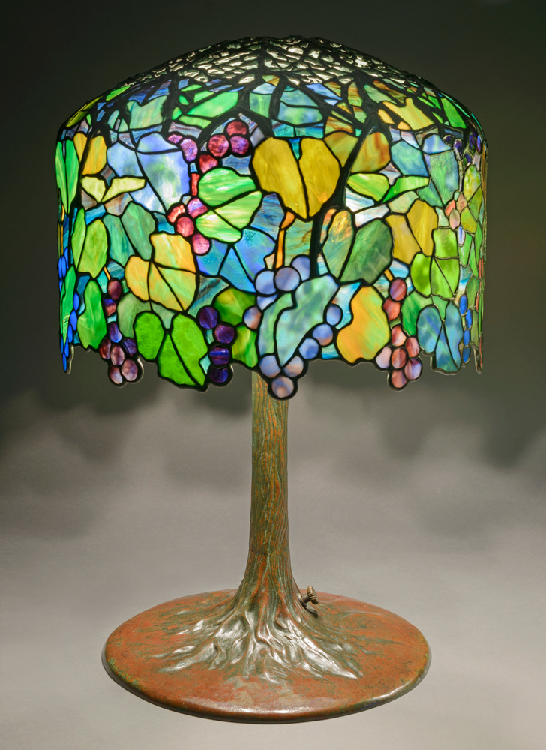
Designer: Louis C. Tiffany, 1848–1933
Maker: Tiffany Studios, 1902–32
‘Grape’ Library Lam, ca. 1905, Leaded glass, bronze,
The Neustadt Collection of Tiffany Glass, NY, USA https://treasuresontrial.winterthur.org/evidence/tiffany/

Slide 3
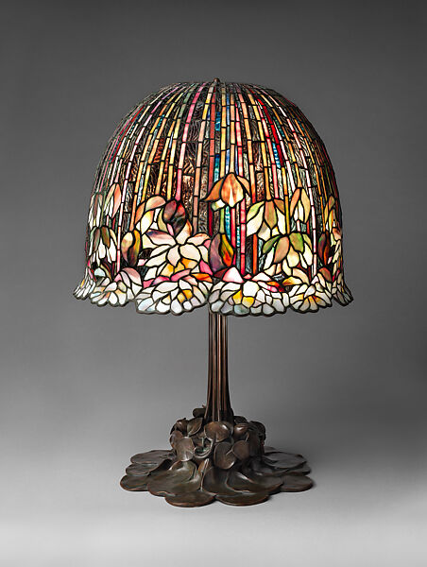
Designer: Louis C. Tiffany, American, 1848–1933
Maker: Tiffany Studios, 1902–32
‘Water-Lily’ Table Lamp, 1904–15, Leaded Favrile glass and bronze, the MET, NY, USA https://www.metmuseum.org/art/collection/search/4715

Slide 4
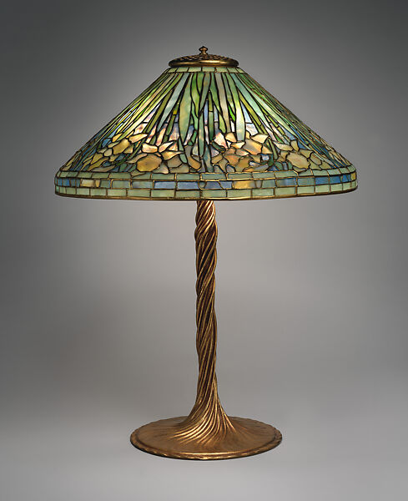
Designer: Louis C. Tiffany, 1848–1933
Maker: Tiffany Studios, 1902–32
‘Daffodil’ Table lamp, ca. 1904–10, Leaded opalescent glass and gilt bronze, the MET, NY, USA https://www.metmuseum.org/art/collection/search/811029

Slide 5
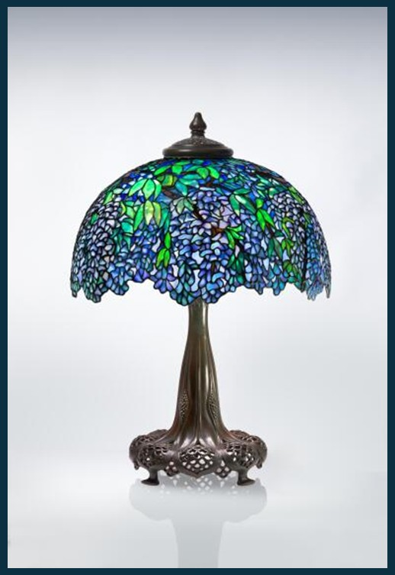
Designer: Louis C. Tiffany, American, 1848–1933 (Shade) - attributed to Clara Driscoll, American, 1861–1944 (Base)
Maker: Tiffany Studios, 1902–32
‘Wisteria-Laburnum’ Table Lamp with a telescoping reticulated “Queen Anne's Lace” base, circa 1910, leaded glass, patinated bronze, Private Collection https://www.sothebys.com/en/buy/auction/2024/louis-comfort-tiffany-artistry-in-glass-the-seymour-and-evelyn-holtzman-collection/a-unique-wisteria-laburnum-table-lamp

Slide 6
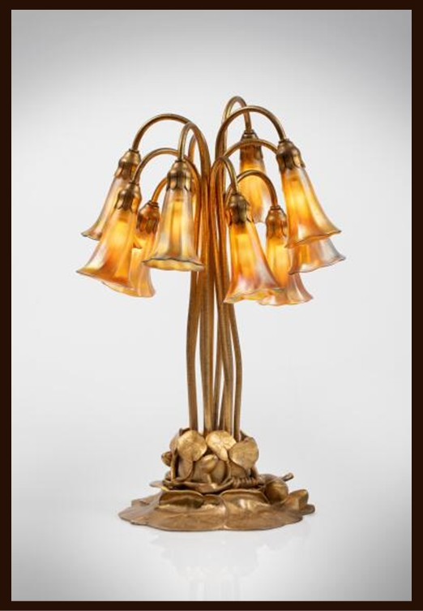
Designer: Louis C. Tiffany, American, 1848–1933
Maker: Tiffany Studios, 1902–32
Ten-Light ‘Lily’ Table Lamp, circa 1910, Favrile glass, gilt bronze, Private Collection https://www.sothebys.com/en/buy/auction/2024/louis-comfort-tiffany-artistry-in-glass-theseymour-and-evelyn-holtzman-collection/ten-light-lily-table-lamp

Slide 7
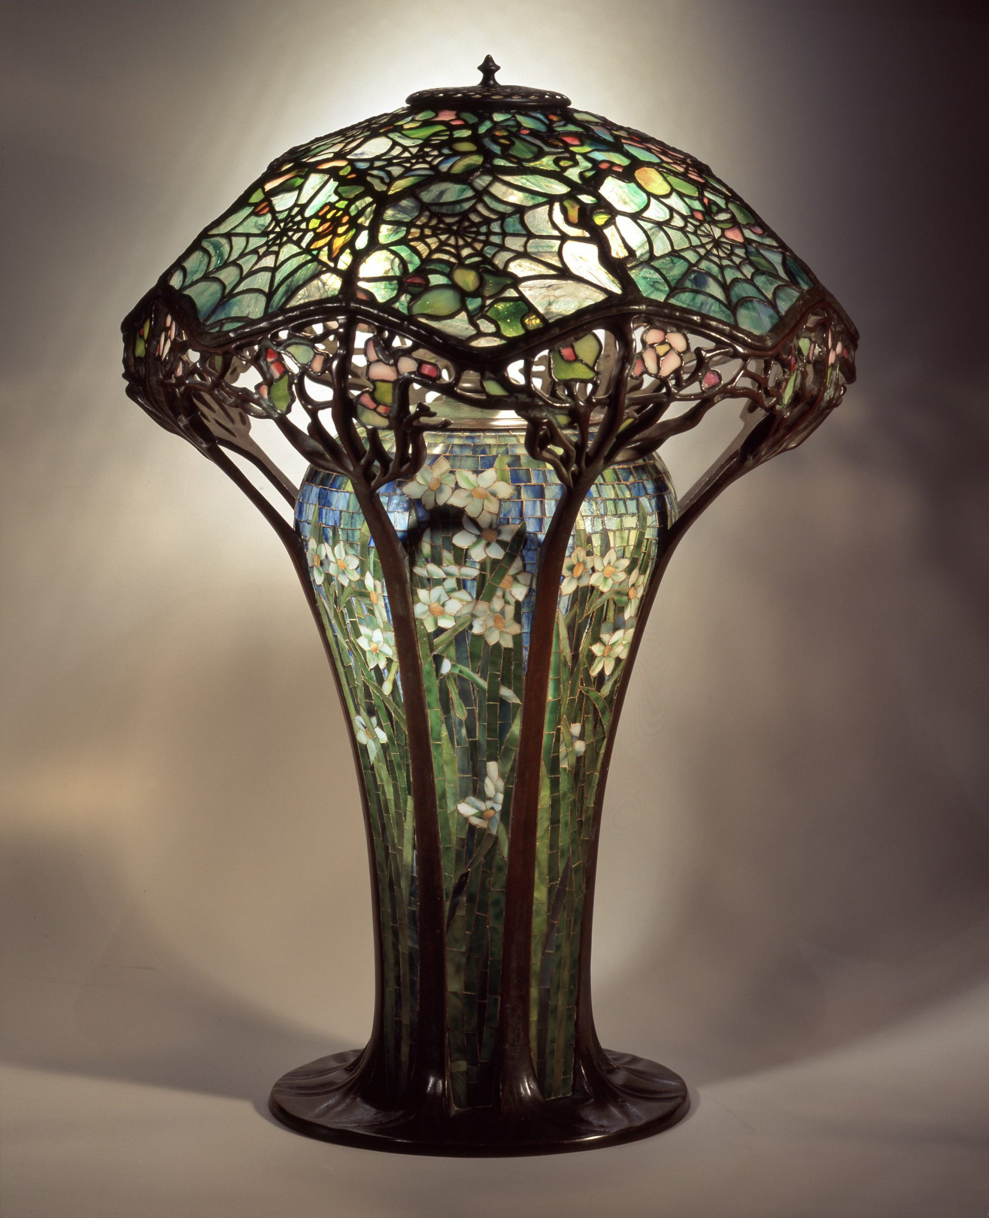
Designer: Louis C. Tiffany, American, 1848–1933
Maker: Tiffany Studios, 1902–32
Library lamp, c. 1900,
Leaded glass, mosaic, bronze, The Charles Hosmer Morse Museum of American Art, FL, USA
, https://morsemuseum.org/collection-highlights/lamps-and-lighting/cobweb-lamp/

Slide 8
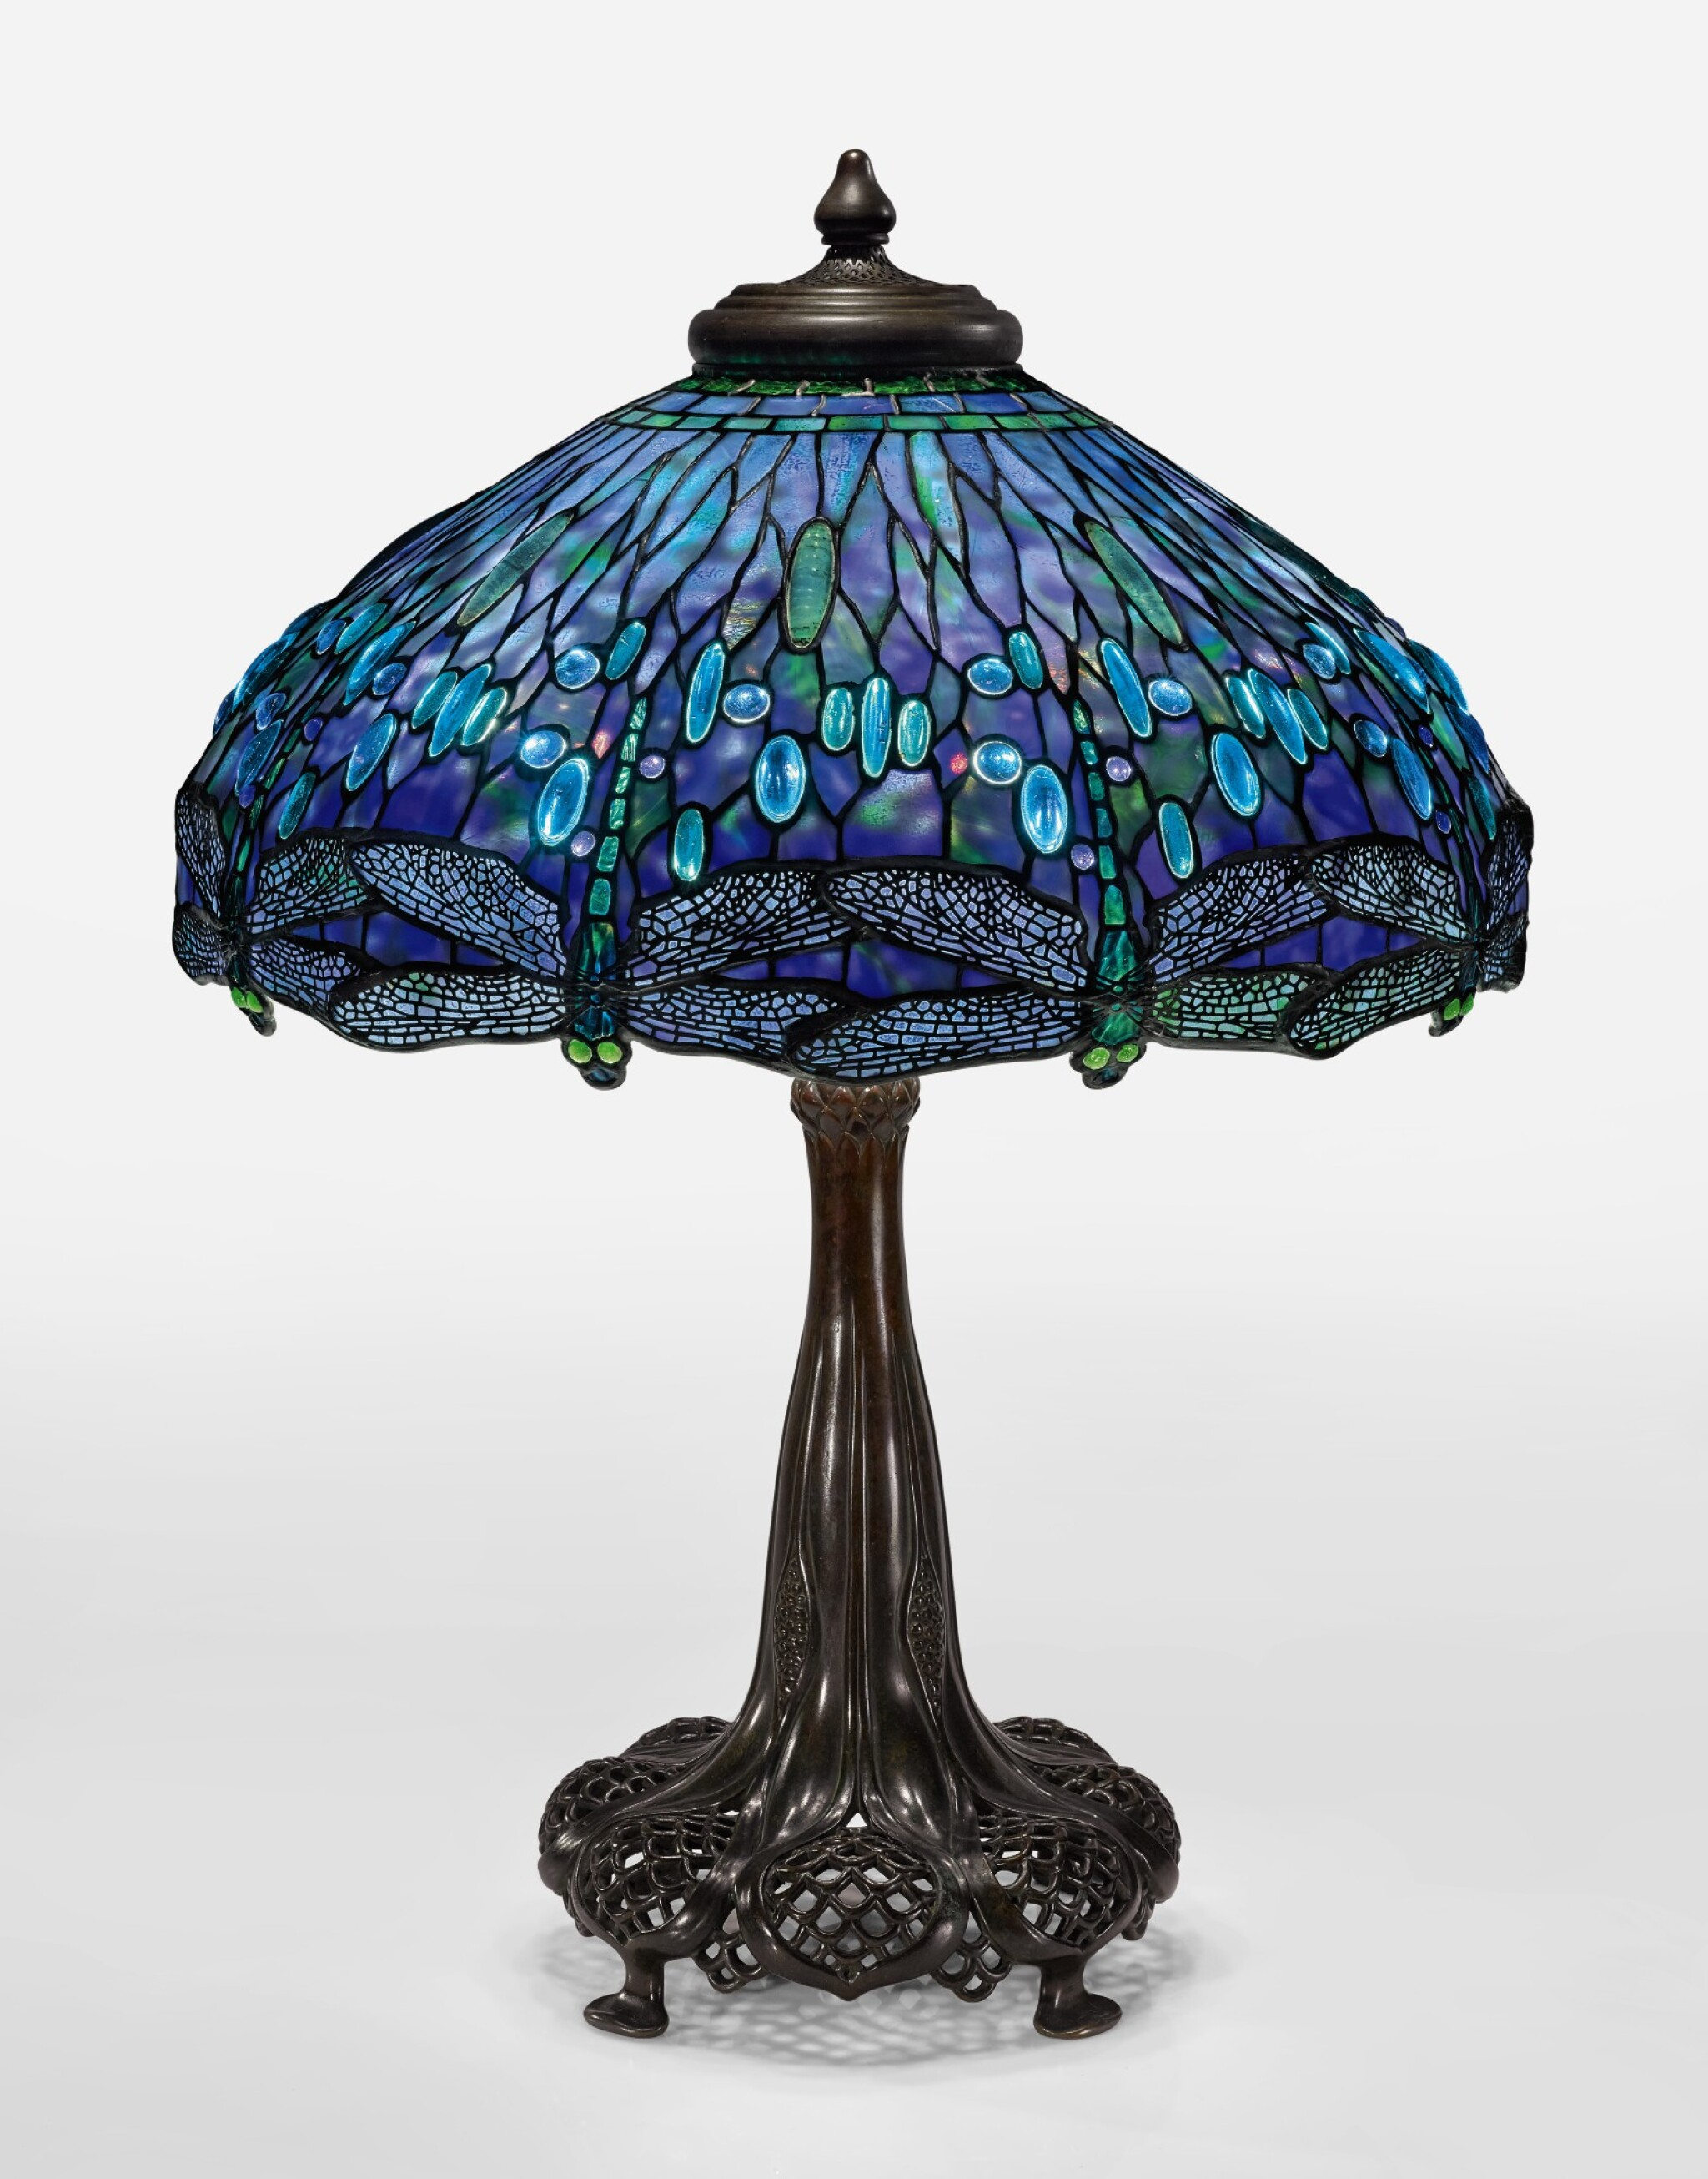
Designer: Louis C. Tiffany, American, 1848–1933
Maker: Tiffany Studios, 1902–32
‘Dragofly’ Table Lamp,c. 1910, Leaded glass, patinated bronze, Private Collection https://www.sothebys.com/en/buy/auction/2019/dreaming-in-glass-masterworks-by-tiffany-studios/tiffany-studios-an-important-dragonfly-table-lamp

Slide 9
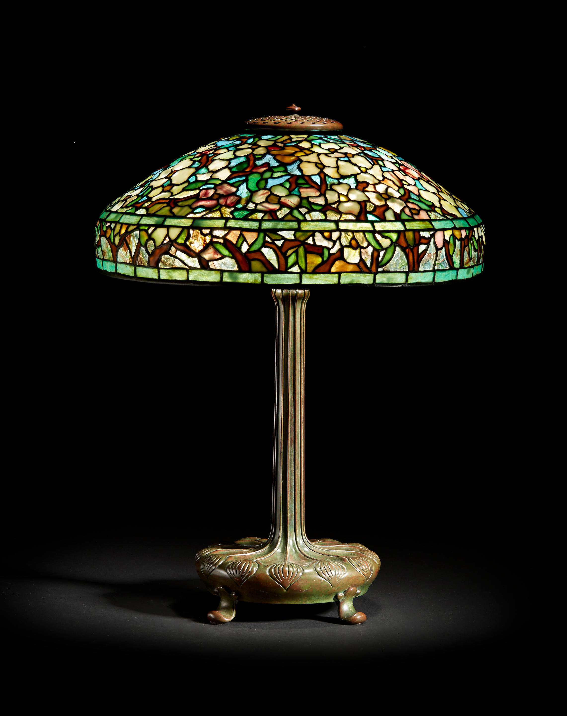
Designer: Louis C. Tiffany, American, 1848–1933
Maker: Tiffany Studios, 1902–32
‘Dogwood’ Table Lamp, c. 1910, Leaded glass and patinated bronze, Private Collection https://www.bonhams.com/auction/23517/lot/21/tiffany-studios-dogwood-table-lamp-circa-1910/

Slide 10
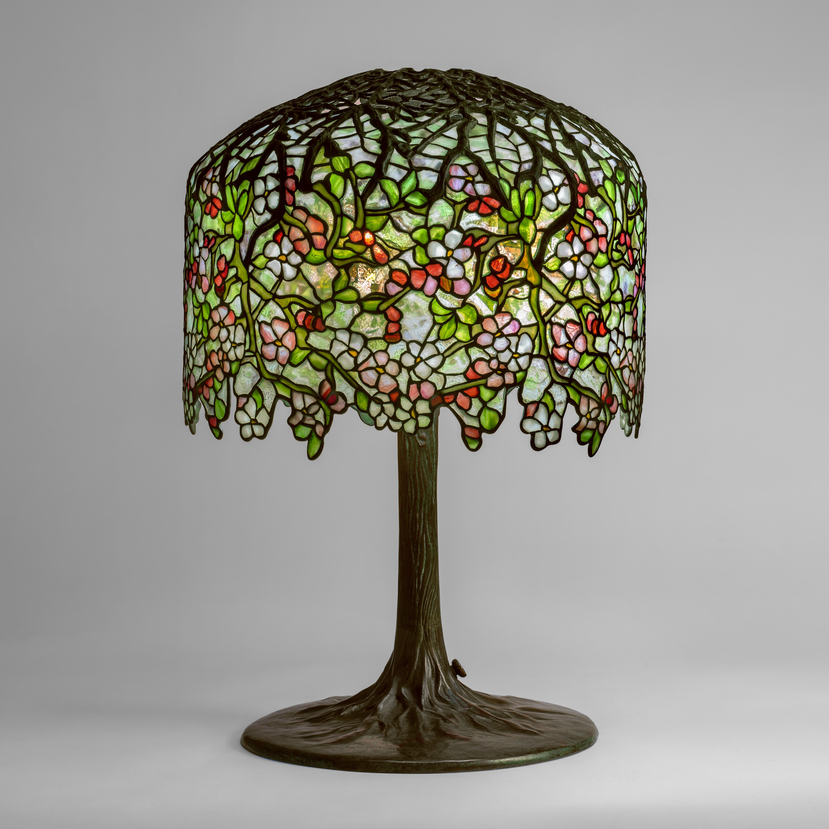
Designer: Clara Driscoll, 1861–1944
Maker: Tiffany Studios, 1902–32
‘Apple Blossom’ Table Lamp, c. 1905, Leaded glass, patinated bronze, Private Collection https://www.sothebys.com/en/buy/auction/2024/louis-comfort-tiffany-artistry-in-glass-the-seymour-and-evelyn-holtzman-collection/apple-blossom-table-lamp

Slide 11
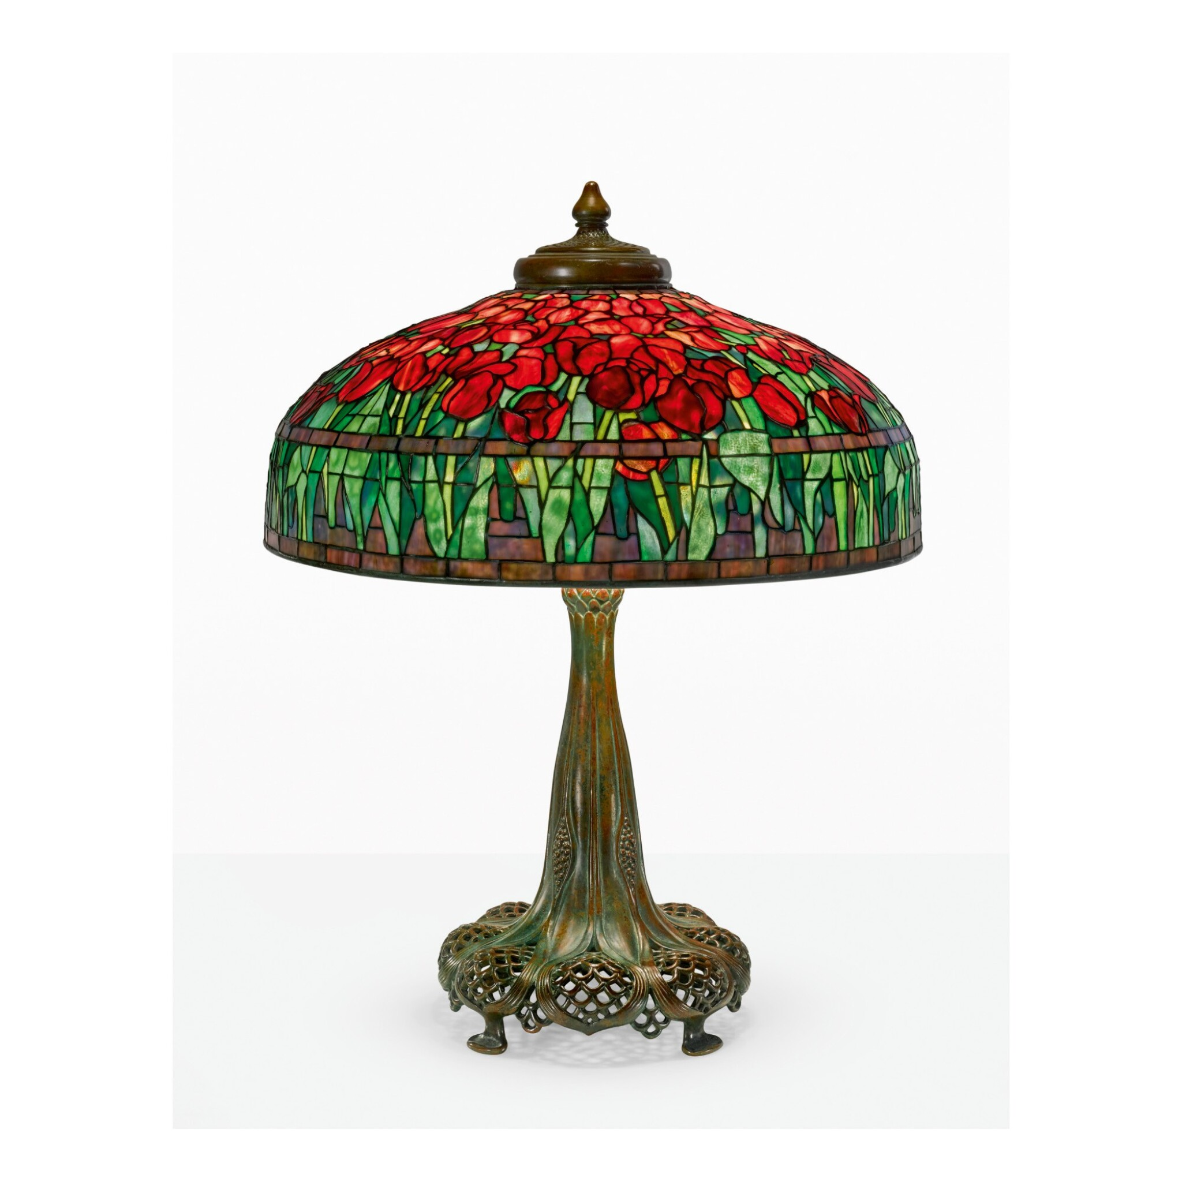
Designer: Louis C. Tiffany, 1848–1933
Maker: Tiffany Studios, 1902–32
‘Tulip’ Table Lamp, circa 1910-1915, Leaded glass, patinated bronze, Private Collection https://www.sothebys.com/en/buy/auction/2024/louis-comfort-tiffany-artistry-in-glass-the-seymour-and-evelyn-holtzman-collection/tulip-table-lamp-2

Slide 12
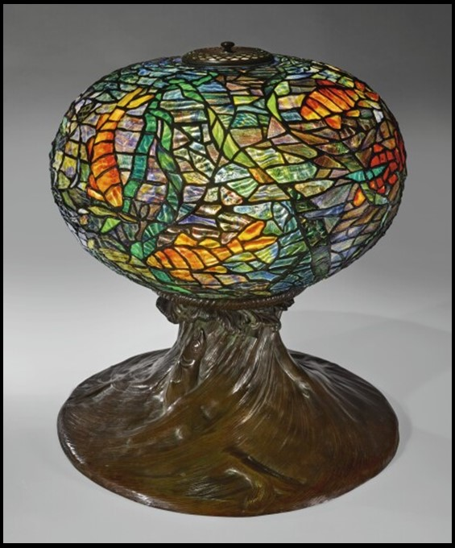
Designer: Clara Driscoll, 1861–1944
Maker: Tiffany Studios, 1902–32
‘Fish and Waves’ Table Lamp, Leaded Glass, patinated bronze, Private Collection https://www.sothebys.com/en/articles/tiffanys-aquarium-in-stained-glass

Slide 13
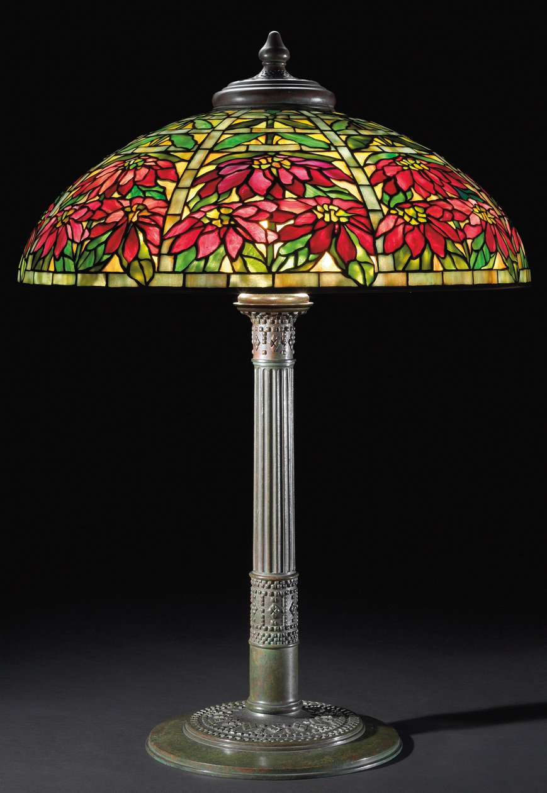
Designer: Louis C. Tiffany, American, 1848–1933
Maker: Tiffany Studios, 1902–32
‘Poinsettia’ Table Lamp, circa 1910, Leaded Glass, patinated bronze, Private Collection https://www.meisterdrucke.us/fine-art-prints/Tiffany-and-Company/910340/Poinsettia-Table-Lamp,-c.1910.html

Slide 14
The
End

