Slide 1
Hans Memling
1435-1494

Slide 2
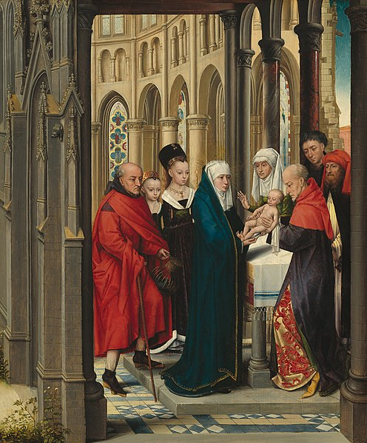
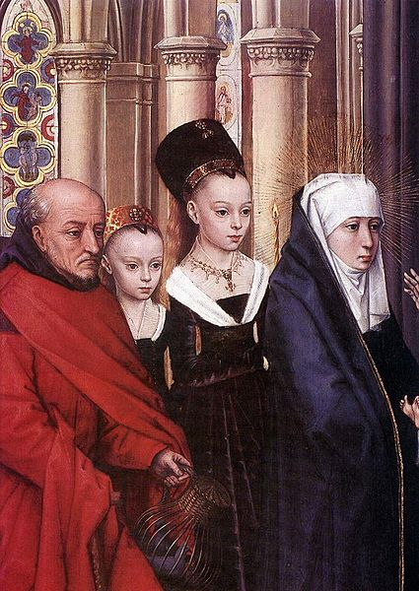
The Presentation in the Temple, 1463, Oil on wood, 60 x 48 cm, National Gallery of Art, Washington DC, USA https://en.m.wikipedia.org/wiki/File:The_Presentation_in_the_Temple_A22018.jpg

Slide 3
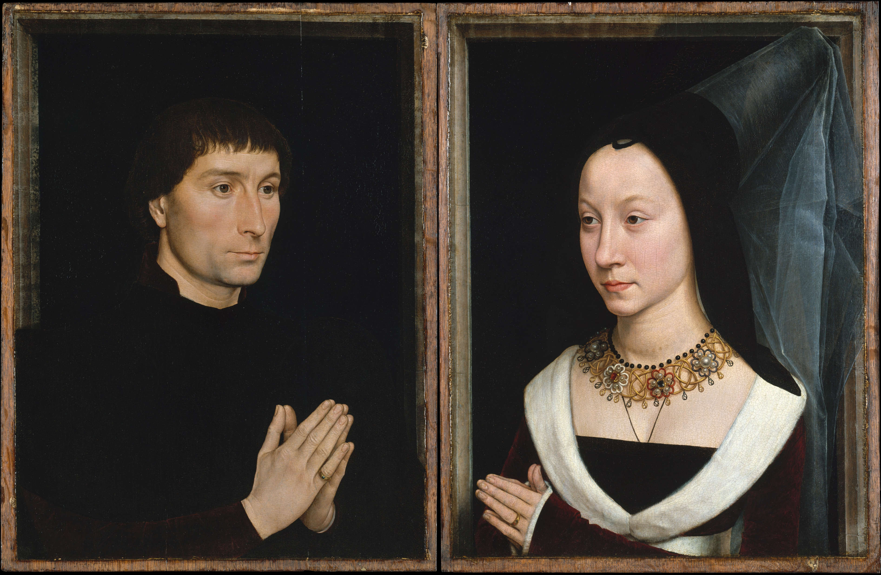
Tommaso Portinari and his Wife, c. 1470, Oil on wood, 44 x 34 cm (each), Metropolitan Museum of Art, New York, USA

Slide 4
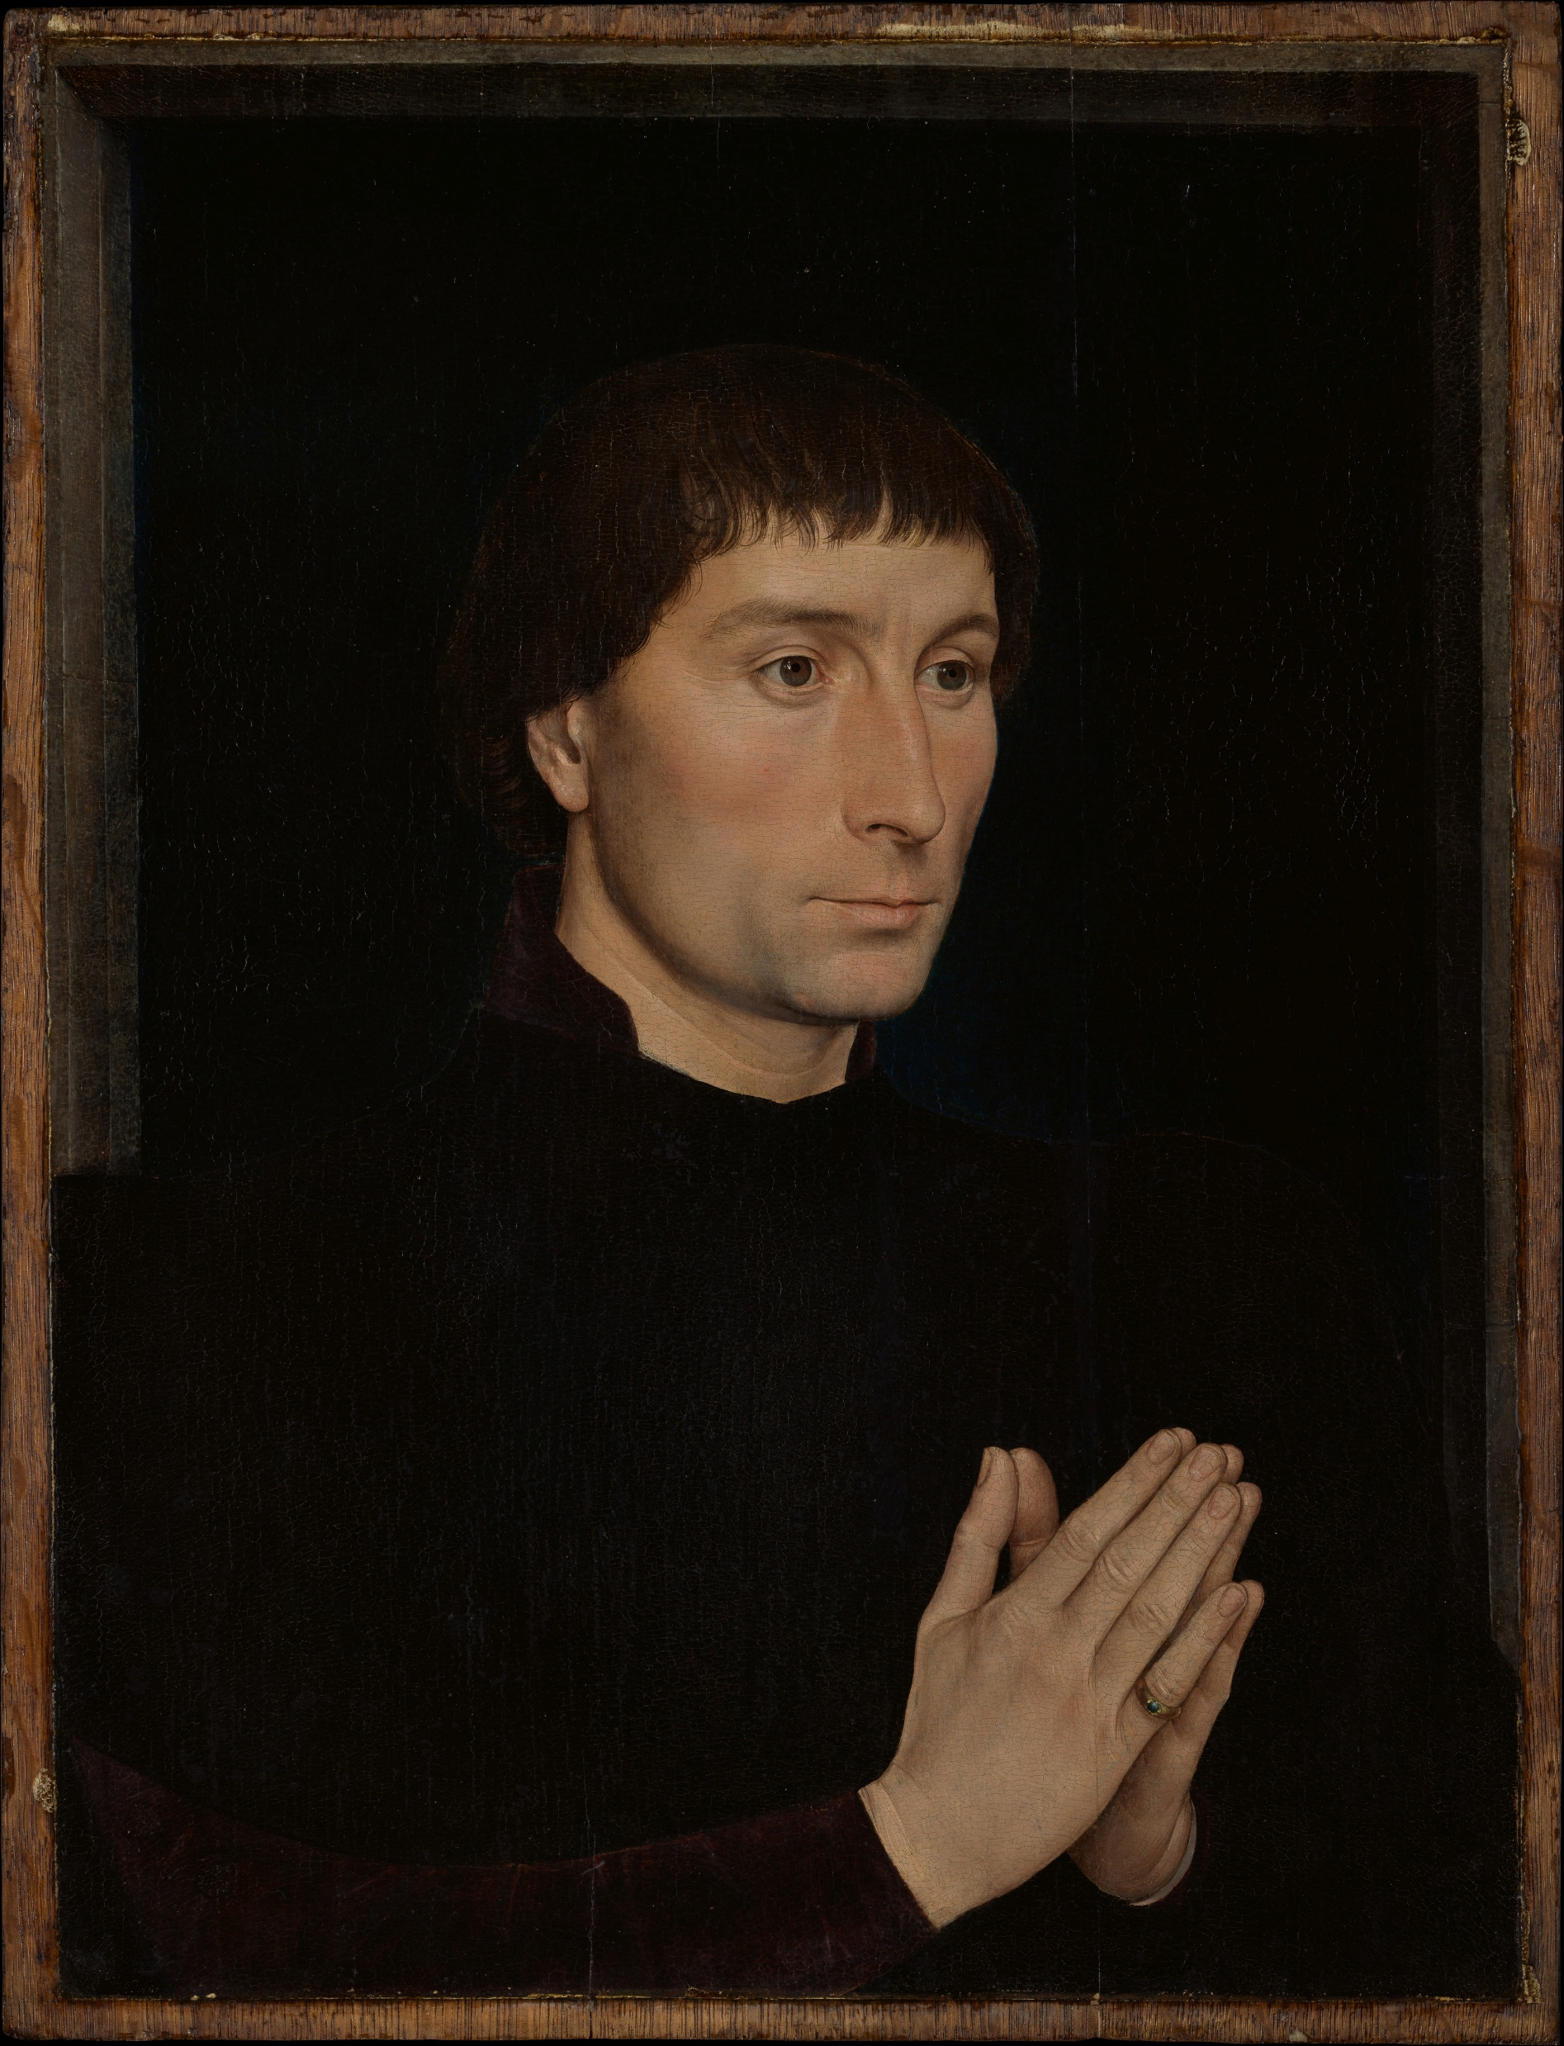
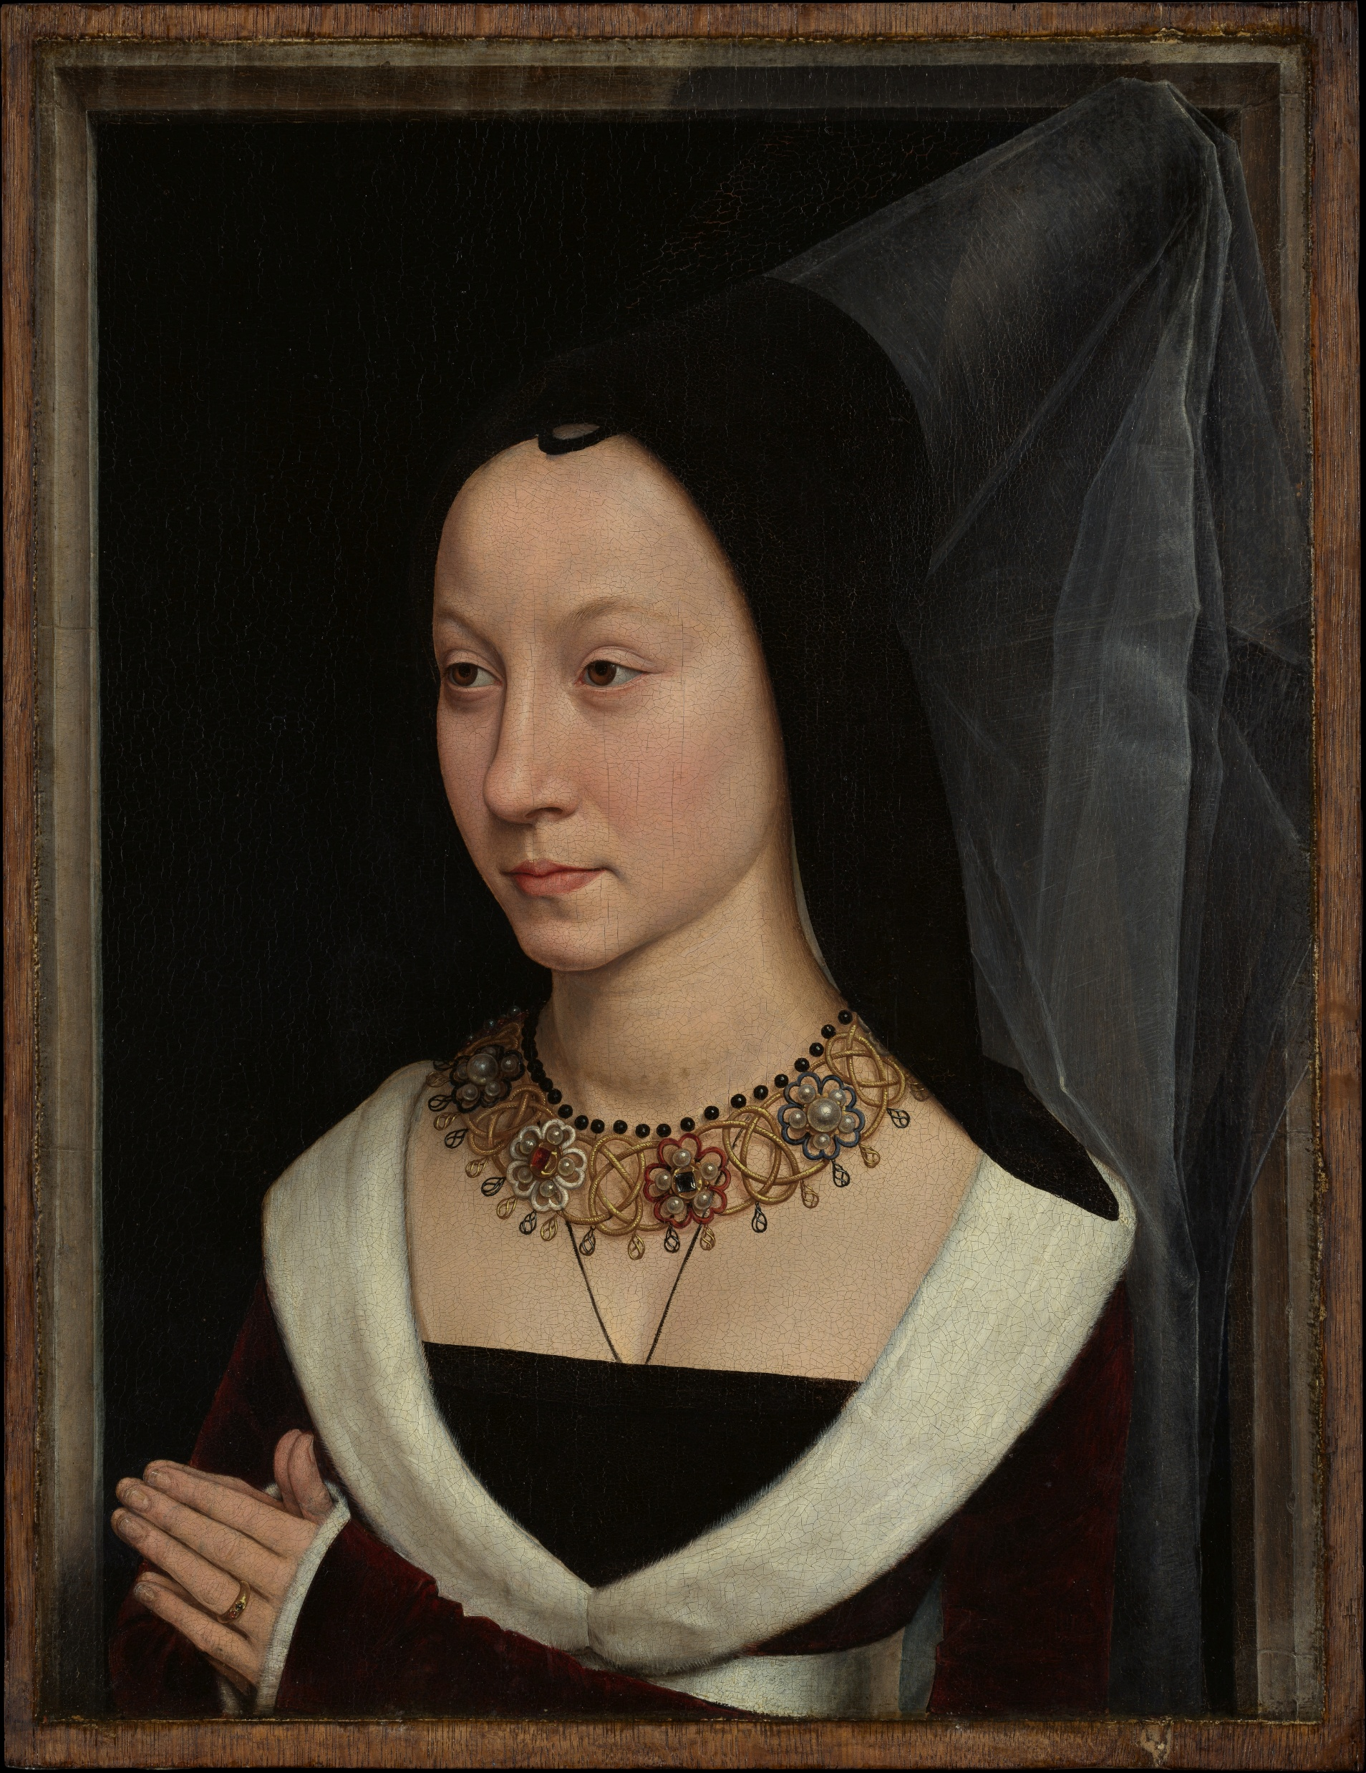

Slide 5
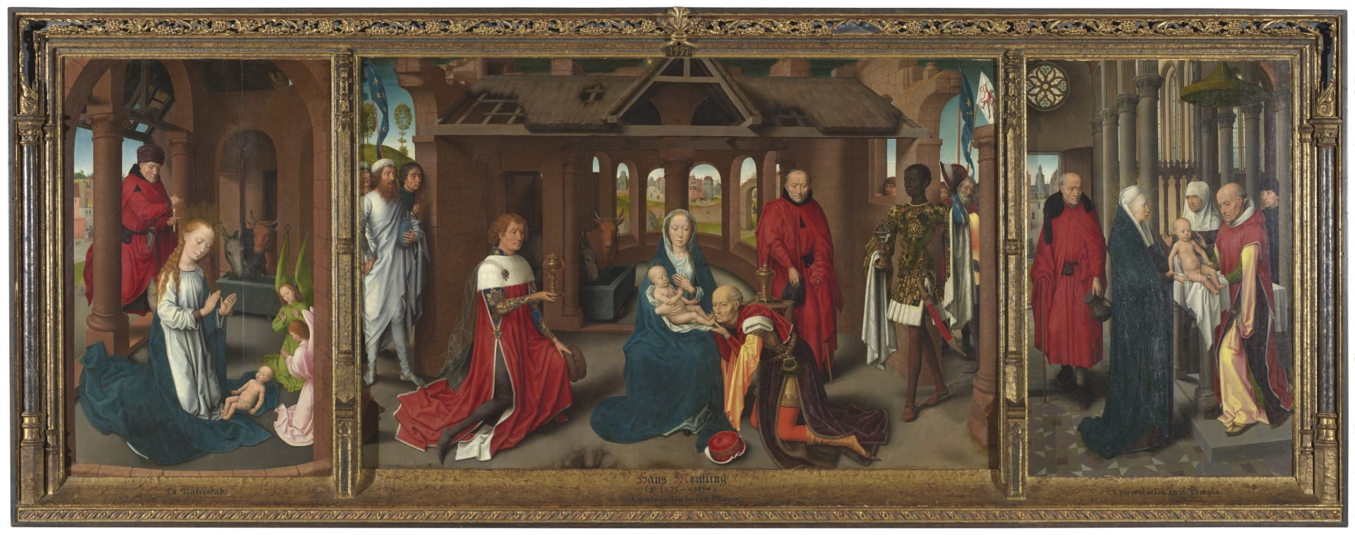
Triptych, c. 1470, Oil on wood, 96,4 x 147 cm (central), 98 x 63,5 cm (each wing), Museo del Prado, Madrid, Spain https://www.museodelprado.es/en/the-collection/art-work/triptych-of-the-adoration-of-the-magi/0efd3706-0f54-4a23-87e3-dc8cd930e85a

Slide 6
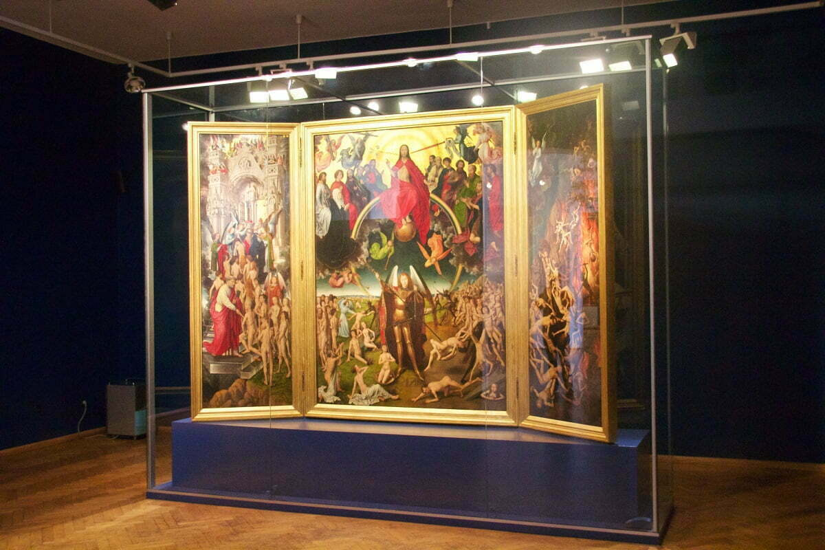
Last Judgment Triptych, 1467-71, Oil on wood, 221x161 cm (central), 223,5x72,5 cm (wings), Muzeum Narodowe, Gdansk, Poland https://www.suerteprzewodnicy.pl/blog/sad-ostateczny-memlinga-najslynniejszy-gdanski-obraz/

Slide 7
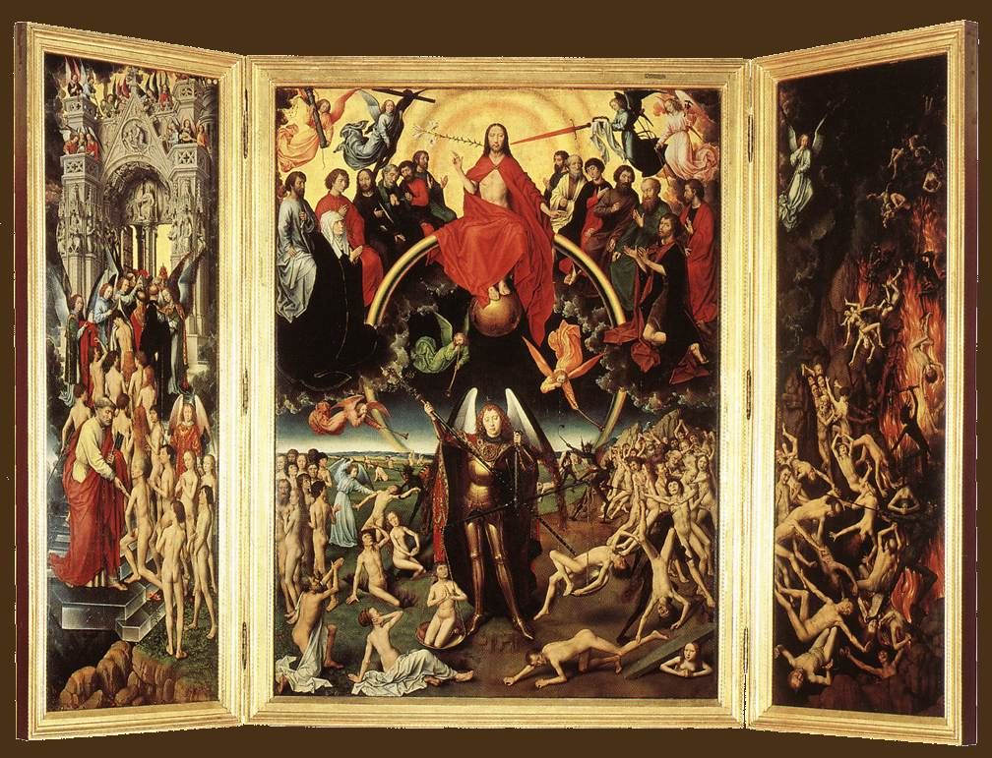
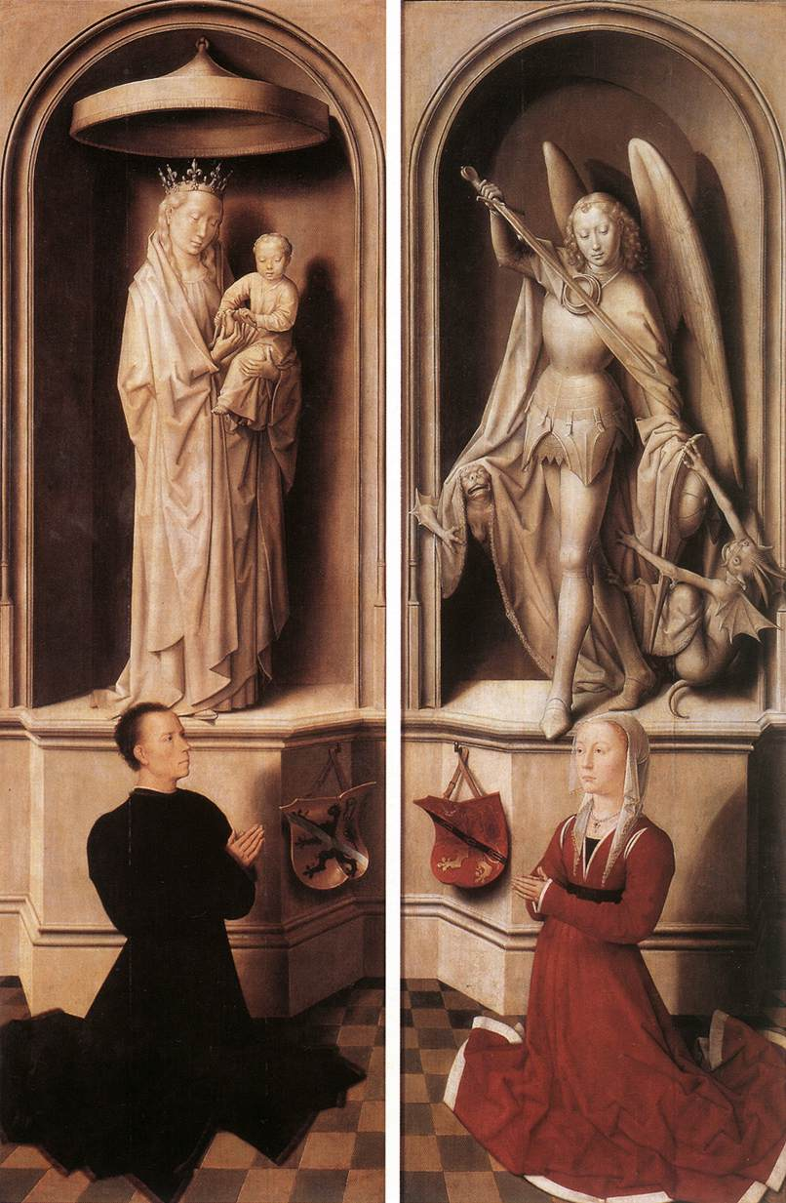
https://www.wga.hu/frames-e.html?/html/m/memling/index.html

Slide 8
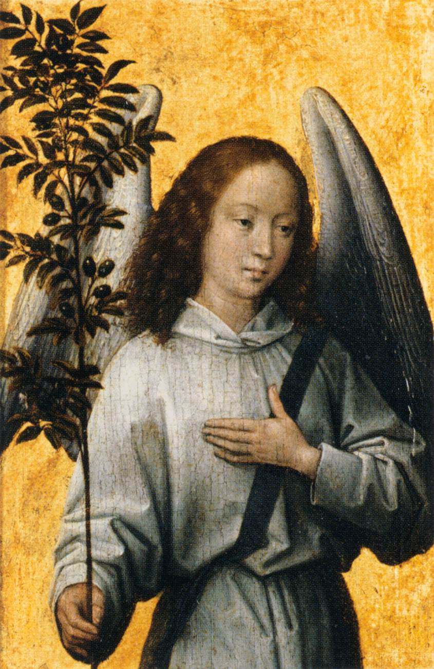
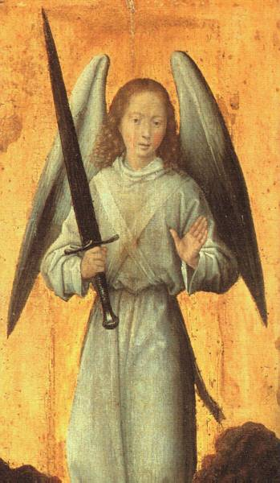
The Archangel Michael, c. 1479, Oil on wood, 37 x 16 cm, Wallace Collection, London, UK
Angel with an Olive Branch, Emblem of Divine Peace, 1475-80, Oil on panel, 16 x 10 cm, Musée du Louvre, Paris, France https://www.wga.hu/frames-e.html?/html/m/memling/index.html

Slide 9
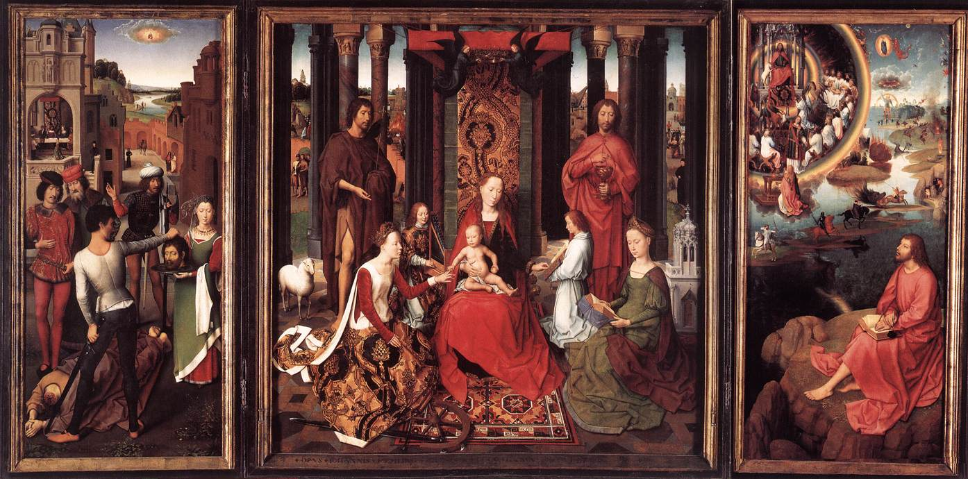
St John Altarpiece, 1474-79, Oil on oak panel, 173,6x173,7 cm (central), 176x78,9 cm, (each wing), Memlingmuseum, Sint-Janshospitaal, Bruges, Belgium https://www.wga.hu/frames-e.html?/html/m/memling/index.html

Slide 10
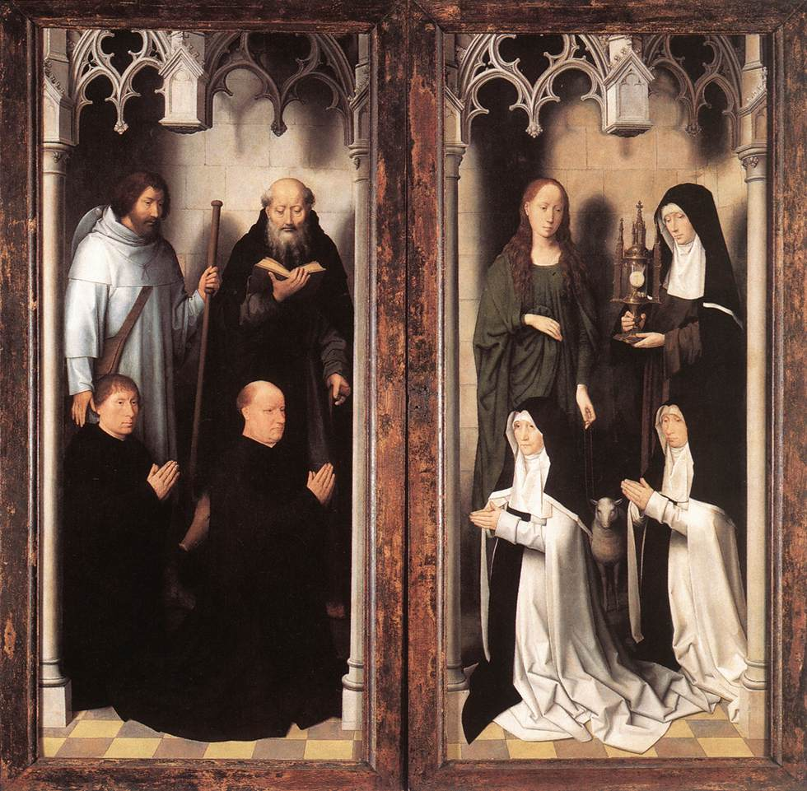
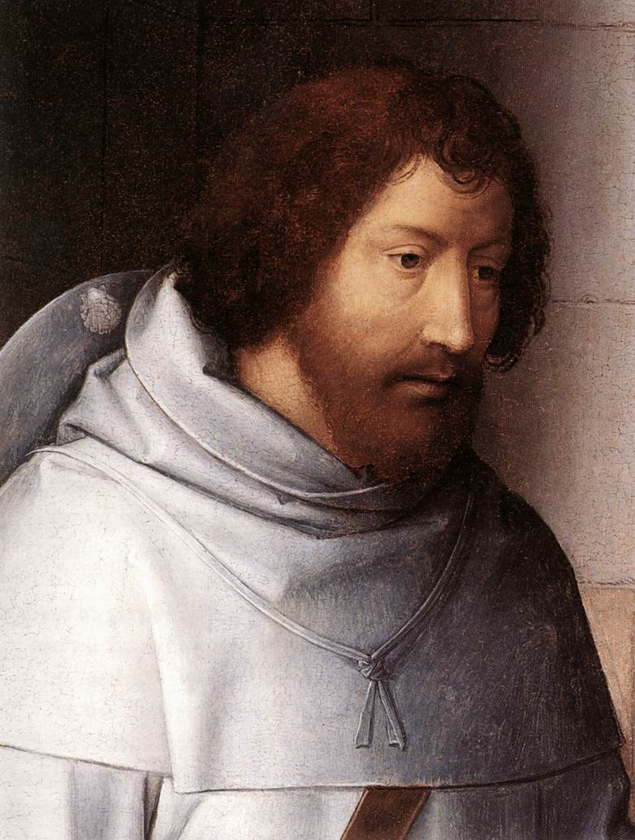
https://www.wga.hu/frames-e.html?/html/m/memling/index.html

Slide 11
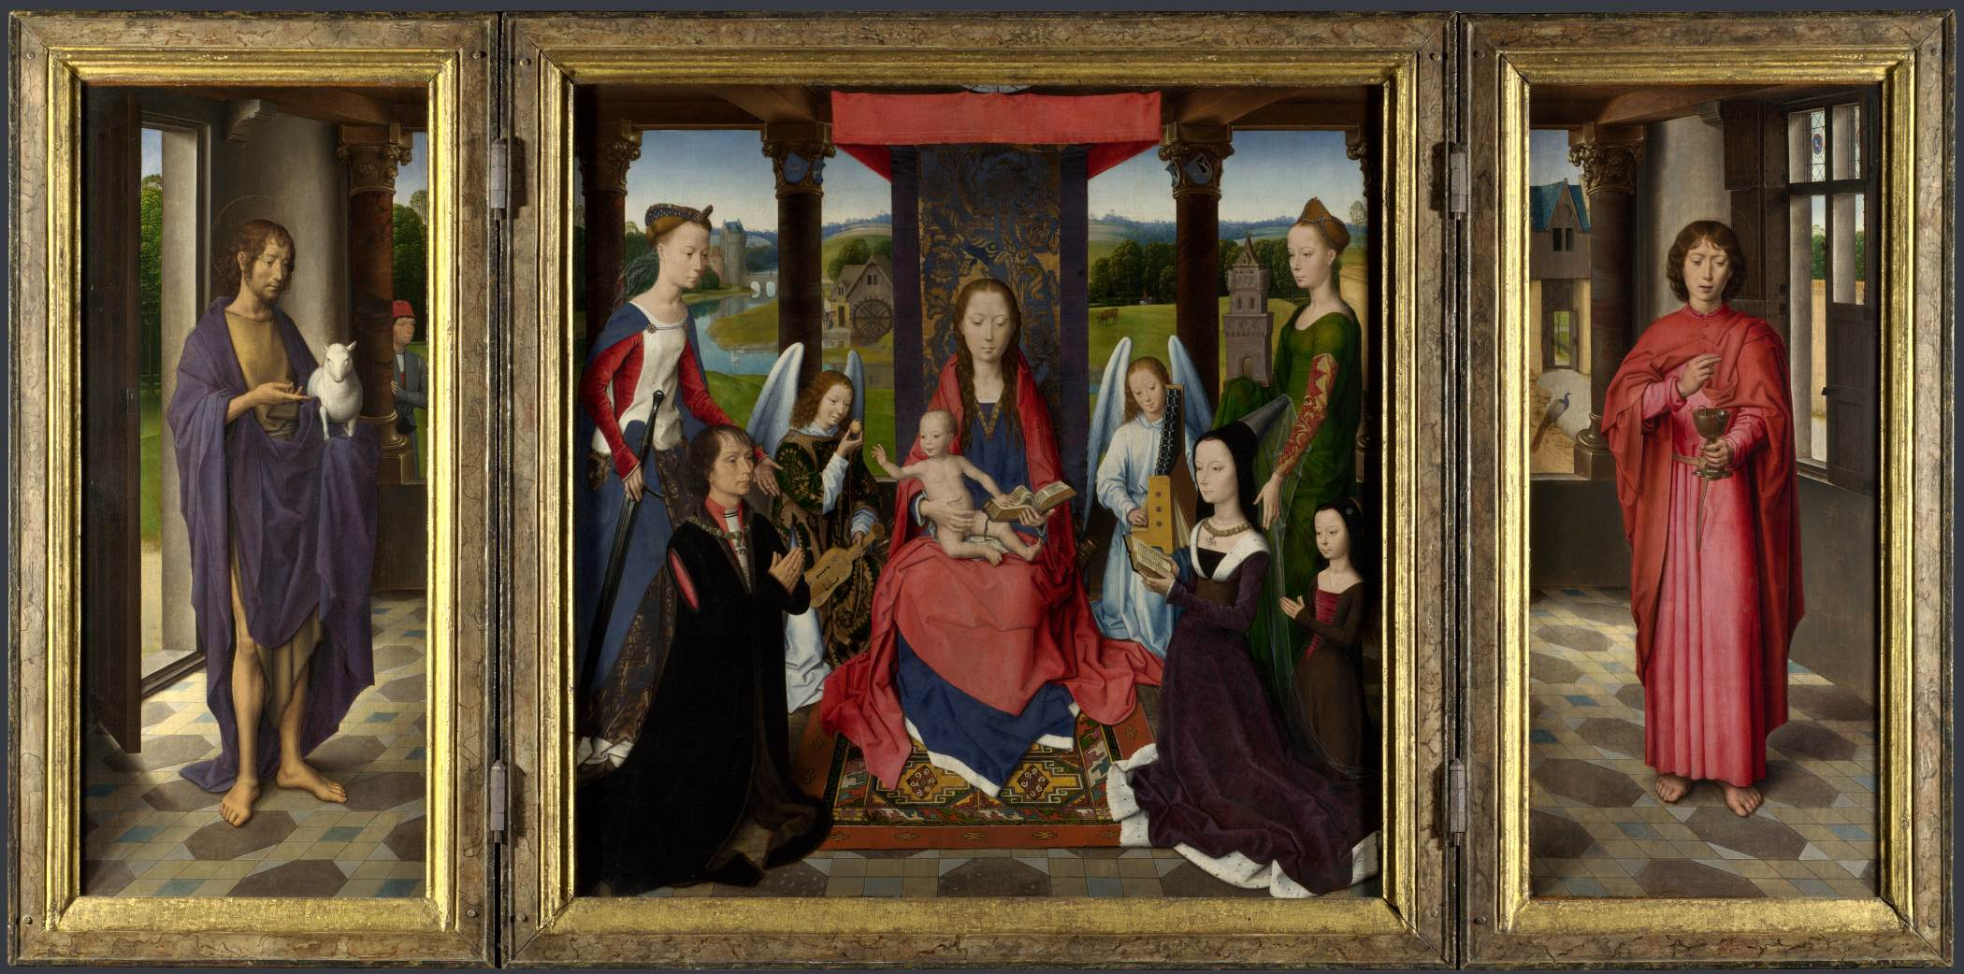
The Donne Triptych, c. 1475, Oil on oak, 70,5x70,5 cm (central panel), 70,5x30,5 cm (wings), National Gallery, London, UK https://www.wga.hu/frames-e.html?/html/m/memling/index.html

Slide 12
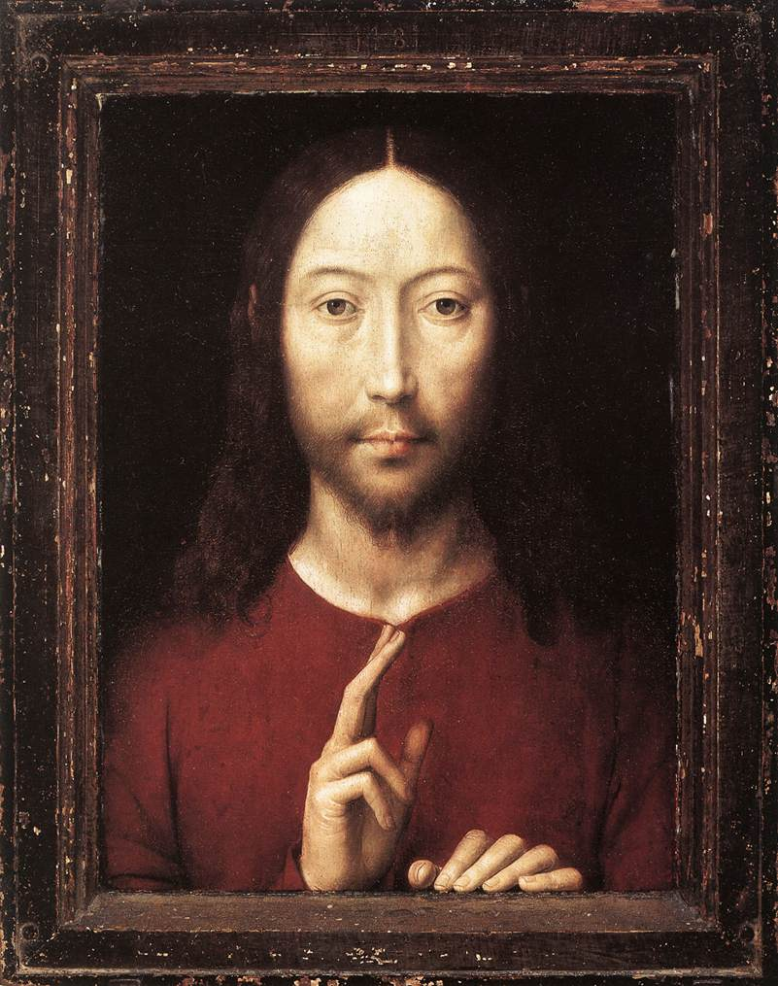
Christ Giving His Blessing, 1481, Oil on oak panel, 34,8 x 26,2 cm, Museum of Fine Arts, Boston, USA https://www.wga.hu/frames-e.html?/html/m/memling/index.html

Slide 13
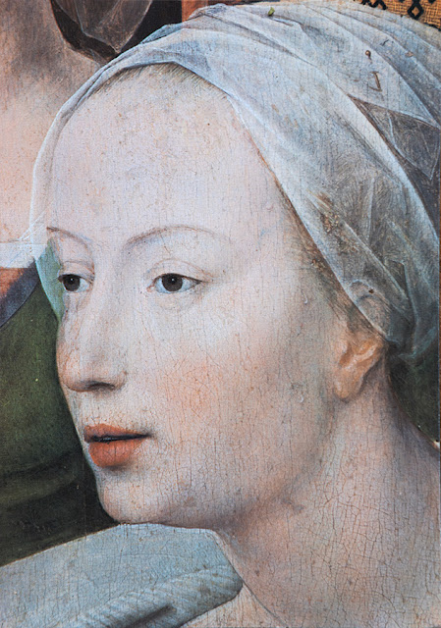
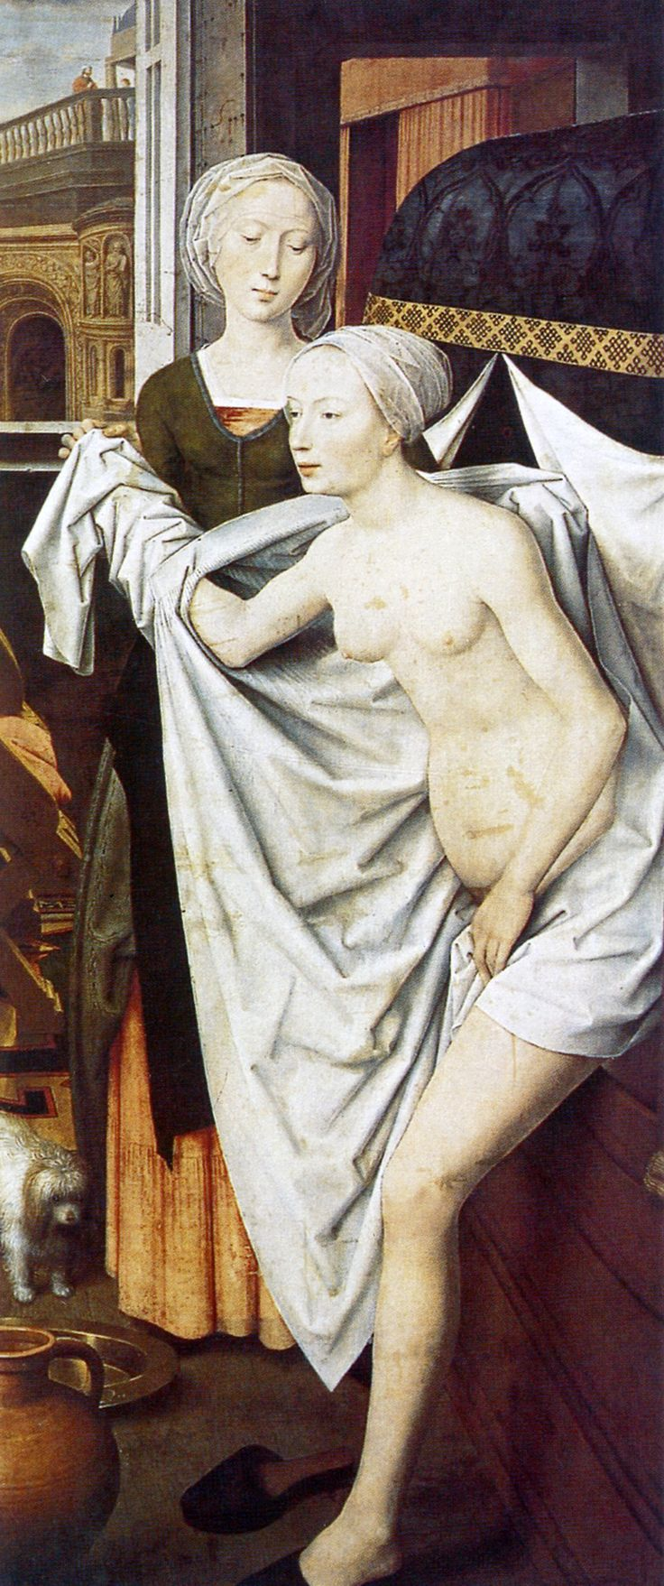
Bathsheba, 1485, Oil on wood, 191x84 cm, Staatsgalerie, Stuttgart, Germany https://nothing-but-good-art.blogspot.com/2018/06/auke-de-vries-hans-memling.html and https://ru.pinterest.com/pin/422494008775079207/

Slide 14
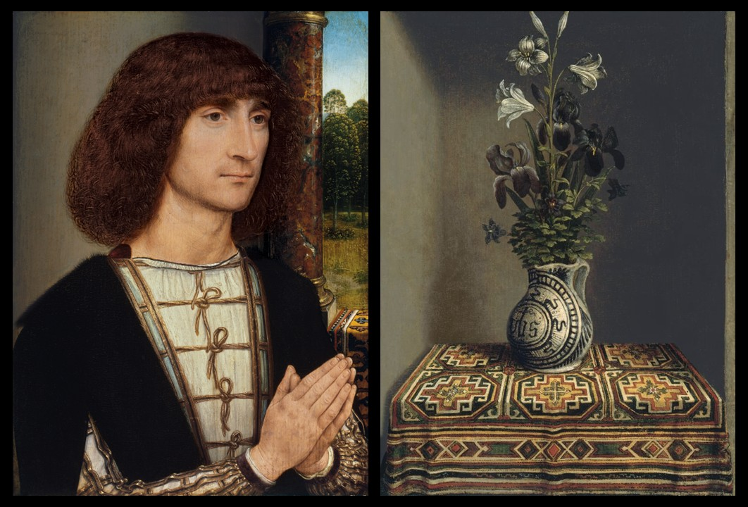
Portrait of a young man praying (obverse) and Flowers in a Jug (verso), ca. 1485, Oil on Panel, 29.2 x 22.5 cm, Museo Nacional Thyssen-Bornemisza, Madrid, Spain https://www.museothyssen.org/coleccion/artistas/memling-hans/retrato-hombre-joven-orante-anverso and https://www.museothyssen.org/coleccion/artistas/memling-hans/florero-reverso

Slide 15
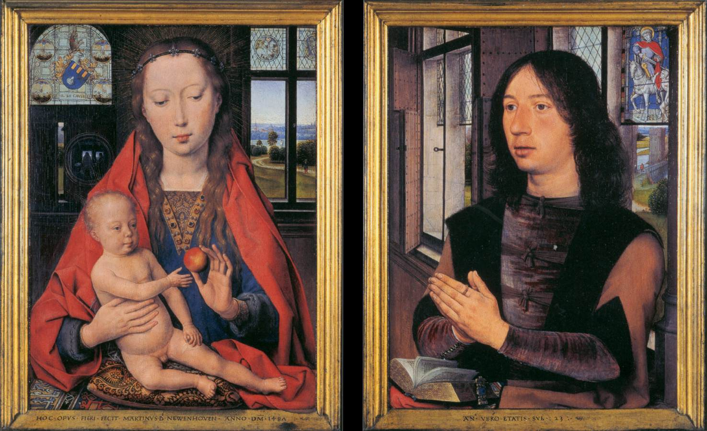
Diptych of Maarten Nieuwenhove, 1487, Oil on oak panel, 52x41,5 cm (each), Memlingmuseum, Sint-Janshospitaal, Bruges, Belgium https://www.wga.hu/frames-e.html?/html/m/memling/index.html

Slide 16
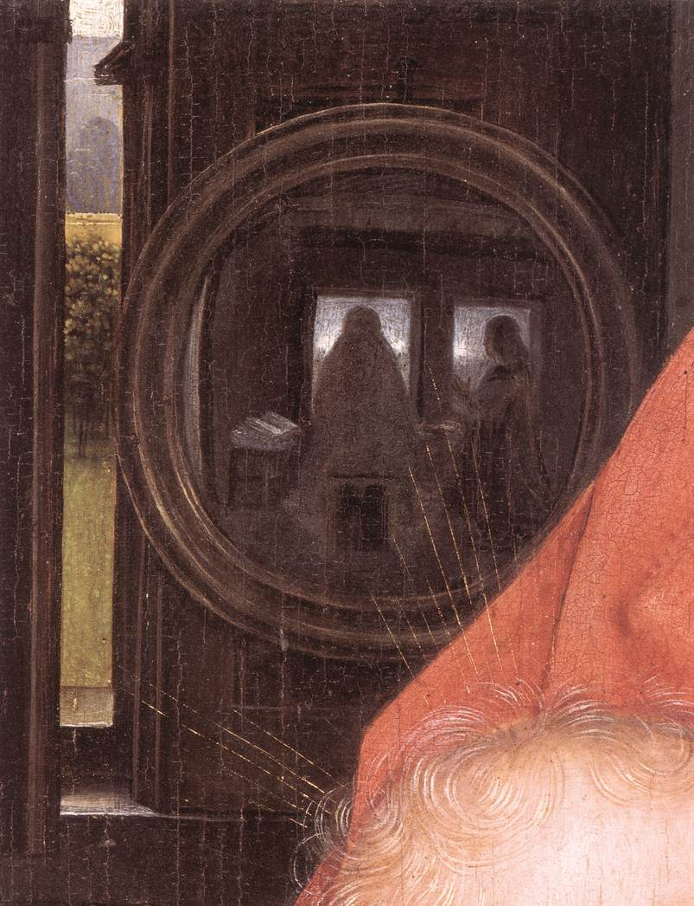
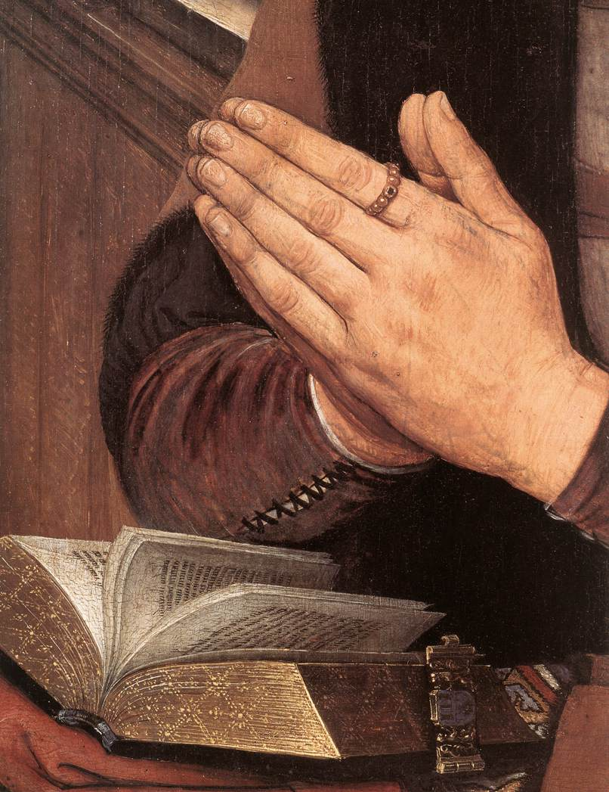
https://www.wga.hu/frames-e.html?/html/m/memling/index.html

Slide 17
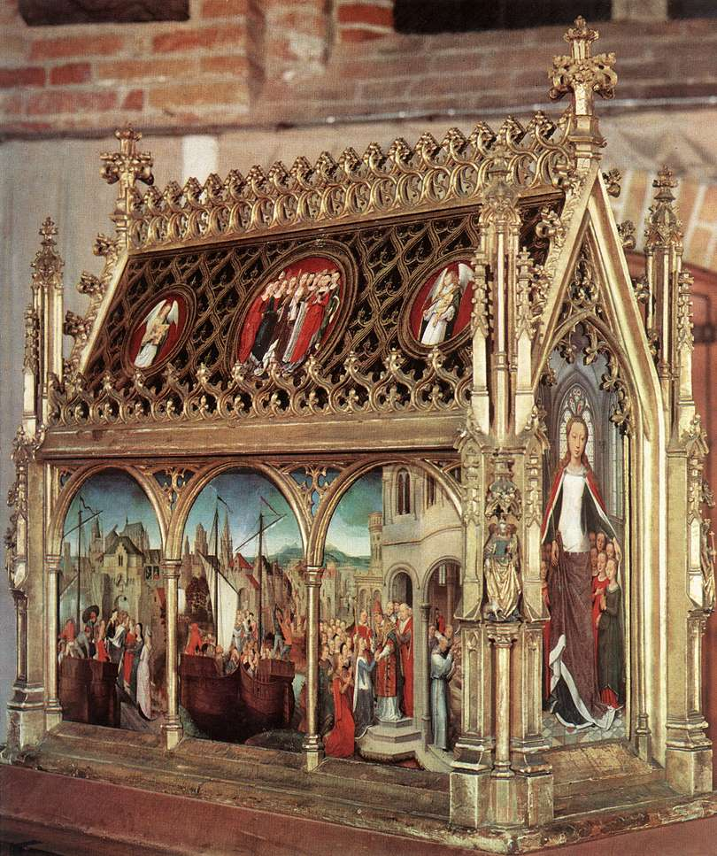
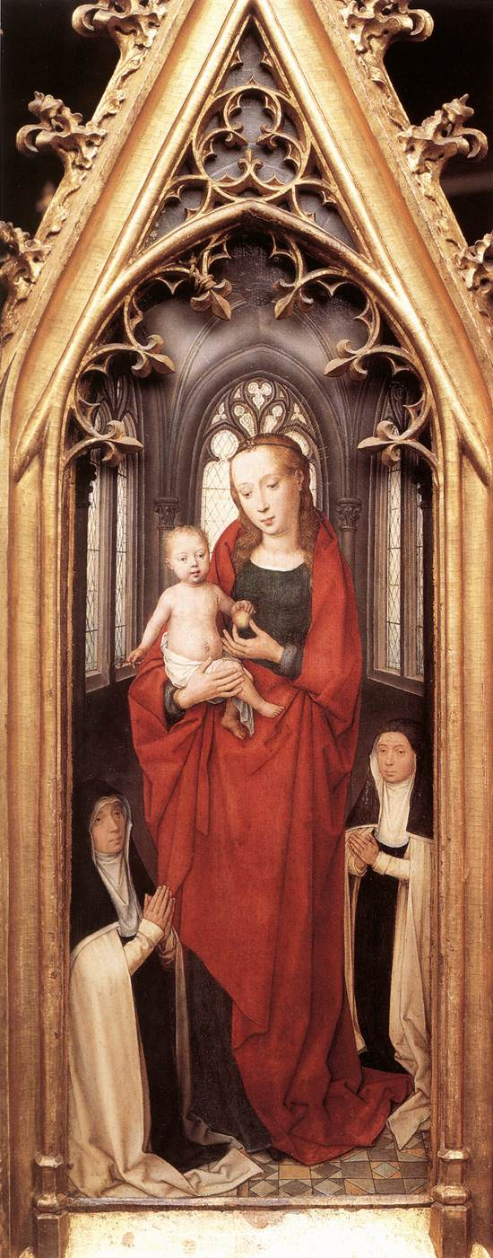
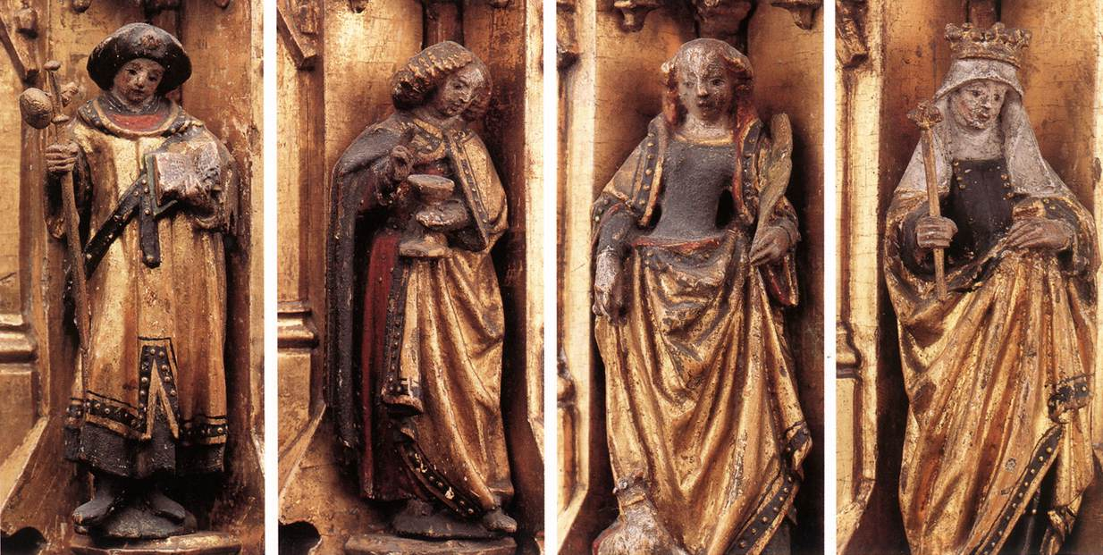
St Ursula Shrine, 1489, Gilded and painted wood, 87x33x91 cm, Memlingmuseum, Sint-Janshospitaal, Bruges, Belgium https://www.wga.hu/frames-e.html?/html/m/memling/index.html

Slide 18
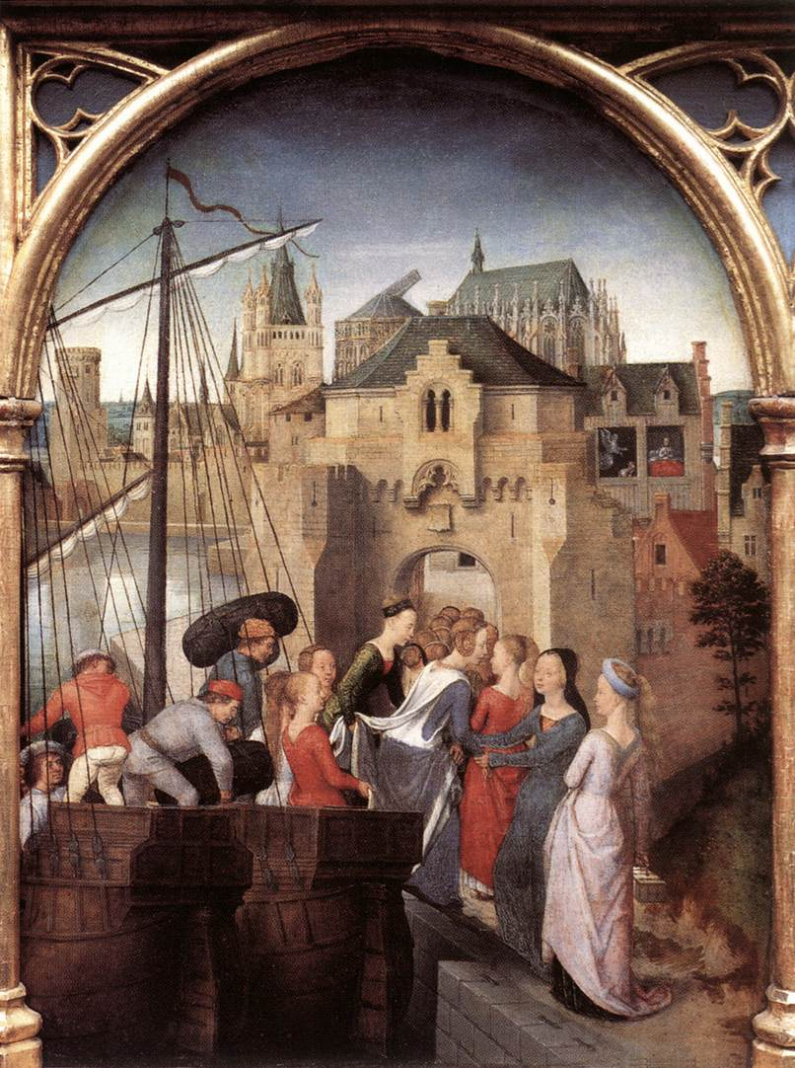
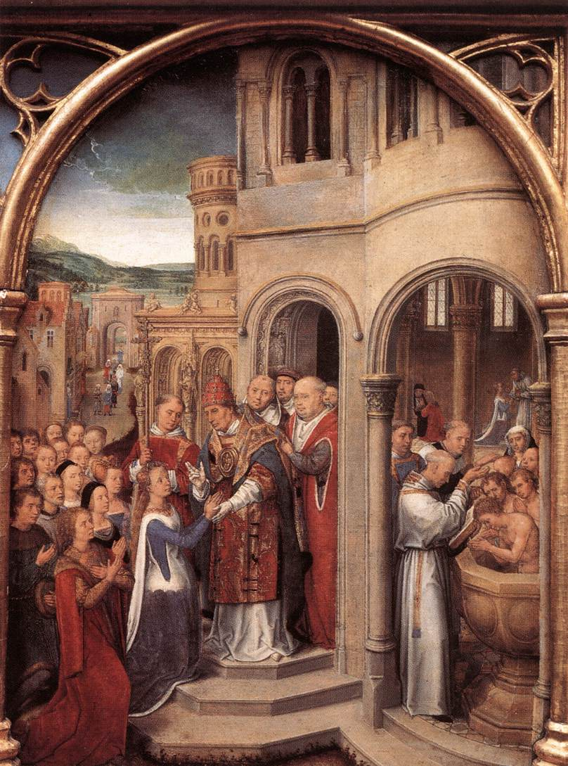
https://www.wga.hu/frames-e.html?/html/m/memling/index.html

Slide 19
The End

