Slide 1
Eros
and
Psyche

Slide 2
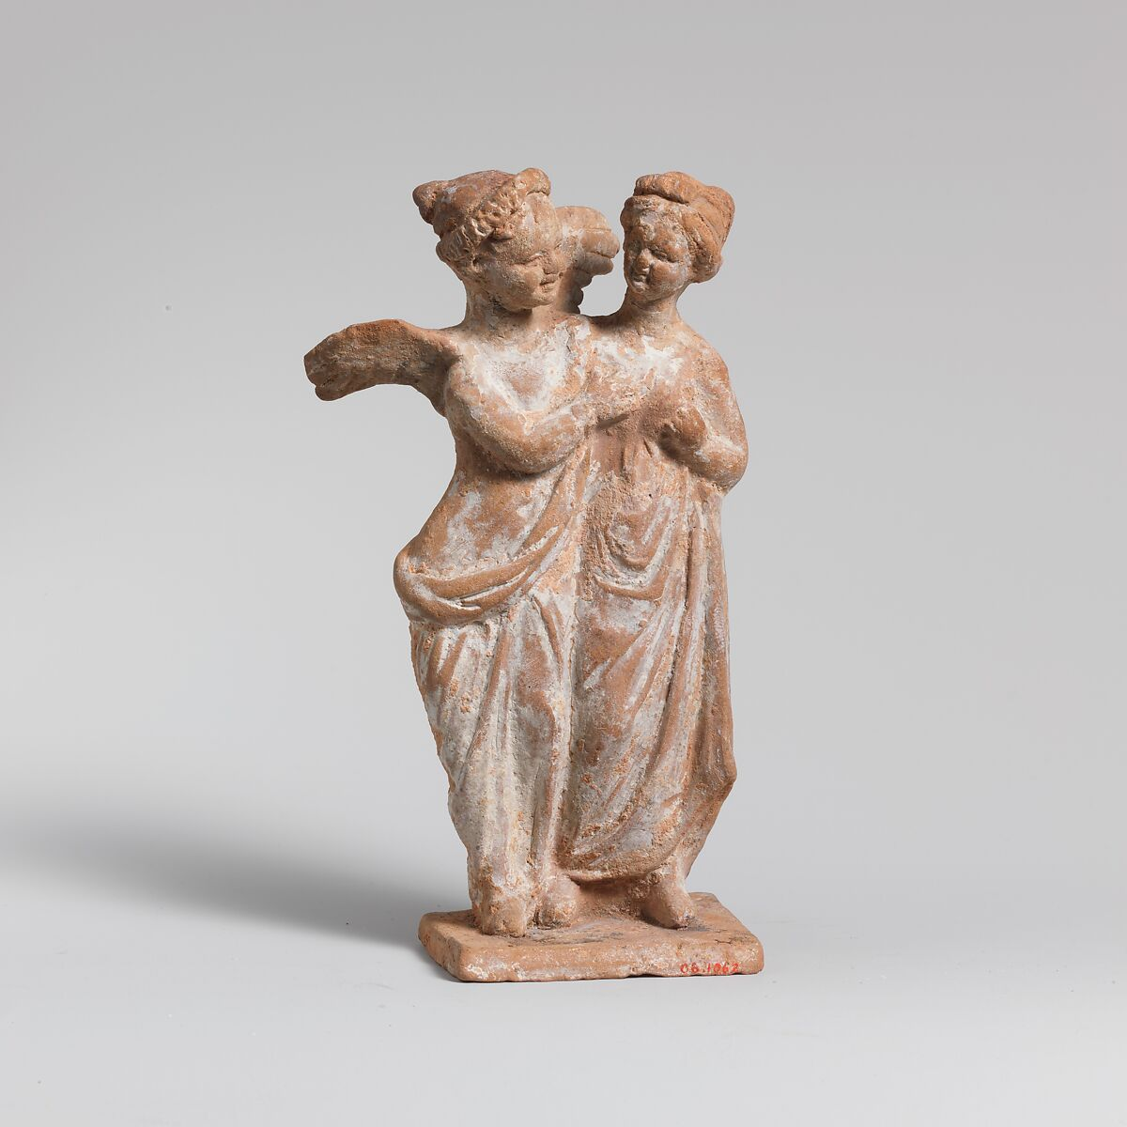
Eros and Psyche, 4th–3rd century BC, Terracotta, Height: 11.5 cm, the MET, NY, USA https://www.metmuseum.org/art/collection/search/247480

Slide 3
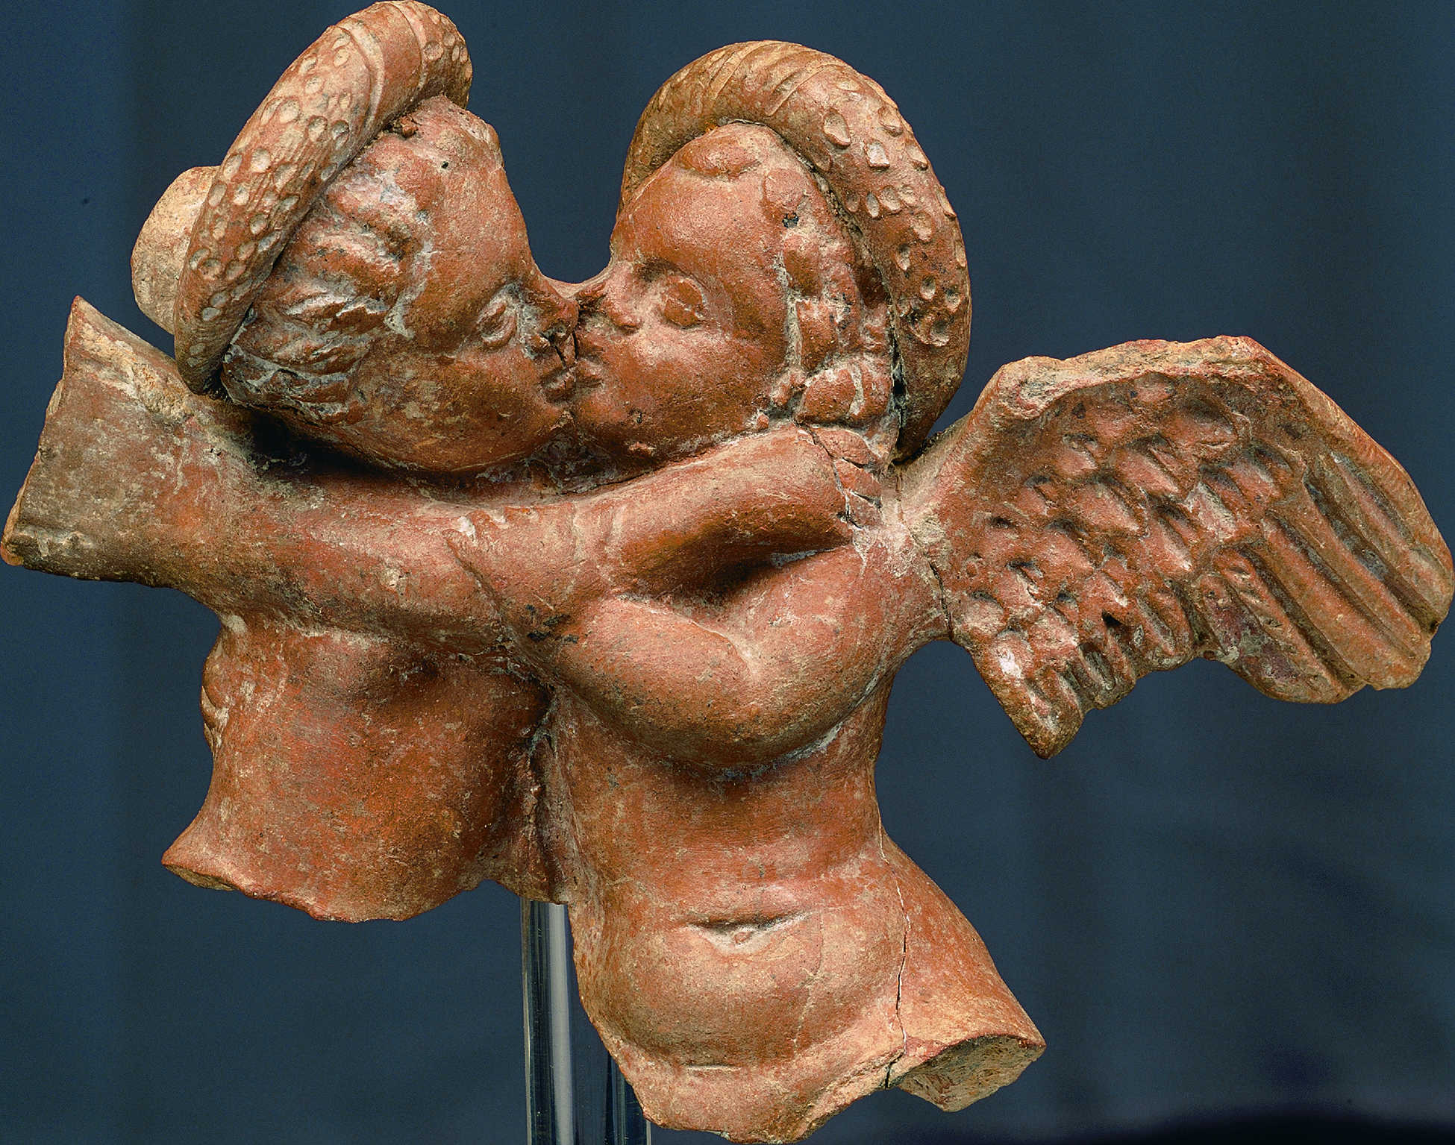
Eros and Psyche Kissing, 1st century BC, Terracotta, rchaeological Museum of Pella, Greece https://www.palaceofpella.gr/archaeological-museum-of-pella/?lang=en

Slide 4
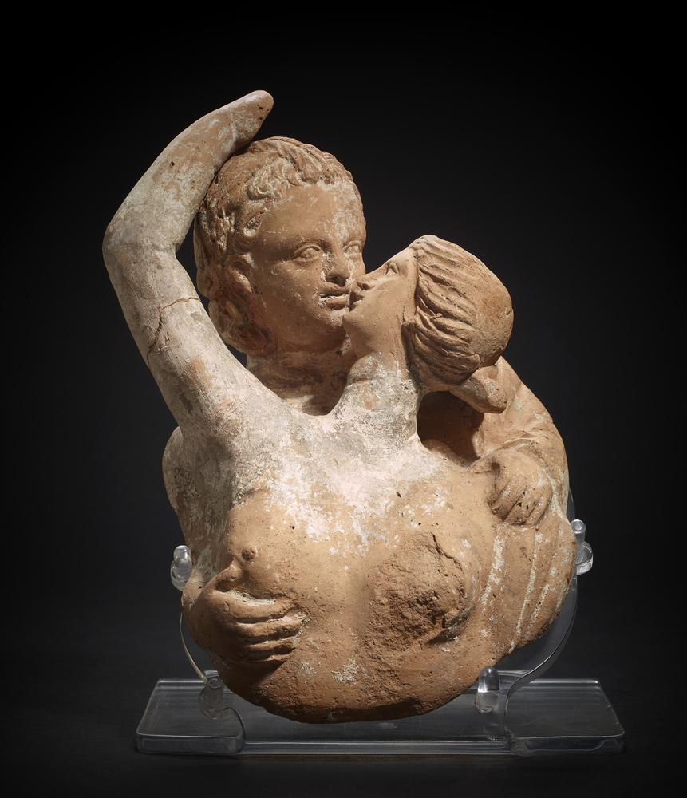
Eros and Psyche, 200-100 BC, Terrsacotta, Height: 20.32 cm, British Museum, London UK https://www.britishmuseum.org/collection/object/G_1836-0224-442

Slide 5
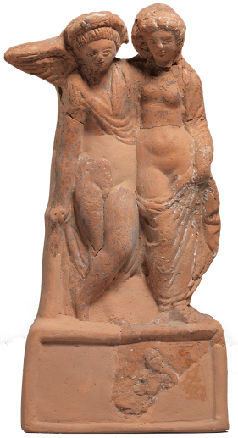
Eros and Psyche, late 1st-2nd century AD, terracotta, Archaeological Museum of Thessaloniki, Greece https://www.amth.gr/en/exhibitions/exhibit-of-the-month/2102

Slide 6
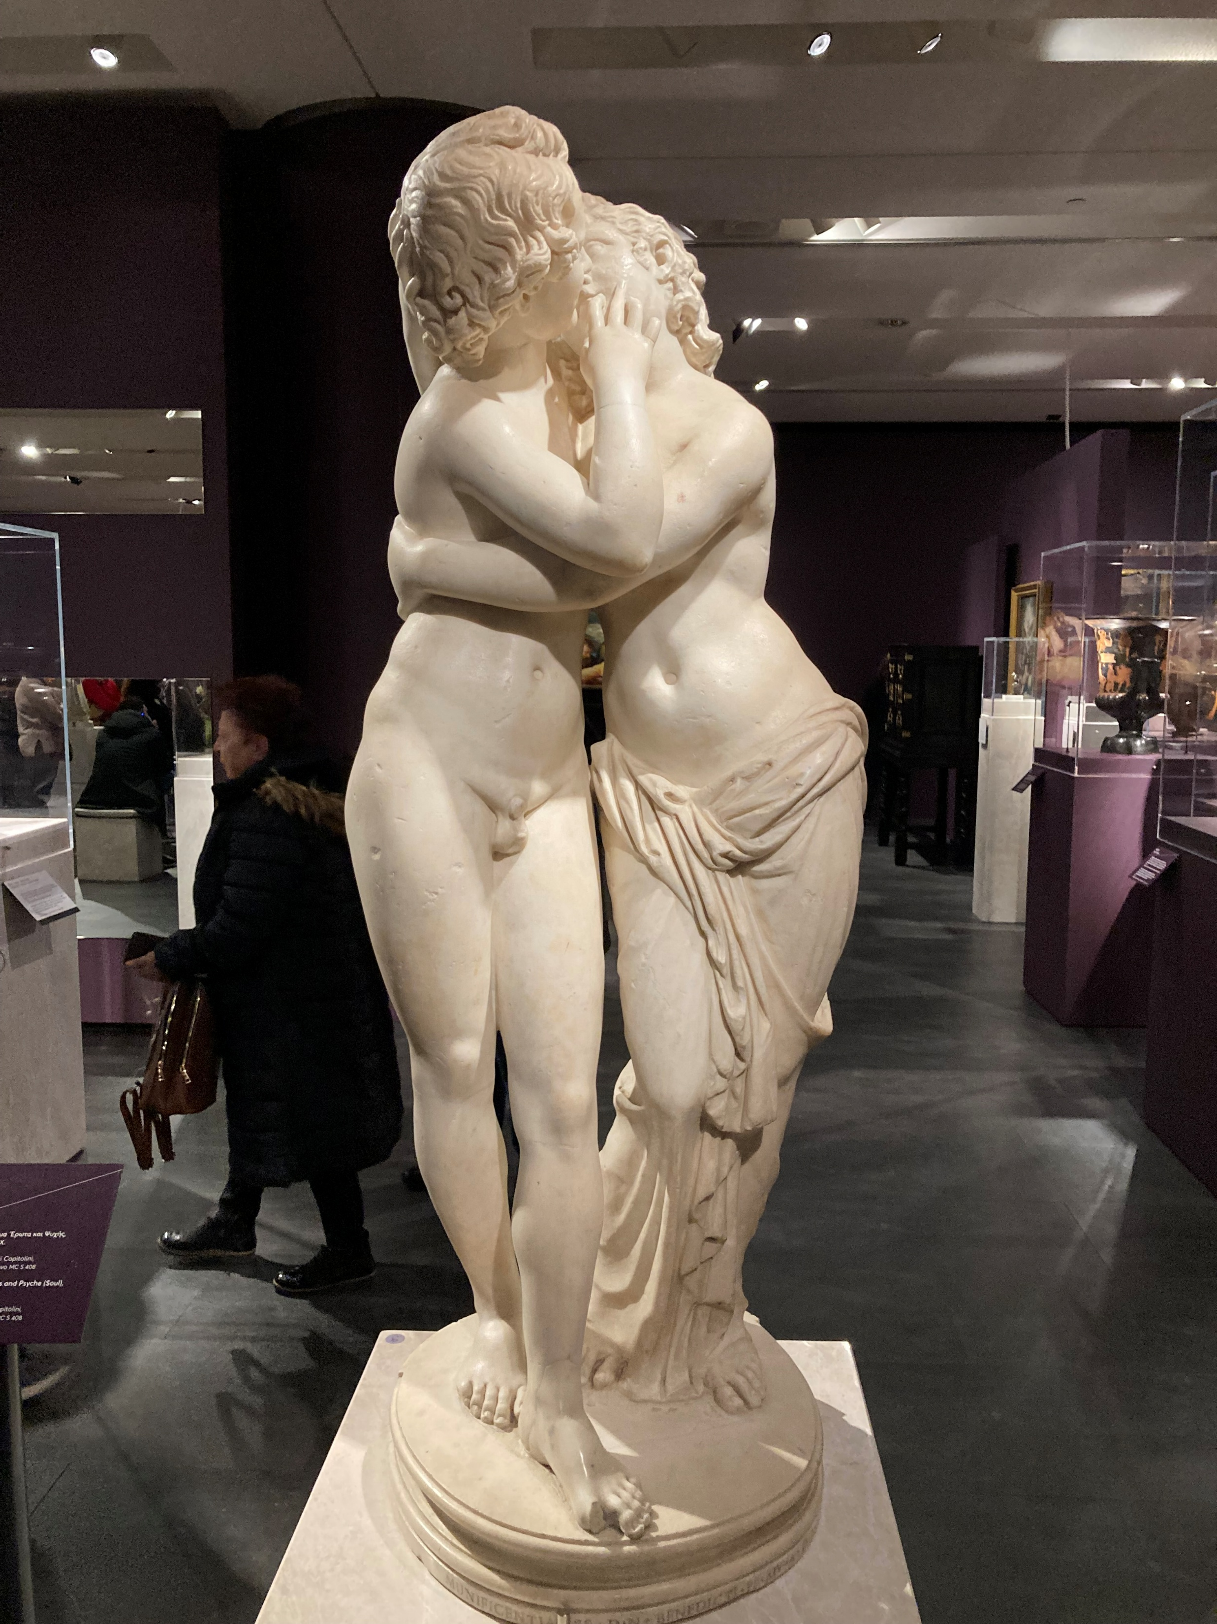
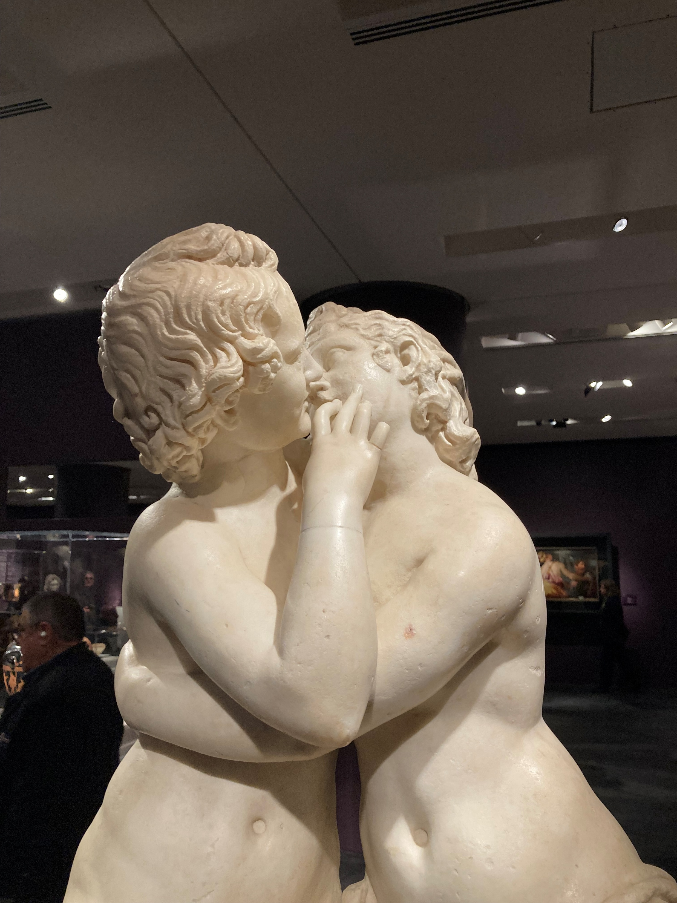
Eros and Psyche, 300 AD, after a Hellenistic statue of the 2nd century BC , Marble, Height: 1.25 m,, Capitoline Museums, Rome, Italy- Photo Credit: Amalia Spiliakou, February 18, 2024, Acropolis Museum, Athens, Greece

Slide 7
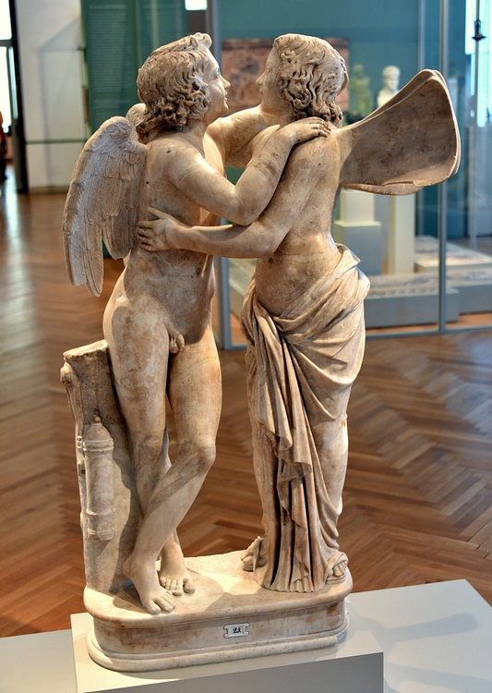
Eros and Psyche, Roman marble sculpture circa 150 AD, after a Hellenistic, 1st century BC original statue, Marble, Height: 1.25 m, Altes Museum, Berlin, Germany https://www.worldhistory.org/image/11404/statue-of-amor--psyche/

Slide 8
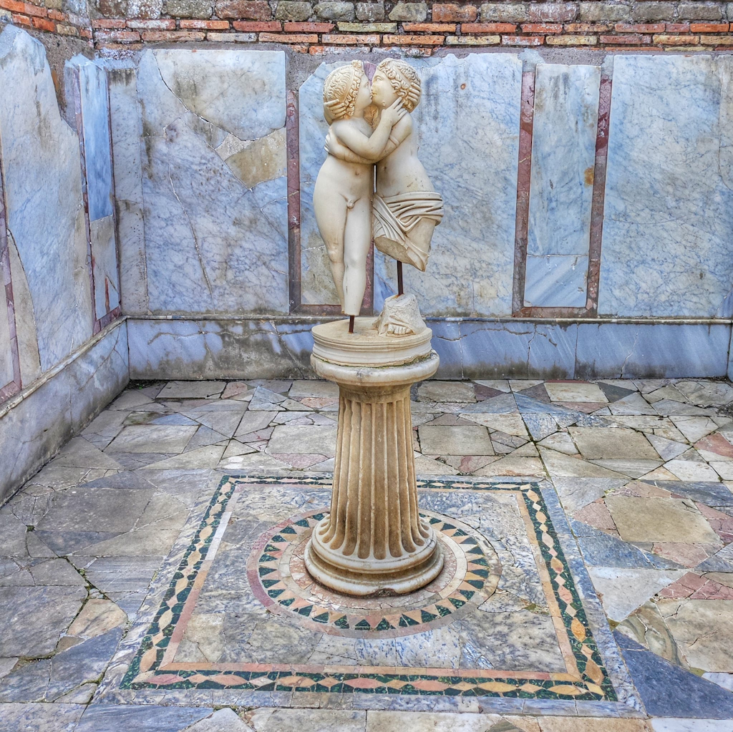
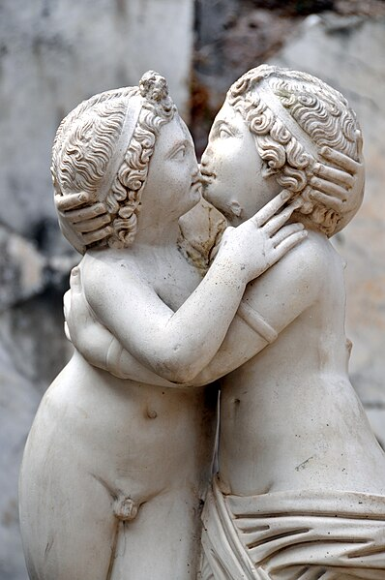
Eros and Psyche, c. 150 AD, Marble, House of Eros and Psyche, Room E. Parco Archeologico di Ostia Antica, Italy https://www.ostia-antica.org/regio1/14/14-5.htm and https://commons.wikimedia.org/wiki/File:Italy-0465_-_Statue_of_Cupid_and_Psyche_%285165528054%29.jpg

Slide 9
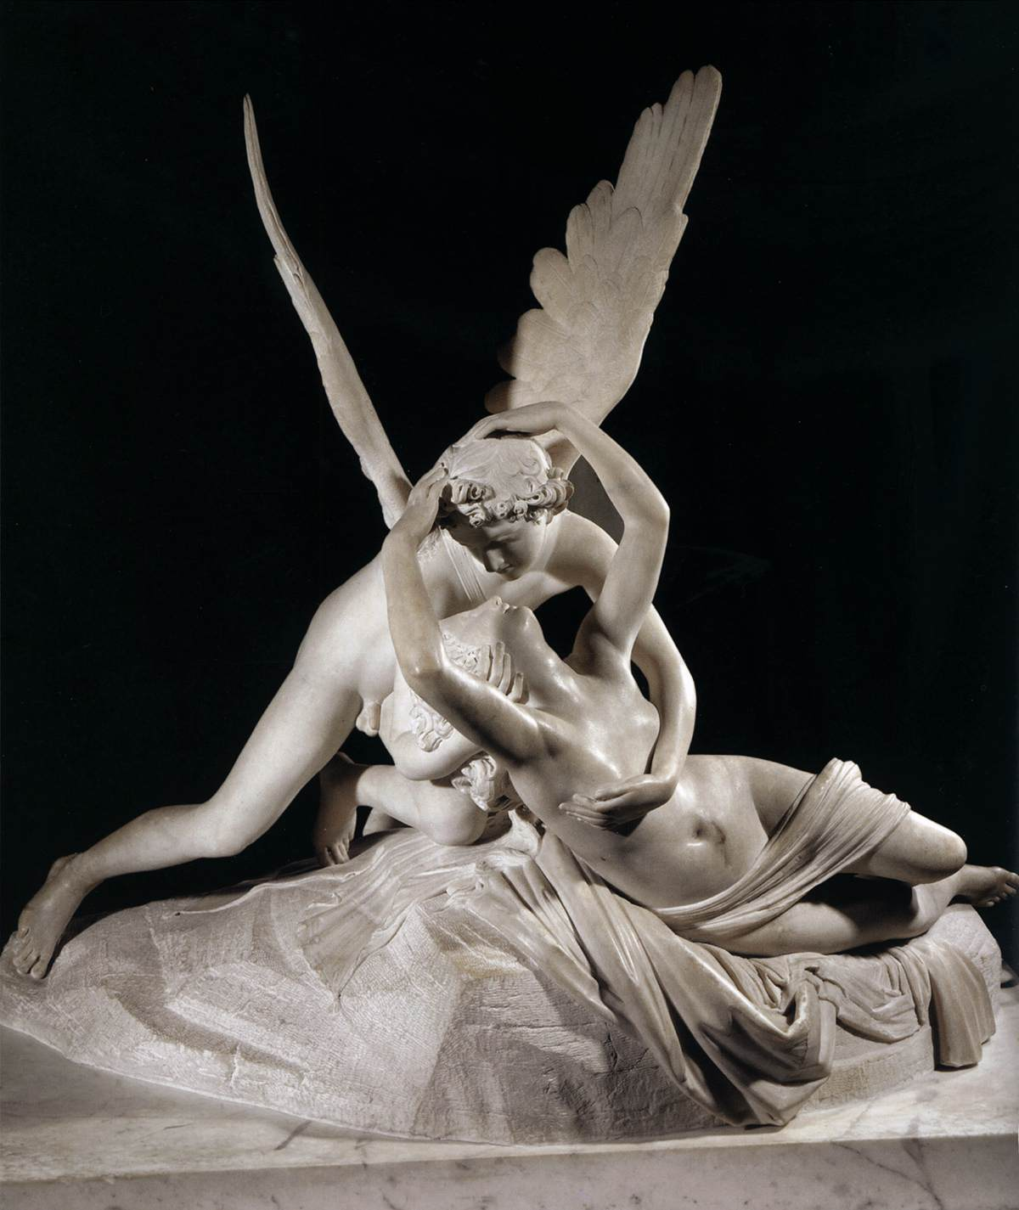
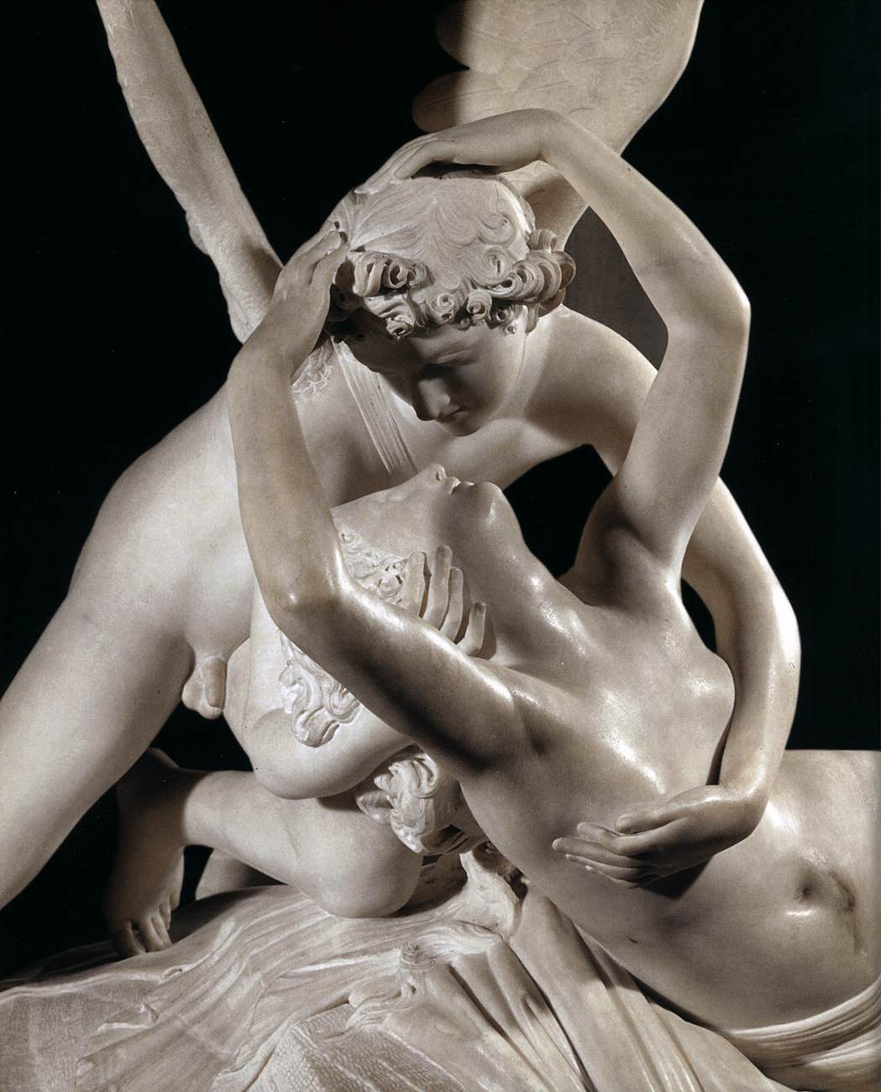
Antonio Canova, 1757-1822
Cupid and Psyche, 1786-93, Marble, Height: 155 cm, Musée du Louvre, Paris, France https://www.wga.hu/frames-e.html?/html/c/canova/index.html

Slide 10
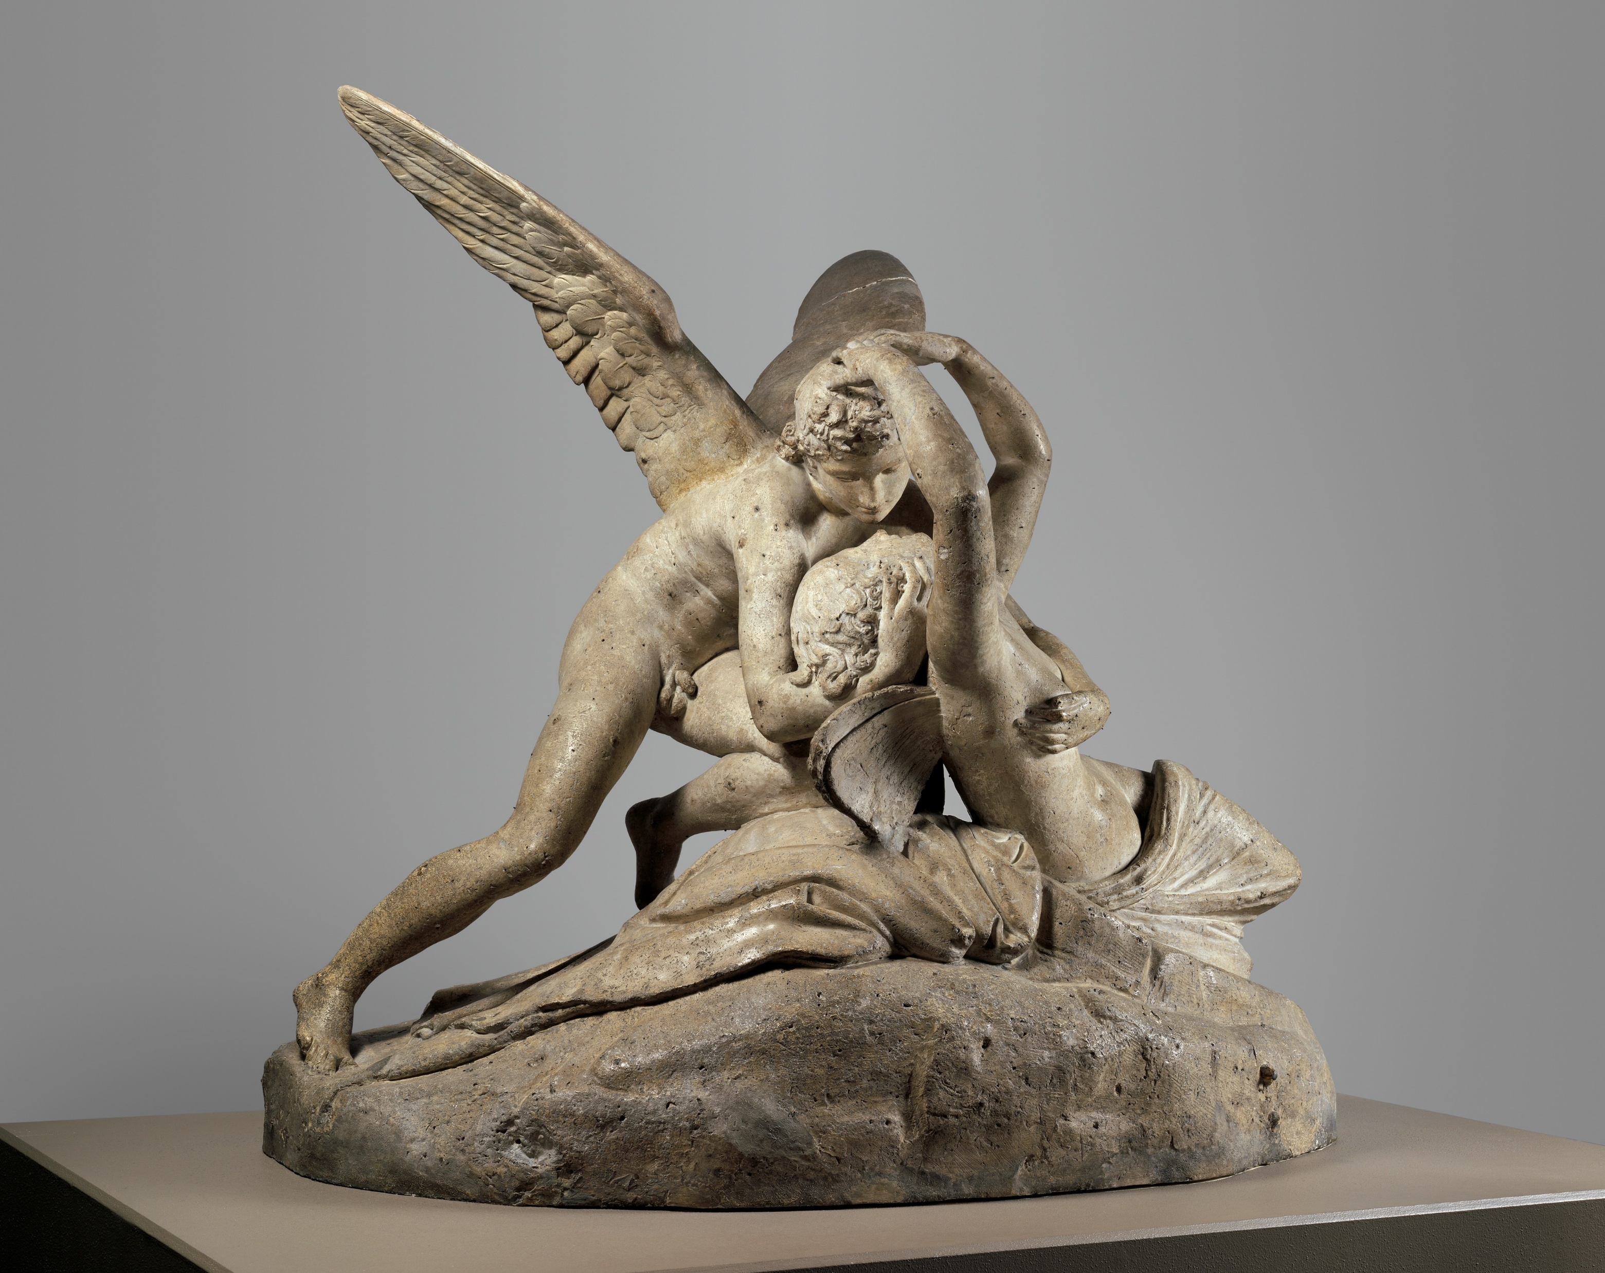
Antonio Canova, 1757-1822
Cupid and Psyche, 1794, Plaster, 134.6x151.1x81.3 cm, the MET, NY, USA https://www.metmuseum.org/art/collection/search/188954

Slide 11
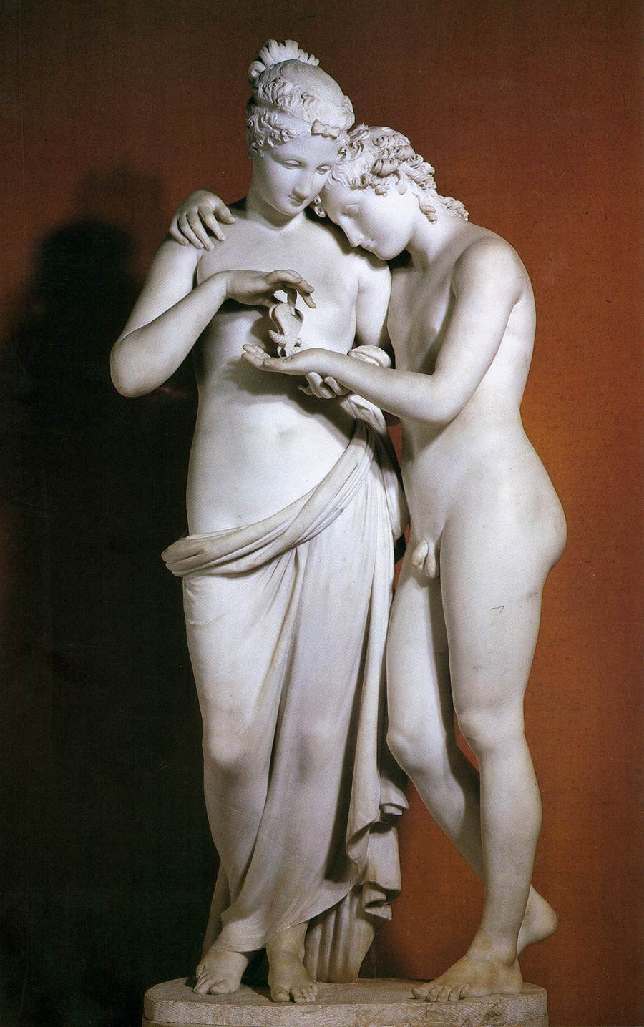
Antonio Canova, 1757-1822
Cupid and Psyche, 1796-1800, Marble, 150x68 cm, Musée du Louvre, Paris, France https://www.wga.hu/frames-e.html?/html/c/canova/index.html

Slide 12
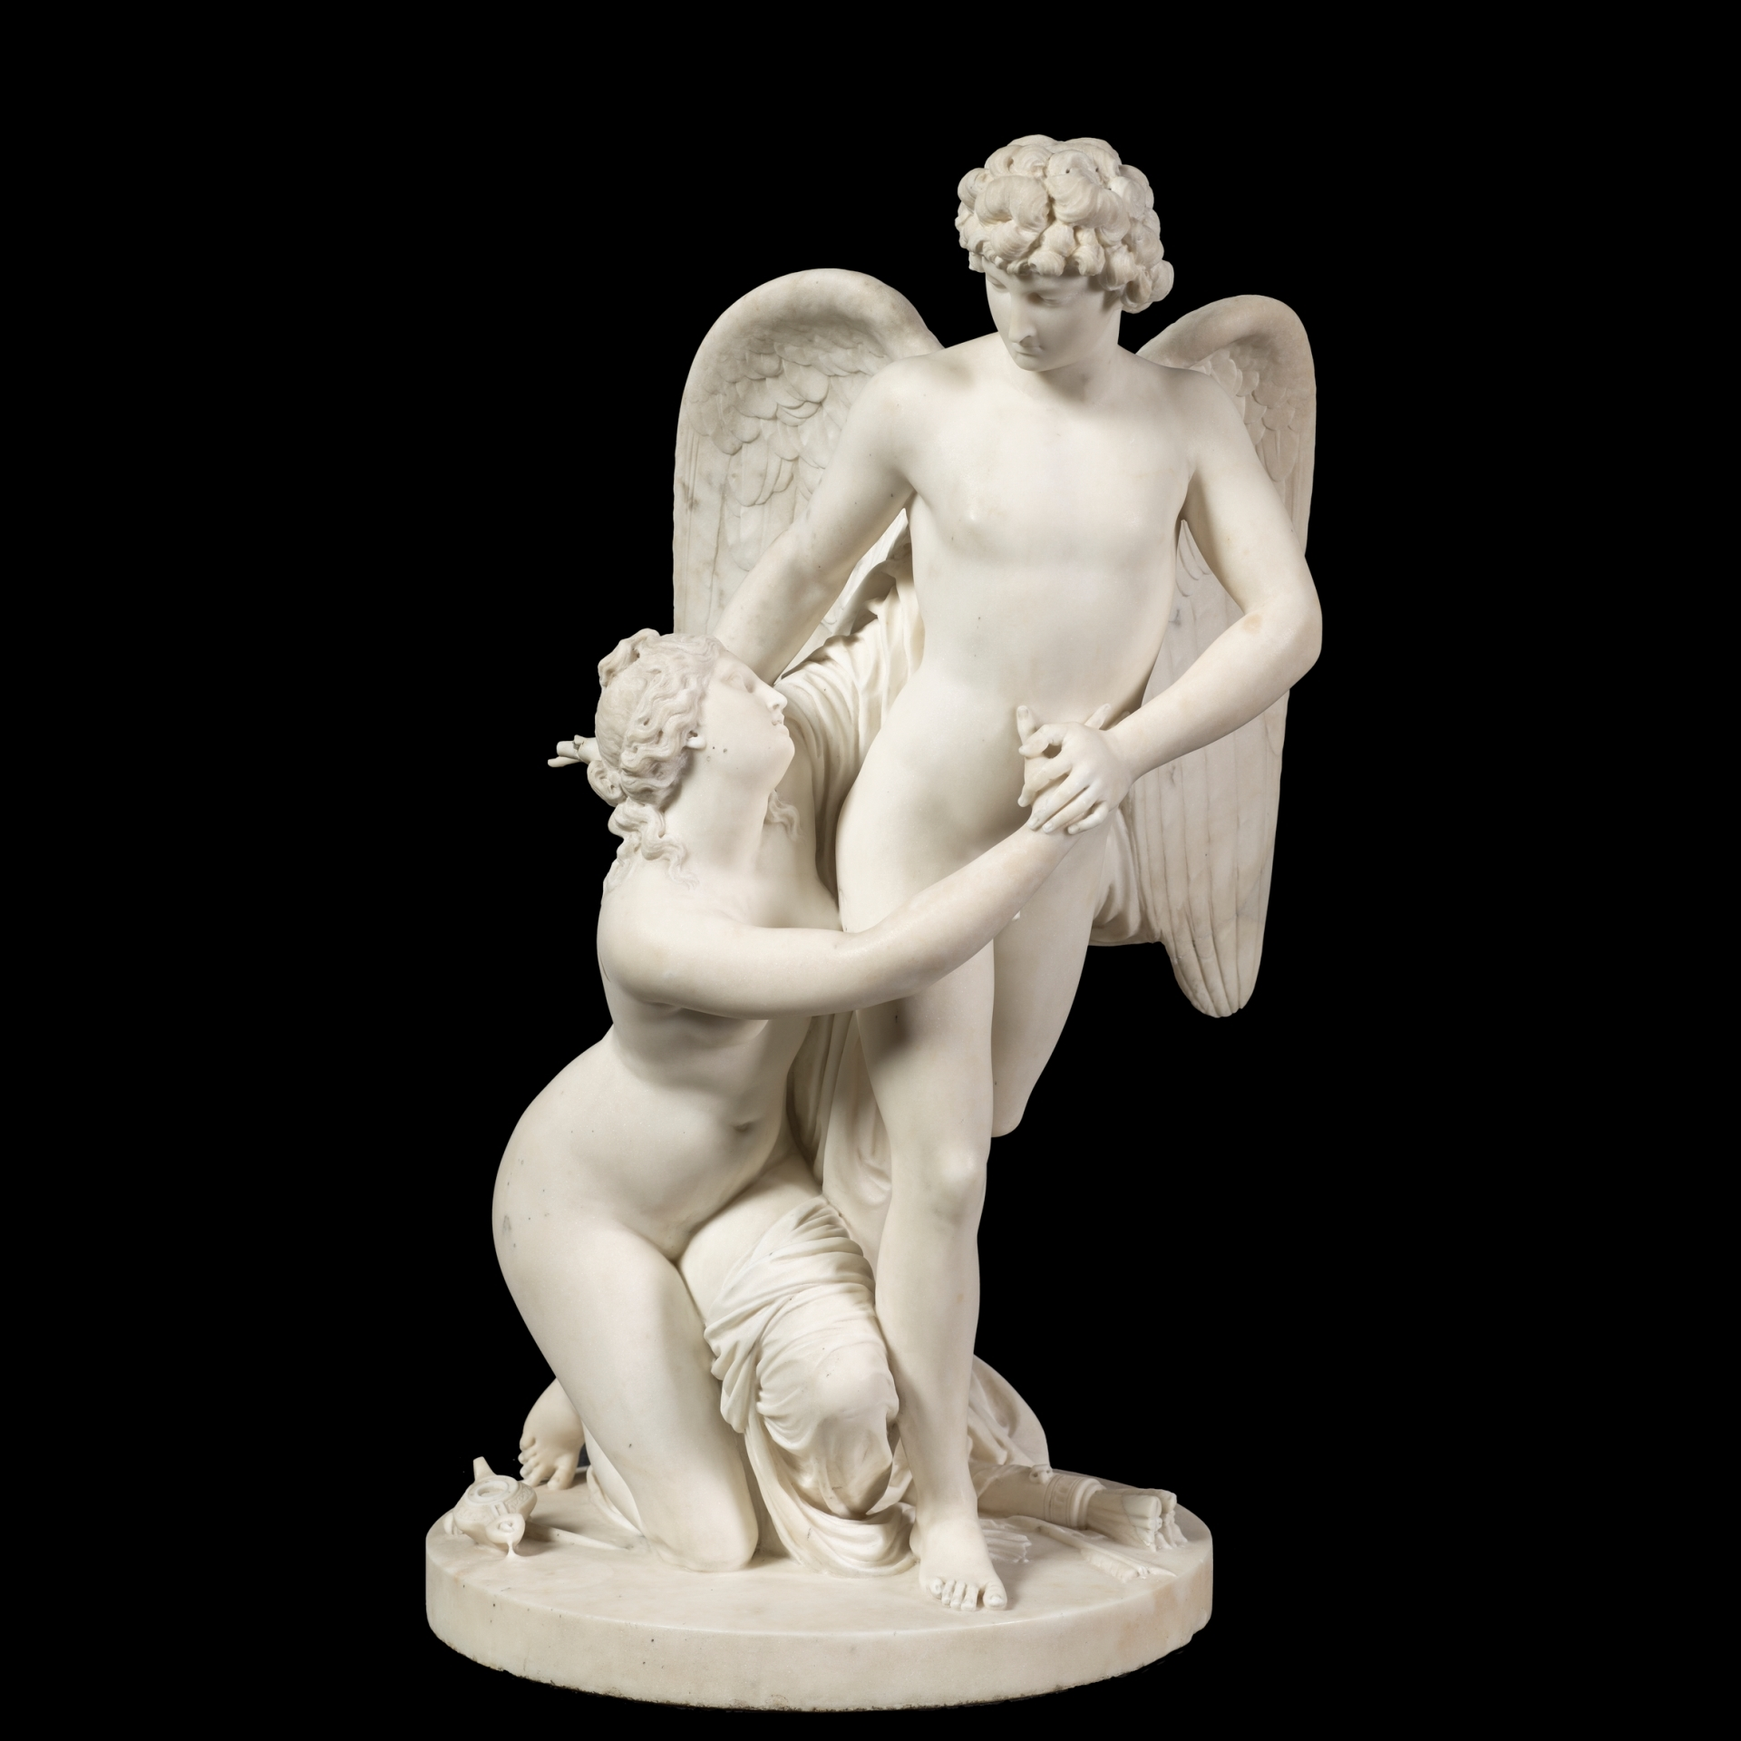
Johan Tobias Sergel, 1740-1814
Eros and Psyche, 1795-1800, Marble, Height : 74cm, Prado Museum, Madrid, Spain https://www.museodelprado.es/en/the-collection/art-work/cupid-and-psyche/2daf50e3-5eba-4bb6-9b42-067f64f760dc

Slide 13
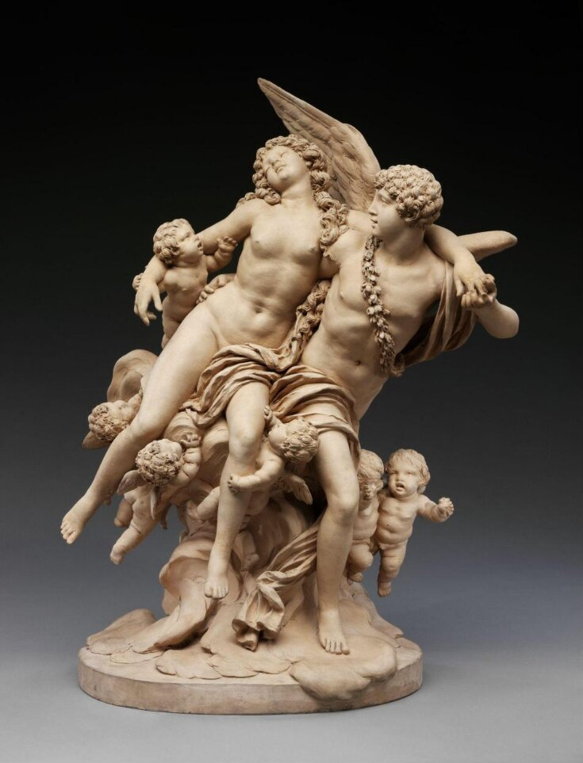
Claude Michel, known as Clodion, 1738-1814
Eros and Psyche, late 18th or early 19th century, Terracotta, Height: 59cm, Victoria and Albert Museum, London, UK https://collections.vam.ac.uk/item/O94281/cupid-and-psyche-figure-group-clodion/

Slide 14
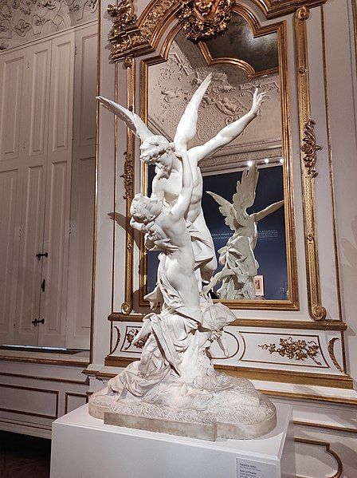
Theodor Friedl, 1842-1900
Eros and Psyche, 1890. Marble, 200x110x72 cm, Belvedere, Vienna, Austria https://commons.wikimedia.org/wiki/File:%CE%88%CF%81%CF%89%CF%84%CE%B1%CF%82_%CE%BA%CE%B1%CE%B9_%CF%88%CF%85%CF%87%CE%AE,_Theodor_Friedl,_1881-82,.jpg

Slide 15
The End

