Slide 1

Luigi Bazzani
1836–1927
23 Paintings inspired by Pompeii

Slide 2
All paintings presented in this PowerPoint, created as watercolours on paper, are part of the collection of the Victoria and Albert Museum in London, UK https://collections.vam.ac.uk/search/?id_person=AUTH347957&page=1&page_size=15

Slide 3
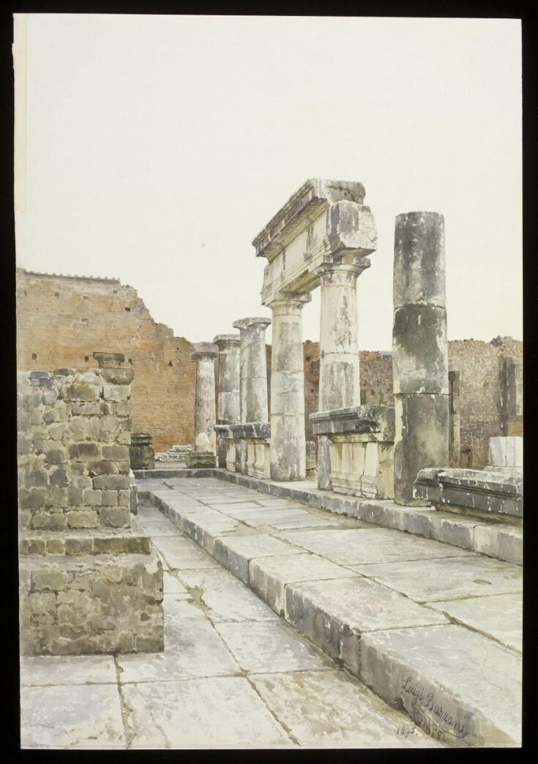
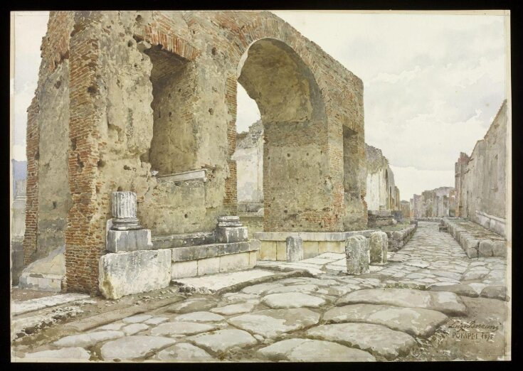
View of the south-west angle of the Forum at Pompeii. On the right are the remains of the New Colonnade, on the left portion of one of the pedestals to support the statues of the imperial family, and in the background are the walls of the municipal buildings.
View of the triumphal arch of Nero at the north-east corner of the forum at Pompeii. The view is taken from the eastern side of the arch looking down the Via dei Soprastani.

Slide 4
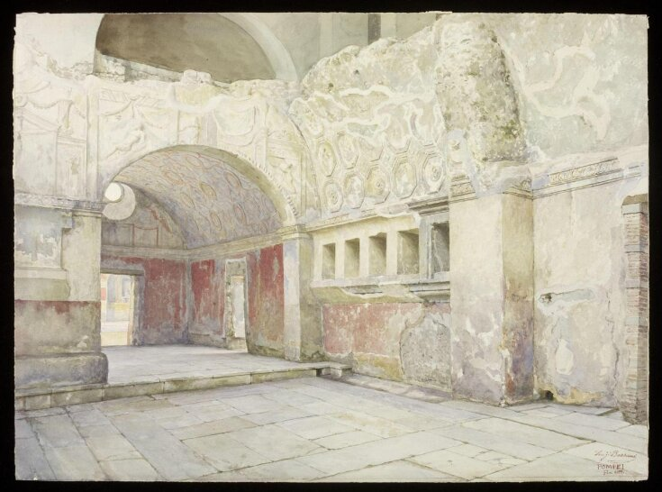
View of the Apodyterium and the ante-room leading from the Palaestra of the Stabian Baths in Pompeii. The view shows extensive stucco works along the walls and ceiling.

Slide 5
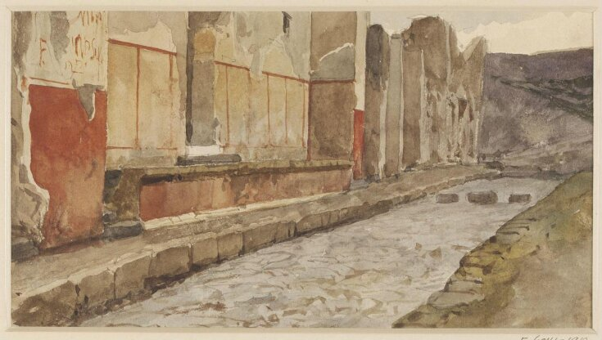
View showing the footway in front of the 'House of Epidius Rufus' and the 'House of Epidius Sabinus' at Pompeii, painted from the perspective of being on the other side of the road to the houses, with the cobbled road seen in the middle.

Slide 6
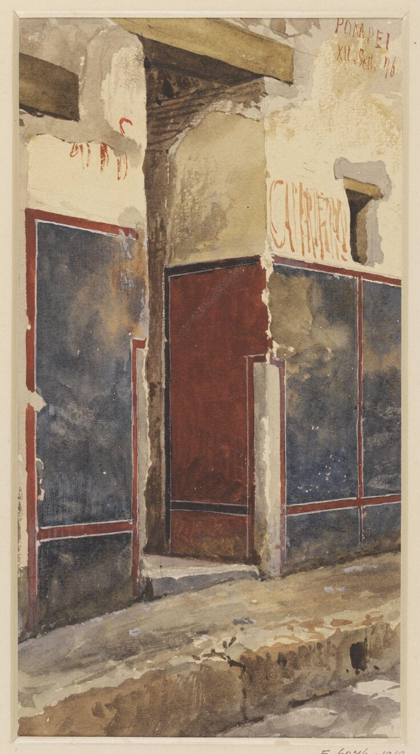
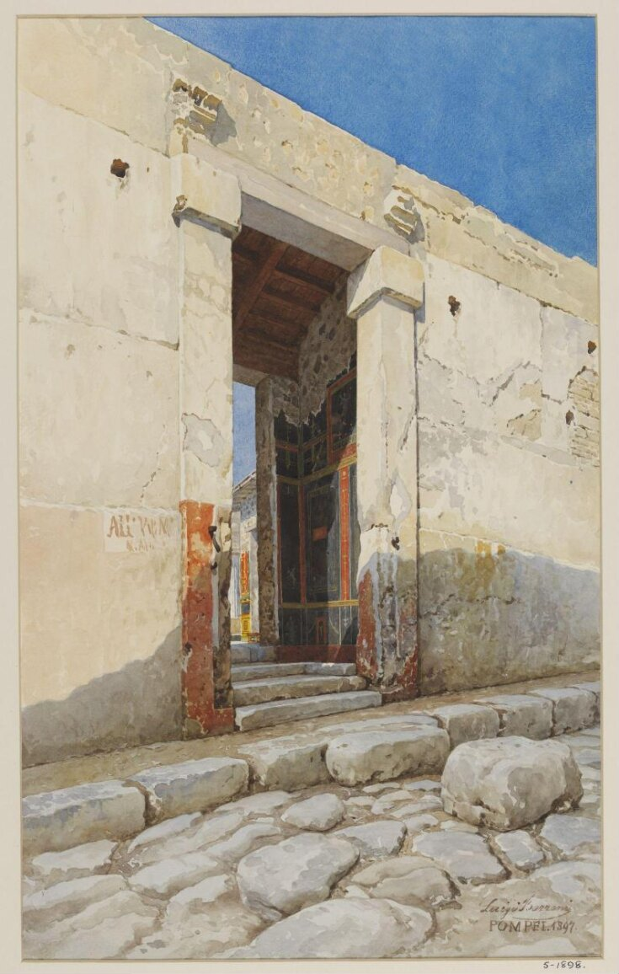
The entrance to the Fullonica or House of Dyers, in the Via del Vesuvio at Pompeii. The footway can be seen in front of it with some of the wall decoration seen on either side of the door.
Entry to an unidentified Pompeiian House

Slide 7
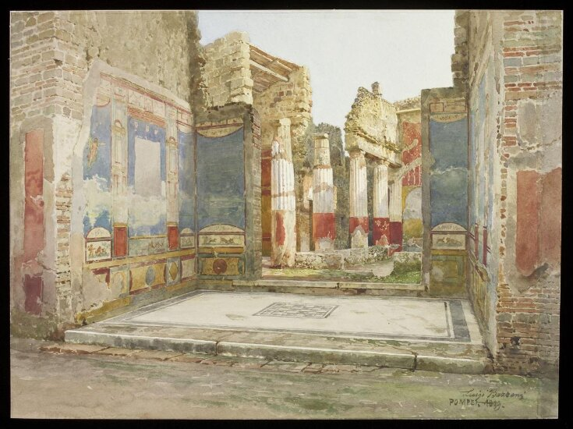
View of the peristyle and the tablinum, as seen from the atrium, of the 'House of the Chase.' Crumbling, decorative wall paintings line the walls in blues and yellows.

Slide 8
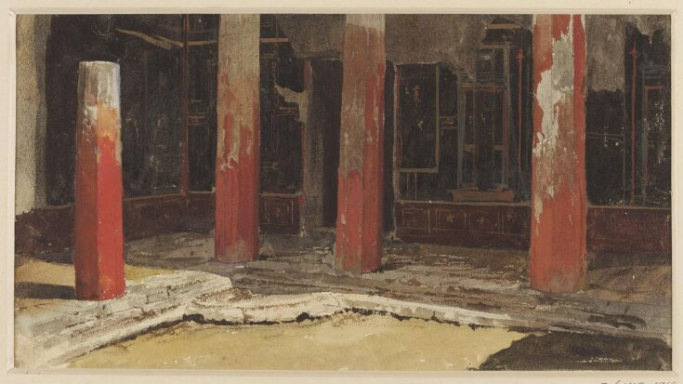
View of a corner of the peristyle of the women’s apartments in the 'House of Sallust' at Pompeii depicting four red columns with a doorway seen behind them as well as the decorated walls.

Slide 9
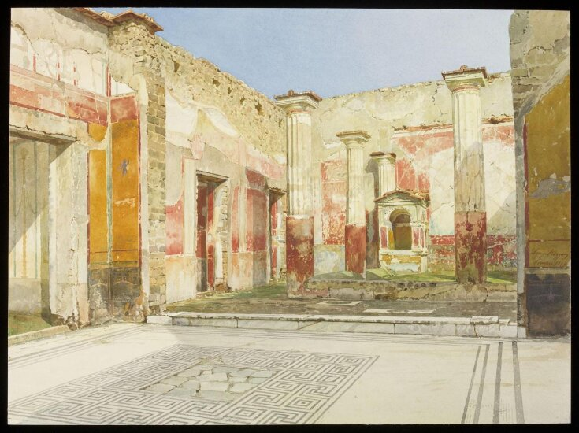
View of the peristyle and shrine, as seen from the tablinum, in the 'House of the Tragic Poet.' A patterned floor is shown at the entry to the peristyle, four of which's columns are visible. The small shrine sits at the back of the peristyle courtyard. Much of the paintwork is in red and yellow.

Slide 10
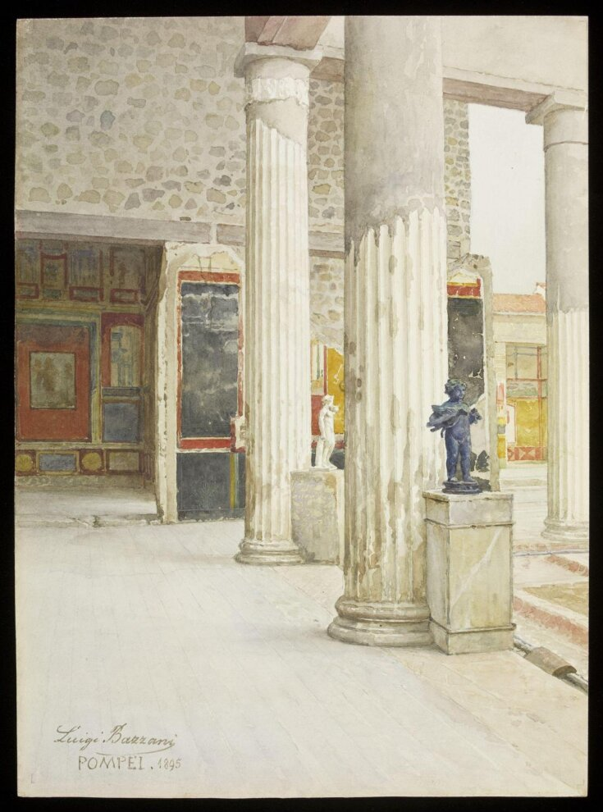
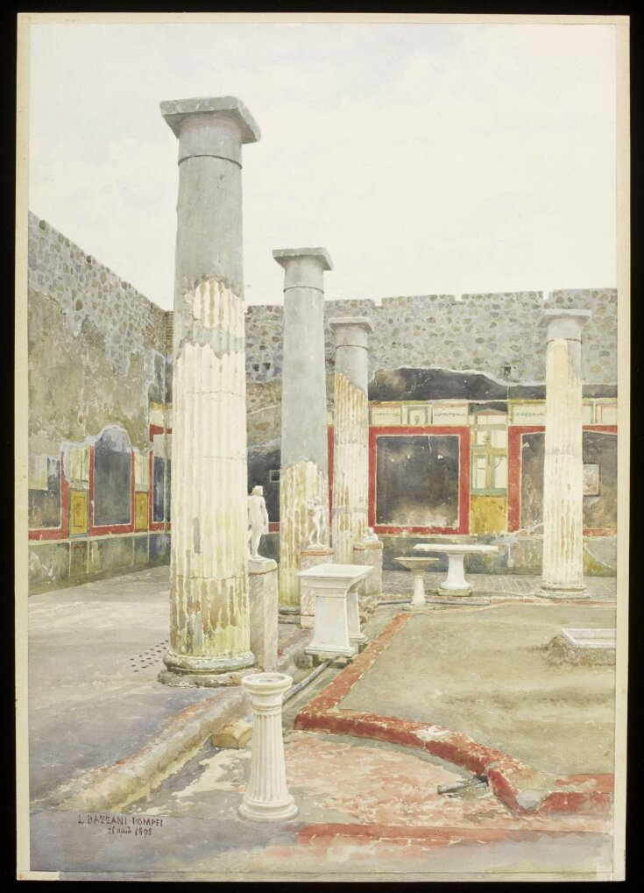
View of the north-east corner of the peristyle in the house of Aulus Vettius. The chamber on the left is the larger triclinium.
View of the south-west corner of the peristyle of the house of Aulus Vettius. Four large columns mark the edge of a courtyard.

Slide 11
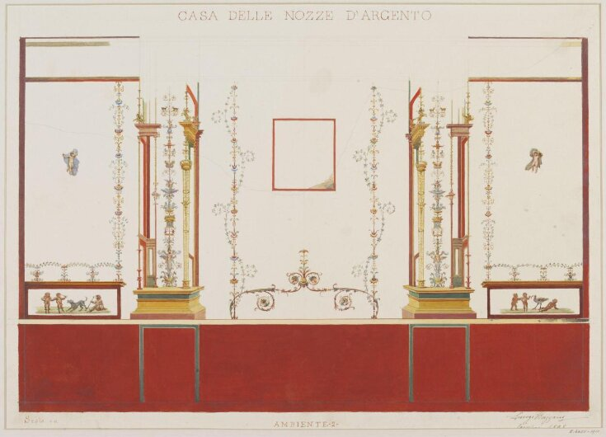
Copy of a wall painting in the house known as 'Casa delle Nozze d'Argento' in Pompeii, excavated in 1894.

Slide 12
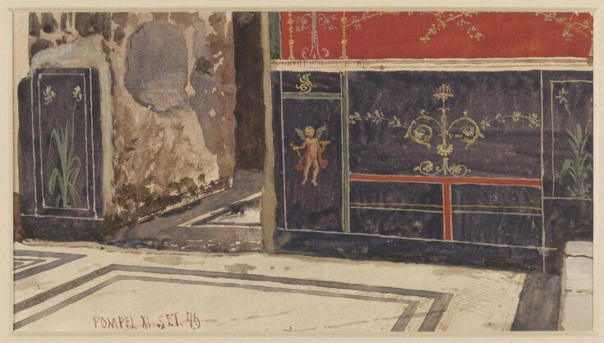
Preliminary study of painted wall decoration in the 'House of Triptolemus' in the Via Marina at Pompeii.

Slide 13
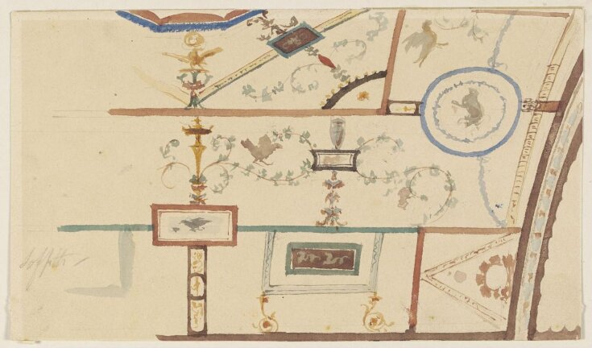
Preliminary study of the painted decoration of a vaulted ceiling in the 'House of the Princess Margherita' in the Strada Stabiana at Pompeii.

Slide 14
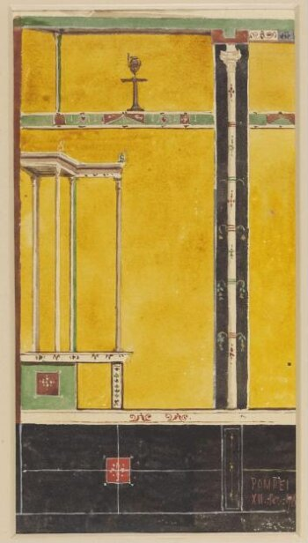
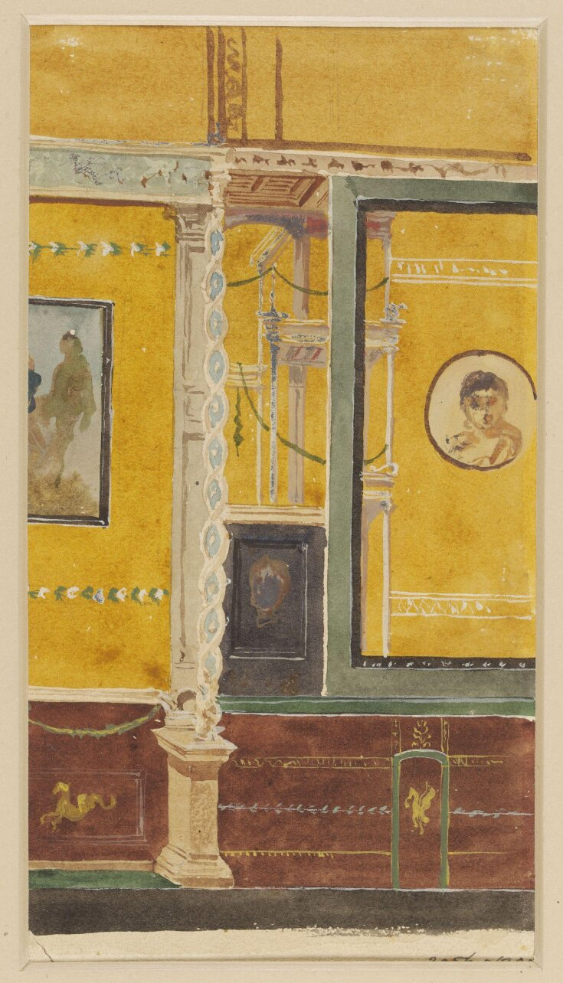
Preliminary study of a painted wall decoration in the 'House of Orpheus' at Pompeii.
Preliminary study of a wall decoration in the 'House of the Citharist', also known as the 'House of Popidius Secundus Augustianus', at Pompeii.

Slide 15
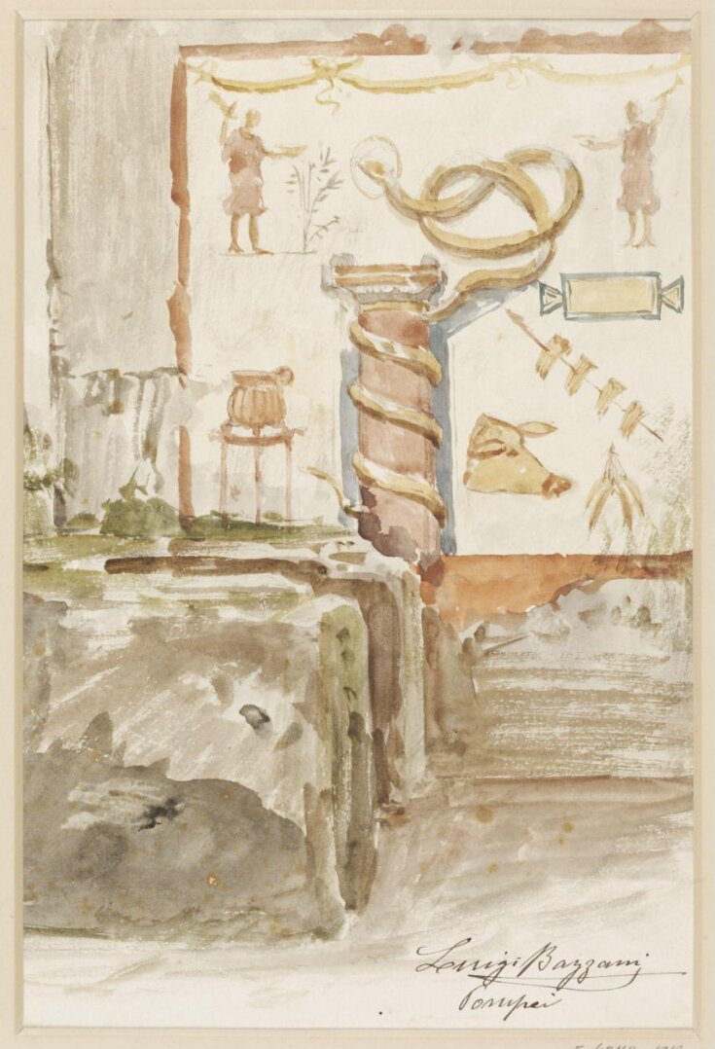
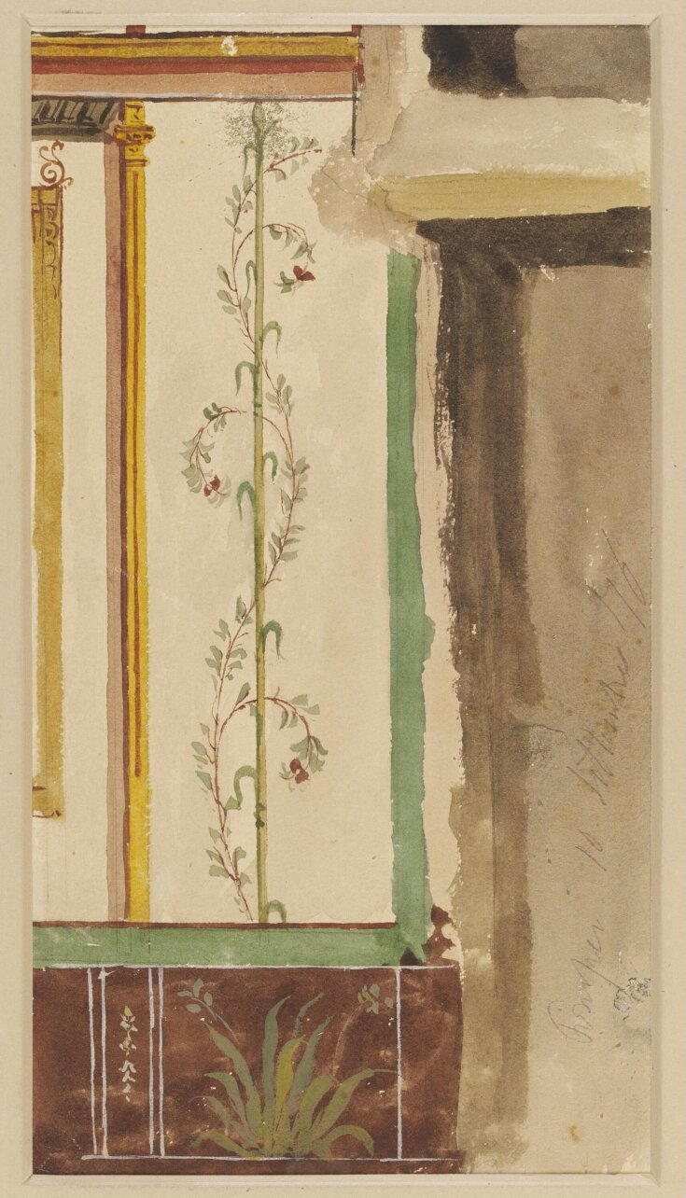
Preliminary study of a painted wall decoration in the 'House of A. Octavius Primus' at Pompeii. It shows part of a column with a spiral design in the centre, with the spiral decoration extending further.
Preliminary study of a wall painting in the 'House of Romulus and Remus' in the Via Marina in Pompeii.

Slide 16
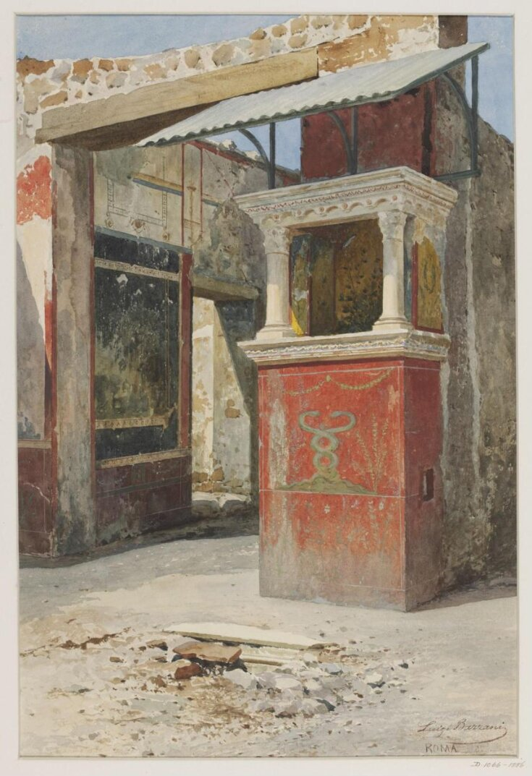
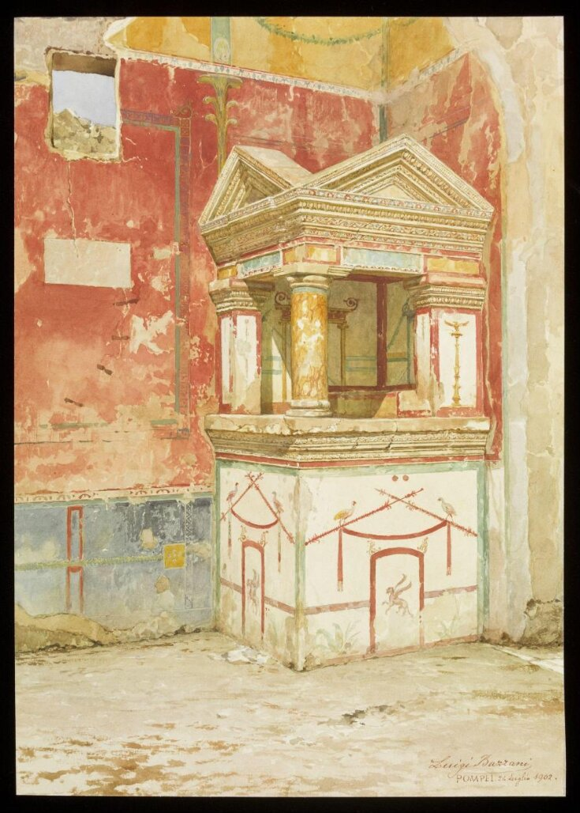
Drawing of the remains of a lararium in Pompeii in an unidentified House.
View of the lararium in the house of Epidius Sabinus, Pompeii. Also known as a shrine to the household gods, it takes the shape of a miniature temple decorated with delicate ornamentation in paint.

Slide 17
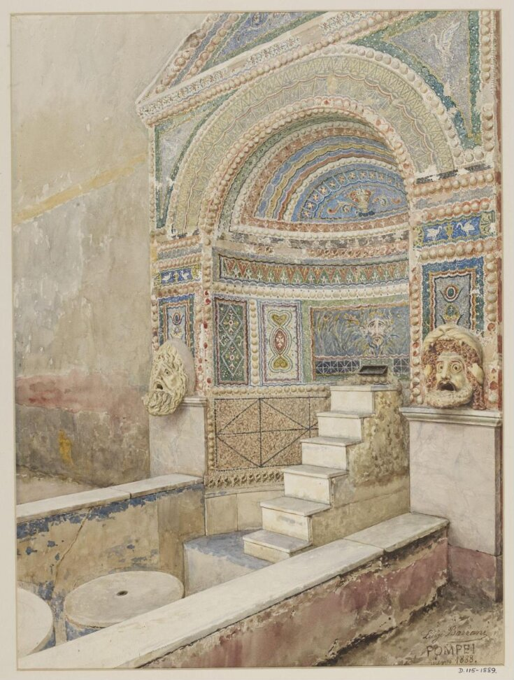
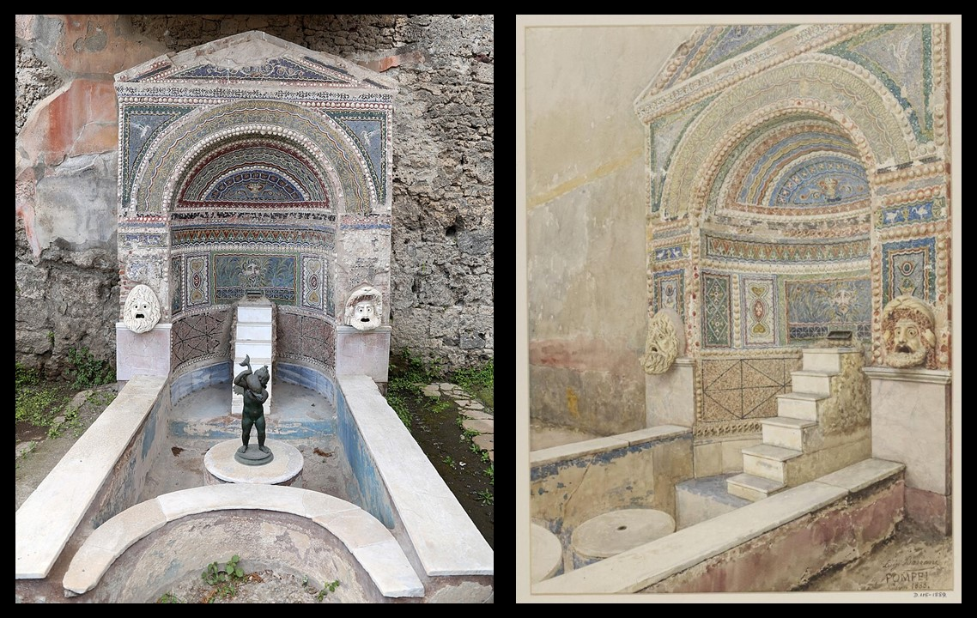
The watercolour painting of a Pompeiian Fountain within a highly decorated alcove, is a wonderful reconstruction of the Mosaic Fountain discovered in the Pompeiian House of the Large Fountain.

Slide 18
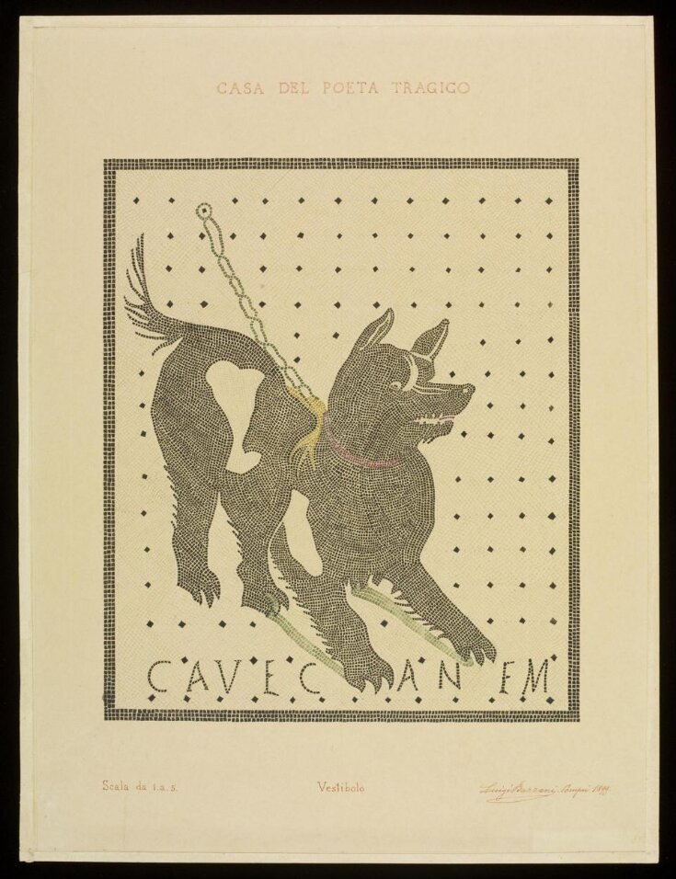
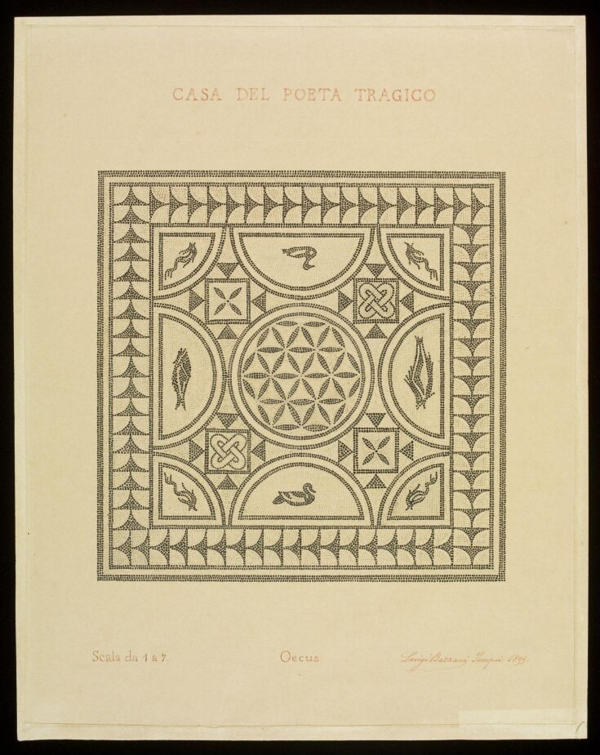
Copy of a mosaic from the Vestibule of the 'House of the Tragic Poet.’
Copy of a mosaic in the large dining room (oecus) of the 'House of the Tragic Poet.' ’

