Slide 1
Gustav Klimt
1862-1918
Portraits

Slide 2
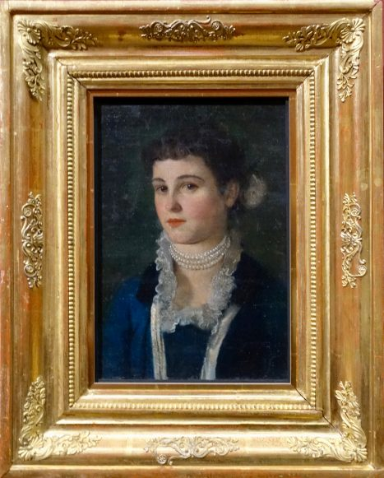
Klara Klimt, c.1880 Oil on Canvas, Leopold Museum, Vienna, Austria https://i0.wp.com/thetravelzealot.com/wp-content/uploads/2019/05/DSC03802-e1558388072337.jpeg?ssl=1

Slide 3
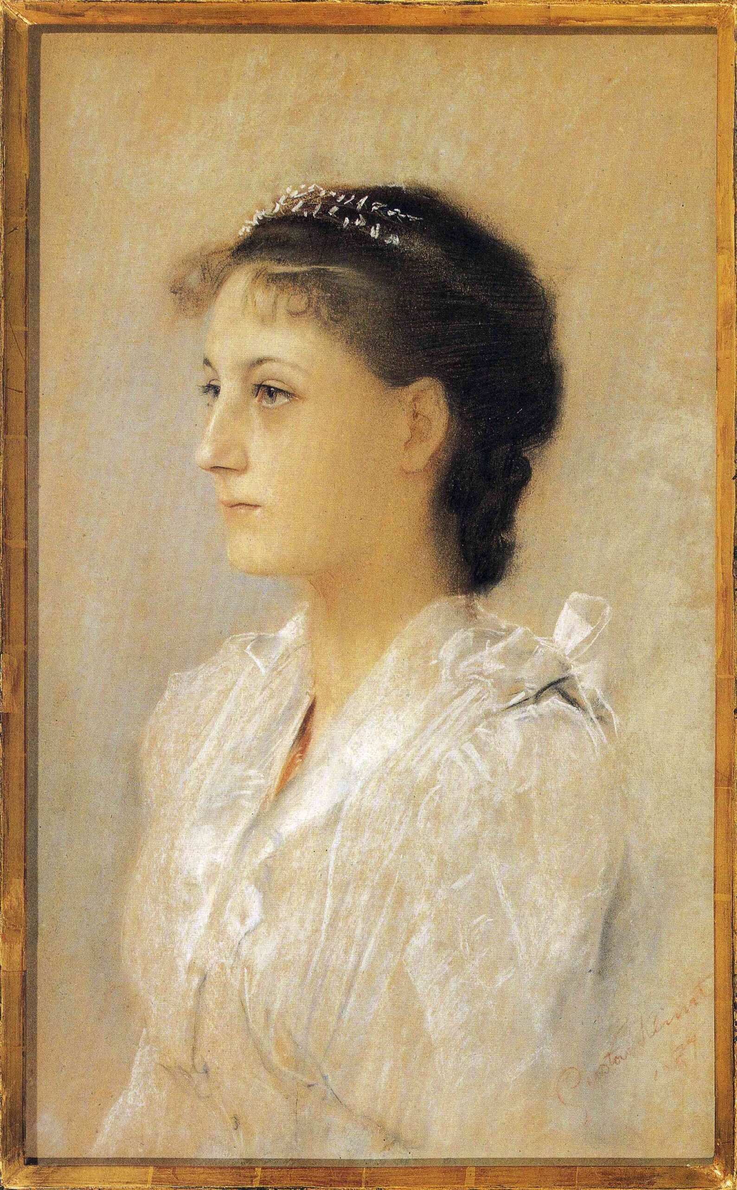
Emilie Flöge, Aged 17, 1891, Pastel on Paper, Private Collection https://www.wikiart.org/en/gustav-klimt/emilie-fl%C3%B6ge-aged-17-1891

Slide 4
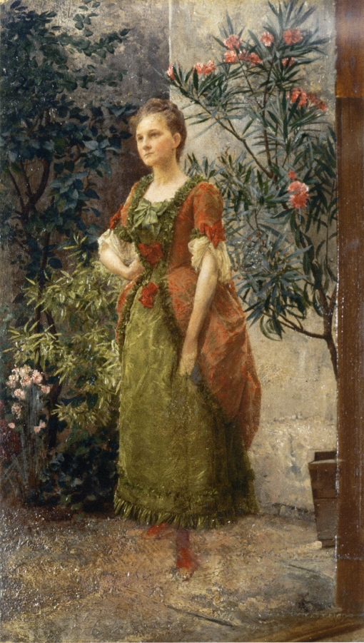
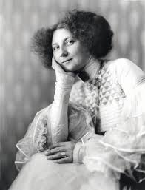
Portrait of Emilie Flöge, c.1893, Oil on Cardboard, Albertina, Vienna, Austria
Emilie Flöge, photographed by the studio d’ora-benda, 1909 https://www.artchive.com/artwork/portrait-of-emilie-floge-gustav-klimt-c-1893/ and http://www.eshph.org/wp-content/uploads/2016/07/emilie_floege_E.pdf

Slide 5
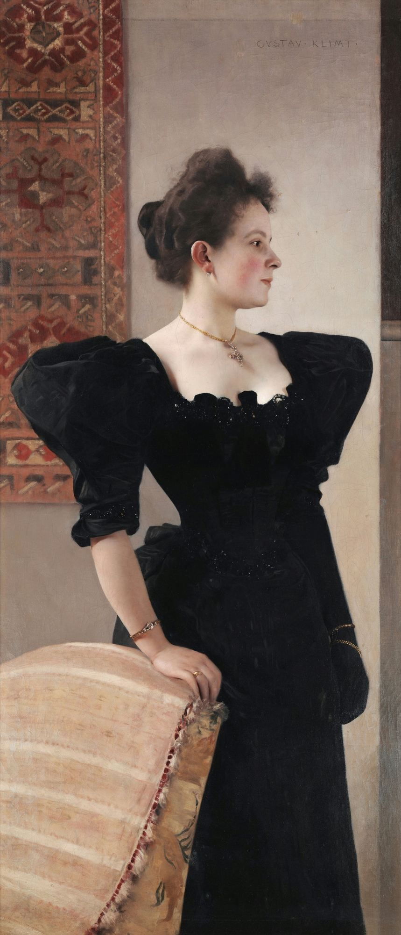
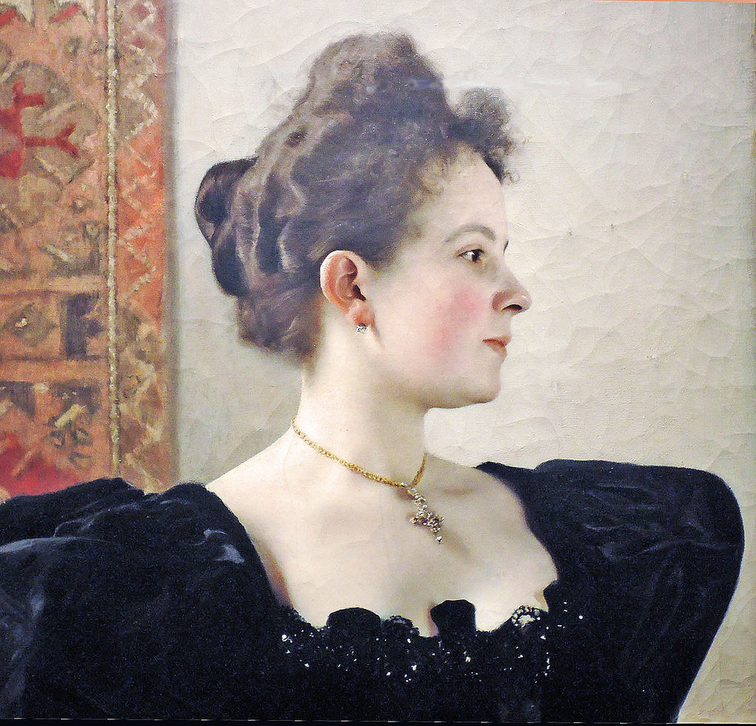
Portrait of Marie Breunig, 1894, Oil on Canvas, 168 x 84 cm, Private Collection https://www.wikiart.org/store/portrait-of-a-lady-marie-breunig-1895.html and https://www.flickr.com/photos/28433765@N07/36298174050

Slide 6
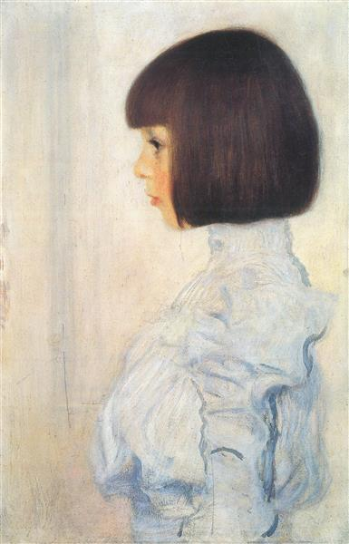
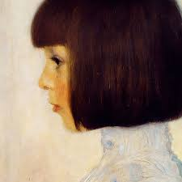
Portrait of Helene Klimt, 1898, Oil on Cardboard, 60x40 cm, Private Collection https://www.wikiart.org/en/gustav-klimt/portrait-of-helene-klimt

Slide 7
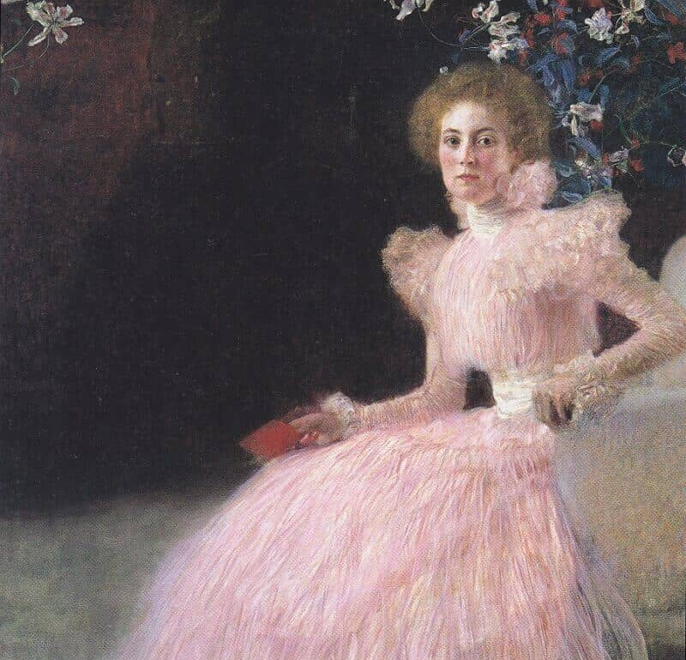
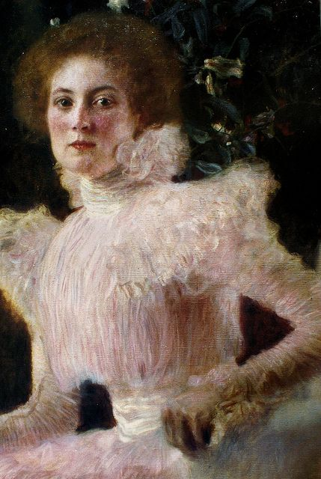
Sonja Knips, 1898, 145x145 cm, Belvedere, Vienna, Austria https://www.gustav-klimt.com/Portrait-of-Sonja-Knips.jsp and https://gr.pinterest.com/pin/673780794222421645/

Slide 8
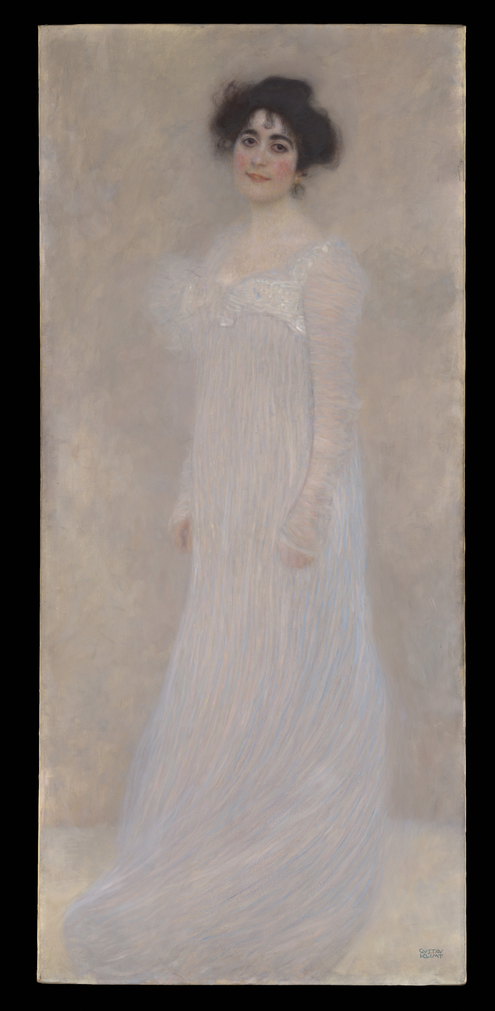
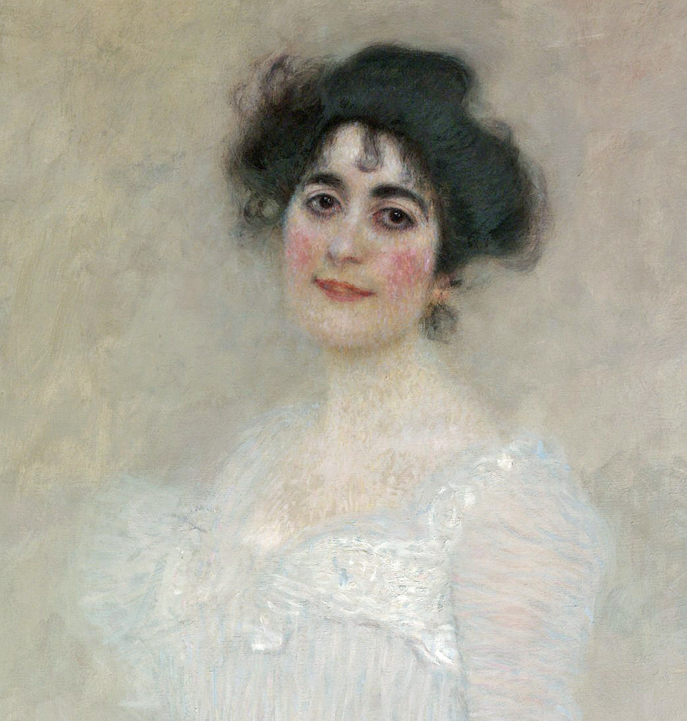
Portrait of Serena Lederer, 1899, Oil on Canvas,
188 x 85.4 cm, the MET, NY, USA https://www.metmuseum.org/art/collection/search/436820 and https://www.flickr.com/photos/28433765@N07/36705736046

Slide 9
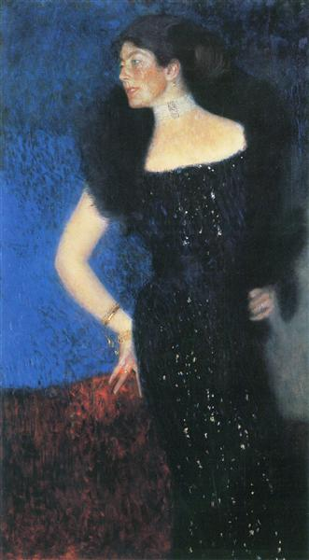
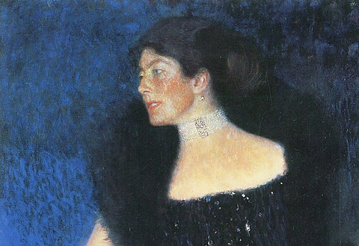
Portrait of Rose von Rosthorn-Friedmann, 1900 – 1901, Oil on Canvas, 190x120 cm, Belvedere, Vienna, Austria https://www.wikiart.org/en/gustav-klimt/portrait-of-rose-von-rosthorn-friedmann-1901 and https://www.portraitsdigital.com/eighty-ninety-face-like-a-sunset

Slide 10
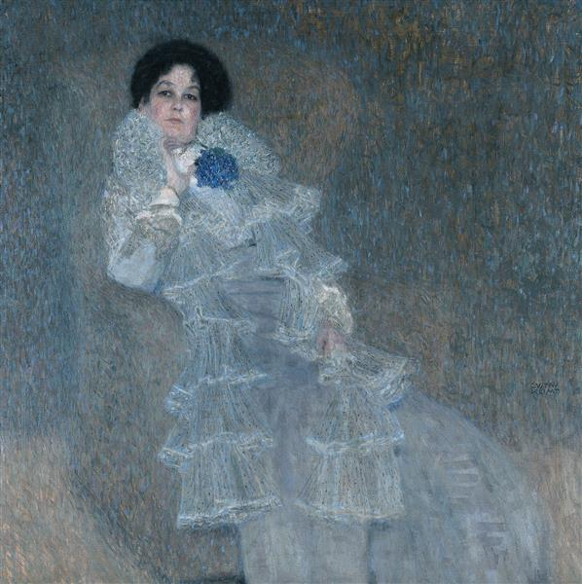
Portrait of Marie Henneberg,
1901 – 1902, Oil on Canvas, 140 x 140 cm, Belvedere, Vienna, Austria https://www.wikiart.org/en/gustav-klimt/portrait-of-marie-henneberg-1902

Slide 11
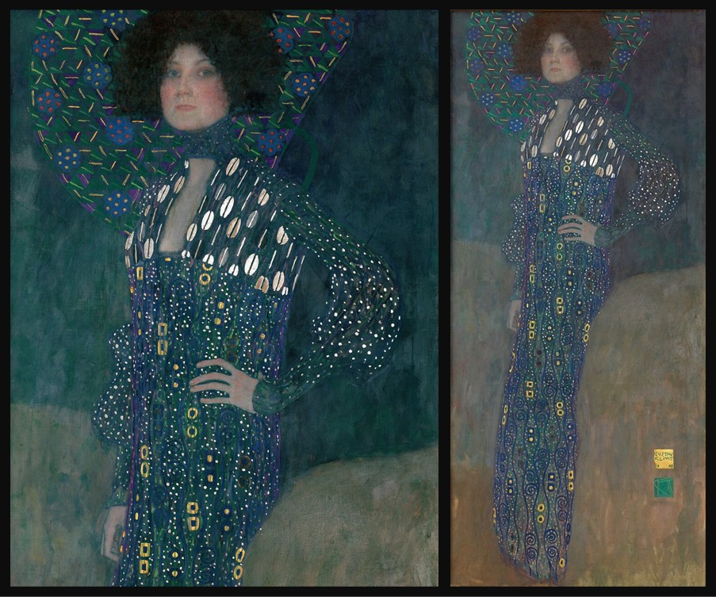
Emilie Flöge, 1902, Oil on Canvas, 181x84 cm, Wien Museum, Austria https://www.sothebysinstitute.com/news-and-events/news/floge-klimts-kiss and https://blog.fabrics-store.com/2024/02/06/emilie-floge-fashion-for-the-fin-de-siecle/

Slide 12
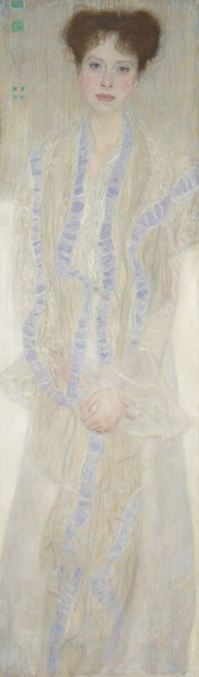
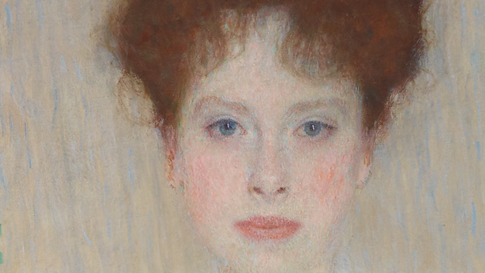
Portrait of Gertha Felssovanyi, 1902, Oil on Canvas, 195,5x45 cm, Private Collection https://www.sothebys.com/en/videos/gustav-klimts-bildnis-gertrud-loew-gertha-felsovanyi

Slide 13
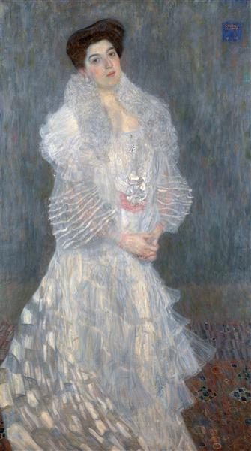
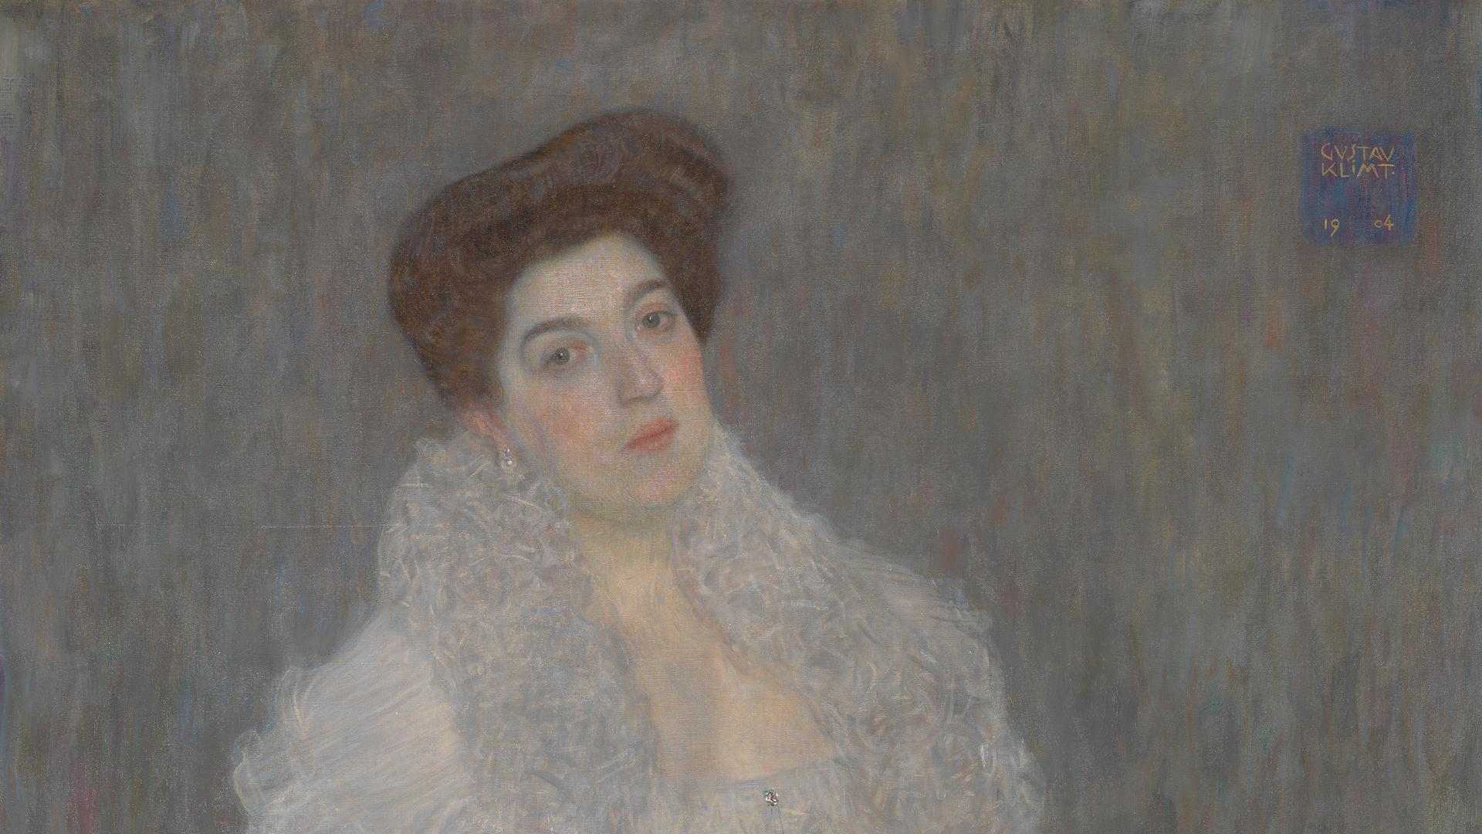
Portrait of Hermine Gallia, 1904, Oil on Canvas, 107.5x96.5 cm, National Gallery, London, UK https://www.wikiart.org/en/gustav-klimt/portrait-of-hermine-gallia-1904 and https://www.nationalgallery.org.uk/paintings/gustav-klimt-portrait-of-hermine-gallia

Slide 14
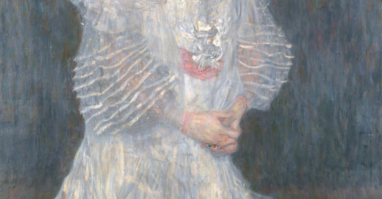

Slide 15
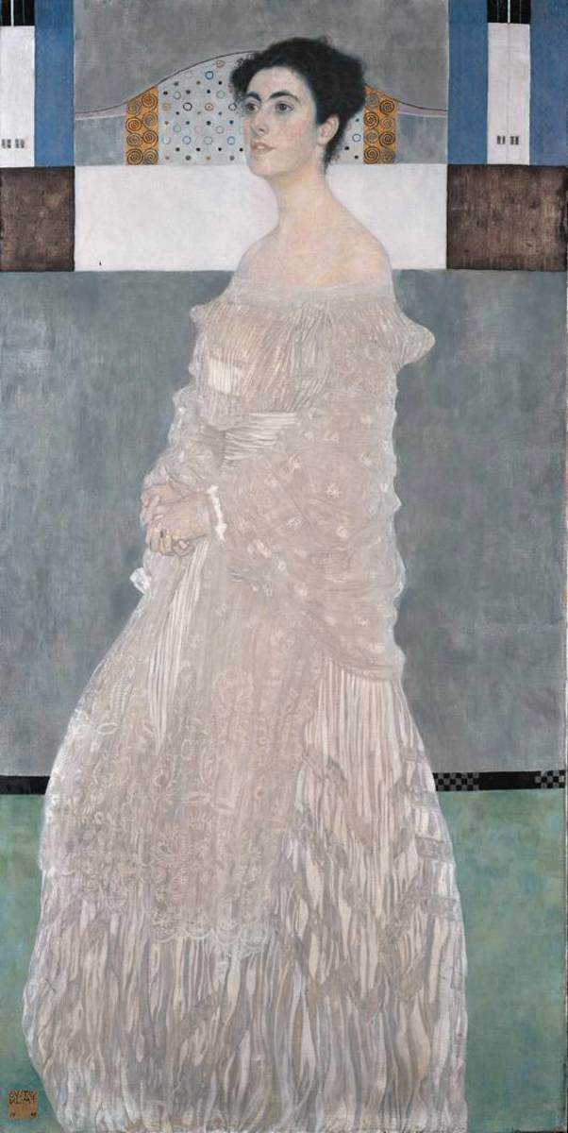
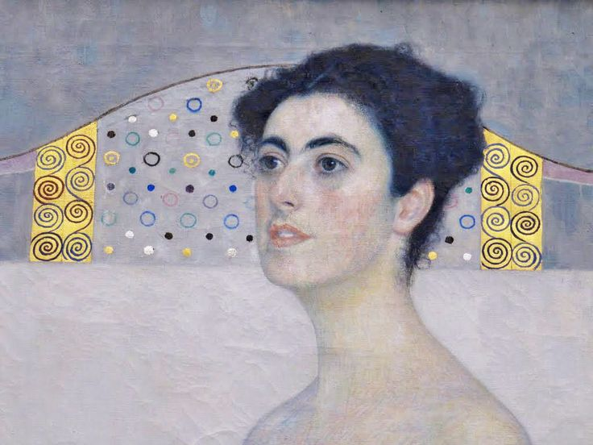
Portrait of Margaret Stonborough-Wittgenstein, 1905, Oil on canvas, 180 x 91 cm, Neue Pinakothek, Munich, Germany https://www.wga.hu/frames-e.html?/bio/k/klimt/biograph.html and https://gr.pinterest.com/pin/406379566368494872/

Slide 16
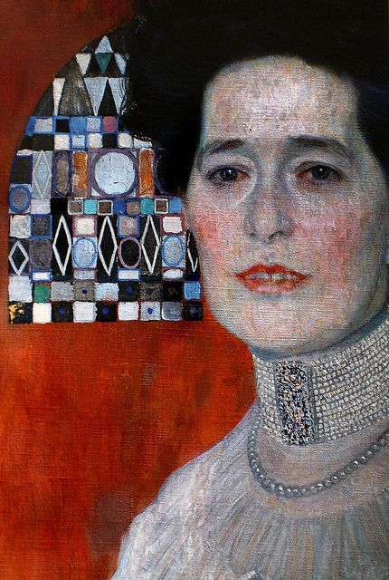
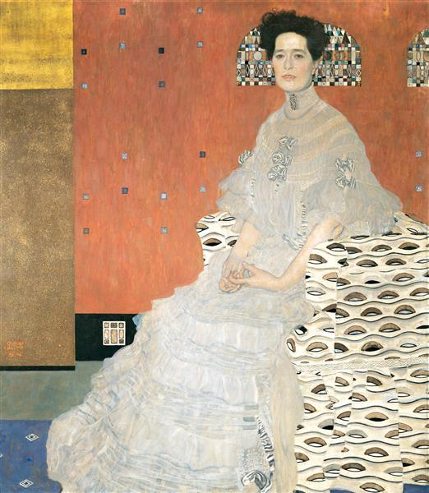
Portrait of Fritza Riedler, 1906, Oil on Canvas, 153x133, Belvedere, Vienna, Austria https://www.wikiart.org/en/gustav-klimt/portrait-of-fritza-riedler and https://gr.pinterest.com/pin/432767845441873955/

Slide 17
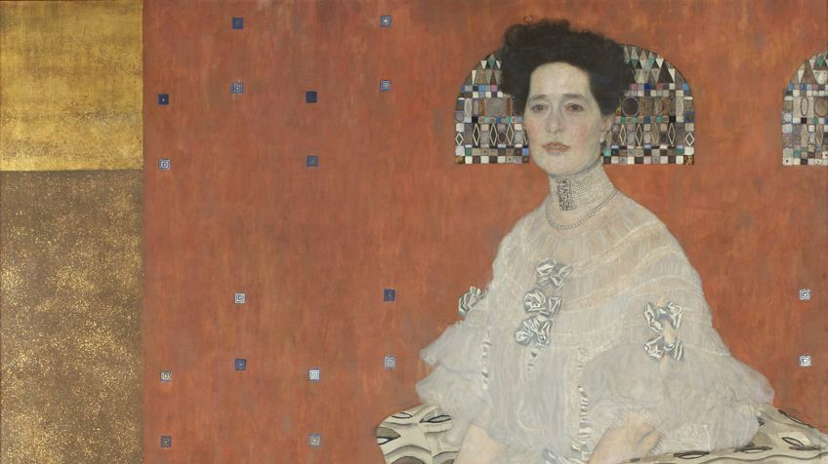

Slide 18
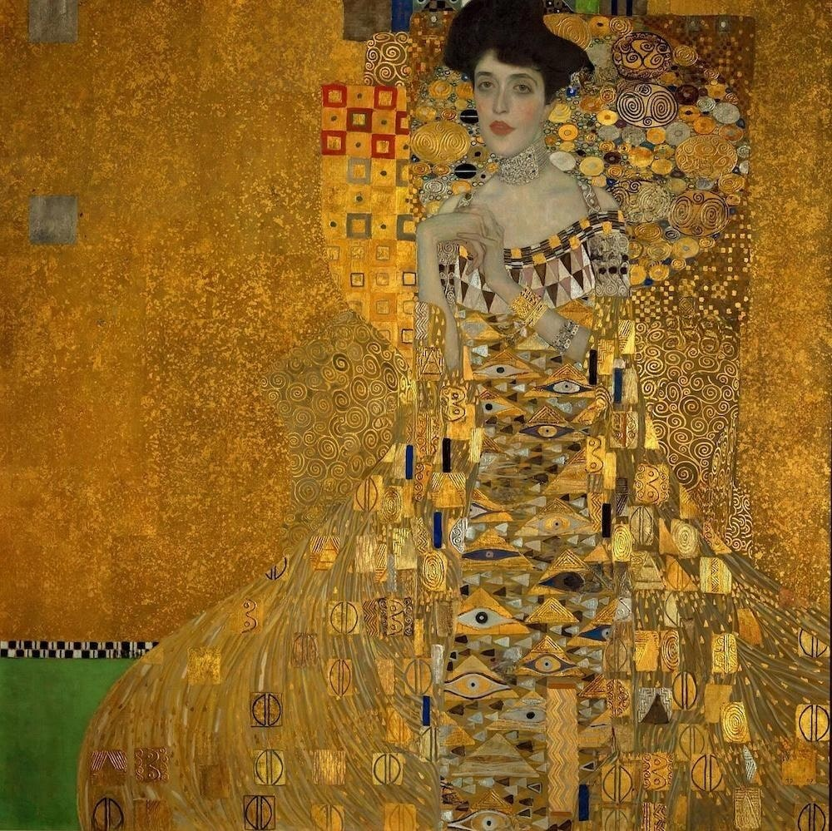
Portrait of Adele Bloch-Bauer I, 1907, Oil, silver and gold on canvas,
140 x 140 cm, Neue Galerie,
New York, USA https://www.gustav-klimt.com/Portrait-Of-Adele-Bloch-Bauer-1.jsp

Slide 19
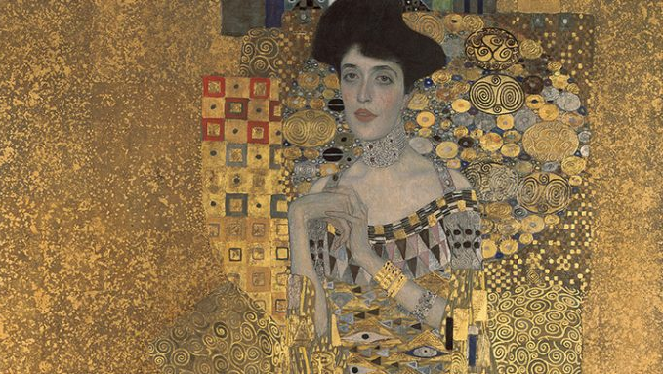

Slide 20
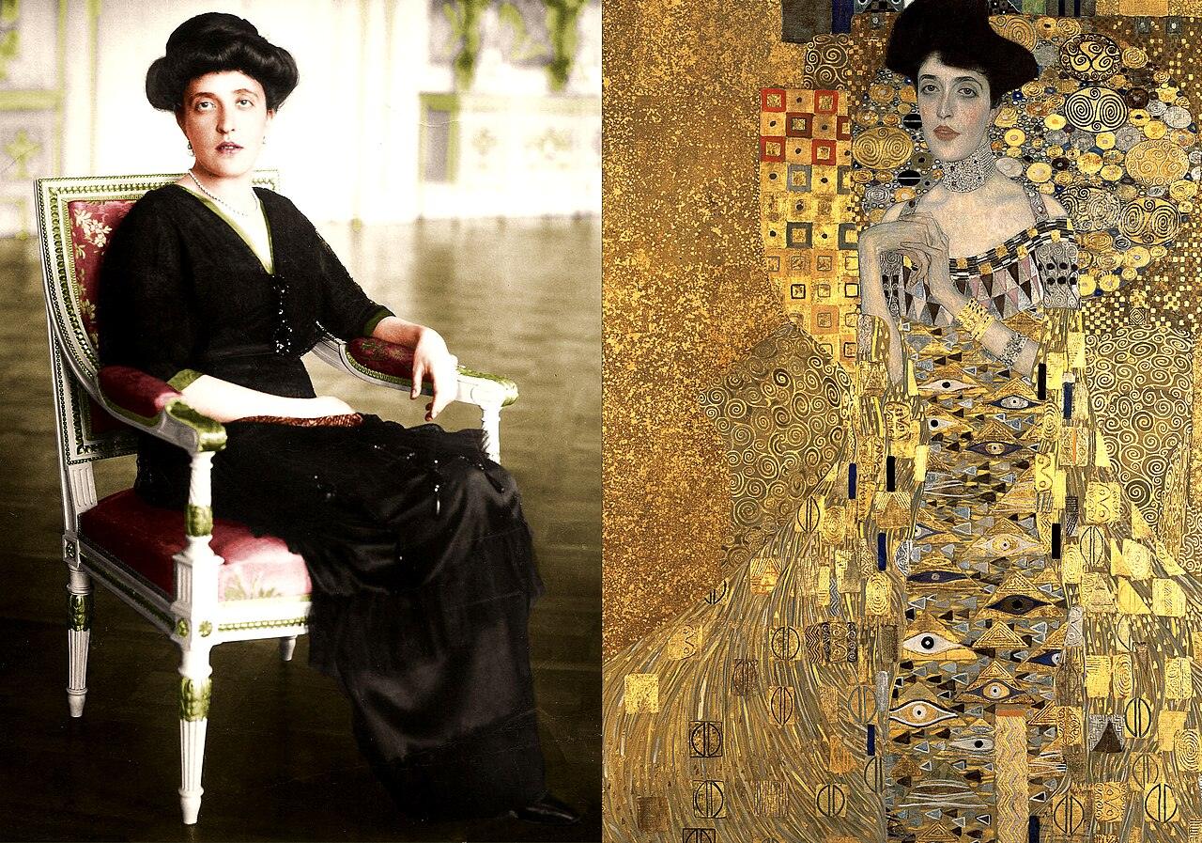
https://simple.wikipedia.org/wiki/Portrait_of_Adele_Bloch-Bauer_I#/media/File:Adele_Bloch-Bauer_et_the_Woman_in_gold_(1907).jpg

Slide 21
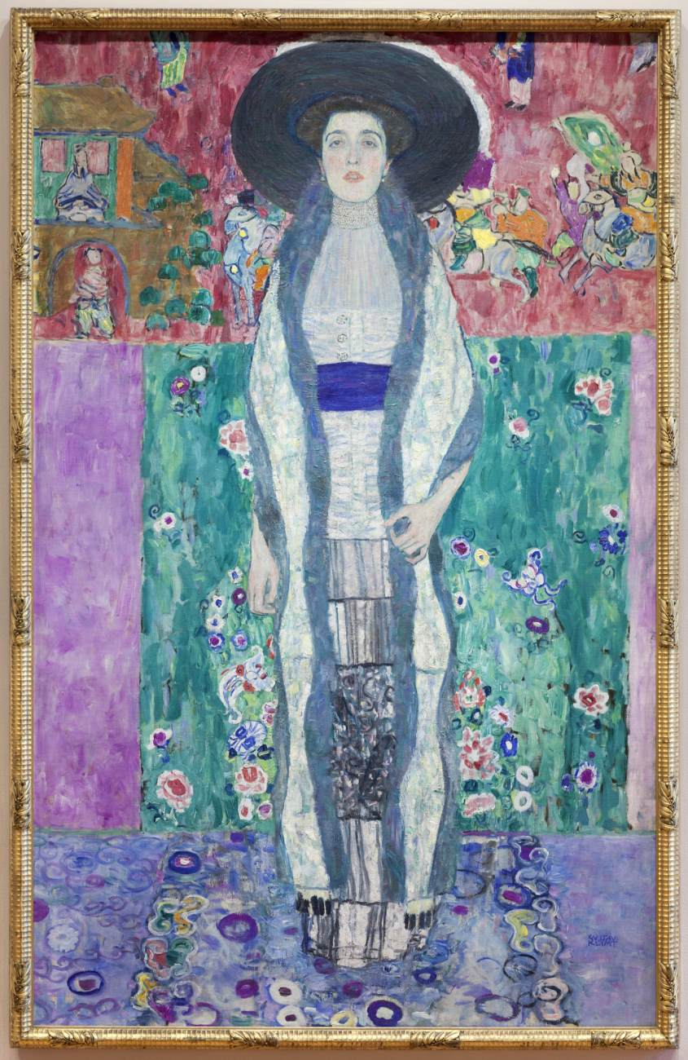
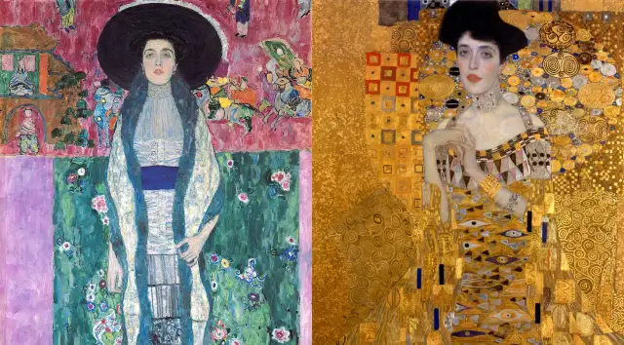
Portrait of Adele Bloch-Bauer II, 1912, Oil on canvas, 190 x 120 cm, Private collection https://www.wga.hu/frames-e.html?/bio/k/klimt/biograph.html and https://money.com/the-surprising-connection-between-oprah-and-a-150-million-art-masterpiece/

Slide 22
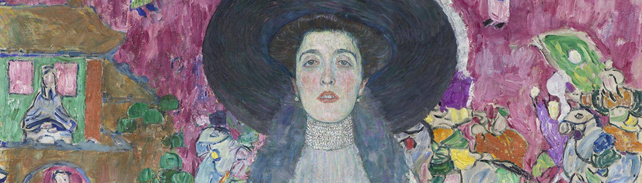
https://www.belvedere.at/en/adele-bloch-bauer-ii

Slide 23
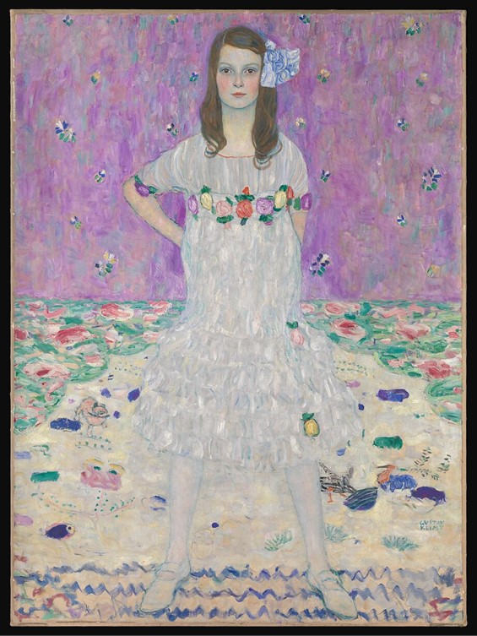
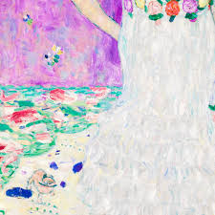
Mäda Primavesi, 1912–13, Oil on Canvas, 149.9 x 110.5 cm, the MET, NY, USA https://www.metmuseum.org/art/collection/search/436819

Slide 24
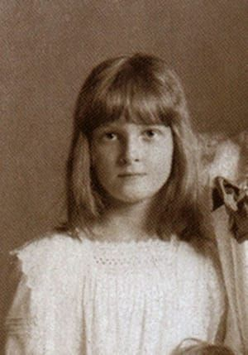
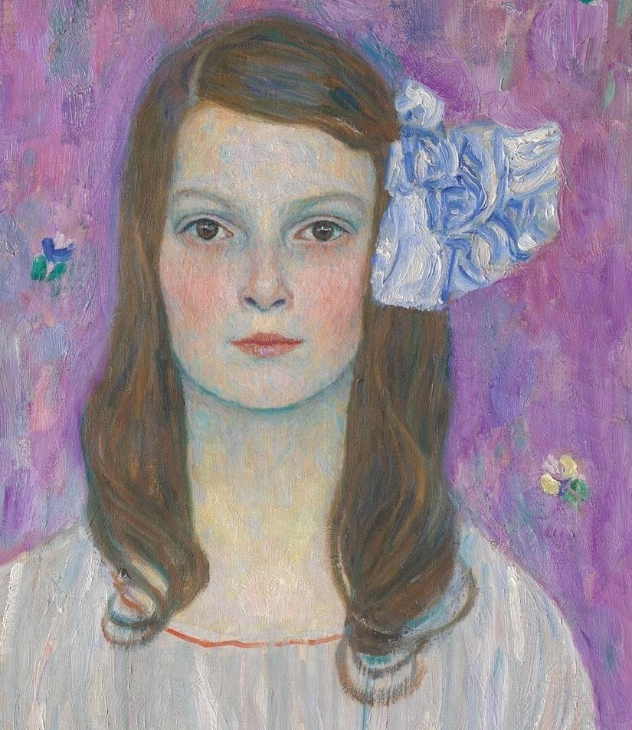
https://arthur.io/art/gustav-klimt/maeda-primavesi/1

Slide 25
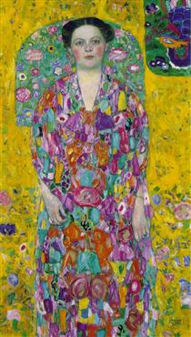
Portrait Of Eugenia Primavesi, 1913, Oil on Canvas, 140.0 × 85.0cm, Toyota Municipal Museum of Art, Japan https://www.wikiart.org/en/gustav-klimt/portrait-of-eugenia-primavesi

Slide 26
The End

