Slide 1
American Art
Jasper Francis Cropsey
1823-1900
Photo Credit: https://commons.wikimedia.org/wiki/Paintings_by_Jasper_Francis_Cropsey

Slide 2
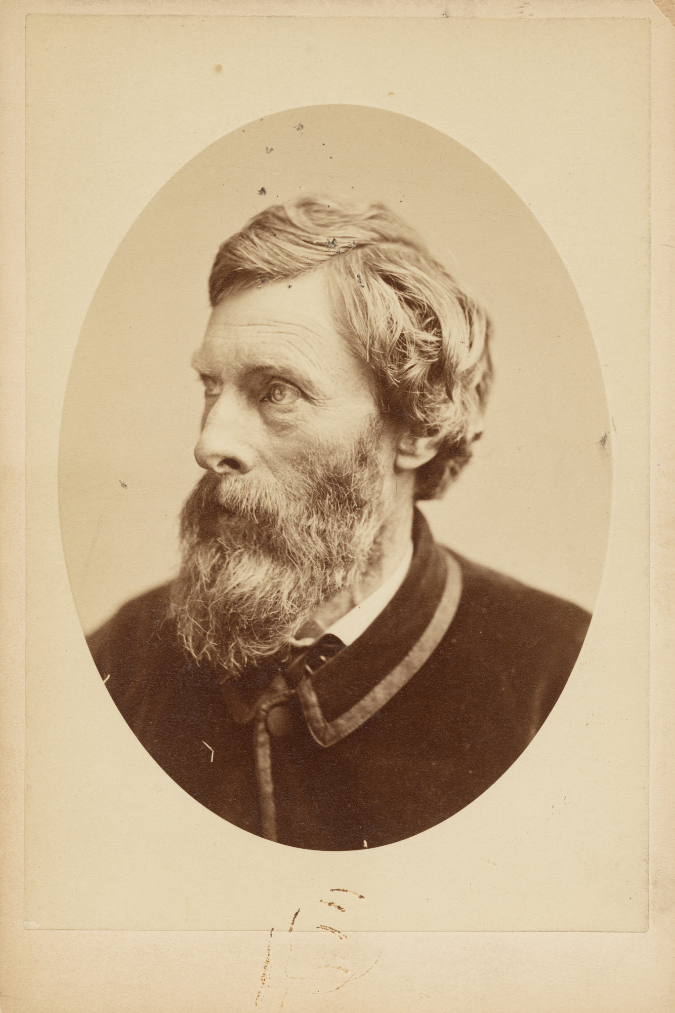
Photograph by Napoleon Sarony (1821-1896) of Jasper Francis Cropsey, circa 1870, Albumen silver print, 11.8 x 8.8 cm, National Portrait Gallery, Washington DC, USA https://npg.si.edu/object/npg_S_NPG.78.41

Slide 3
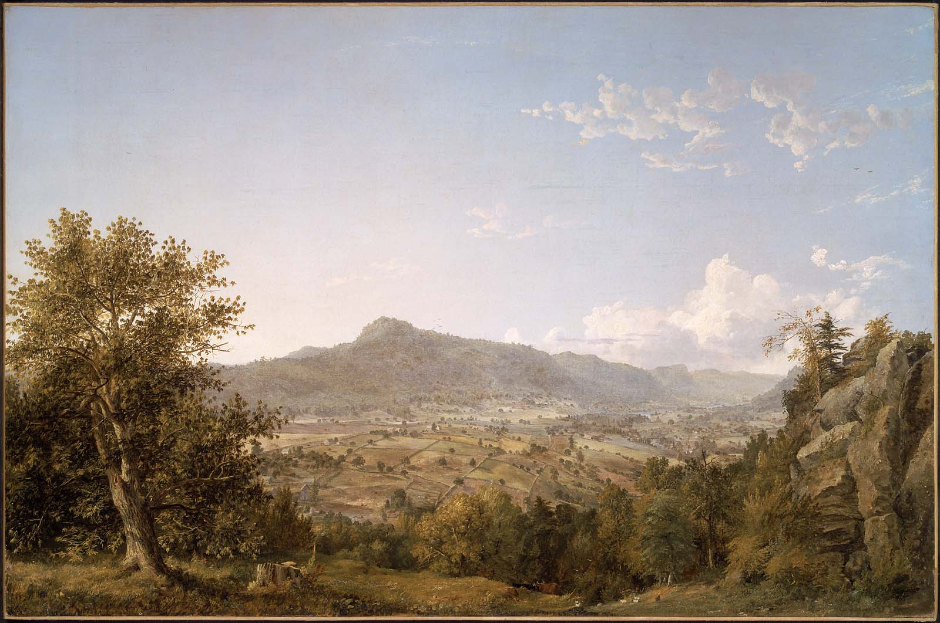
Schatacook Mountain, Housatonic Valley, Connecticut, 1845, Oil on Canvas, 78 x118 cm, Museum of Fine Arts, Boston, USA

Slide 4
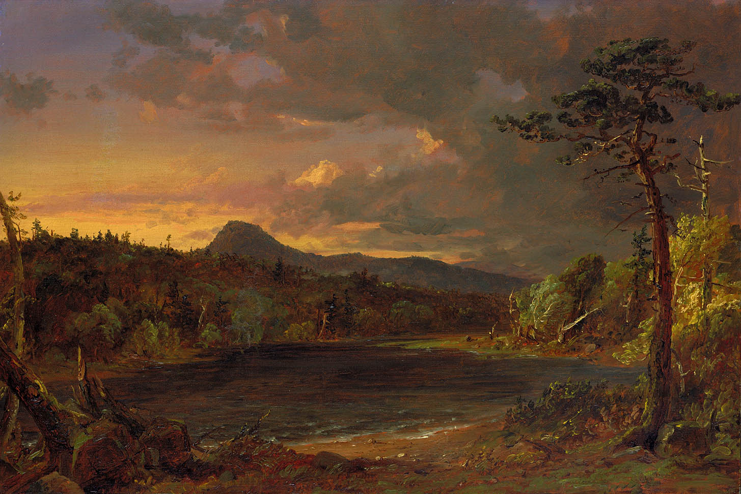
Catskill, 1850, Oil on Canvas, 47.1x69.1 cm, Smithsonian American Art Museum , Washington DC, USA

Slide 5
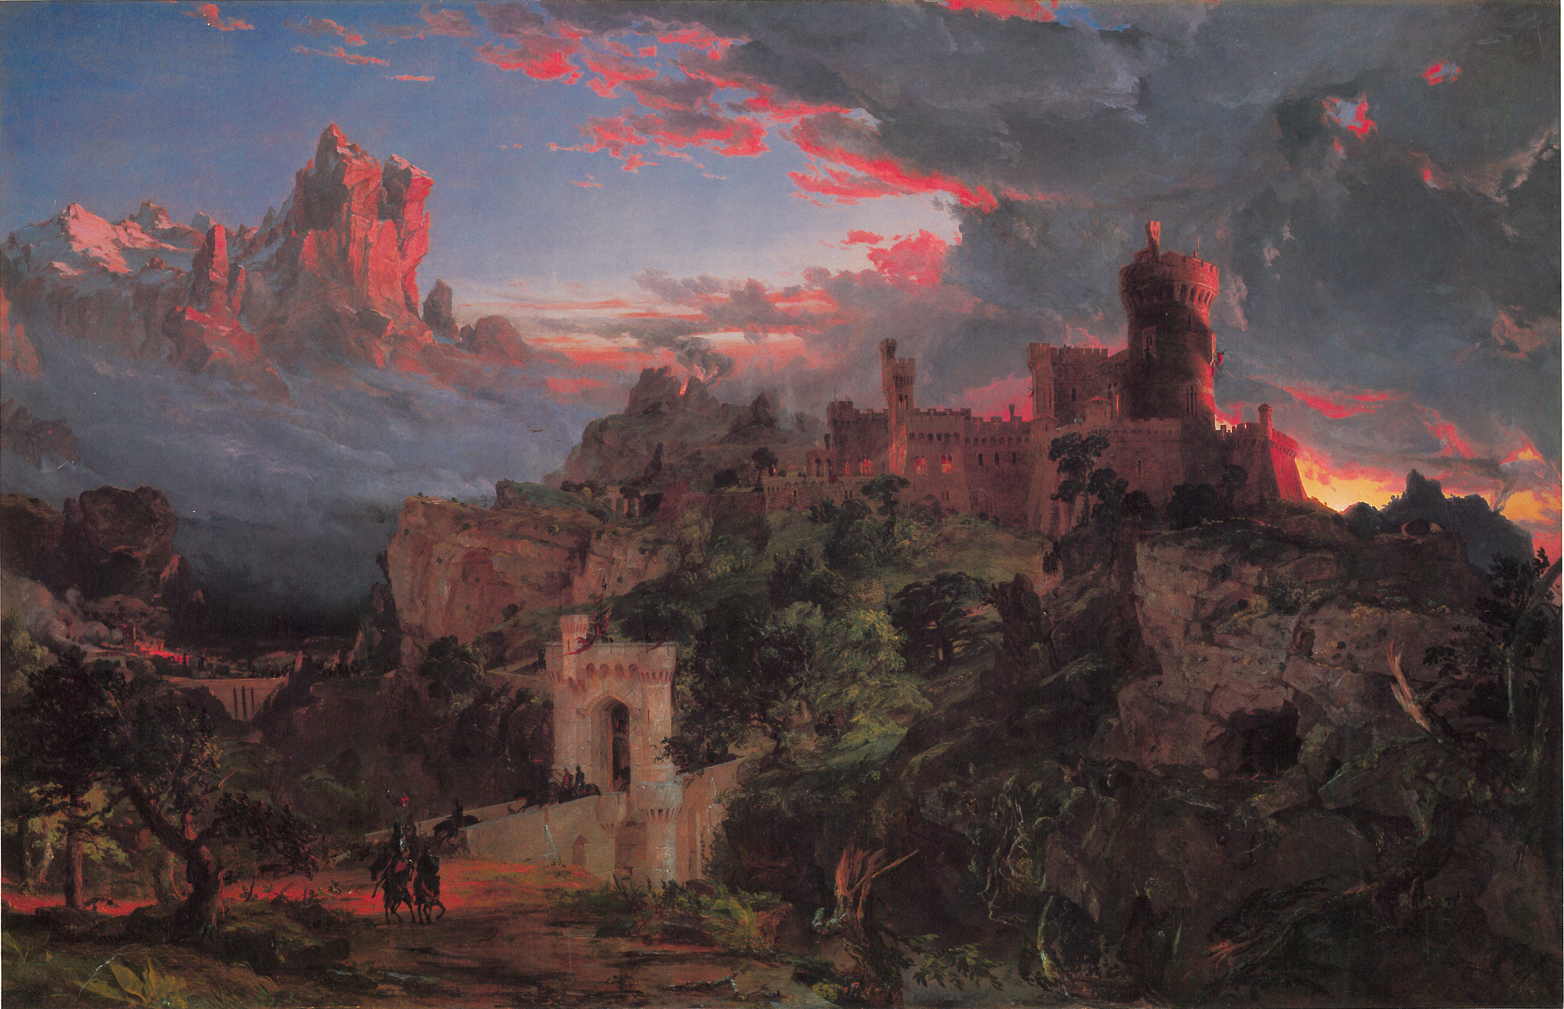
The Spirit of War, 1851, Oil on Canvas, 110.8x171.6 cm, National Gallery of Art, Washington DC, USA

Slide 6
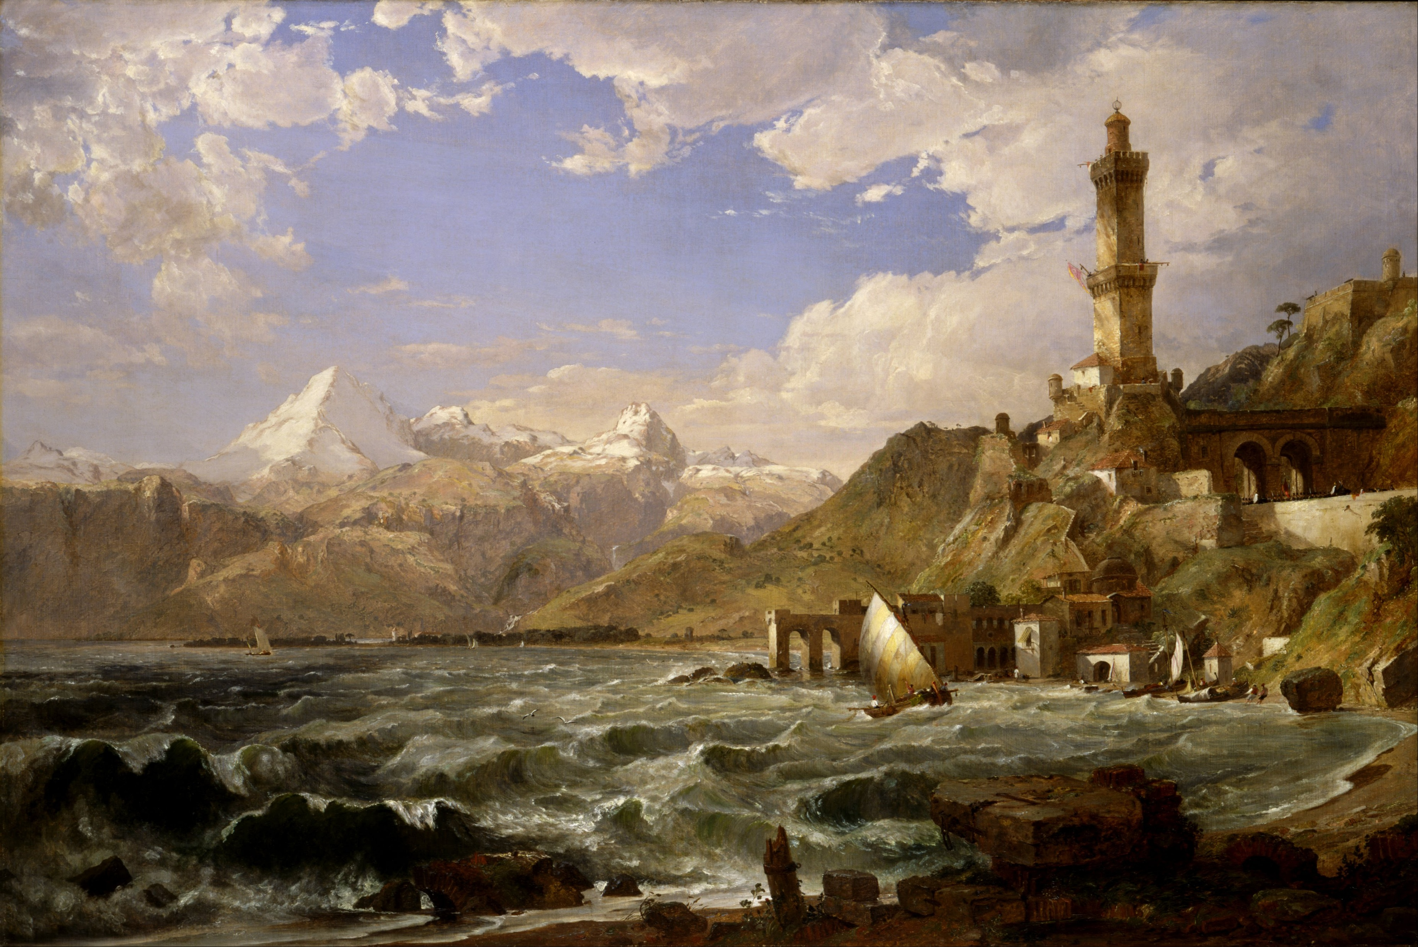
The Coast of Genoa, 1854, Oil on Canvas, 1,225.55x1,841.50 mm, Smithsonian American Art Museum, Washington DC, USA

Slide 7
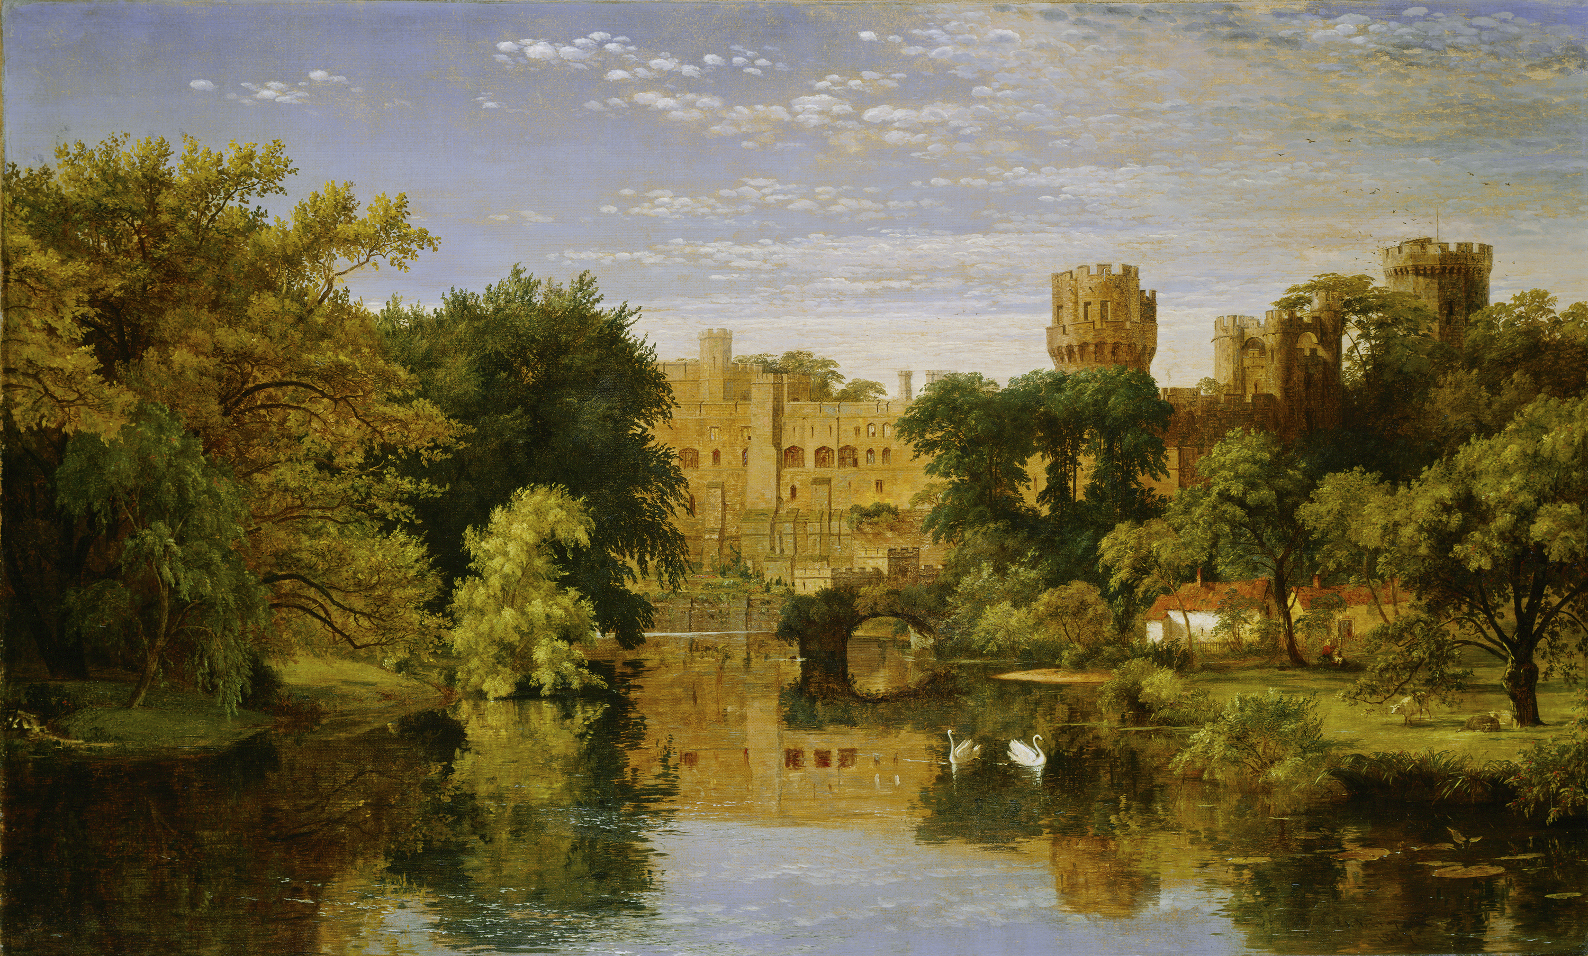
Warwick Castle, England, 1857, Oil on Canvas, 81.1x132.3 cm, National Gallery of Art, Washington DC, USA

Slide 8
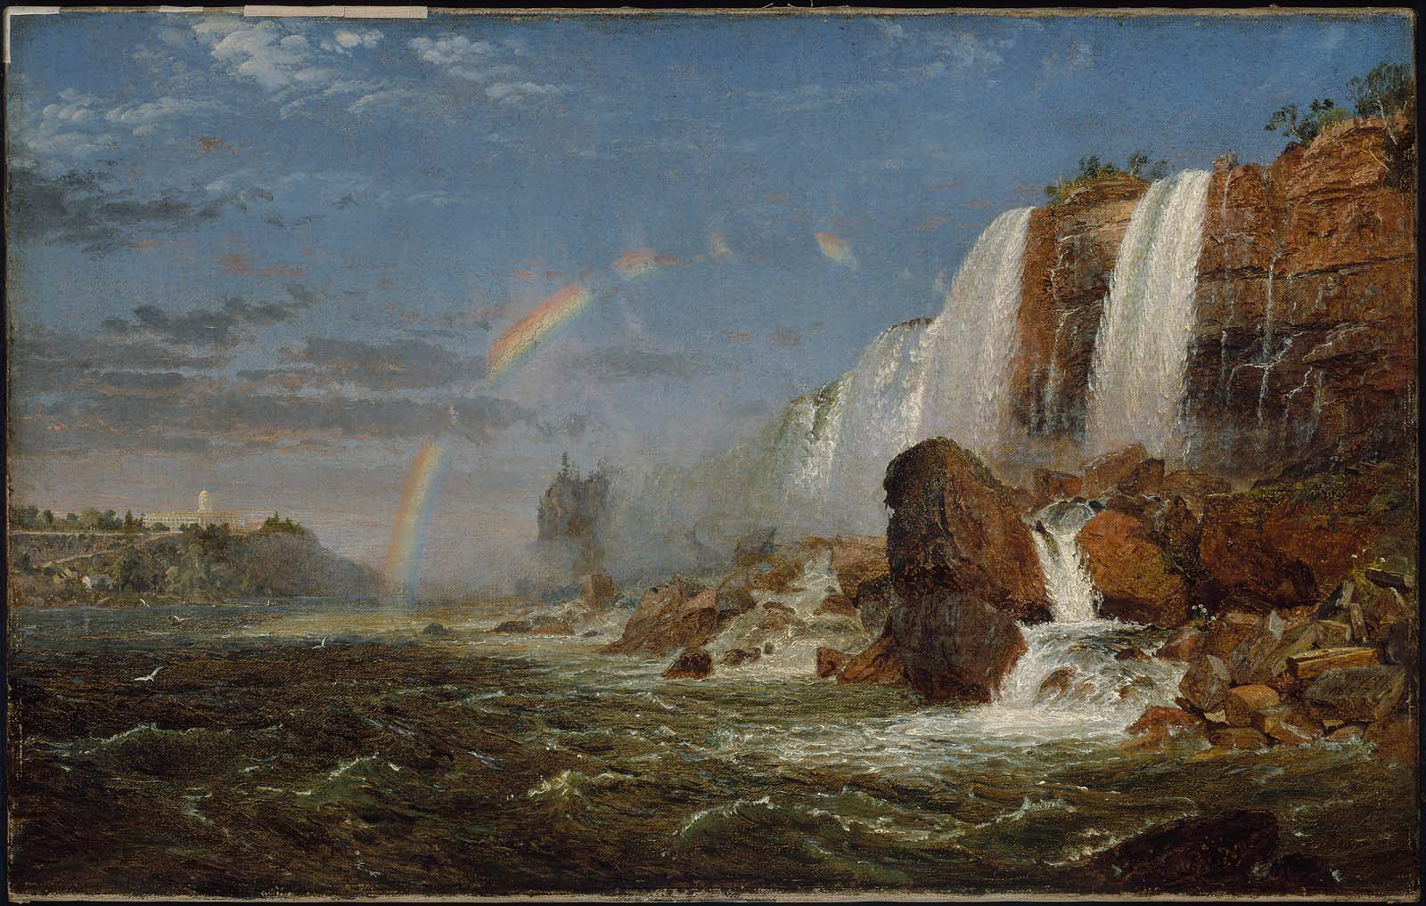
Niagara Falls from the Foot of Goat Island, 1857, Oil on Canvas, 39x61.2 cm, Museum of Fine Arts, Boston, USA

Slide 9
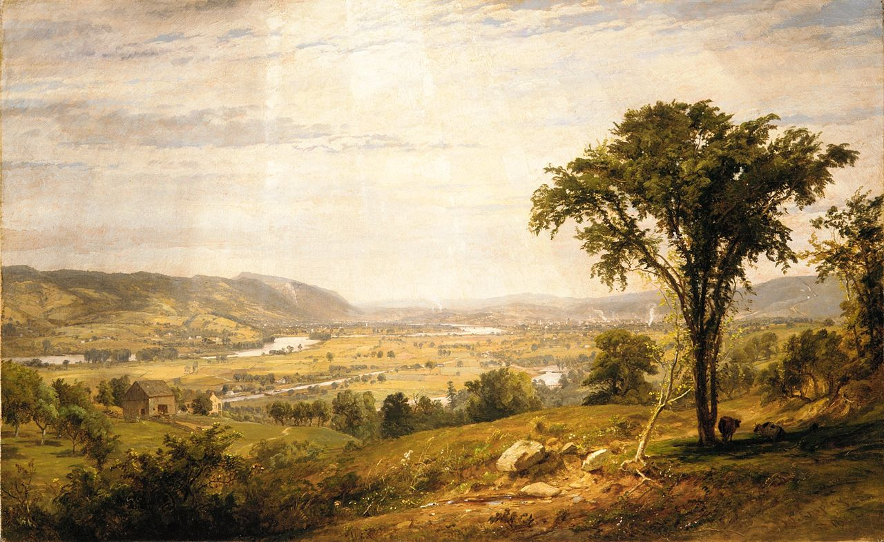
Wyoming Valley, Pennsylvania, 1864, Oil on Canvas, 38.1 x 61 cm, the MET, NY, USA

Slide 10
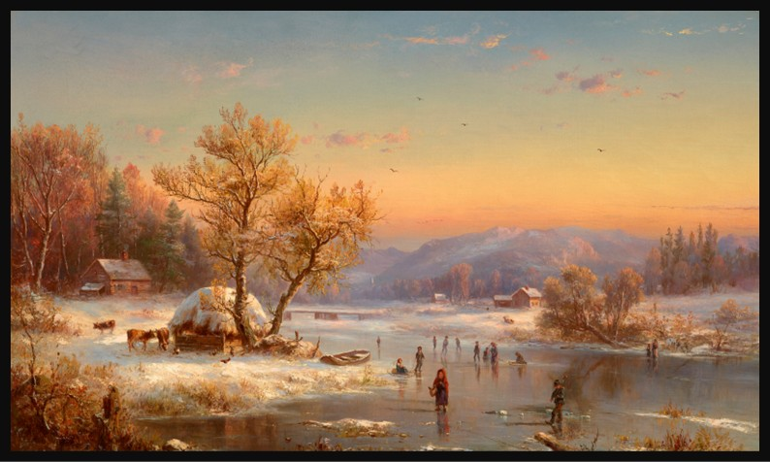
Winter Evening in the Country, 1865, Oil on Canvas, 61 x 102.2 cm, Private Collection https://www.christies.com/en/lot/lot-6519595?ldp_breadcrumb=back#lot-essay

Slide 11
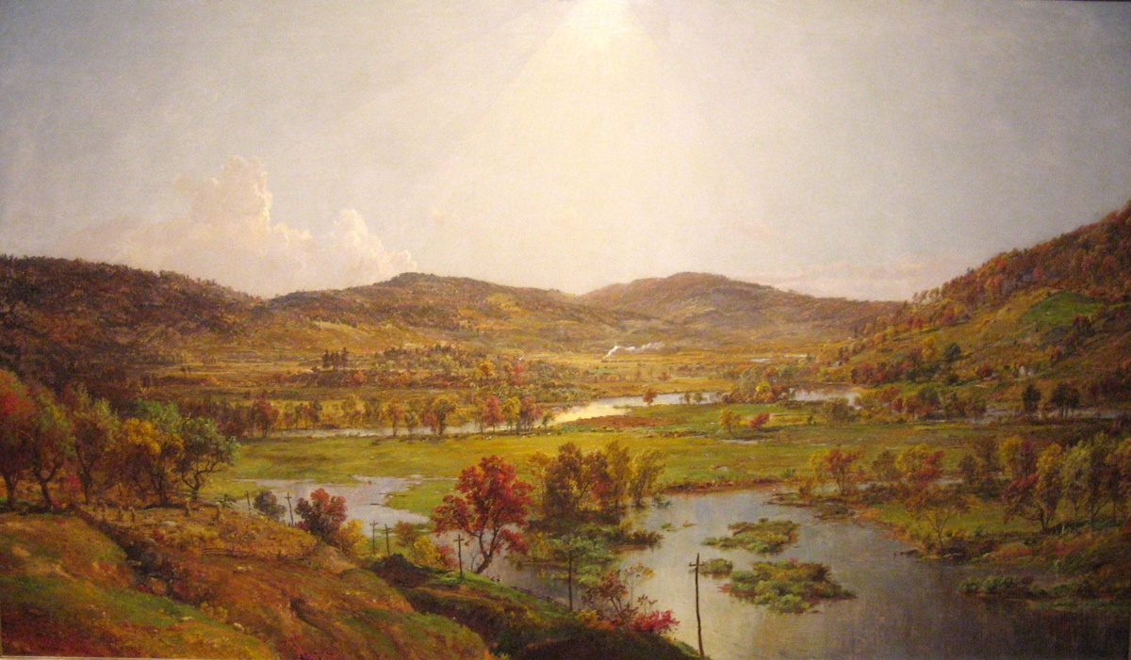
Sidney Plains with the Union of the Susquehanna and Unadilla Rivers, 1874, Oil on Canvas, 106.9x182.5 cm, Los Angeles County Museum of Art, USA

Slide 12
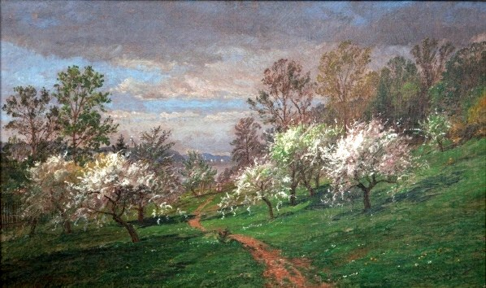
Apple Blossoms, 1887, Oil on Canvas, 30.7x53.6 cm, Timken Museum of Art, CA, USA

Slide 13
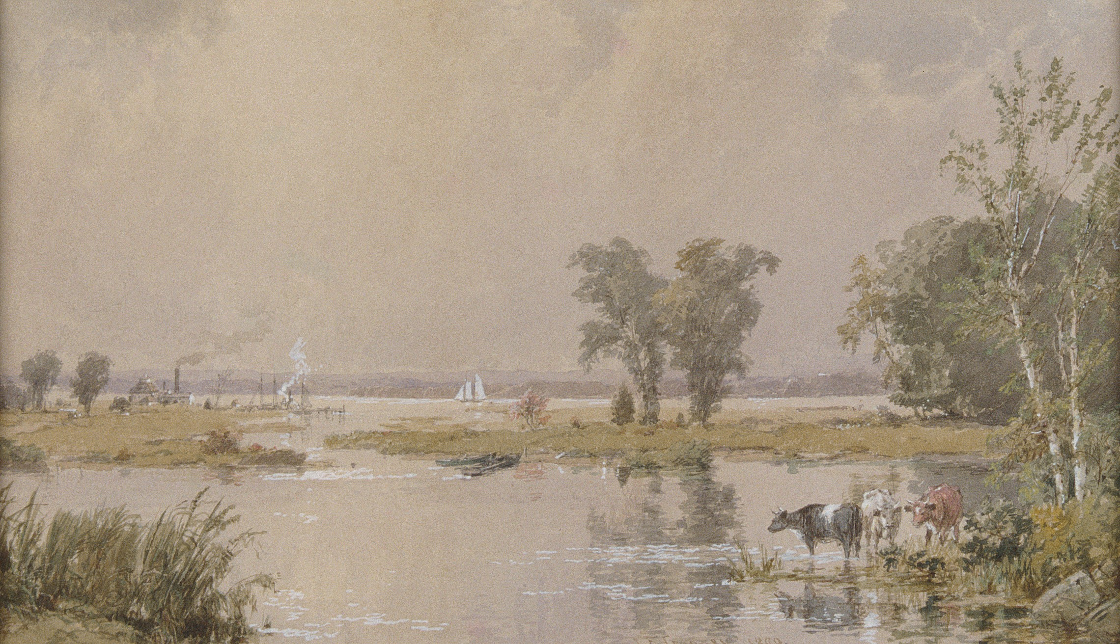
Hackensack Meadows, 1890, Watercolor, Gouache and Graphite on wove Paper, 30.4X52 cm, the MET, NY, USA

Slide 14
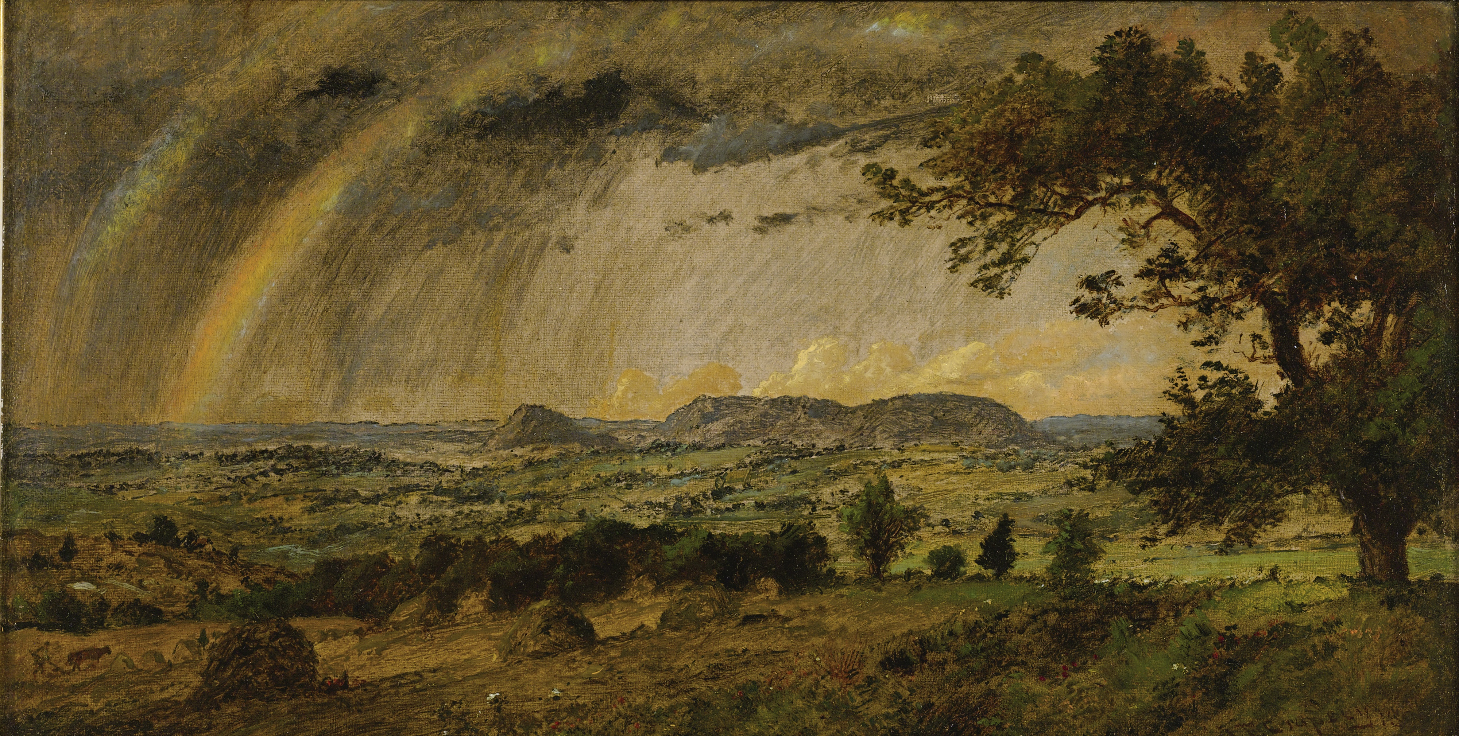
A passing shower over Mts. Adam and Eve, 1896, Oil on Canvas, 20.3x39.4 cm, Private Collection, CA, USA

Slide 15
The END

