Slide 1

Etruscan Art
Etruscan Funerary Art and Practices

Slide 2
Etruscan Funerary Art and Practices - Tomb Architecture
Etruscan tombs were often designed to resemble houses, reflecting the belief that the afterlife was a continuation of earthly existence. The tombs at Cerveteri, known as tumuli, are round structures built with tufa stone and covered with earth, resembling small hills. Inside, these tombs were intricately carved and decorated to mimic domestic interiors, complete with furniture and household items. The Tomb of the Reliefs at Cerveteri is a prime example, featuring carved and painted reliefs that depict everyday objects, suggesting the tomb was meant to be a comfortable home for the deceased in the afterlife.

Slide 3
Etruscan Funerary Art and Practices – Funerary Paintings and Reliefs
Funerary paintings and reliefs in Etruscan tombs often depicted scenes of banquets, dances, and athletic competitions, emphasizing the celebratory aspects of life and death. The Tomb of the Leopards in Tarquinia features vibrant frescoes of a banquet scene, reflecting the Etruscan belief in a joyful afterlife. These images often included symbolic elements, such as leopards or other animals, that had protective or guiding roles in the journey to the afterlife.

Slide 4
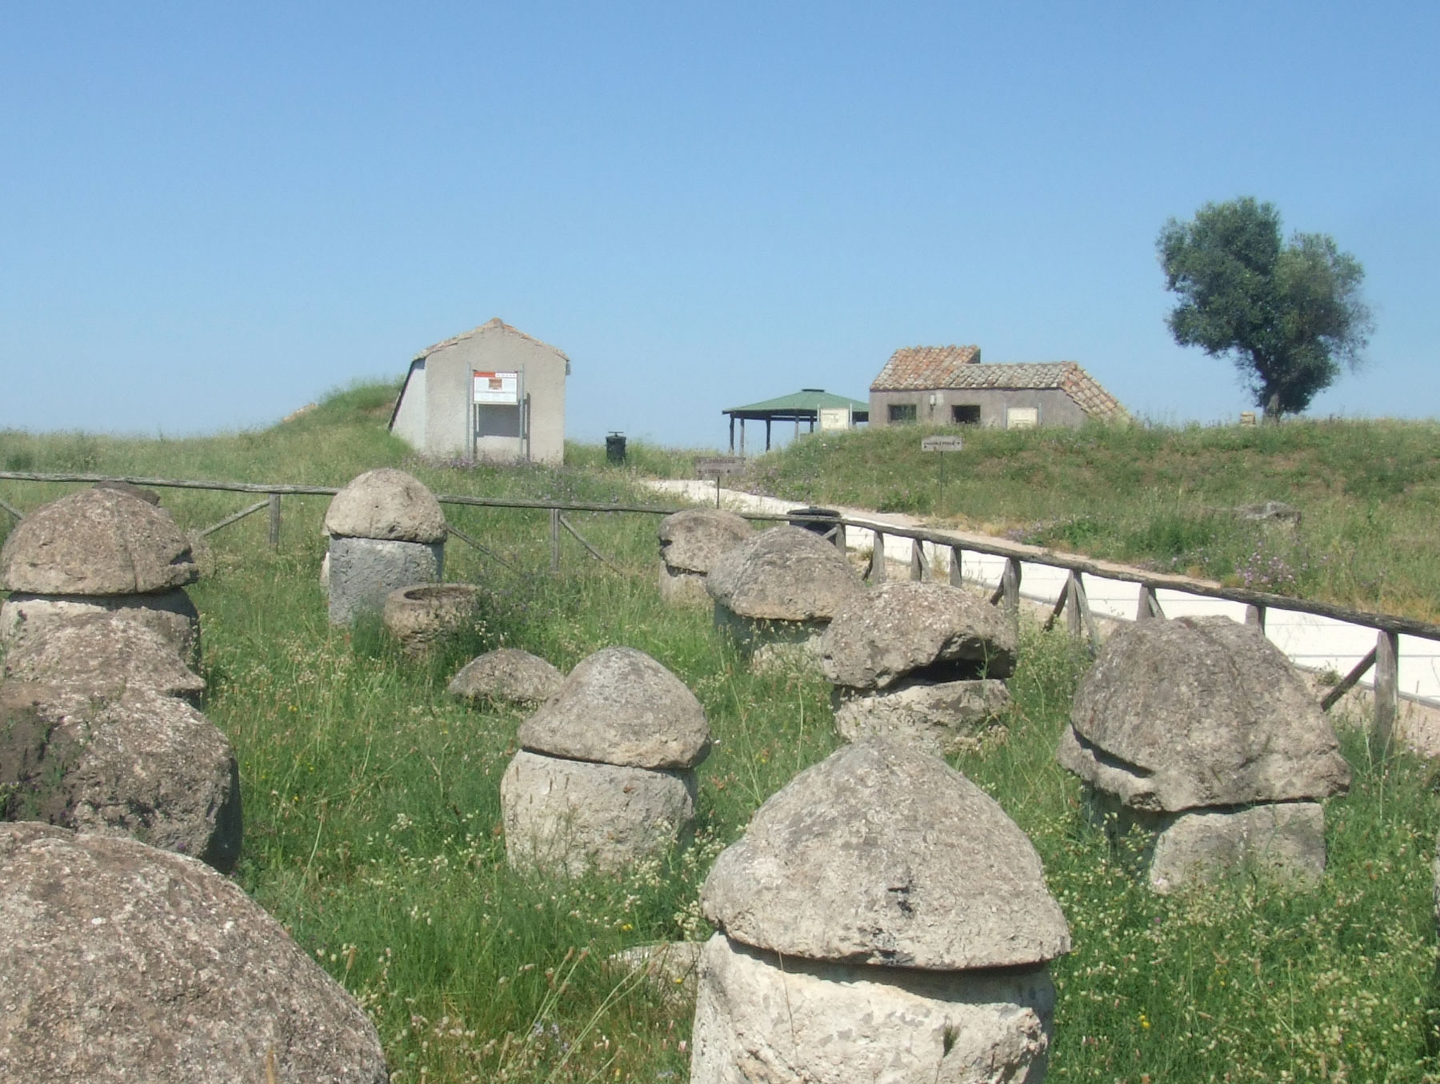
Monterozzi Necropolis, Tarquinia, Italy https://commons.wikimedia.org/wiki/File:UrnesMonterozzi.jpg

Slide 5
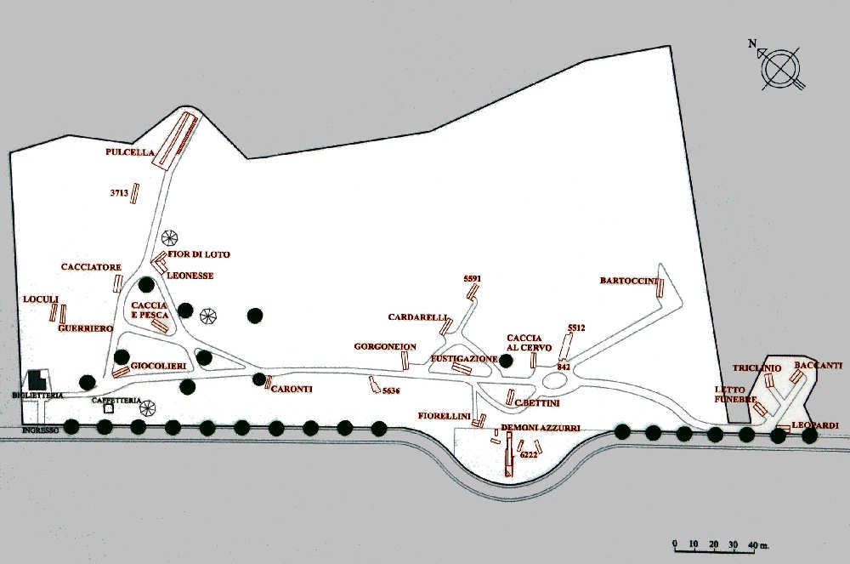
Plan of the Calvary area in the Monterozzi Necropolis, Tarquinia, Italy https://www.etruschi.name/tarquinia/index.html

Slide 6
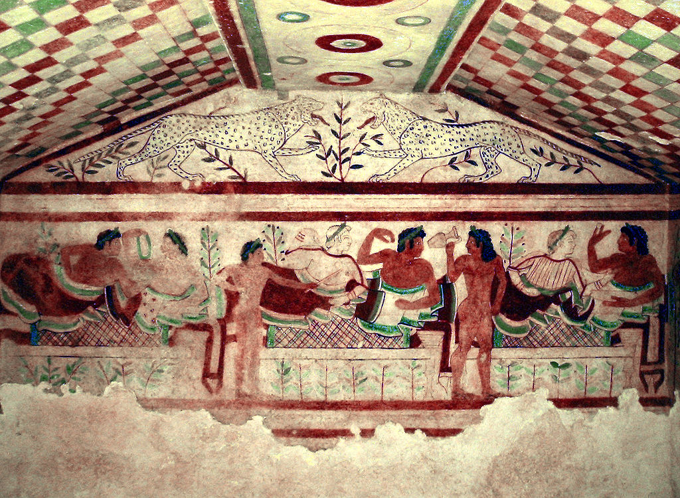
Tomb of the Leopards, 473 BC, Monterozzi Necropolis, Tarquinia, Italy
The Tomb of the Leopards was discovered during an excavation campaign in 1875, it measures 3.52 x 3.3 x 2.16 in height https://en.wikipedia.org/wiki/Tomb_of_the_Leopards#/media/File:Tarquinia_Tomb_of_the_Leopards.jpg

Slide 7
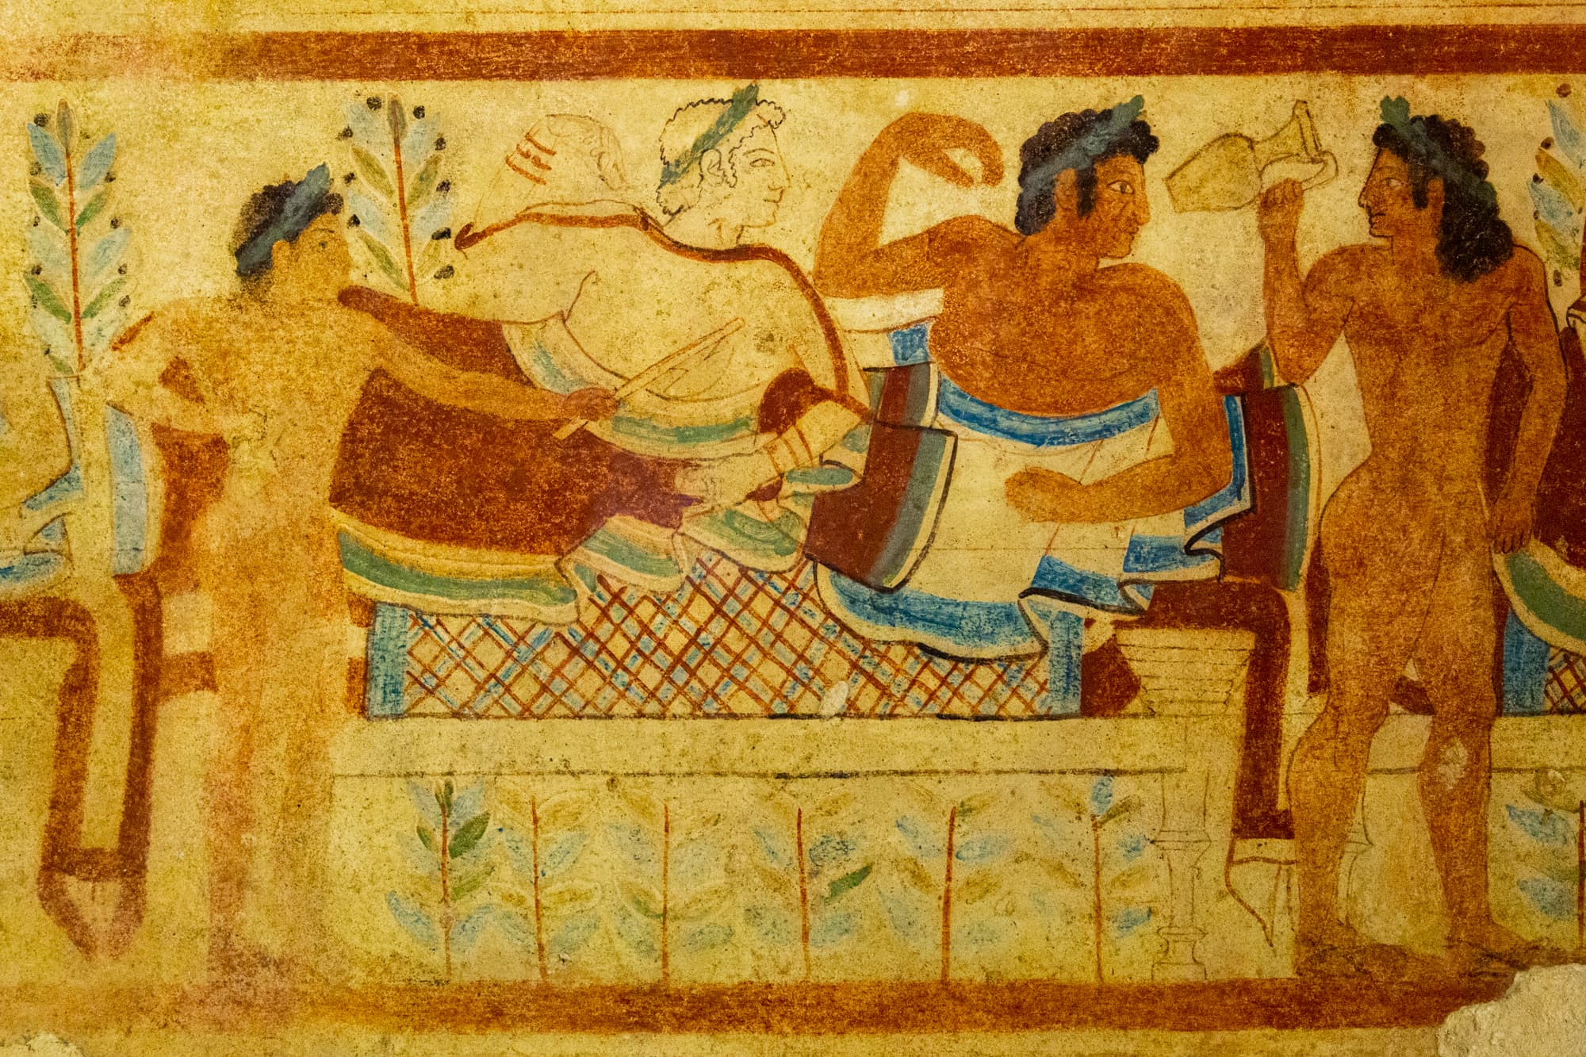
https://tarquiniaturismo.com/tomb-of-the-leopards/?lang=en

Slide 8
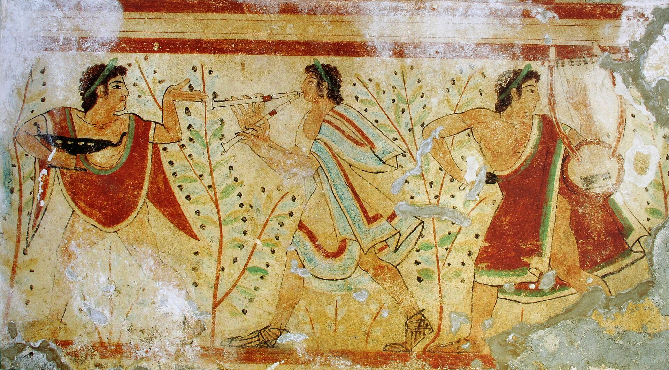
https://en.wikipedia.org/wiki/Tomb_of_the_Leopards#/media/File:Danseurs_et_musiciens,_tombe_des_l%C3%A9opards.jpg

Slide 9
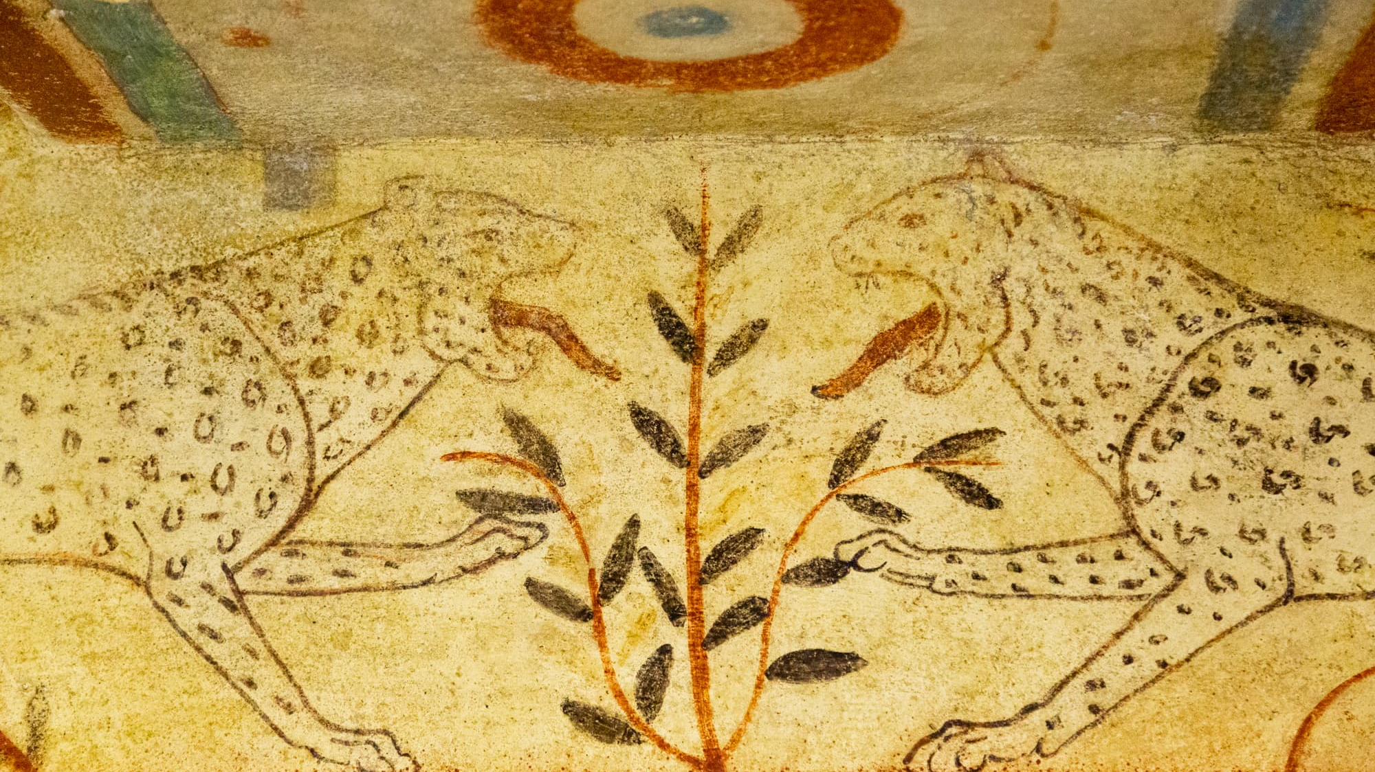
https://tarquiniaturismo.com/tomb-of-the-leopards/?lang=en

Slide 10
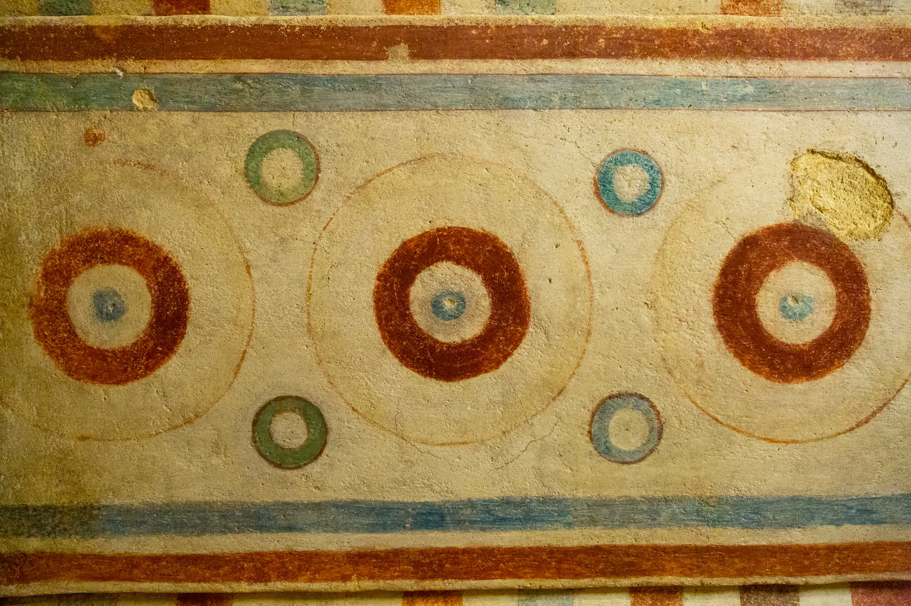
https://tarquiniaturismo.com/tomb-of-the-leopards/?lang=en

