Slide 1

Joaquín Sorolla y Bastida, 1863-1923
15 Paintings

Slide 2
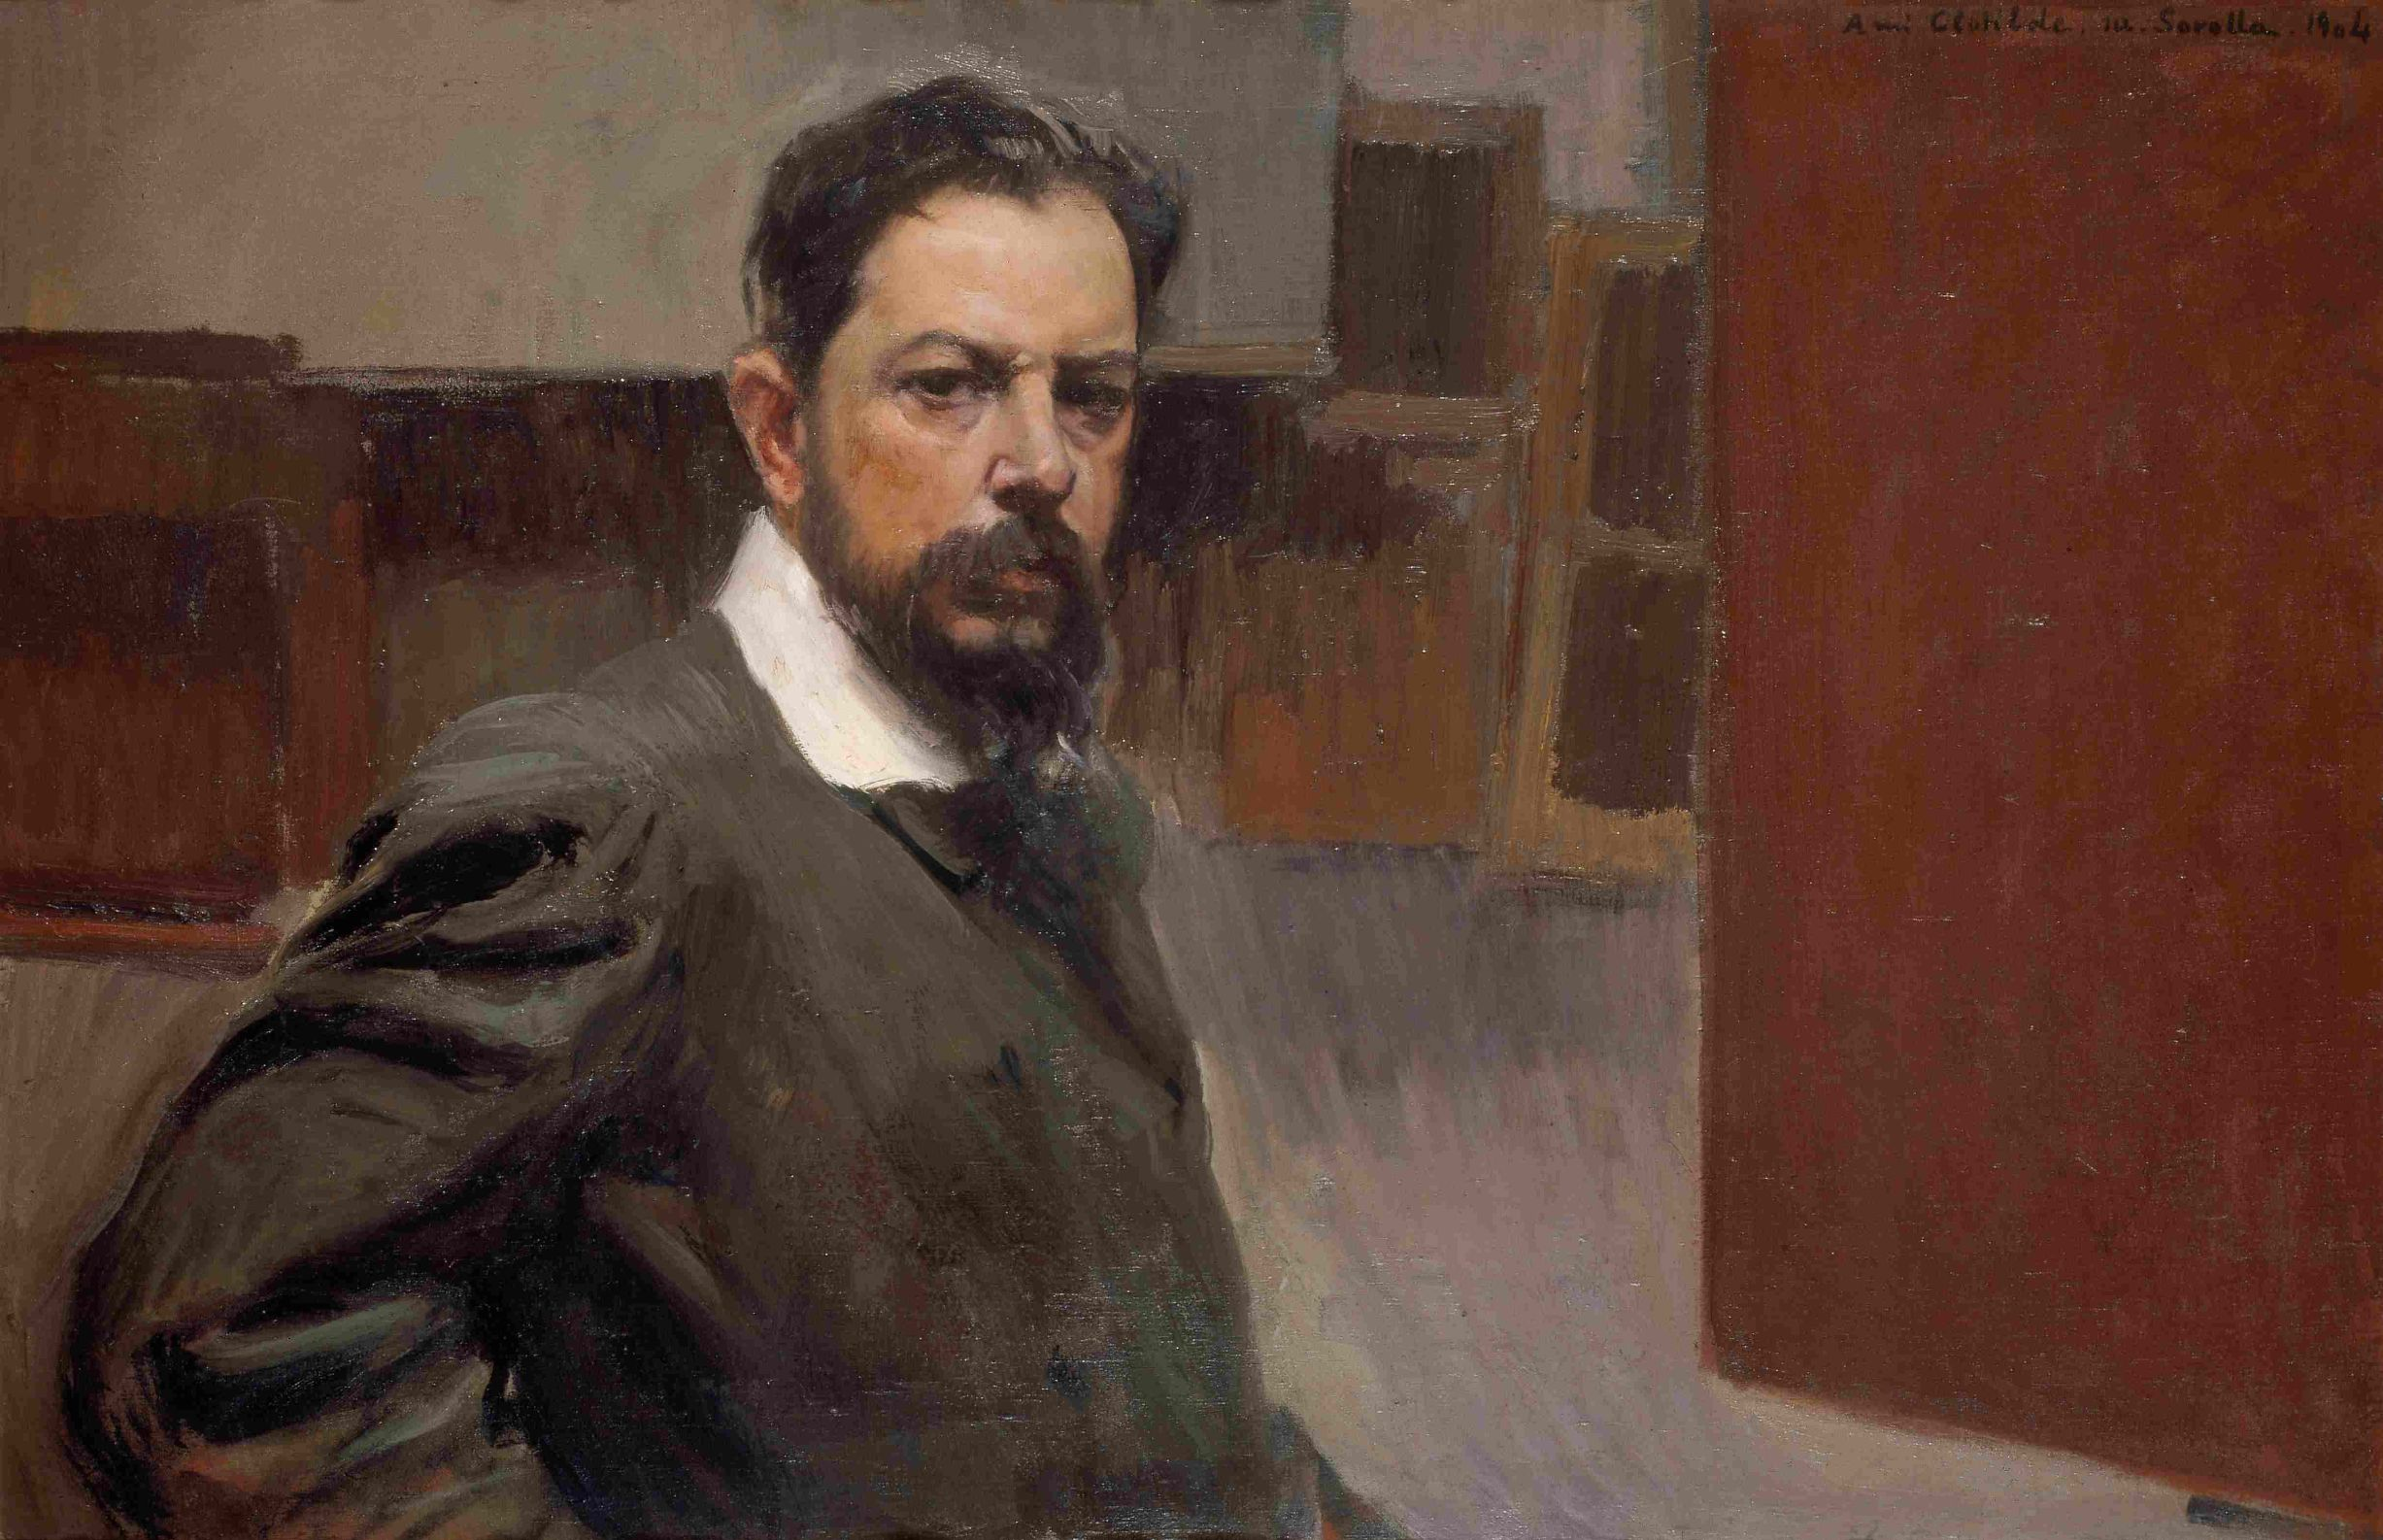
Self-Portrait, 1904, Oil on Canvas, 66 x 105.5 cm, Museo Sorolla, Madrid, Spain https://www.cultura.gob.es/msorolla/en/colecciones/colecciones-del-museo/pintura/autorretrato.html

Slide 3
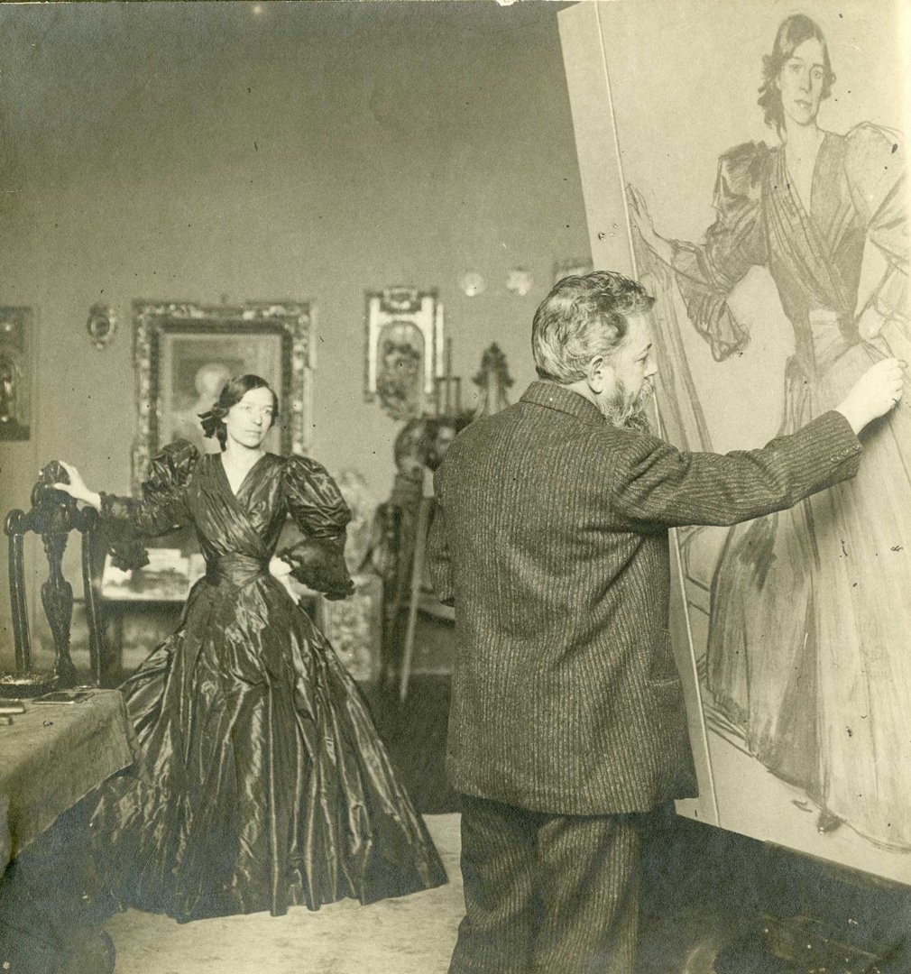
Sorolla painting 'Clotilde in a Black Dress', 1905. Photograph by Christian Franzen © Museo Sorolla, Madrid, Spain https://www.nationalgallery.org.uk/exhibitions/past/sorolla/what-you-need-to-know-about-sorolla

Slide 4
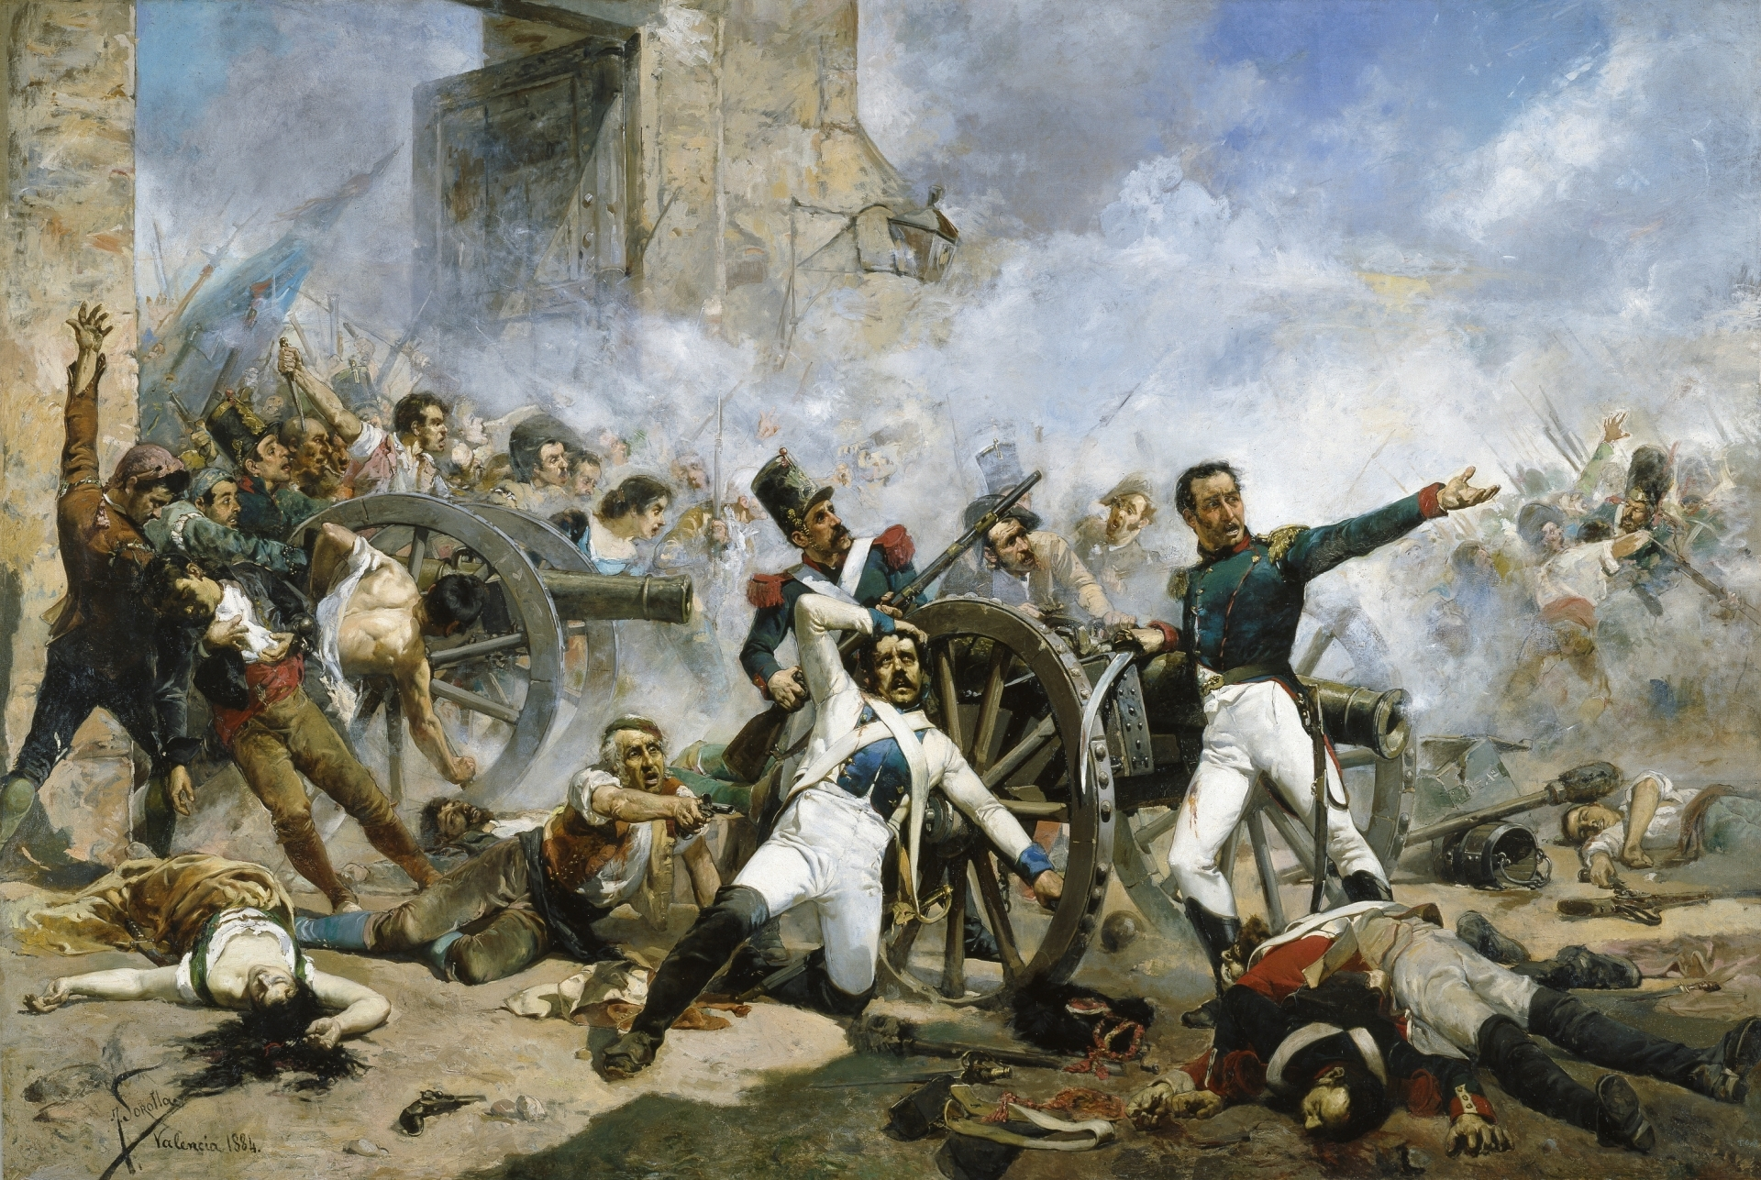
The Second of May, 1884, Oil on Canvas, 400x580 cm, Prado Museum, Madrid, Spain https://www.museodelprado.es/en/the-collection/artist/sorolla-y-bastida-joaquin/06fcd1dd-8983-45be-9e60-6adc32f513e4

Slide 5
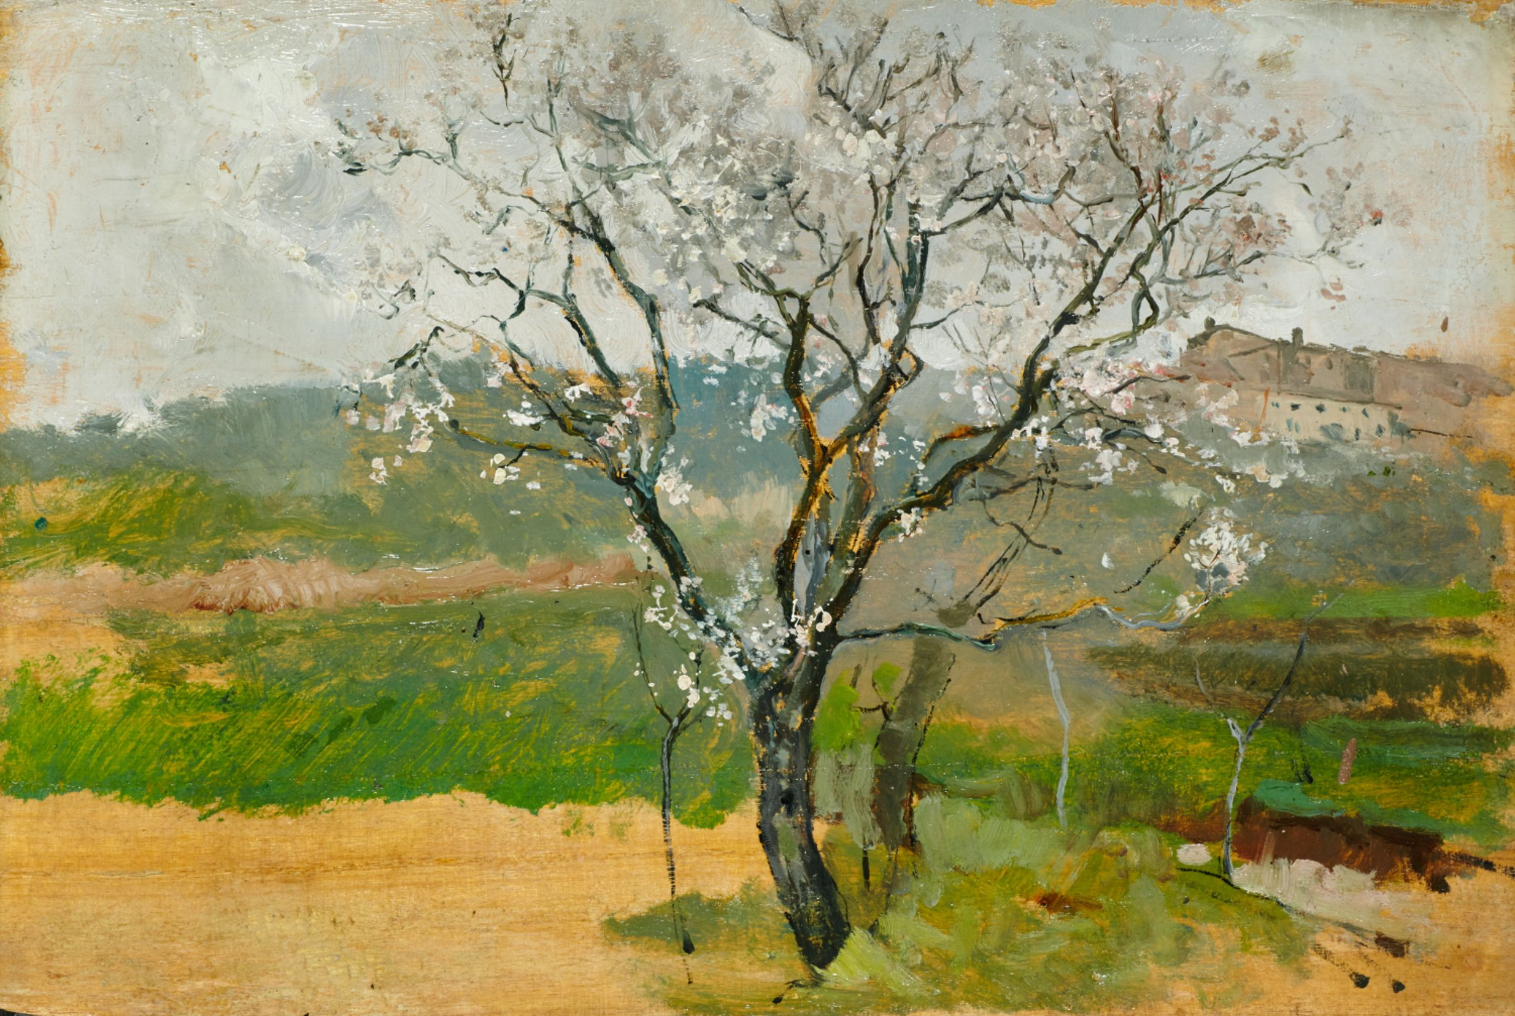
Almond tree in flower, 1888-1889, Oil on Panel, 15.5 x 25.3 cm, Museo Sorolla, Madrid, Spain https://www.cultura.gob.es/msorolla/en/colecciones/colecciones-del-museo/pintura/almendro-en-flor.html

Slide 6
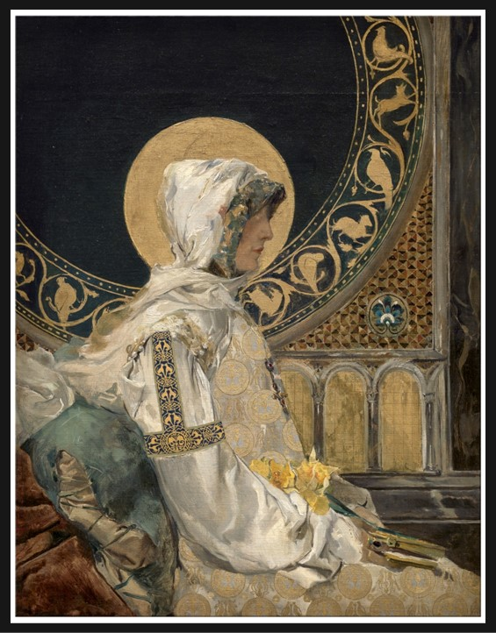
Saint in Prayer, 1888 – 1889, Oil on Canvas, 78x61 cm, Prado Museum, Madrid, Spain https://www.museodelprado.es/en/the-collection/artist/sorolla-y-bastida-joaquin/06fcd1dd-8983-45be-9e60-6adc32f513e4

Slide 7
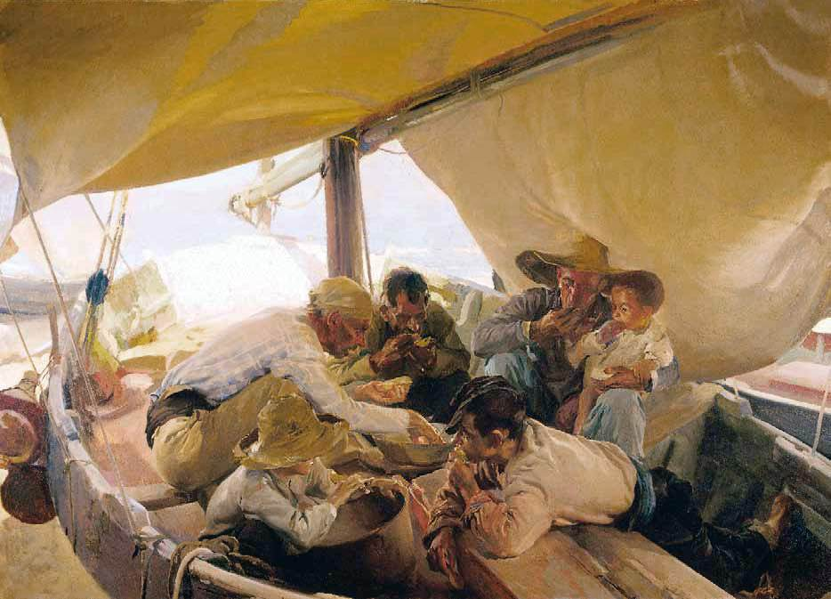
Eating on the Boat, 1898, Oil on Canvas, 180 x 250 cm, Museo de la Real Academia de San Fernando, Madrid, Spain https://www.wga.hu/html_m/s/sorolla/index.html

Slide 8
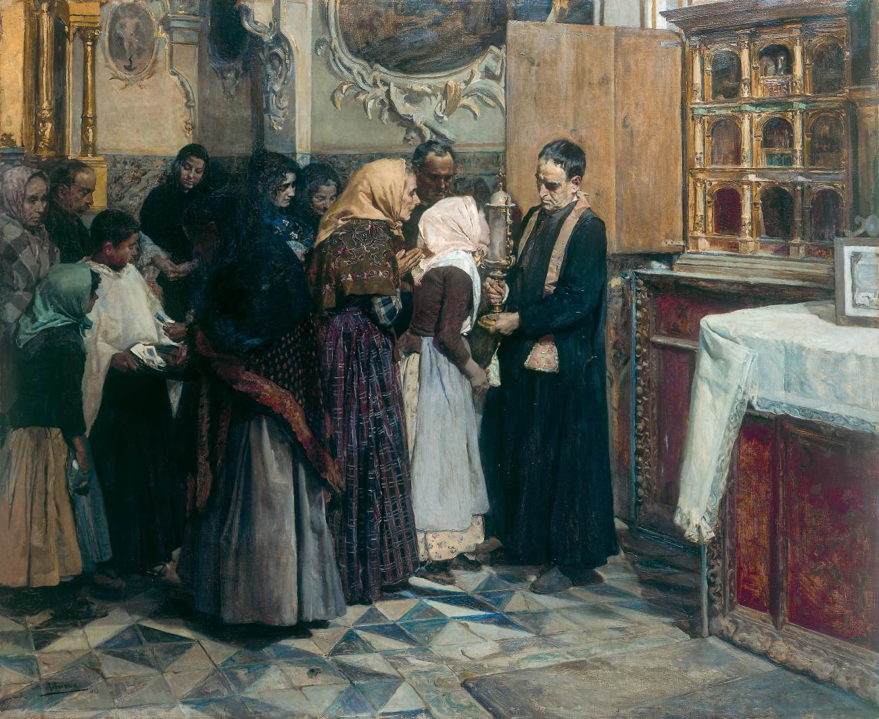
Kissing the Relic, 1893, Oil on Canvas, 104 x 123 cm, Museo de Bellas Artes, Bilbao, Spain https://www.wga.hu/html_m/s/sorolla/index.html

Slide 9
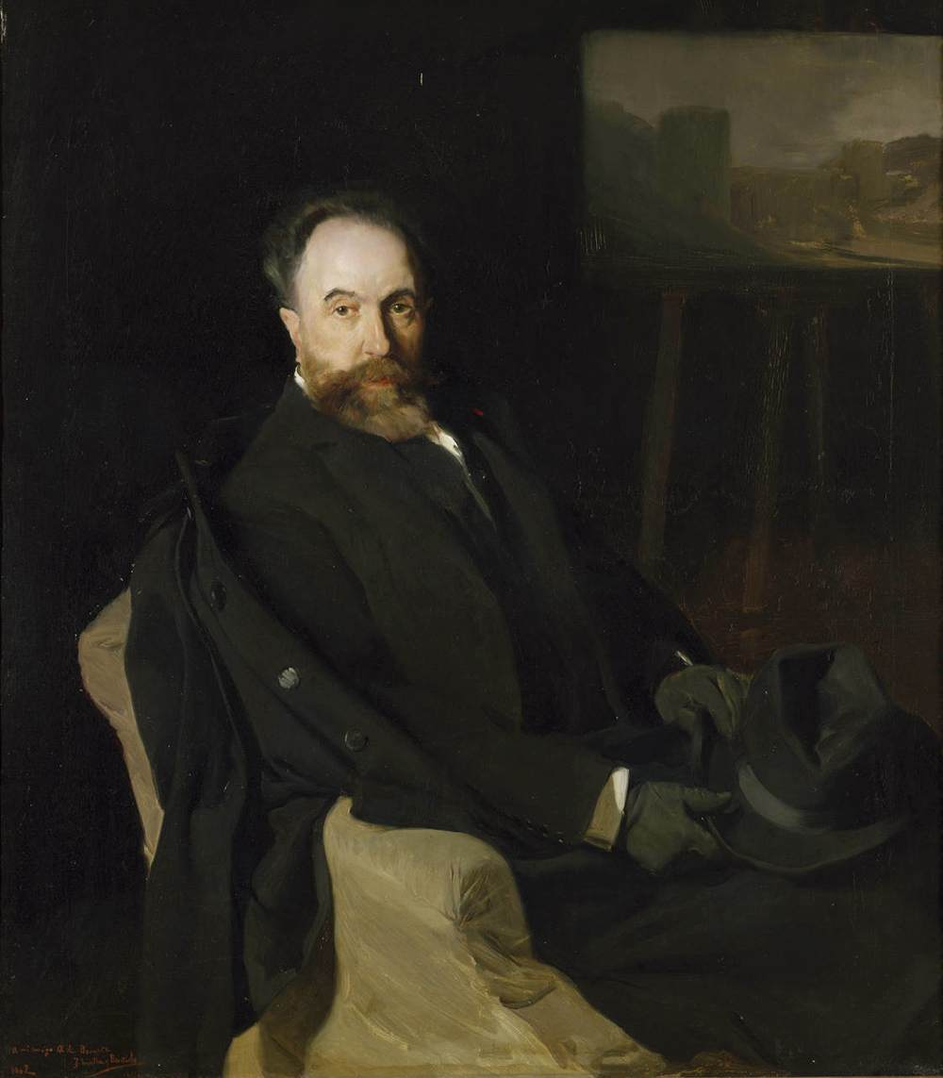
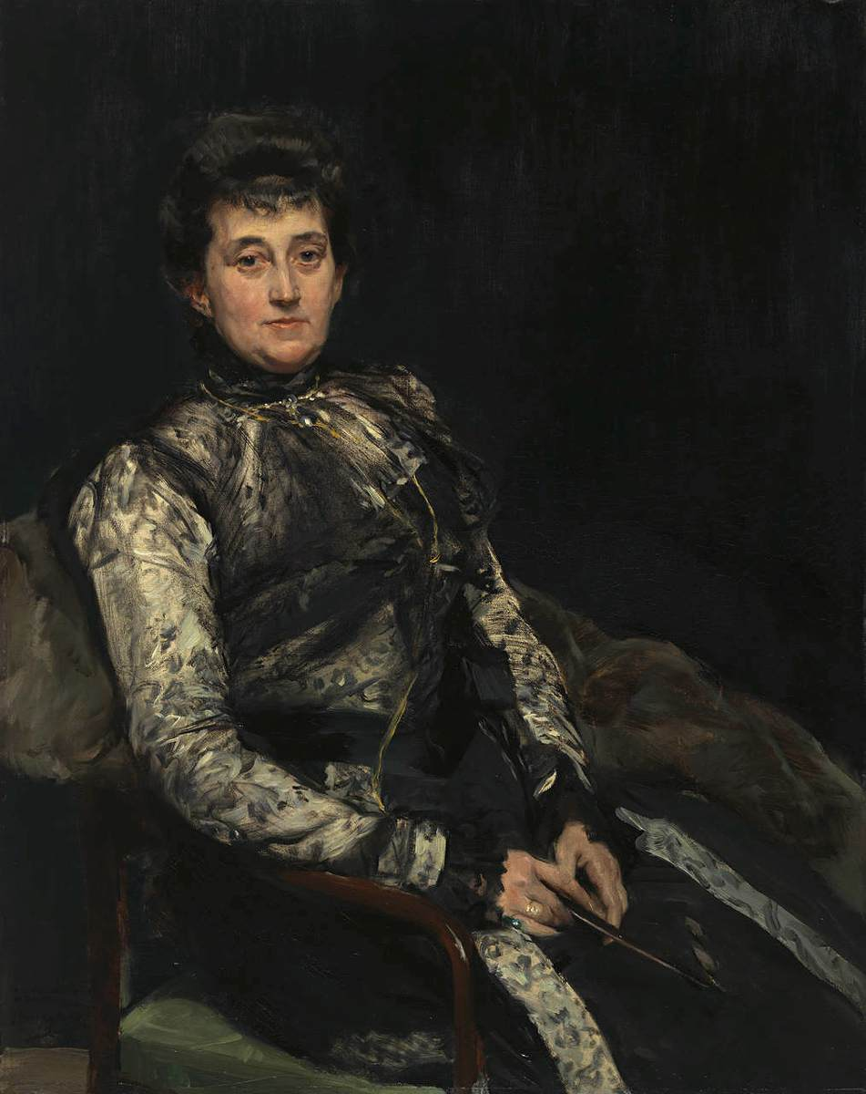
Portrait of Aureliano Beruete the Elder, 1902, Oil on Canvas, 116 x 111 cm,
Portrait of Aurelio’s Wife, 1902, Oil on Canvas, 111 x 88 cm,
Museo del Prado, Madrid, Spain https://www.wga.hu/html_m/s/sorolla/index.html

Slide 10
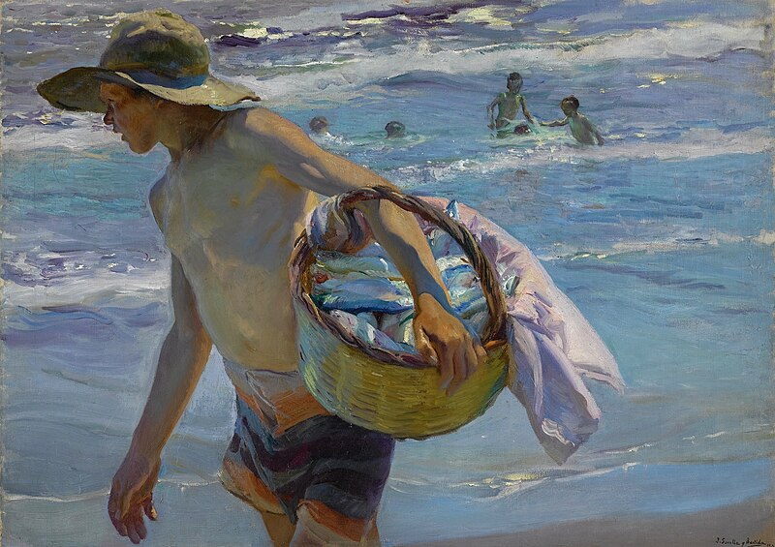
The Fisherman, 1904, Oil on Canvas, 76x106 cm, Private Collection https://commons.wikimedia.org/wiki/File:Joaqu%C3%ADn_Sorolla_y_Bastida_-_El_pescador.jpg

Slide 11
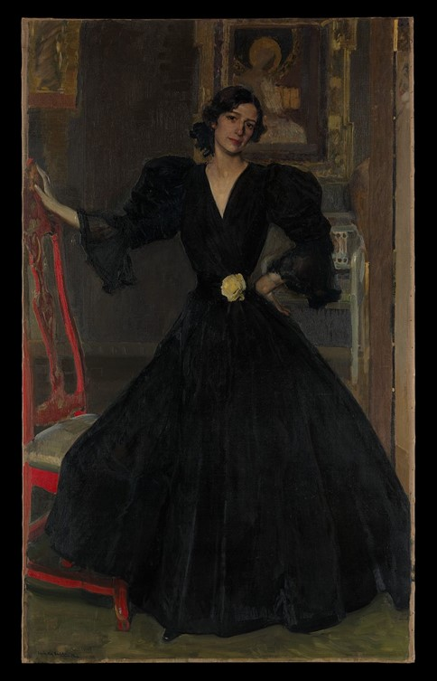
Señora de Sorolla in Black, 1906, Oil on Canvas, 186.7 x 118.7 cm, the MET, NY, USA https://commons.wikimedia.org/wiki/File:Se%C3%B1ora_de_Sorolla_(Clotilde_Garc%C3%ADa_del_Castillo,_1865%E2%80%931929)_in_Black_MET_DP168810.jpg

Slide 12
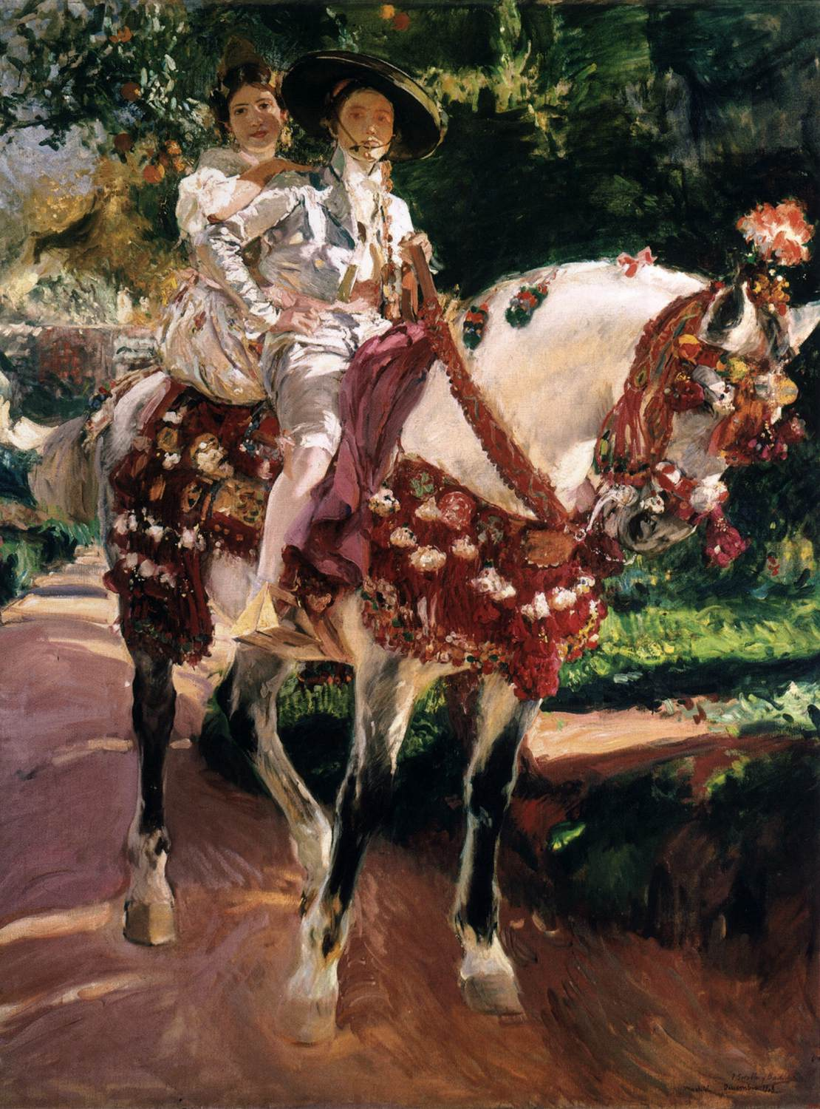
Elena and Maria in Old-Fashioned Valencian Costume, 1908, Oil on Canvas, 255 x 185 cm, Museo de Arte Moderno, Barcelona, Spain https://www.wga.hu/html_m/s/sorolla/index.html

Slide 13
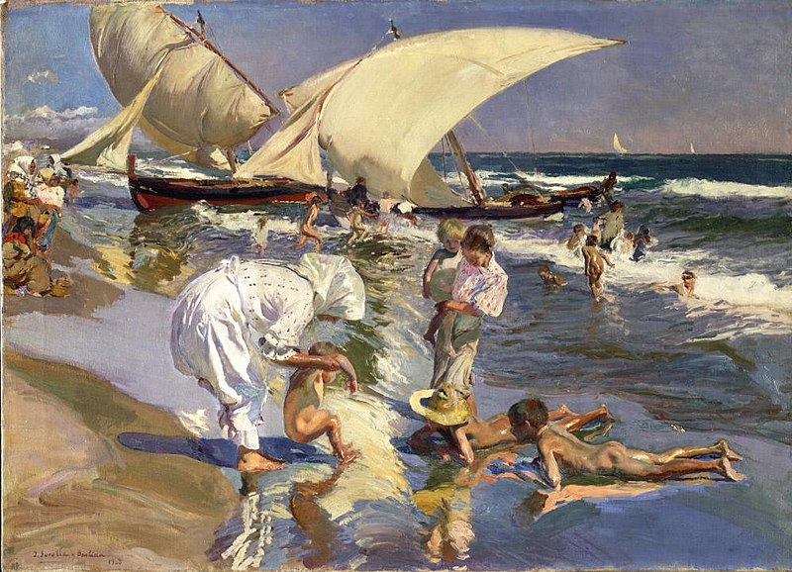
Beach of Valencia by Morning Light, 1908, Oil on Canvas, 76x105.6 cm, Hispanic Society of America, New York City, USA https://commons.wikimedia.org/wiki/File:Joaqu%C3%ADn_Sorolla_y_Bastida_-_Beach_of_Valencia_by_Morning_Light_-_A2137_-_Hispanic_Society_of_America.jpg

Slide 14
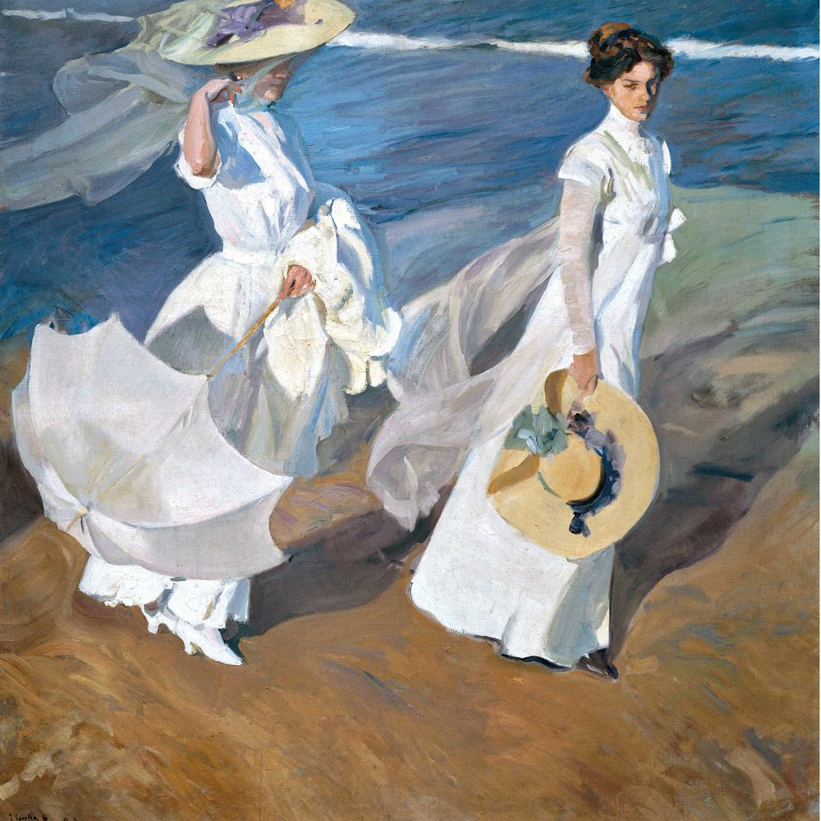
Walk by the sea, 1909, Oil on Canvas, 205x200 cm, Fundación Museo Sorolla, Madrid, Spain https://www.nationalgallery.org.uk/exhibitions/past/sorolla/what-you-need-to-know-about-sorolla

Slide 15
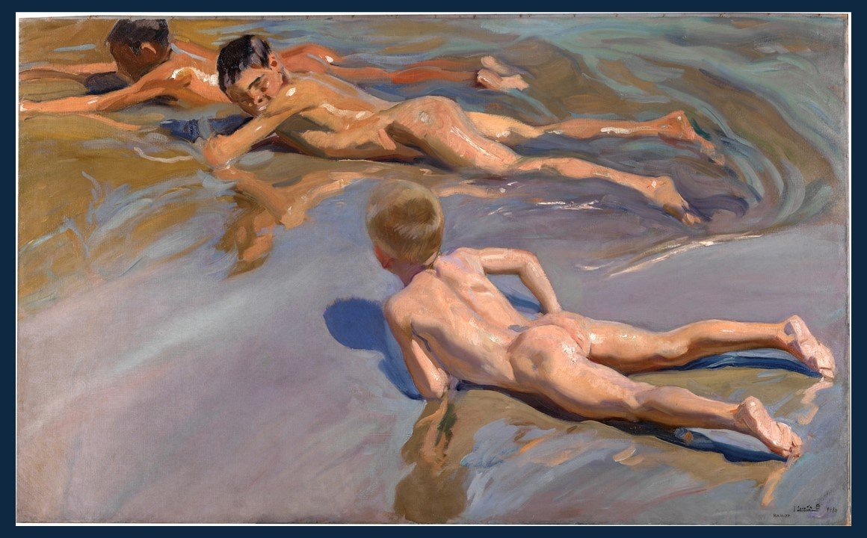
Boys on the Beach, 1909, Oil on Canvas, 118x185 cm, Prado Museum, Madrid, Spain https://www.museodelprado.es/en/the-collection/art-work/boys-on-the-beach/edd7a202-c069-49f1-a3f4-eacf9b4022c2

Slide 16
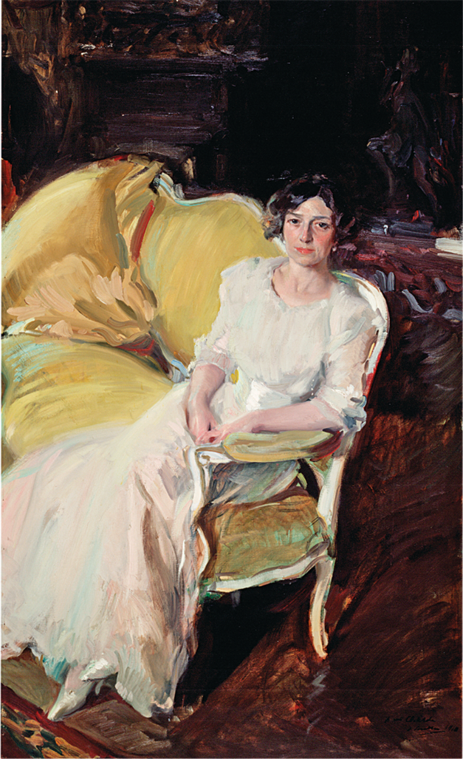
Clotilde sitting on a sofa, 1910, Oil on Canvas, 180 x 110 cm, Museo Sorolla, Madrid, Spain https://www.cultura.gob.es/msorolla/en/colecciones/colecciones-del-museo/pintura/clotilde-sentada.html

Slide 17
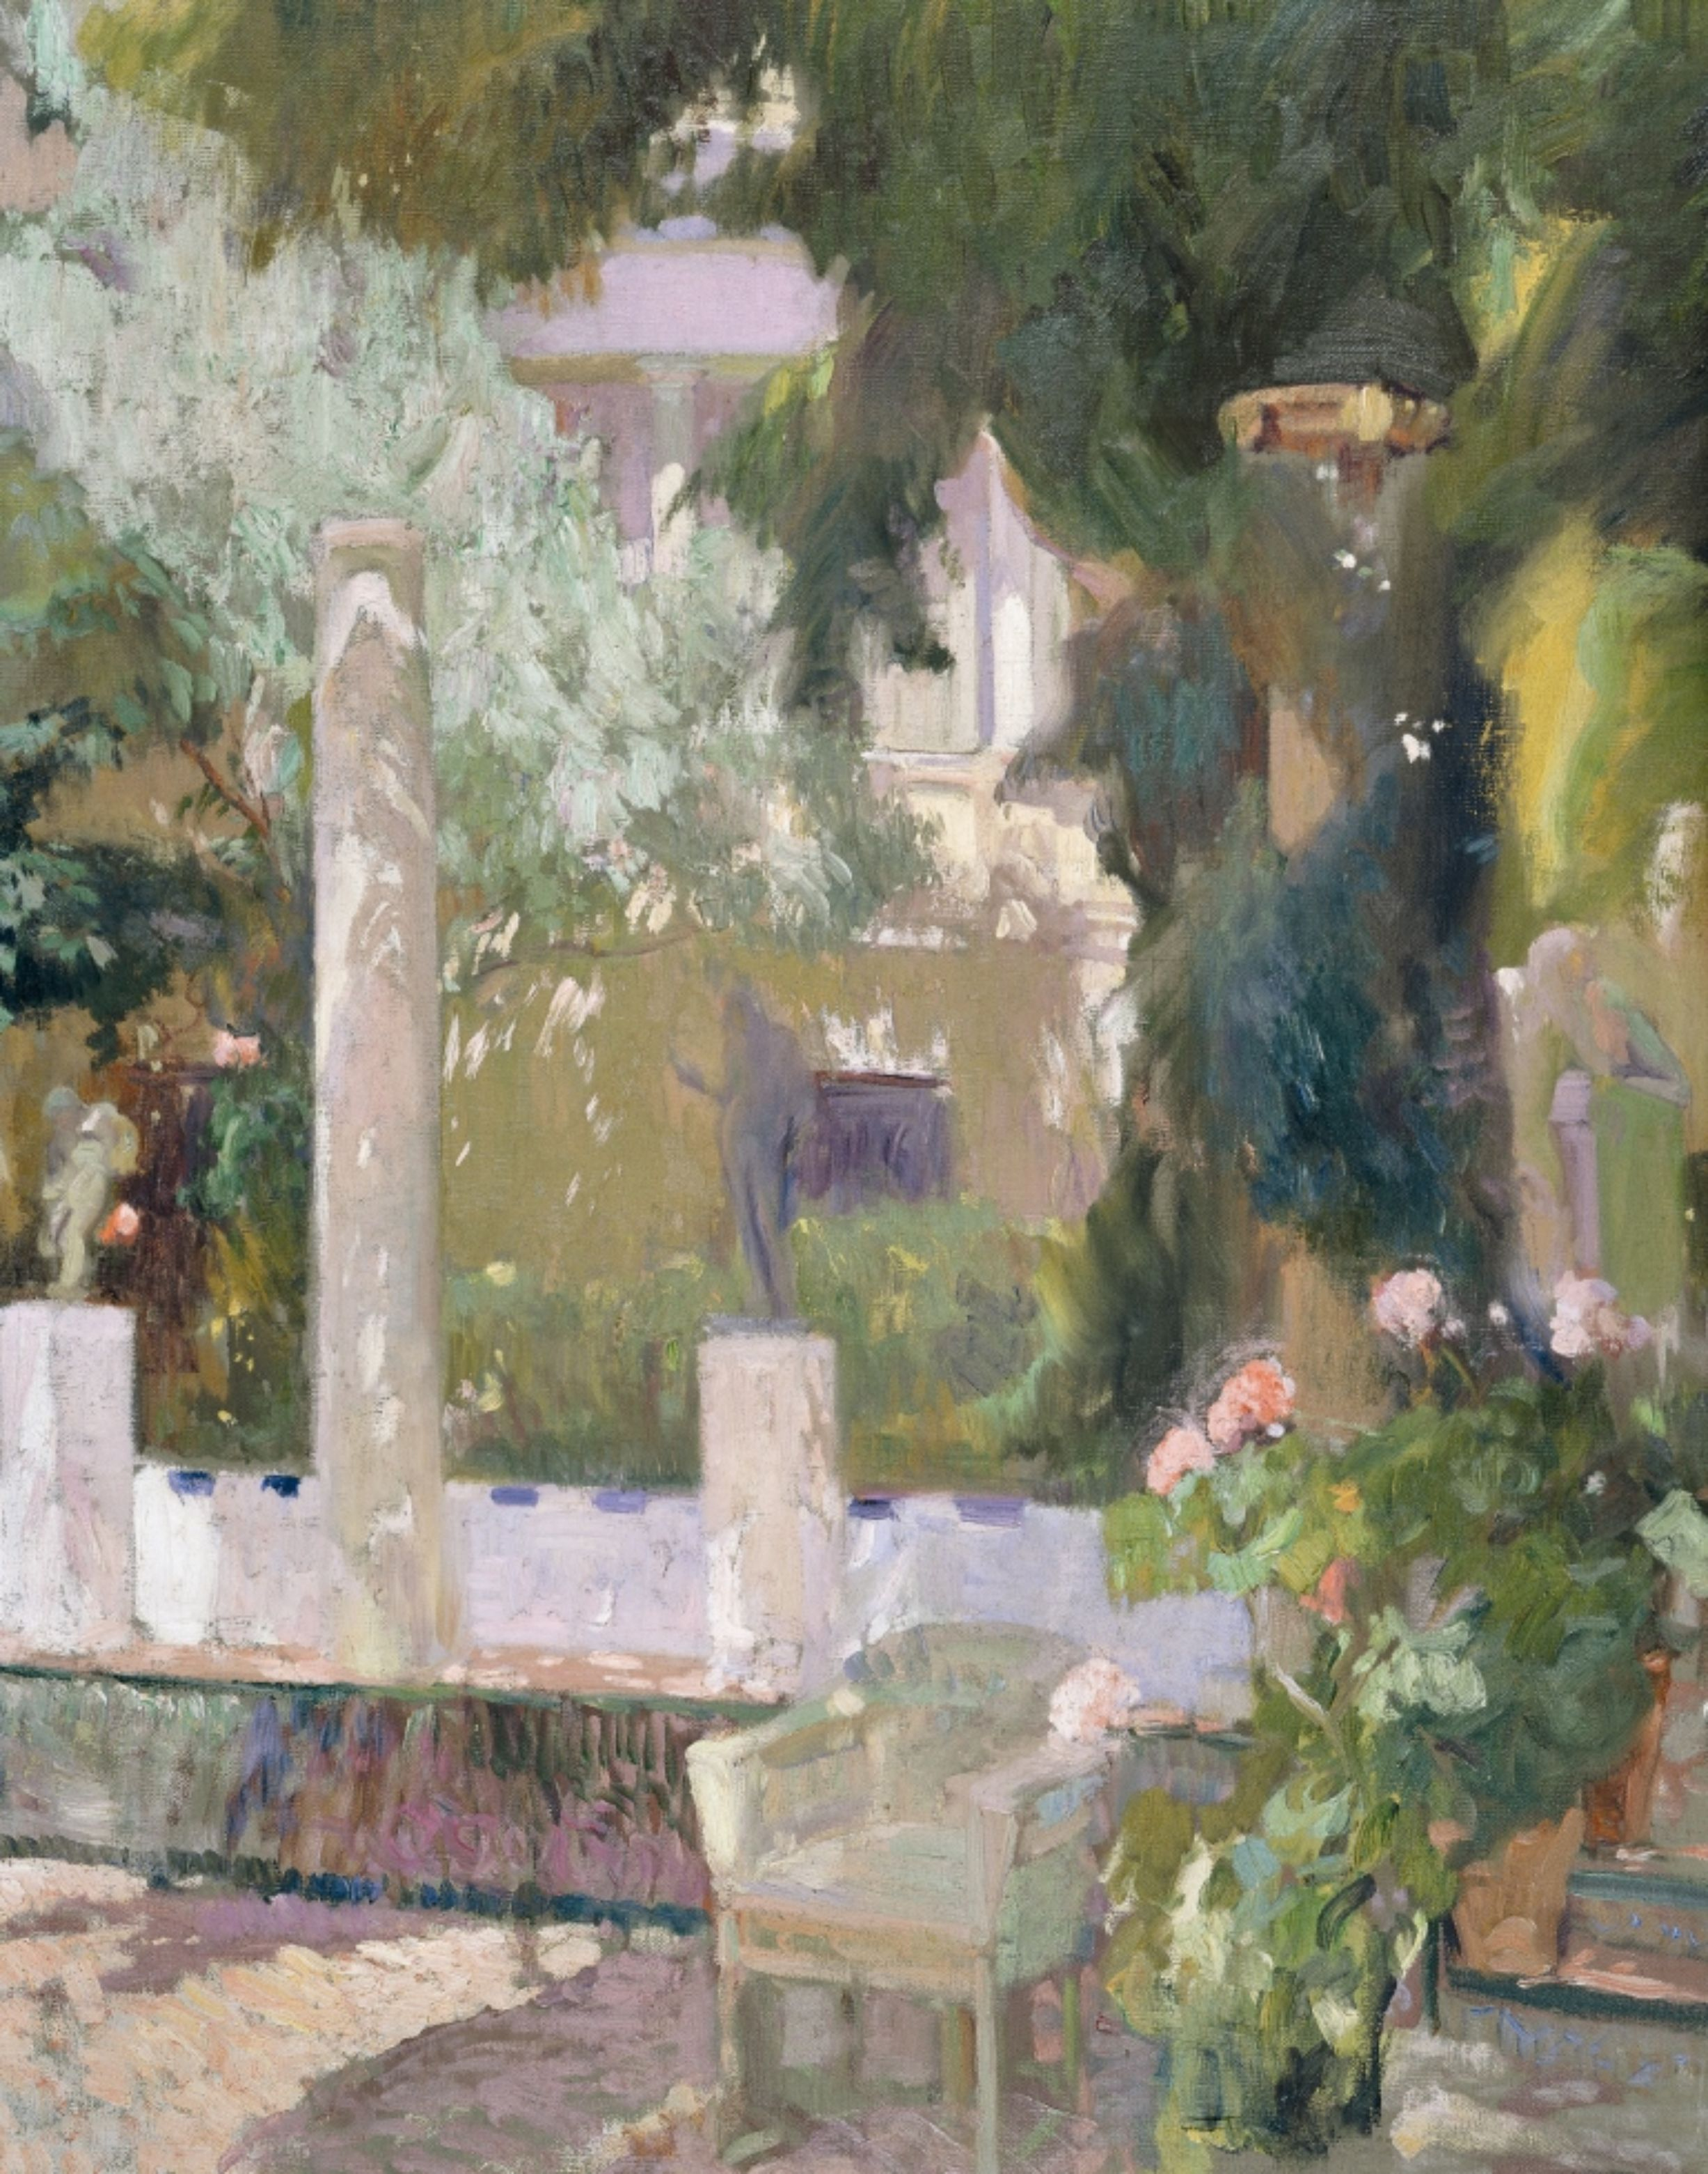
The Garden of the Sorilla House, 1920, Oil on Canvas, 104 x 87.5 cm, Museo Sorolla, Madrid, Spain https://www.cultura.gob.es/msorolla/en/colecciones/colecciones-del-museo/pintura/jardin.html

