Slide 1
House of the Large Fountain in Pompeii

Slide 2
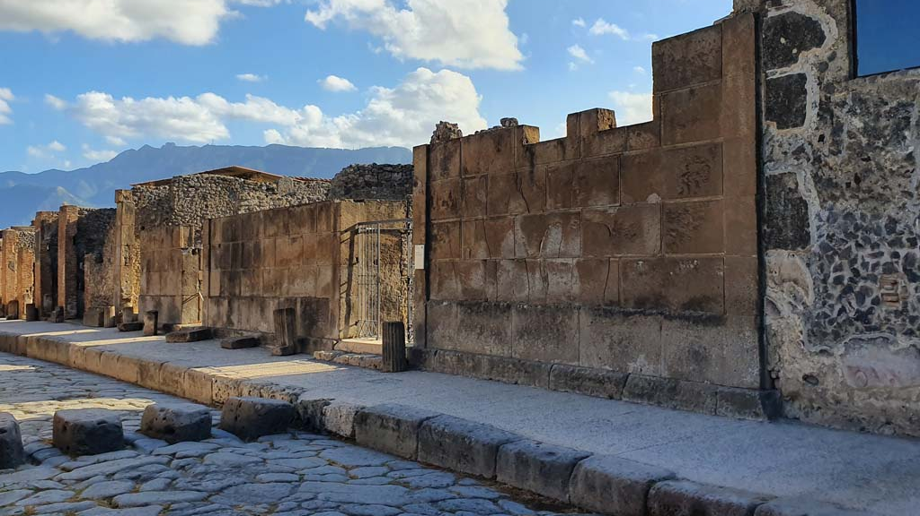
House of the Large Fountain, Entrance doorway on west side of Via di Mercurio, 2nd century BC to 1st century AD, Pompeii (Regio VI Insula 8.22), Italy https://www.pompeiiinpictures.com/pompeiiinpictures/r6/6%2008%2022.htm

Slide 3
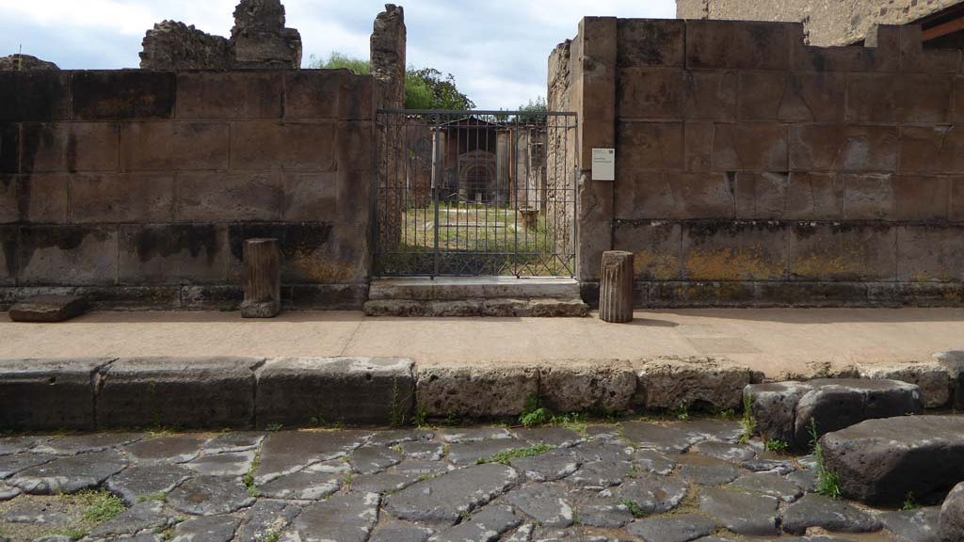
House of the Large Fountain, Entrance doorway, the Large Fountain at the back of the Garden, on west side of Via di Mercurio , 2nd century BC to 1st century AD, Pompeii (Regio VI Insula 8.22), Italy https://www.pompeiiinpictures.com/pompeiiinpictures/r6/6%2008%2022.htm

Slide 4
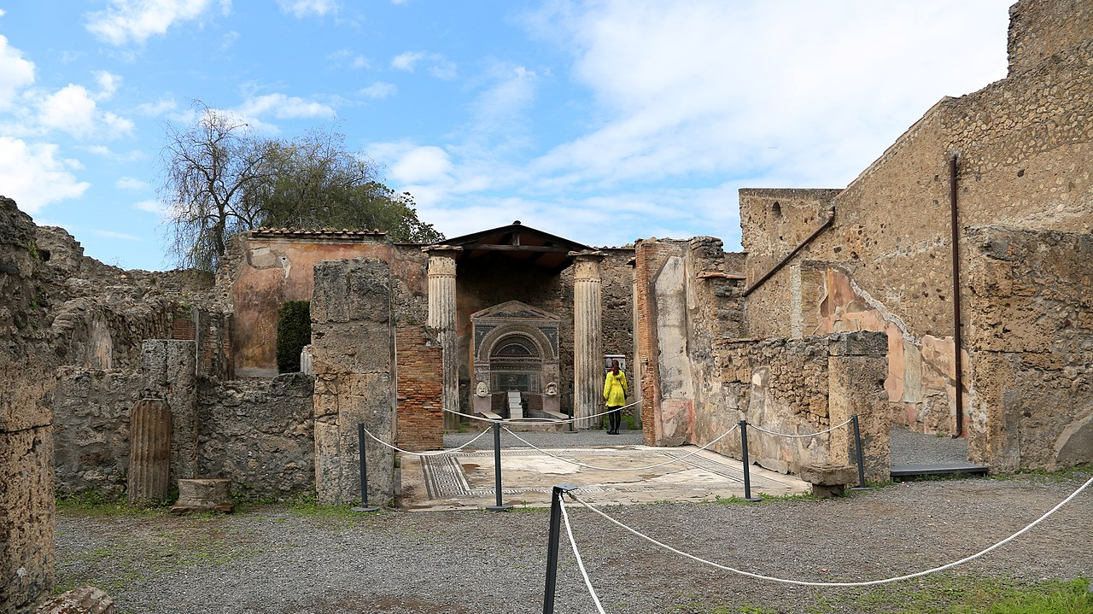
House of the Large Fountain, 2nd century BC to 1st century AD, Pompeii (Regio VI Insula 8.22), Italy https://commons.wikimedia.org/wiki/Category:Fountain_in_the_House_of_the_Large_Fountain_(Pompeii)#/media/File:Casa_della_fontana_grande,_con_una_fontana_del_I_secolo_dc._01.jpg

Slide 5
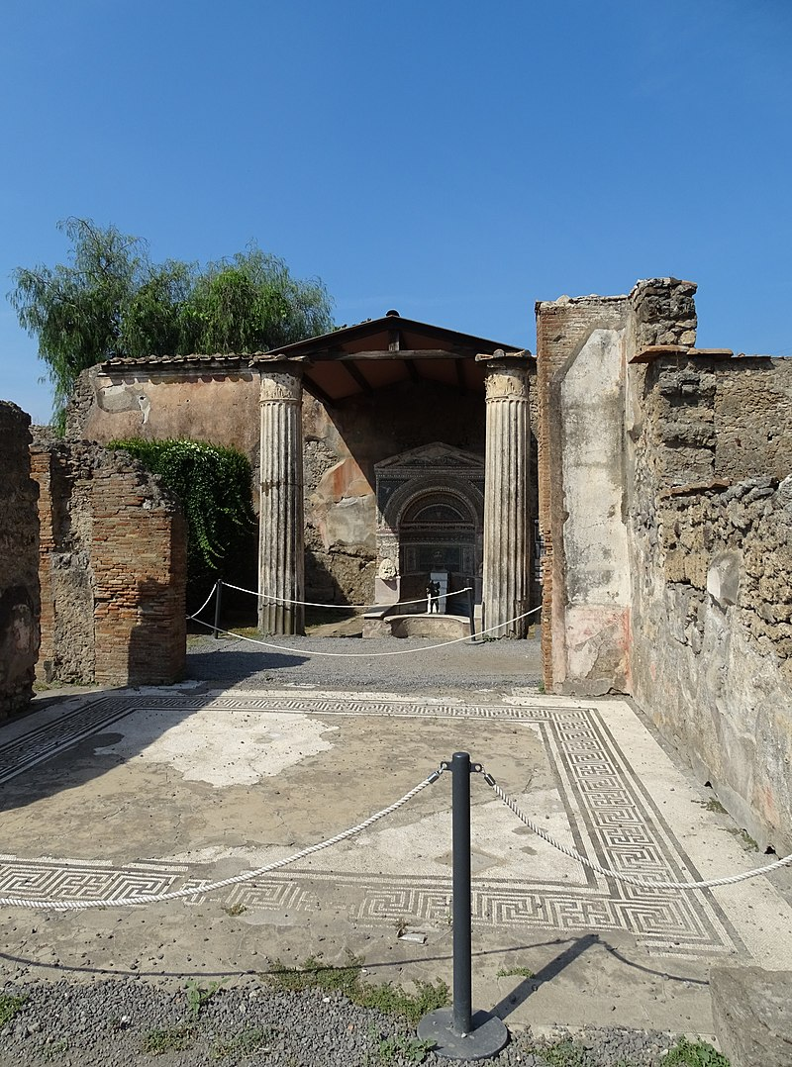
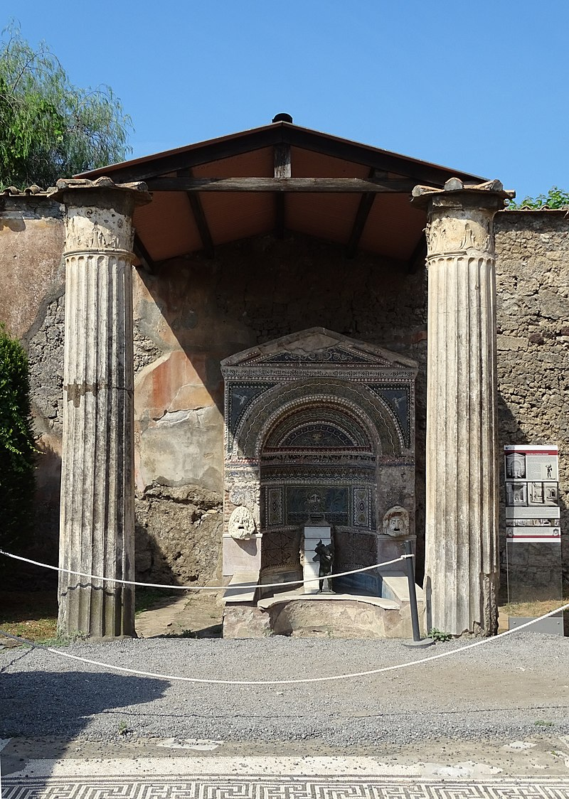
https://commons.wikimedia.org/wiki/Category:Fountain_in_the_House_of_the_Large_Fountain_(Pompeii)

Slide 6
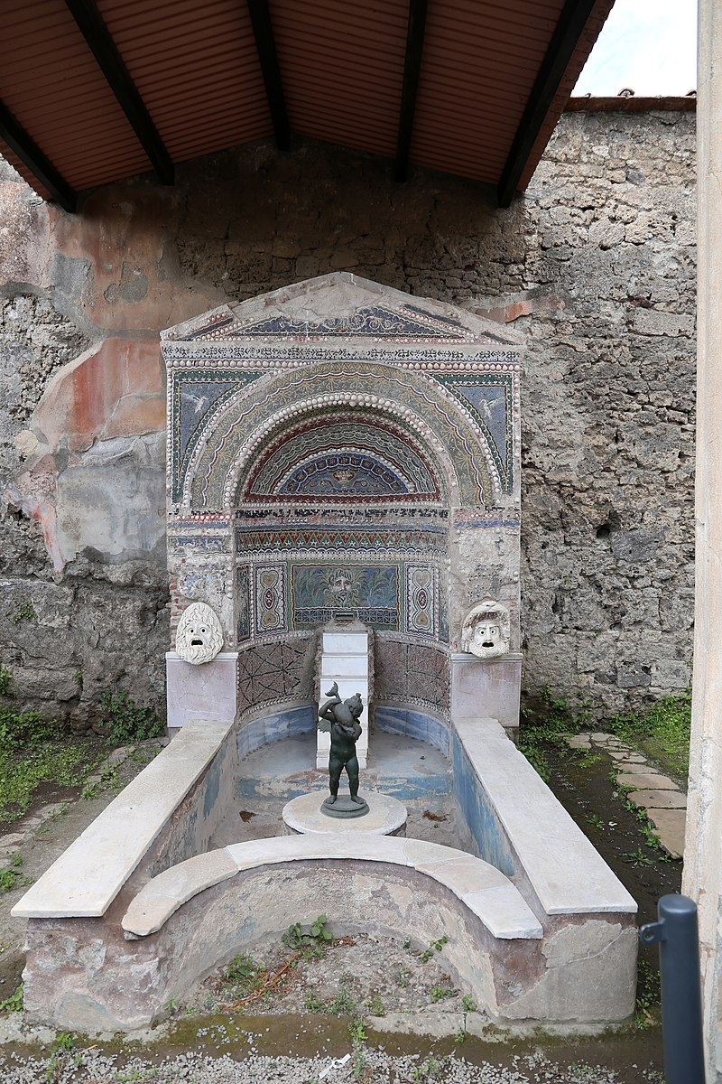
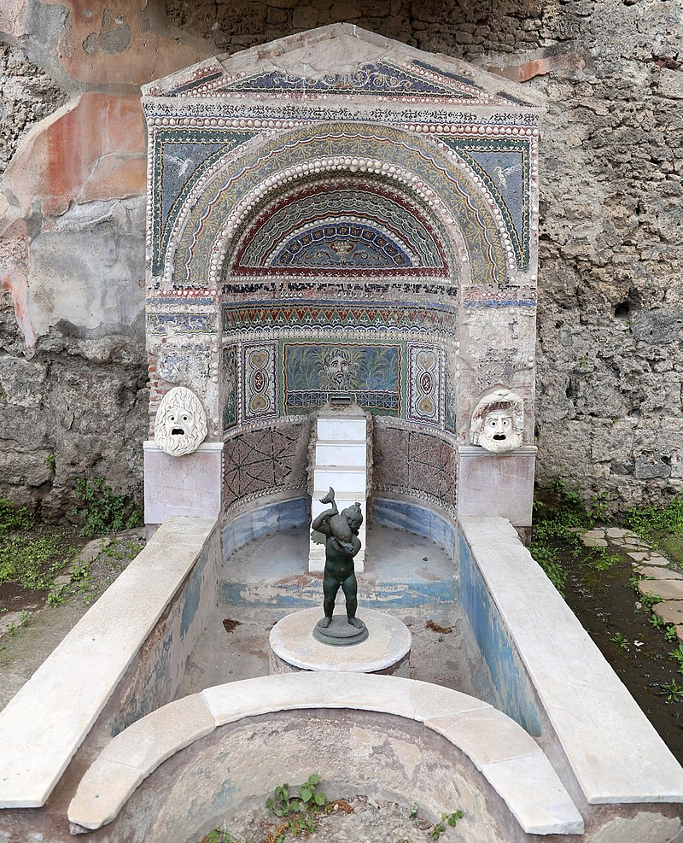
https://commons.wikimedia.org/wiki/Category:Fountain_in_the_House_of_the_Large_Fountain_(Pompeii)#/media/File:Casa_della_fontana_grande,_con_una_fontana_del_I_secolo_dc._03.jpg

Slide 7
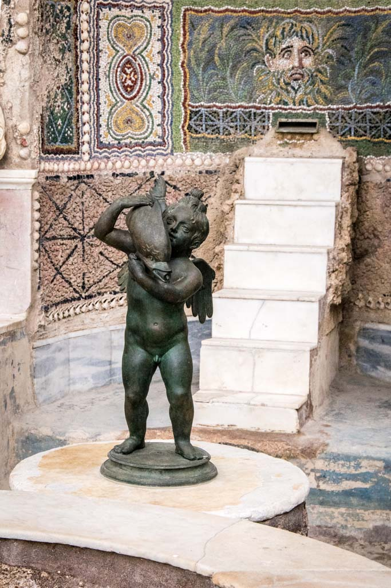
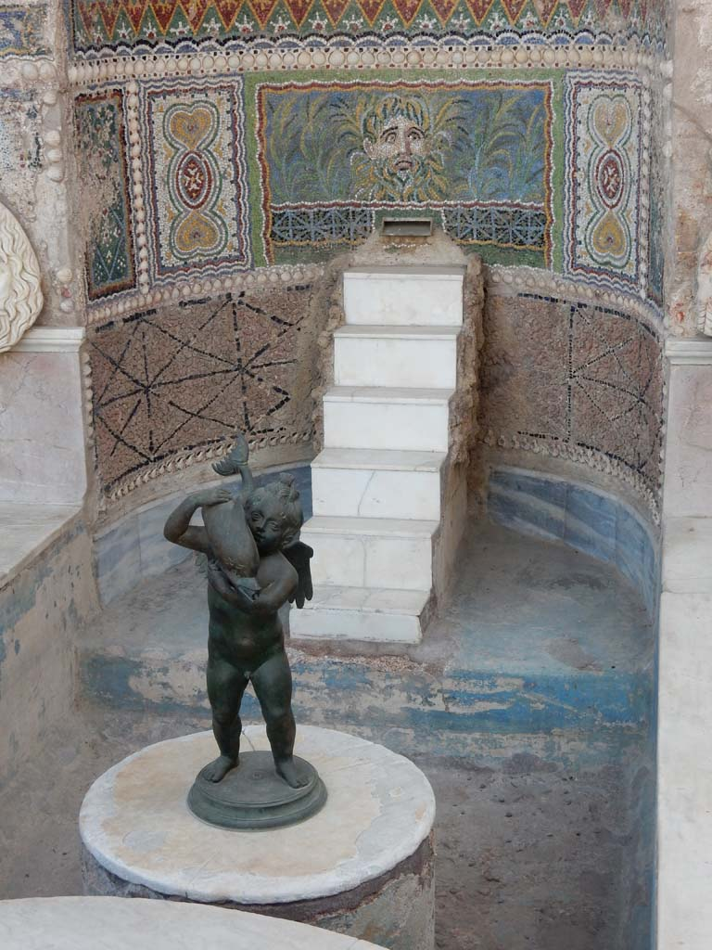
https://www.pompeiiinpictures.com/pompeiiinpictures/r6/6%2008%2022%20p3.htm

Slide 8
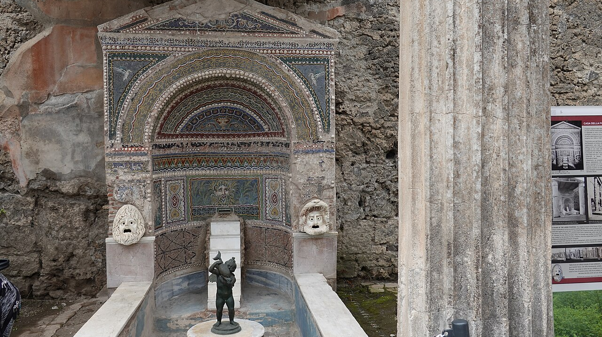
https://commons.wikimedia.org/wiki/Category:Fountain_in_the_House_of_the_Large_Fountain_(Pompeii)#/media/File:House_of_the_Large_Fountain,_Pompeii_(48754863121).jpg

Slide 9
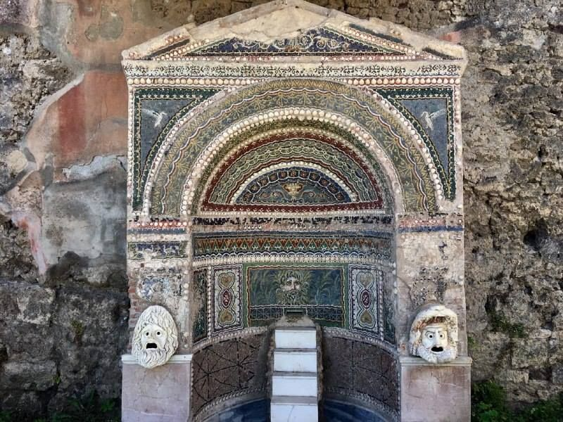
https://pompeiisites.org/en/comunicati/the-house-of-the-large-fountain-the-house-of-the-anchor-and-the-temple-of-isis-all-reopen-to-the-public/#&gid=1&pid=13

Slide 10
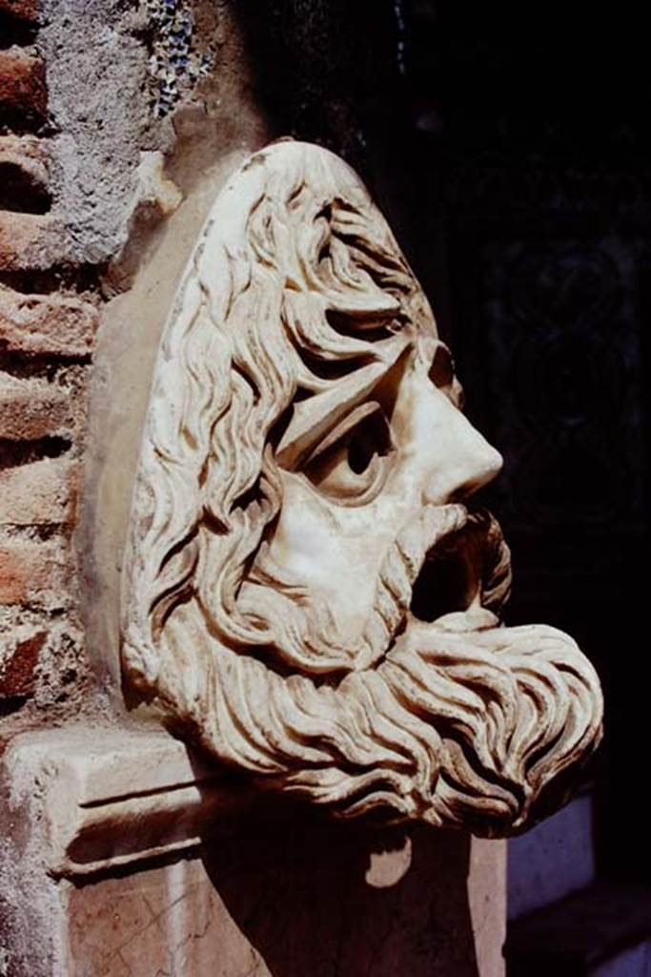
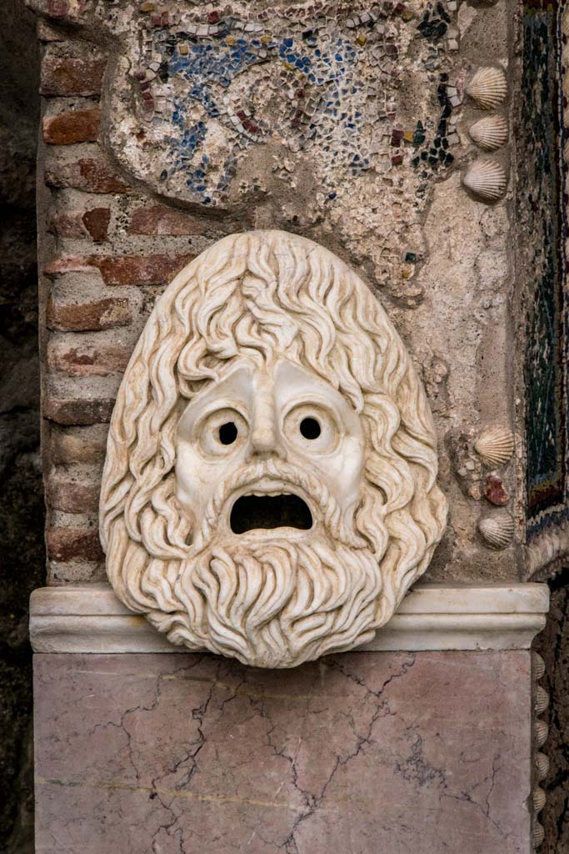
https://www.pompeiiinpictures.com/pompeiiinpictures/r6/6%2008%2022%20p3.htm

Slide 11
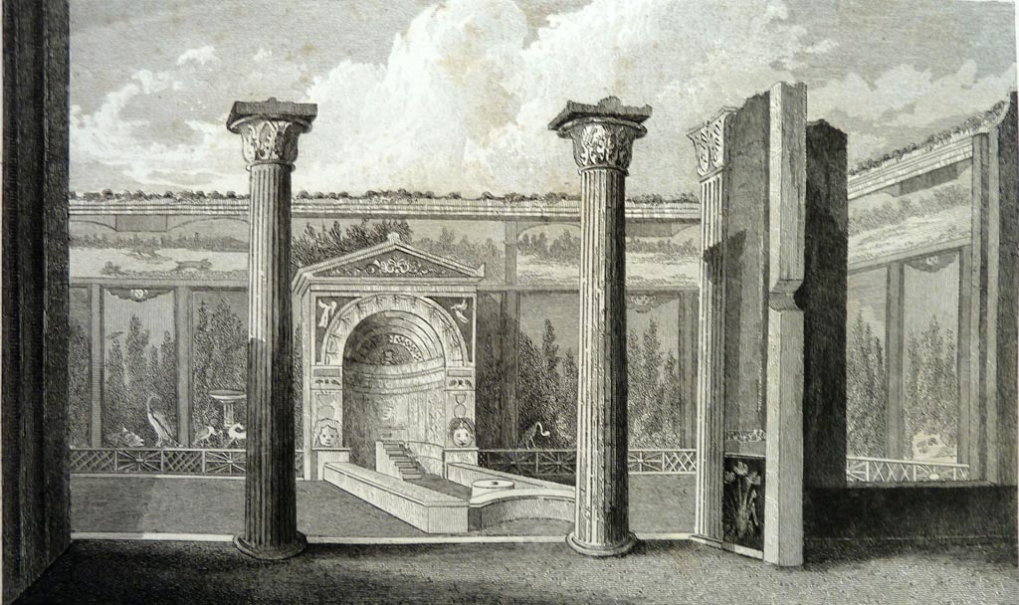
Drawing by Gell of Room 11, garden area and portico with doorway to triclinium on right. Gell wrote..’This plate exhibits the garden, pseudo-garden or painted wall, and part of the inner portico of a dwelling which, on account of the fountain here also represented, caused a greater sensation at Naples than any previous discovery had created. The house was found in the month of June 1830, and the excavation terminated in October. The arch or alcove of the fountain is on the spot termed the grotto, and that is the name by which at the moment it may be found…’ https://www.pompeiiinpictures.com/pompeiiinpictures/r6/6%2008%2022%20p3.htm
House of the Large Fountain, 2nd century BC to 1st century AD, Pompeii (Regio VI Insula 8.22), Italy,

Slide 12
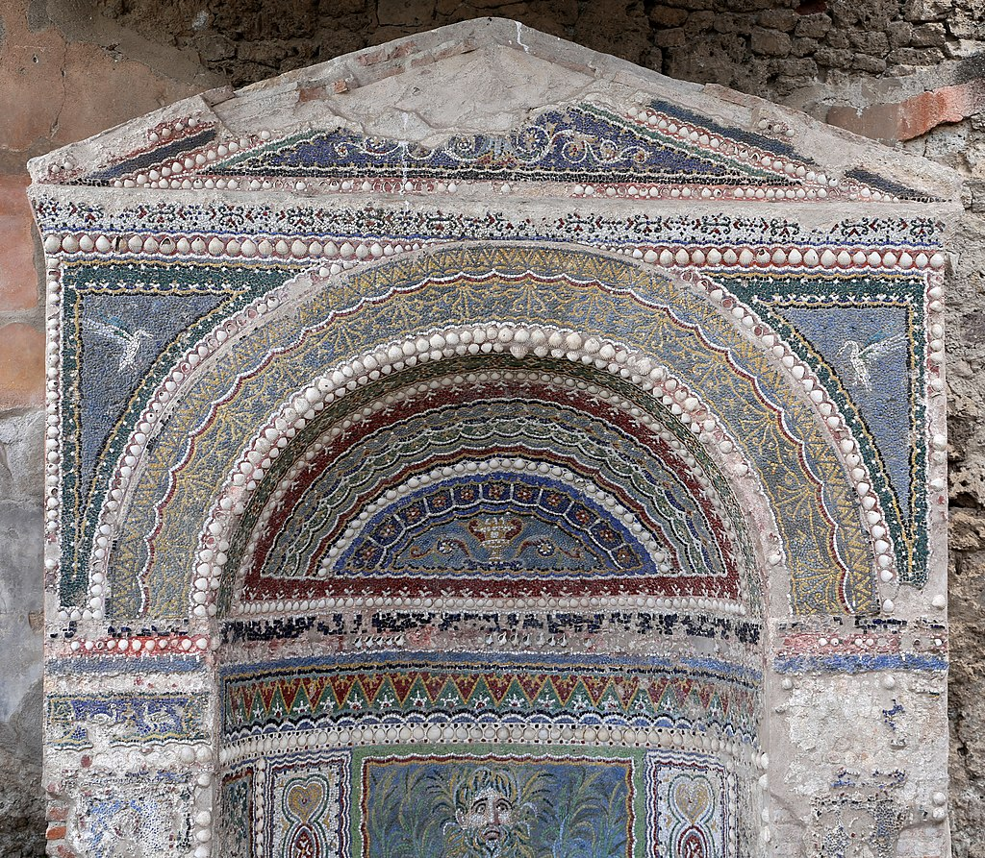
https://commons.wikimedia.org/wiki/Category:Fountain_in_the_House_of_the_Large_Fountain_(Pompeii)#/media/File:Casa_della_fontana_grande,_con_una_fontana_del_I_secolo_dc._04_mosaici.jpg

Slide 13
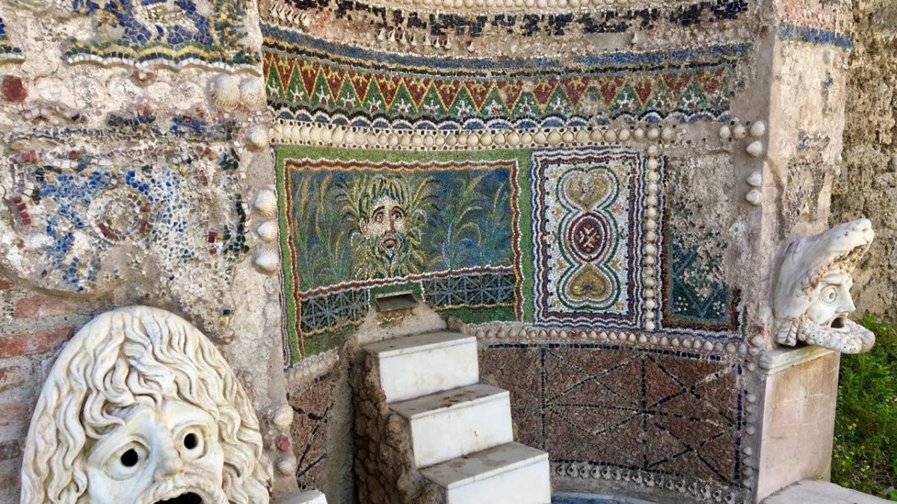
https://pompeiisites.org/en/comunicati/the-house-of-the-large-fountain-the-house-of-the-anchor-and-the-temple-of-isis-all-reopen-to-the-public/#&gid=1&pid=14

Slide 14
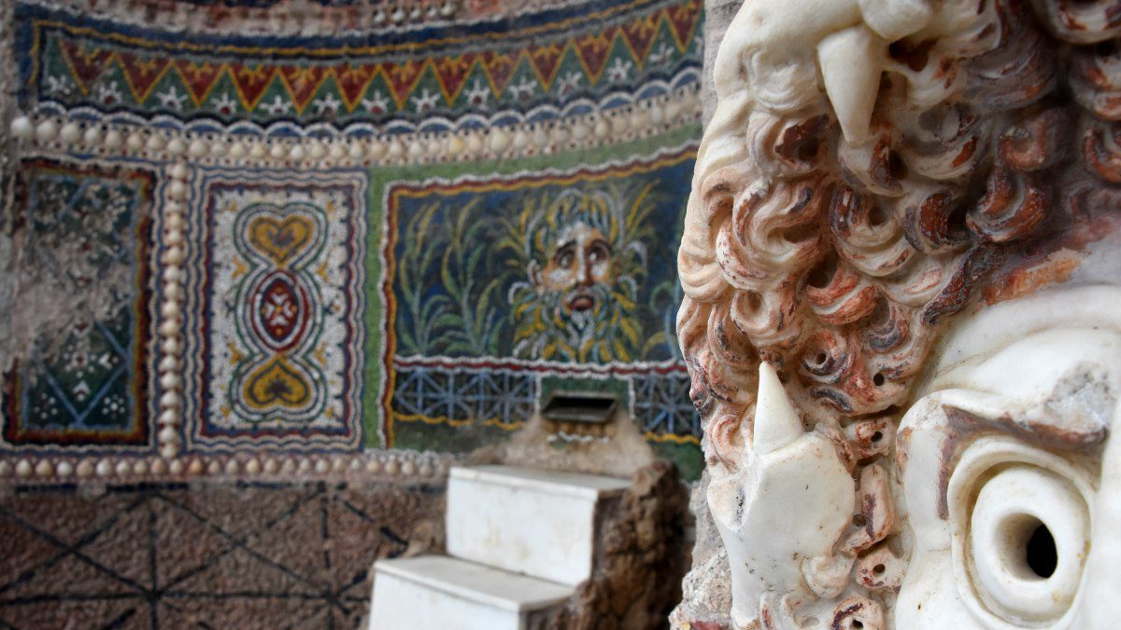
https://pompeiisites.org/en/comunicati/the-house-of-the-large-fountain-the-house-of-the-anchor-and-the-temple-of-isis-all-reopen-to-the-public/#&gid=1&pid=8

Slide 15
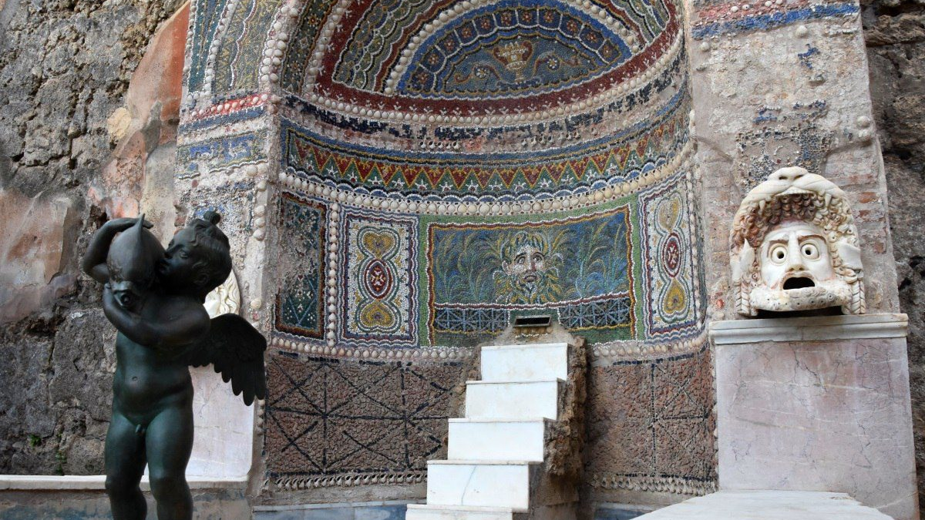
https://pompeiisites.org/en/comunicati/the-house-of-the-large-fountain-the-house-of-the-anchor-and-the-temple-of-isis-all-reopen-to-the-public/#&gid=1&pid=2

Slide 16
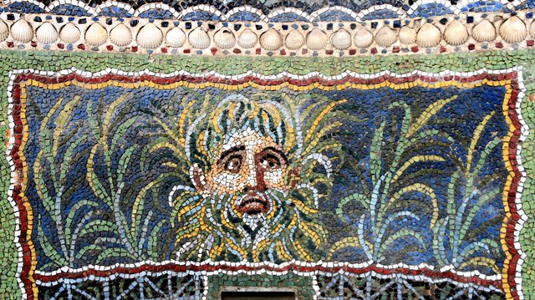
https://pompeiisites.org/en/comunicati/the-house-of-the-large-fountain-the-house-of-the-anchor-and-the-temple-of-isis-all-reopen-to-the-public/#&gid=1&pid=12

Slide 17
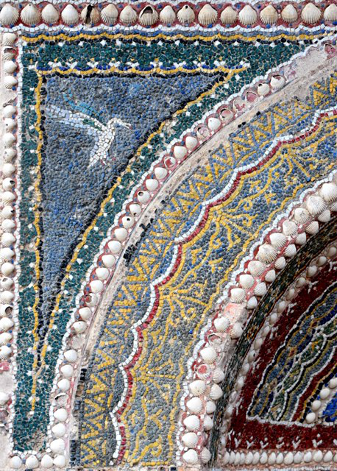
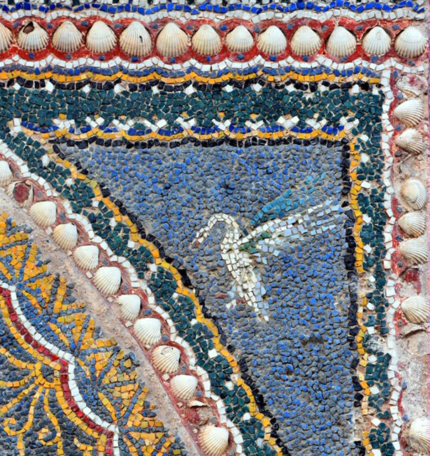
https://pompeiisites.org/en/comunicati/the-house-of-the-large-fountain-the-house-of-the-anchor-and-the-temple-of-isis-all-reopen-to-the-public/

Slide 18
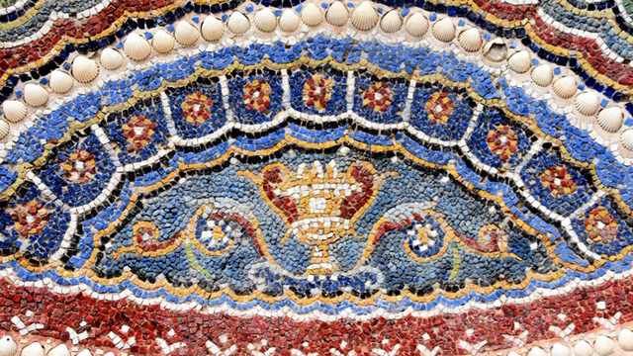
https://pompeiisites.org/en/comunicati/the-house-of-the-large-fountain-the-house-of-the-anchor-and-the-temple-of-isis-all-reopen-to-the-public/#&gid=1&pid=11

Slide 19
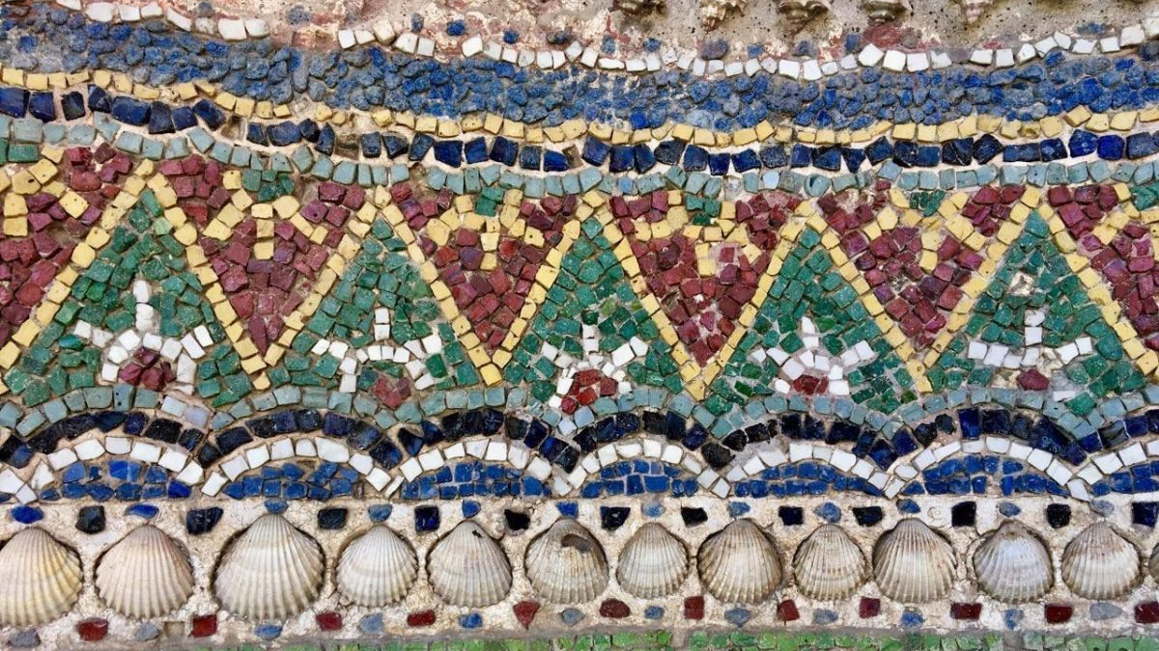
https://pompeiisites.org/en/comunicati/the-house-of-the-large-fountain-the-house-of-the-anchor-and-the-temple-of-isis-all-reopen-to-the-public/#&gid=1&pid=15

Slide 20
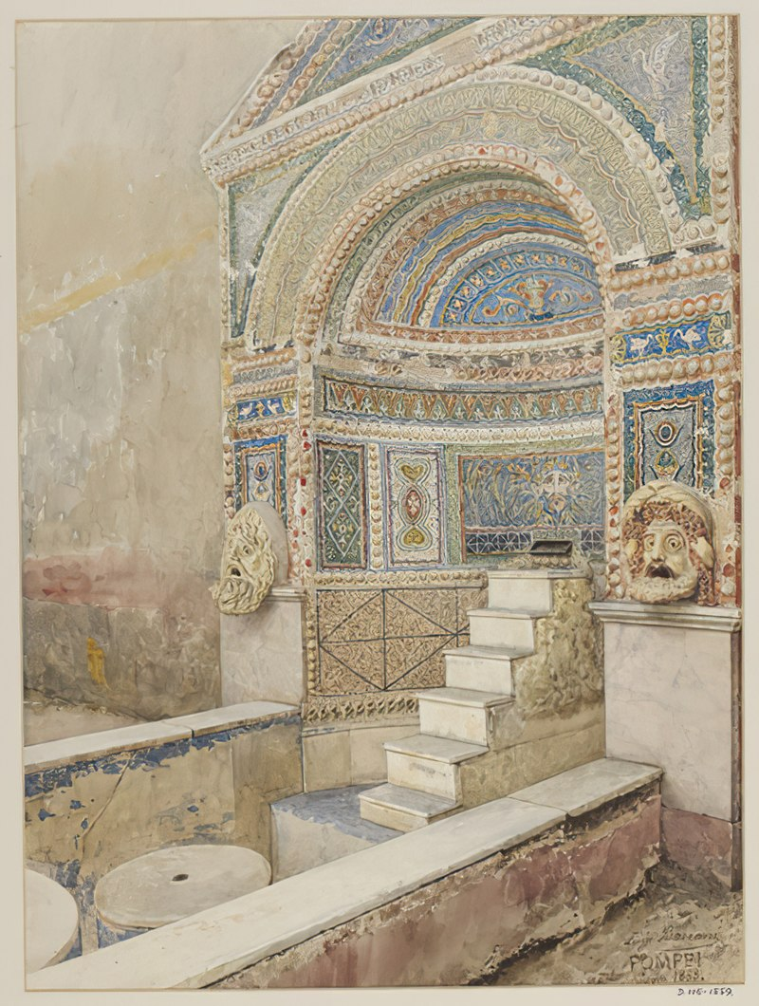
Luigi Bazzani, 1836 - 1927
Mosaic fountain with cascade and tragic masks in the House of the Great Fountain in Pompeii, 1888, Watercolour, 47.498x 35.56 cm, Victoria and Albert Museum, London, UK https://commons.wikimedia.org/wiki/Category:Fountain_in_the_House_of_the_Large_Fountain_(Pompeii)#/media/File:Mosaic_fountain_with_cascade_and_tragic_masks_in_Pompeii_watercolor_by_Luigi_Bazzani.jpg

Slide 21
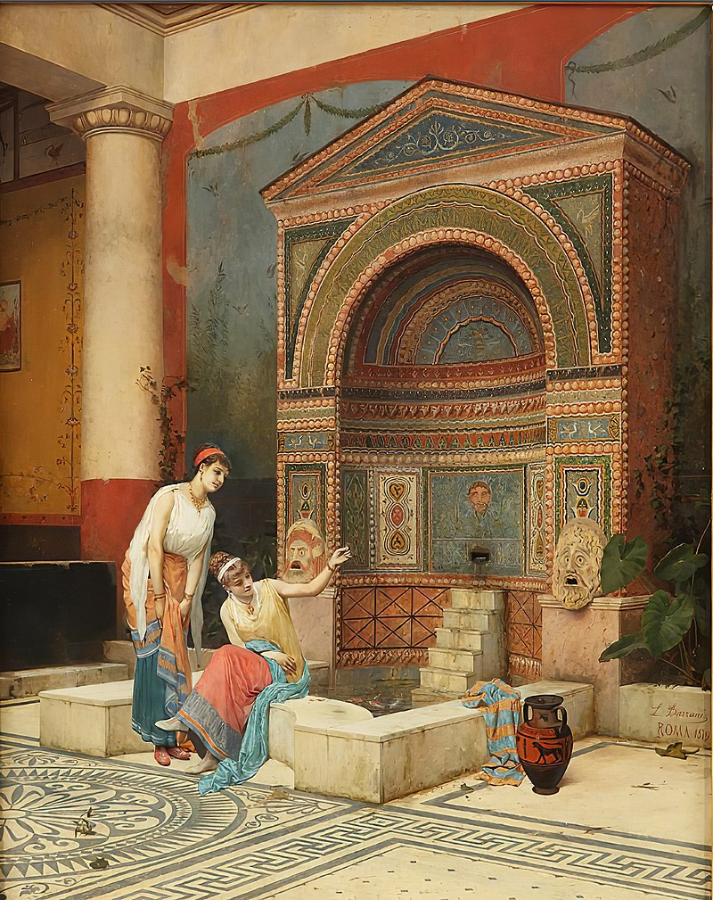
Luigi Bazzani, 1836 – 1927
Women feeding fish in a Pompeian Atrium, late 19th century, Oil on Panel
73.66 cm × 58.42 cm, Private Collection https://commons.wikimedia.org/wiki/Category:Fountain_in_the_House_of_the_Large_Fountain_(Pompeii)#/media/File:Women_feeding_fish_in_a_Pompeian_Atrium_by_Luigi_Bazzani.jpg

Slide 22
The End

