Slide 1

Félix François Georges Philibert Ziem
1821-1911
Paintings of Venice and Constantinople

Slide 2
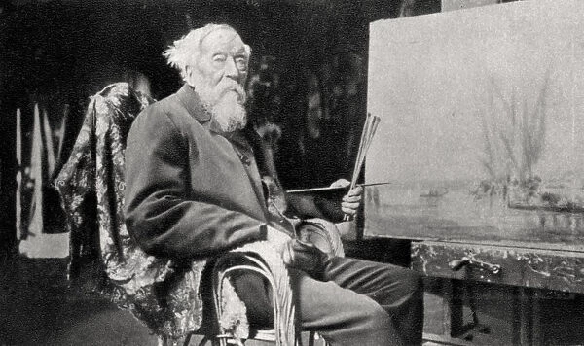

Slide 3
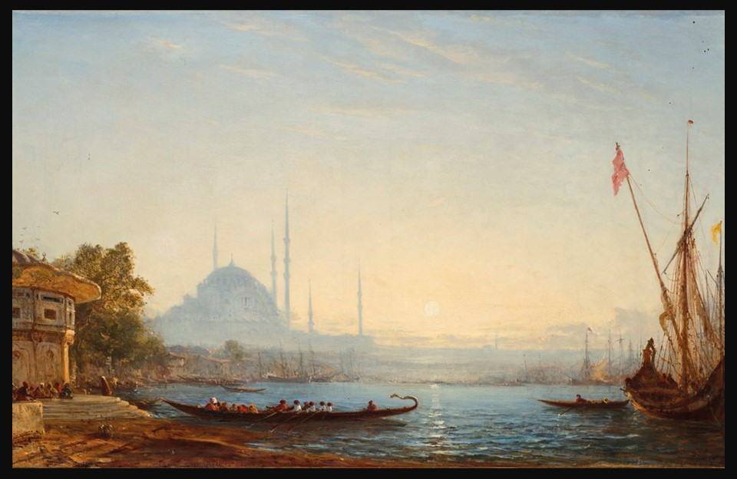
Constantinople, 1857-58, Oil on Canvas, 58 x 93.4 cm, Private Collection https://www.christies.com/en/private-sales/privateitems/private-item-SN00656940-001

Slide 4
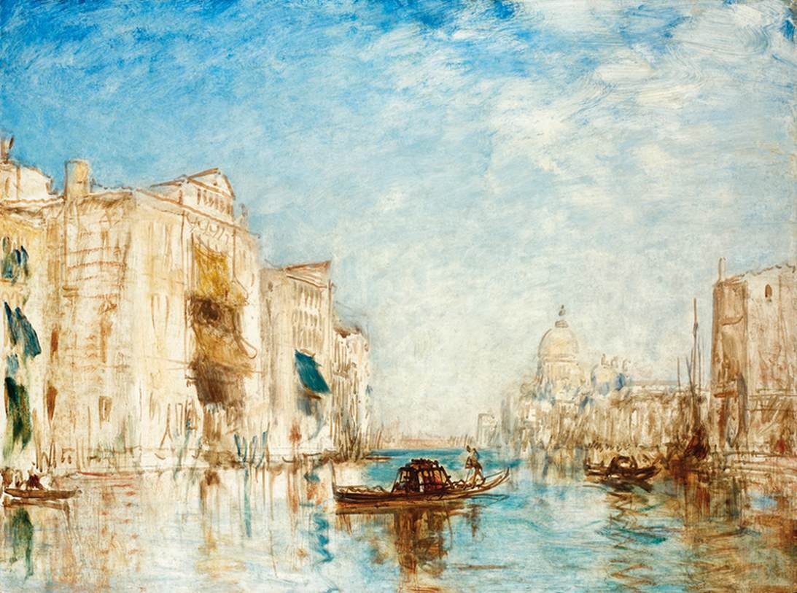
Vista de Venecia, 1861
Oil on Canvas, 60.1x80.8 cm, Museo Soumaya, Fundación Carlos Slim, Mexico City, Mexico https://artsandculture.google.com/asset/vista-de-venecia-f%C3%A9lix-ziem/ZgFreua0RS-f5A

Slide 5
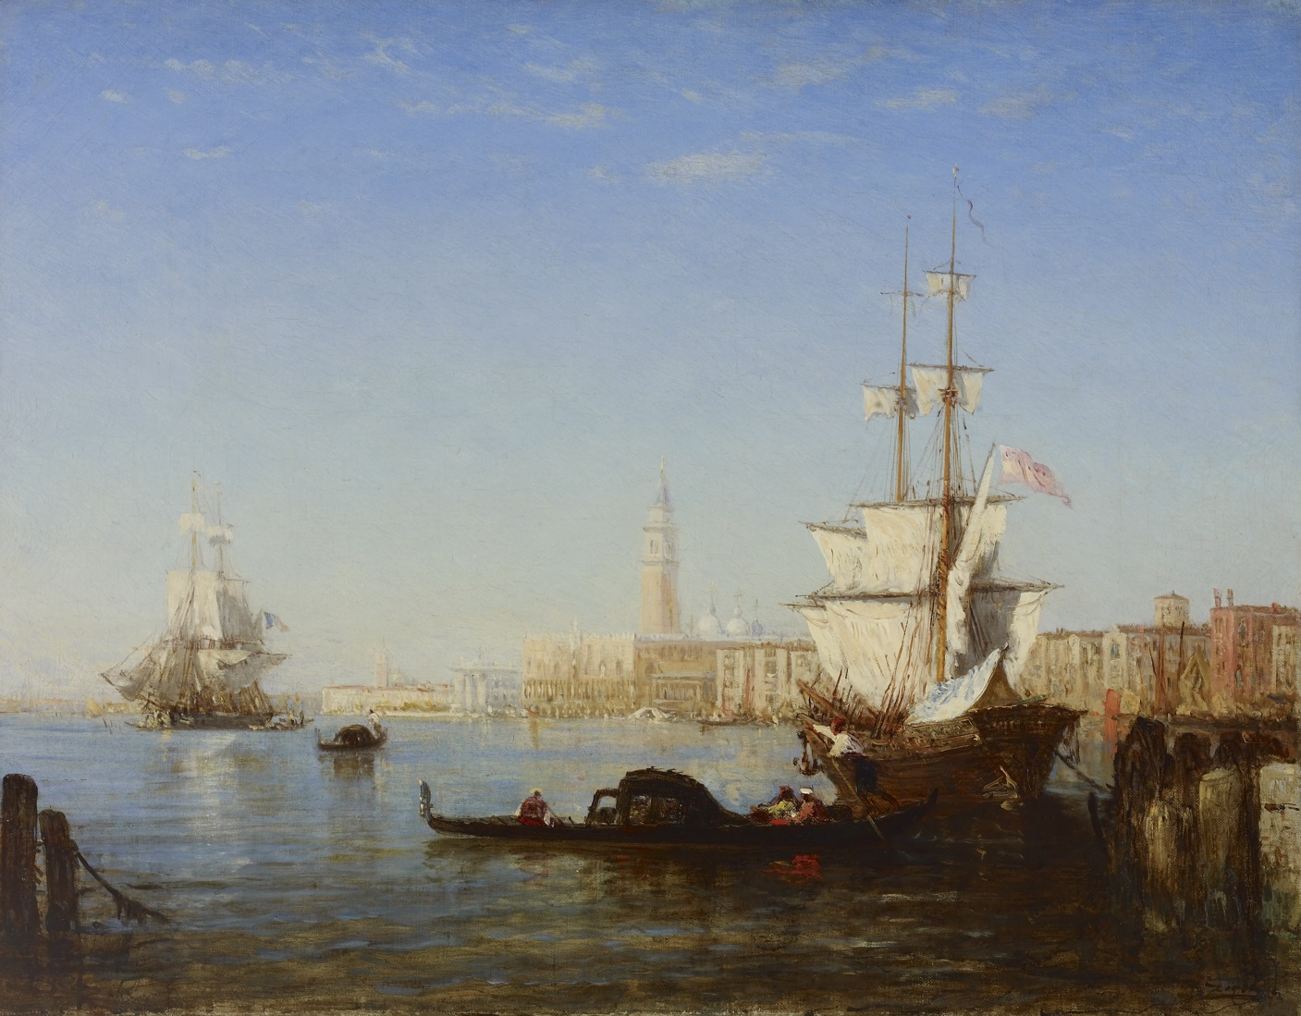
Venice, Morning, ca. 1864, Oil on Canvas, 43 x 55.5 cm, The Walters Art Museum, Baltomore, USA https://art.thewalters.org/detail/38302/venice-morning/

Slide 6
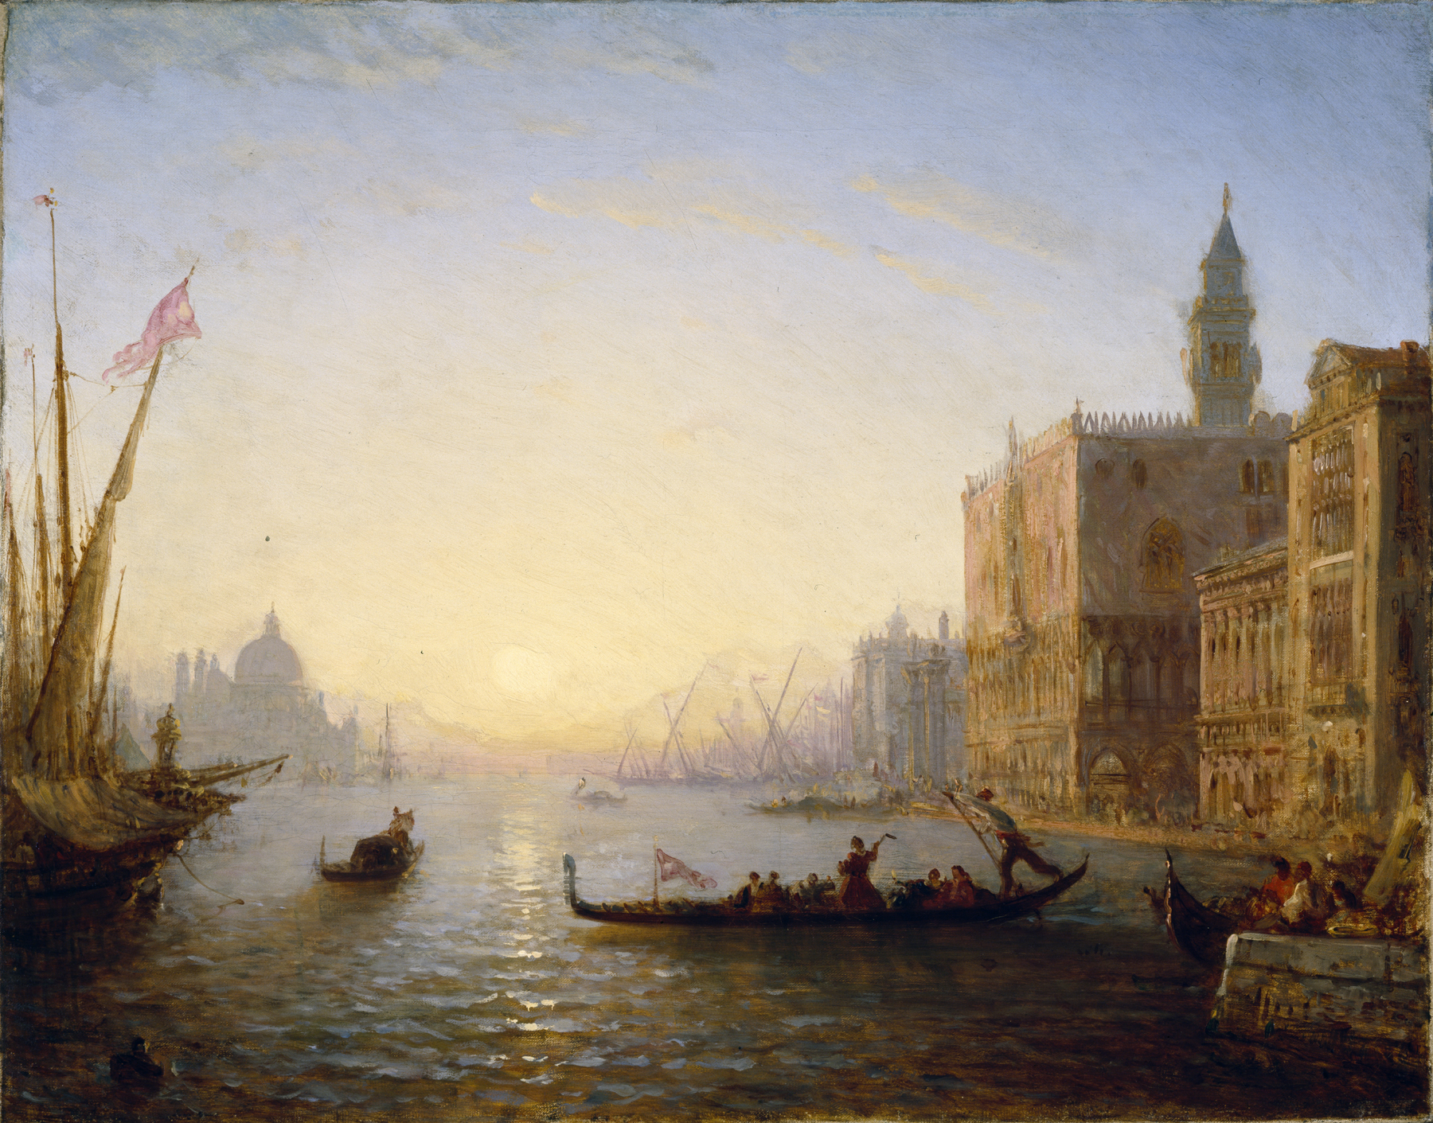
Venice, Evening, ca. 1865, Oil on Canvas, 43 x 55.5 cm, The Walters Art Museum, Baltomore, USA https://art.thewalters.org/detail/33761/venice-evening-2/

Slide 7
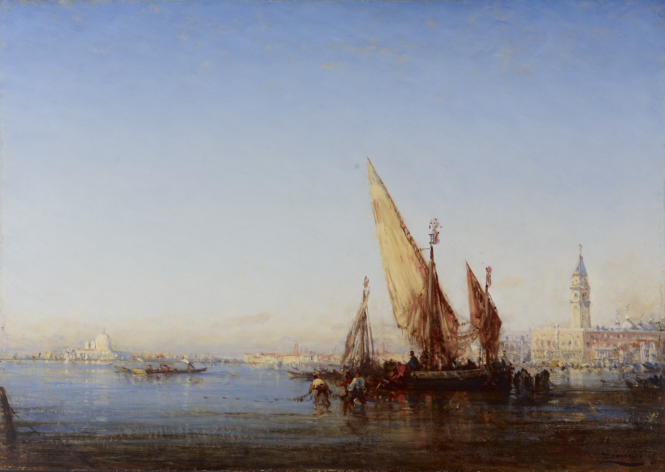
Venice, Midday, ca. 1868, Oil on Canvas, 42.23 x 59.4 cm, The Walters Art Museum, Baltomore, USA https://art.thewalters.org/detail/33607/venice-midday/

Slide 8
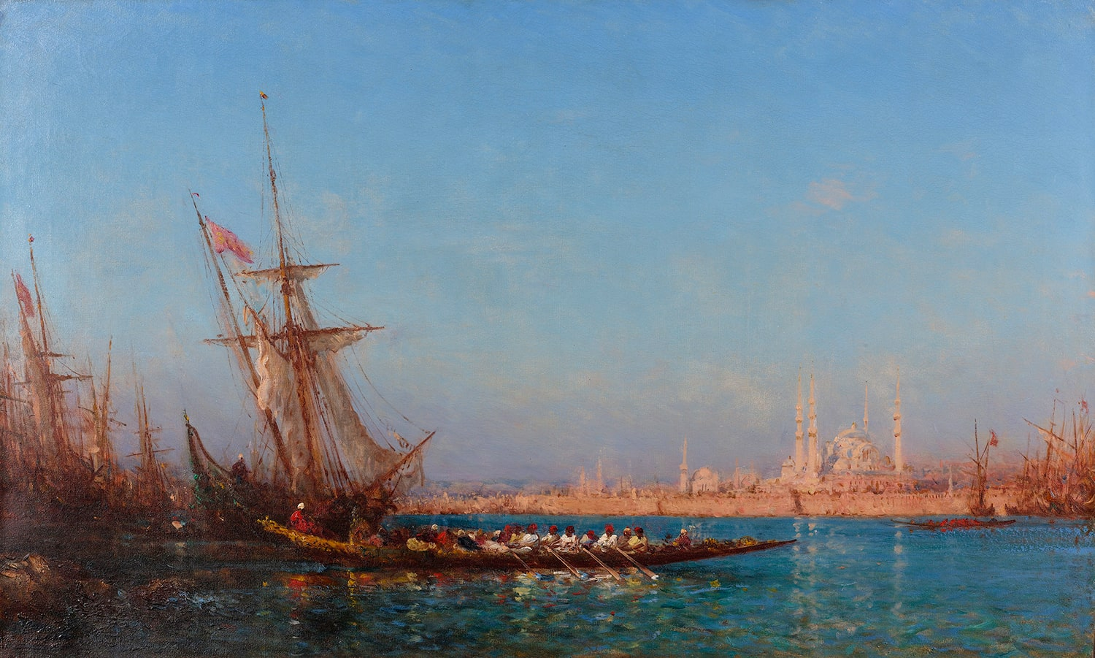
View of Istanbul, Date: Second half of the 19th century, Oil on Canvas, 69x113 cm, Suna and İnan Kıraç Foundation Orientalist Paintings Collection, Istanbul, Turkey https://www.peramuseum.org/blog/five-unmissable-istanbul-paintings-of-felix-ziem/1454

Slide 9
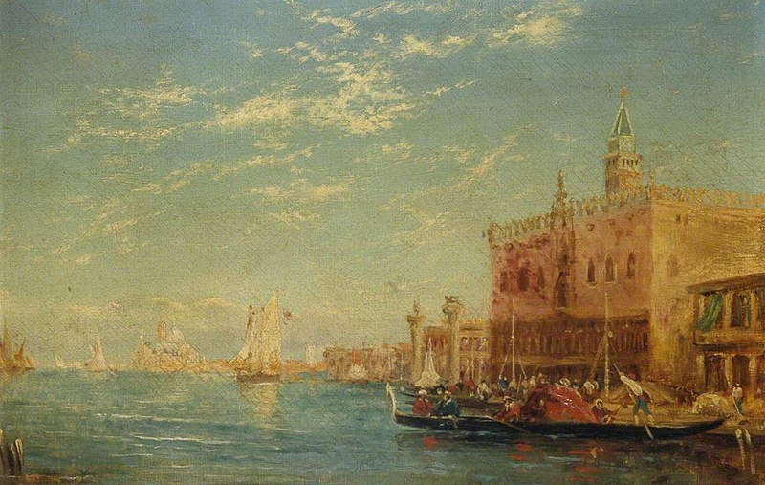
The Doge's Palace, Venice, Date: Second half of the 19th century, Oil on Canvas, 35x53, Brighton Museum, UK https://commons.wikimedia.org/wiki/File:F%C3%A9lix_Fran%C3%A7ois_Georges_Philibert_Ziem_%281821-1911%29_-_The_Doge%27s_Palace,_Venice_-_FAPM090024_-_Brighton_Museum_%5E_Art_Gallery.jpg

Slide 10
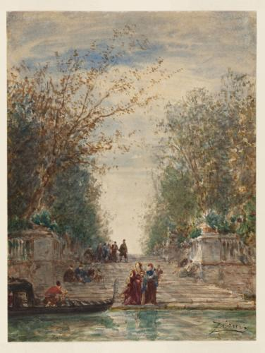
Venise, l'entrée du jardin français, Date: Second half of the 19th century, Watercolour on Paper, 26.9x20.2 cm, Musée des Beaux-Arts de la ville de Paris, France https://www.parismuseescollections.paris.fr/en/node/233680#infos-secondaires-detail

Slide 11
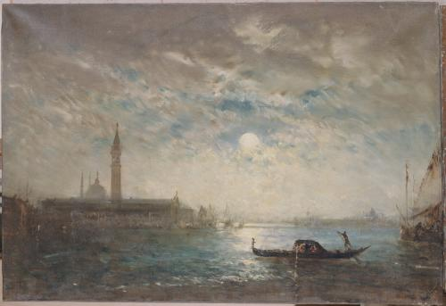
Venise, Vue de la Lagune éclairée par la pleine Lune,
1870-80, Oil on Canvas, 65.5x95.5 cm, Musée des Beaux-Arts de la ville de Paris, France https://www.parismuseescollections.paris.fr/en/node/226156#infos-secondaires-detail

Slide 12
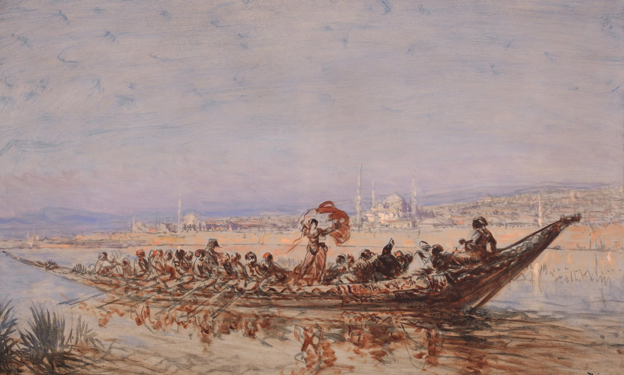
Dancer in a Caique,
1870 - 1880, Oil on Wood, 69 x 113 cm, Musée Ziem Collection, instanbul, Turkey https://www.peramuseum.org/blog/five-unmissable-istanbul-paintings-of-felix-ziem/1454

Slide 13
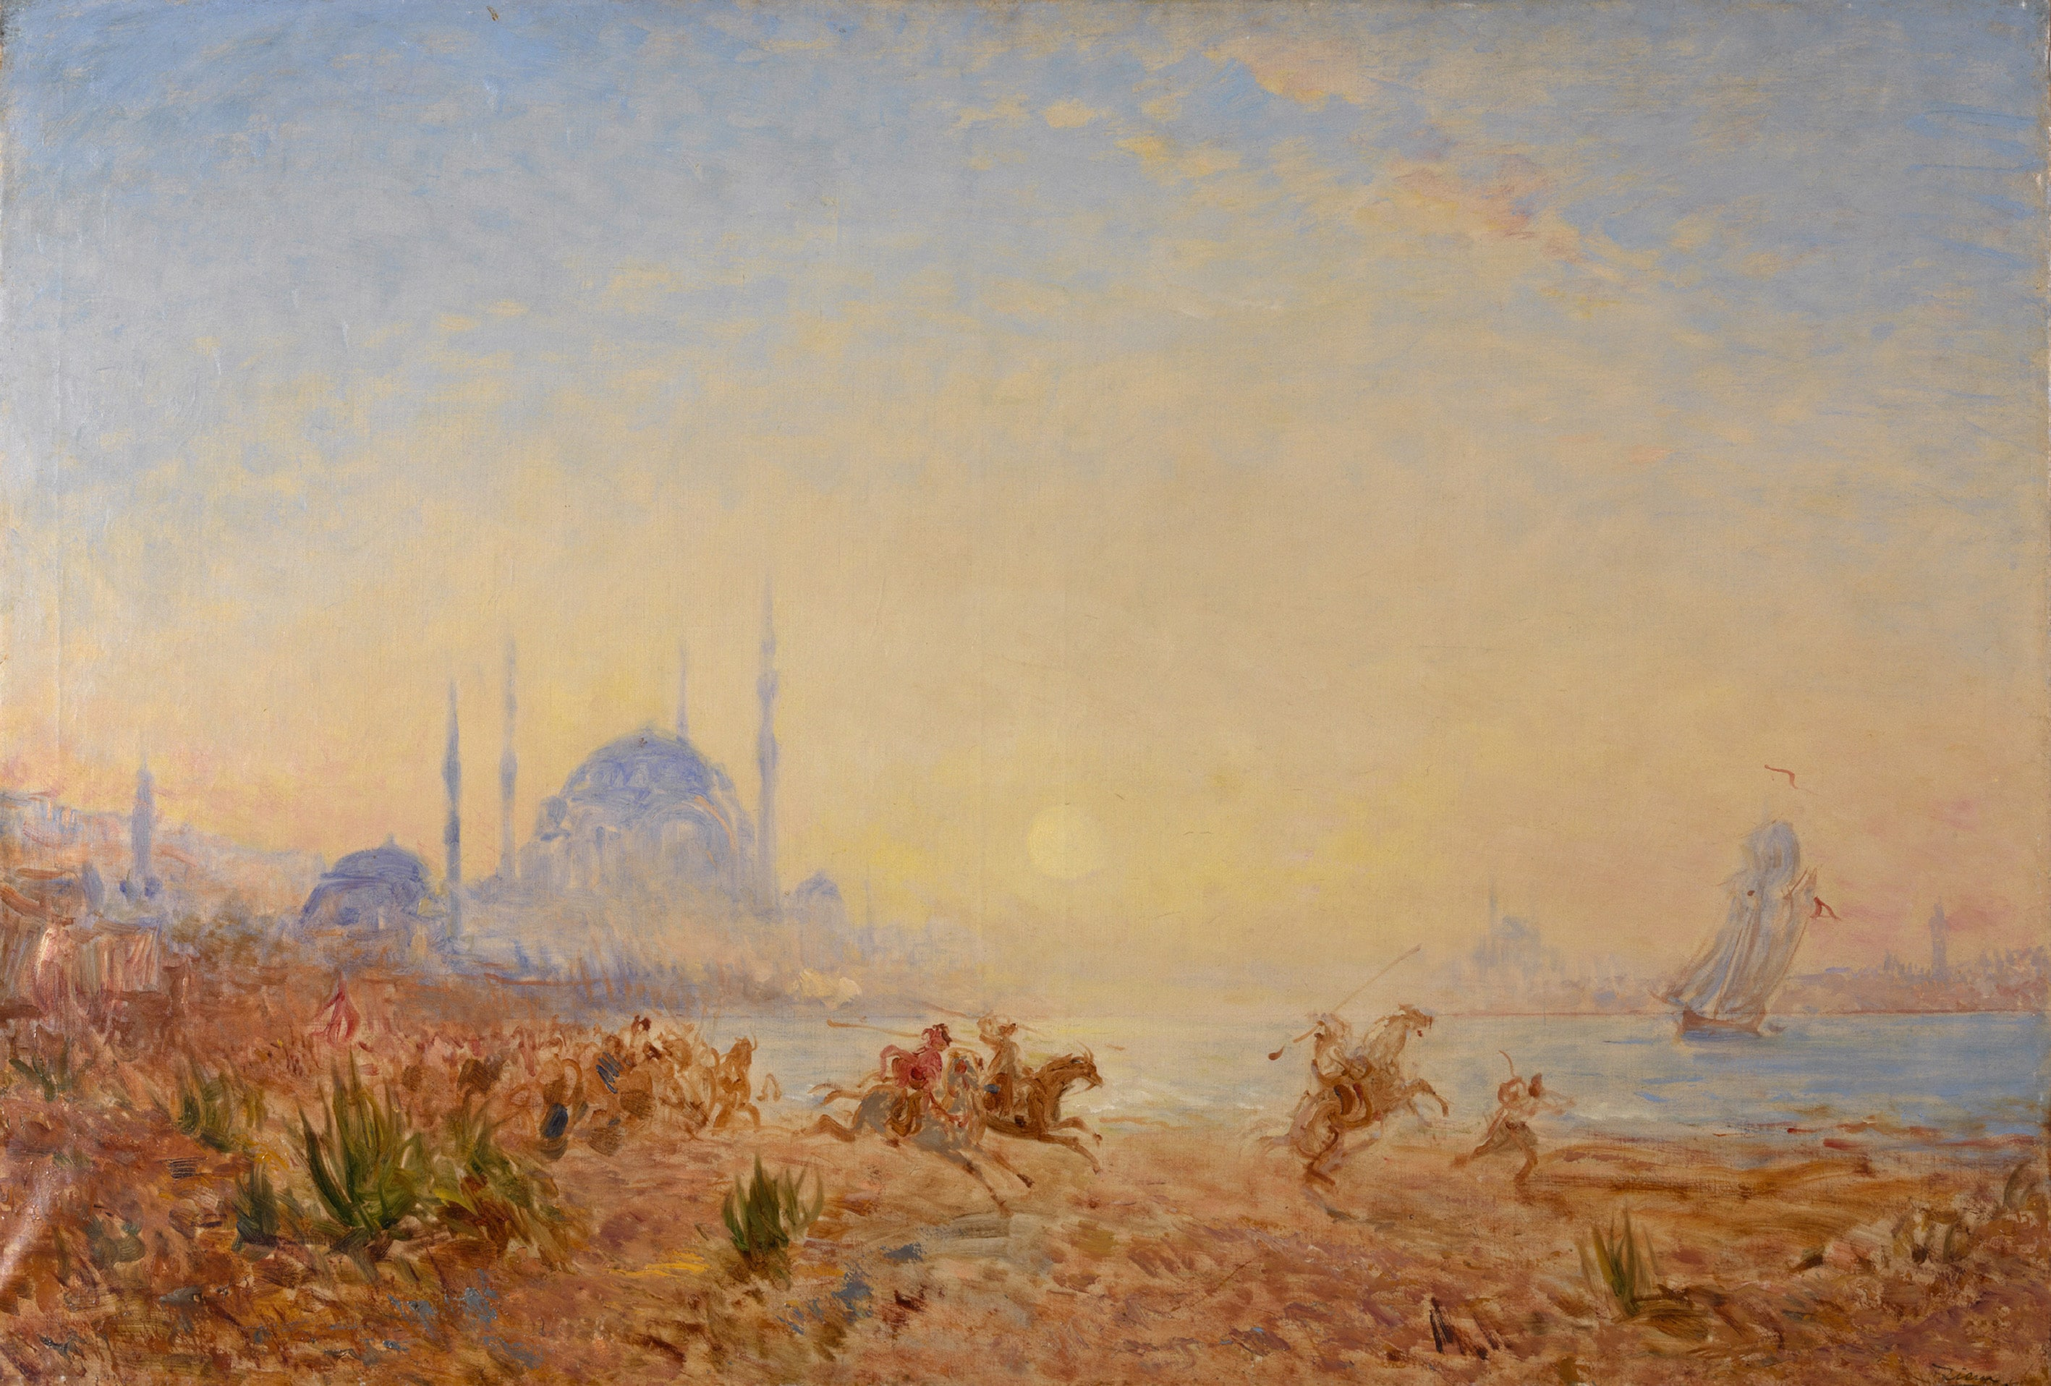
Constantinople, Fantasia, 1880 -1890, Oil on Canvas, 83 x 120 cm, Musée Ziem Collection, Istanbul, Turkey https://www.peramuseum.org/blog/five-unmissable-istanbul-paintings-of-felix-ziem/1454

Slide 14
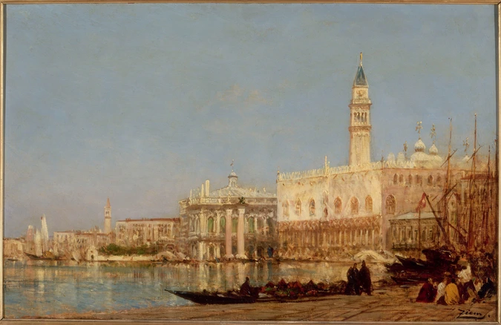
Venice, the Doge's Palace, between 1880 and 1890, Oil on Canvas, 54.5x85.6 cm, Musée d'Orsay, Paris, France https://www.musee-orsay.fr/fr/oeuvres/venise-le-palais-des-doges-812

Slide 15
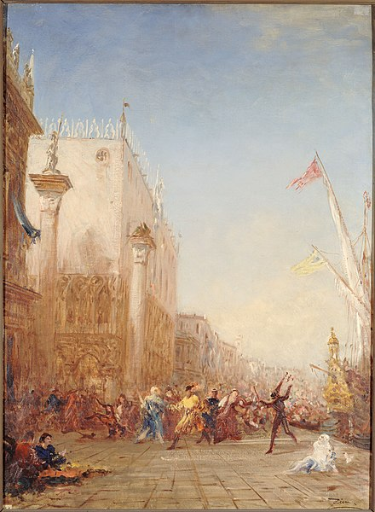
Carnaval à Venise, quai des Esclavons, Date: n.d., Oil on Canvas, 117x94 cm, Musée des Beaux-Arts de la ville de Paris, France https://fr.m.wikipedia.org/wiki/Fichier:F%C3%A9lix_Ziem_-_Carnaval_%C3%A0_Venise,_quai_des_Esclavons_-_PPP233_-_Mus%C3%A9e_des_Beaux-Arts_de_la_ville_de_Paris.jpg

Slide 16
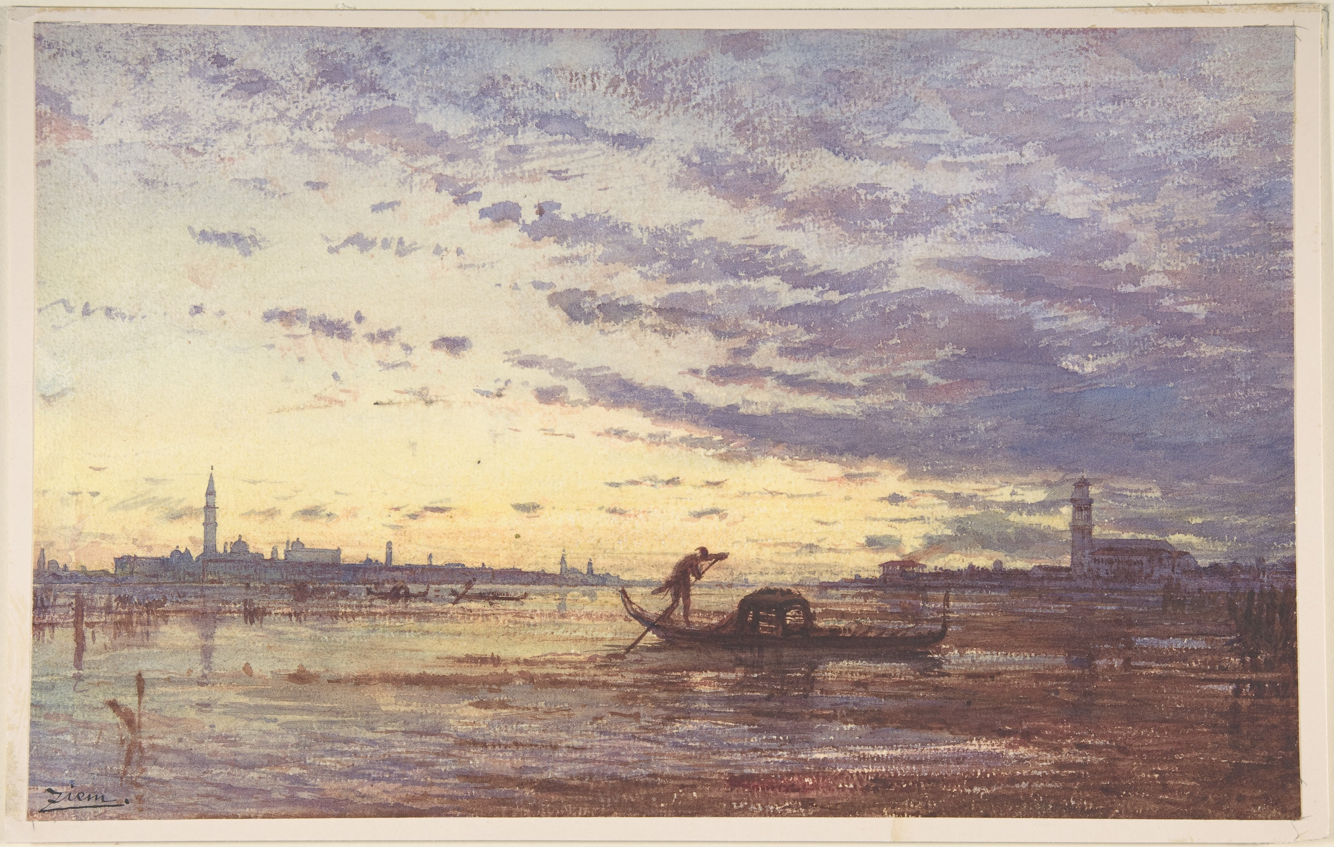
Venice,
Date: n.d., Watercolour, 20.3x32.4 cm, the MET, NY, USA https://www.metmuseum.org/art/collection/search/339860

Slide 17
The End

