Slide 1
American Art during the 19th century
The Hudson River School
Martin Johnson Heade 1819-1904
10 Paintings

Slide 2
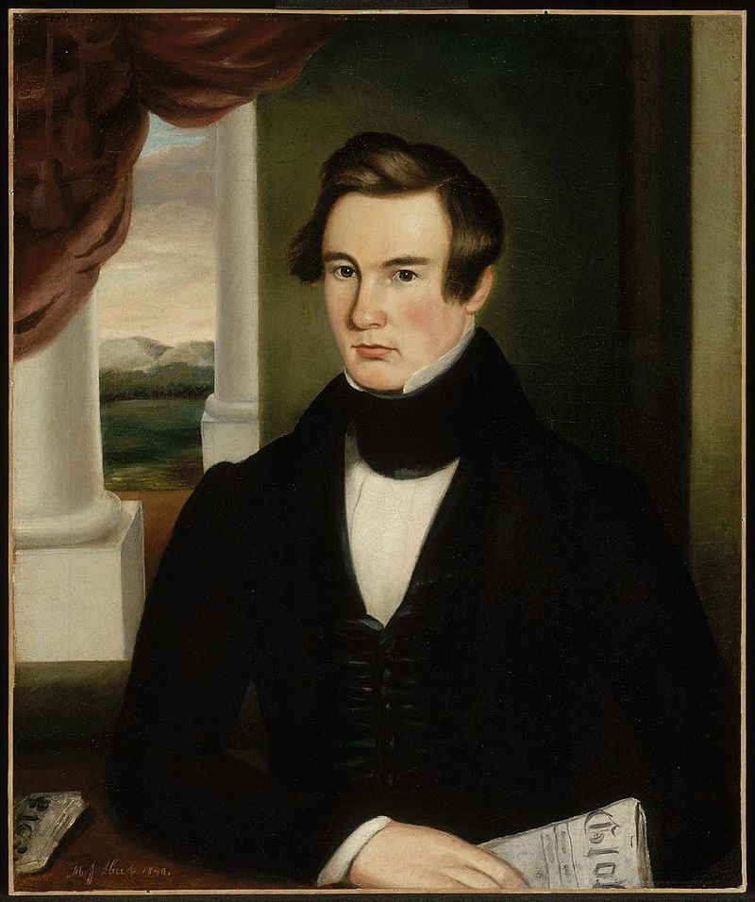
Portrait of a Man, 1840, Oil on Canvas, 76.52 x 63.82 cm, Museum of Fine Arts Boston, MA, USA https://commons.wikimedia.org/wiki/File:MJ_Heade_Portrait_of_a_Man,_1840.jpg

Slide 3
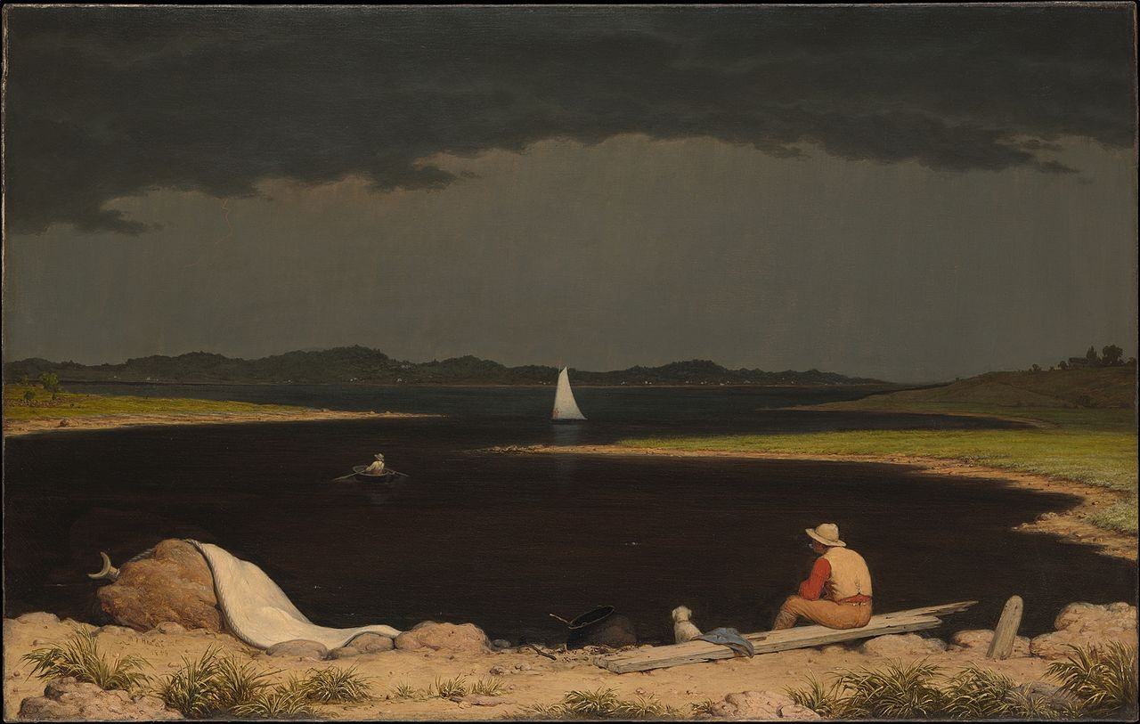
Approaching Thunderstorm, 1859, Oil on Canvas, 71.1 x 111.8cm, the MET, NY, USA https://commons.wikimedia.org/wiki/File:Approaching_Thunder_Storm_MET_DP248013.jpg

Slide 4
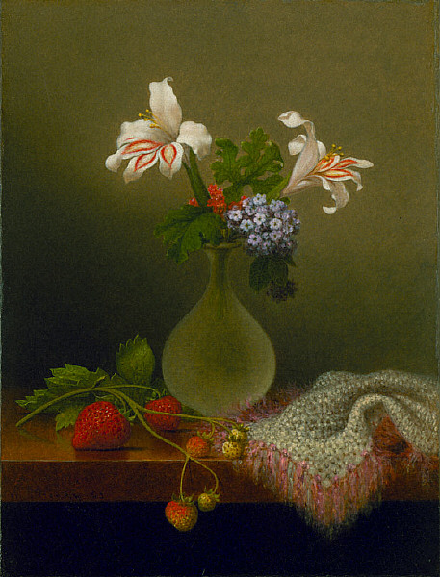
A Vase of Corn Lilies and Heliotrope, 1863, Oil on Canvas, 41.6x31.4 cm, Saint Louis Art Museum, USA https://commons.wikimedia.org/wiki/File:Martin_Johnson_Heade_-_A_Vase_of_Corn_Lilies_and_Heliotrope.jpg

Slide 5
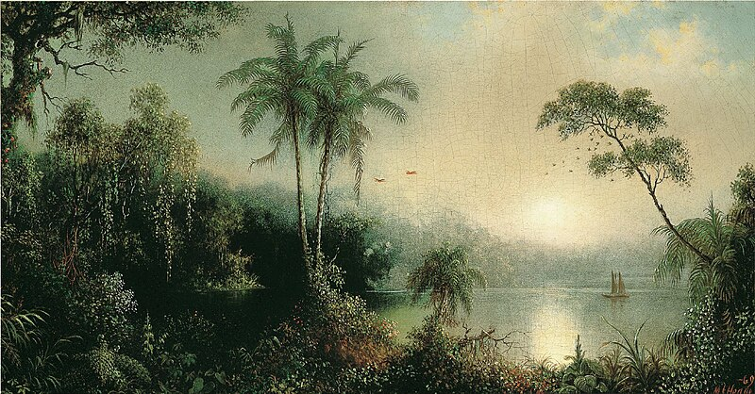
Sunrise in Nicaragua, 1869, Oil on Canvas, 38.7x73 cm, Thyssen-Bornemisza Museum, Madrid, Spain https://commons.wikimedia.org/wiki/File:Martin_Johnson_Heade_-_Sunrise_in_Nicaragua.jpg

Slide 6
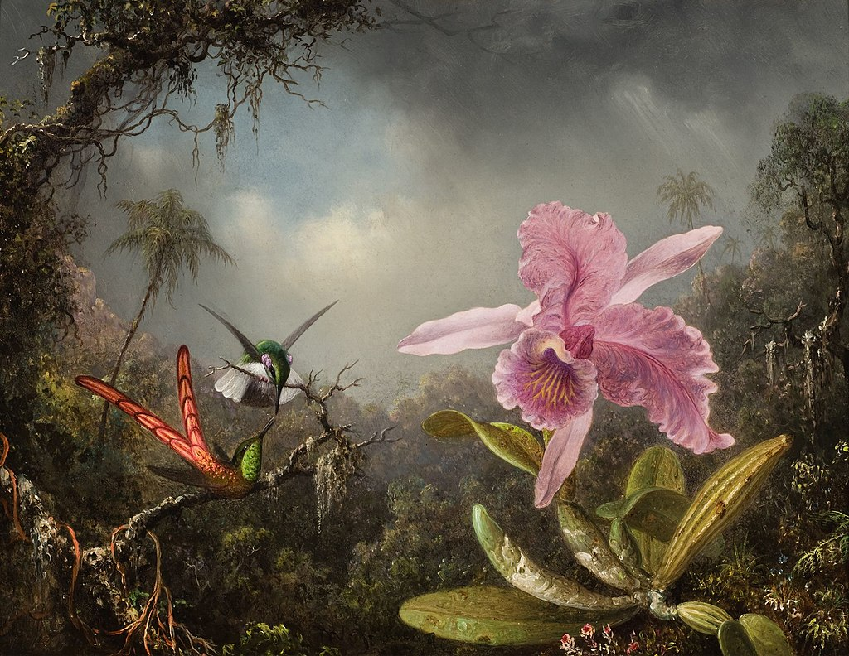
Orchid with Two Hummingbirds, 1871, Oil on Panel, 37.8x48.3 cm, Reynolda House Museum of American Art, North Carolina, USA https://commons.wikimedia.org/wiki/File:Orchid_with_Two_Hummingbirds_1871.jpeg

Slide 7
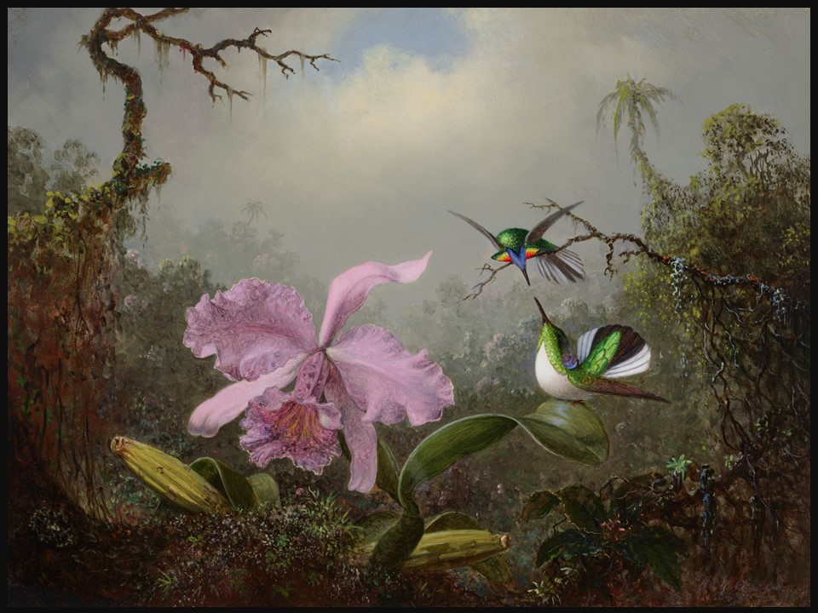
Cattleya Orchid with Two Brazilian Hummingbirds, 1871, Oil on Panel, 34.9 x 45.7 cm, Private Collection https://www.christies.com/lot/lot-6465936?ldp_breadcrumb=back&intObjectID=6465936&from=salessummary&lid=1

Slide 8
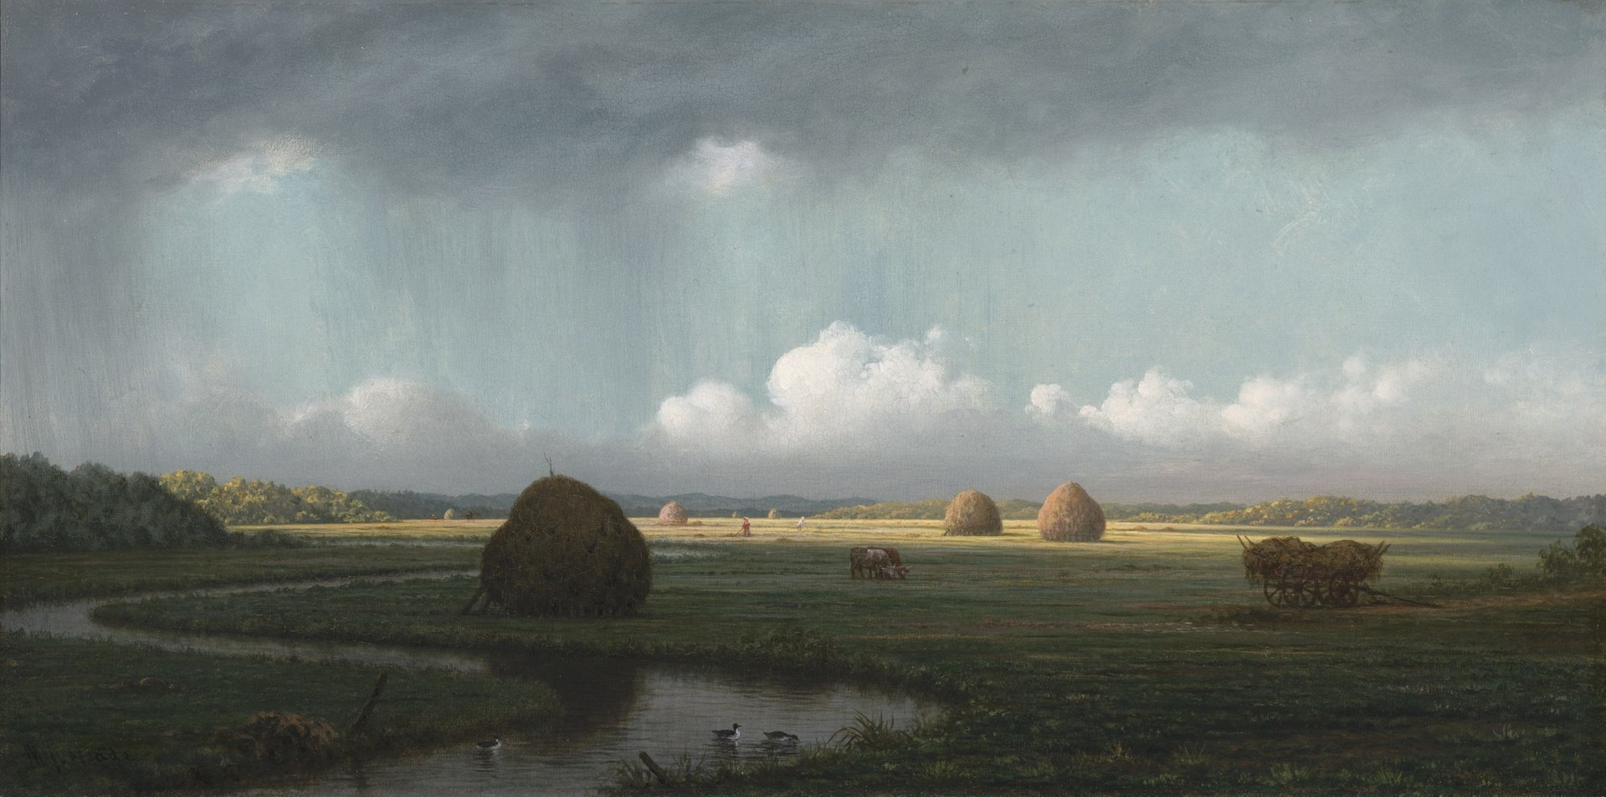
Sudden Showers, Newbury Marshes, circa 1865-1875, Oil on Canvas, 33.6x66.8 cm, Yale University Art Gallery, USA https://commons.wikimedia.org/wiki/File:Sudden_Shower_Newbury_Marshes_by_Martin_Johnson_Heade.jpeg

Slide 9
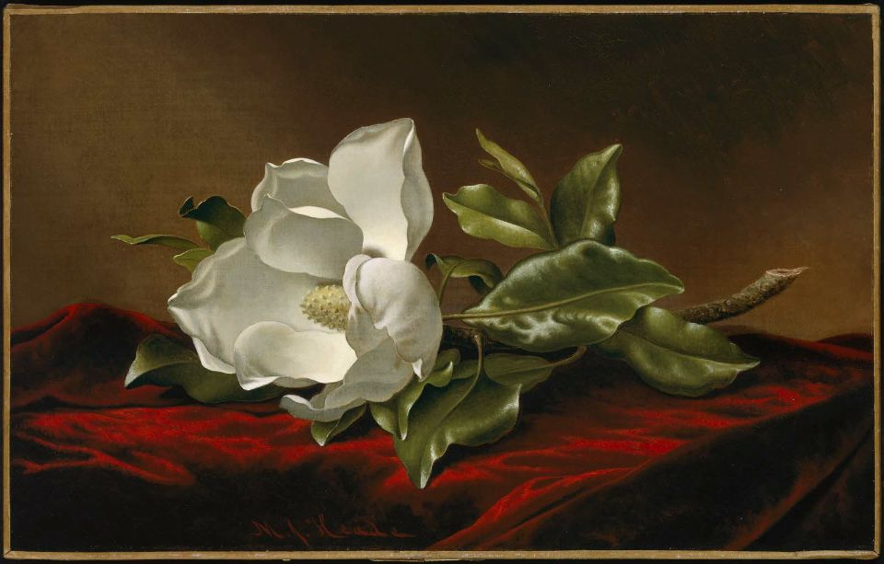
Magnolia Grandiflora, between 1885 and 1895, Oil on Canvas, 38.42 x 61.28 cm,
Museum of Fine Arts, Boston, USA https://commons.wikimedia.org/wiki/File:MJ_Heade_Magnolia_Grandiflora_1885-1895.jpg

Slide 10
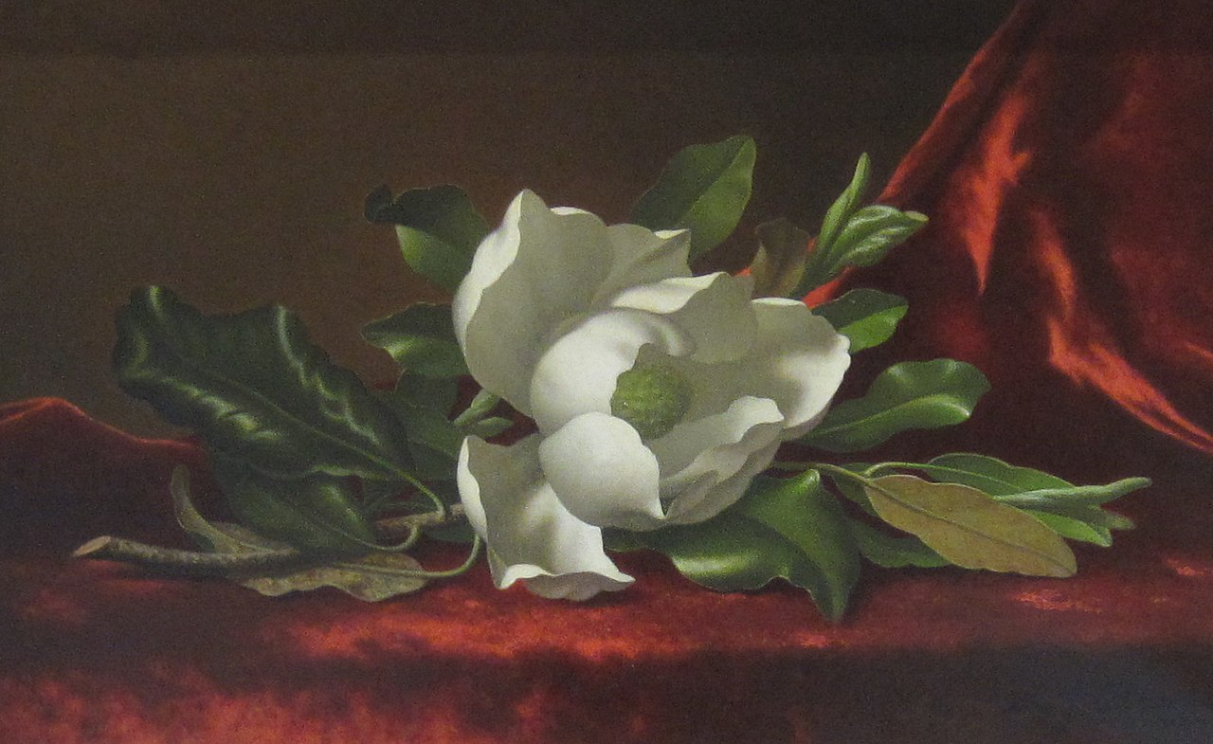
The Magnolia Blossom, 1880s, Oil on Canvas, 38.4x61.2 cm, Timken Museum of Art, CA, USA https://commons.wikimedia.org/wiki/File:San_Diego,_2016_-_416_(cropped).jpg

Slide 11
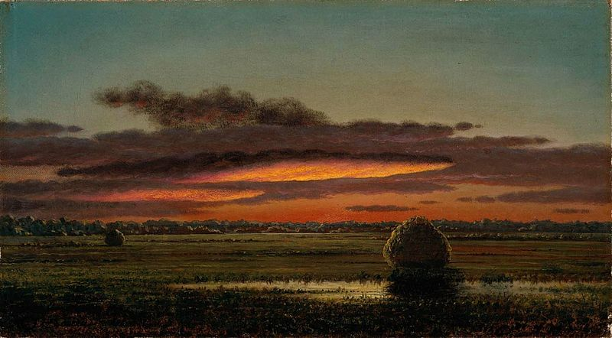
Sunset over the Marshes, circa 1890–1904, Oil on Canvas, 26x46.3 cm, Museum of Fine Arts, Boston, USA https://commons.wikimedia.org/wiki/File:MJ_Heade_Sunset_Over_the_Marshes_1890-1904.jpg

Slide 12
The END

