Slide 1
Fra Angelico - Guido di Piero di Gino
1395-1455

Slide 2
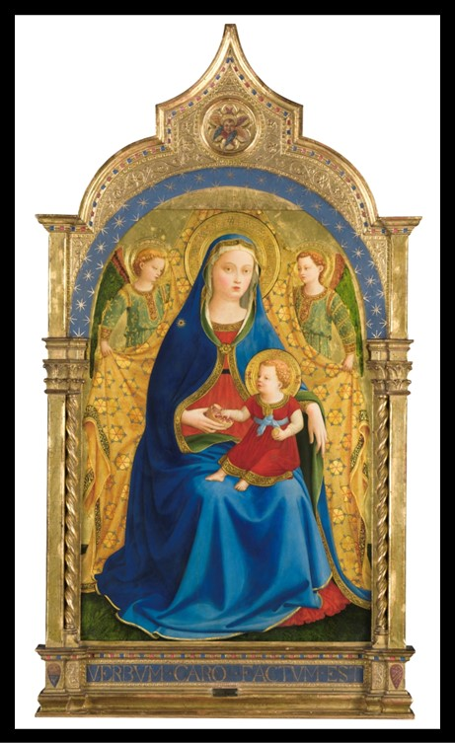
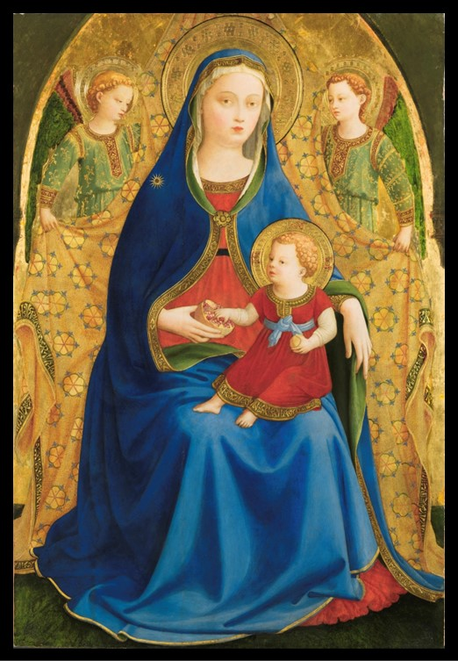
The Virgin with the Pomegranate, ca. 1426, Tempera on Panel, 87x59 cm, Prado Museum, Madrid, Spain https://www.museodelprado.es/en/the-collection/art-work/the-virgin-with-the-pomegranate/61b654df-1de2-483f-88bb-404f37747d4a?searchid=55f3ec41-7c92-bebf-e83c-b0e5c7f74a9f

Slide 3
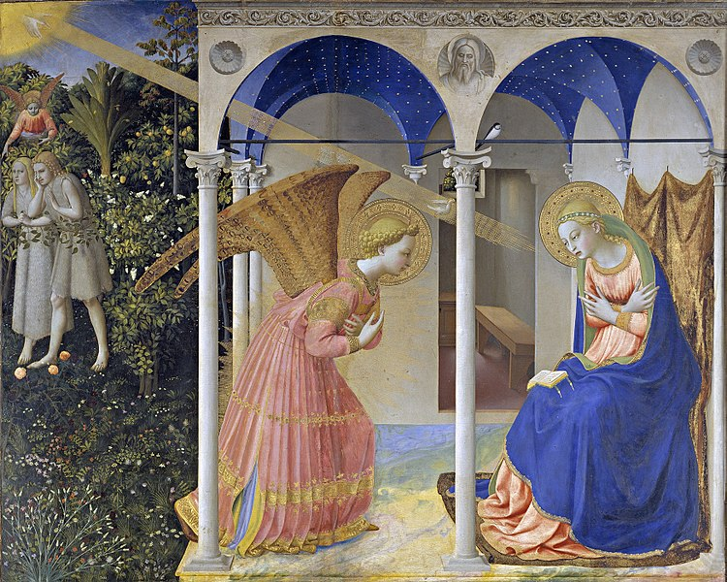
The Annunciation, between 1425 and 1428, Témpera on panel,, 194x194 cm, Prado Museum, Madrid, Spain https://commons.wikimedia.org/wiki/File:La_Anunciaci%C3%B3n,_de_Fra_Angelico.jpg

Slide 4
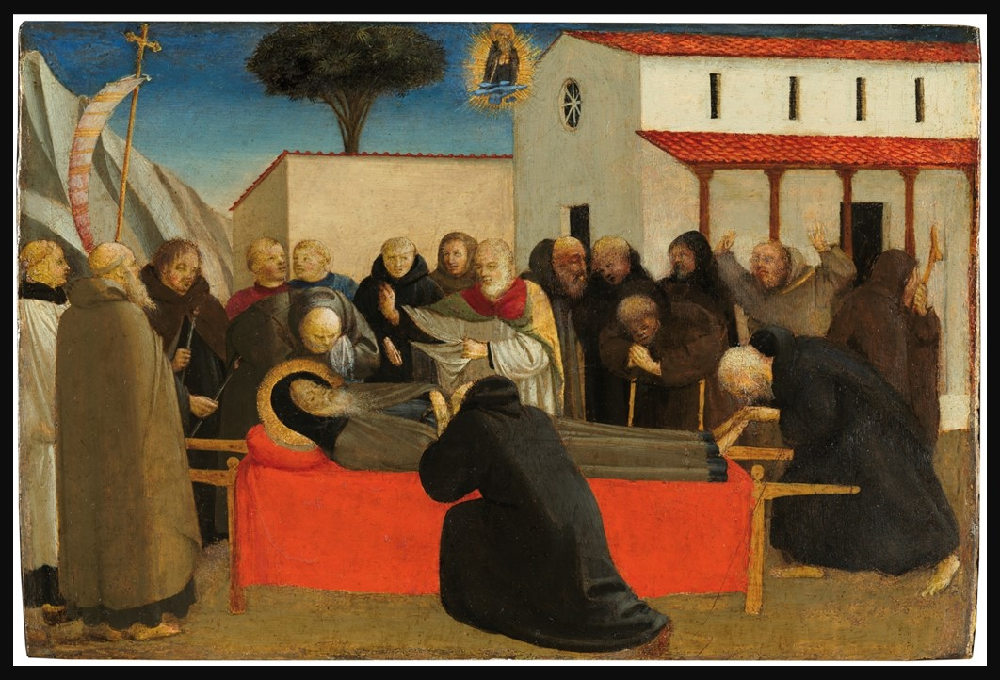
The Funeral of Saint Anthony Abbot, 1426 – 1430, Tempera on Poplar panel, 19.7x29.3cm, Prado Museum, Madrid, Spain https://www.museodelprado.es/en/the-collection/art-work/the-funeral-of-saint-anthony-abbot/1af1dc35-845c-43d3-b701-f5f9747e3113

Slide 5
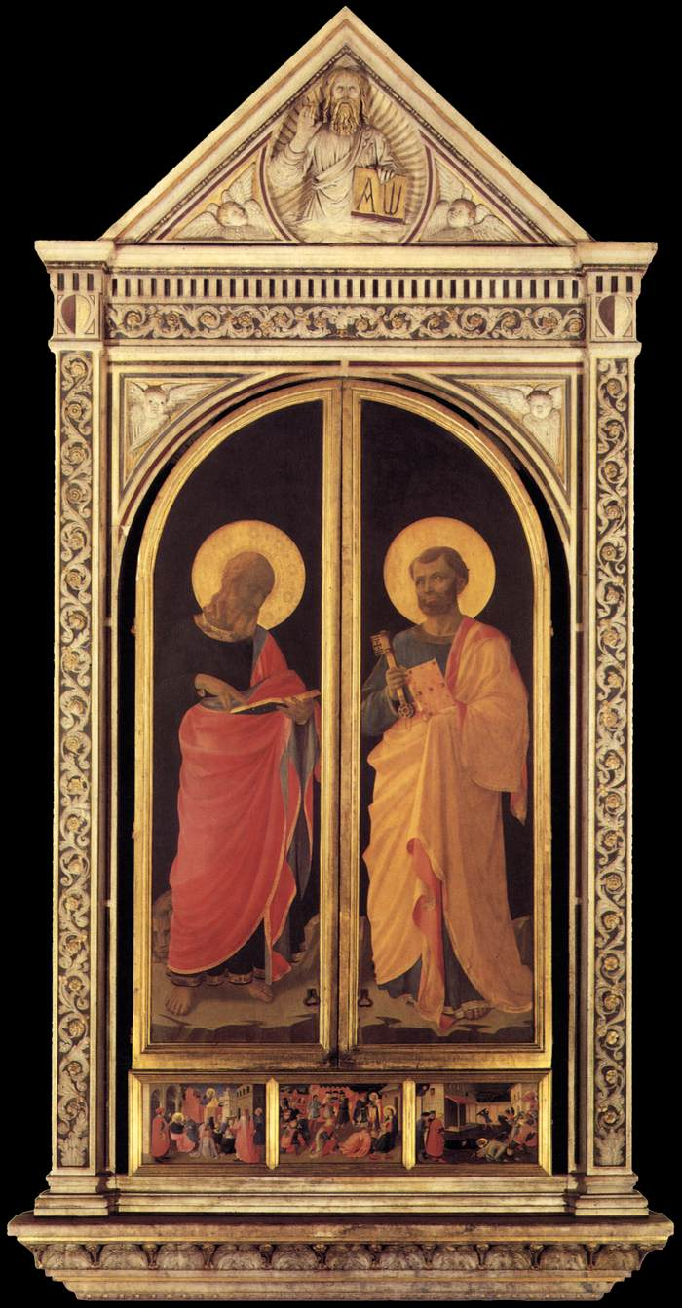
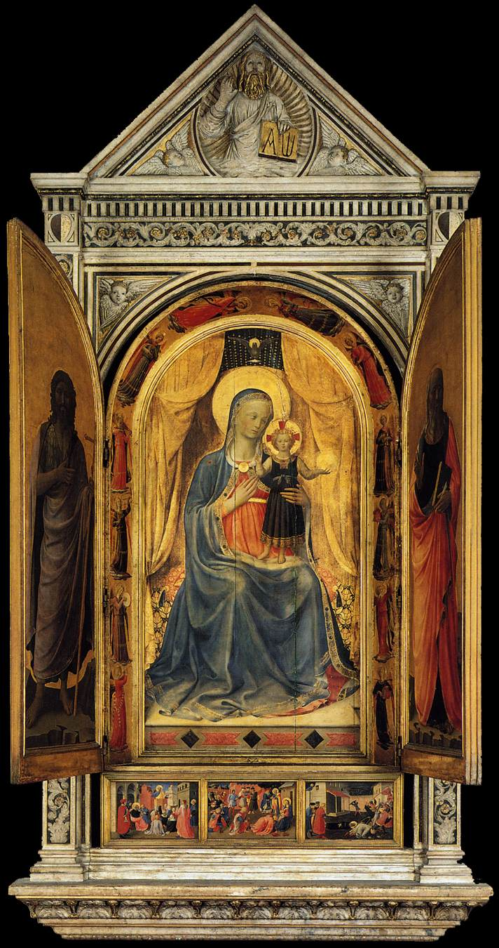
Linaioli Tabernacle, c. 1433, Tempera on panel, 260 x 330 cm, Museo di San Marco, Florence, Italy https://www.wga.hu/frames-e.html?/html/a/angelico/index.html

Slide 6
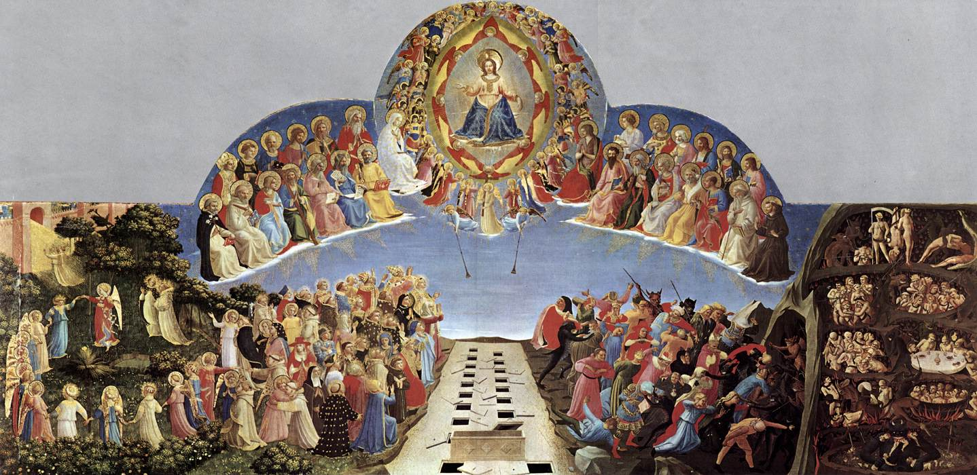
Last Judgment, c. 1431, Tempera on panel, 105 x 210 cm, Museo di San Marco, Florence, Italy https://www.wga.hu/frames-e.html?/html/a/angelico/index.html

Slide 7
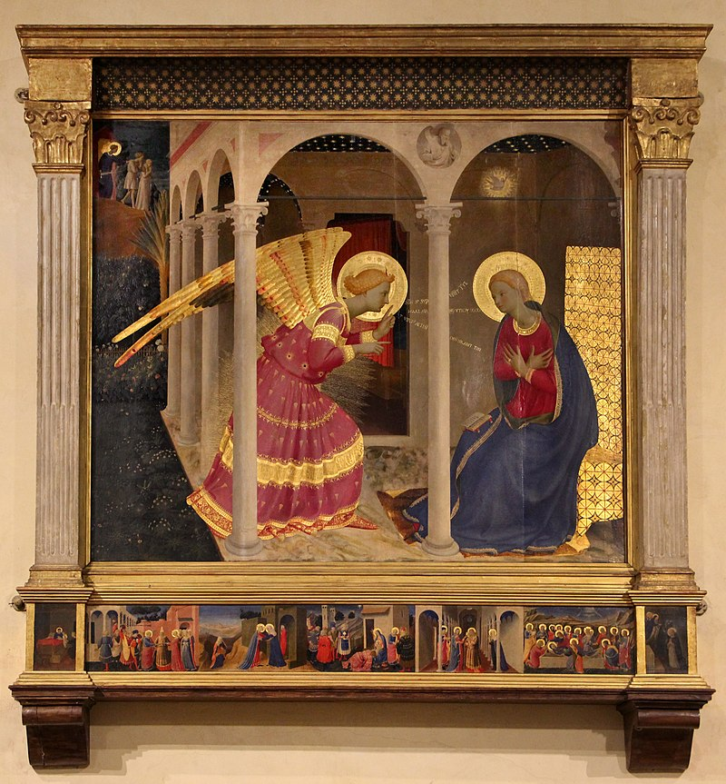
Annunciation, 1433-34, Tempera on wood, 175 x 180 cm, Museo Diocesano, Cortona, Italy https://en.wikipedia.org/wiki/Annunciation_of_Cortona#/media/File:Beato_angelico,_annunciazione_di_cortona,_1434-36,_da_s._domenico,_01.jpg

Slide 8
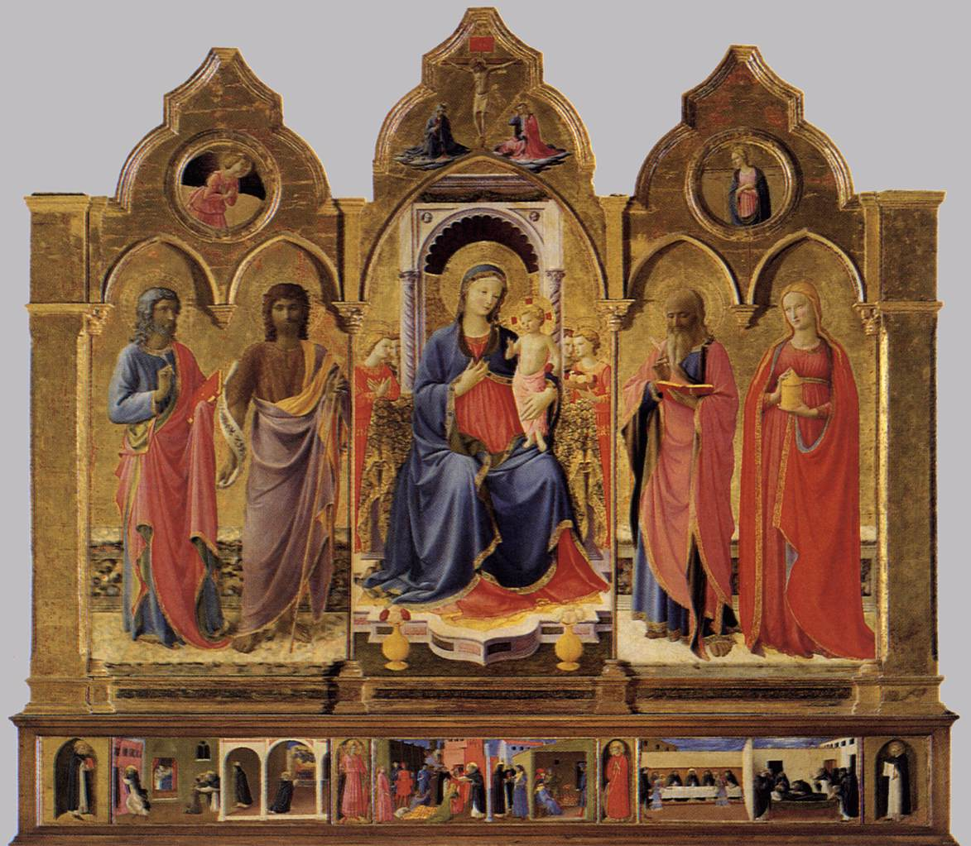
Cortona Polyptych, c. 1437, Tempera and gold on panel, 218 x 240 cm, Museo Diocesano, Cortona, Italy https://www.wga.hu/frames-e.html?/html/a/angelico/index.html

Slide 9
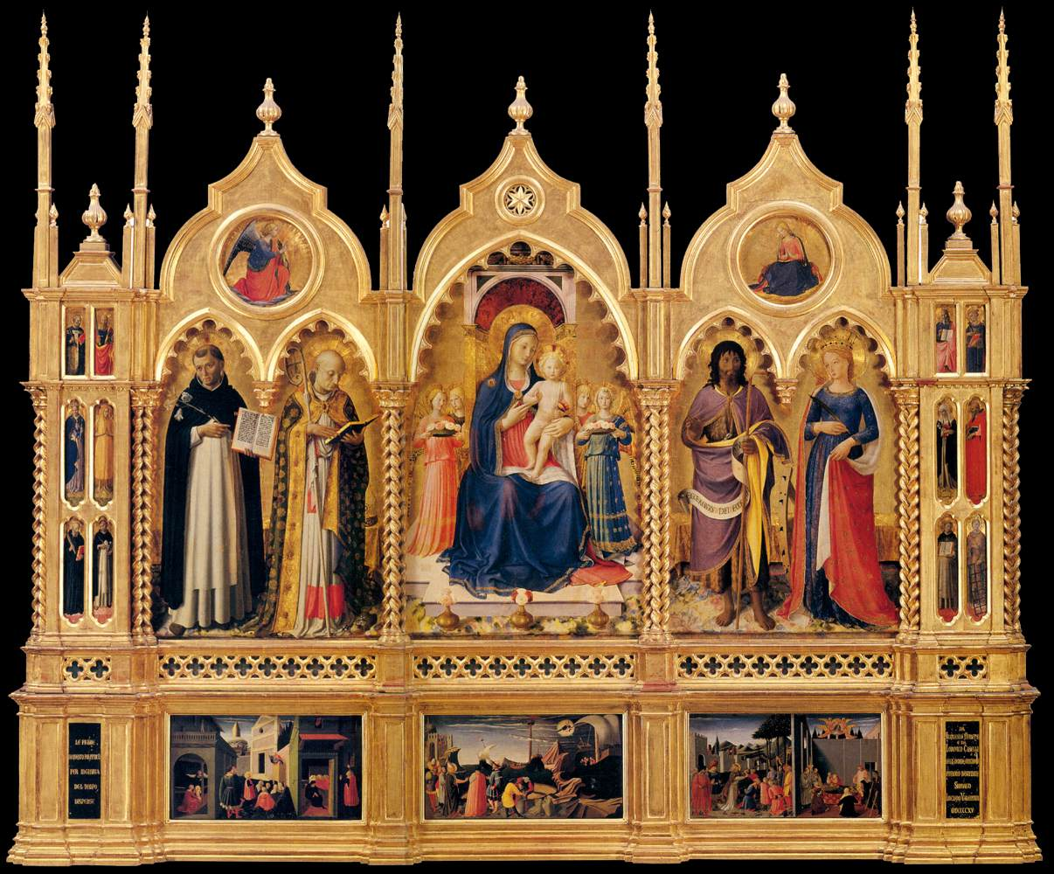
Perugia Altarpiece, 1447-48, Tempera and gold on panel, Galleria Nazionale dell'Umbria, Perugia, Italy https://www.wga.hu/frames-e.html?/html/a/angelico/index.html

Slide 10
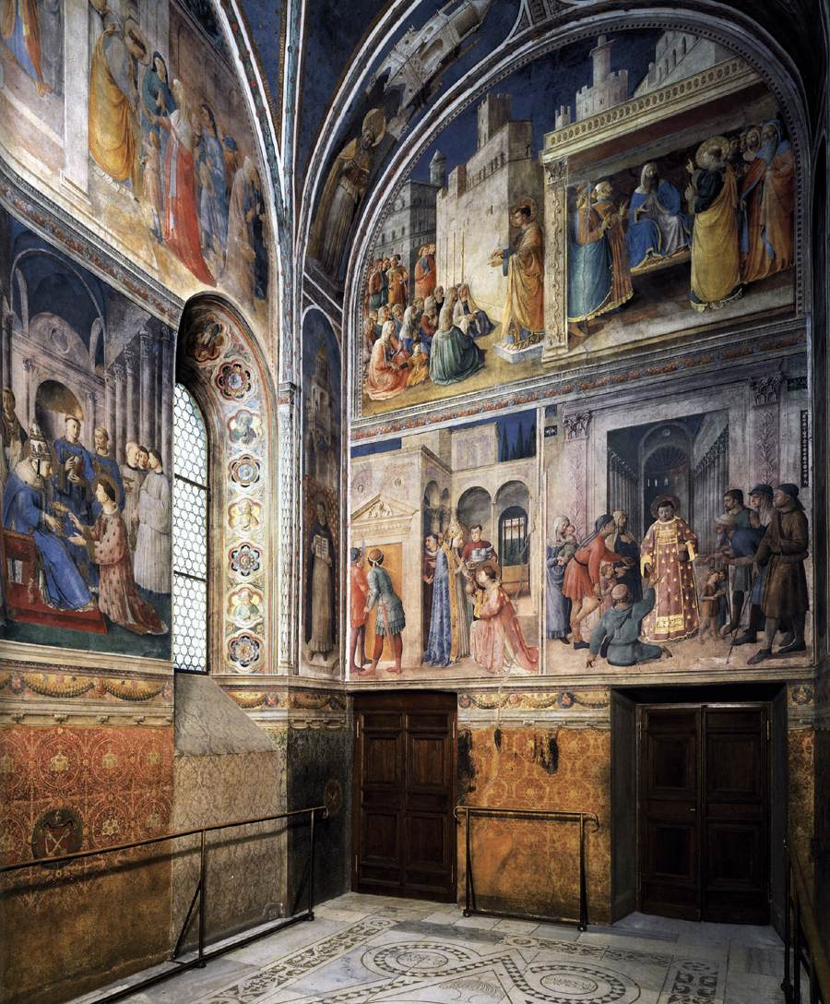
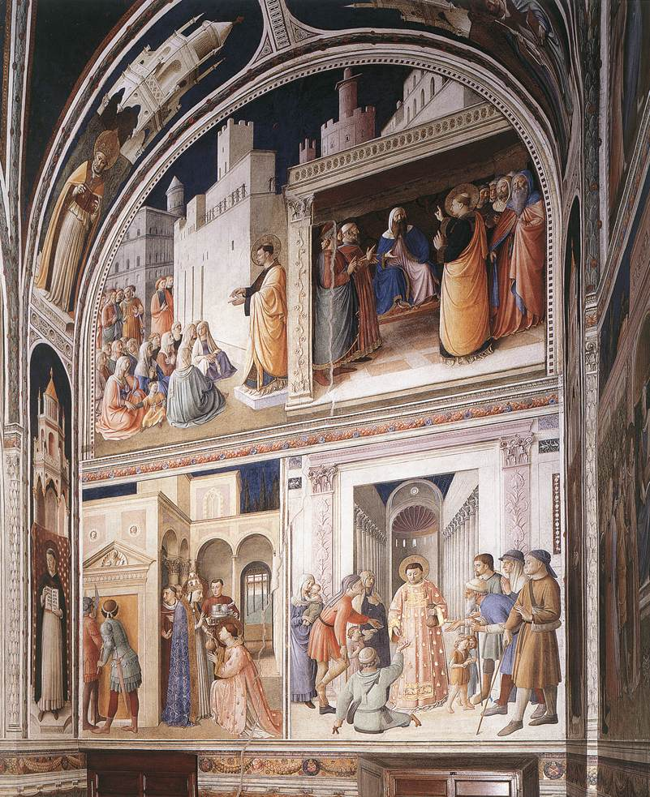
Scenes from the Lives of Sts Lawrence and Stephen
1447-49
Fresco
Cappella Niccolina, Palazzi Pontifici, Vatican https://www.wga.hu/frames-e.html?/html/a/angelico/index.html

Slide 11
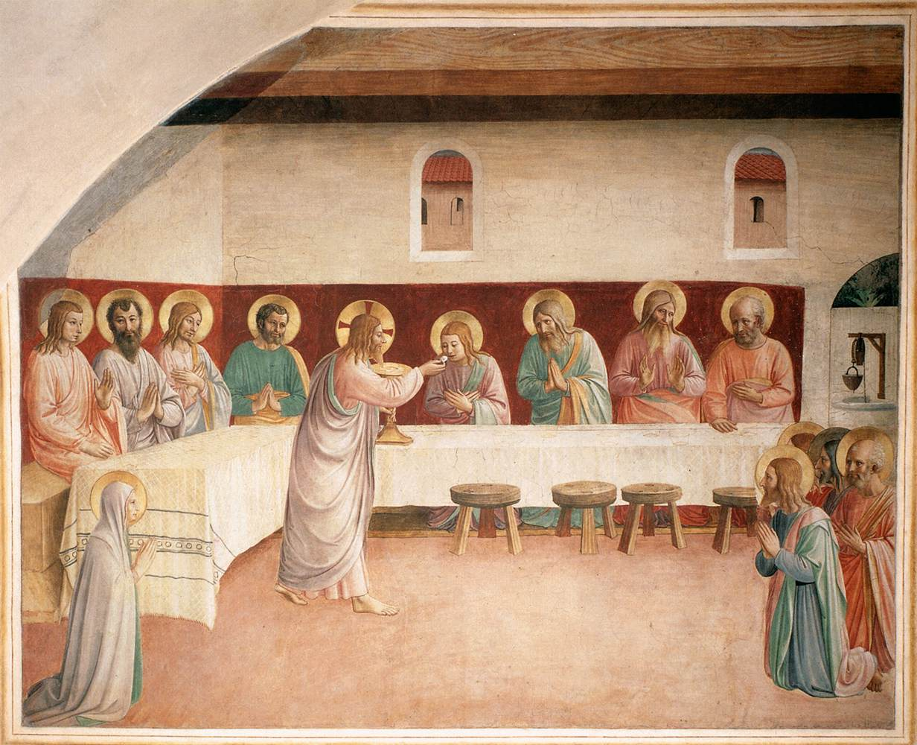
Institution of the Eucharist (Cell 35)
1441-42
Fresco, 186 x 234 cm
Convento di San Marco, Florence https://www.wga.hu/frames-e.html?/html/a/angelico/index.html

Slide 12
THE END

