Slide 1
Tullio Lombardo
ca. 1455–1532
13 Masterpieces

Slide 2
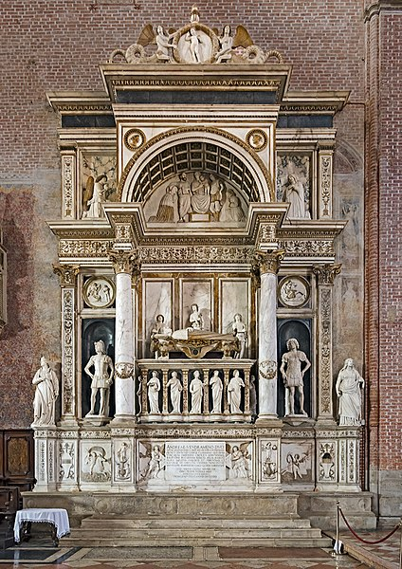
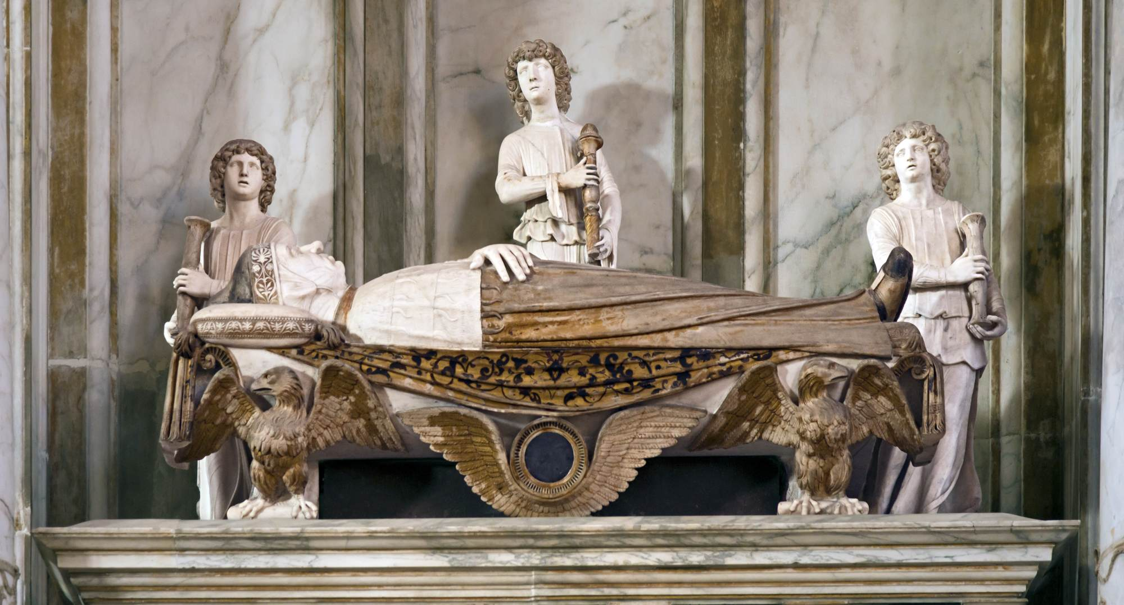
Monument of Andrea Vendramin, 1480-95, Marble, Basilica dei Santi Giovanni e Paolo, Venice, Italy https://commons.wikimedia.org/wiki/File:Monument_to_doge_Andrea_Vendramin.jpg and https://www.wga.hu/html_m/l/lombardo/tullio/1vendra3.html

Slide 3
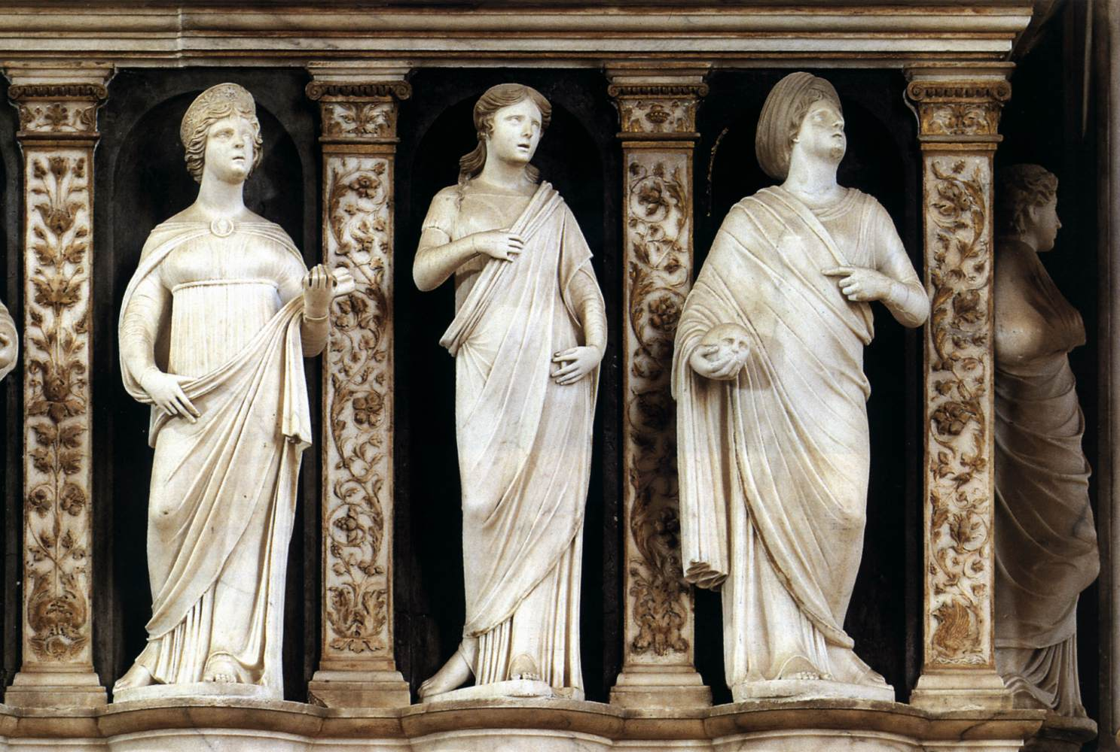
https://www.wga.hu/frames-e.html?/html/l/lombardo/tullio/2adam.html

Slide 4
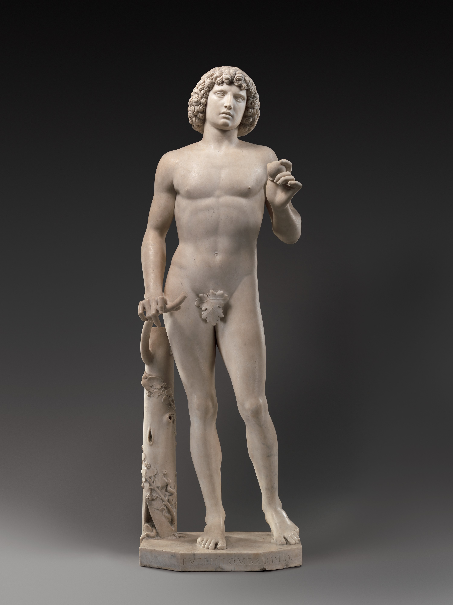
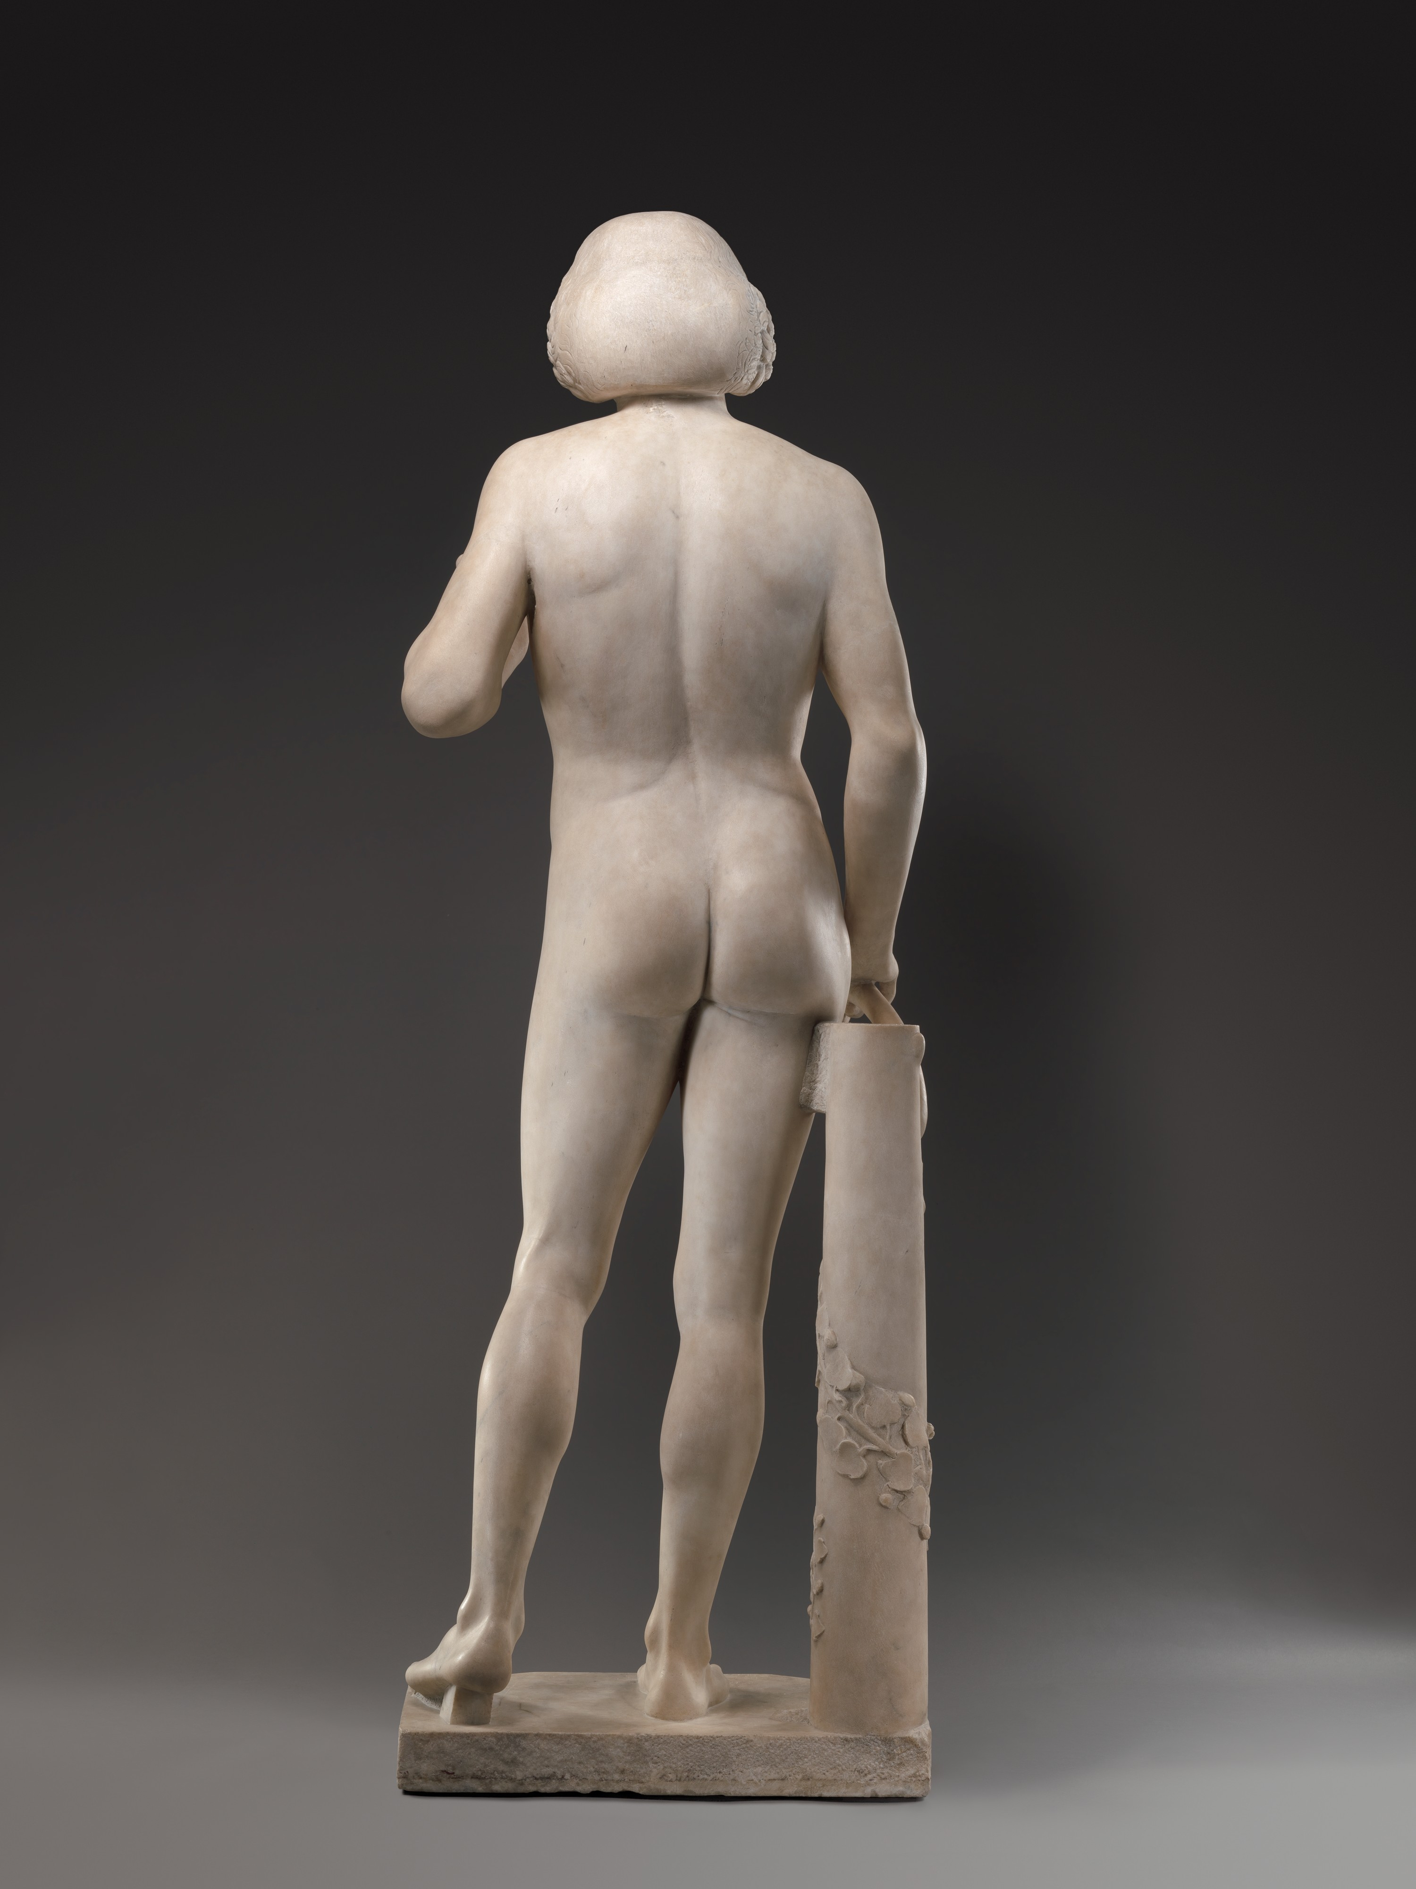
Adam, ca. 1490–95, Marble, Height: 191.8 cm, the MET, NY, USA https://www.metmuseum.org/art/collection/search/197822

Slide 5
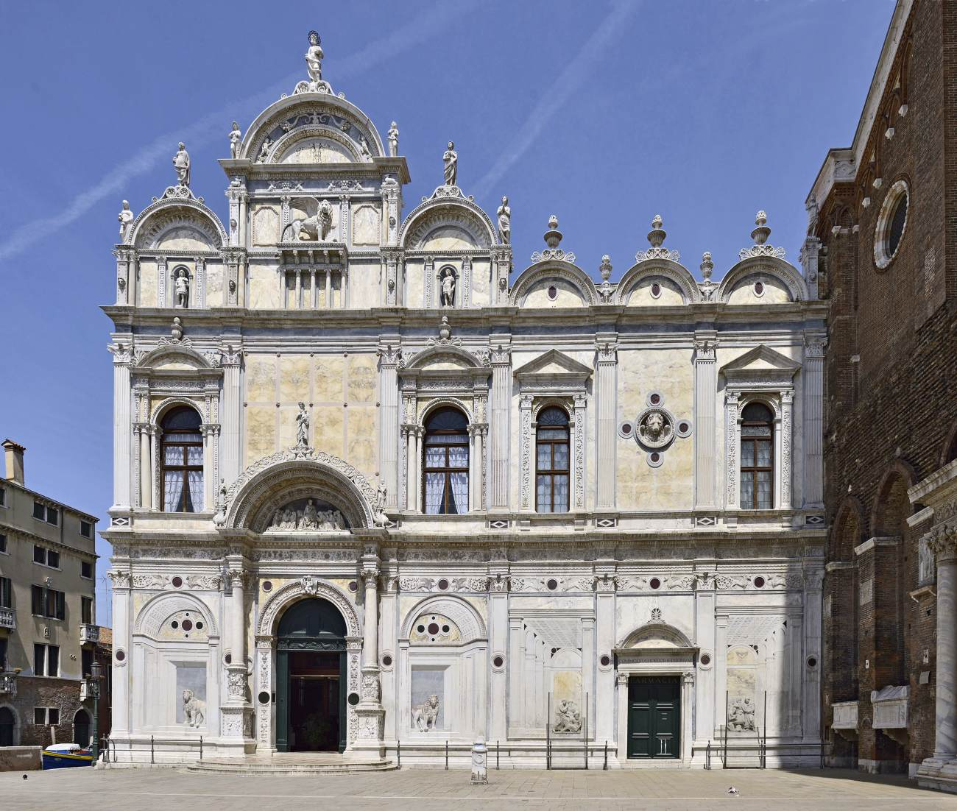
Scuola Grande di San Marco: Façade, begun 1489, Campo San Giovanni e Paolo, Venice, Italy https://www.wga.hu/frames-e.html?/html/l/lombardo/tullio/2adam.html

Slide 6
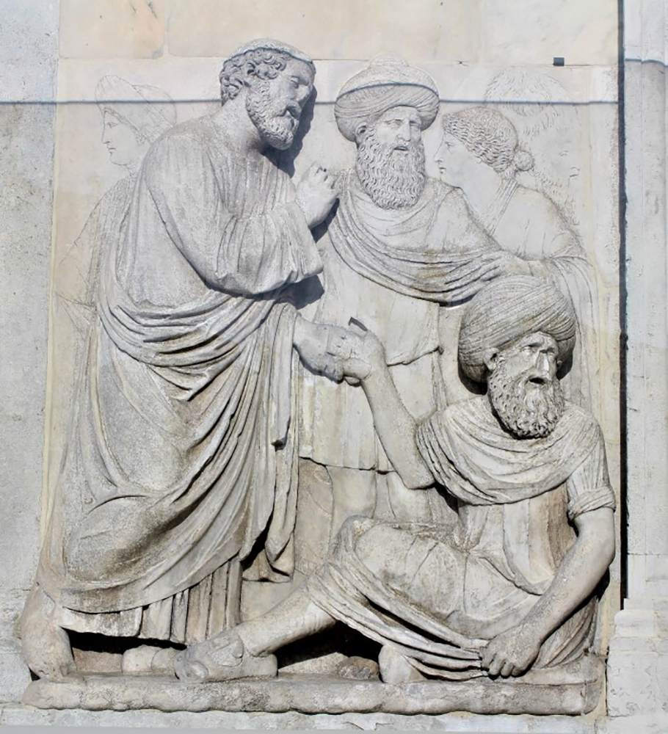
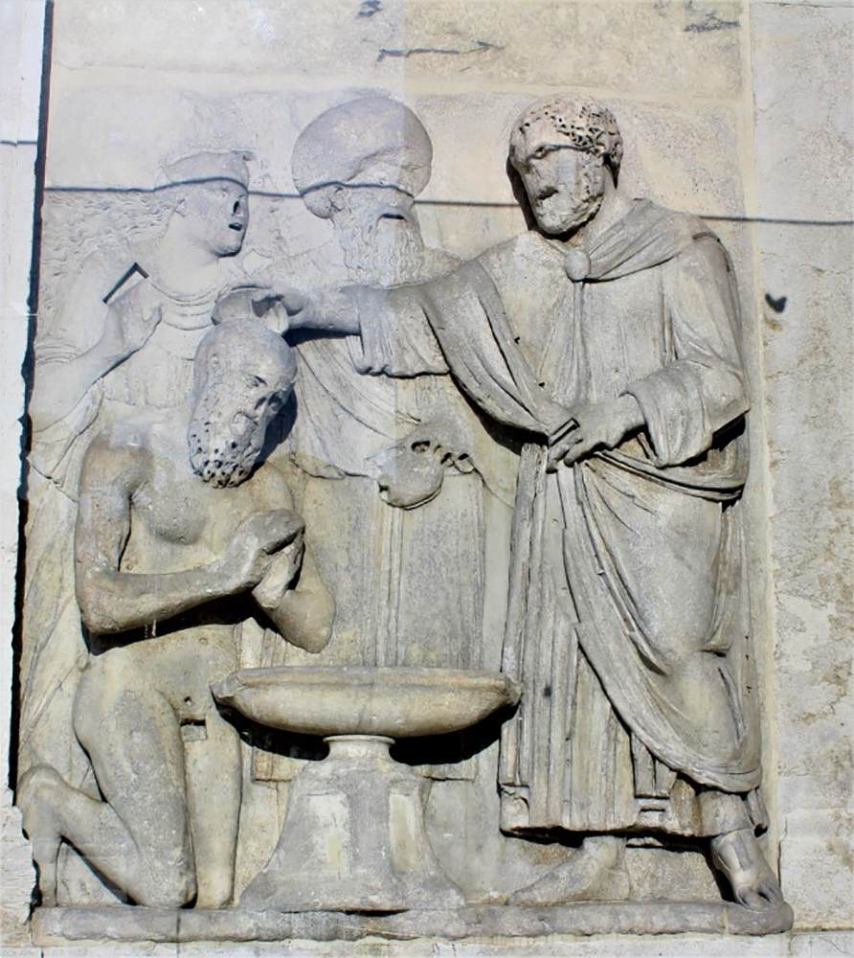
St Mark Healing Anianus c. 1489 and
St Mark Baptizing Anianus c. 1489
Marble
Campo San Giovanni e Paolo, Venice https://www.wga.hu/frames-e.html?/html/l/lombardo/tullio/2adam.html

Slide 7
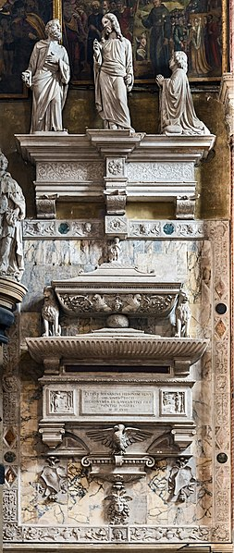
Monument to Pietro Bernardo, 1524, Marble, Santa Maria Gloriosa dei Frari, Venice, Italy https://commons.wikimedia.org/wiki/File:Frari_%28Venice%29_interior_facade_-_Monument_to_Pietro_Bernardo_by_Tullio_Lombardo.jpg

Slide 8
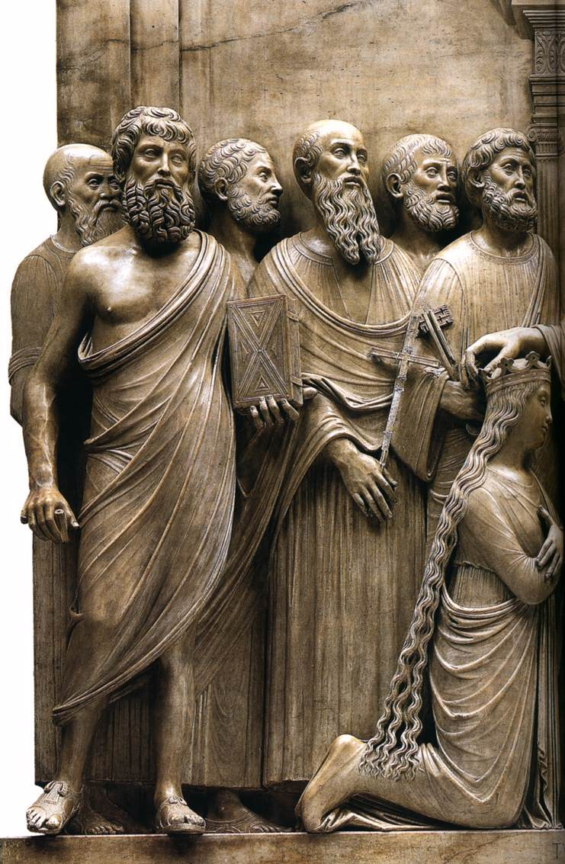
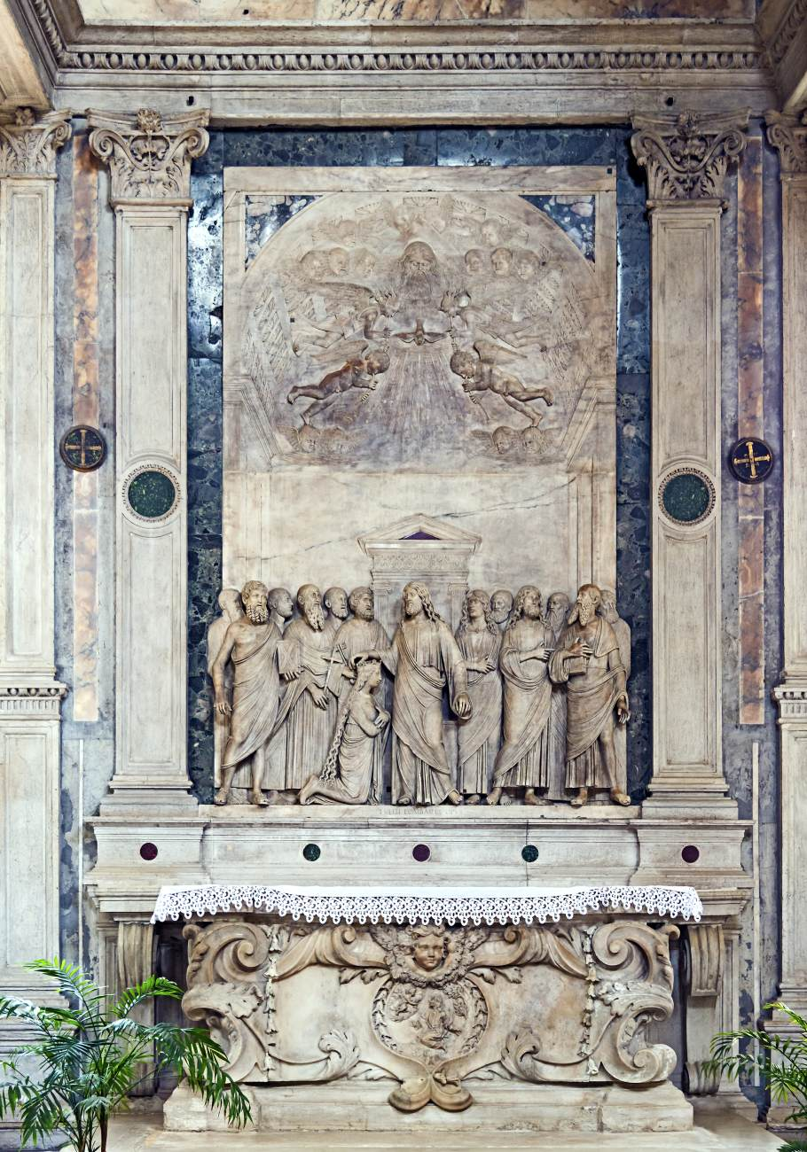
Coronation of the Virgin, 1500-02, Marble, San Giovanni Crisostomo, Venice, Italy https://www.wga.hu/frames-e.html?/html/l/lombardo/tullio/2adam.html

Slide 9
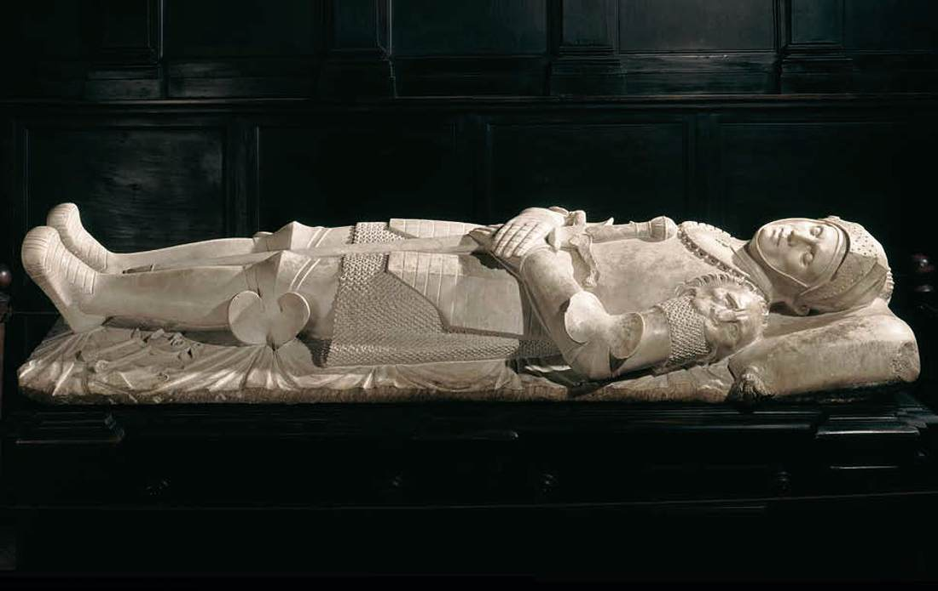
Effigy of Guidarello Guidarelli, 1520-25, Marble, Galleria dell'Accademia, Ravenna, Italy https://www.wga.hu/frames-e.html?/html/l/lombardo/tullio/2adam.html

Slide 10
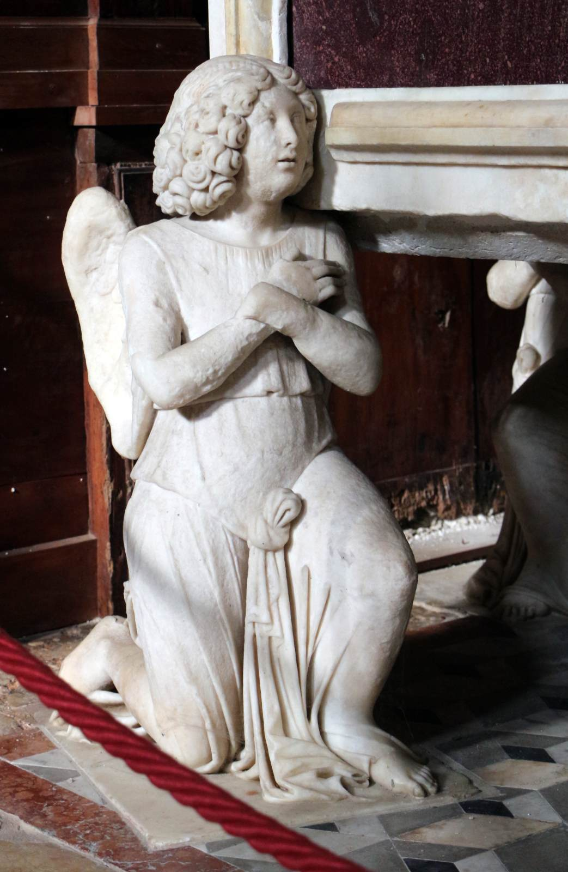
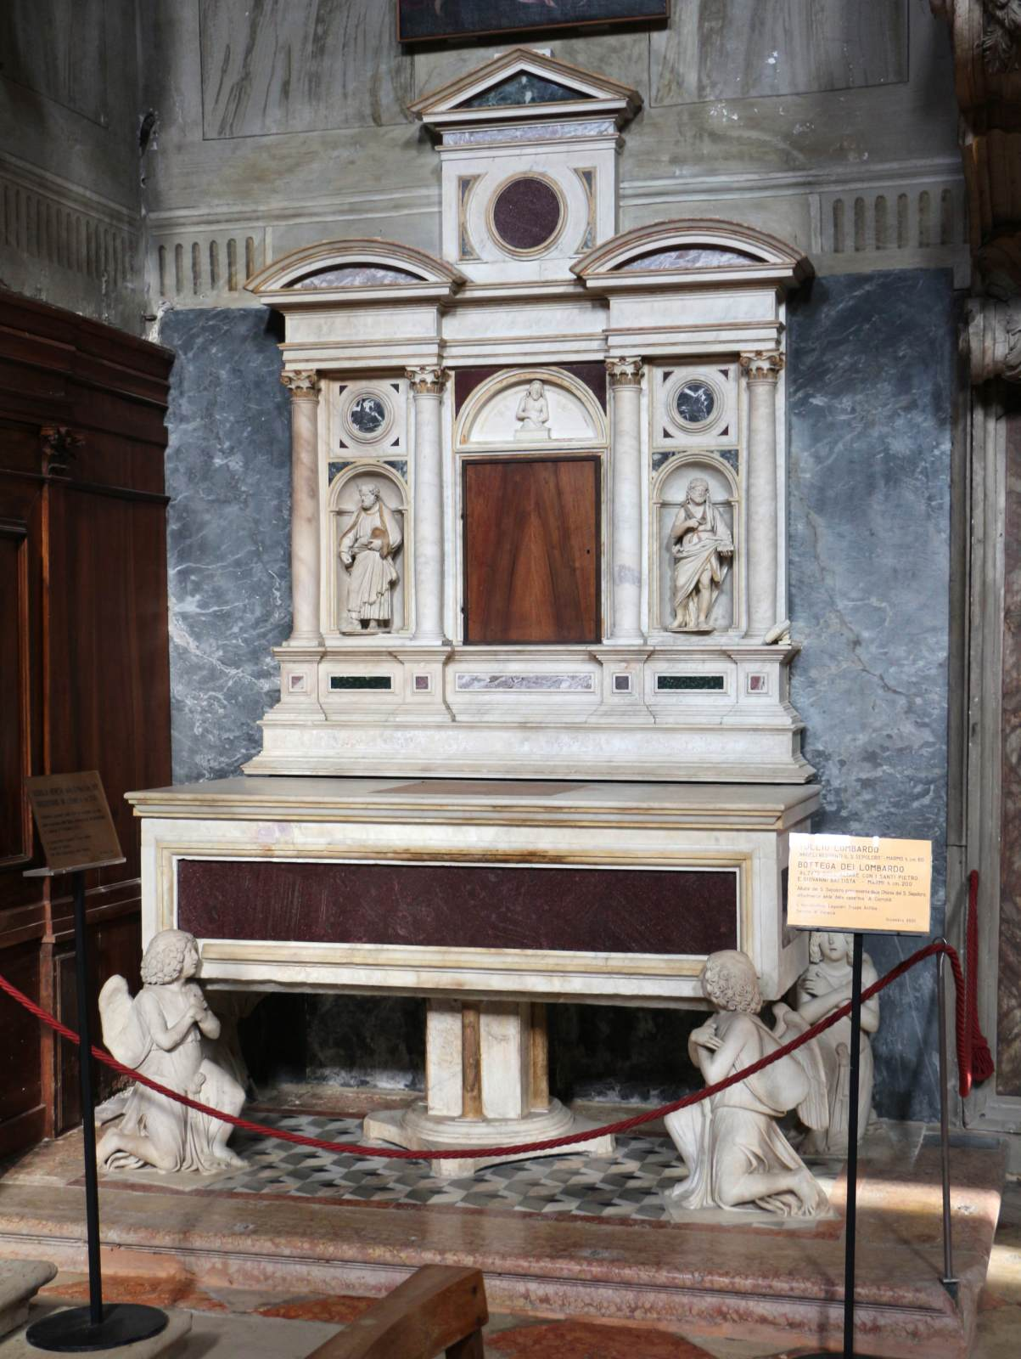
Shrine of the Holy Sepulchre, c. 1484, Marble, San Martino, Venice, Italy https://www.wga.hu/frames-e.html?/html/l/lombardo/tullio/2adam.html

Slide 11
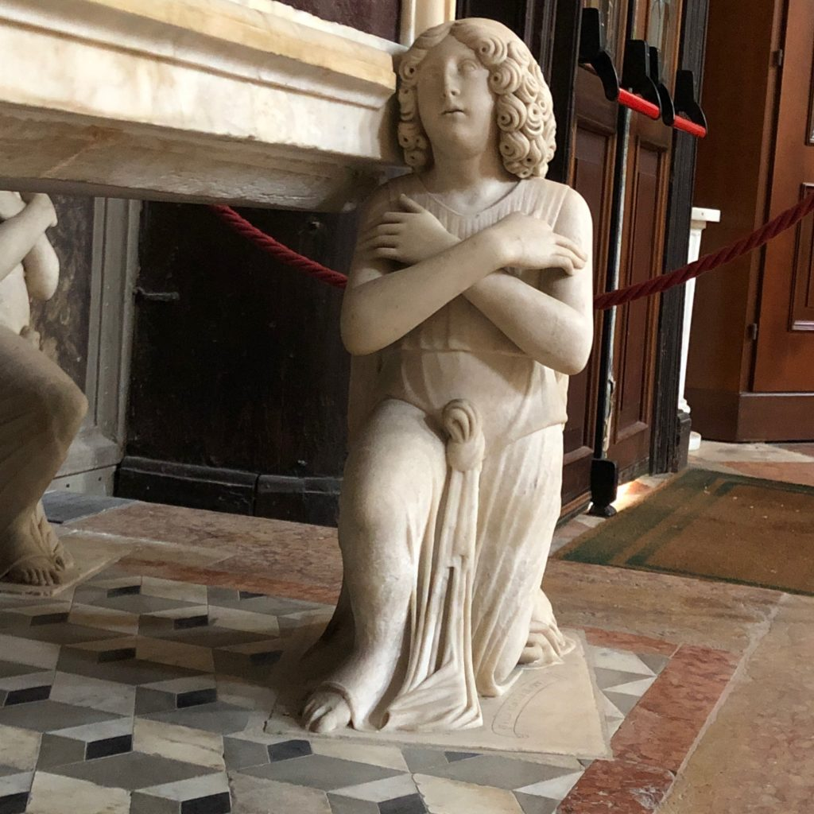
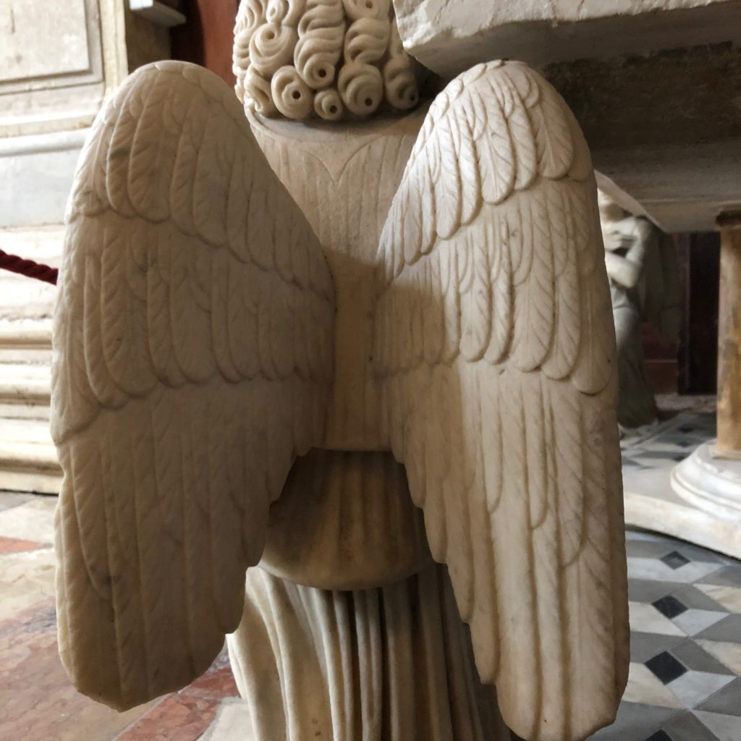
https://www.veniceinperil.org/altar-tullio-lombardo-church-of-san-martino/

Slide 12
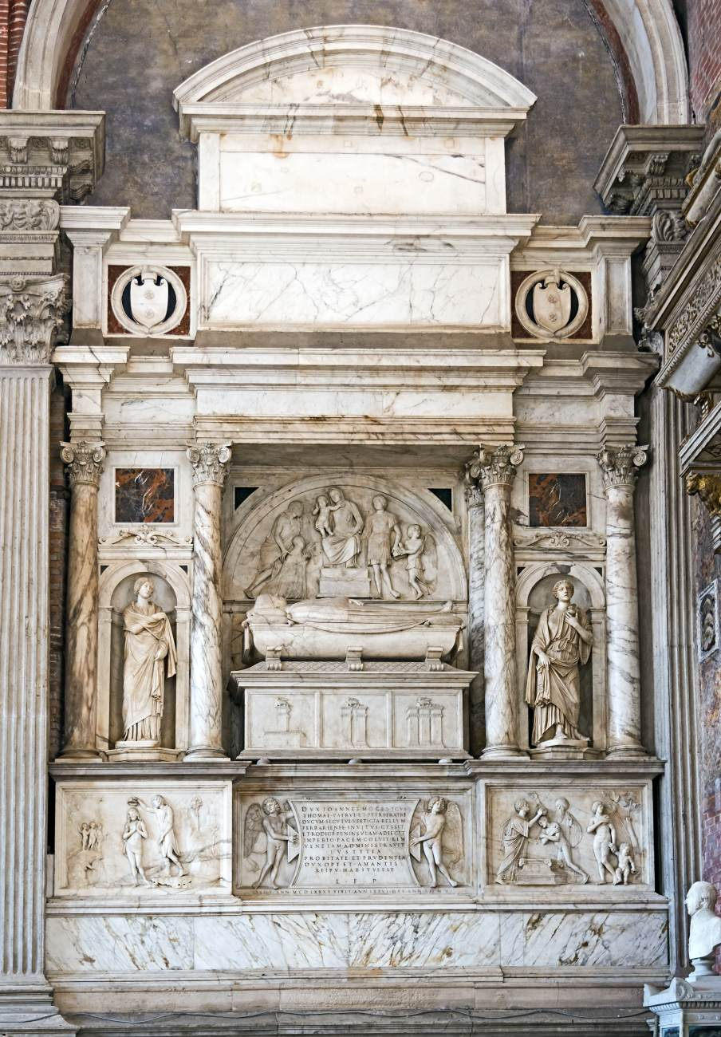
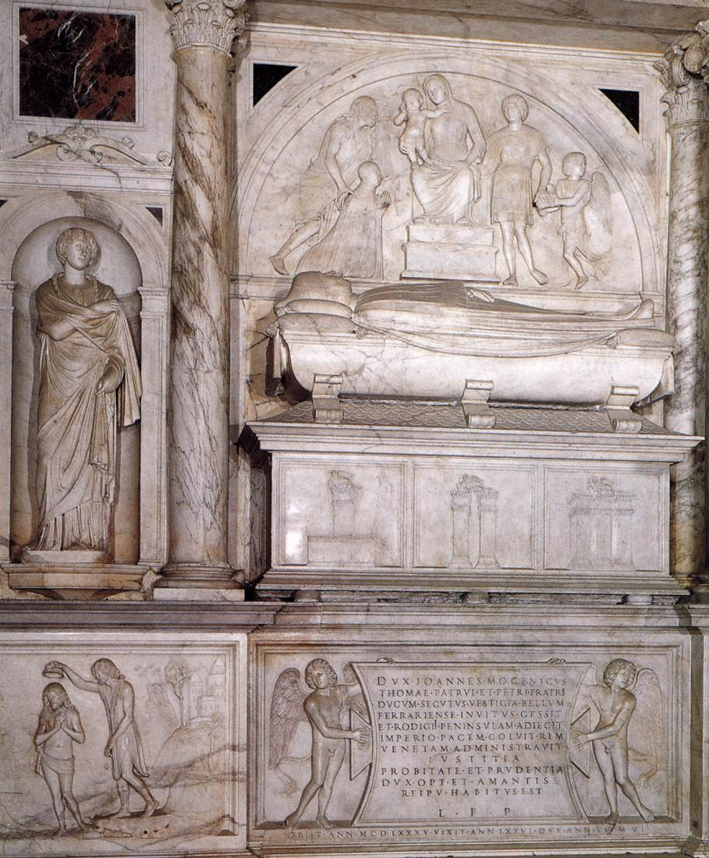
Monument to Doge Giovanni Mocenigo, 1500-10, Marble, Basilica dei Santi Giovanni e Paolo, Venice, Italy https://www.wga.hu/frames-e.html?/html/l/lombardo/tullio/2adam.html

Slide 13
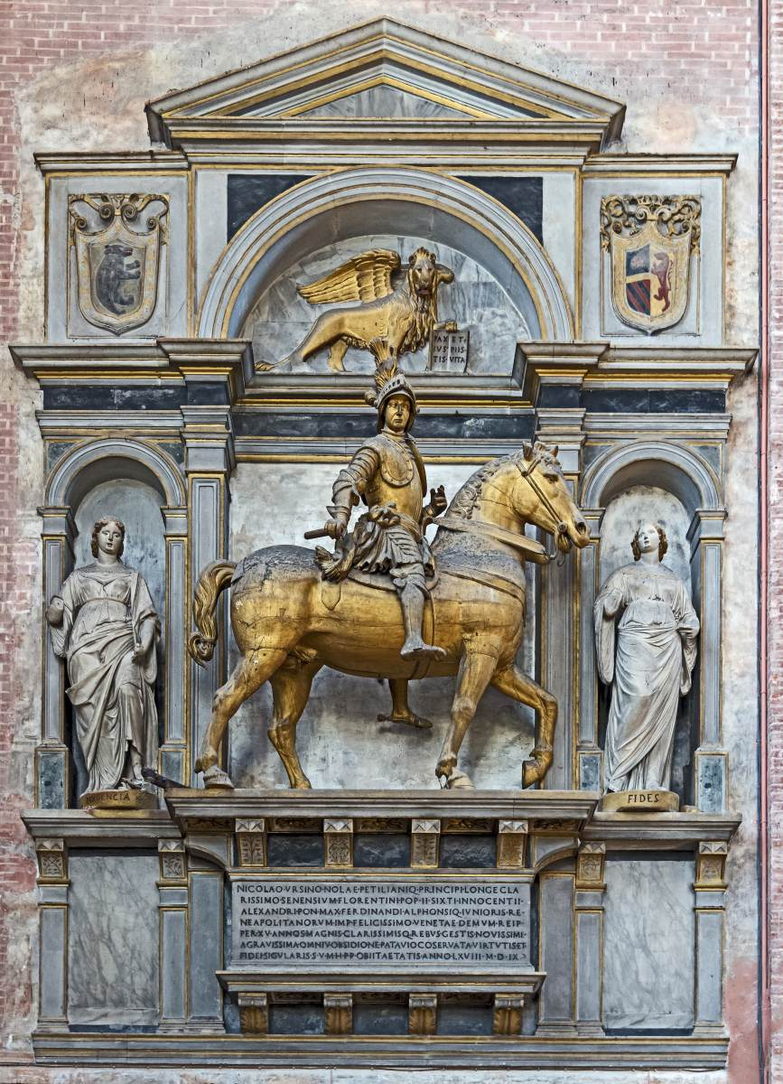
Tomb of Niccolò Orsini di Pitigliano, 1510s, Marble, Santi Giovanni e Paolo, Venice, Italy https://www.wga.hu/frames-e.html?/html/l/lombardo/tullio/2adam.html

Slide 14
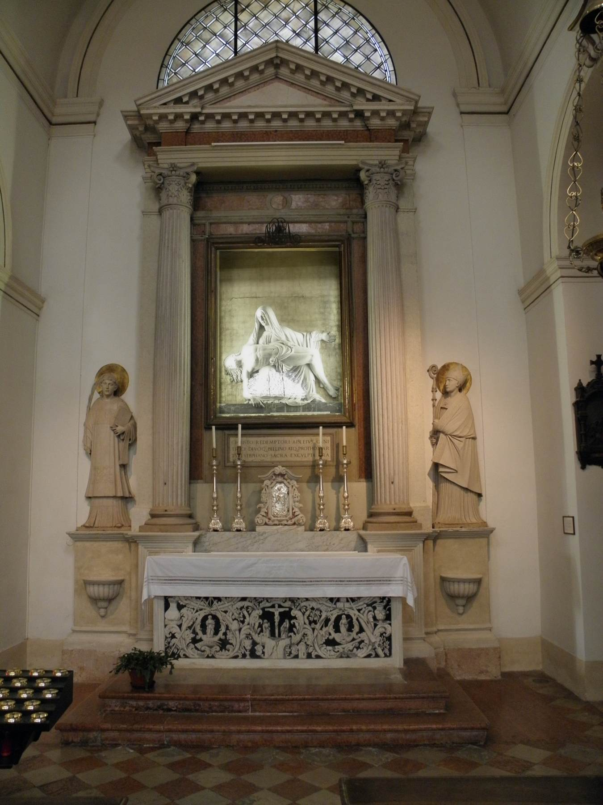
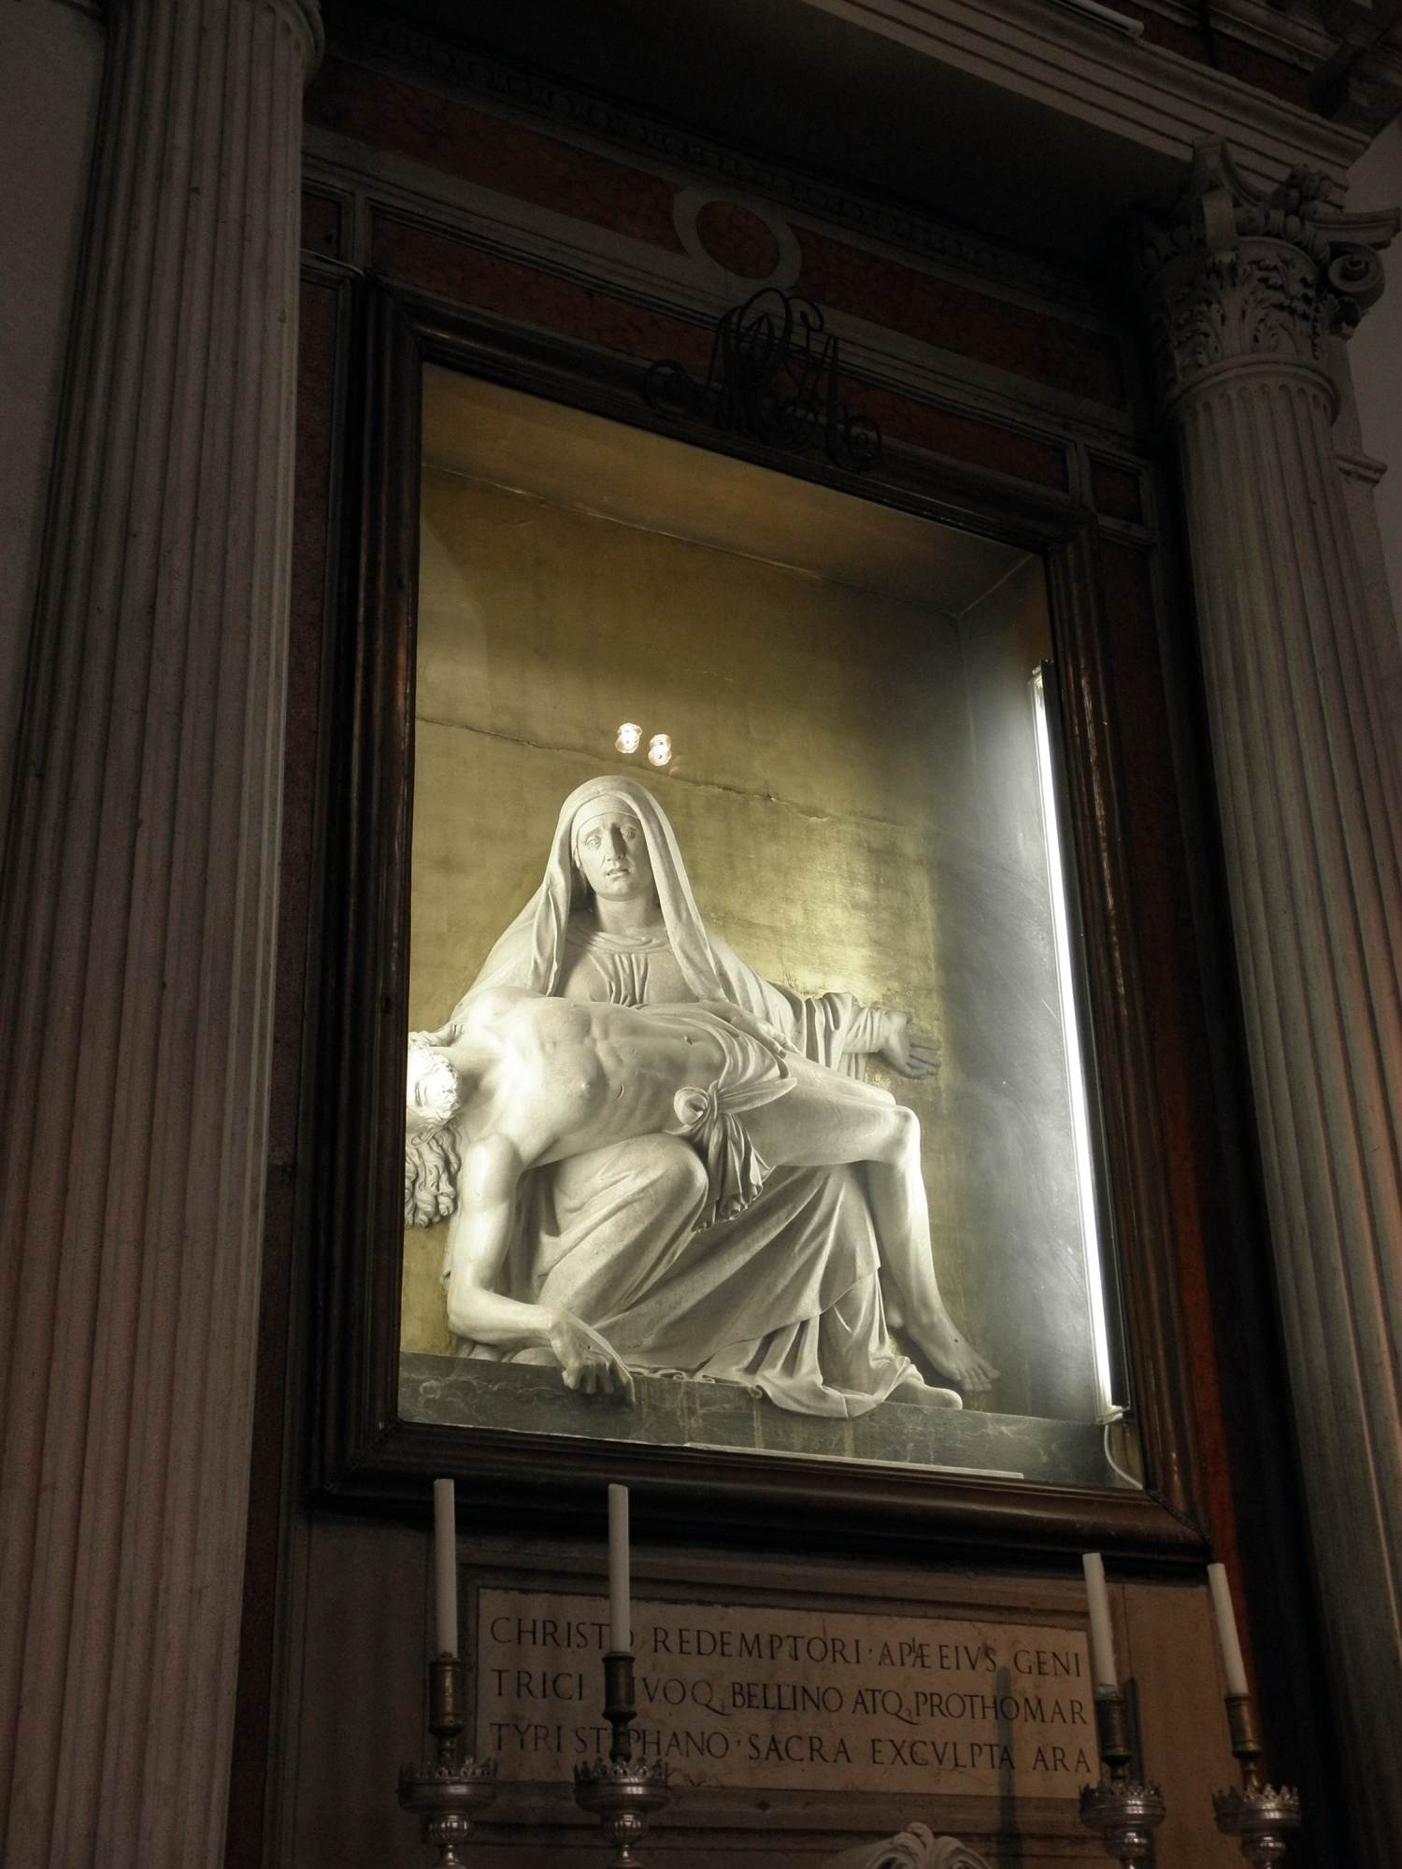
Altar of the Pietà, 1526, Marble, Santi Francesco e Giustina, Rovigo, Italy https://www.wga.hu/frames-e.html?/html/l/lombardo/tullio/2adam.html

Slide 15
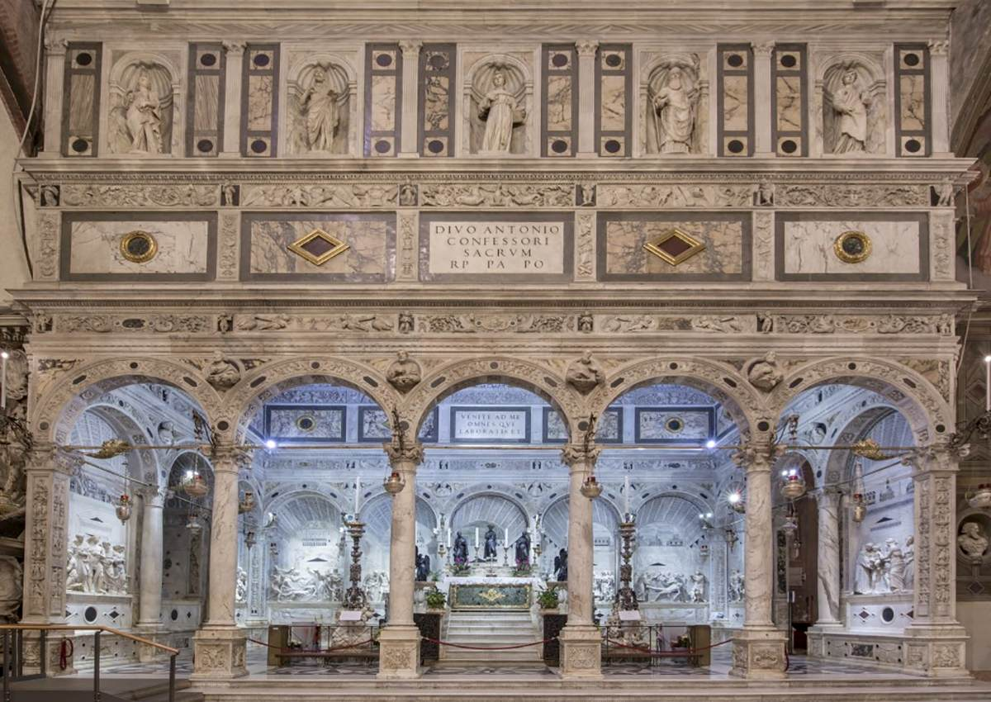
View of the Cappella dell'Arca di Sant'Antonio, 1500-77,
Basilica di Sant'Antonio, Padua, Italy https://www.wga.hu/frames-e.html?/html/l/lombardo/tullio/2adam.html

Slide 16
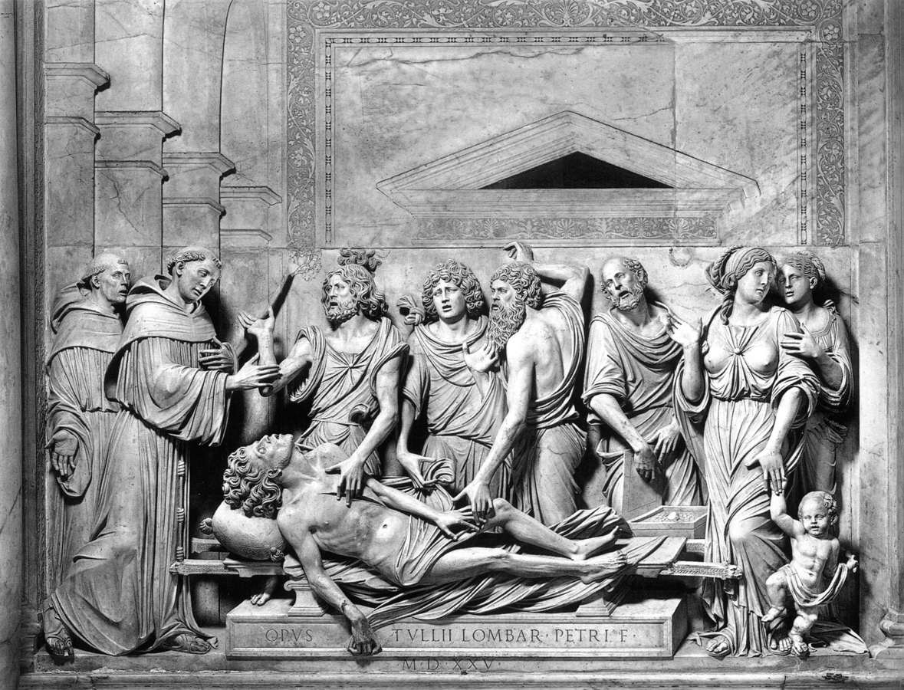
Miracle of the Miser's Heart,
1520-25,
Marble,
130 x 245 cm,
Basilica di Sant'Antonio, Padua, Italy https://www.wga.hu/frames-e.html?/html/l/lombardo/tullio/2adam.html

Slide 17
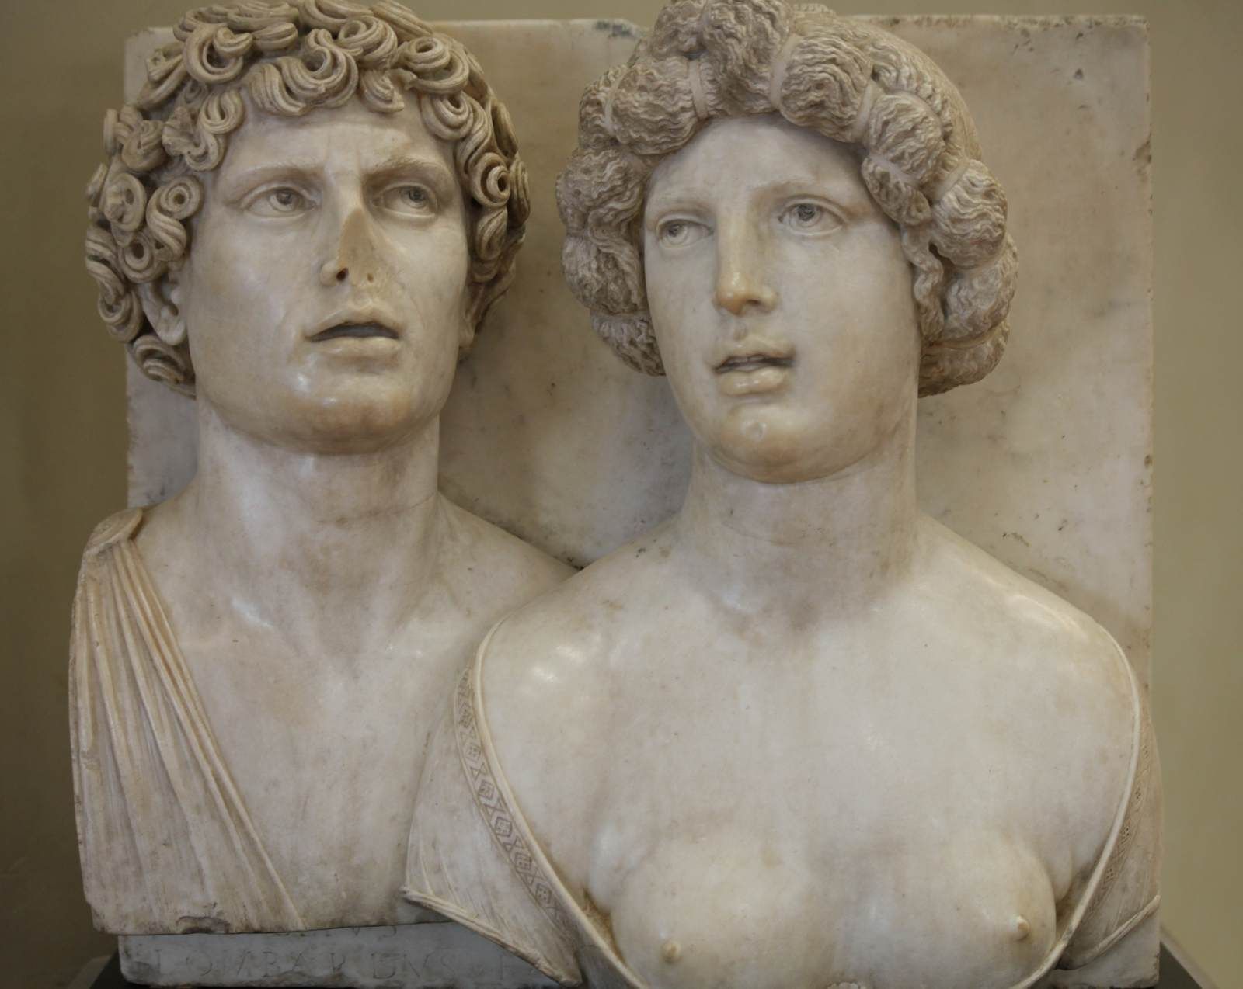
Self-portrait (?) with his Wife in Ancient Guise
1490-1510
Marble, 47 x 50 cm
Galleria Franchetti, Ca' d'Oro, Venice, Italy https://www.wga.hu/frames-e.html?/html/l/lombardo/tullio/2adam.html

Slide 18
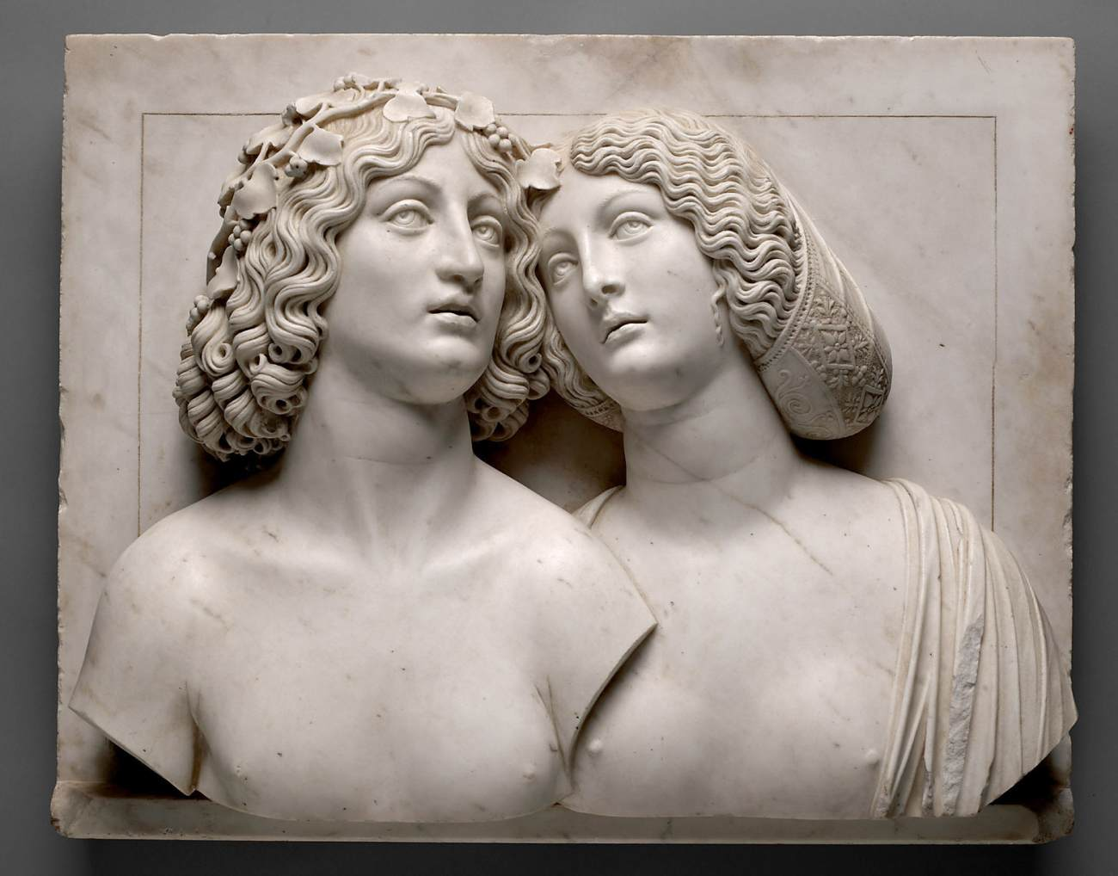
Young Couple (formerly: Bacchus and Ariadne), 1505-10, Marble, Height 56 x 71 cm, Kunsthistorisches Museum, Vienna, Austria https://www.wga.hu/frames-e.html?/html/l/lombardo/tullio/2adam.html

Slide 19
The End

