Slide 1
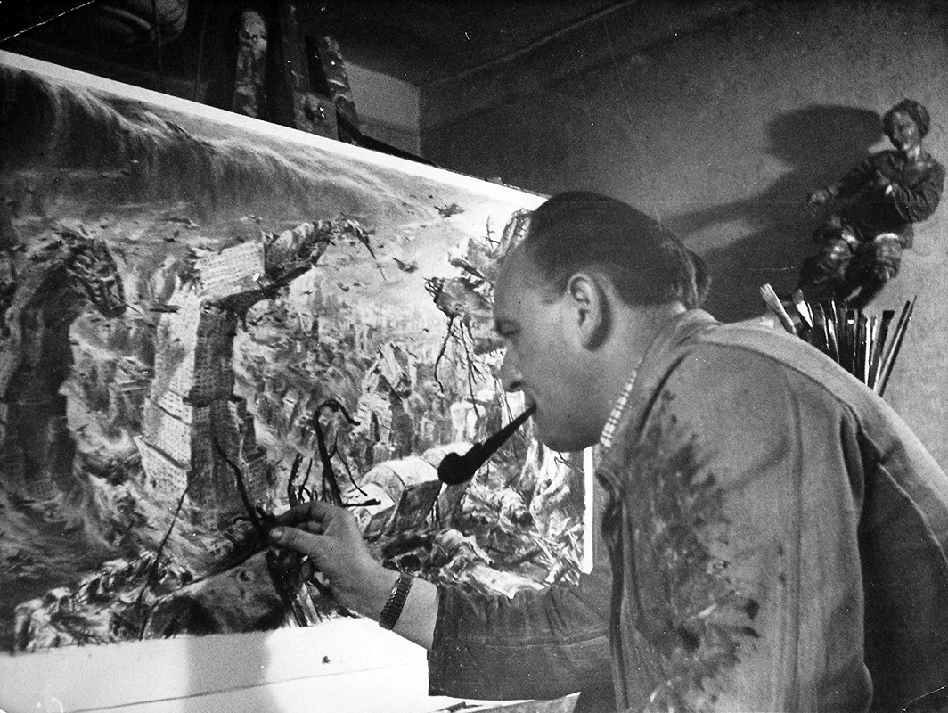
Frank Liska
1907-1984
WORLD WAR II
SKETCHES
During the years following the war Liska worked with many large illustrated magazines like the newly founded 'Quick' and other large illustrated magazines and newspapers. With his colourful imagination he gave life to many futurist visions and inventions. https://www.hansliska.com/en/biography

Slide 2
In 1942 and 1943 German publishing house Carl Werner in Reichenbach, sponsored by Junkers Flugzeug und Motorenwerke AG, published 2 albums with Hans Liska’s sketches and color illustrations "to please the frontline soldiers and the workers of the weapon factories" in Germany. Definitely, Liska's art lived up to the expectations of his peers, and propaganda clichés left the well-recognizable footprints all over his painting and drawings. https://www.allworldwars.com/World%20War%20II%20Sketches%20By%20Hans%20Liska.html

Slide 3
France 1940

Slide 4
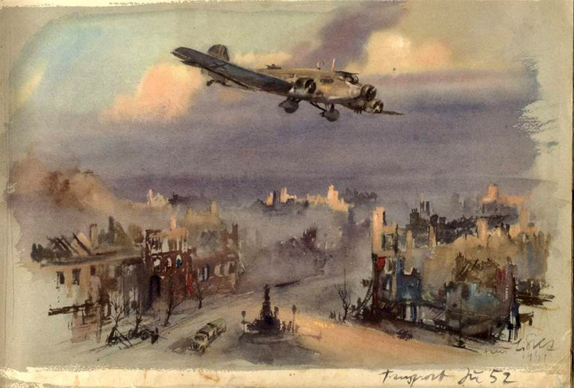

Slide 5
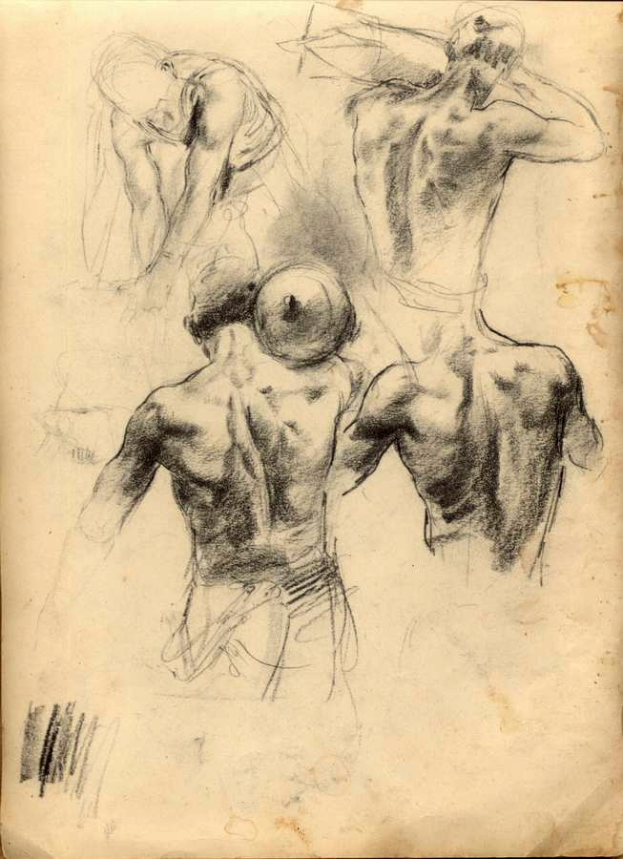
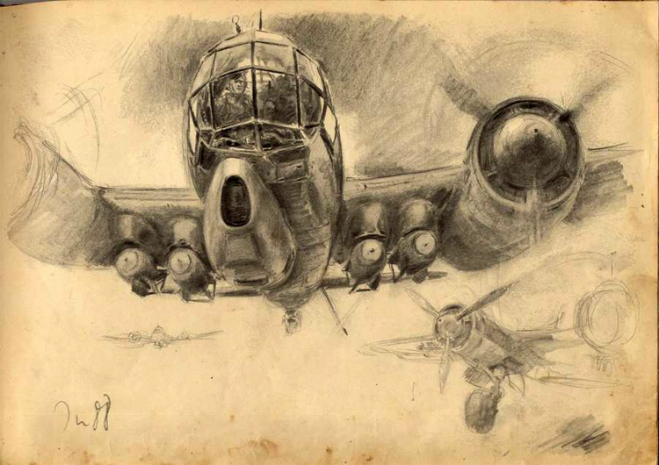

Slide 6
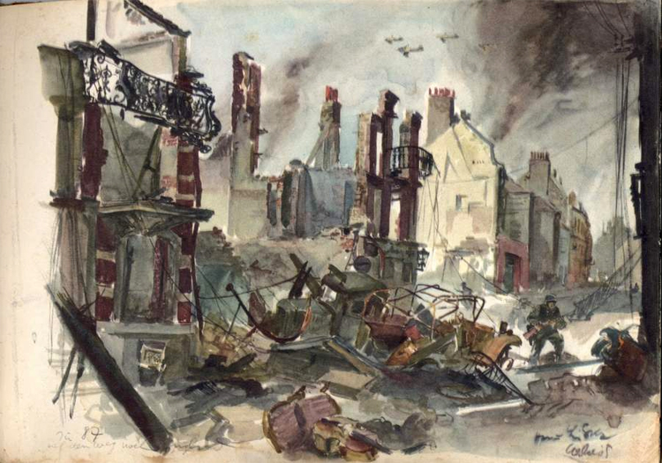

Slide 7
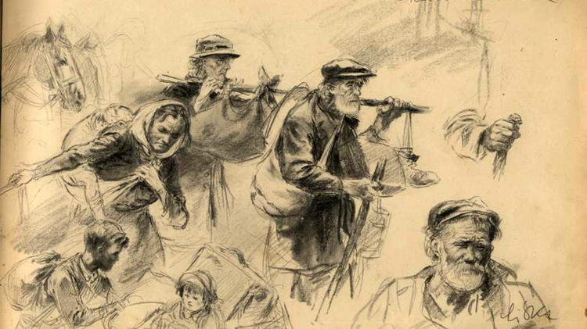

Slide 8
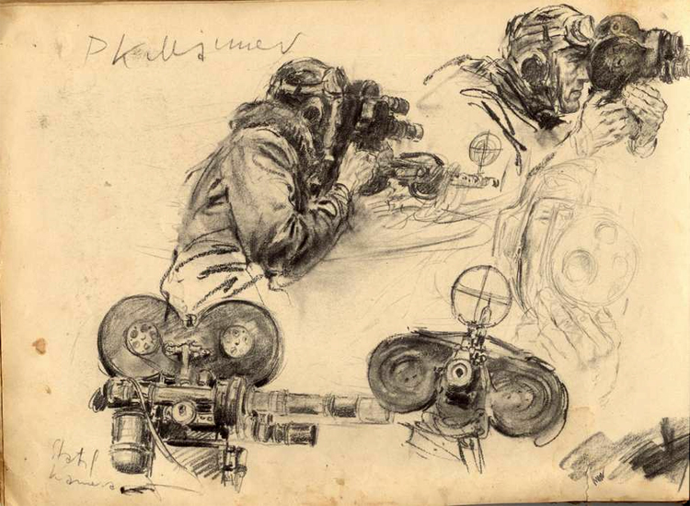

Slide 9
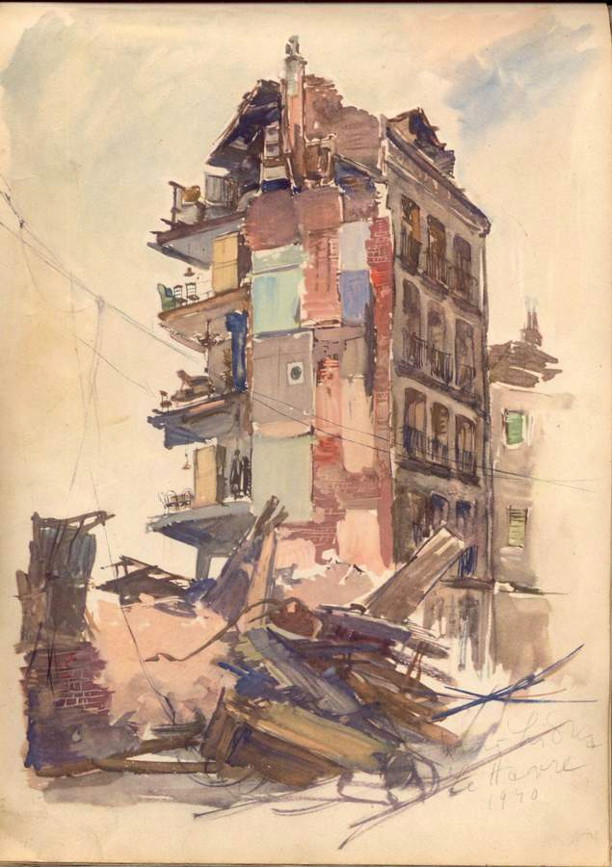
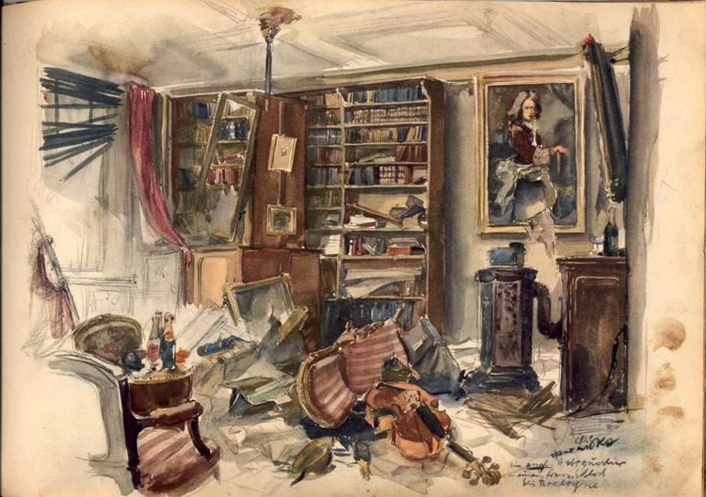

Slide 10
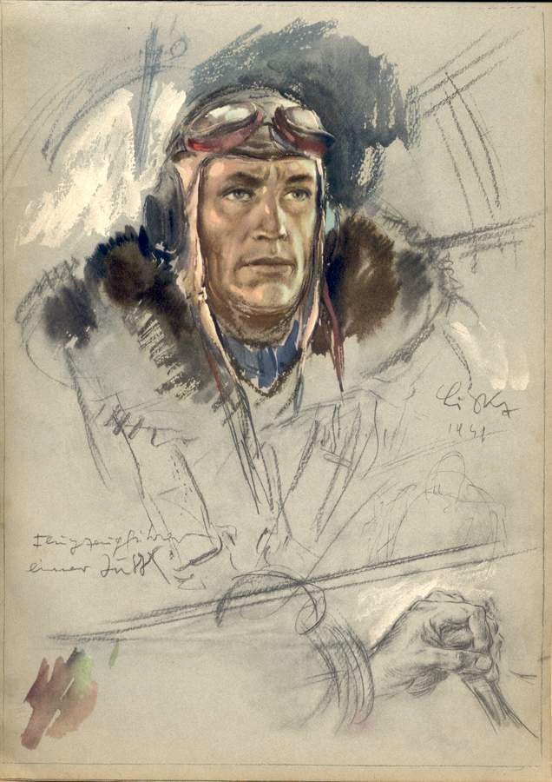
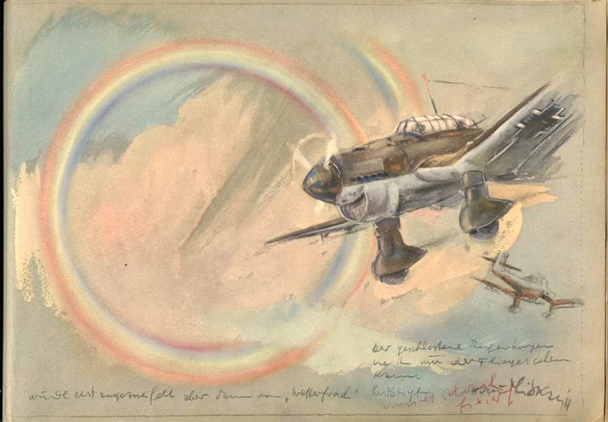

Slide 11
Greece and Crete

Slide 12
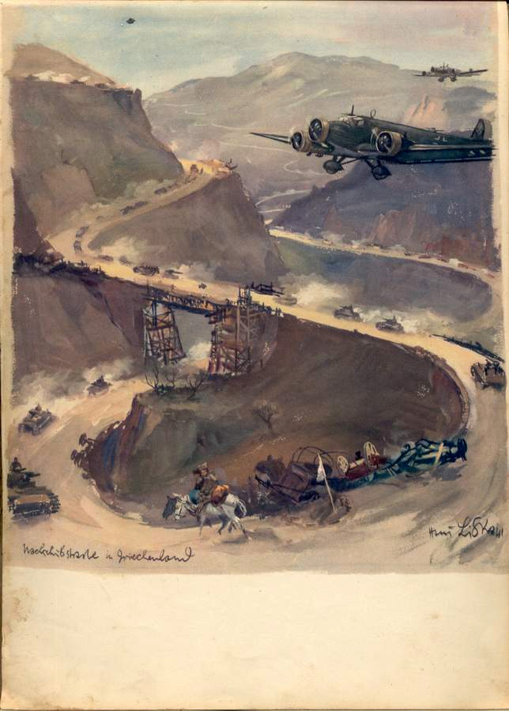
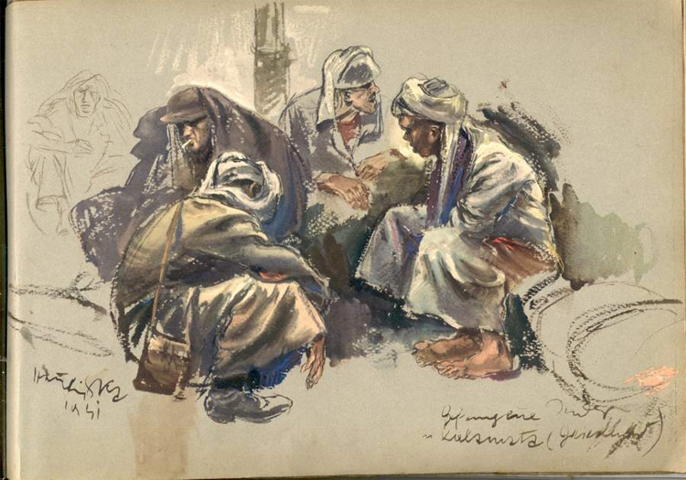

Slide 13
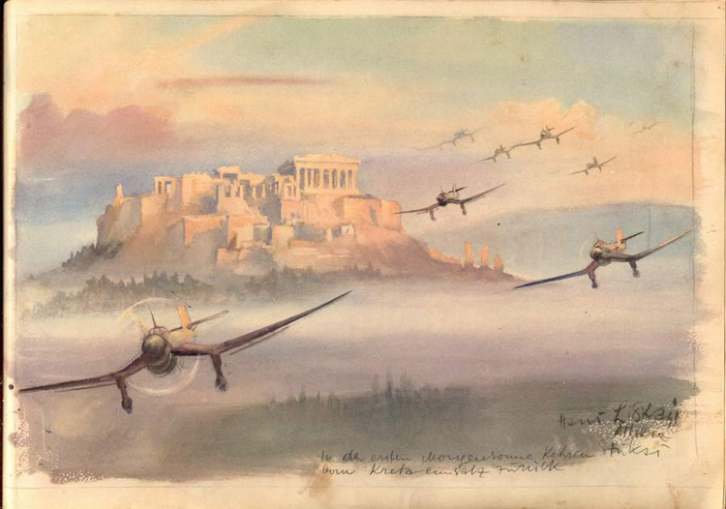

Slide 14
Sevastopol

Slide 15
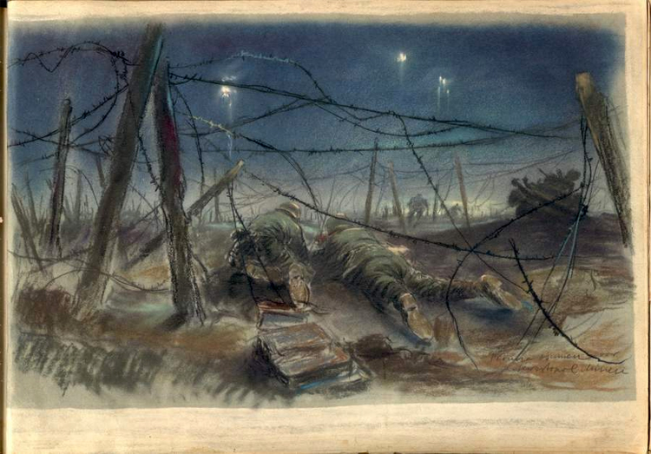

Slide 16
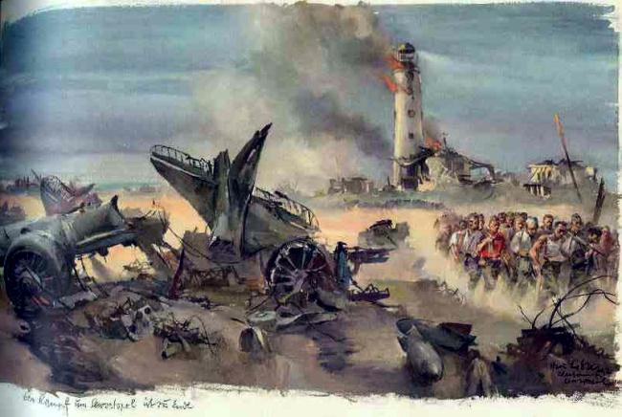

Slide 17
The End

