Slide 1
Spain
Monuments of Oviedo and the Kingdom of the Asturias
Pre-Romanesque, 8th century to Late 9th century

Slide 2
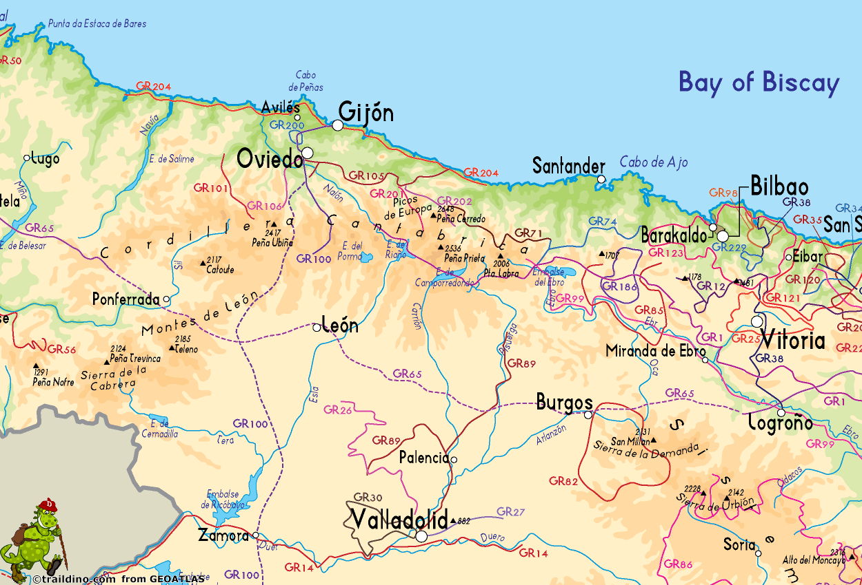
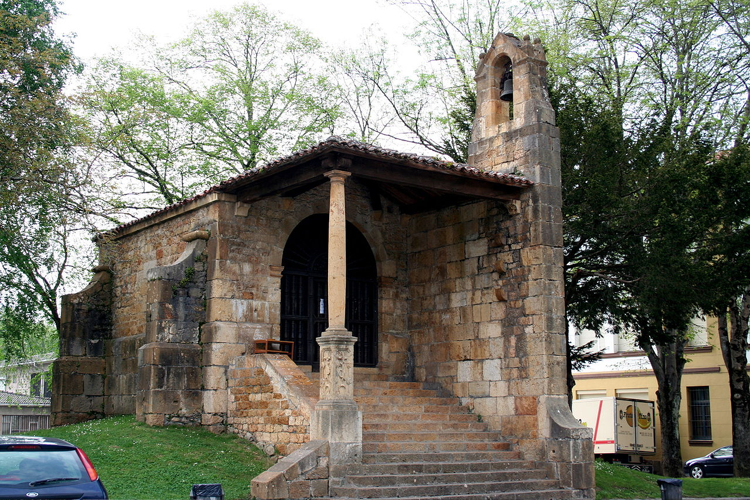
Church of Santa Cruz de Cangas de Onís, 737, Cangas de Onís, (the first capital of the Kingdom of Asturias), Spain https://en.wikipedia.org/wiki/Church_of_Santa_Cruz_de_Cangas_de_On%C3%ADs

Slide 3
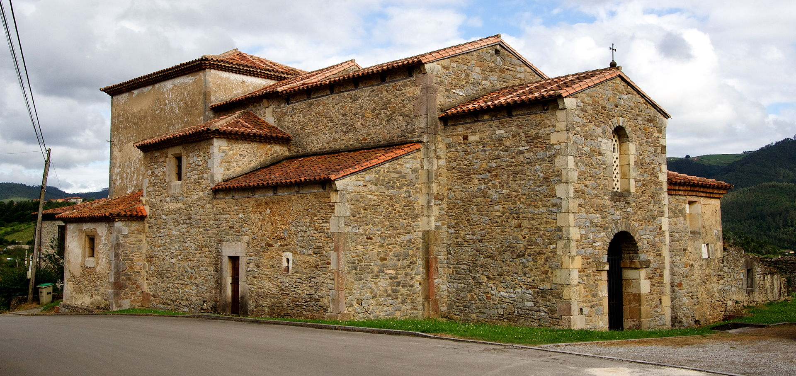
St. John Apostle and Evangelist, 8th century, Santianes de Pravia, Spain https://en.wikipedia.org/wiki/Church_of_San_Juan_Ap%C3%B3stol_y_Evangelista,_Santianes_de_Pravia#/media/File:Santianes_de_Pravia_-_04.jpg

Slide 4
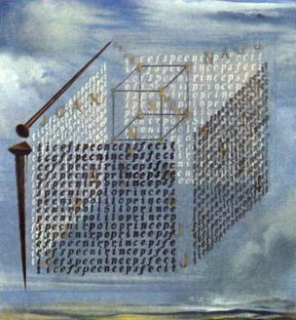
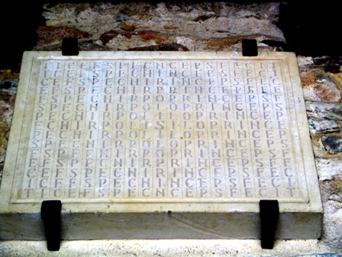
Foundation stone in the form of a letter labyrinth: Silo princeps fecit and Sarvador Dali’s painting A Propos of the "Treatise on Cubic Form" by Juan de Herrera, 1960, Museo Reina Sofia, Madrid, Spain https://en.wikipedia.org/wiki/Church_of_San_Juan_Ap%C3%B3stol_y_Evangelista,_Santianes_de_Pravia

Slide 5
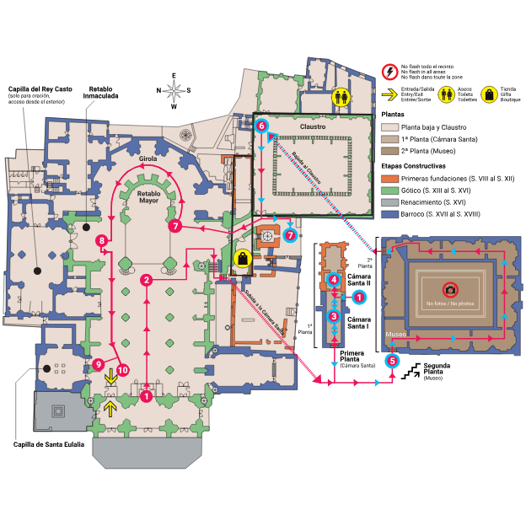
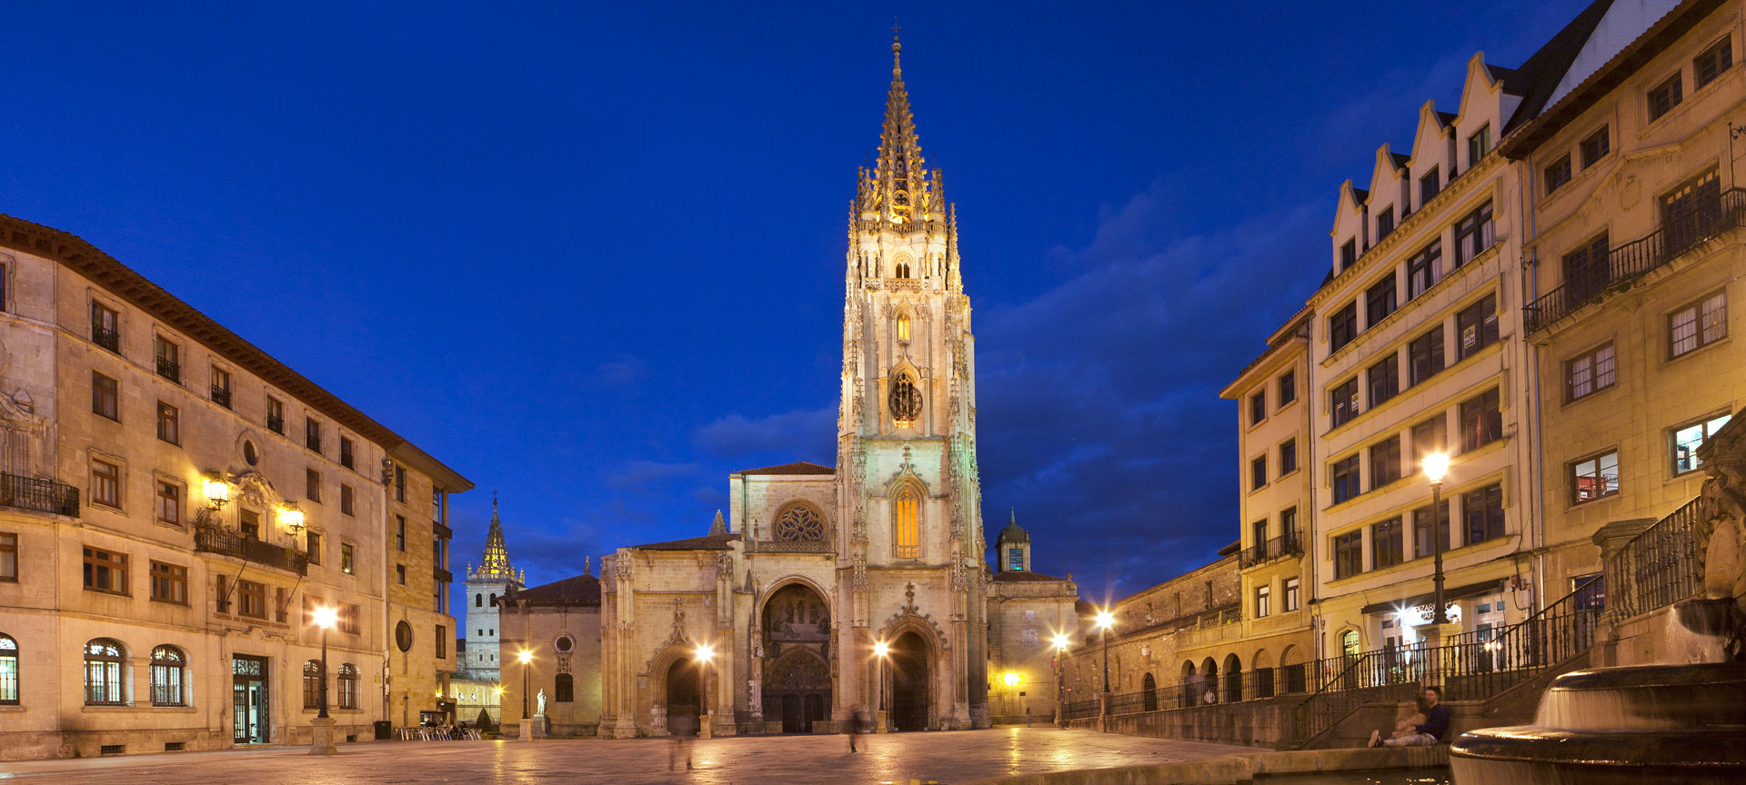
Metropolitan Cathedral Basilica of the Holy Saviour, Oviedo, Spain https://www.spain.info/en/places-of-interest/cathedral-oviedo/

Slide 6
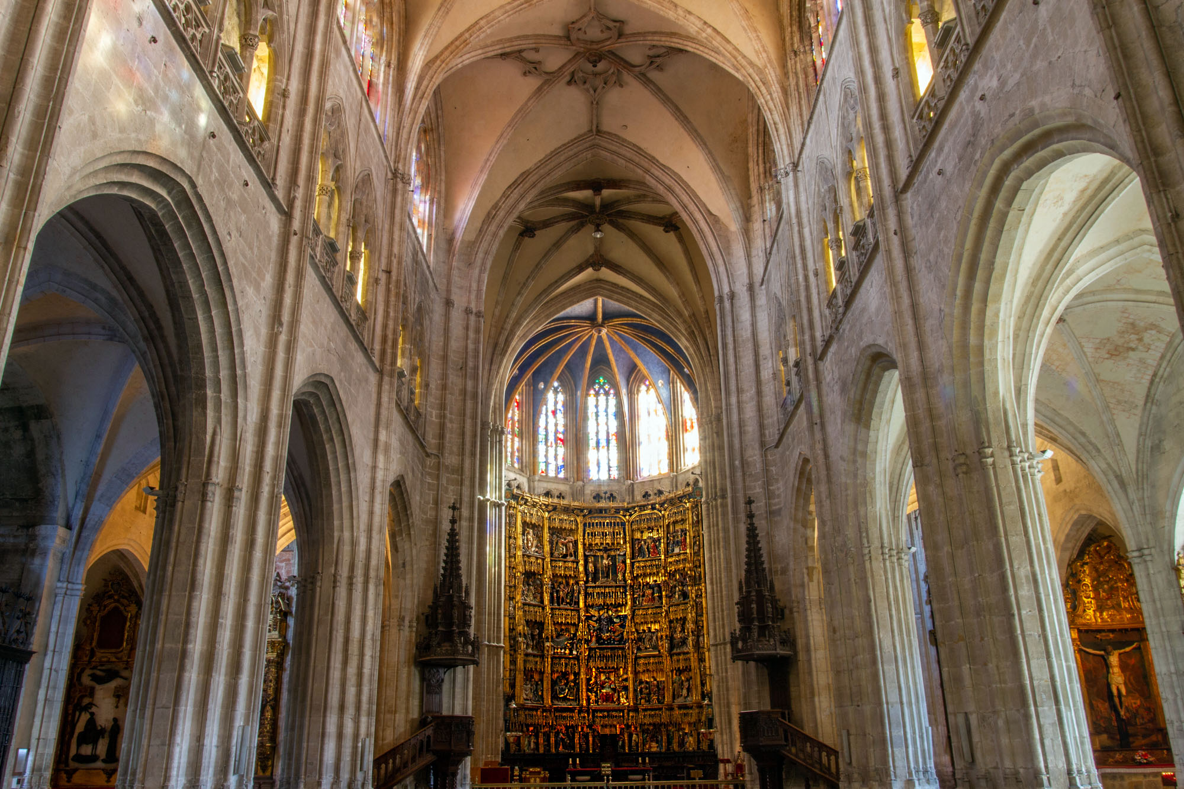
Metropolitan Cathedral Basilica of the Holy Saviour, (Interior View), Oviedo, Spain https://www.google.com/url?sa=i&url=https%3A%2F%2Foviedo.for91days.com%2Finside-the-cathedral-of-san-salvador%2F&psig=AOvVaw30jMdeGcCUt1blM9KizgTf&ust=1693758770371000&source=images&cd=vfe&opi=89978449&ved=0CA4QjRxqFwoTCNjElaKtjIEDFQAAAAAdAAAAABAN

Slide 7
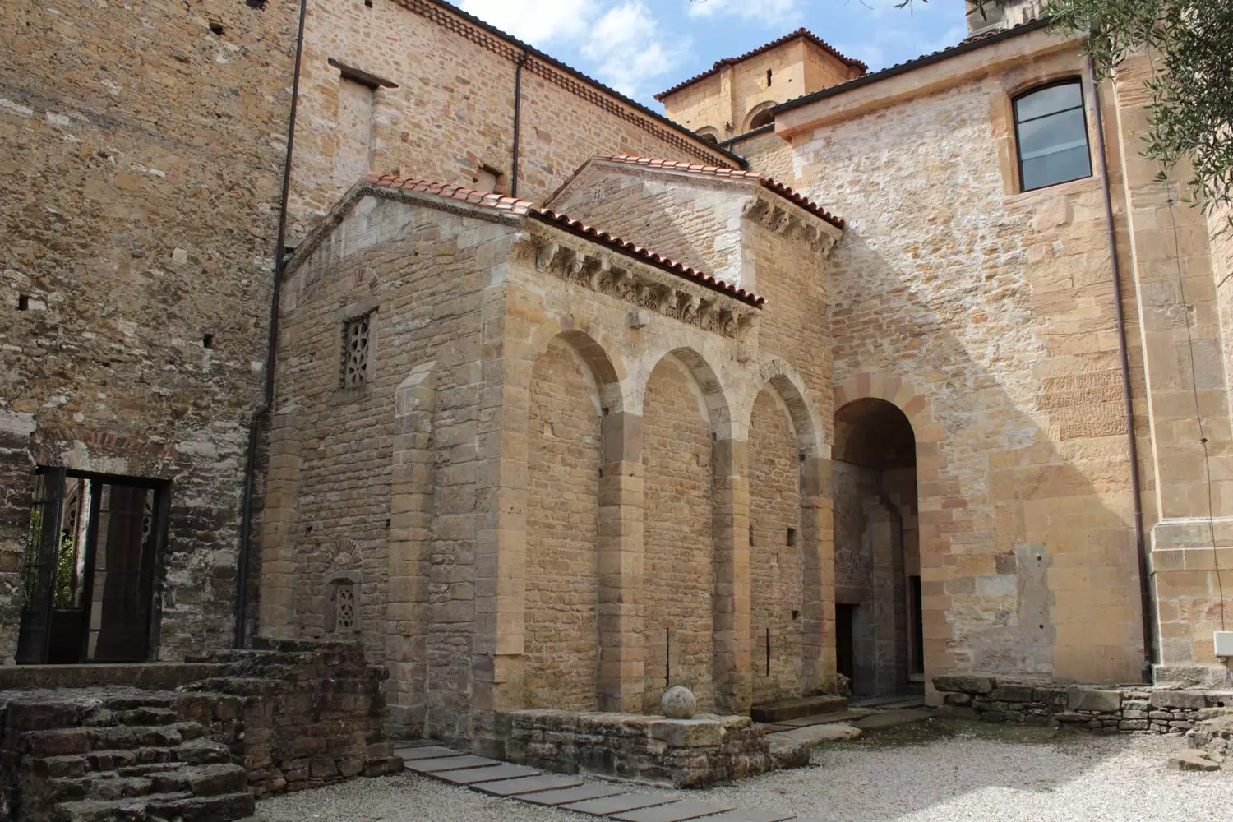
Exterior of the Holy Chamber of the Oviedo Cathedral https://catedraldeoviedo.com/conoce-cada-rincon/camara-santa/

Slide 8
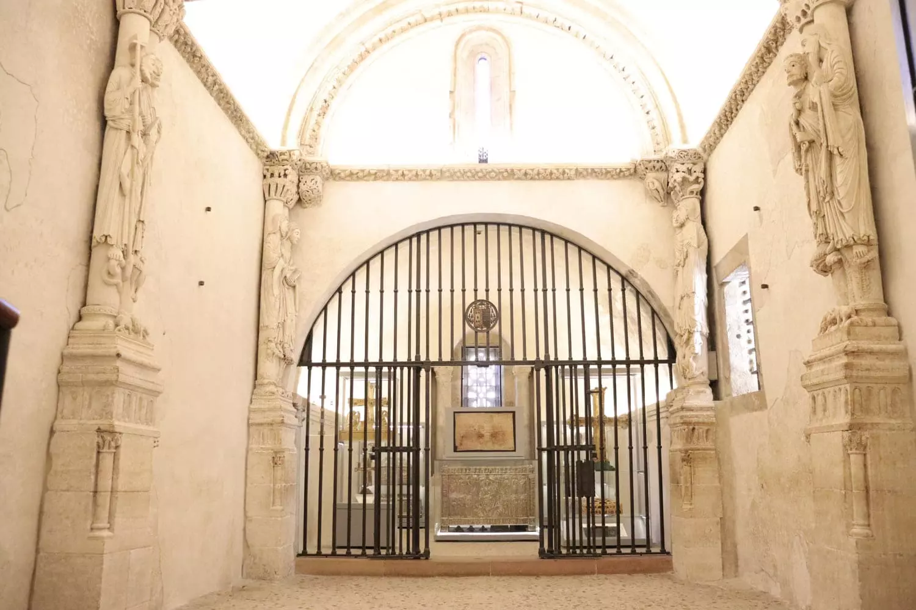
General View of the Holy Chamber and Apostolate of the Cathedral of Oviedo https://catedraldeoviedo.com/conoce-cada-rincon/camara-santa/

Slide 9
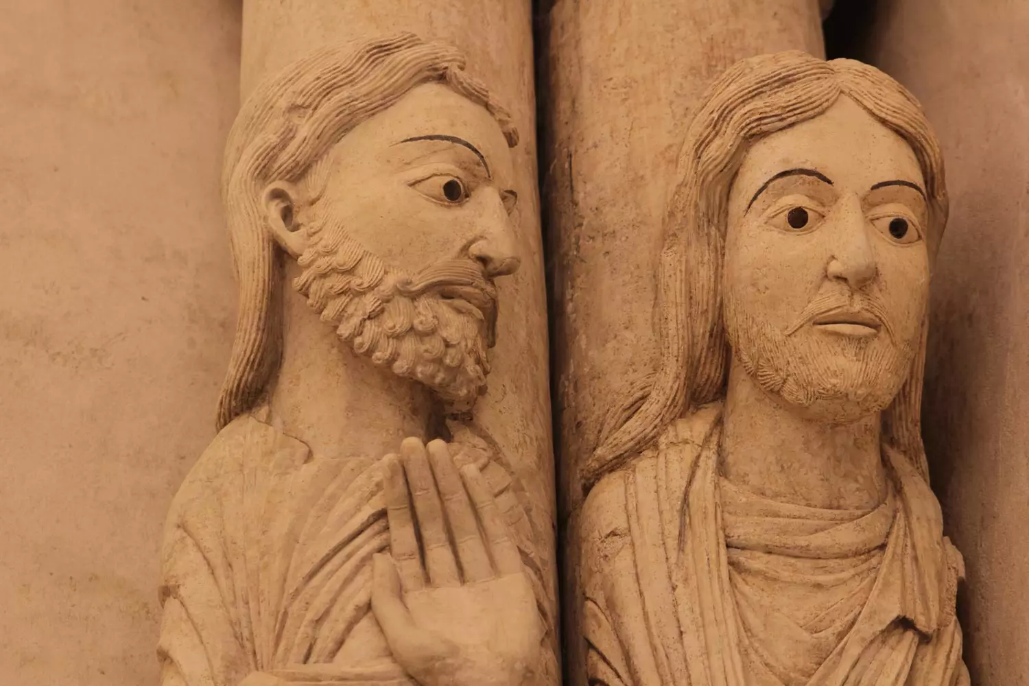
Saint Andrew and Saint Matthew. Apostolate of the Holy Chamber of the Cathedral of Oviedo https://catedraldeoviedo.com/conoce-cada-rincon/camara-santa/

Slide 10
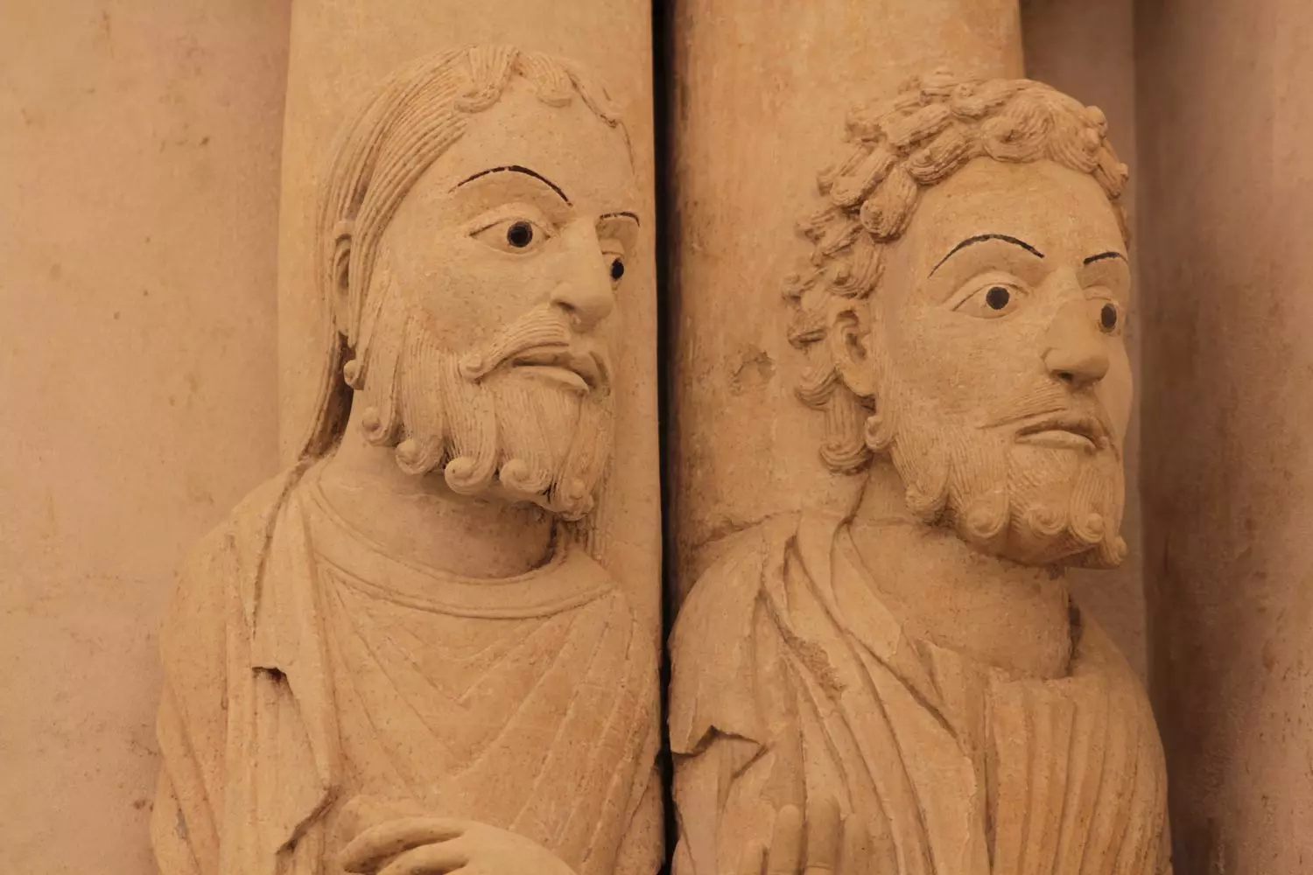
Saint Bartholomew and Saint Thomas. Apostolate of the Holy Chamber of the Cathedral of Oviedo https://catedraldeoviedo.com/conoce-cada-rincon/camara-santa/

Slide 11
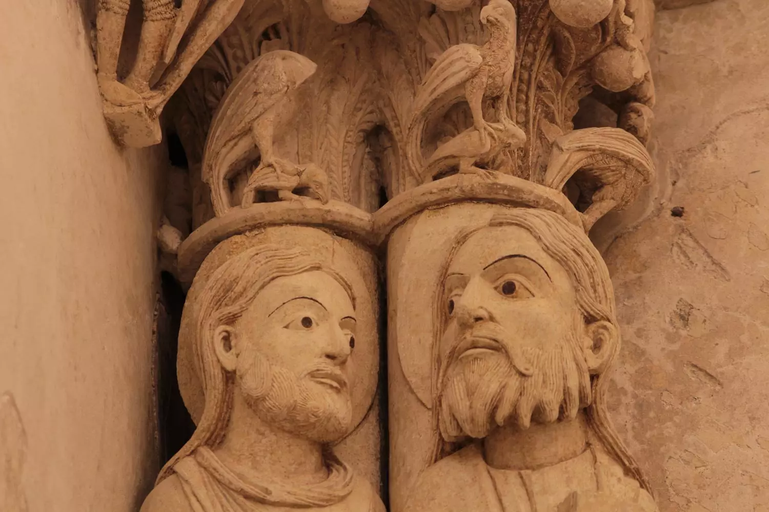
Saint Philip and Saint James the Less. Apostolate of the Holy Chamber of the Cathedral of Oviedo https://catedraldeoviedo.com/conoce-cada-rincon/camara-santa/

Slide 12
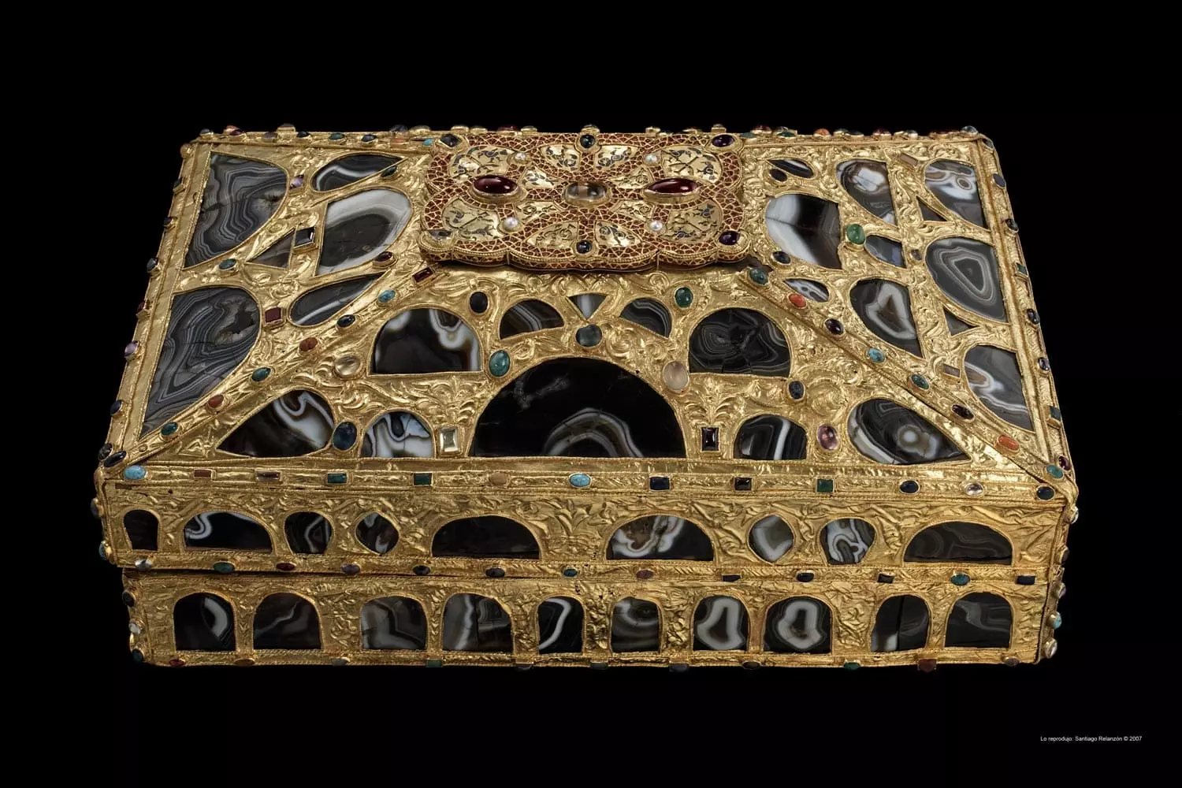
Box of the Agates of the Holy Chamber of the Cathedral of Oviedo https://catedraldeoviedo.com/conoce-cada-rincon/camara-santa/

Slide 13
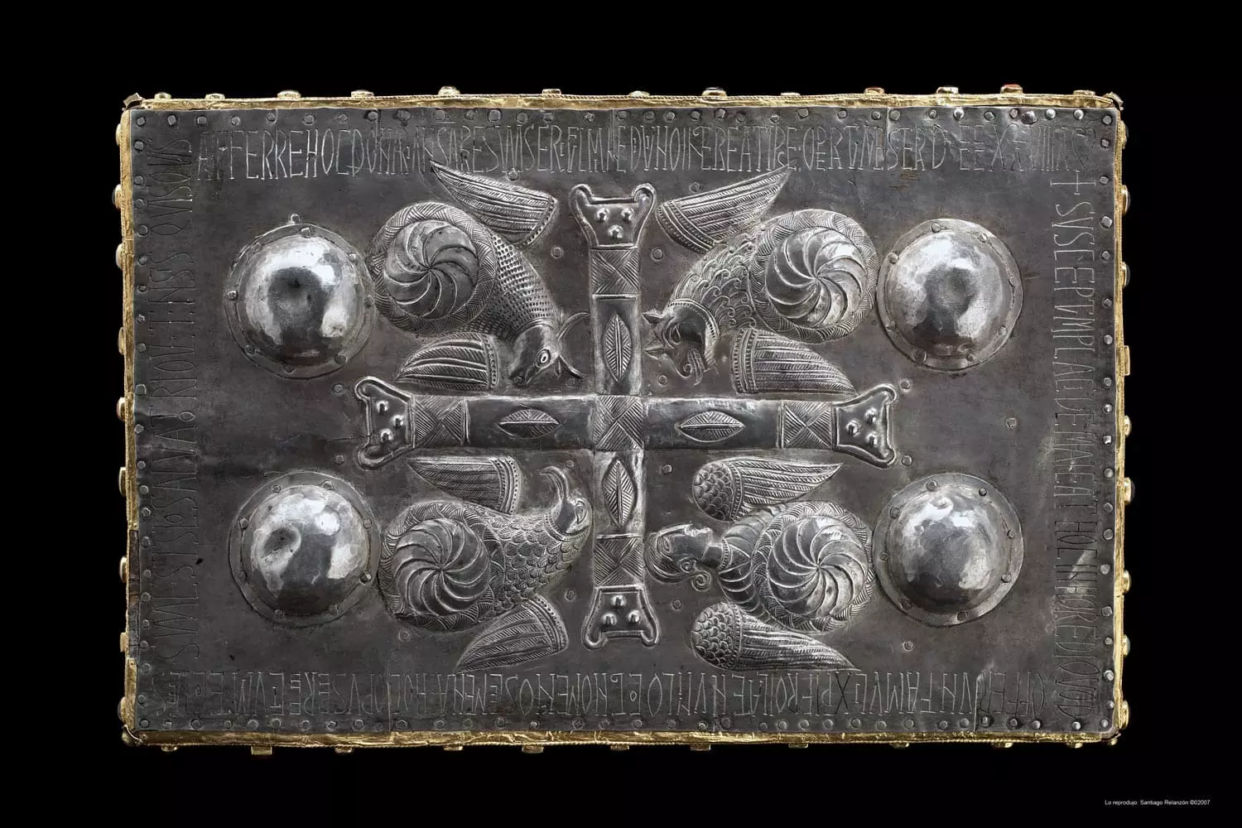

Slide 14
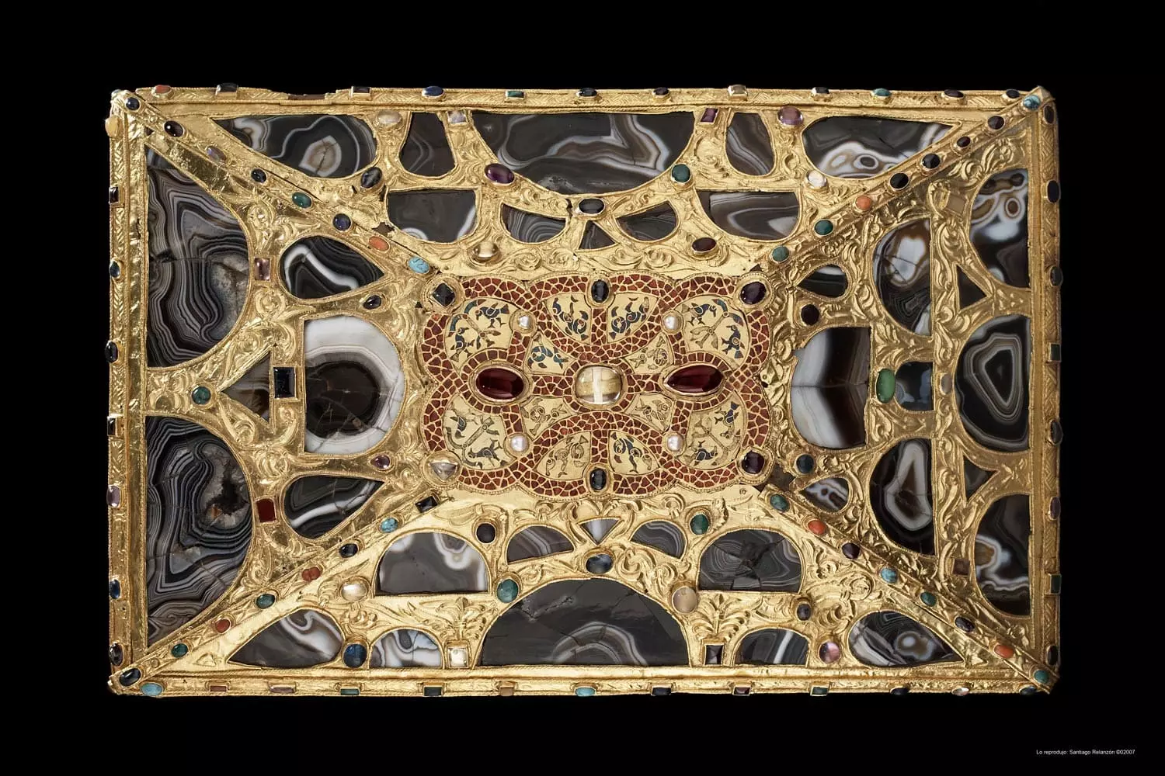

Slide 15
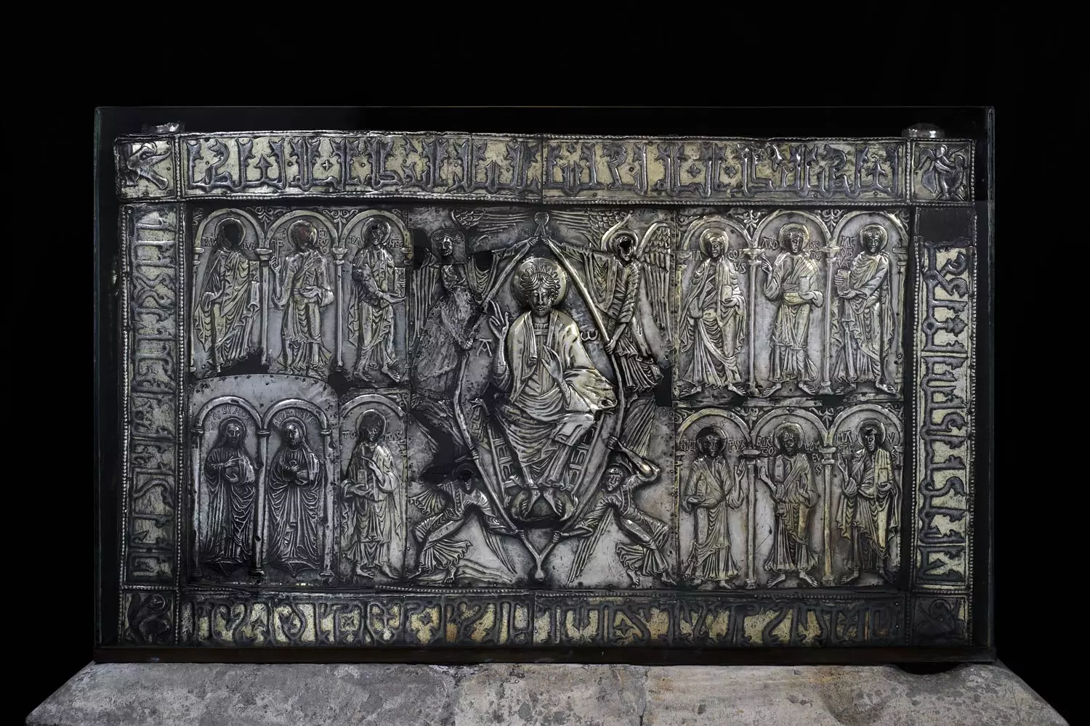
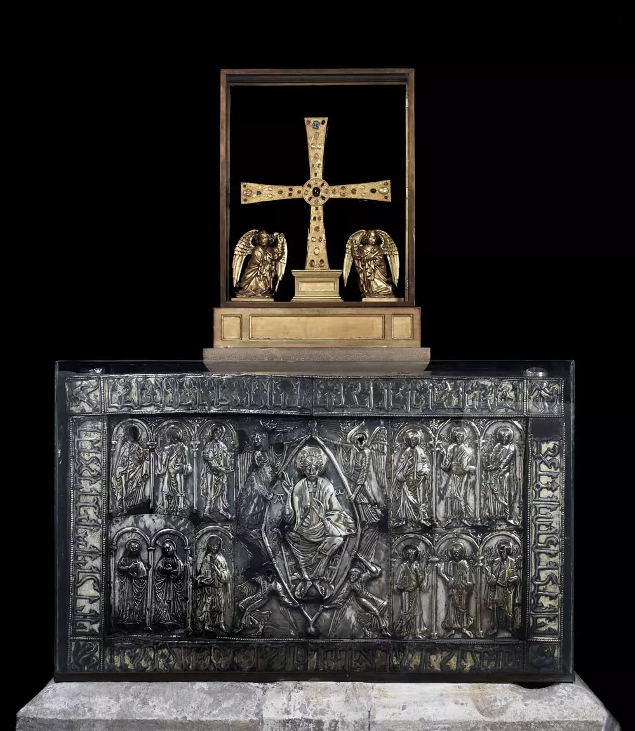
Ark of the relics with the Cross of the Angels of the Holy Chamber of the Cathedral of Oviedo https://catedraldeoviedo.com/conoce-cada-rincon/camara-santa/

Slide 16
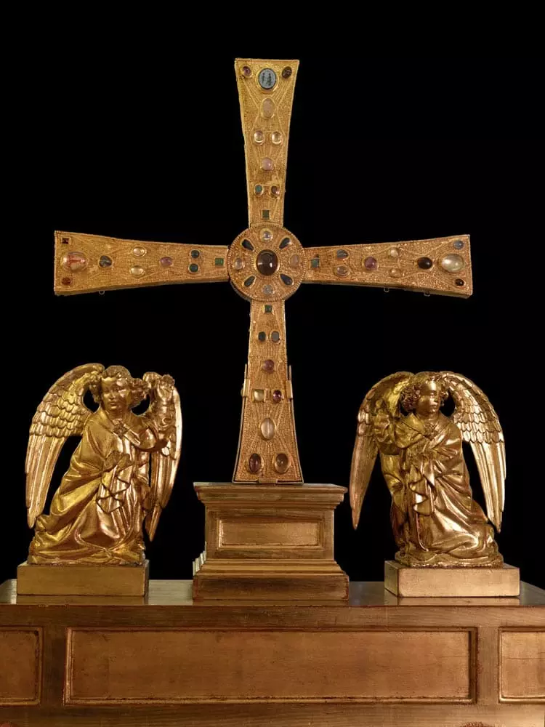
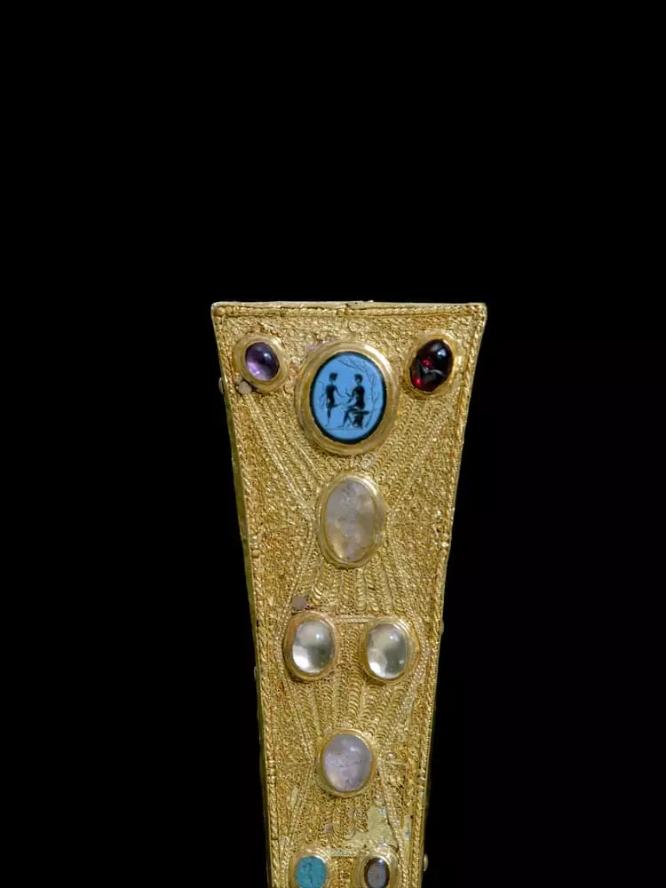
Cross of Los Angeles of the Holy Chamber of the Cathedral of Oviedo https://catedraldeoviedo.com/conoce-cada-rincon/camara-santa/

Slide 17
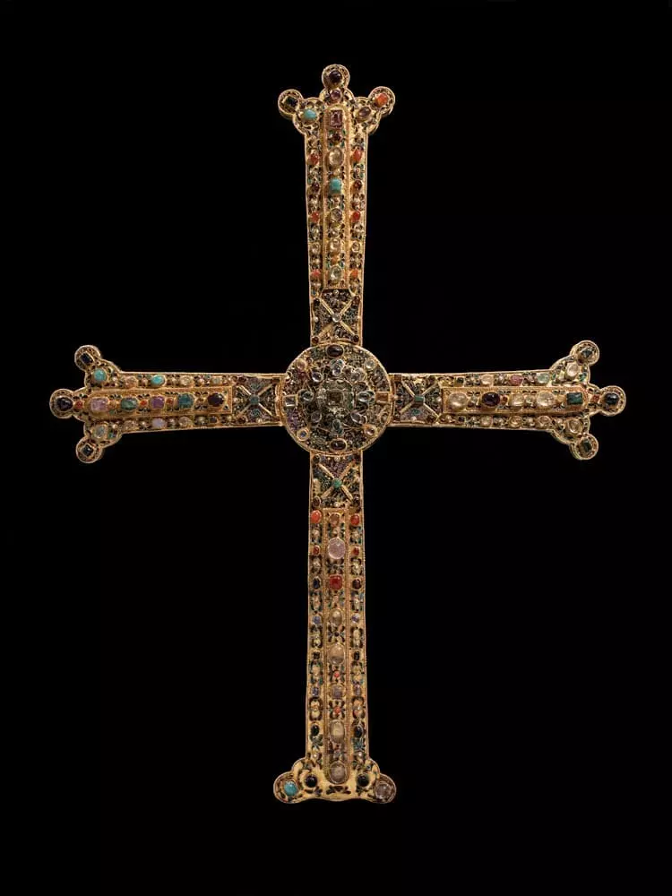
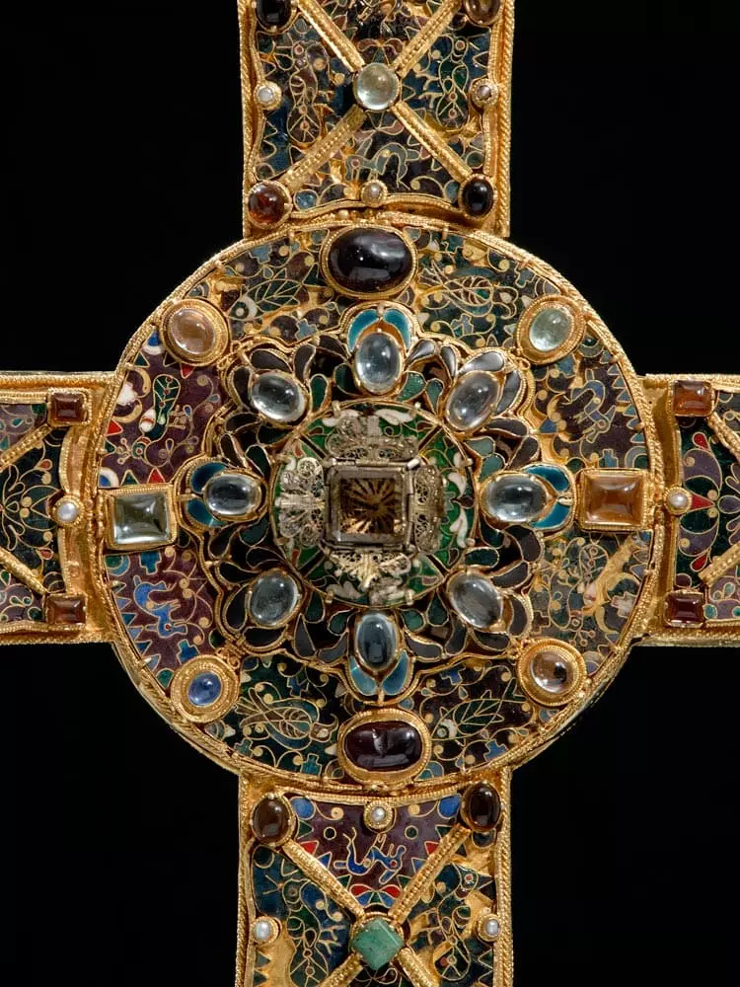
Cross of the Victory of the Holy Chamber of the Cathedral of Oviedo https://catedraldeoviedo.com/conoce-cada-rincon/camara-santa/

Slide 18
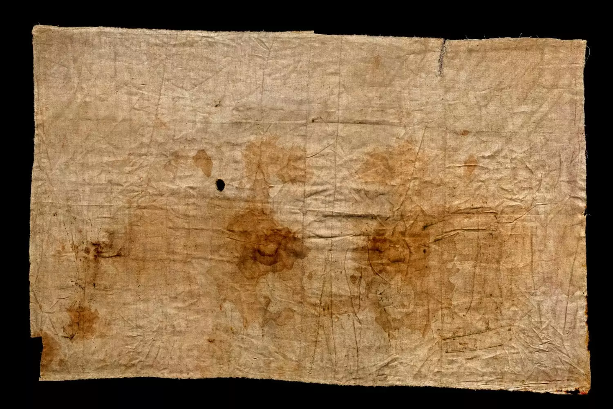
Holy Shroud of the Holy Chamber of the Cathedral of Oviedo https://catedraldeoviedo.com/conoce-cada-rincon/camara-santa/

Slide 19
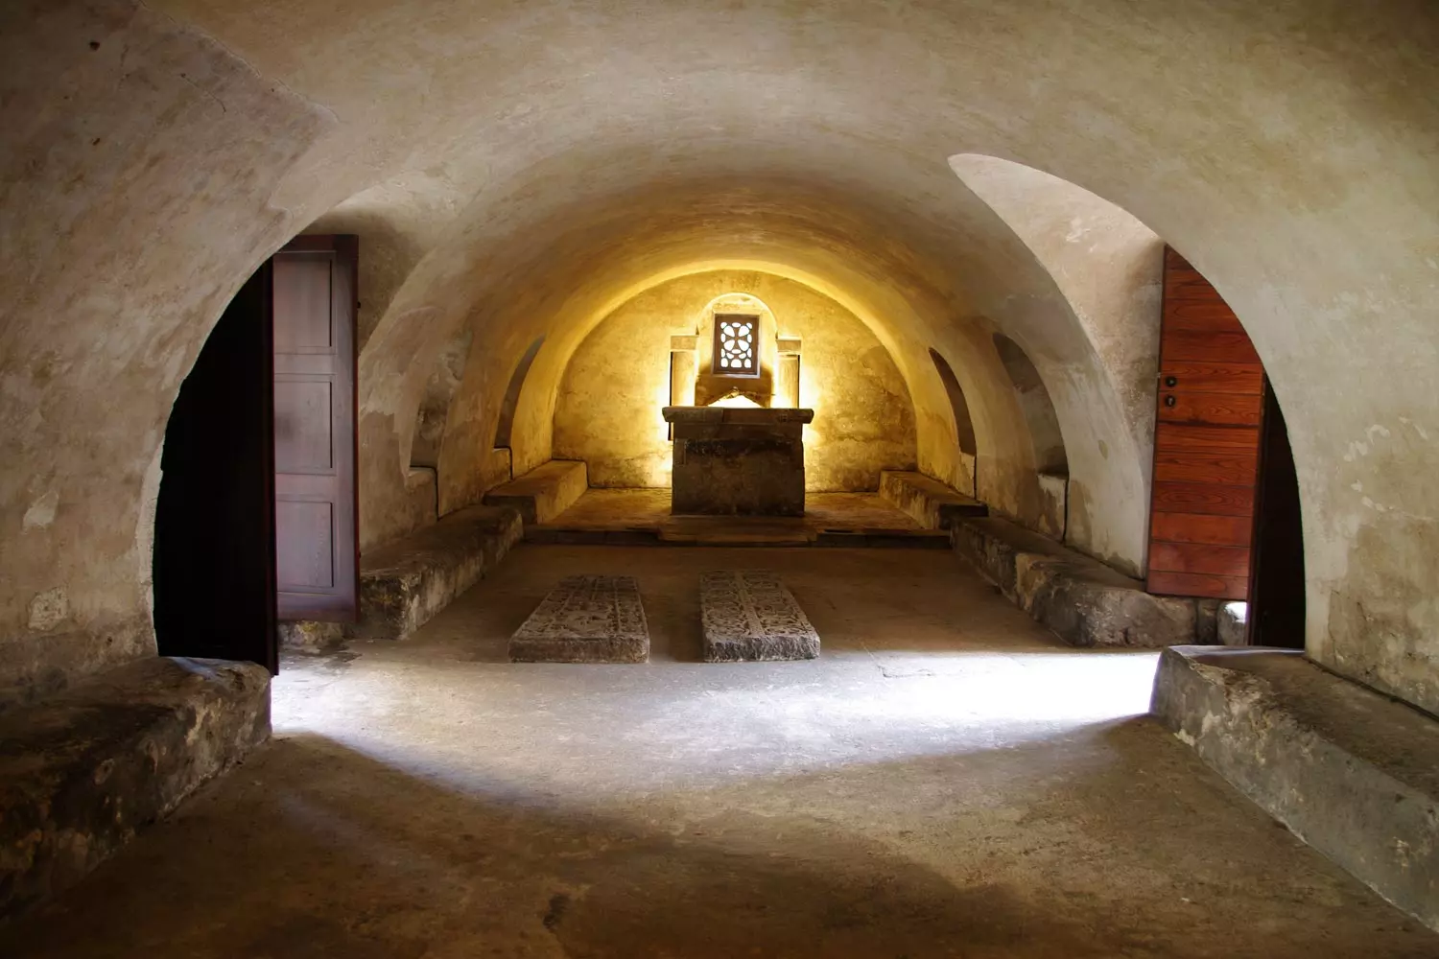
Crypt of Santa Leocadia of the Cathedral of Oviedo https://catedraldeoviedo.com/conoce-cada-rincon/camara-santa/

Slide 20
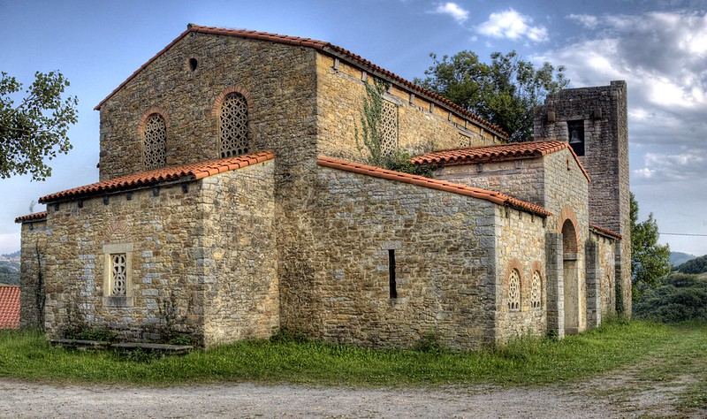
Santa María de Bendones, build between 792 and 842, Bendones, Spain https://www.spottinghistory.com/view/10923/church-of-santa-maria-de-bendones/

Slide 21
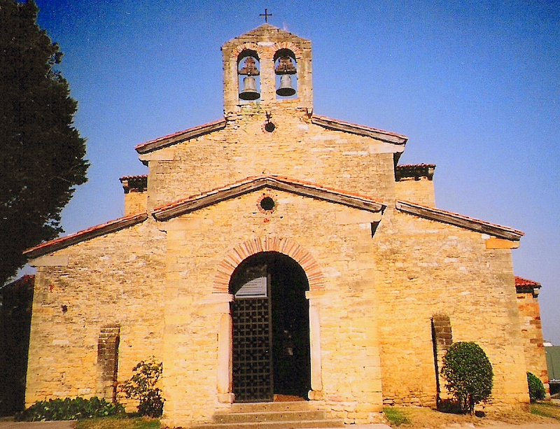
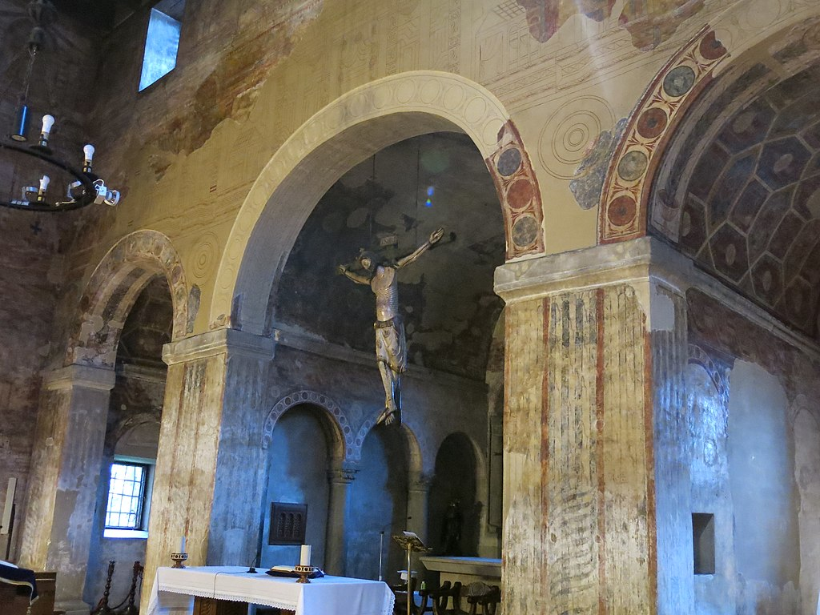
San Julián de los Prados, also known as Santullano, 9th century, Oviedo, Spain https://en.wikipedia.org/wiki/San_Juli%C3%A1n_de_los_Prados

Slide 22
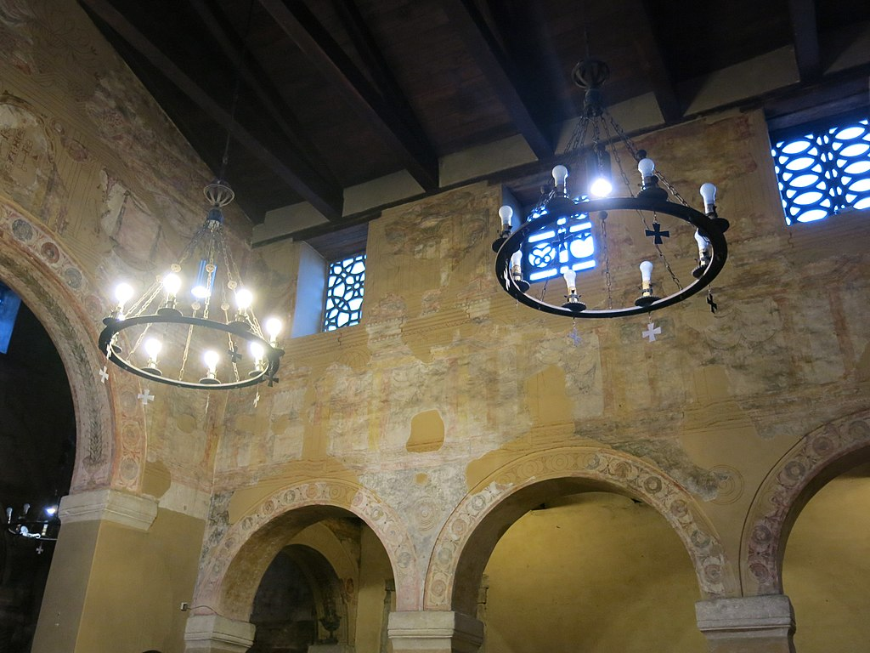

Slide 23
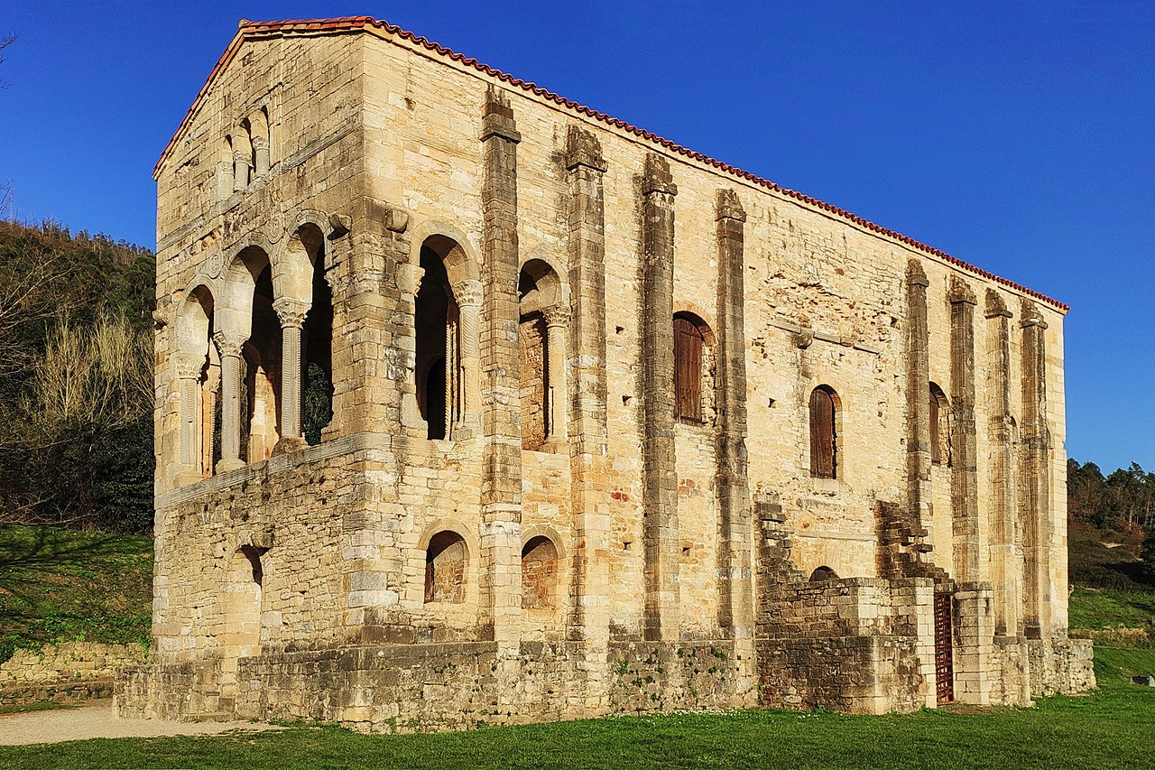
The church of St Mary at Mount Naranco, consecrated in 848, Naranco, Spain https://en.wikipedia.org/wiki/Santa_Mar%C3%ADa_del_Naranco#/media/File:Santa_Mar%C3%ADa_del_Naranco,_Oviedo_edited.jpg

Slide 24
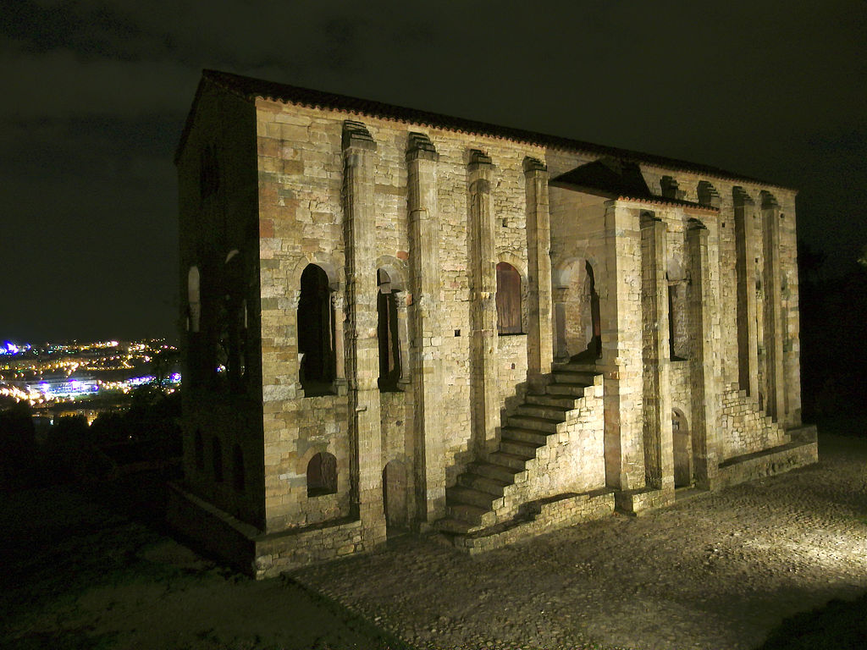

Slide 25
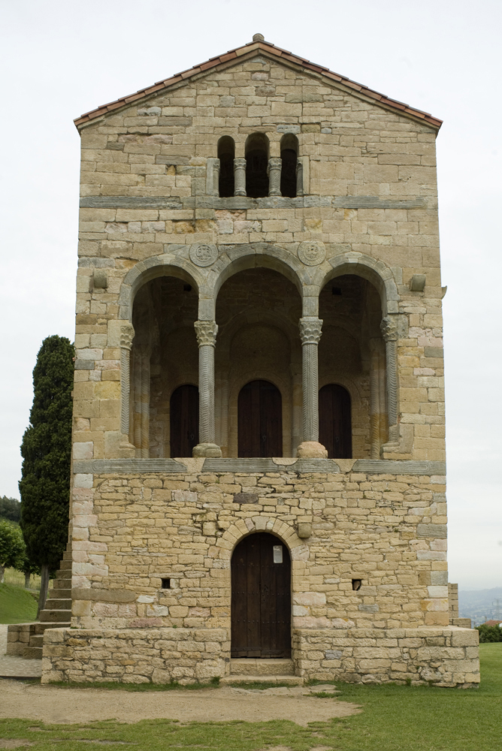
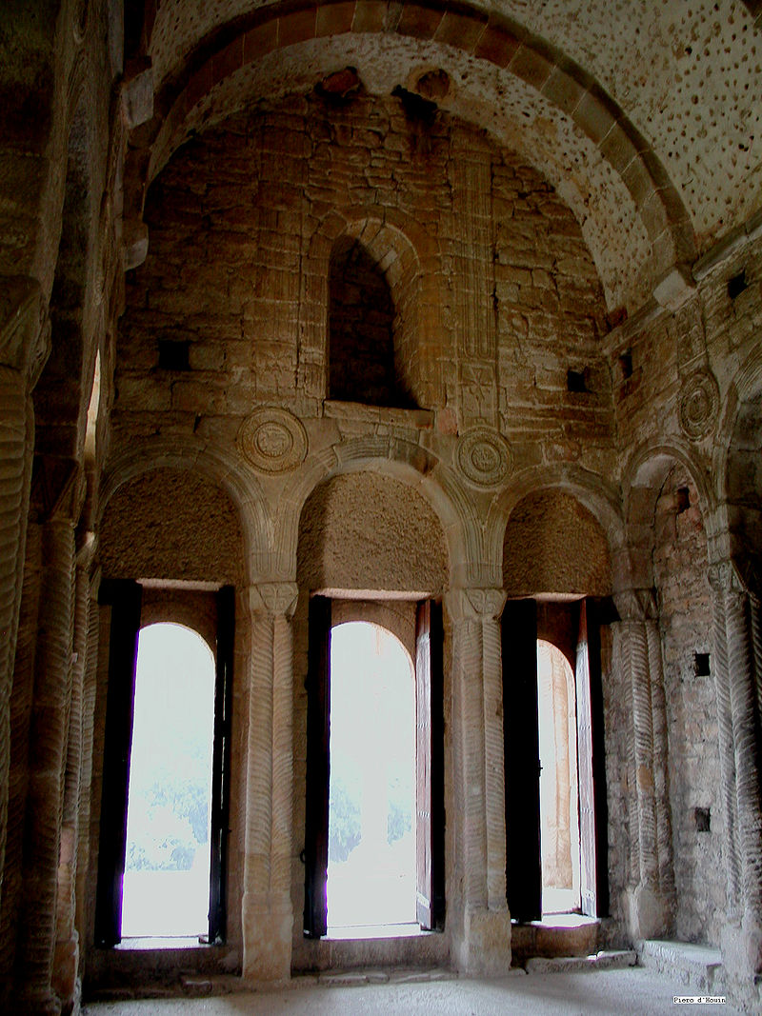
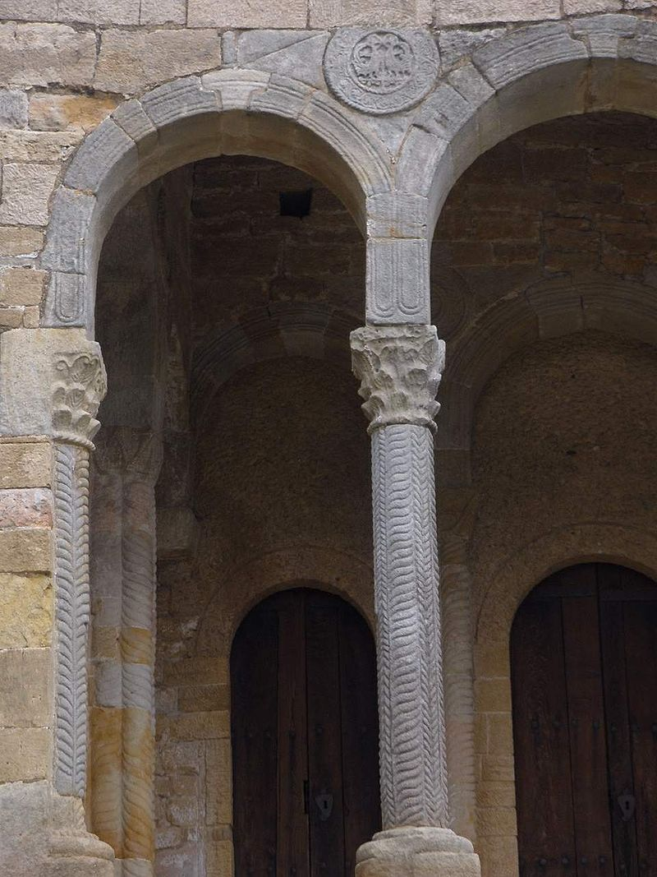

Slide 26
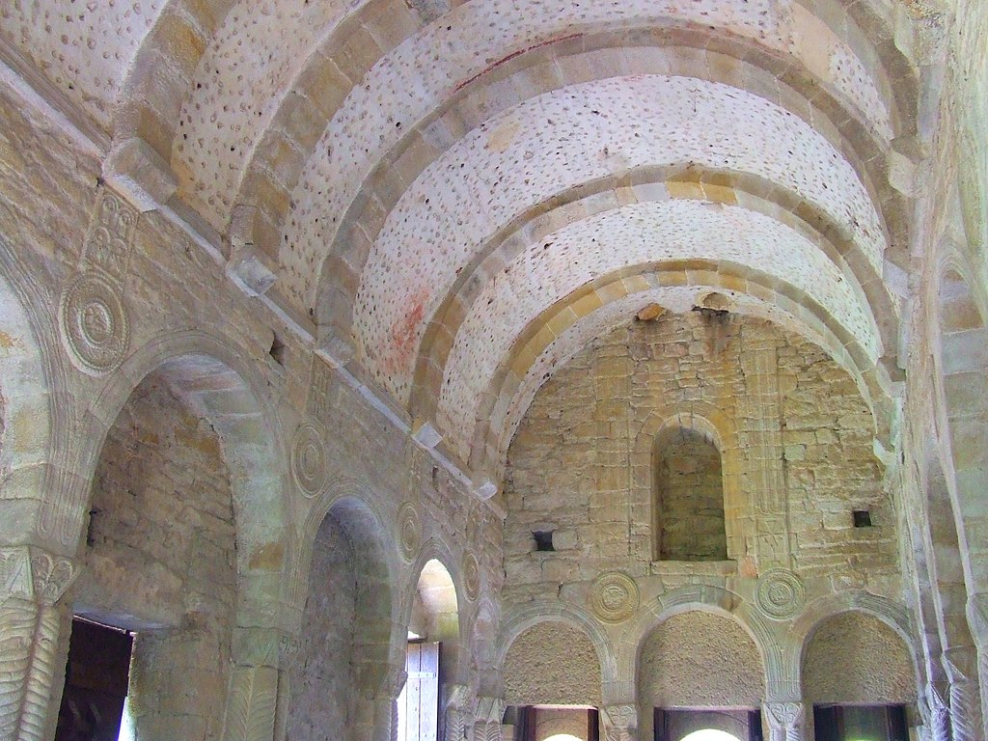

Slide 27
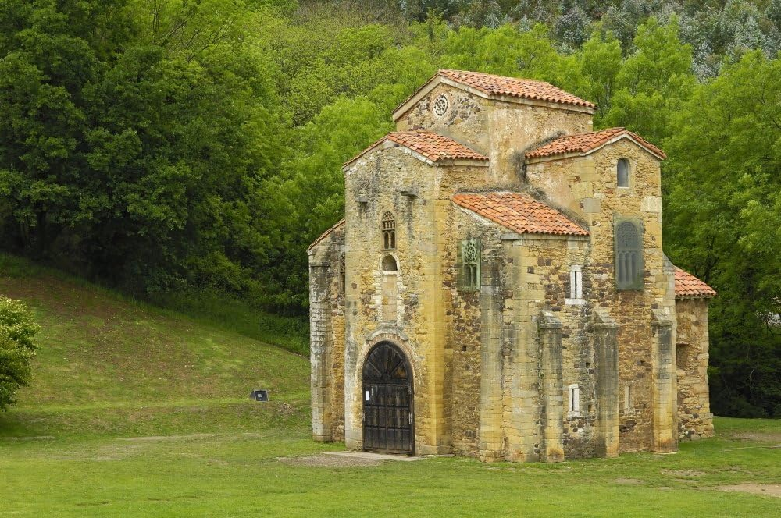
St. Michael of Lillo, completed in 842, Naranco, Spain https://www.amazon.com/Preromanesque-Pre-Romanesque-Architecture-rezAisaEverett-Collection/dp/B07GVY21CV

Slide 28
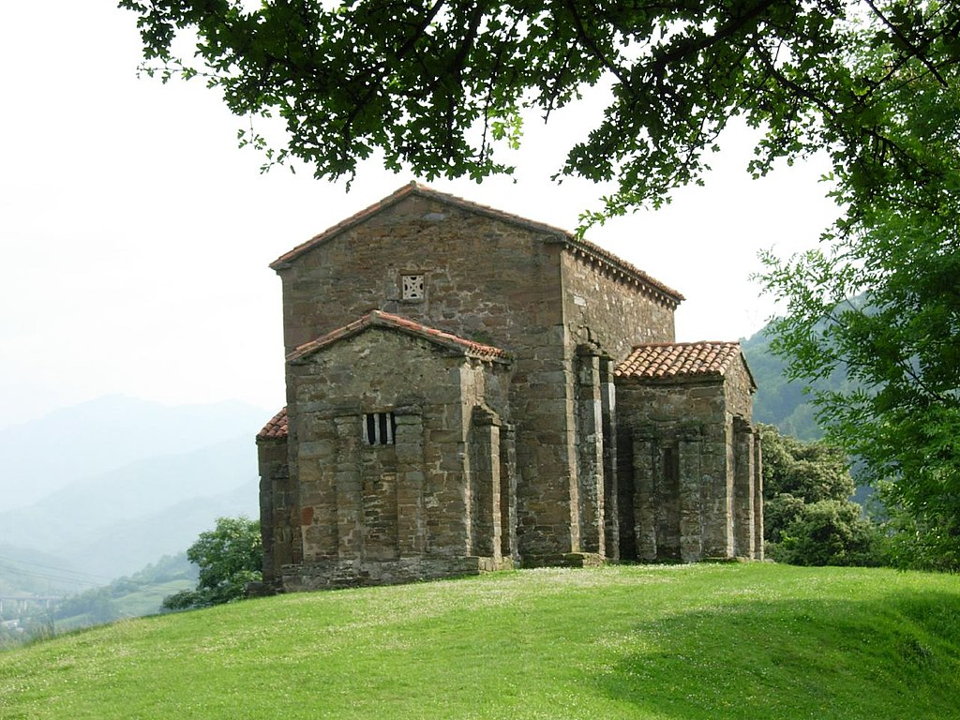
St Christine of Lena, 9th century, Lena Municipality, Spain https://en.wikipedia.org/wiki/Santa_Cristina_de_Lena

Slide 29
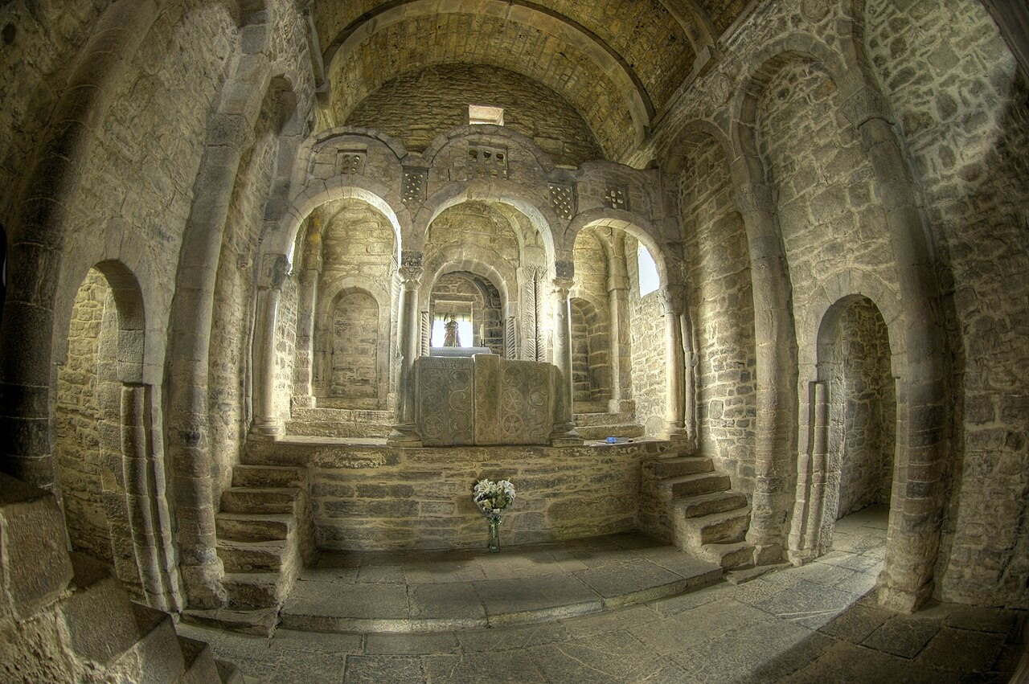

Slide 30
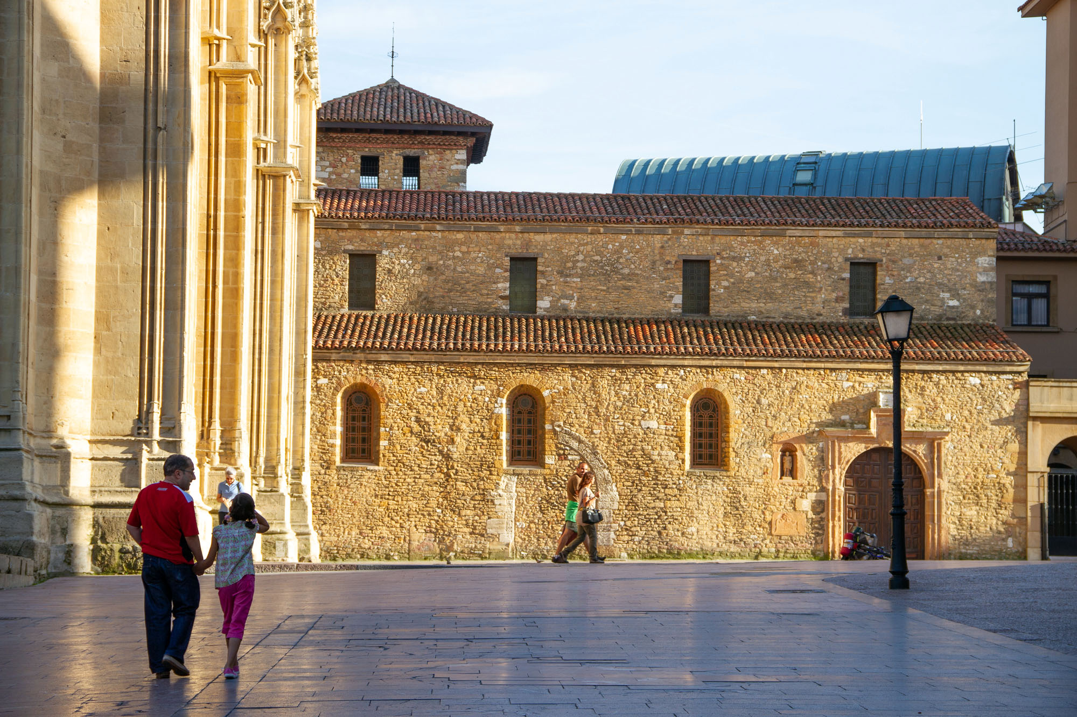
The Church of Saint Thyrsus, 9th century, Oviedo, Spain https://oviedo.for91days.com/san-tirso-oviedos-oldest-church/

Slide 31
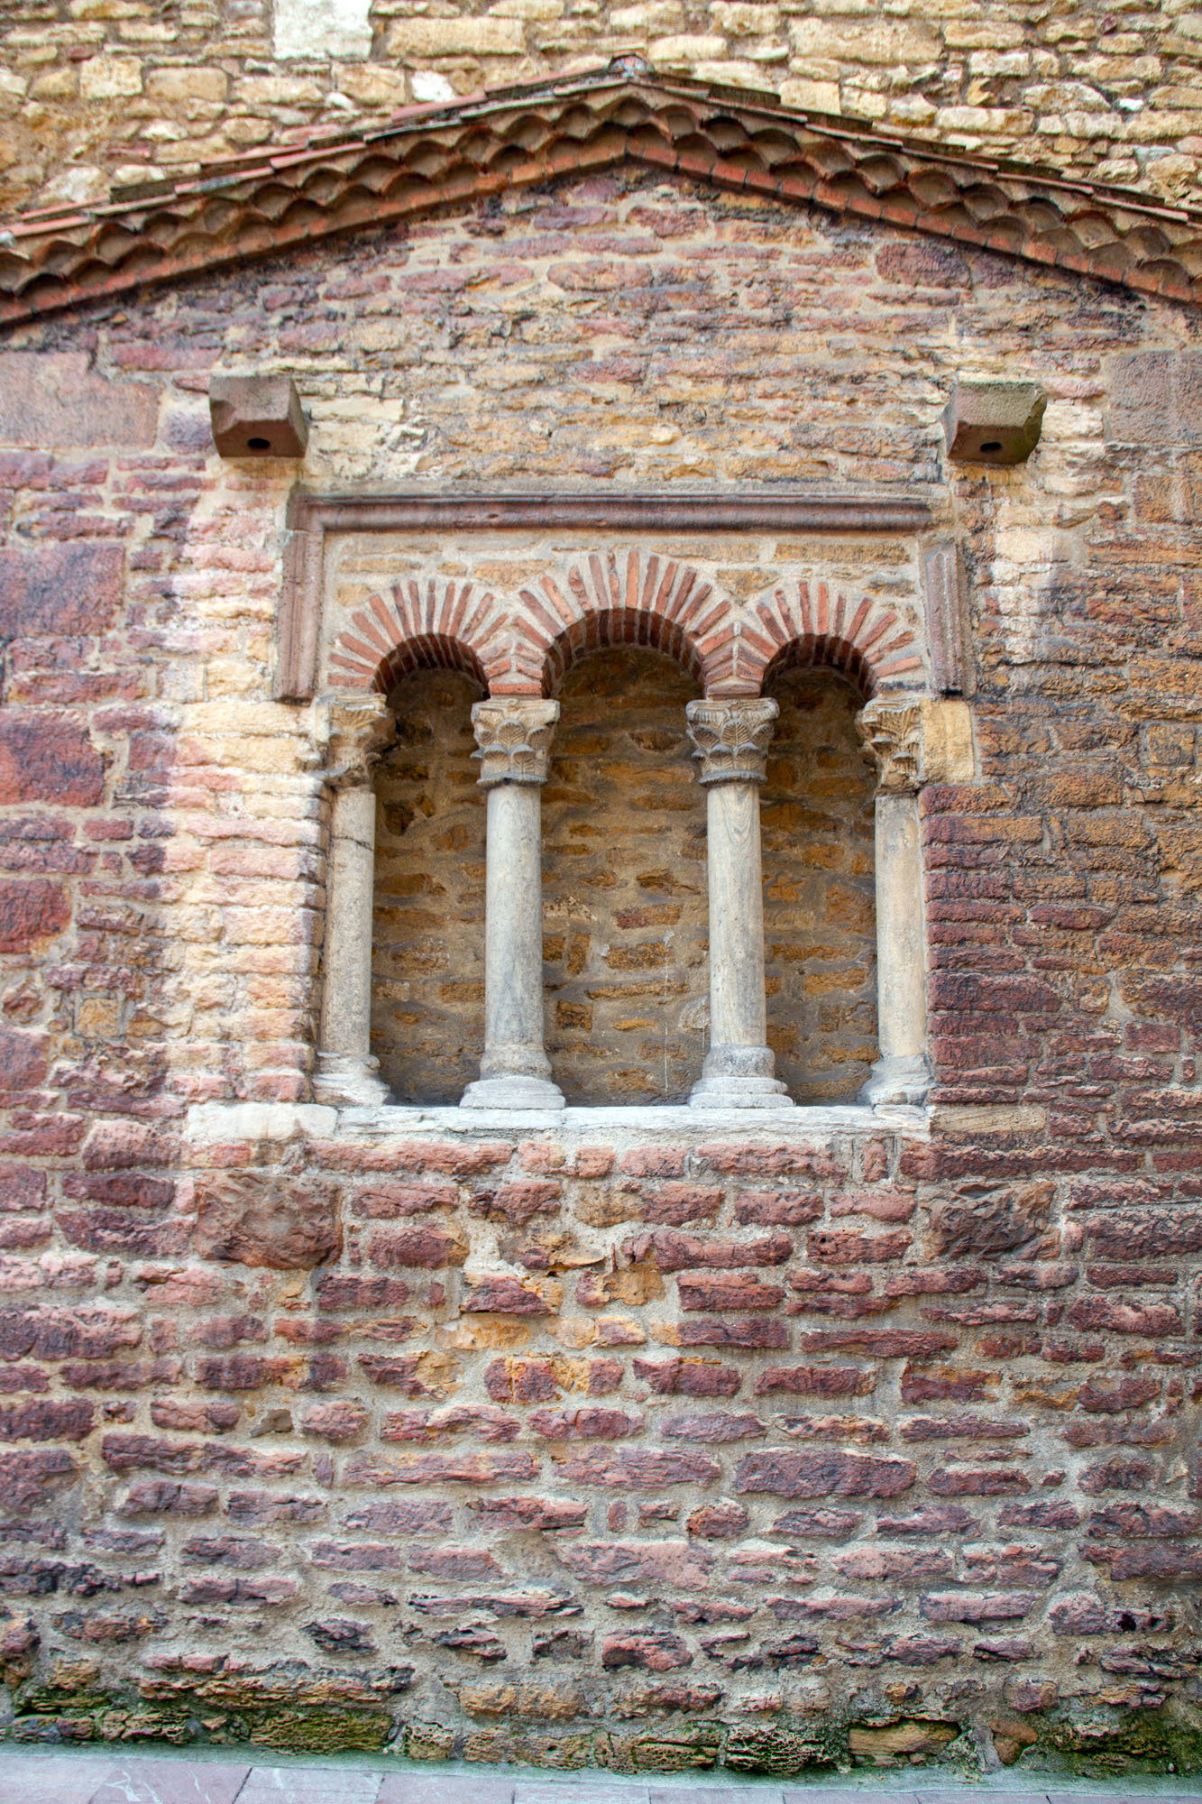
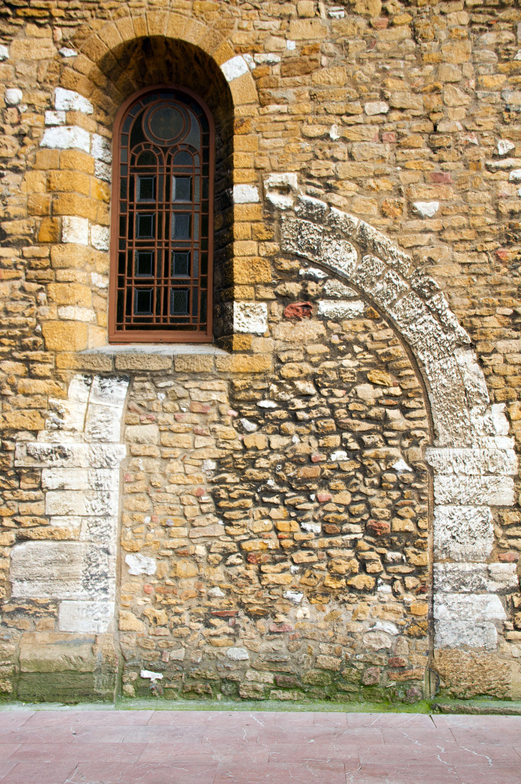

Slide 32
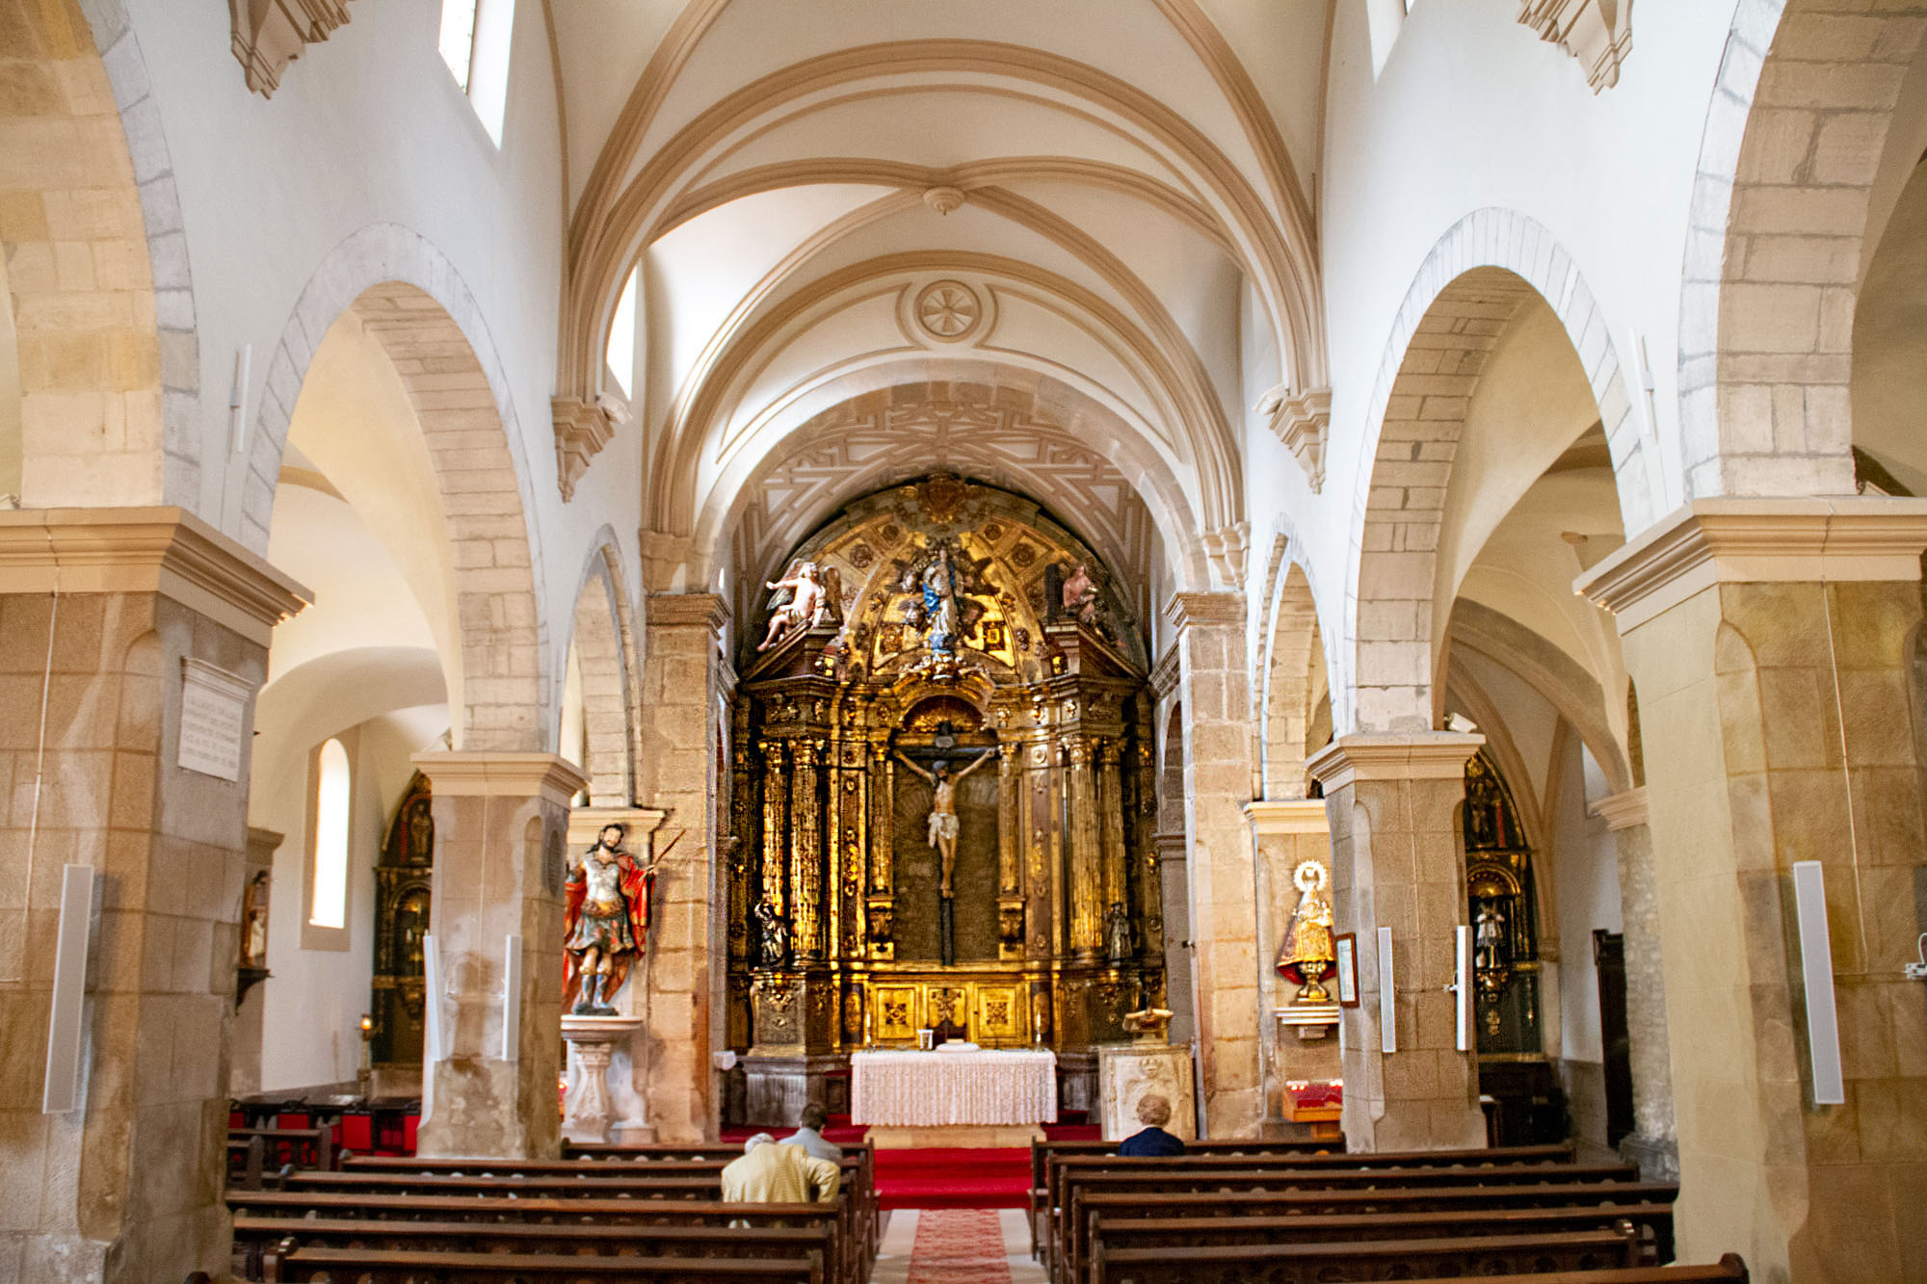

Slide 33
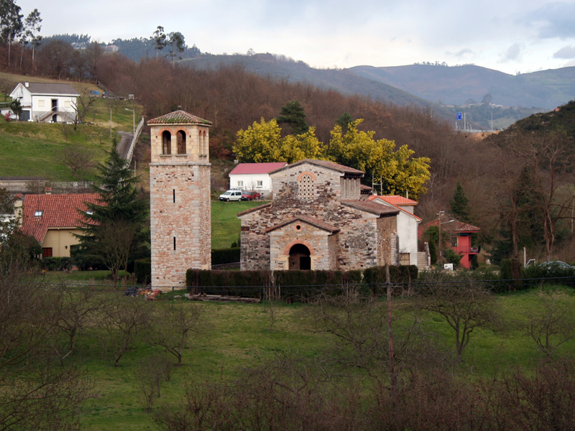
Saint Peter of Nora, late 9th century, Las Regueras, Spain https://en.wikipedia.org/wiki/Church_of_San_Pedro_de_Nora#/media/File:San_Pedro_de_Nora0527.jpg

Slide 34
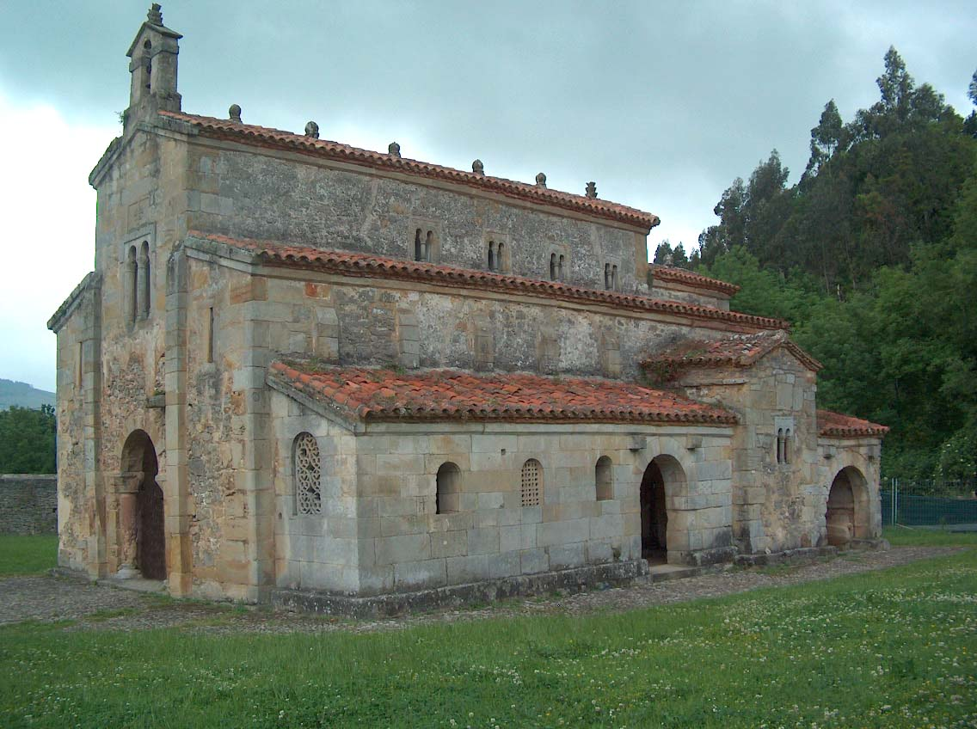
The church of the Holy Savior of Valdediós, late 9th century, located next to Villaviciosa, Asturias, Spain https://en.wikipedia.org/wiki/Church_of_San_Salvador_de_Valdedi%C3%B3s#/media/File:SanSalvadorValdedios-1.jpg

Slide 35
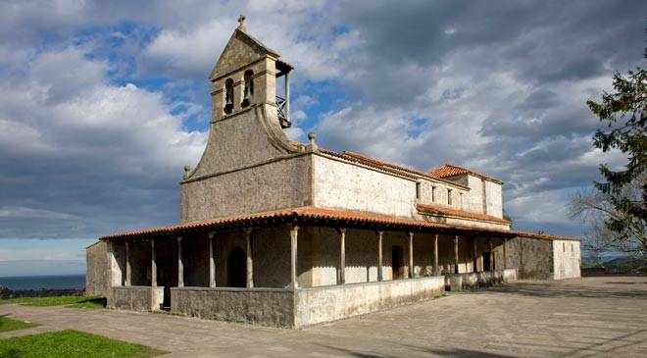
Saint James of Gobiendes, late 9th century, Gobiendes, Spain http://www.spainisculture.com/en/monumentos/asturias/iglesia_de_santiago_de_gobiendes.html

Slide 36
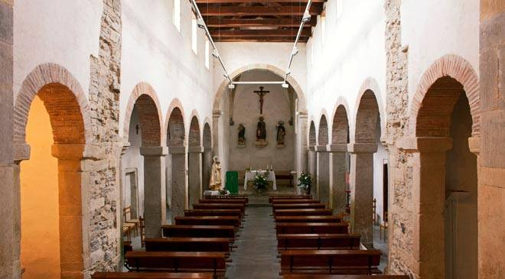

Slide 37
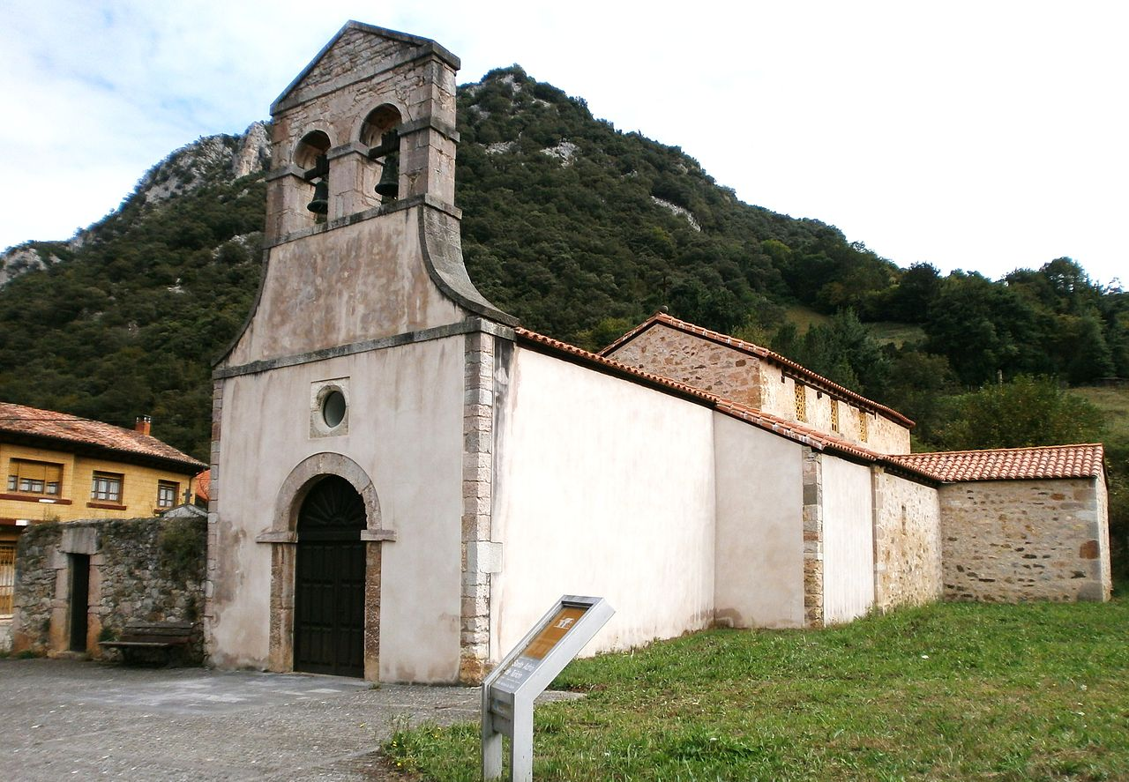
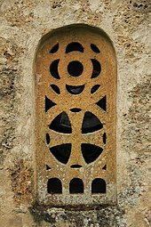
Santo Adriano de Tunon, late 9th century, Tunon, Spain https://es.wikipedia.org/wiki/Santo_Adriano_de_Tu%C3%B1%C3%B3n

Slide 38
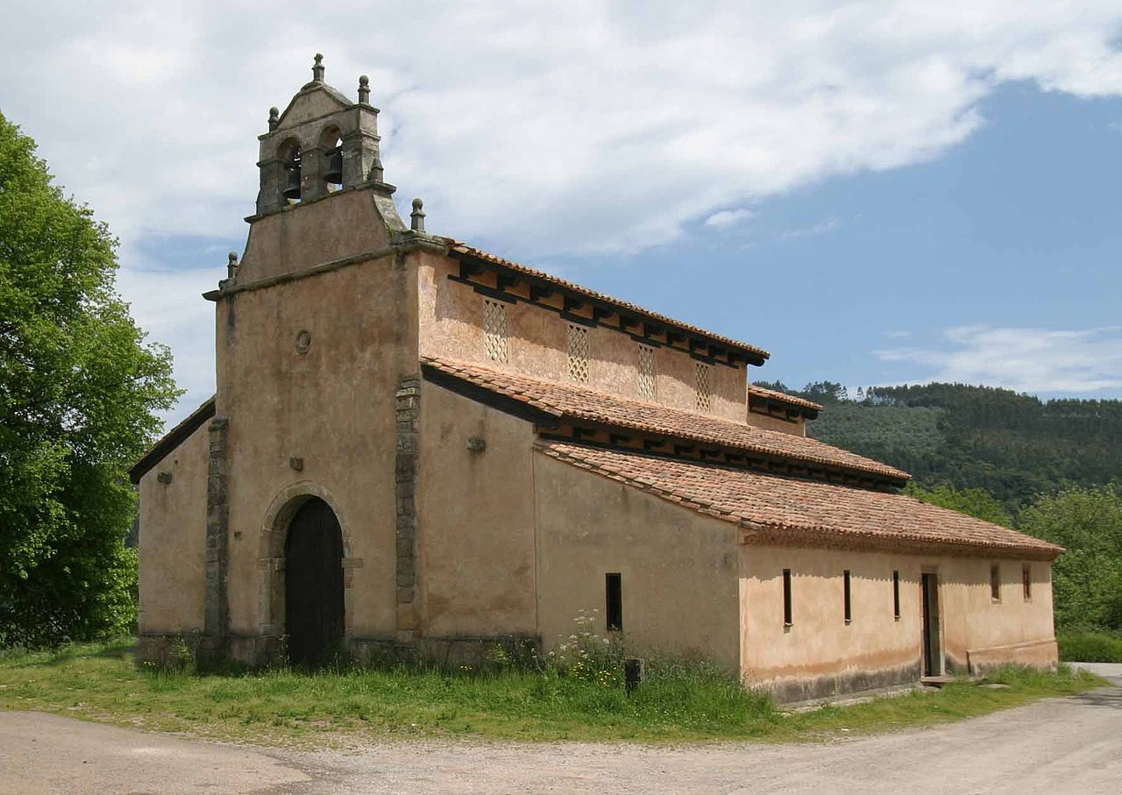
Holy Saviour of Priesca, late 9th century, Priesca, Spain https://en.wikipedia.org/wiki/Church_of_San_Salvador_de_Priesca#/media/File:Priesca1.jpg

Slide 39
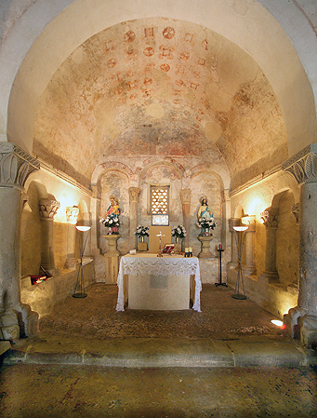
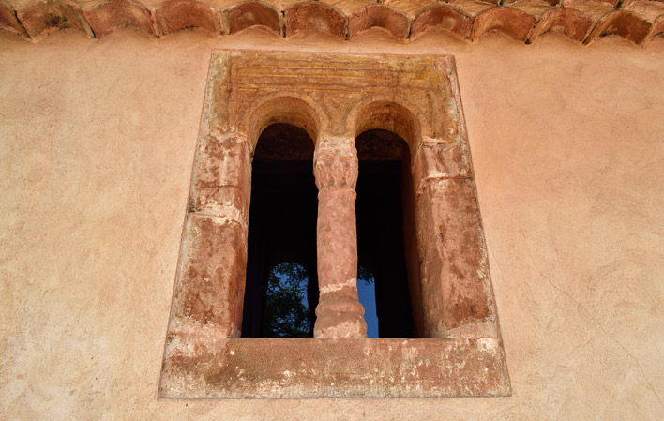
https://www.turismoasturias.es/en/descubre/cultura/prerromanico/iglesia-de-san-salvador-de-priesca

Slide 40
The End

