Slide 1


Slide 2
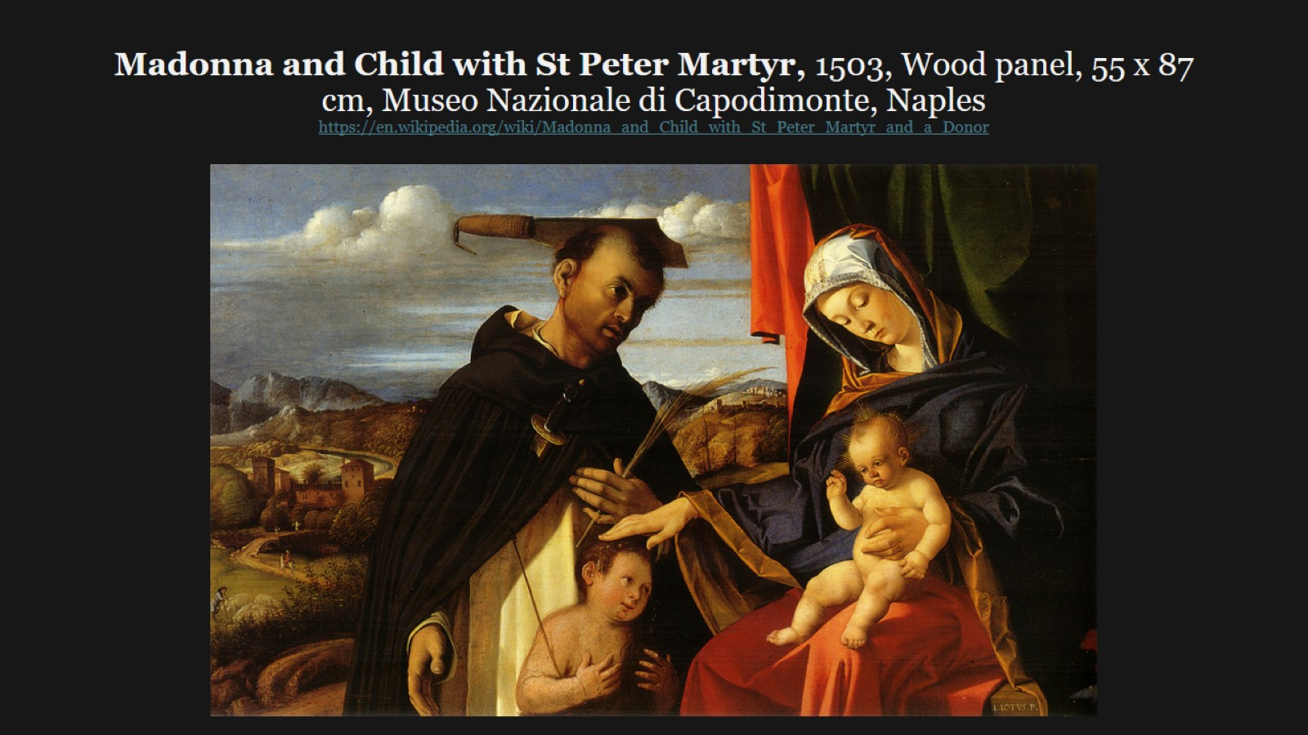
Madonna and Child with St Peter Martyr, 1503, Wood panel, 55 x 87 cm, Museo Nazionale di Capodimonte, Naples https://en.wikipedia.org/wiki/Madonna_and_Child_with_St_Peter_Martyr_and_a_Donor

Slide 3
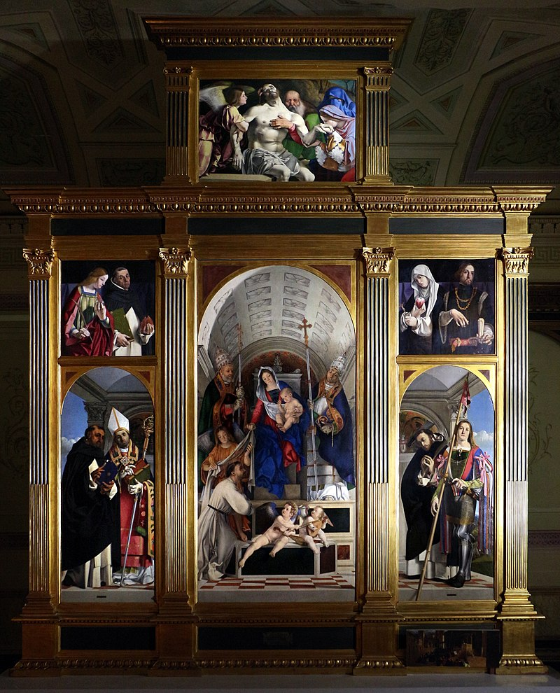
Recanati Polyptych, 1508, Oil on wood, Pinacoteca Civica, Recanati https://en.wikipedia.org/wiki/Recanati_Polyptych#/media/File:Lorenzo_lotto,_polittico_di_san_domenico_di_recanati,_1508,_01.jpg

Slide 4
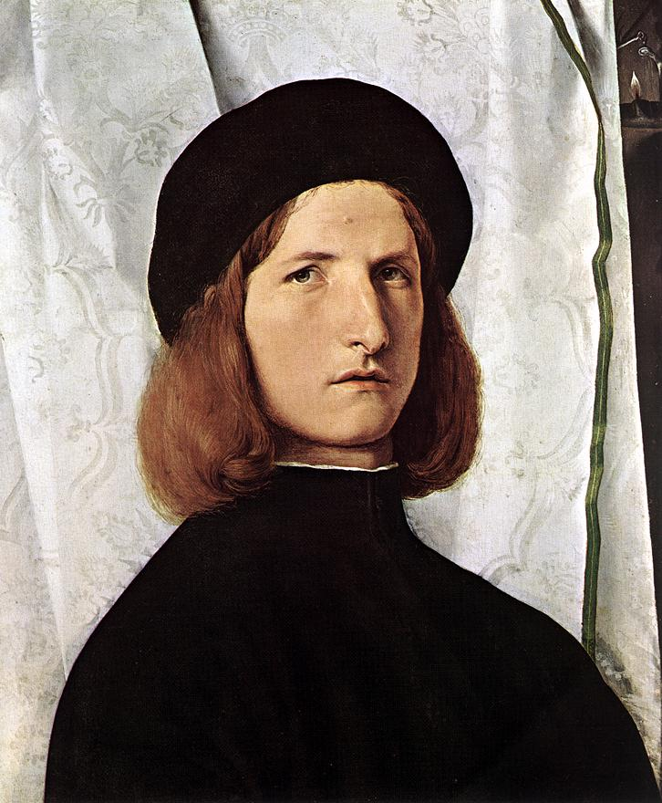
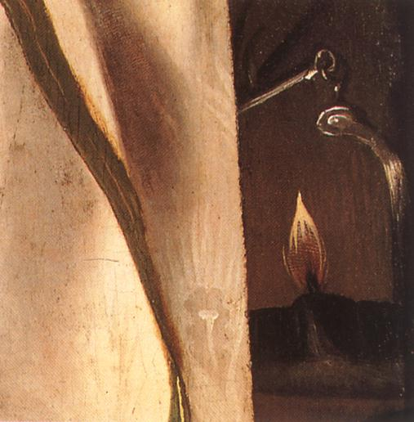
Portrait of a Young Man with an Oil-lamp
1506-10, Oil on wood, 42 x 36 cm, Kunsthistorisches Museum, Vienna https://www.wga.hu/frames-e.html?/html/l/lotto/index.html

Slide 5
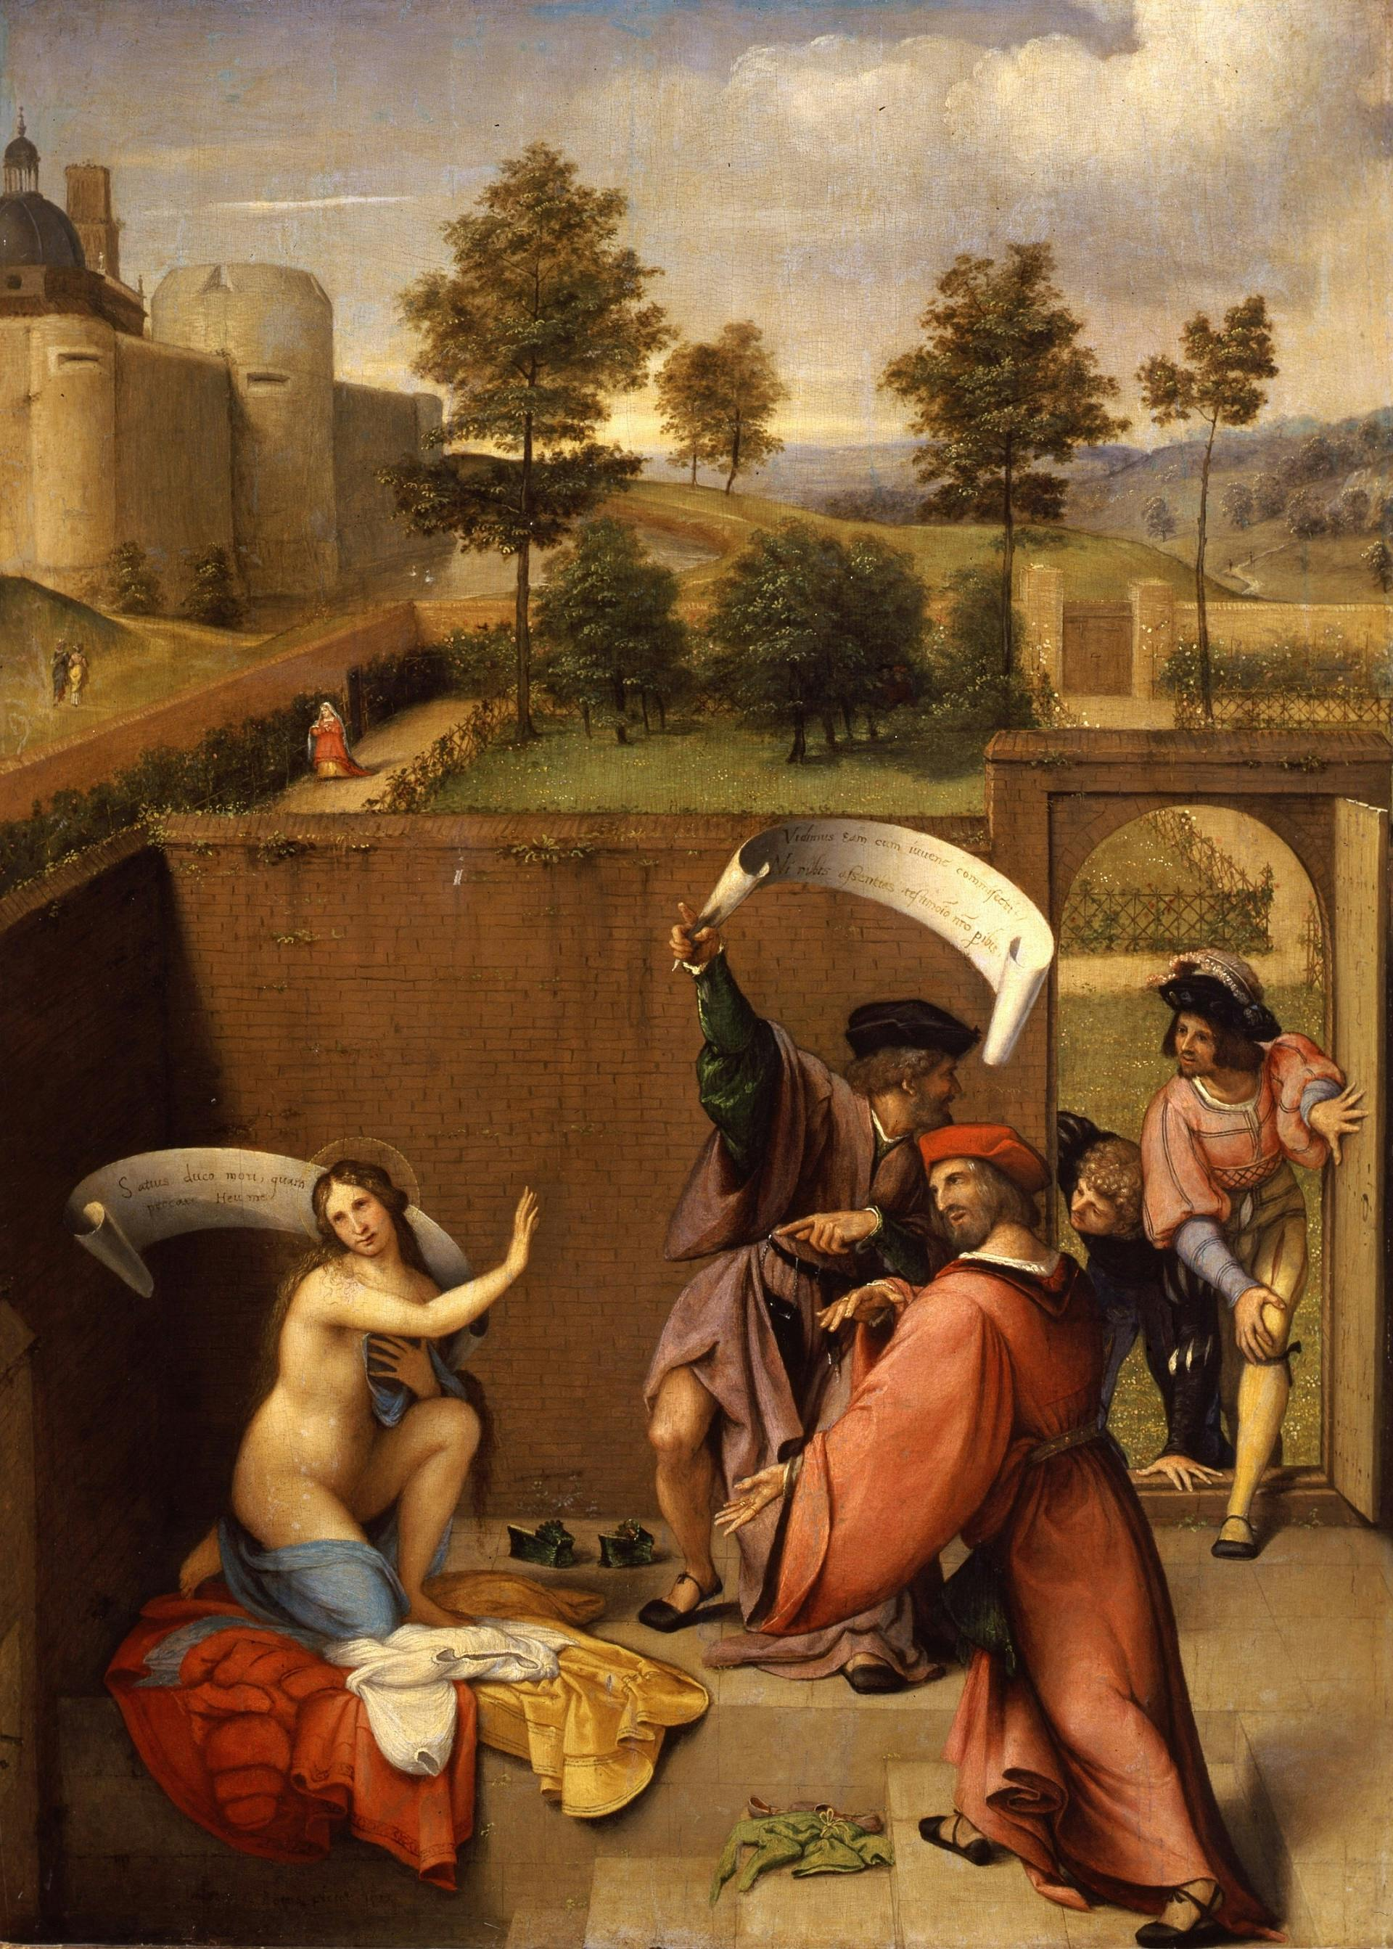
Susanna and the Elders, 1517, Oil on wood, 66 x 50 cm, Galleria degli Uffizi, Florence, Italy https://www.uffizi.it/en/artworks/susanna-and-the-elders

Slide 6
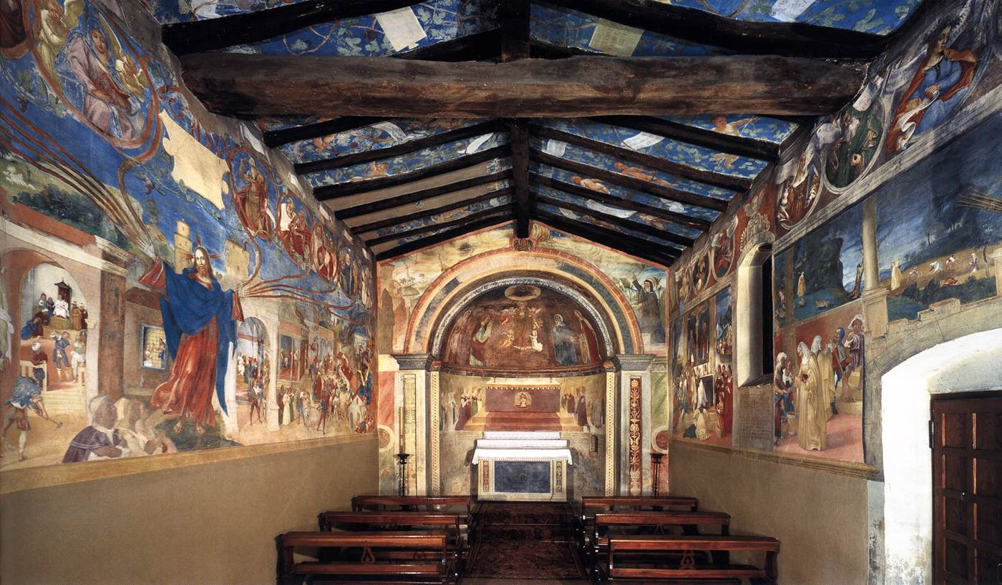
View of the oratory toward the altar, 1523-24, Fresco, Oratorio Suardi, Trescore, Italy https://www.wga.hu/frames-e.html?/html/l/lotto/index.html

Slide 7
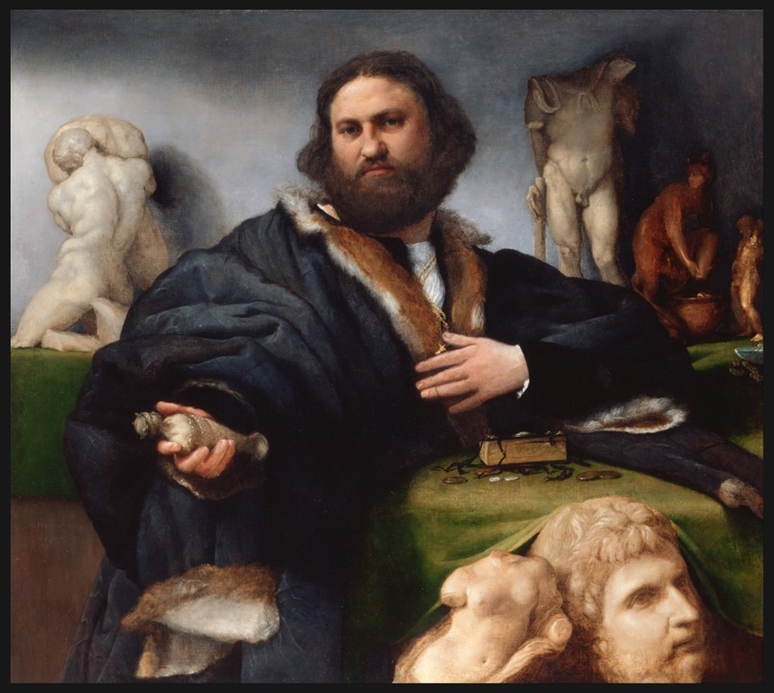
Portrait of Andrea Odoni, 1527, Oil on canvas, 104 x 117 cm, Royal Collection, Hampton Court, UK https://el.wikipedia.org/wiki/%CE%91%CF%81%CF%87%CE%B5%CE%AF%CE%BF:Lorenzo_Lotto_-_Andrea_Odoni_%281488-1545%29_-_Google_Art_Project.jpg

Slide 8
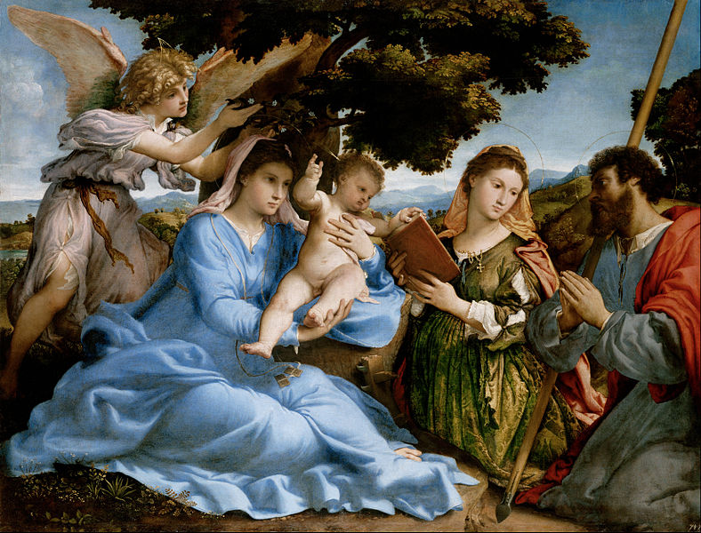
Madonna and Child with Saints and an Angel, 1527-28, Oil on canvas, 114 x 152 cm, Kunsthistorisches Museum, Vienna, Austria https://commons.wikimedia.org/wiki/File:Lorenzo_Lotto_-_Madonna_and_Child_with_Saints_Catherine_and_Thomas_(sacra_conversazione)_-_Google_Art_Project.jpg

Slide 9
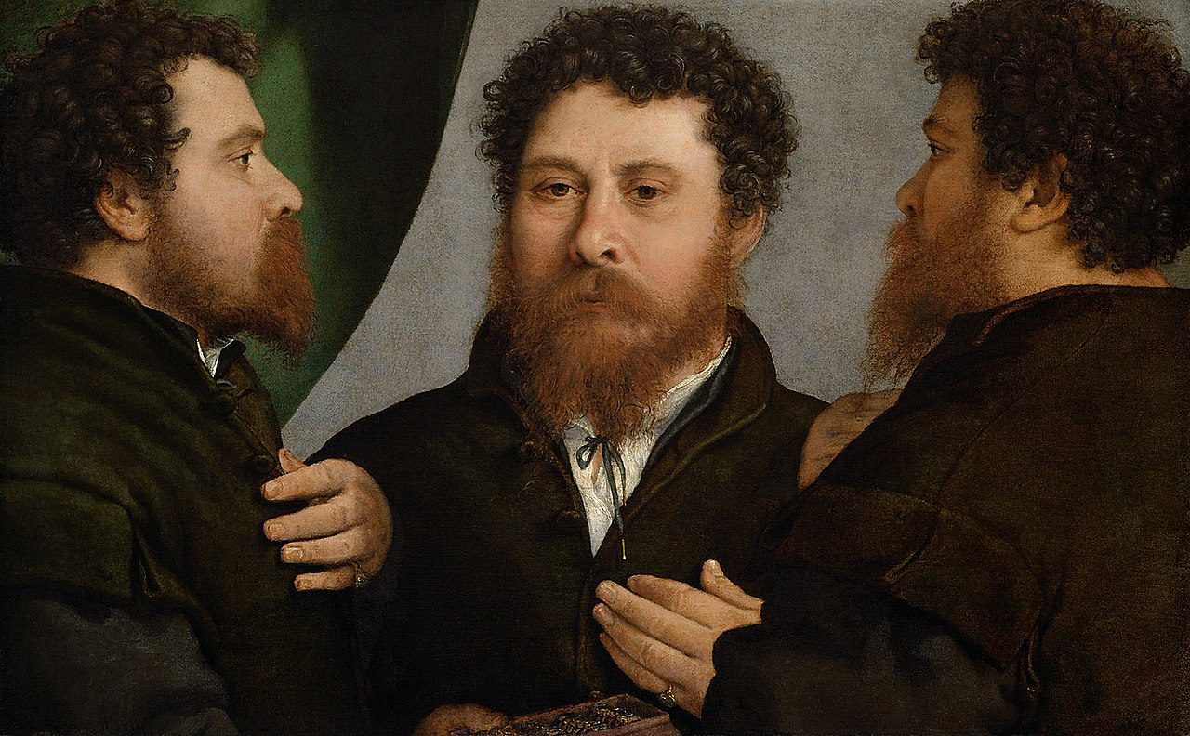
Portrait of a Goldsmith in Three Positions, c. 1530, Oil on canvas, 52 x 79 cm, Kunsthistorisches Museum, Vienna, Austria https://en.wikipedia.org/wiki/Triple_Portrait_of_a_Goldsmith#/media/File:Lorenzo_Lotto,_,_Kunsthistorisches_Museum_Wien,_Gem%C3%A4ldegalerie_-_Ein_Goldschmied_in_drei_Ansichten_-_GG_92_-_Kunsthistorisches_Museum.jpg

Slide 10
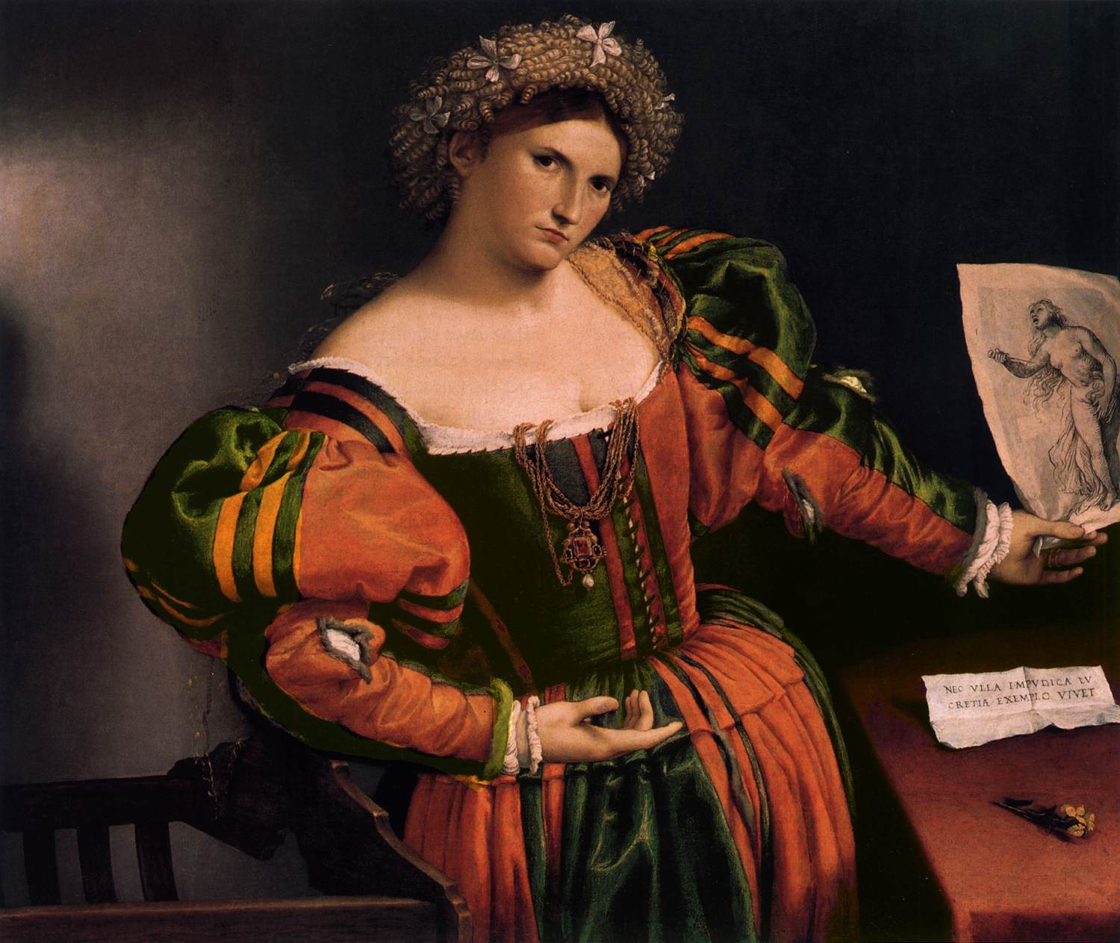
Portrait of a Lady as Lucretia, 1530-32, Oil on canvas, 96 x 111 cm, National Gallery, London, UK https://www.wga.hu/frames-e.html?/html/l/lotto/index.html

Slide 11
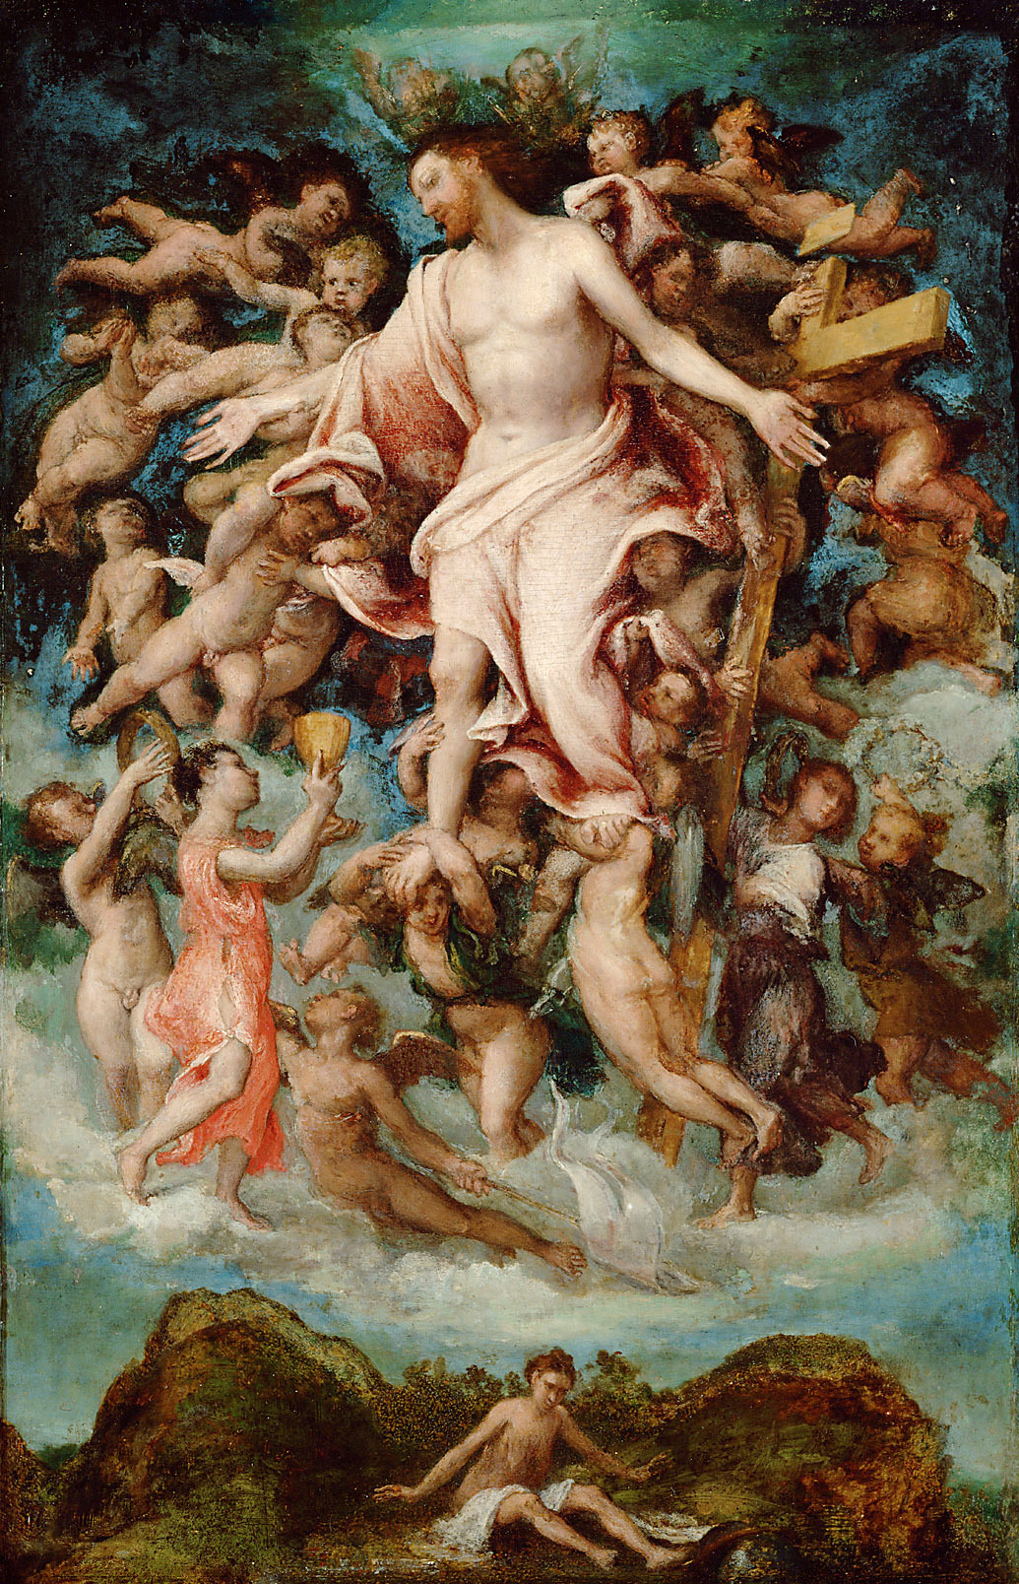
Christ, Giving His Blood, 1543, Poplar wood, 50 x 32 cm, Kunsthistorisches Museum, Vienna, Austria https://upload.wikimedia.org/wikipedia/commons/9/98/Lorenzo_Lotto_071.jpg

