Slide 1
American Art during the 19th century
The Hudson River School
Sanford Robinson Gifford, 1823–1880
10 Paintings

Slide 2
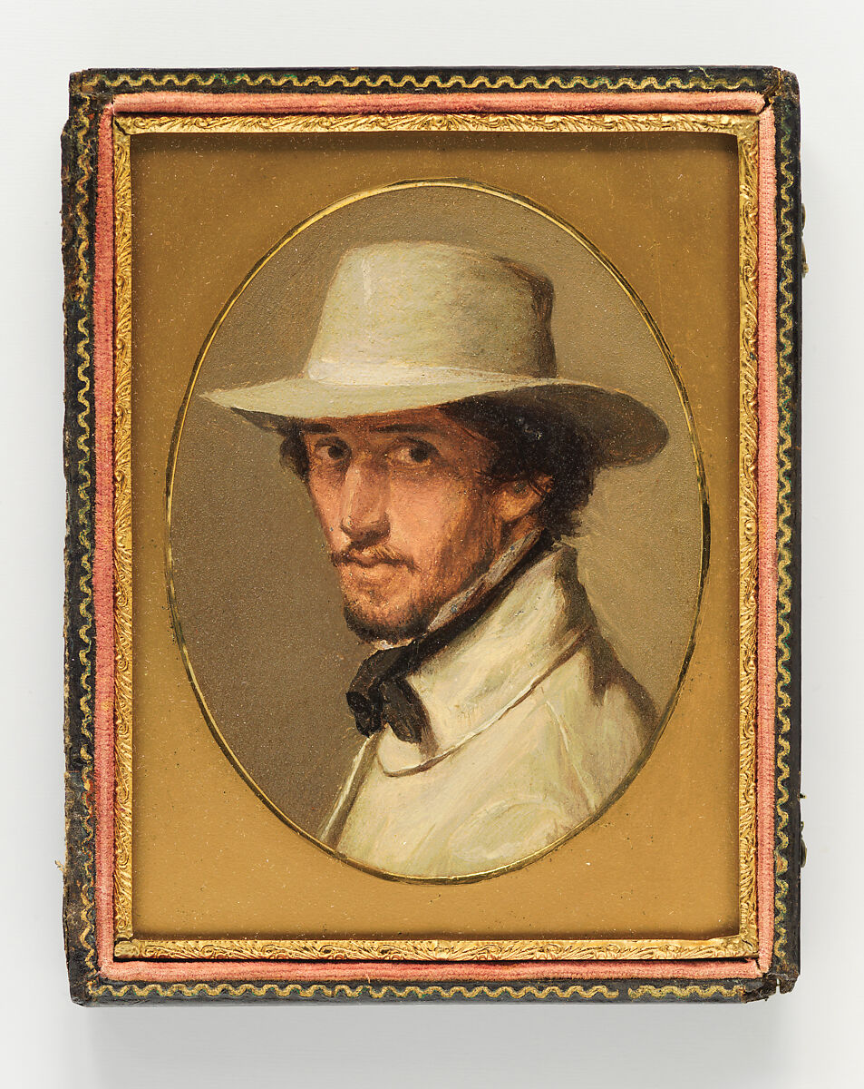
Self-portrait, 1853, Oil on Paper, 10.8 × 8.3 cm, the MET, NY, USA https://www.metmuseum.org/art/collection/search/700489

Slide 3
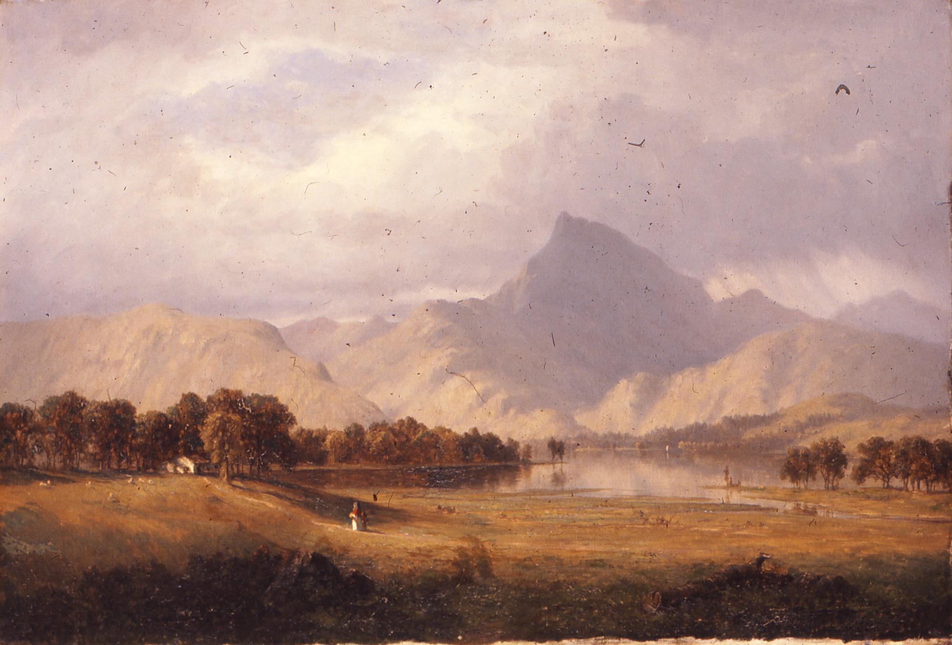
Derwentwater, 1856. Oil on Canvas, 44.8 × 65.1 cm, Brooklyn Museum, NY, USA https://www.brooklynmuseum.org/opencollection/objects/115

Slide 4
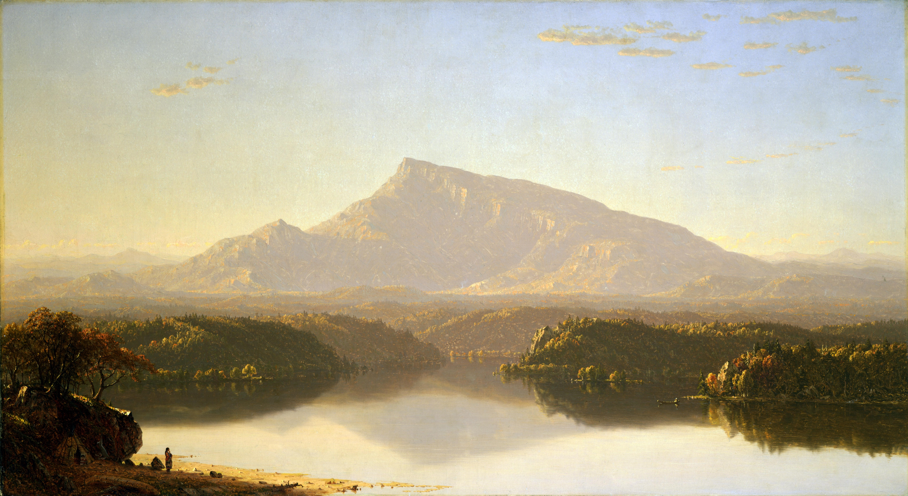
The wilderness, 1860, Oil on Canvas, 76.2 x 138 cm, Toledo Museum of Art, USA http://emuseum.toledomuseum.org/objects/54981/the-wilderness?ctx=8bf451c2-6604-4621-beb8-7e0369cc10b0&idx=1

Slide 5
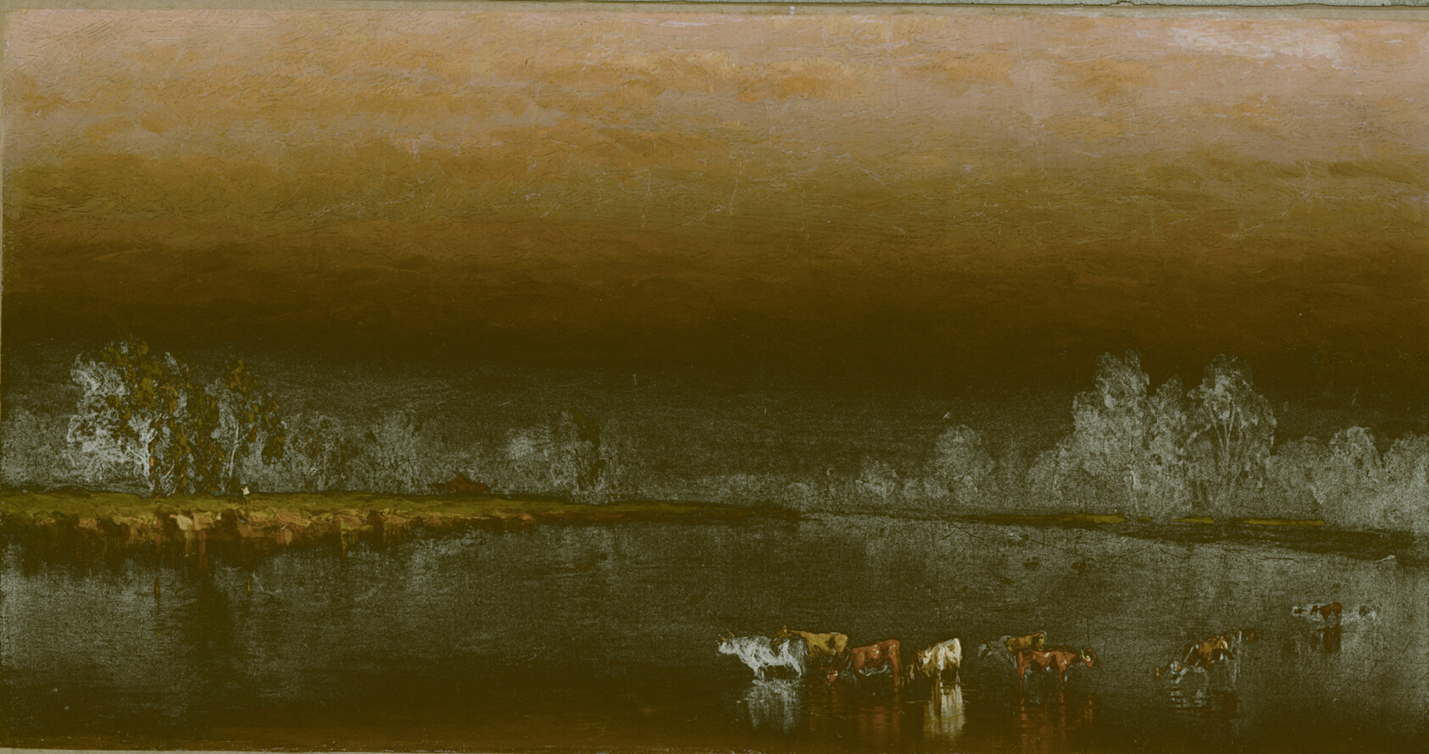
Cows in a Pond at Sunset, 1860, Oil on Canvas, 19.1 × 35.9 cm, the Art institute of Chicago, USA https://www.artic.edu/artworks/72398/cows-in-a-pond-at-sunset

Slide 6
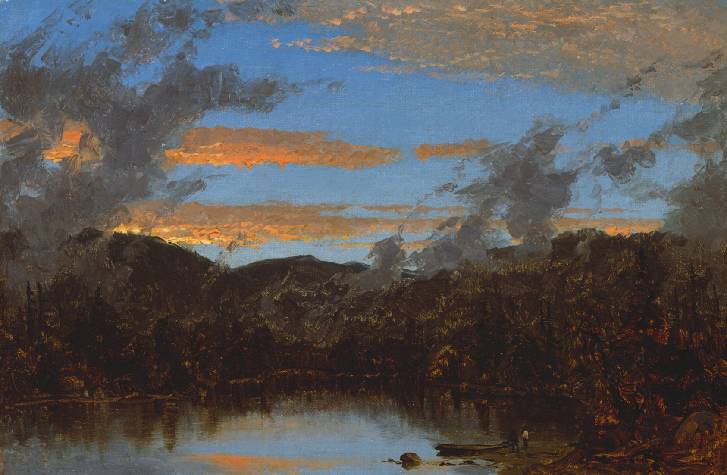
Mist Rising at Sunset in the Catskills, c. 1861, Oil on Canvas, 17.2 × 24.1 cm, the Art Institute of Chicago, USA https://www.artic.edu/artworks/71971/mist-rising-at-sunset-in-the-catskills

Slide 7
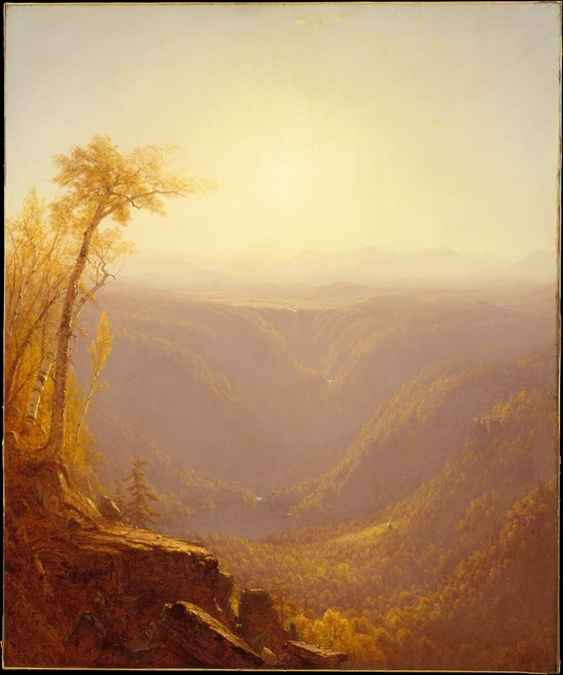
A Gorge in the Mountains (Kauterskill Clove), 1862, Oil on Canvas, 121.9 x 101.3 cm, the ET, NY, USA https://www.metmuseum.org/art/collection/search/10946?searchField=All&amp;sortBy=Relevance&amp;high=on&amp;ao=on&amp;showOnly=openAccess&amp;ft=*&amp;offset=80&amp;rpp=80&amp;pos=139

Slide 8
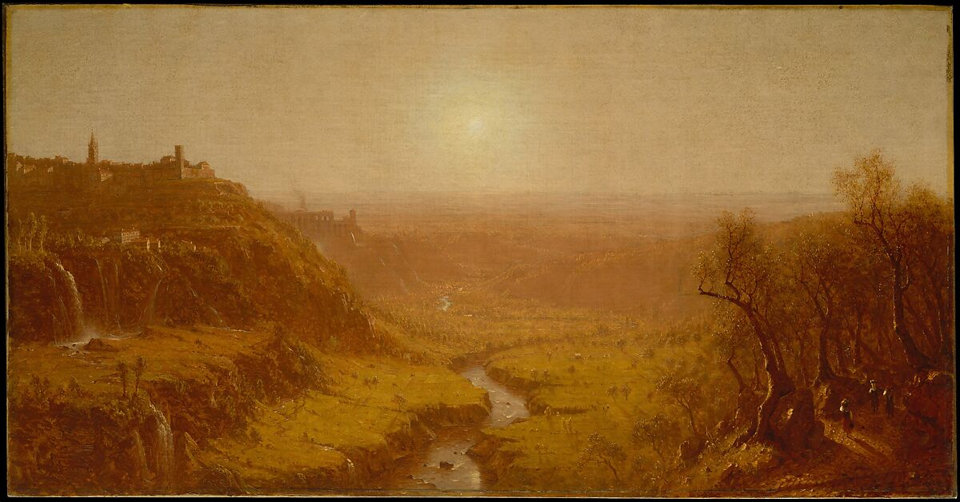
Tivoli, 1870, Oil on Canvas, 67 x 128 cm, the MET, NY, USA https://www.metmuseum.org/art/collection/search/10947

Slide 9
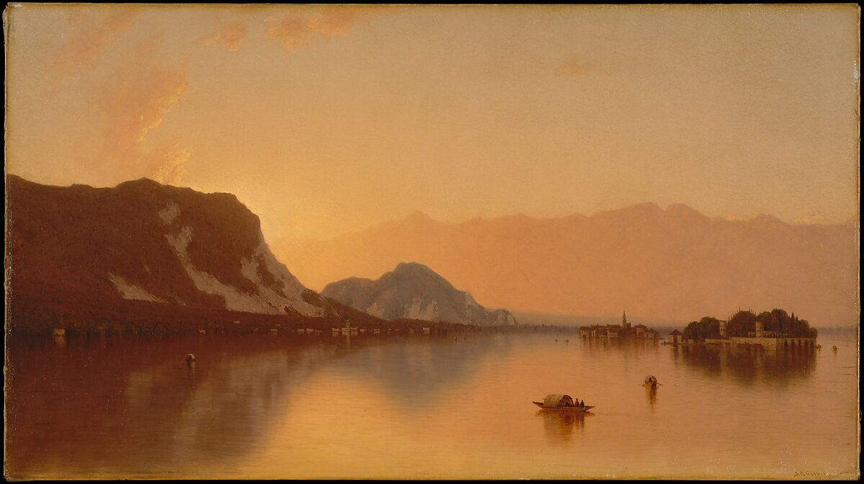
Isola Bella in Lago Maggiore, 1871, Oil on Canvas, 51.4 x 91.4 cm, the MET, NY, USA https://www.metmuseum.org/art/collection/search/10945

Slide 10
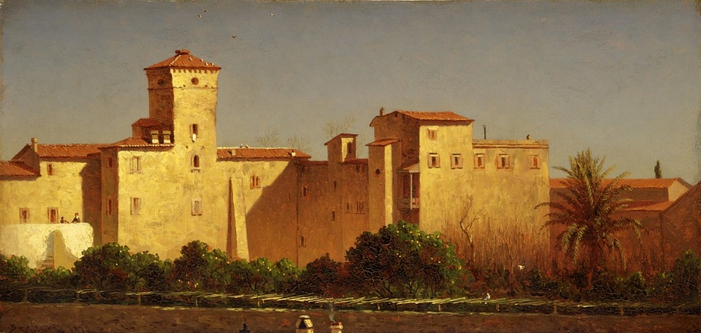
Villa Malta, Rome, 1879, Oil on Canvas, 33.6 x 69.5 cm, Smithsonian American Art Museum, Washington DC, USA https://americanart.si.edu/artwork/villa-malta-rome-9004

Slide 11
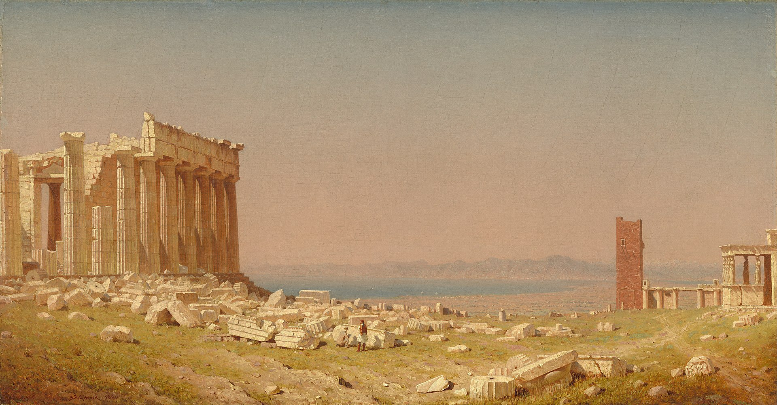
Ruins of the Parthenon, 1880, Oil on Canvas, 69.53 × 132.72 cm, the National Gallery of Art, Washington DC, USA https://www.nga.gov/collection/art-object-page.121547.html

Slide 12
the End

