Slide 1
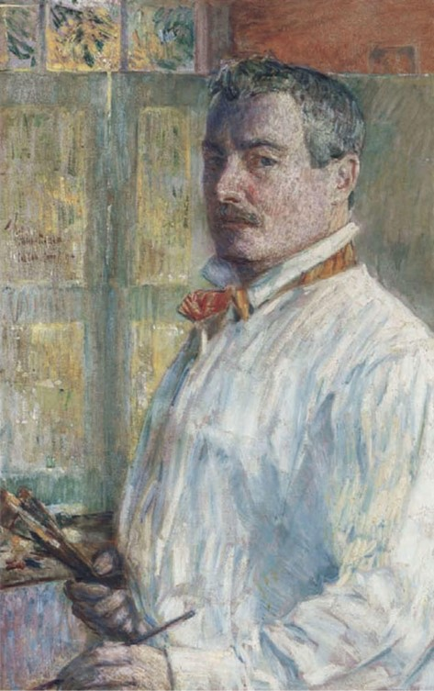
16 Paintings by
Childe Hassam
Childe Hassam, 1859–1935
Self-Portrait, 1914, Oil on Canvas, 83.4 x 52.7 cm, American Academy of Arts and Letters, NY, USA https://www.pubhist.com/w15056

Slide 2
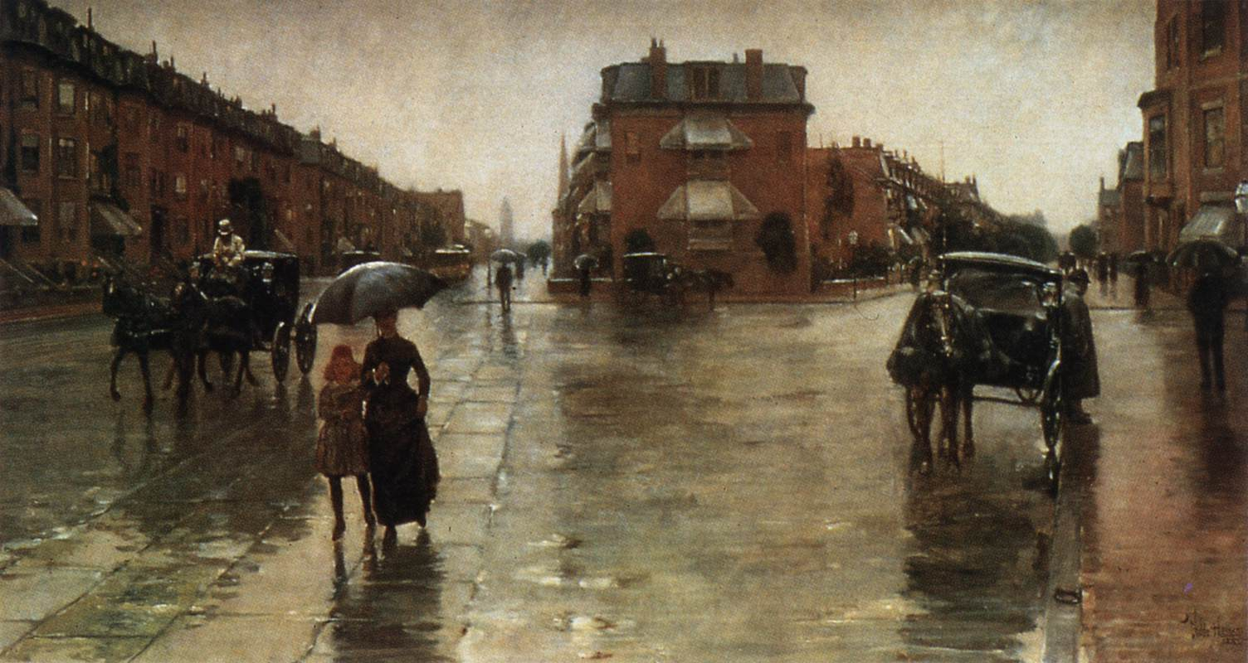
Rainy Day, Columbus Avenue, Boston, 1885, Oil on canvas, 66 x 122 cm, Toledo Museum of Art, Toledo, Ohio, USA https://www.wga.hu/frames-e.html?/html/h/hassam/index.html

Slide 3
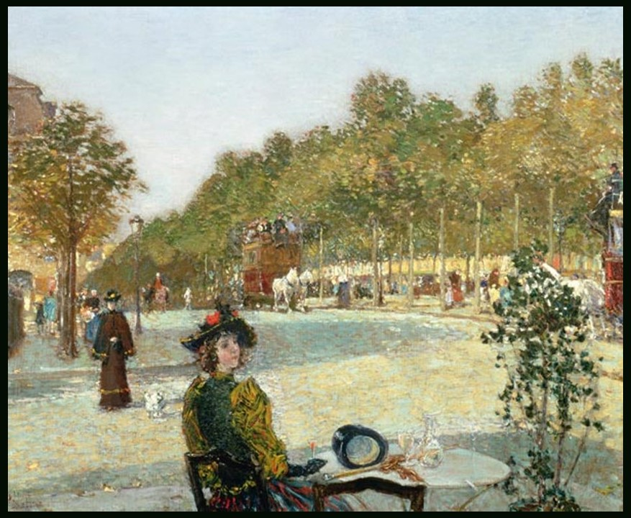
September Sunlight, circa 1887, Oil on Canvas, 45.8 x 55.8 cm, Private Collection https://www.facebook.com/photo.php?fbid=710256554473763&set=a.559870122845741&type=3&locale=it_IT&paipv=0&eav=AfaH9KHKOLoFA2Q2dpyw10i8ycH0KFTFgQ3GXNBBtewHGh34TvI_l-T1UjHORJ-rVCw&_rdr

Slide 4
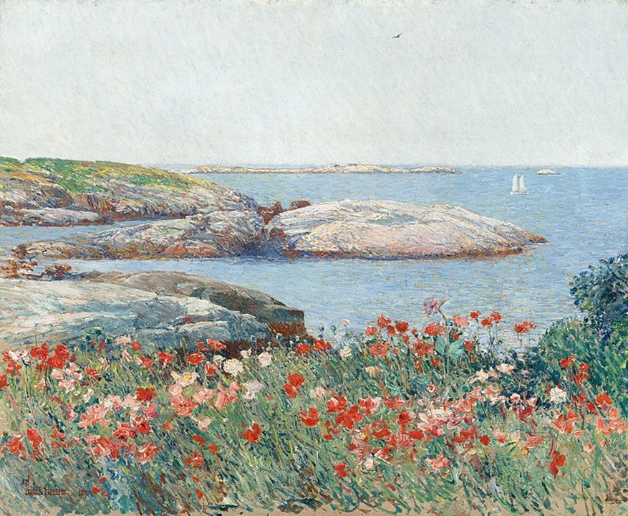
Poppies on the Isles of Shoals, 1891, 50.2x61 cm, National Gallery of Art, Washington DC, USA https://commons.wikimedia.org/wiki/File:Childe_Hassam,_Poppies,_Isles_of_Shoals,_1891.jpg

Slide 5
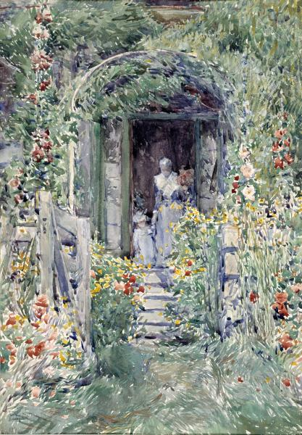
The Garden in Its Glory, 1892, Watercolor on Paper, 50.6 x 35.2 cm, Smithsonian American Art Museum, Washington DC, USA https://americanart.si.edu/artwork/garden-its-glory-10075

Slide 6
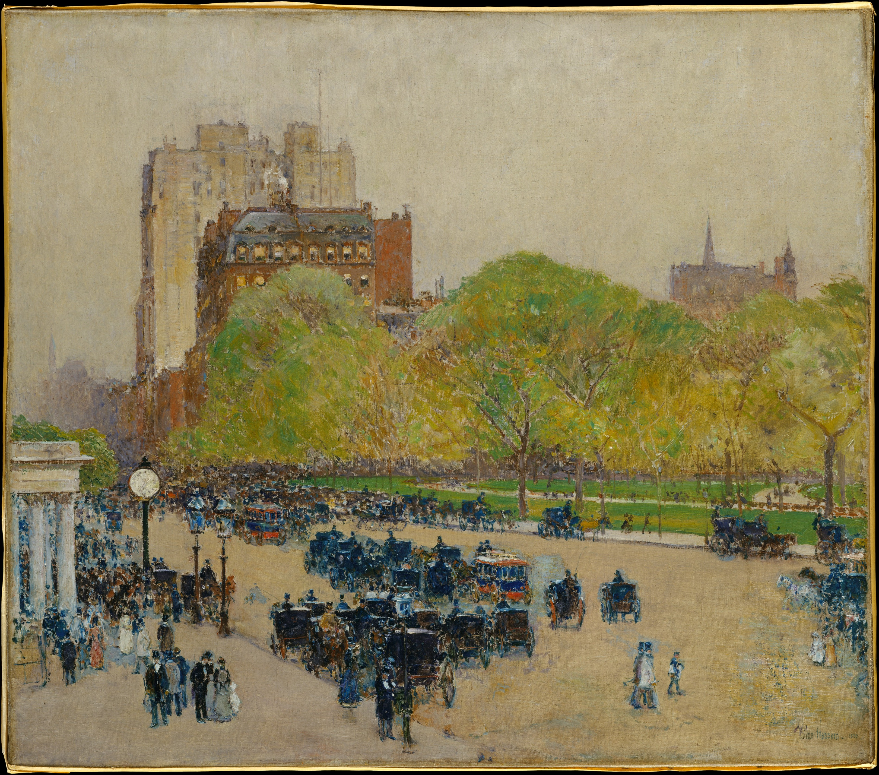
Spring Morning in the Heart of the City, 1890; reworked 1895–99, Oil on canvas, 46 x 52.7 cm, The MET, NY, USA https://upload.wikimedia.org/wikipedia/commons/e/e1/Spring_Morning_in_the_Heart_of_the_City_MET_DT5572.jpg

Slide 7
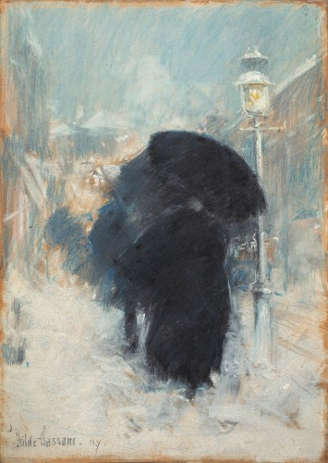
A New York Blizzard, 1890, Pastel on grey paper, 35 x 24 cm, Isabella Steward Gardner Museum, Boston, USA https://www.gardnermuseum.org/experience/collection/10824

Slide 8
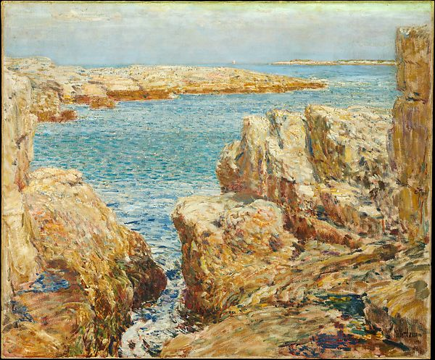
Coast Scene, Isles of Shoals, 1901, Oil on Canvas, 63.2 x 76.5 cm, the MET, NY, USA https://www.metmuseum.org/art/collection/search/11032

Slide 9
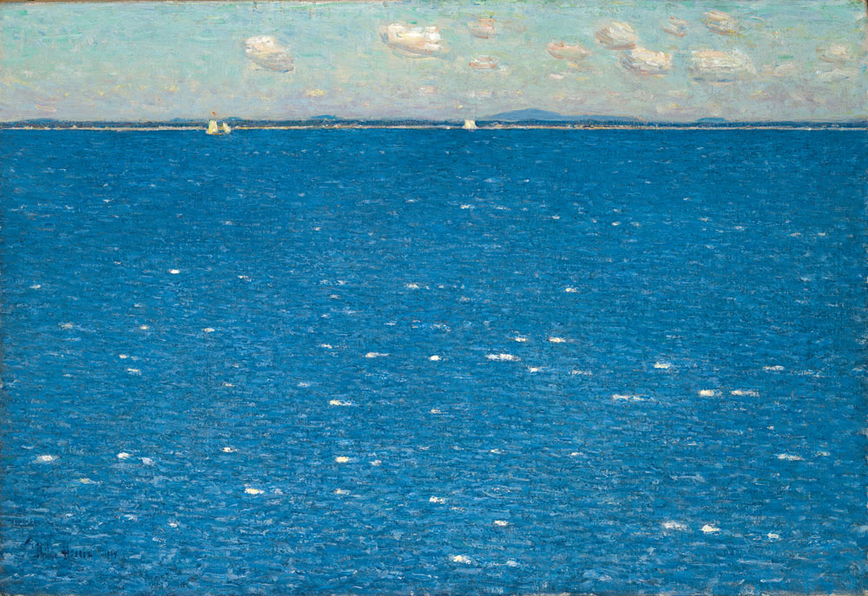
West Wind, Isles of Shoals, 1904, Oil on Canvas, 38.1x55.9 cm, Yale University Art Gallery, USA https://www.incollect.com/articles/american-impressionist-childe-hassam-and-the-isles-of-shoals

Slide 10
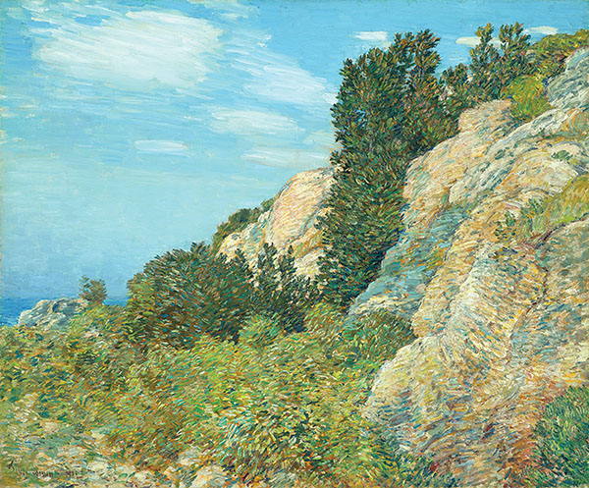
The Laurel in the Ledges, Appledore, 1905, Oil on Canvas, 63.5x76.2 cm, North Carolina Museum of Art, Raleigh, NC, USA https://www.historynet.com/childe-hassams-island-escape/

Slide 11
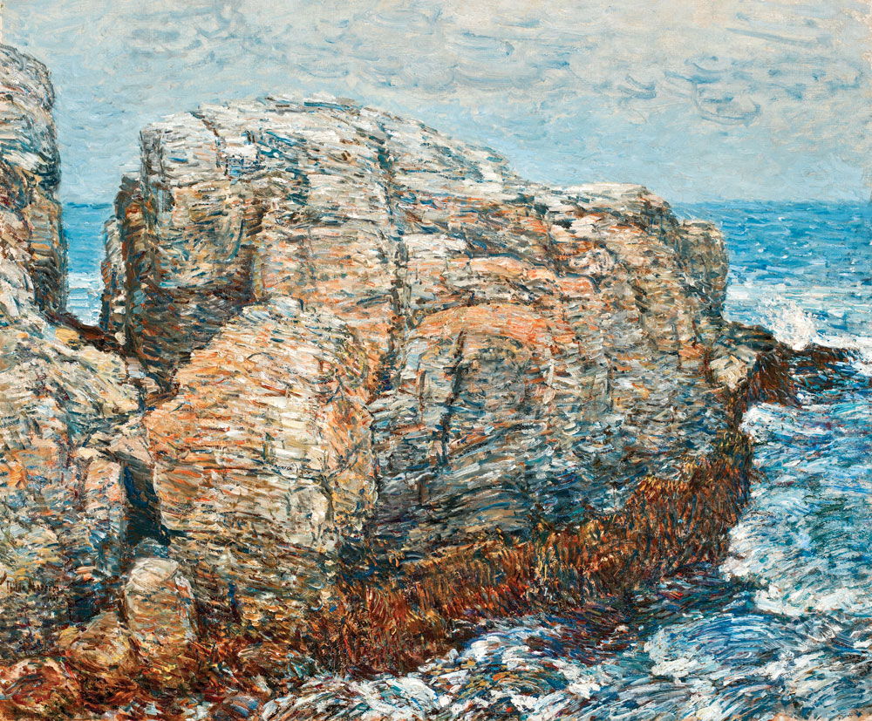
Sylph’s Rock, Appledore, 1907, Oil on Canvas, 63.5x76.2 cm, Worcester Art Museum, Worcester, Mass, USA https://www.incollect.com/articles/american-impressionist-childe-hassam-and-the-isles-of-shoals

Slide 12
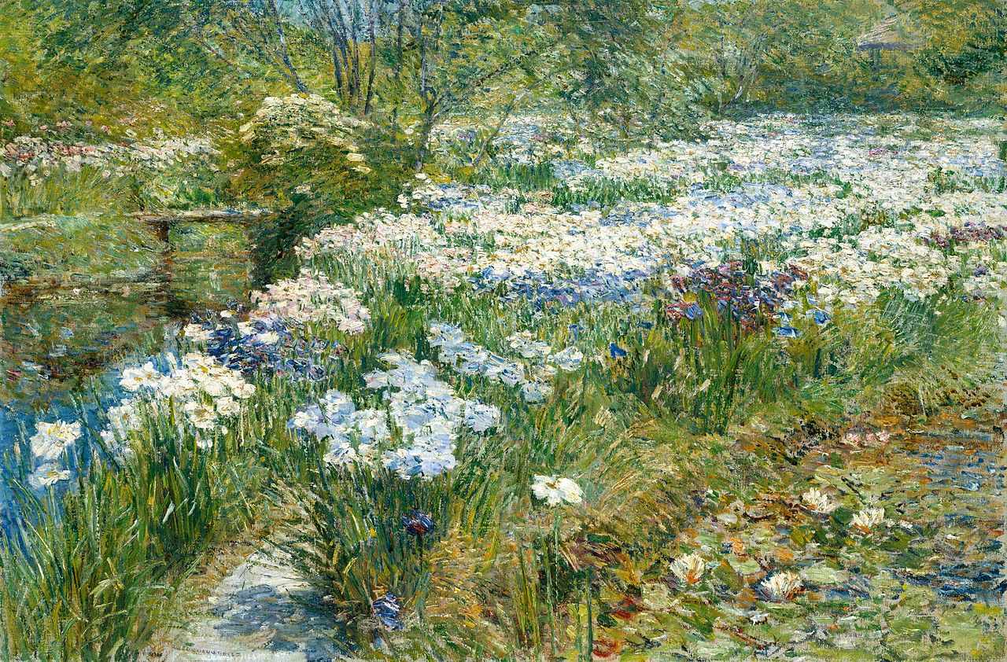
The Water Garden,1909, Oil on Canvas, 61x91.44 cm, the MET, NY, USA https://en.wikipedia.org/wiki/The_Water_Garden_%28Childe_Hassam%29

Slide 13
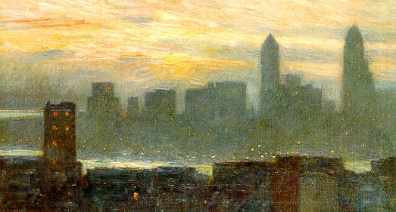
Manhattan's Misty Sunset, 1911, Oil on canvas, 45.72 x 81.28 cm, Butler Institute of Art, USA http://americanartgallery.org/uploads/pictures/001254/fchassam05.jpg

Slide 14
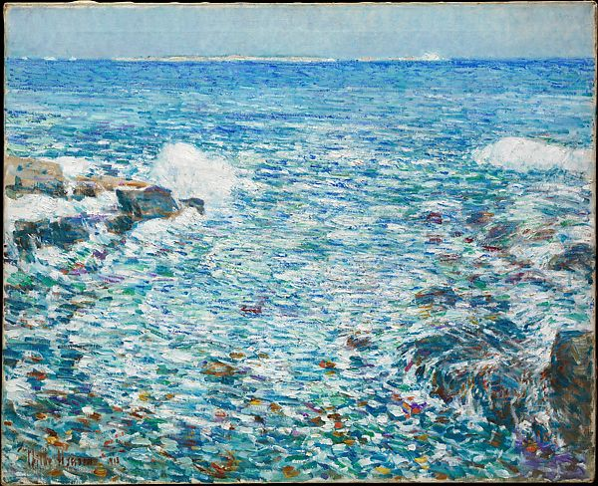
Isles of Shoals, 1913, Oil on Canvas, 89.5 x 71.8 cm, the MET, NY, USA https://www.metmuseum.org/art/collection/search/15583

Slide 15
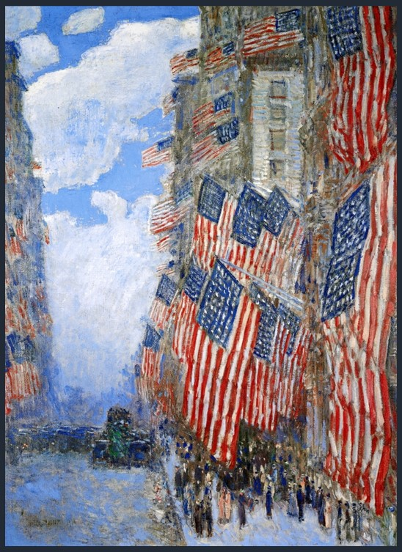
The Fourth of July, 1916, 1916, oil on canvas, 91.4 x 66.7 cm, New York Historical Society, USA https://commons.wikimedia.org/wiki/File:The_Fourth_of_July,_1916_Childe_Hassam.jpg

Slide 16
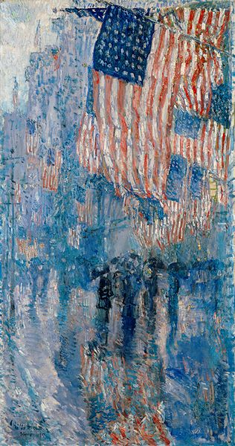
The Avenue of Rain, 1917, oil on canvas, The White House, Washington, DC, USA https://en.wikipedia.org/wiki/The_Avenue_in_the_Rain

