Slide 1
Joachim Patinir
1480-1524
10 Paintings

Slide 2
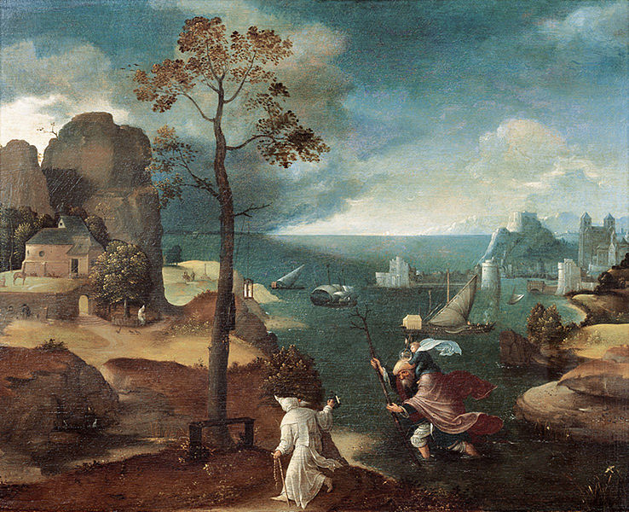
St Christopher Bearing the Christ Child, 1st quarter of the 16th century, Oil on Panel, 48 x 59,5 cm, Rockox House, Antwerp, Belgium https://fr.m.wikipedia.org/wiki/Fichier:Joachim_Patinir,_St_Christopher_Bearing_the_Christ_Child,_Rockox_House,_Antwerp.jpg

Slide 3
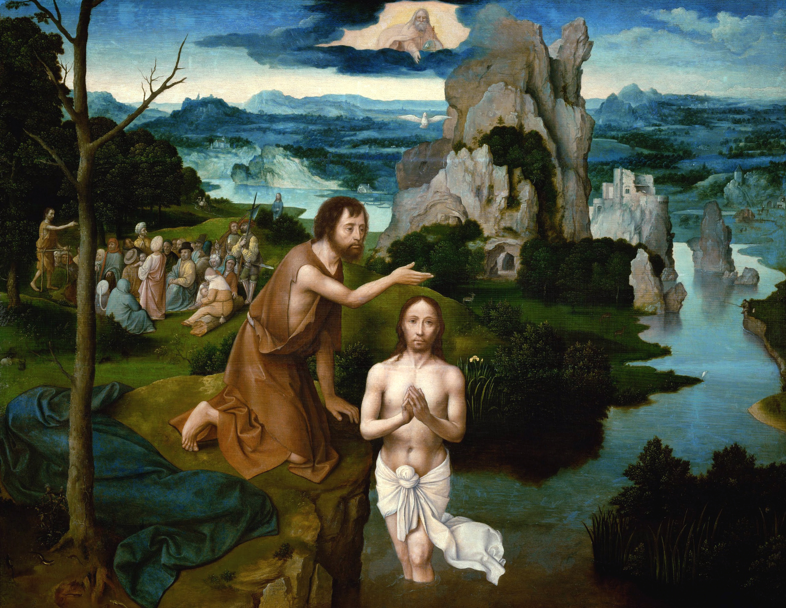
Baptism of Christ, c. 1515, Oil on Oak, 59,5 x 77 cm, Kunsthistorisches Museum, Vienna, Austria https://upload.wikimedia.org/wikipedia/commons/2/26/Joachim_Patinir_-_The_Baptism_of_Christ_-_Google_Art_Project_2.jpg

Slide 4
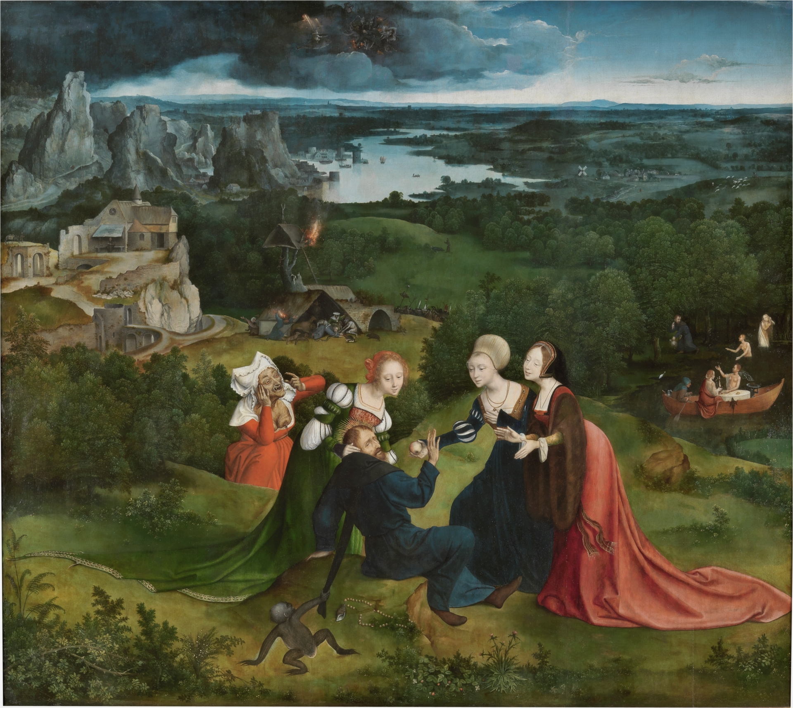
Temptation of St Anthony, c. 1515, Oil on Panel, 155 x 173 cm, Museo del Prado, Madrid, Spain https://www.museodelprado.es/en/the-collection/art-work/the-temptations-of-saint-anthony/b93e9da4-8a77-44ae-ba29-1811cc546fd8

Slide 5
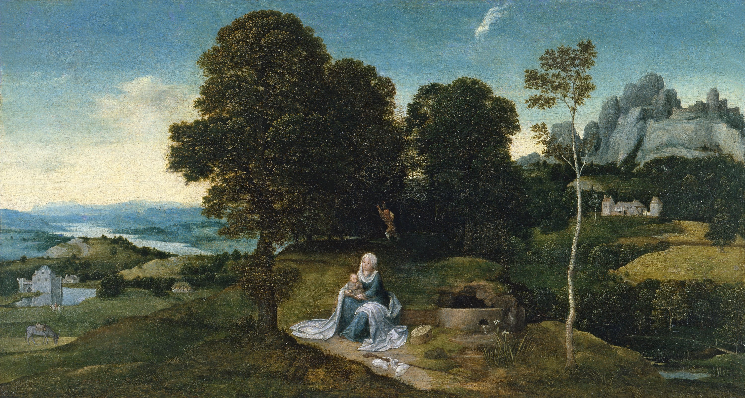
Landscape with the Flight into Egypt, 1515-16, Oil on Panel, 32 x 58 cm,
Museo Thyssen-Bornemisza, Madrid, Spain https://www.museothyssen.org/en/collection/artists/patinir-joachim/landscape-rest-flight-egypt

Slide 6
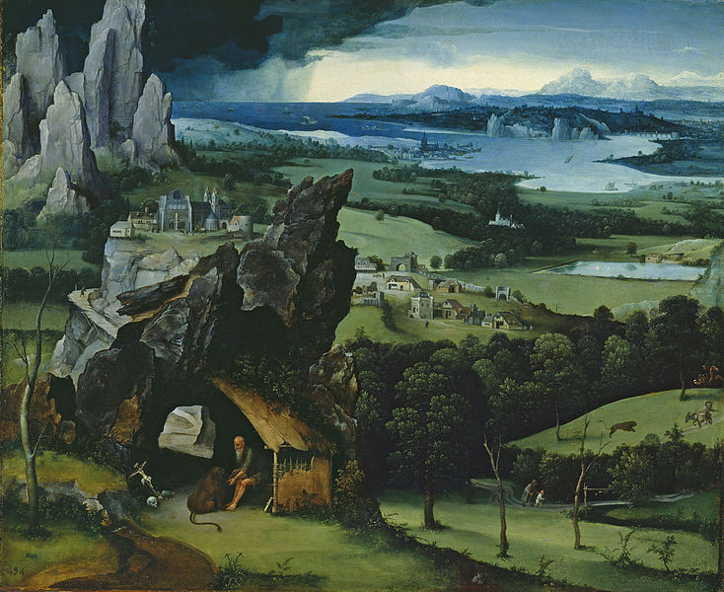
Landscape with St Jerome, 1515-19, Oil on Panel, 74 x 91 cm, Museo del Prado, Madrid, Spain https://commons.wikimedia.org/wiki/File:Paisaje_con_san_Jer%C3%B3nimo,_Joachim_Patinir,_Museo_del_Prado.jpg

Slide 7
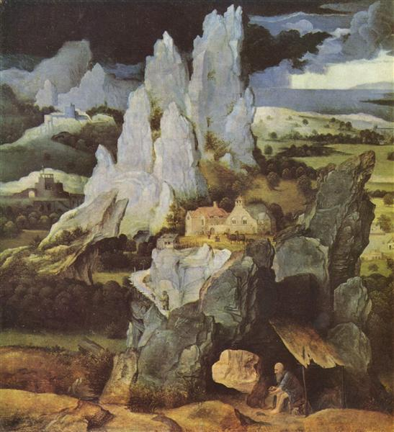
St Jerome in Rocky Landscape, c. 1520, Oil on Oak, 36,5 x 34 cm, National Gallery, London, UK https://www.wikiart.org/en/joachim-patinir/st-jerome-in-rocky-landscape

Slide 8
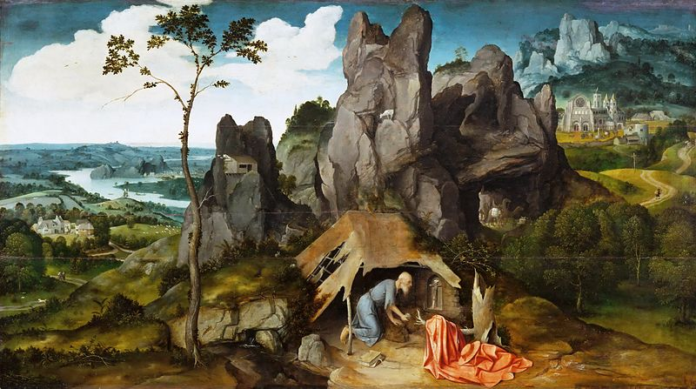
St Jerome in the Desert, c. 1520, Oil on Wood, 78 x 137 cm, Musée du Louvre, Paris France https://commons.wikimedia.org/wiki/File:Joachim_Patinir_-_St_Jerome_in_the_Desert_-_WGA17100.jpg

Slide 9
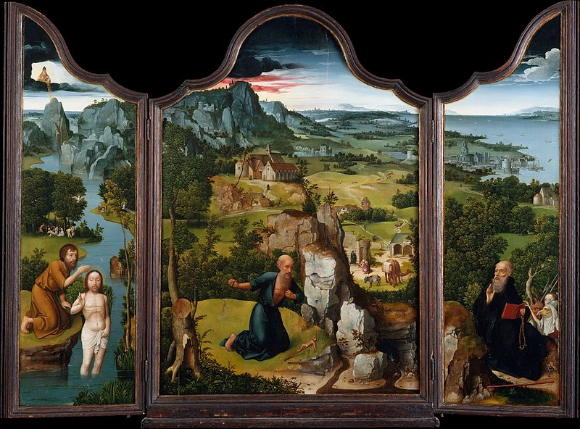
Triptych, c. 1520, Oil on Wood, 118 x 81 cm (central), 121 x 36 cm (lateral),
Metropolitan Museum of Art, New York, USA https://commons.wikimedia.org/wiki/File:Joachim_Patinir_-_Triptych_-_WGA17104.jpg

Slide 10
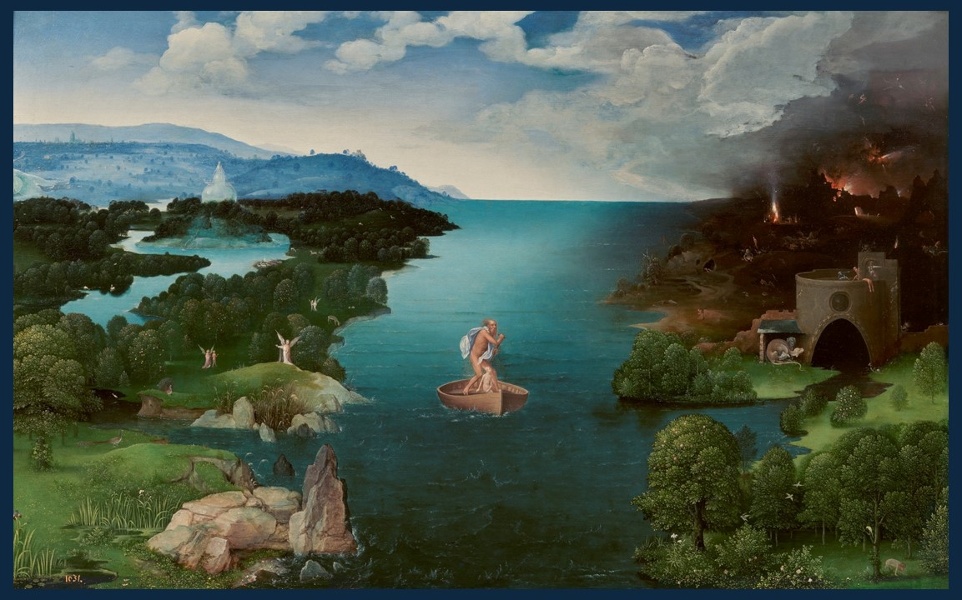
Charon crossing the Styx, 1520 – 1524, Oil on Panel, 64x103 cm, Prado Museum, Madrid, Spain https://www.museodelprado.es/en/the-collection/art-work/charon-crossing-the-styx/c51349b6-049e-476c-a388-5ae6d301e8c1

Slide 11
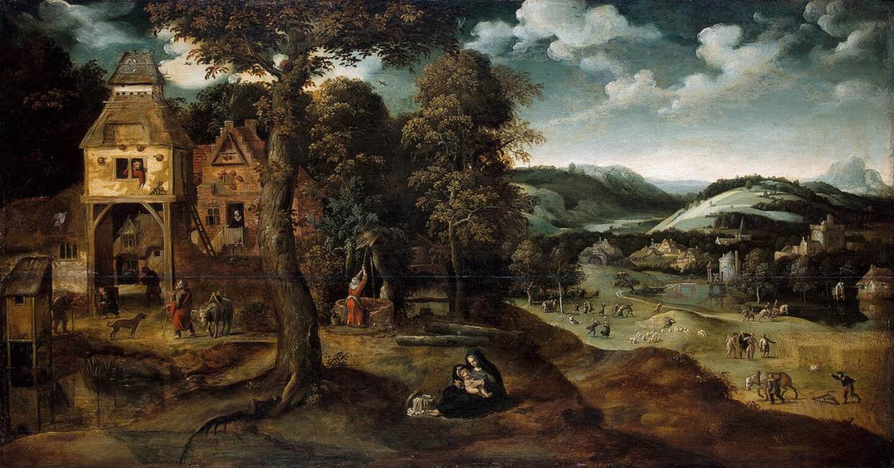
Landscape with the Flight into Egypt, c. 1524, Oil on Panel, 51 x 96 cm, The Hermitage, St. Petersburg, Russia https://www.wga.hu/frames-e.html?/bio/p/patenier/biograph.html

Slide 12
The End

