Slide 1

Joaquín Sorolla y Bastida, 1863-1923
At the Seafront, 13 Paintings

Slide 2
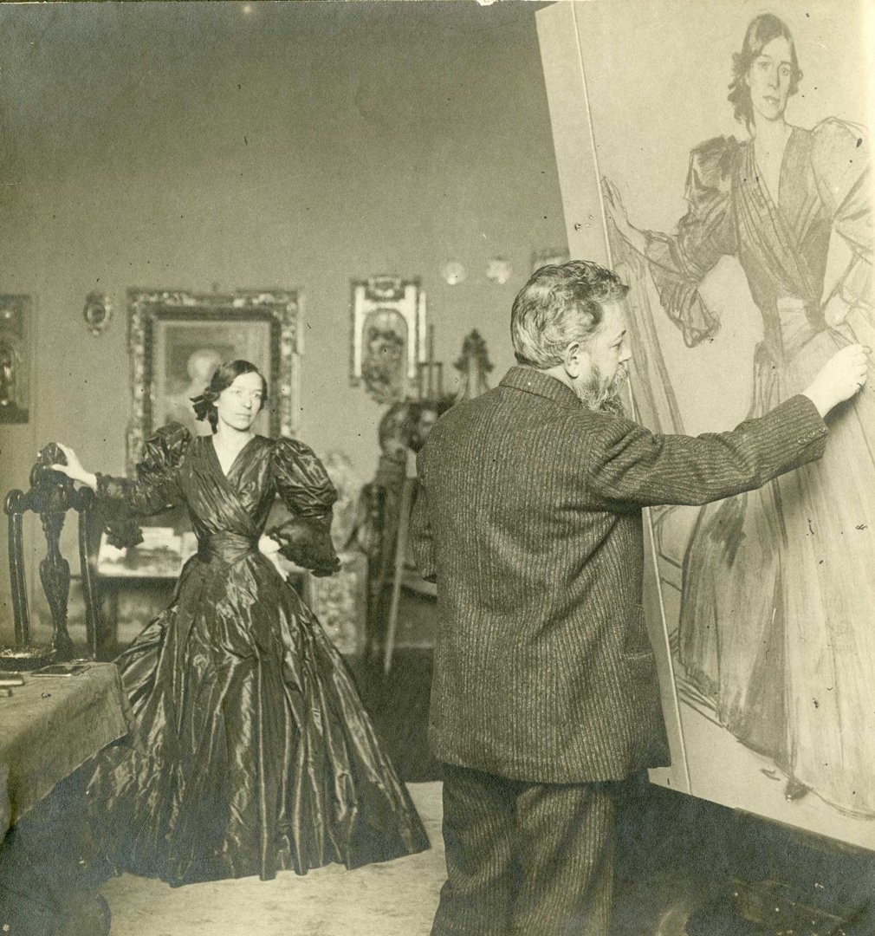
Sorolla painting 'Clotilde in a Black Dress', 1905. Photograph by Christian Franzen © Museo Sorolla, Madrid, Spain https://www.nationalgallery.org.uk/exhibitions/past/sorolla/what-you-need-to-know-about-sorolla

Slide 3
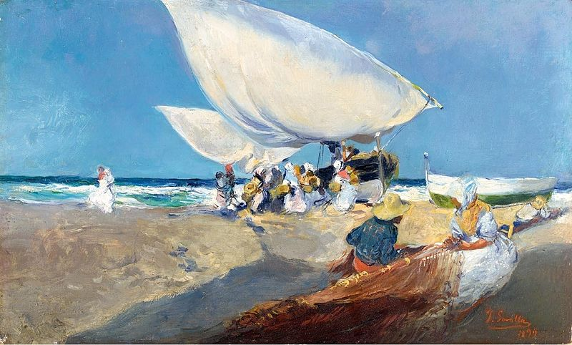
Mending the nets, 1899, Oil on Canvas, 22.2x36.9 cm, Private Collection https://commons.wikimedia.org/wiki/File:Joaquin_Sorolla_y_Bastida_-_Arreglando_las_redes.jpg

Slide 4
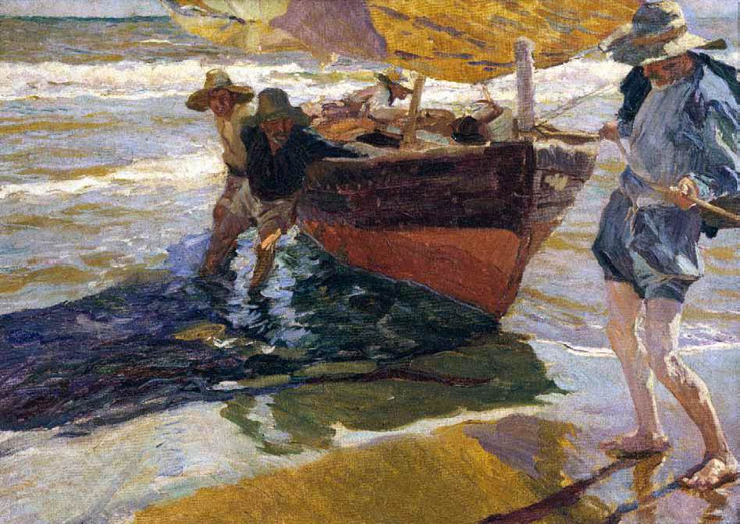
Return from Fishing, 1904,
Oil on Canvas,
45 x 75 cm,
Raccolte Frugone, Nervi, Genova, Italy https://www.wga.hu/html_m/s/sorolla/index.html

Slide 5
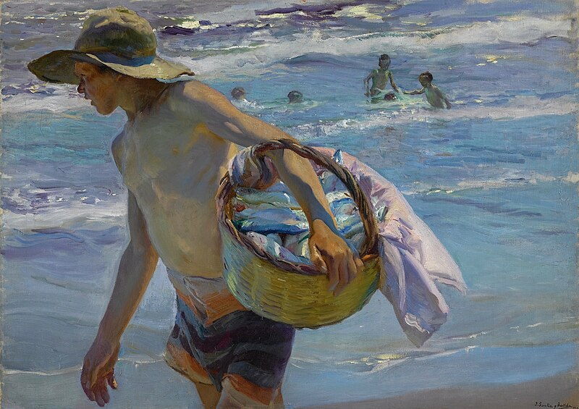
The Fisherman, 1904, Oil on Canvas, 76x106 cm, Private Collection https://commons.wikimedia.org/wiki/File:Joaqu%C3%ADn_Sorolla_y_Bastida_-_El_pescador.jpg

Slide 6
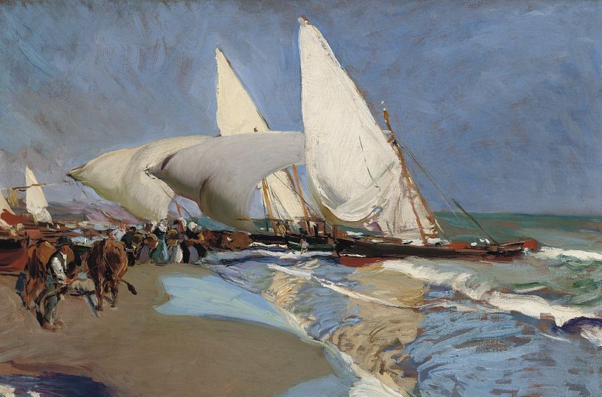
The beach at Valencia, 1908, Oil on Canvas, 50x65.5 cm, Private Collection https://commons.wikimedia.org/wiki/File:Joaquin_Sorolla_y_Bastida_-_La_playa_de_Valencia.jpg

Slide 7
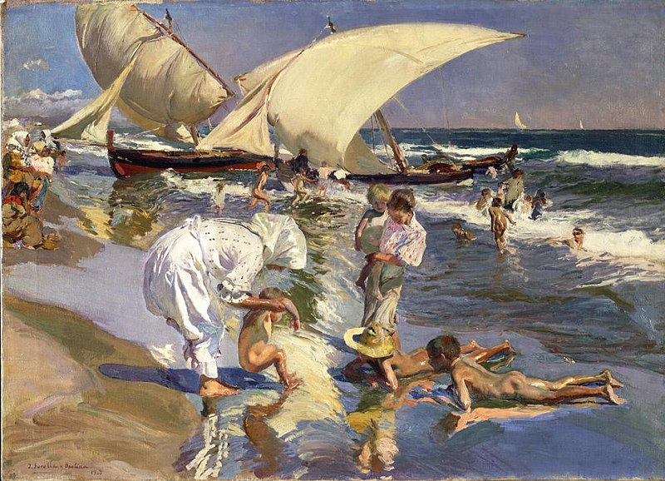
Beach of Valencia by Morning Light, 1908, Oil on Canvas, 76x105.6 cm, Hispanic Society of America, New York City, USA https://commons.wikimedia.org/wiki/File:Joaqu%C3%ADn_Sorolla_y_Bastida_-_Beach_of_Valencia_by_Morning_Light_-_A2137_-_Hispanic_Society_of_America.jpg

Slide 8
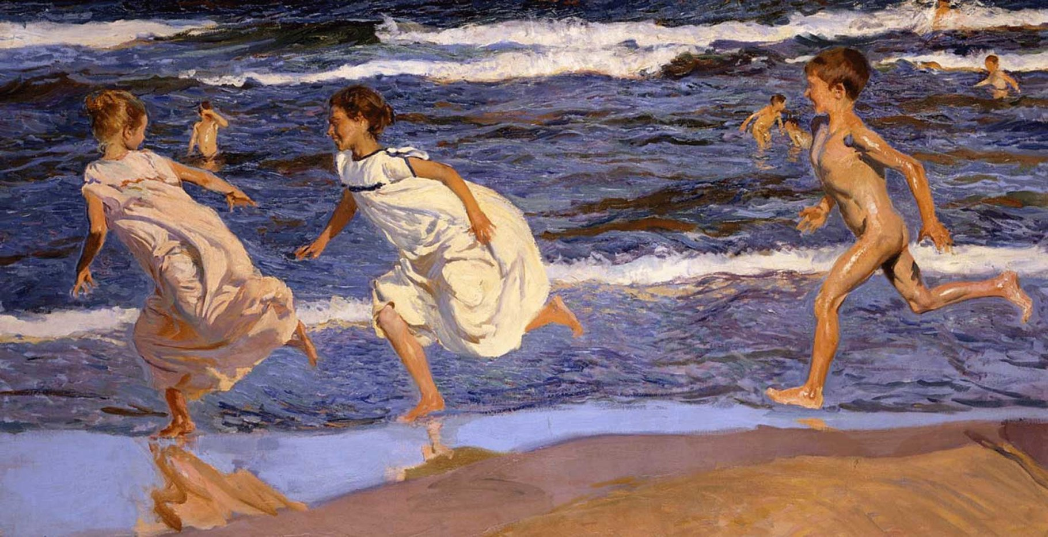
Running along the Beach, Valencia, 1908, Oil on Canvas,90x166.5 cm, Fine Arts Museum of Asturias, Oviedo, Spain https://www.nationalgallery.org.uk/exhibitions/past/sorolla/what-you-need-to-know-about-sorolla

Slide 9
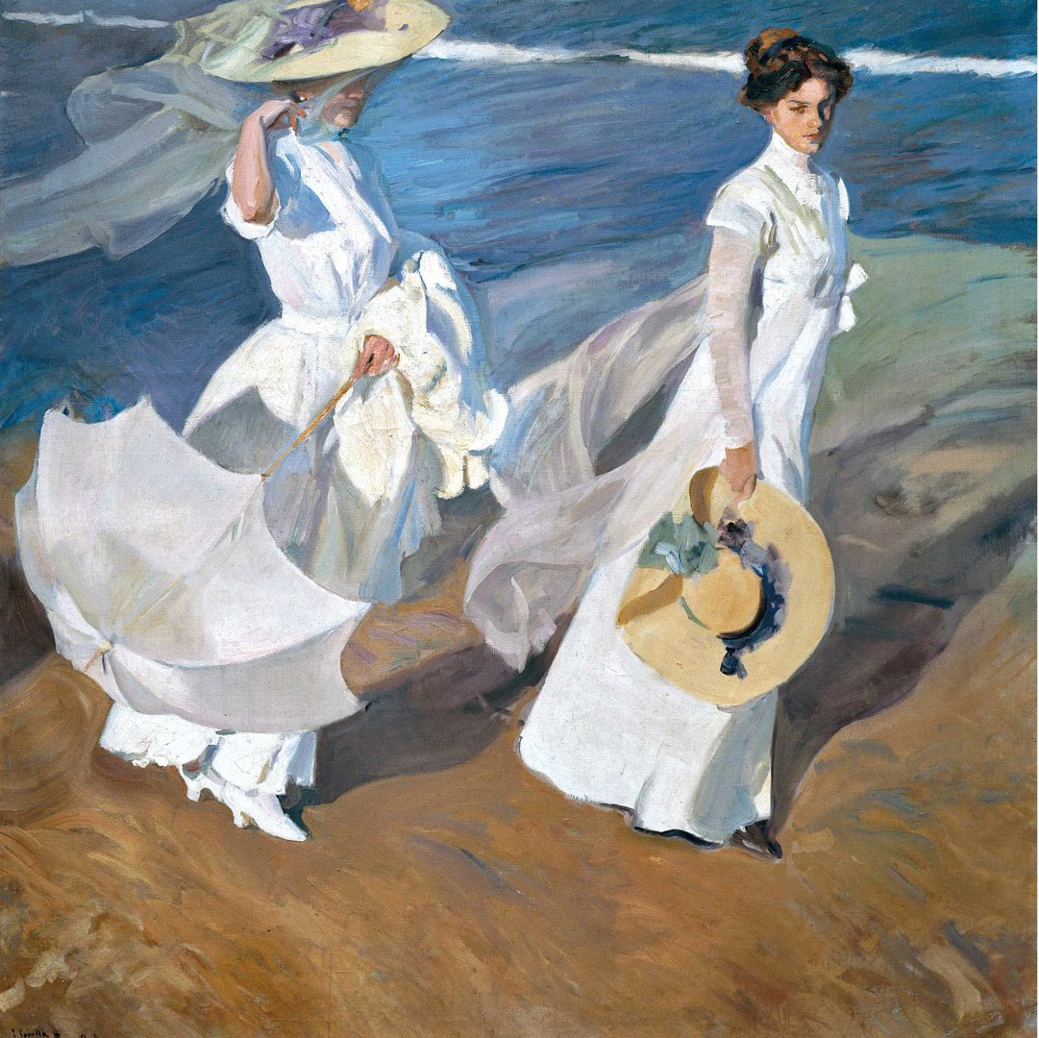
Walk by the sea, 1909, Oil on Canvas, 205x200 cm, Fundación Museo Sorolla, Madrid, Spain https://www.nationalgallery.org.uk/exhibitions/past/sorolla/what-you-need-to-know-about-sorolla

Slide 10
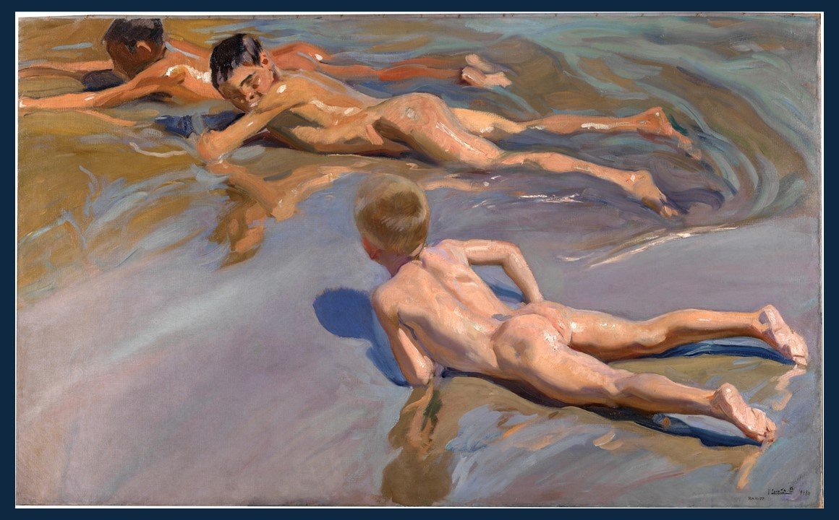
Boys on the Beach, 1909, Oil on Canvas, 118x185 cm, Prado Museum, Madrid, Spain https://www.museodelprado.es/en/the-collection/art-work/boys-on-the-beach/edd7a202-c069-49f1-a3f4-eacf9b4022c2

Slide 11
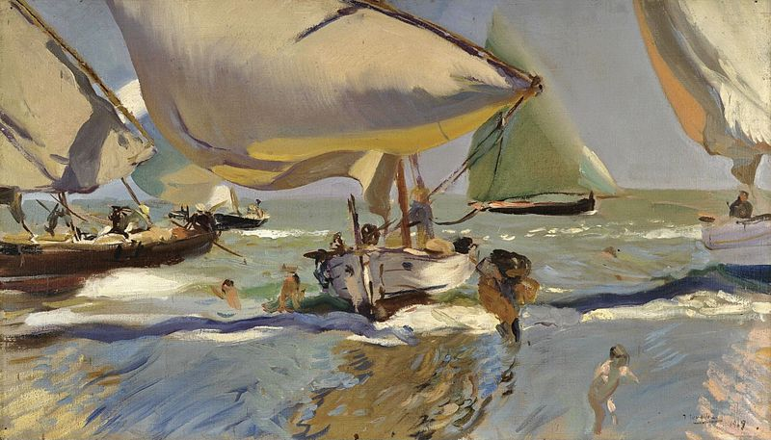
Boats on the shore, 1909, Oil on Canvas, 56x94 cm, Buenos Aires, Institución cultural Española, Argentina https://commons.wikimedia.org/wiki/File:Joaqu%C3%ADn_Sorolla_y_Bastida_-_Barcas_en_la_playa.jpg

Slide 12
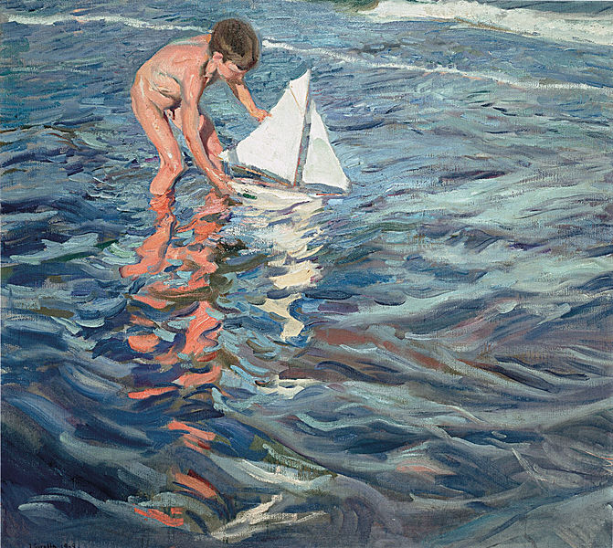
The Little Sailing Boat, 1909, Oil on Canvas, 100x110 cm, Fundación Museo Sorolla, Madrid, Spain https://commons.wikimedia.org/wiki/File:Joaqu%C3%ADn_Sorolla_y_Bastida_-_The_Little_Sailing_Boat_-_Google_Art_Project.jpg

Slide 13
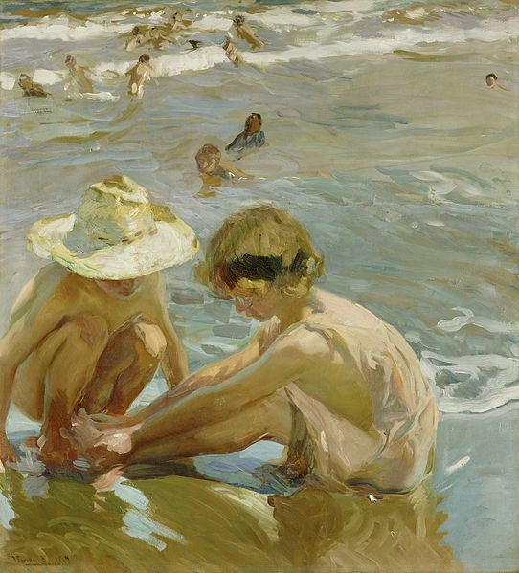
The wounded foot, 1909, Oil on Canvas, 109.2x99 cm, Getty Center, CA, USA https://commons.wikimedia.org/wiki/File:Joaqu%C3%ADn_Sorolla_y_Bastida_-_El_pie_herido_%281909%29.jpg

Slide 14
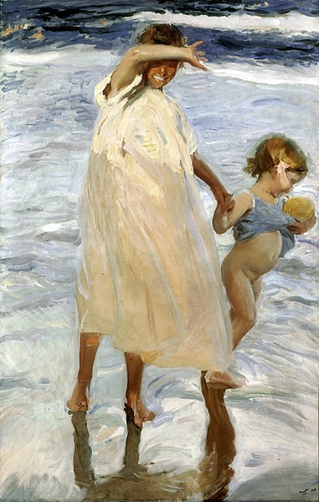
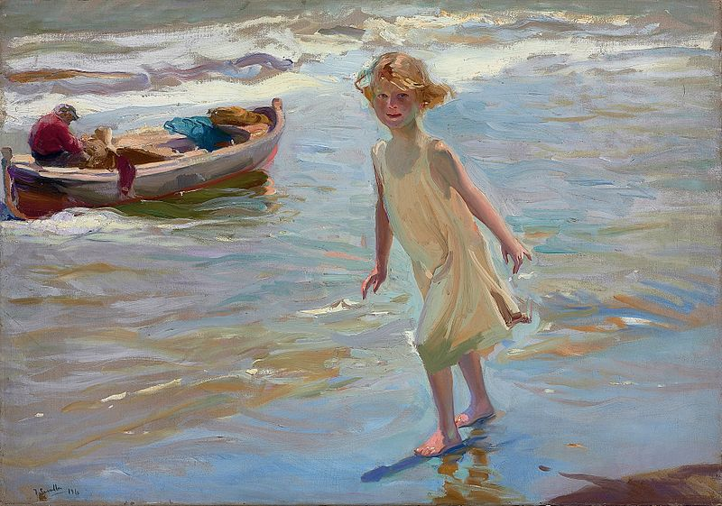
Two Sisters, Valencia, 1909, Oil on Canvas, 176.2x112.1 cm, Art Institute of Chicago, USA
Girl in the Beach, Valencia, 1910, Oil on Canvas, 69x100 cm, Private Collection https://commons.wikimedia.org/wiki/File:Joaqu%C3%ADn_Sorolla_y_Bastida_-_Dos_Hermanas,_Valencia.jpg https://commons.wikimedia.org/wiki/File:Joaquin_Sorolla_y_Bastida_-_Ni%C3%B1a_en_la_playa,_Valencia.jpg

Slide 15
THE END

