Slide 1
Thaleia Flora Karavia
1871 – 1960
10 Portraits of Women

Slide 2
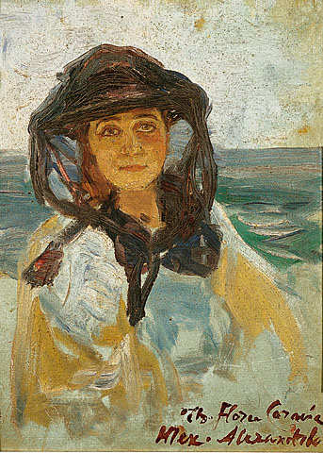
Sef-Portrait, Unknown Date, Watercolour, 33x24 cm, The Greek Parliament Art Collection, Athens, Greece https://el.wikipedia.org/wiki/%CE%98%CE%AC%CE%BB%CE%B5%CE%B9%CE%B1_%CE%A6%CE%BB%CF%89%CF%81%CE%AC-%CE%9A%CE%B1%CF%81%CE%B1%CE%B2%CE%AF%CE%B1#/media/%CE%91%CF%81%CF%87%CE%B5%CE%AF%CE%BF:Flora-karavia-thalia_portraito_gynaikos.jpg

Slide 3
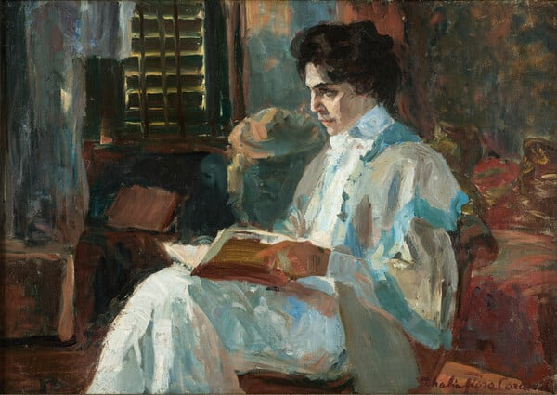
Portrait of Kleoniki Aspiotou, 1907, Oil on Canvas, 42 x 60 cm, Private Collection https://www.lifo.gr/culture/eikastika/thaleia-flora-karabia-mia-zografos-me-anexitilo-apotypoma-stin-elliniki-tehni-toy

Slide 4
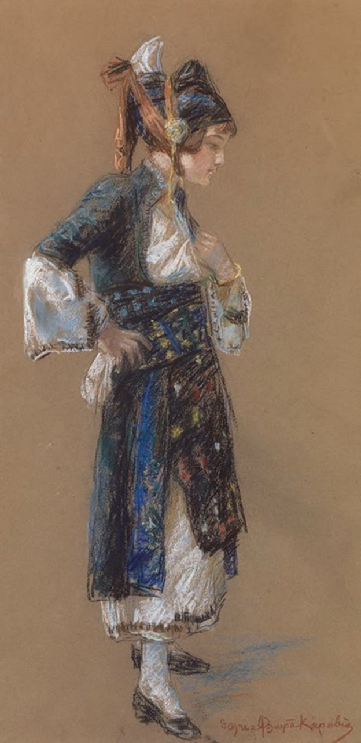
A Girl dressed in the traditional costume of Gida, 1905, pastel on paper, 0,73x0,40 cm, Athanasios Zahos Collection https://www.zografiki.gr/content/%CE%B8%CE%AC%CE%BB%CE%B5%CE%B9%CE%B1-%CF%86%CE%BB%CF%89%CF%81%CE%AC-%CE%BA%CE%B1%CF%81%CE%B1%CE%B2%CE%AF%CE%B1

Slide 5
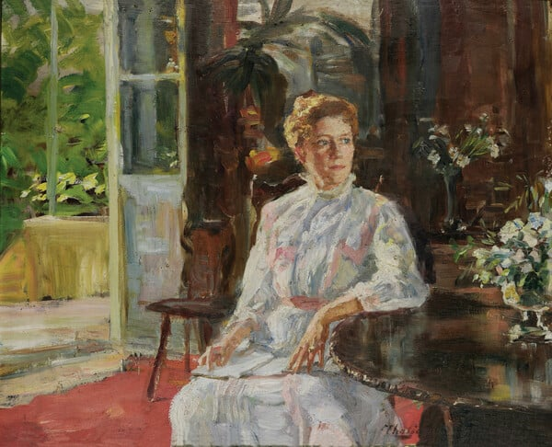
German Woman in Domestic Interior,
1912, Oil on Cardboard, 41 x 51 cm, National Gallery of Greece, Athens, Greece https://www.nationalgallery.gr/en/artwork/german-woman-in-domestic-interior/

Slide 6
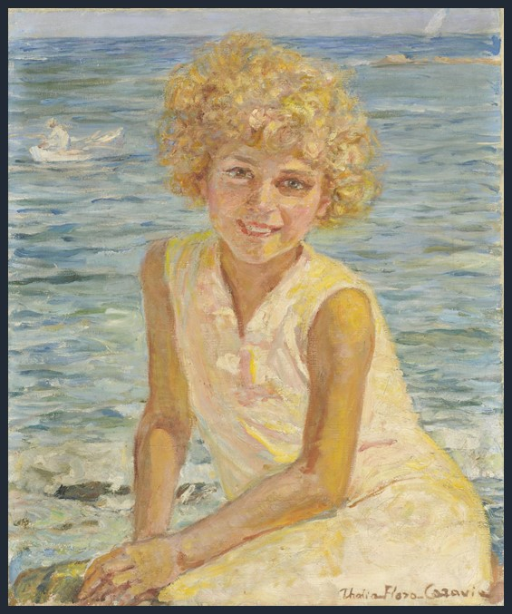
Girl on the Beach, 1922-25, Oil on Canvas, 61 x 50 cm, National Gallery, Athens, Greece https://www.nationalgallery.gr/en/artwork/girl-on-the-beach/

Slide 7
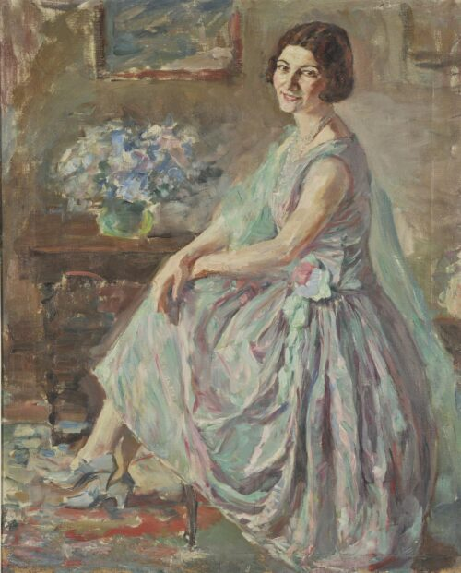
Lady in Interior, Date Unknown, Oil on Canvas, 81 x 65 cm, National Gallery of Greece, Athens, Greece https://www.nationalgallery.gr/en/artwork/lady-in-interior/

Slide 8
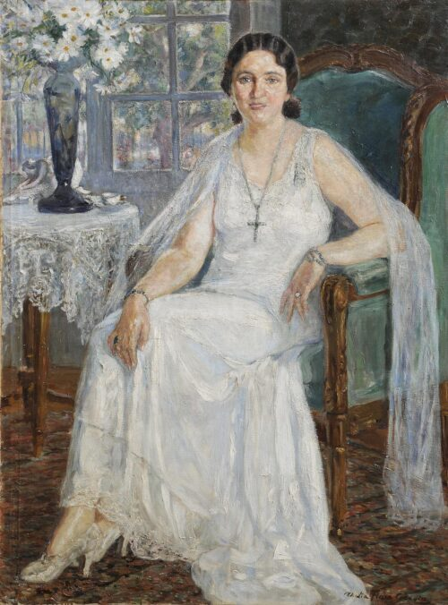
Portrait of the Actress Kyveli, Date Unknown, Oil on Canvas, 139 x 104 cm, National Gallery of Greece, Athens, Greece https://www.nationalgallery.gr/en/artwork/the-actress-kyveli-2/

Slide 9
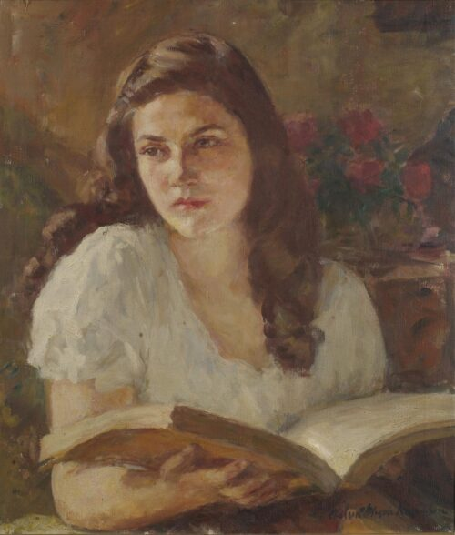
Portrait of a Young Woman Reading, Date Unknown, Oil on Canvas, 53 x 46,5 cm, National Gallery of Greece, Athens, Greece https://www.nationalgallery.gr/en/artwork/young-woman-reading/

Slide 10
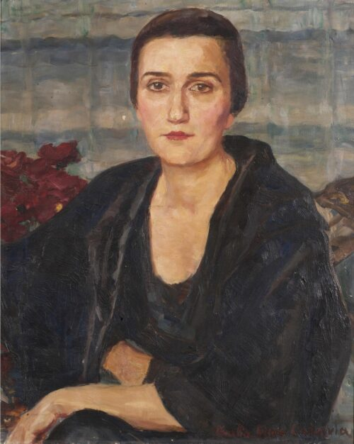
Portrait of Mrs Stavrinou, Date Unknown, Oil on Canvas, 64,5 x 53,5 cm, National Gallery of Greece, Athens, Greece https://www.nationalgallery.gr/en/artwork/portrait-of-mrs-stavrinou/

Slide 11
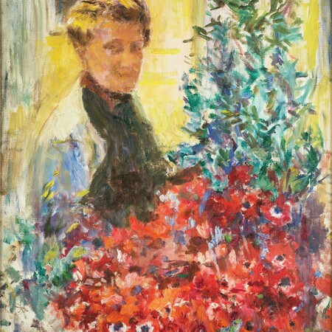
Self-Portrait, 1957, Oil on Canvas, 60x50 cm, Private Collection https://www.lifo.gr/culture/eikastika/thaleia-flora-karabia-mia-zografos-me-anexitilo-apotypoma-stin-elliniki-tehni-toy

