Slide 1
Jules Bastien-Lepage, 18480-1884
10 Paintings

Slide 2
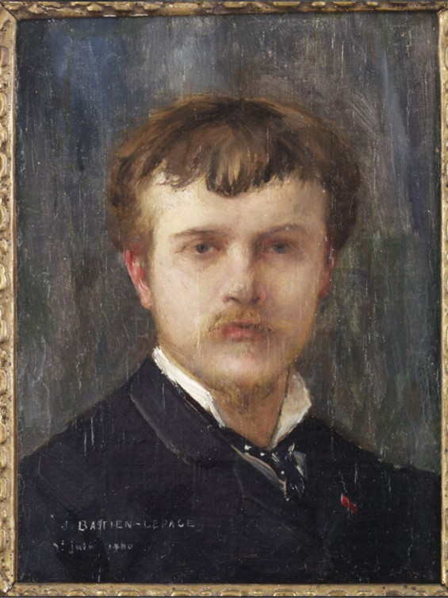
Self-portrait at 32 years old, 1880, oil on canvas, 31x25 cm, Musée Bastien-Lepage, Clos Raymond, France https://www.vosgesmatin.fr/art-et-culture/2019/05/12/autoportrait

Slide 3
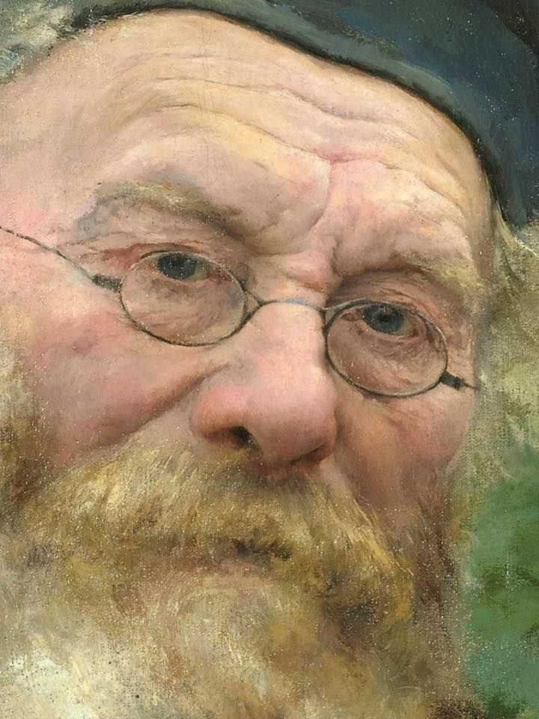
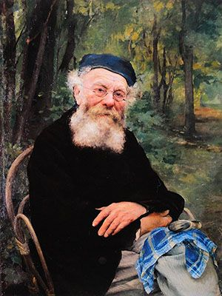
Portrait of My Grandfather, 1874, Oil on Canvas, 103x77 cm, Musée d’Orsay, Paris, France https://commons.wikimedia.org/wiki/File:Jules_Bastien-Lepage_-_son_grand-p%C3%A8re_1874.jpg and https://gr.pinterest.com/pin/557742735083201461/

Slide 4
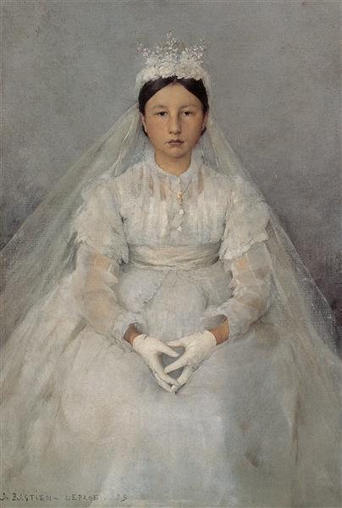
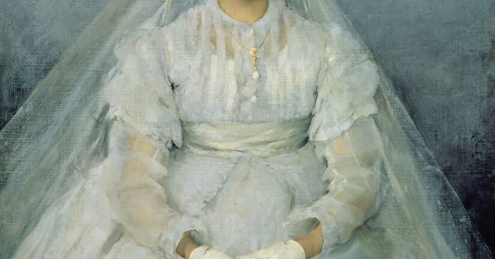
The Communicant, 1875, Oil on Canvas, 53x37.7 cm Musée des Beaux-Arts, Tournai, France https://commons.wikimedia.org/wiki/File:Bastien_Lepage_La_Communiante.jpg and https://en.muzeo.com/art-print/the-young-communicant/jules-bastien-lepage

Slide 5
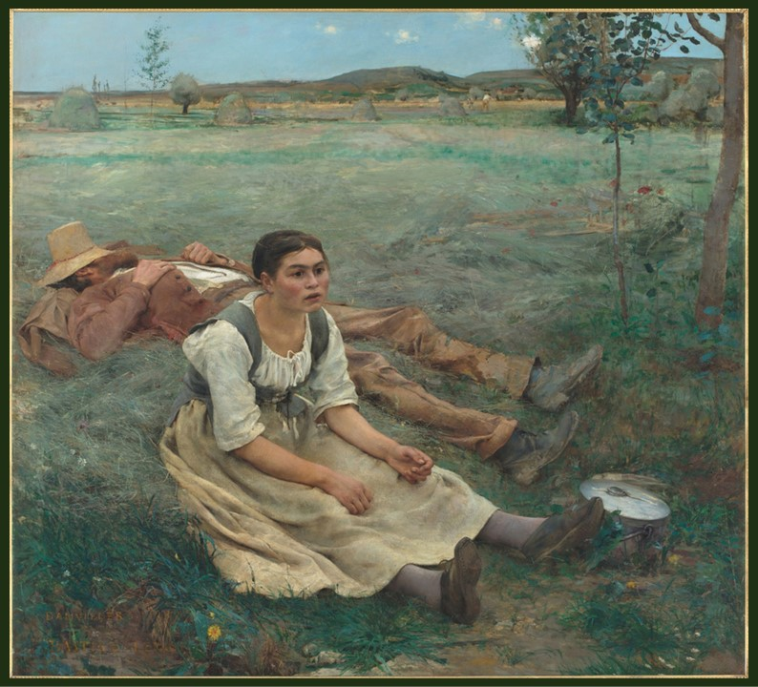
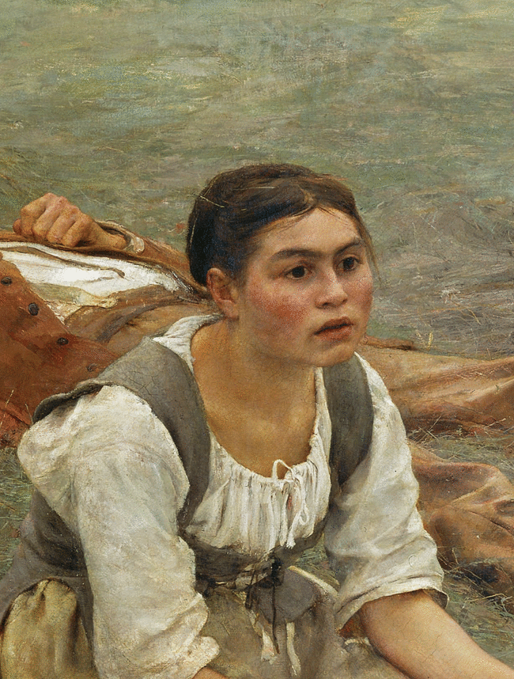
Hay Making, 1877, Oil on Canvas, 180x195 cm, Musée d’Orsay, Paris, France http://www.musee-orsay.fr/fr/agenda/expositions/jules-bastien-lepage-1848-1884 and https://onlinelibrary.wiley.com/doi/abs/10.1111/1467-8365.12061

Slide 6
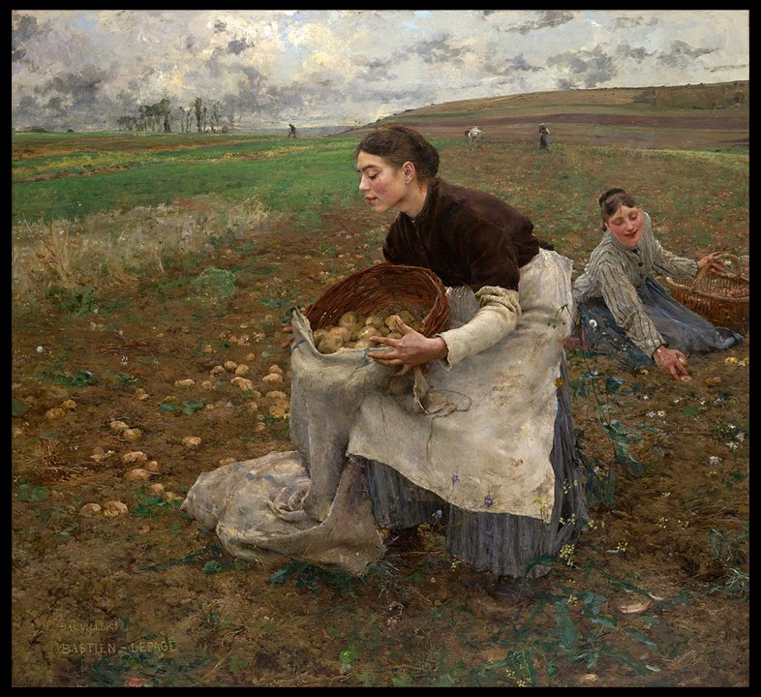
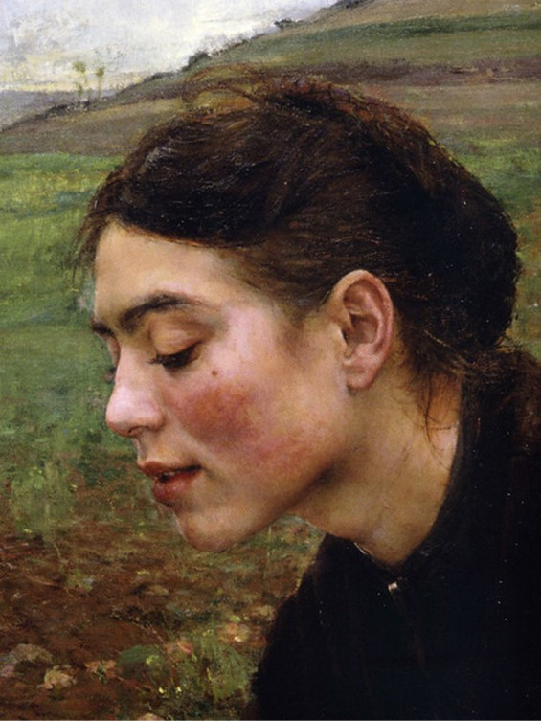
October, 1878, oil on canvas, 180.7 x 196.0 cm, National Gallery of Victoria, Melbourne, Australia https://en.wikipedia.org/wiki/October_(painting)#/media/File:Jules_Bastien-Lepage_-_October_-_Google_Art_Project.jpg and https://www.flickr.com/photos/eoskins/19429557290

Slide 7
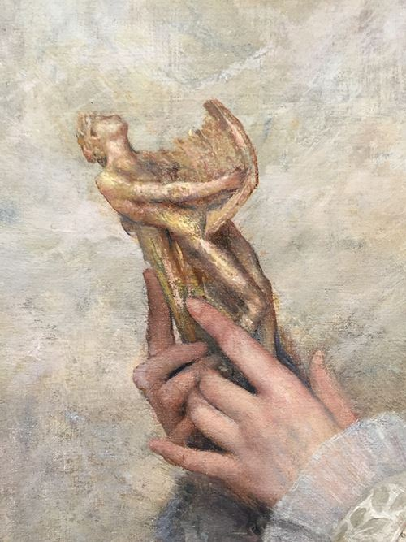
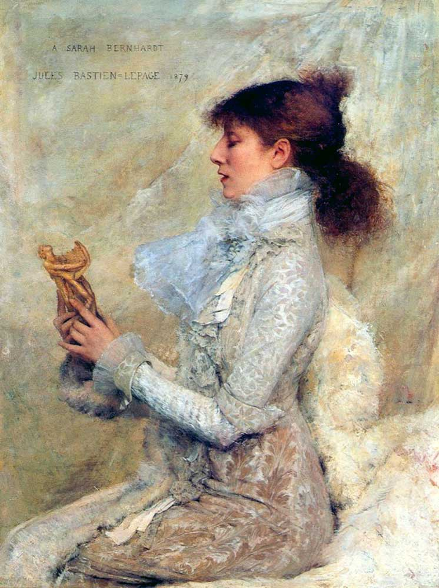
Portrait of Sarah Bernhardt holding a statue of Orpheus, 1879,Oil on Canvas, 44x35 cm, Legion of Honor museum, San Francisco, USA https://commons.wikimedia.org/wiki/File:%C2%A7%C2%A7Bernhardt,_Sarah_(1844-1923)_par_Jules_Bastien-Lepage_(1848-1884)_-_1879.jpg and https://www.stephenongpin.com/object/790361/0/orpheus

Slide 8
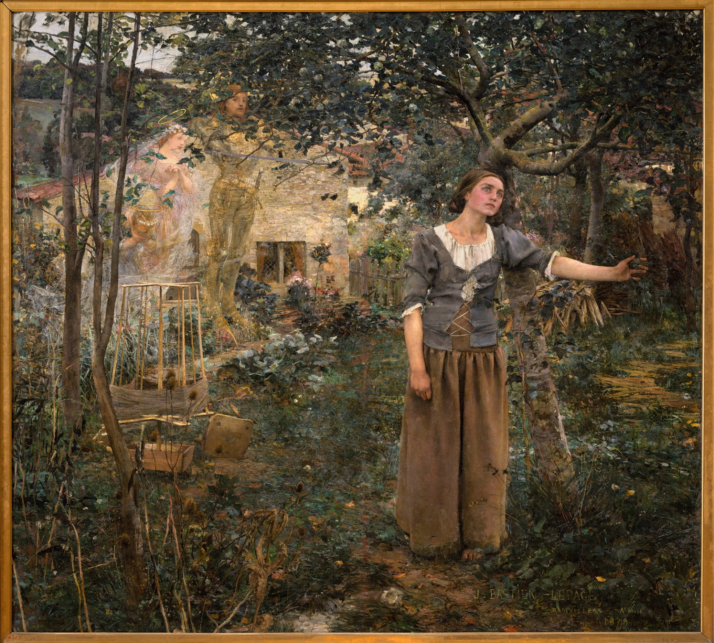
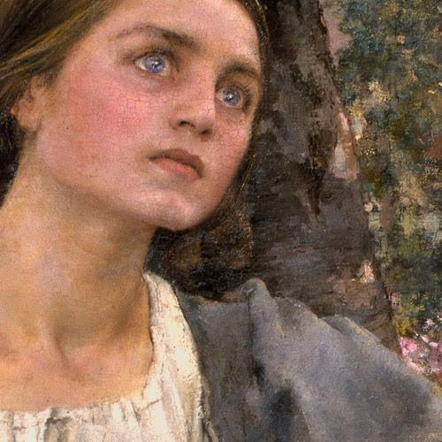
Joan of Arc, 1879, Oil on Canvas, 254 x 279.4 cm, the MET, NY, USA http://lacrank.blogspot.com/2017/03/jules-bastien-lepage-and-his-art.html

Slide 9
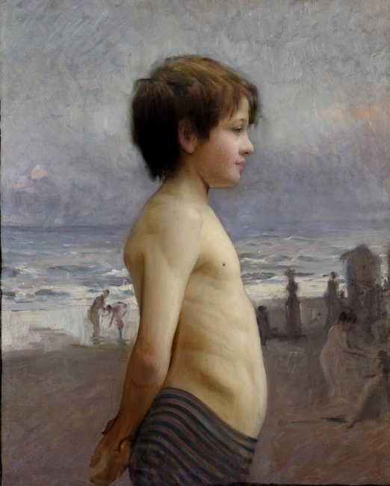
Young Boy in the Beach, 1880, Oil on Canvas, 80 x 65 cm. Musée d'Art et d'Industrie de Roubaix, France https://commons.wikimedia.org/wiki/File:Jules_Bastien-Lepage_Jeune_gar%C3%A7on_%C3%A0_la_plage_1880.jpg

Slide 10
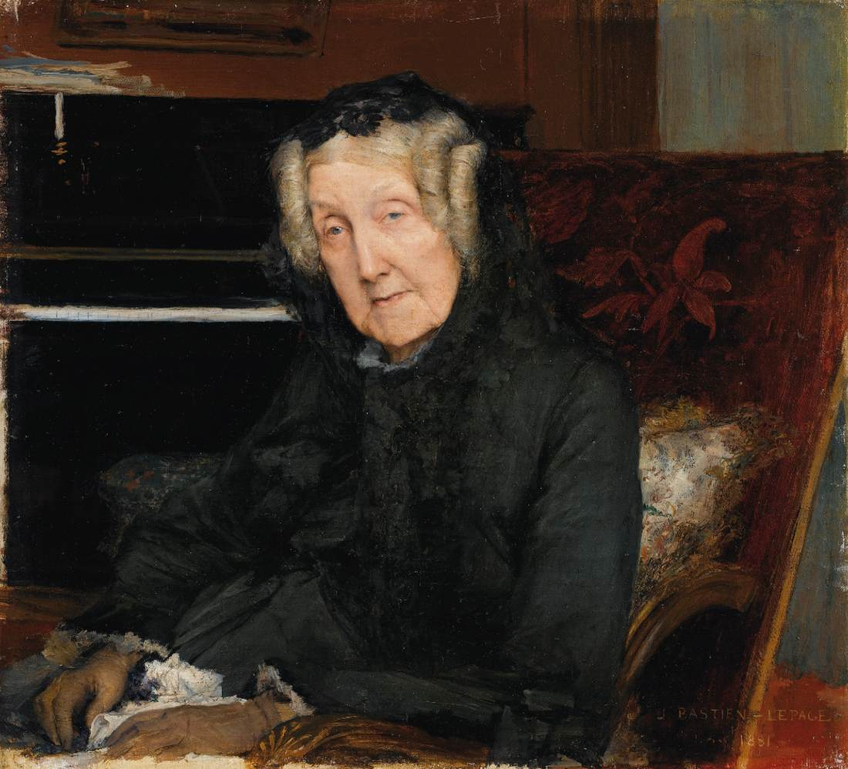
Portrait of Mme Waskiewicz, 1881, Oil on Canvas, 31 x 34 cm, Private collection https://www.wga.hu/frames-e.html?/html/b/bastien/index.html

Slide 11
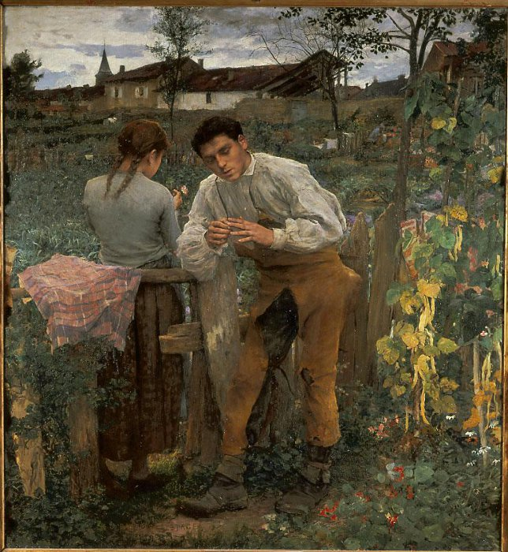
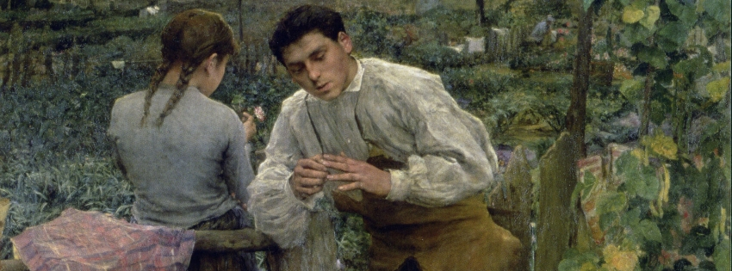
Rural Love, 1882, Oil on Canvas, 199 x 181 cm, Pushkin Museum Moskow, Russia https://collection.pushkinmuseum.art/entity/OBJECT/78059?index=0&paginator=entity-set&entityType=PERSON&entityId=445&attribute=objects and https://slowlander.com/2017/10/13/lamour-au-village-1882-jules-bastien-lepage/

Slide 12
The End

