Slide 1
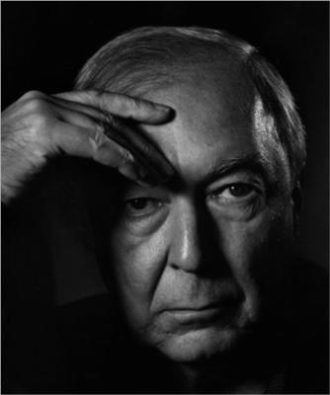
Jasper Johns Jr., b. May 15, 1930
10 Works of Art https://www.wikiart.org/en/jasper-johns

Slide 2
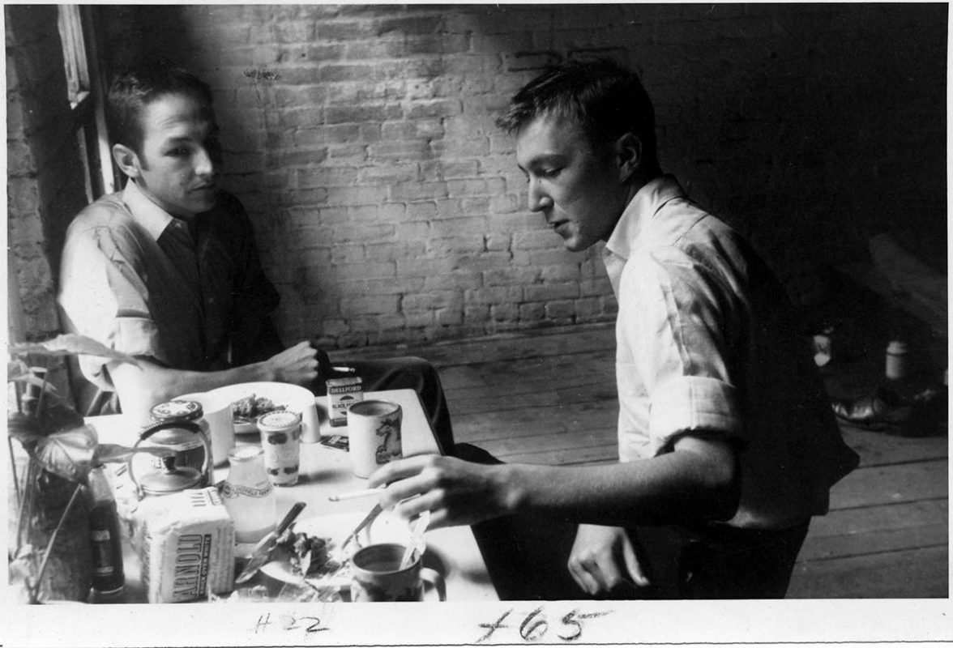
Robert Rauschenberg and Jasper Johns In John’s Peart Street Studio by Rachel Rosenthal, 1954, via MoMA, New York https://www.thecollector.com/jasper-johns/

Slide 3
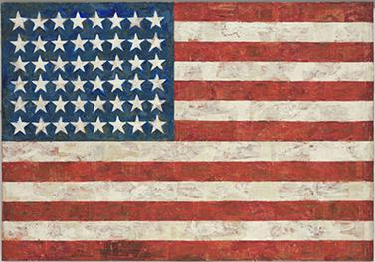
Flag, 1954-55, encaustic, oil and collage on fabric mounted on wood (3 panels), The Museum of Modern Art, New York, NY, USA https://en.wikipedia.org/wiki/Flag_%28painting%29#/media/File:Jasper_Johns's_'Flag',_Encaustic,_oil_and_collage_on_fabric_mounted_on_plywood,1954-55.jpg

Slide 4
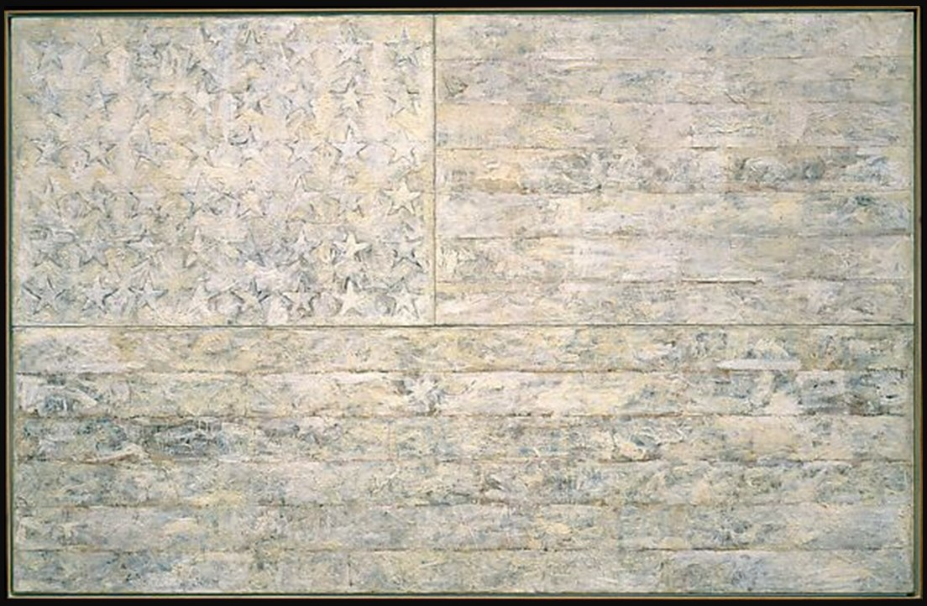
White Flag, 1955, Encaustic, Oil, Newsprint, and Charcoal on Canvas, 198.9 × 306.7 cm, the MET, NY, USA https://www.metmuseum.org/art/collection/search/487065

Slide 5
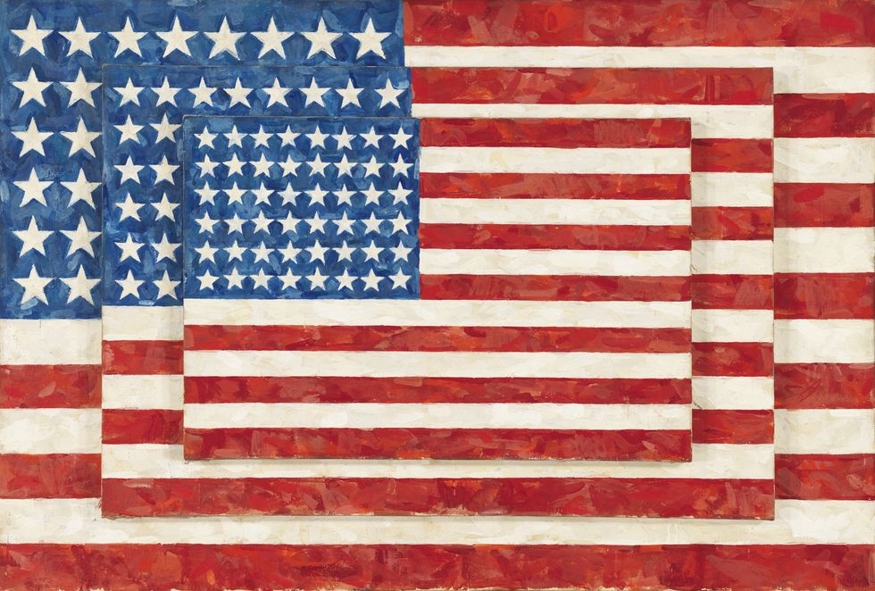
Three Flags, 1958, Encaustic on Canvas (three panels), 78.4 × 116.2 cm overall, Whitney Museum of American Art, NY, USA https://www.harpersbazaar.com/culture/features/a37530392/jasper-johns-september-2021

Slide 6
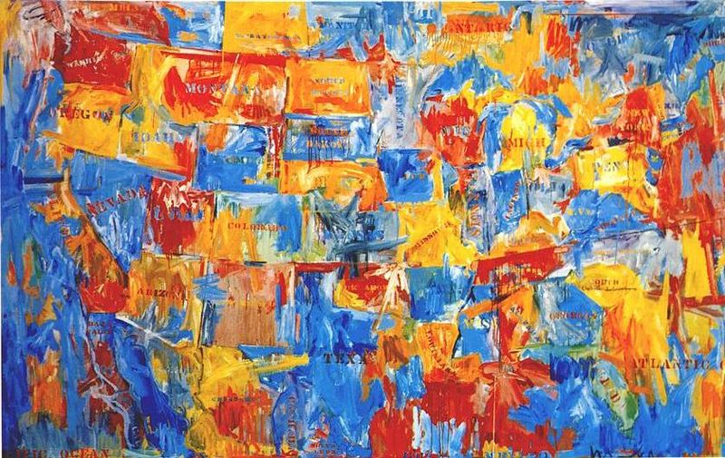
Map, 1961, Oil on canvas, 198.2 x 314.7 cm, MOMA, NY https://www.youtube.com/watch?v=wer4F-2qd-Y

Slide 7
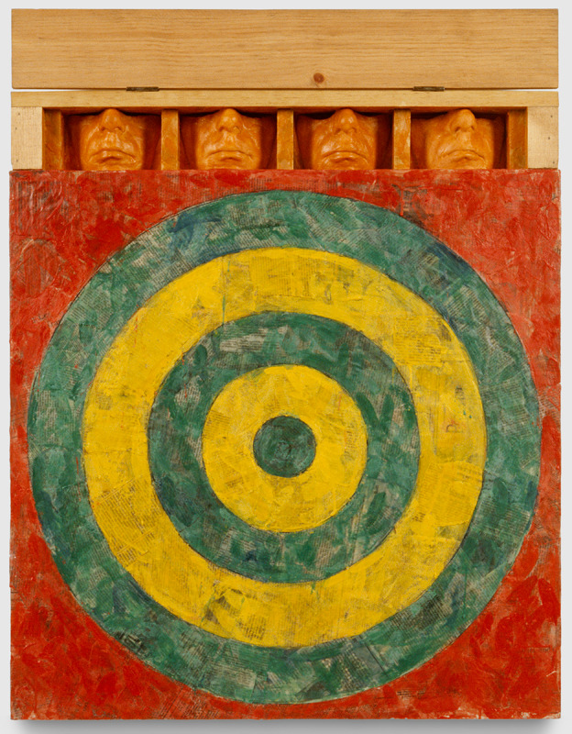
Johns Target with Four Faces (First Study), 1986, Encaustic and Collage on Canvas, Wood, Plaster,
86 × 66 cm, The Museum of Contemporary Art, Los Angeles, CA, USA https://matthewmarks.com/exhibitions/sturtevant-04-2024

Slide 8
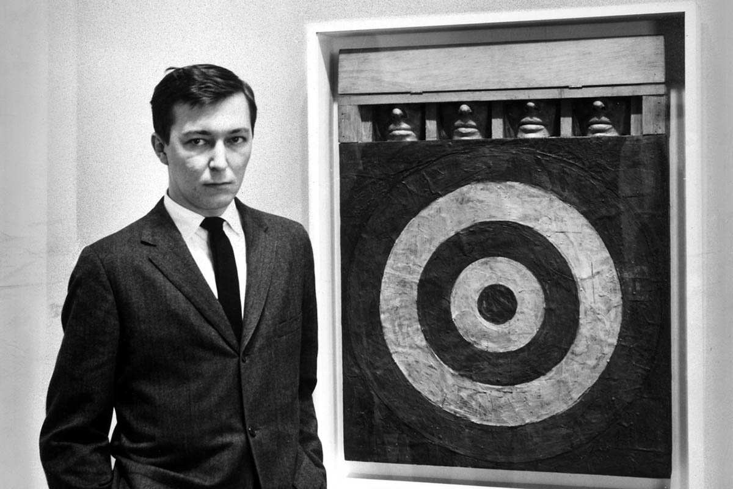
Jasper Johns and His Target by Ben Martin, 1959, via Getty Images https://www.thecollector.com/jasper-johns/

Slide 9
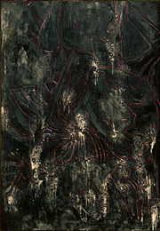
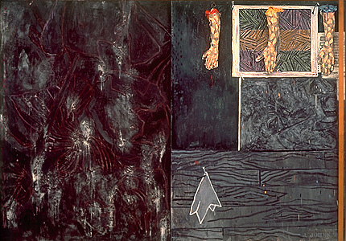
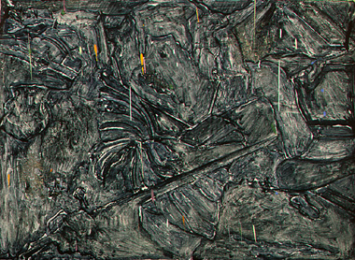
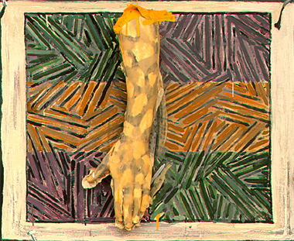
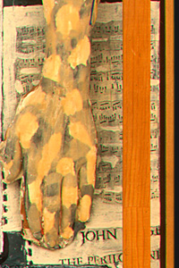
Perilous Night, 1982, Encaustic on Canvas with Objects, 170.5 x 244.2 x 15.9 cm, National Gallery of Art, Washington DC, USA

Slide 10
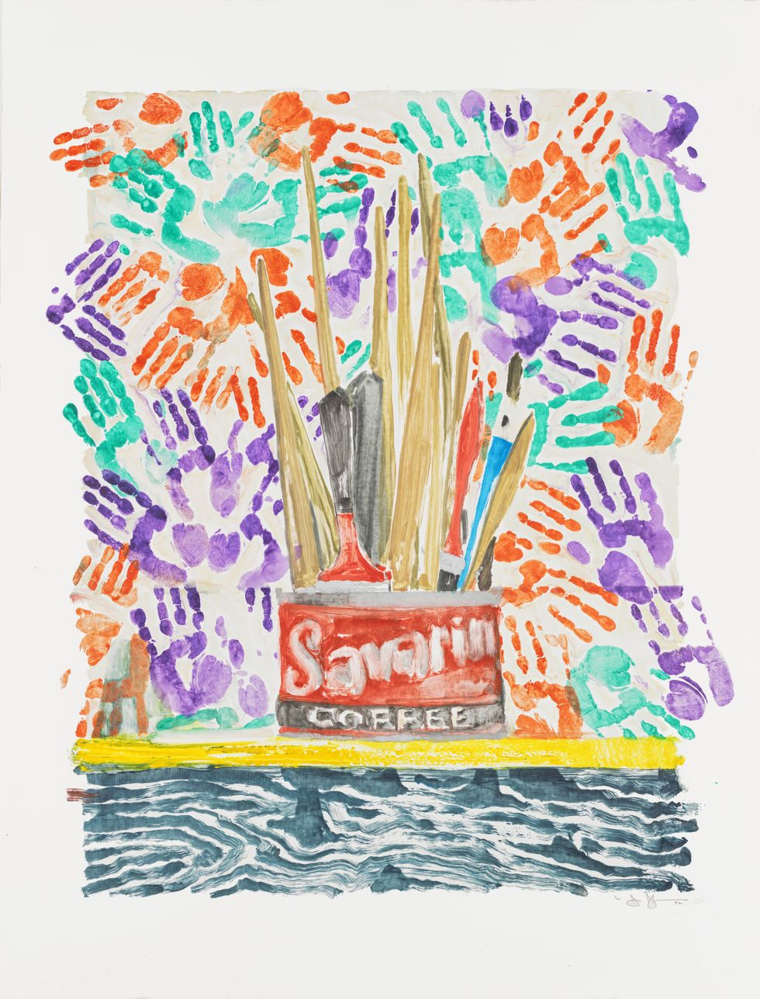
Savarin, 1982, Monotype, 127 × 96.5 cm, Whitney Museum of American Art, NY, USA https://www.harpersbazaar.com/culture/features/a37530392/jasper-johns-september-2021/

Slide 11
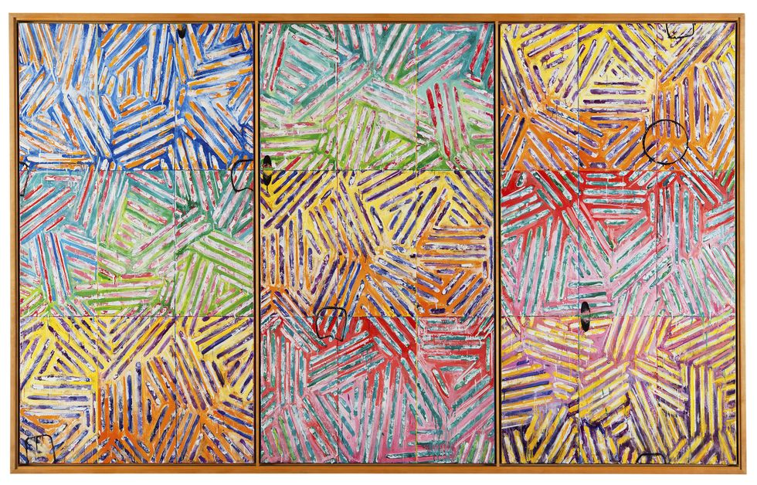
Usuyuki, 1982, Encaustic on Canvas (three panels), 180.3 × 288.9 cm overall, Sezon Museum of Modern Art, Nagano, Japan https://www.harpersbazaar.com/culture/features/a37530392/jasper-johns-september-2021

Slide 12
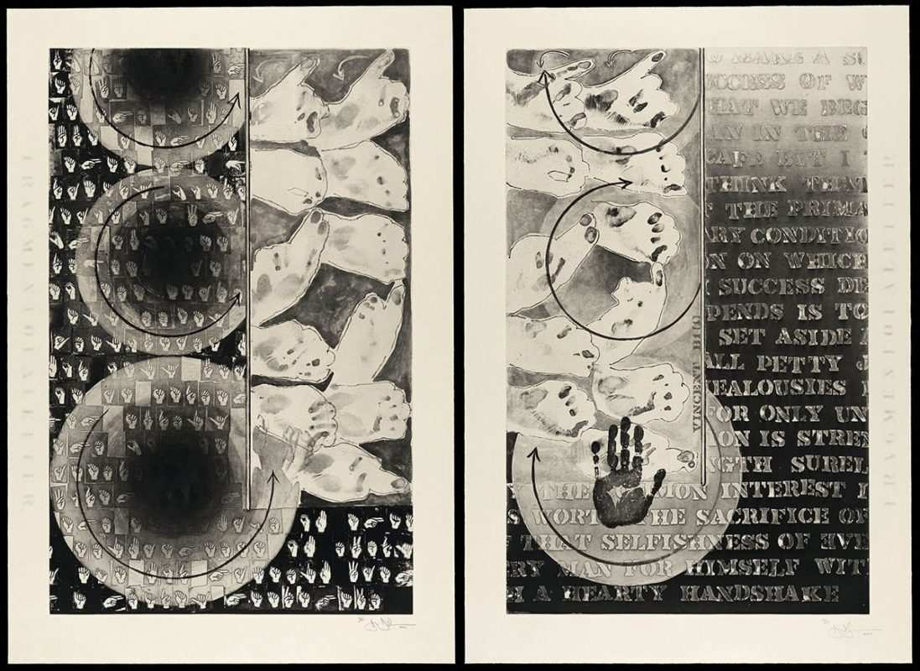
Fragment Of A Letter by Jasper Johns, 2009, 2 Intaglios in 1 colour on Echizen Torinoko handmade Paper, 114 × 77.5 cm, Edition of 51, in the Museum of Fine Arts, Boston, USA https://www.thecollector.com/jasper-johns/

Slide 13
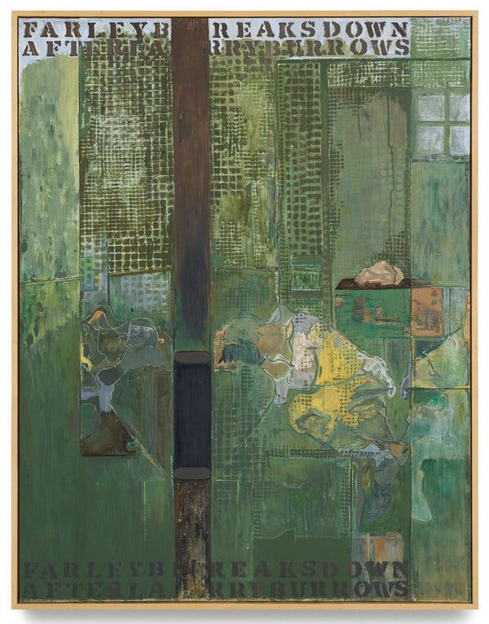
Untitled” (2018).Credit...Jasper Johns, “Untitled,” 2018. Oil on Canvas, Private Collection https://www.nytimes.com/2019/02/18/t-magazine/jasper-johns.html

Slide 14
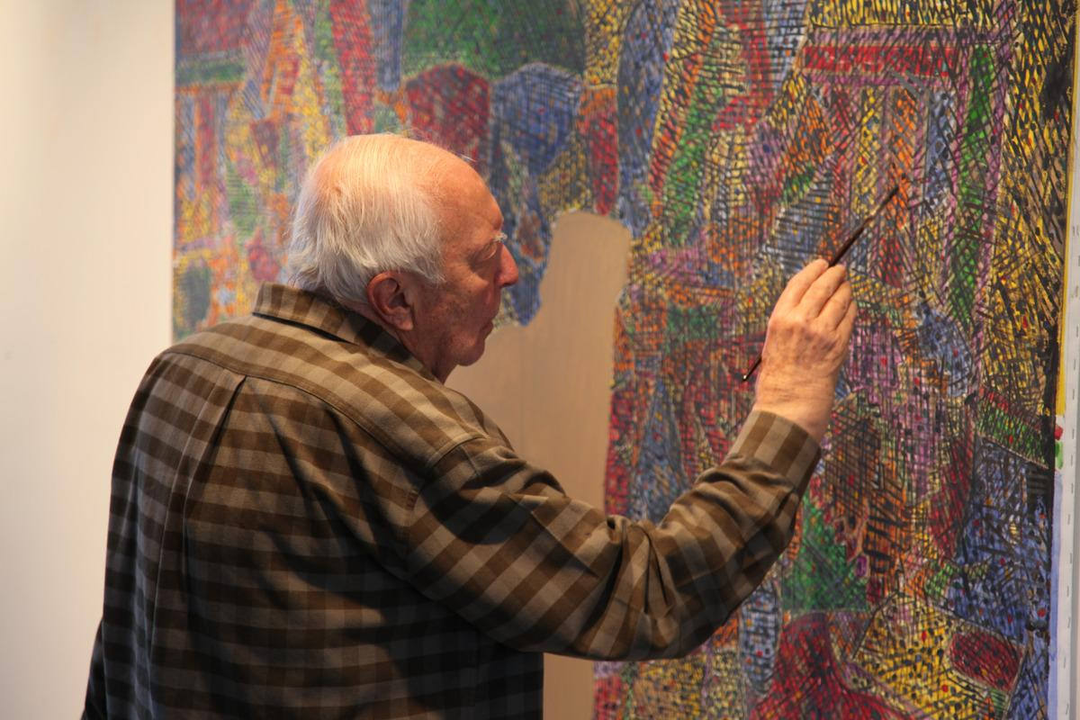
Jasper Johns working in his painting studio, Sharon Connecticut, 2013 https://www.artandobject.com/news/jasper-johns-turns-90

