Slide 1
The Treasure of Childeric I
Ruled 470 - 481/2 AD

Slide 2
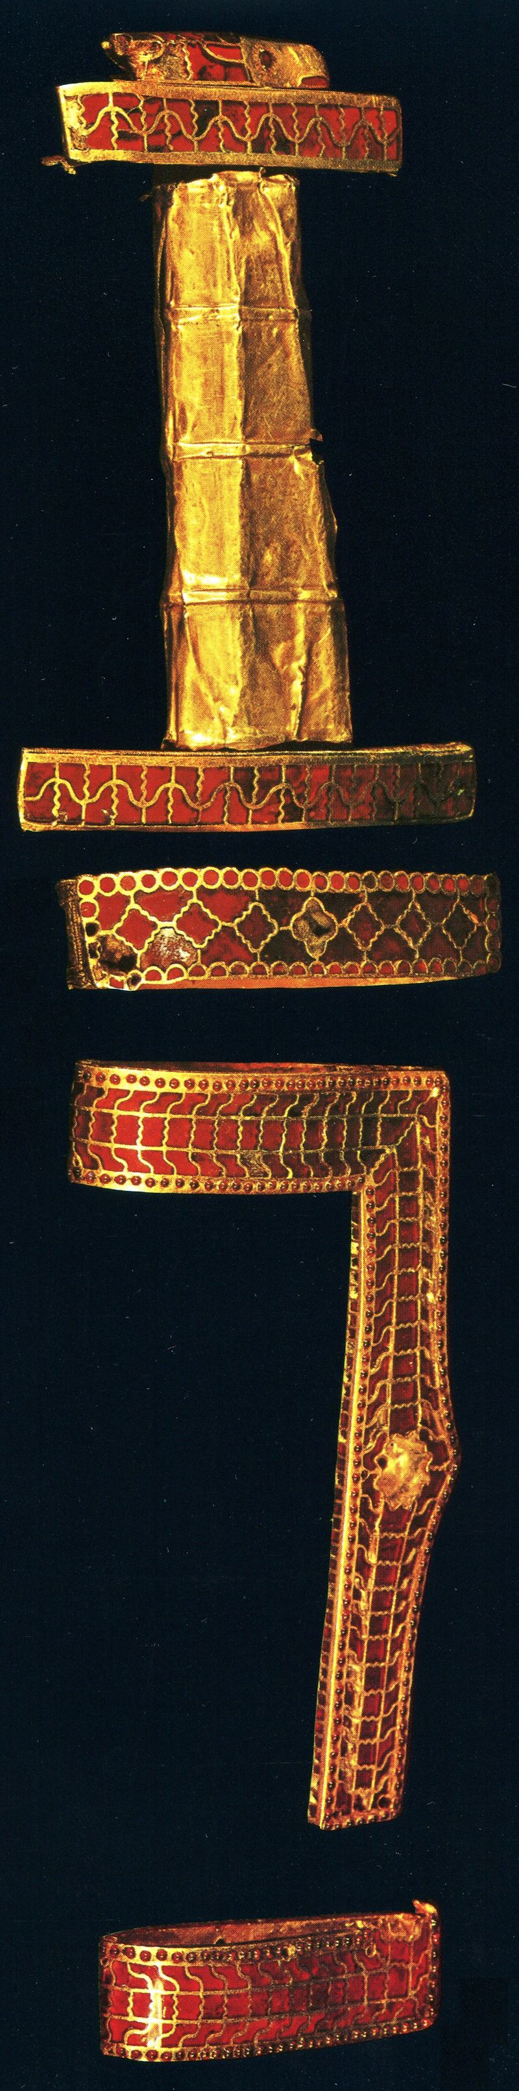
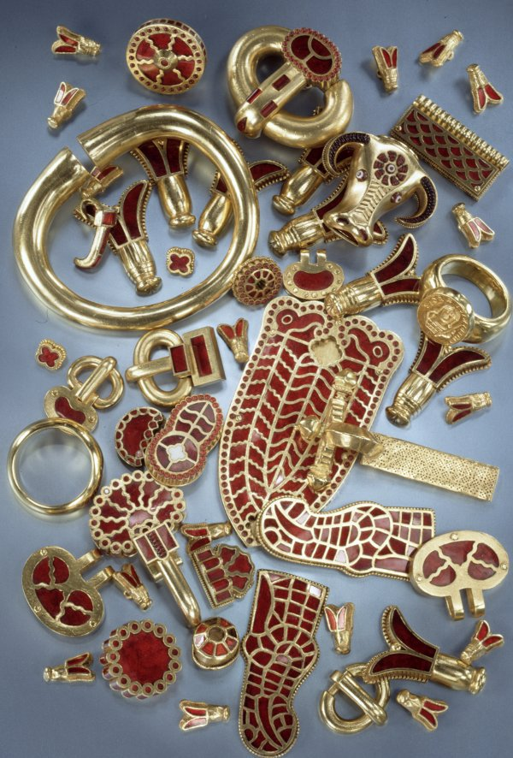
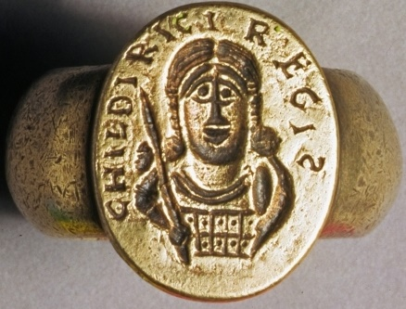
Among the greatest discoveries of lost objects was the 1653 accidental discovery of Childeric I’s Tomb (ruled 473–480) in the church of Saint Brice in Tournai.
The grave objects included a golden bull's head and the famous golden insects (perhaps bees, cicadas, aphids, or flies) on which Napoleon modelled his coronation cloak. https://twitter.com/caitlinrgreen/status/826771331106689024 and https://gr.pinterest.com/pin/455848793529220985/ and http://www.thehistoryblog.com/wp-content /uploads/2015/07/Childeric-hilt-of-double-edged-sword-or-spatha-and-fittings-from-scramasax-scabbard.jpg

Slide 3
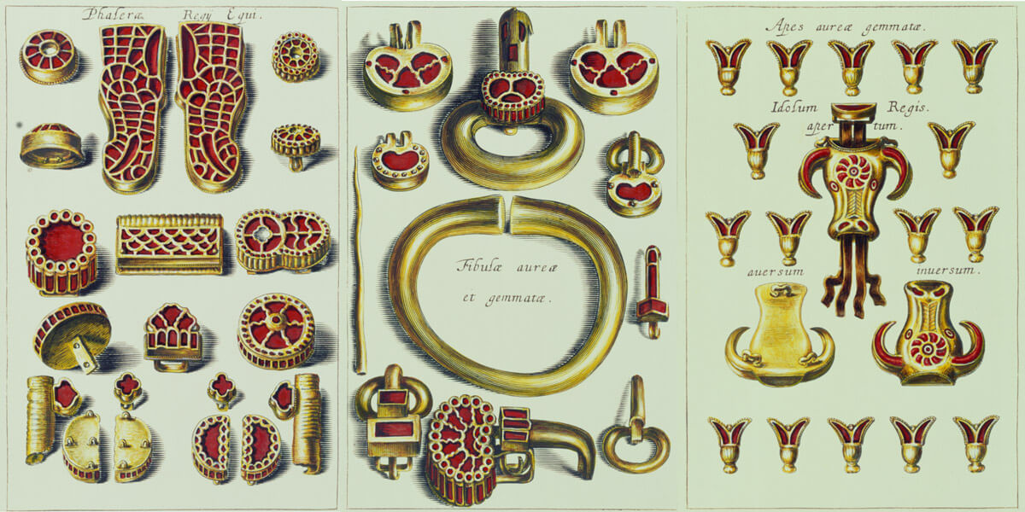
Illustrations from ‘’ Anastasis Childerici I Francorum regis, sive thesaurus sepulchralis Tornaci Neviorum effossus et commentario illustrates’ by Jean-Jacques Chifflet, Published 1655 https://barbarzynskie-tsunami.muzeum.szczecin.pl/wystawa-barbarzynskie-tsunami/wielkie-sprzatanie.html#fancybox-14

Slide 4
Replicas of the largely lost (melted down) 5thC treasure of Childeric I at Mainz, Germany https://twitter.com/caitlinrgreen/status/826771331106689024/photo/1

Slide 5
Childeric’s I intaglio Ring (a copy after te original was stolen and destroyed in 1831), Ashmolean Museum https://www.hhantiquejewelry.com/napoleon-bees-jewelry-tomb-childeric-i-symbols-empire/

Slide 6
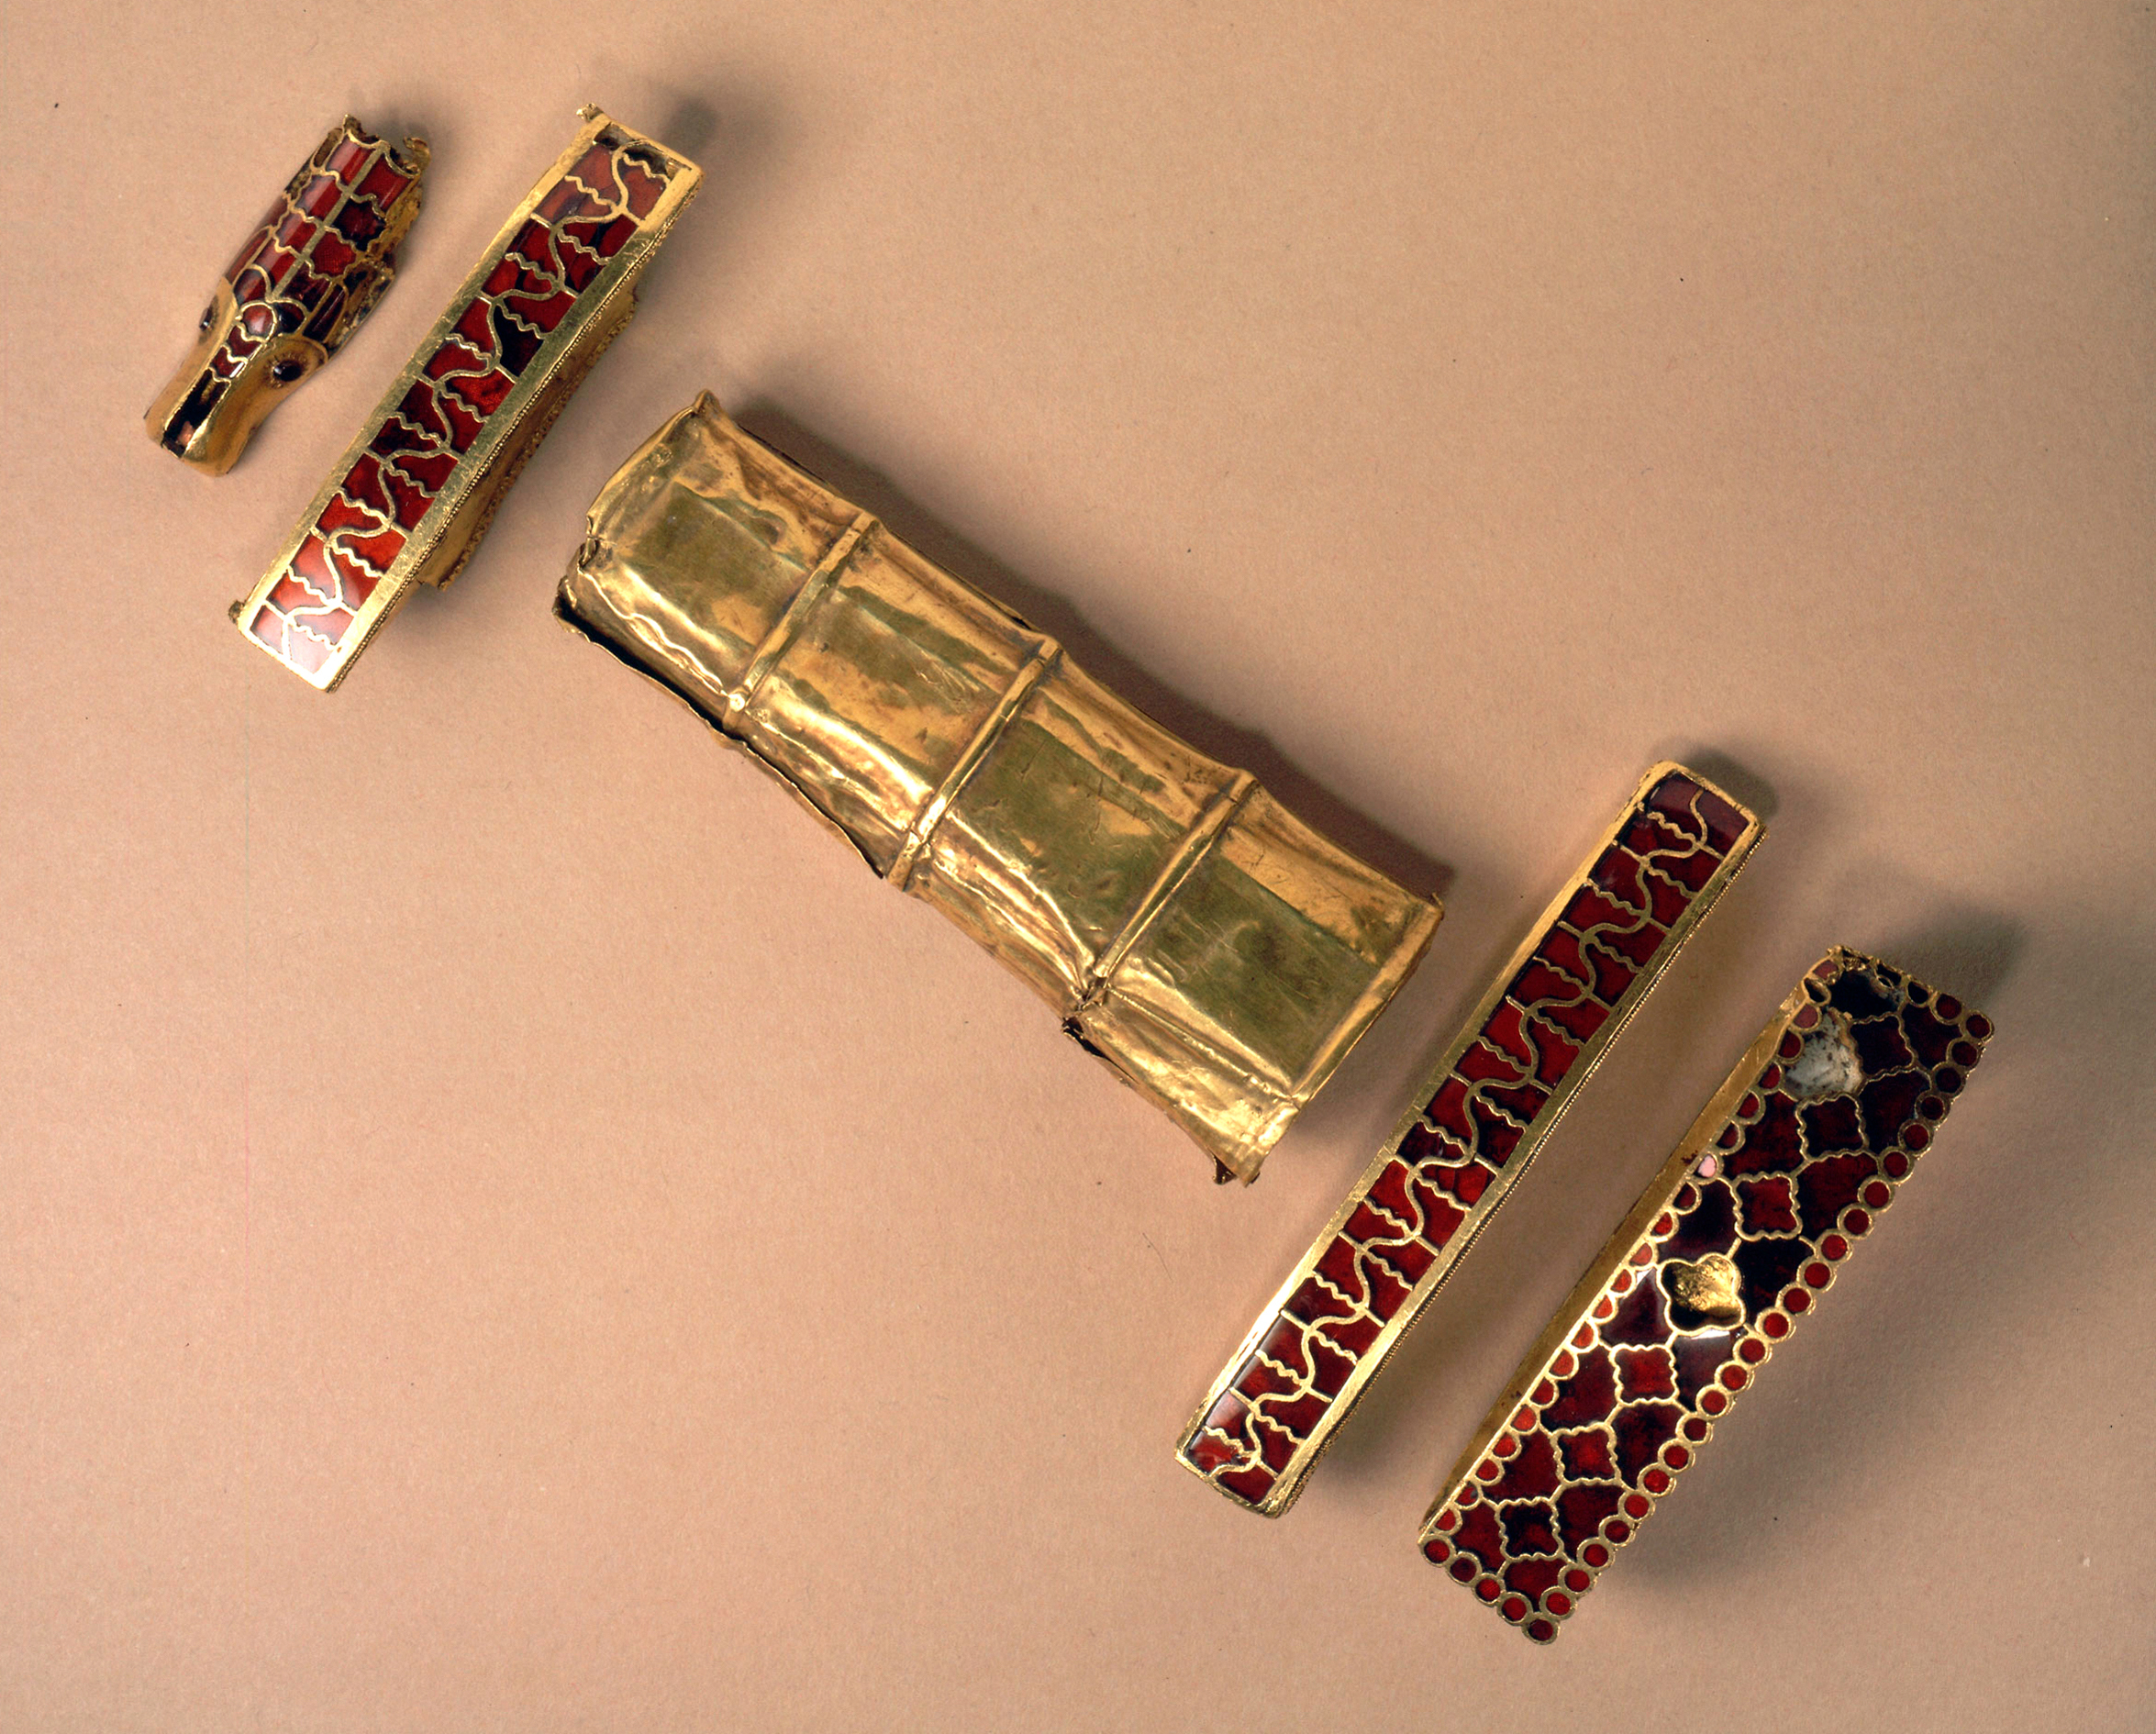
Hilt of a Spatha and fittings from a Scramasax of Childeric I, 5th century, National Library of France, Paris, France https://www.hhantiquejewelry.com/napoleon-bees-jewelry-tomb-childeric-i-symbols-empire/

Slide 7
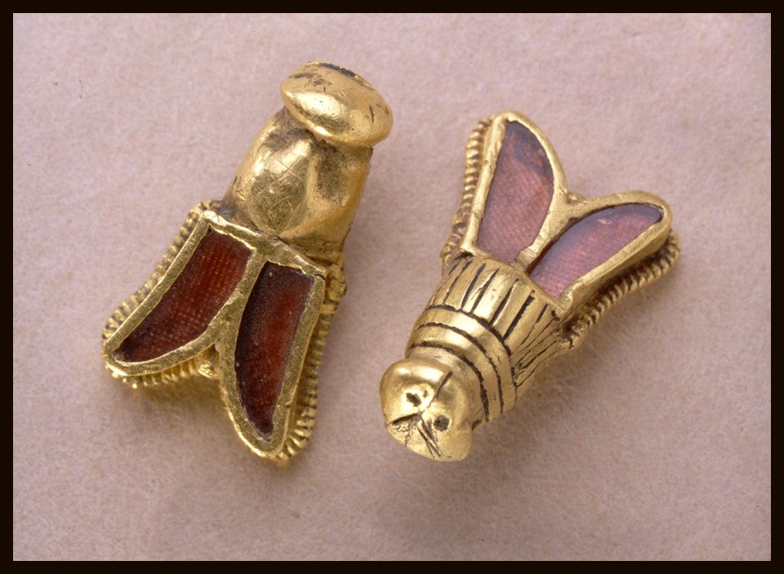
Detailed View of the surviving two Bees from the Treasure of Childeric I, 5th century, National Library of France, Paris, France https://www.hhantiquejewelry.com/napoleon-bees-jewelry-tomb-childeric-i-symbols-empire/

Slide 8
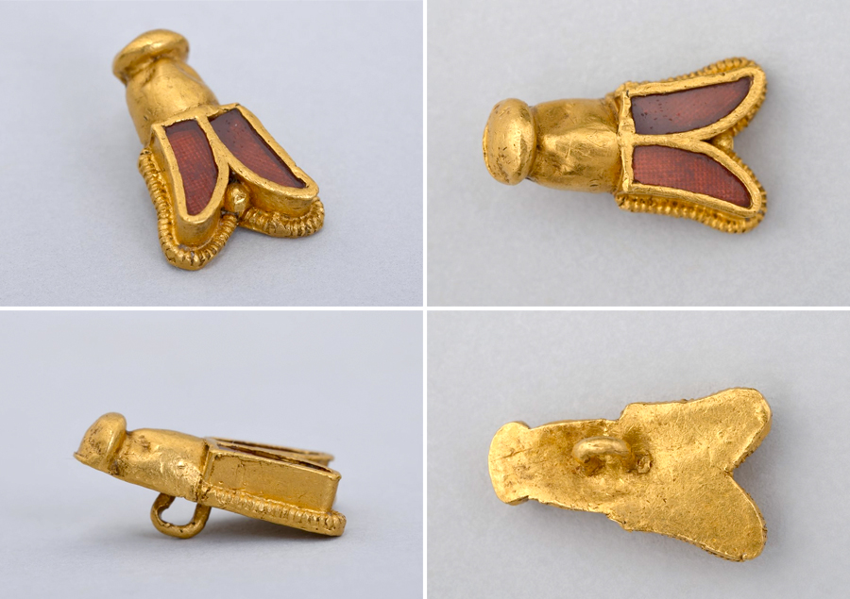
Detailed View of the surviving two Bees from the Treasure of Childeric I, 5th century, National Library of France, Paris, France https://www.hhantiquejewelry.com/napoleon-bees-jewelry-tomb-childeric-i-symbols-empire/

Slide 9
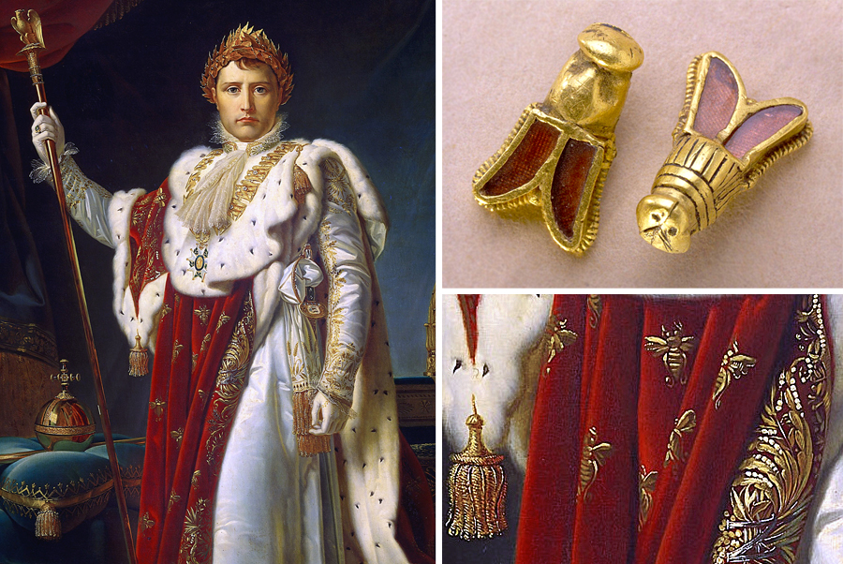
https://www.hhantiquejewelry.com/napoleon-bees-jewelry-tomb-childeric-i-symbols-empire/

Slide 10
The End

