Slide 1
Paul Signac
1863 – 1935
10 Paintings

Slide 2
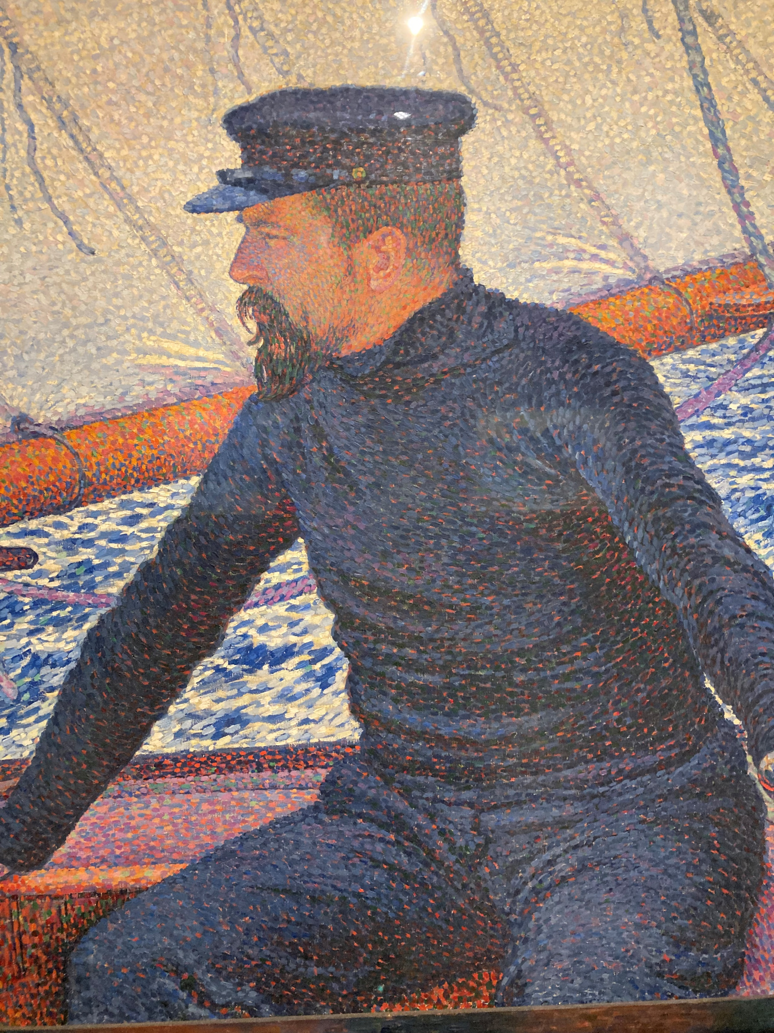
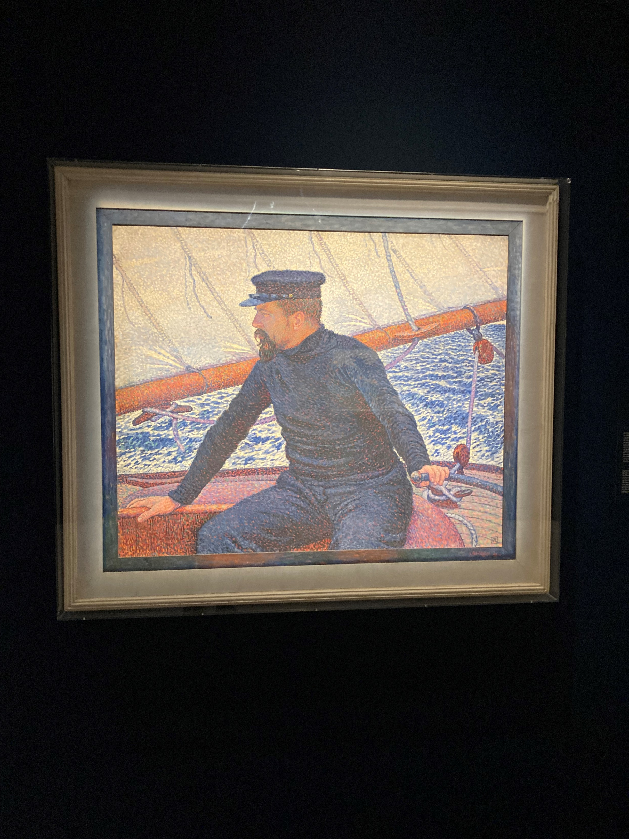
Théo van Rysselberghe, Belgian Artist,
1862-1926
Portrait of Paul Signac at the helm of the Olympia, 1896, Oil on Canvas, 93x114 cm, Private Collection
Photo Credit: Amalia Spiliakou, 2024

Slide 3
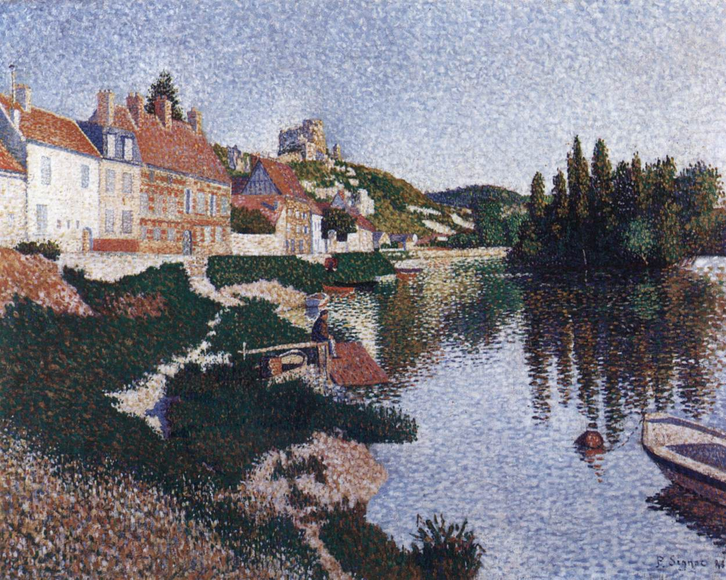
The River Bank, Petit-Andely, 1886, Oil on canvas, 65 x 81 cm,
Private collection https://www.wga.hu/frames-e.html?/html/s/signac/1/

Slide 4
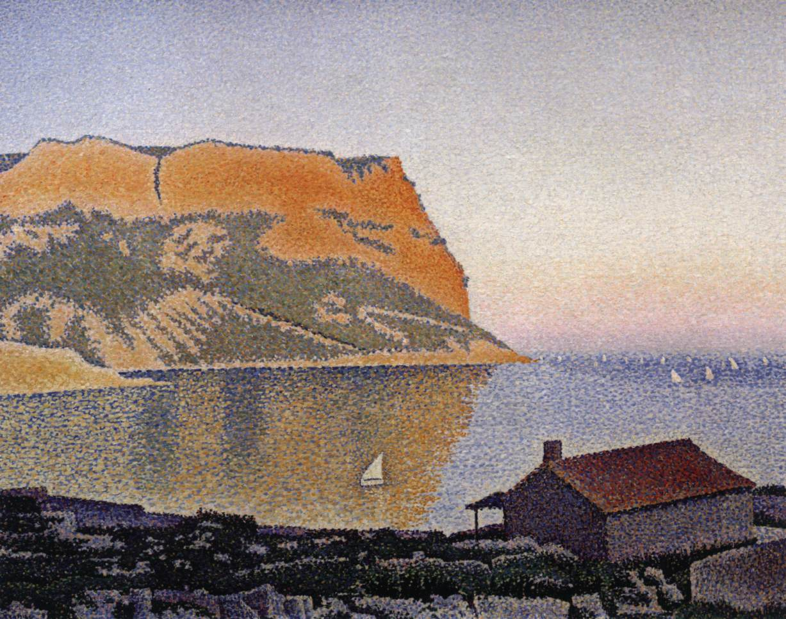
View of the Bay of Cassis, Cap Canaille, 1889, Oil on canvas, 66 x 82 cm, Private collection https://www.wga.hu/frames-e.html?/html/s/signac/1/

Slide 5
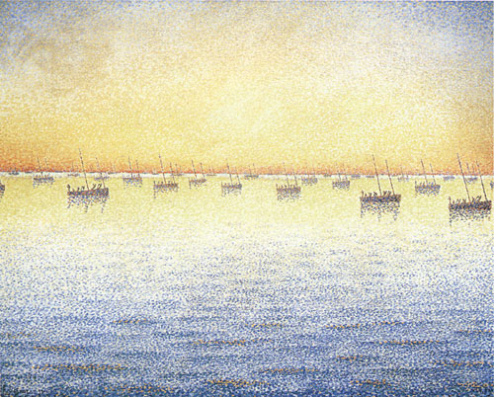
Setting Sun, Sardine Fishing, Concarneau, 1891, Oil on canvas,
65 x 81 cm, Museum of Moden Art, New York https://www.wikiart.org/store/en/paul-signac/concarneau-opus-221-adagio-1891

Slide 6
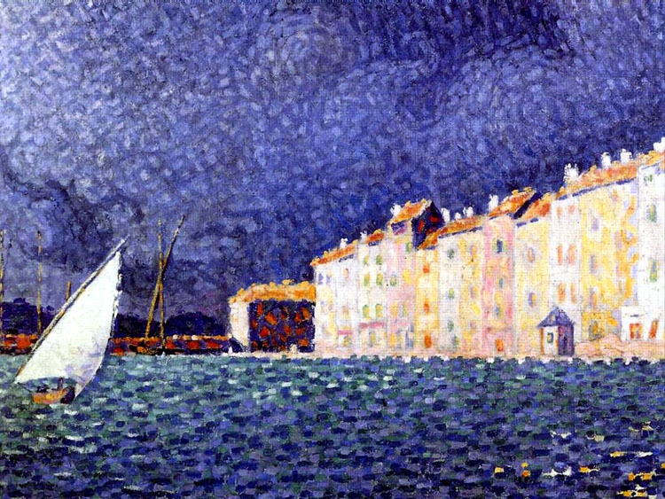
Saint-Tropez, the Storm, 1895, Oil on canvas, 47 x 55 cm, Musée de l'Annonciade, Saint-Trope, France https://commons.wikimedia.org/wiki/File:Signac-L%27orage-Saint-Tropez-Annonciade.jpg

Slide 7
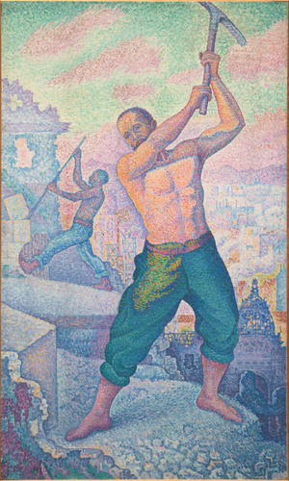
The Demolisher, between 1897 and 1899, Oil on canvas, 251,0x150,5 cm, Musée d’Orsay, Paris, France https://www.musee-orsay.fr/en/artworks/le-demolisseur-78255

Slide 8
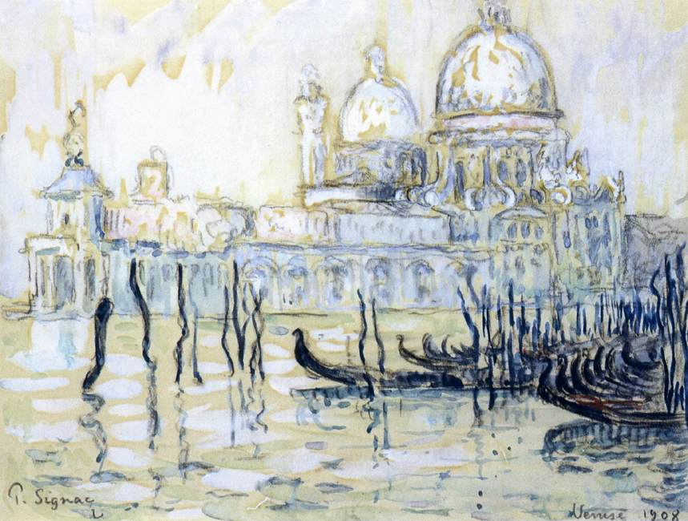
The Grand Canal, Venice, 1908, Watercolour,
190 x 250 mm,
Musée Marmottan Monet, Paris https://www.wga.hu/frames-e.html?/html/s/signac/1/

Slide 9
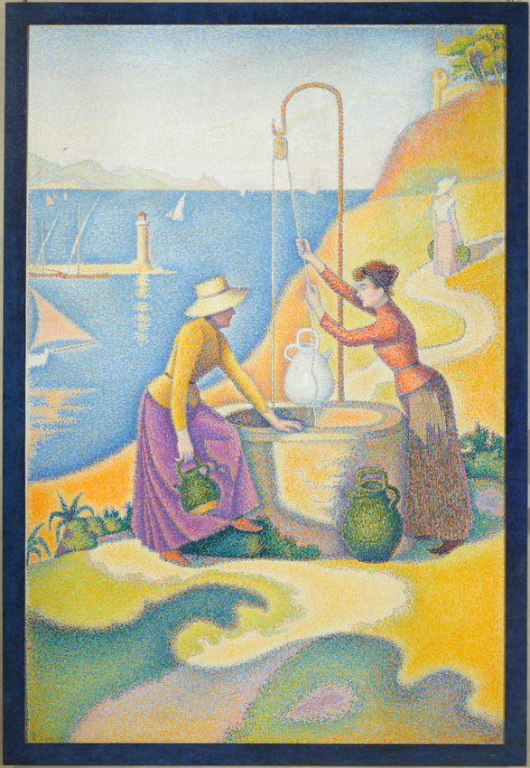
Women at the well, 1892, Oil on canvas, 194.5x130.0 cm, Musée d’Orsay, Paris, France https://www.musee-orsay.fr/fr/oeuvres/femmes-au-puits-opus-238-3017

Slide 10
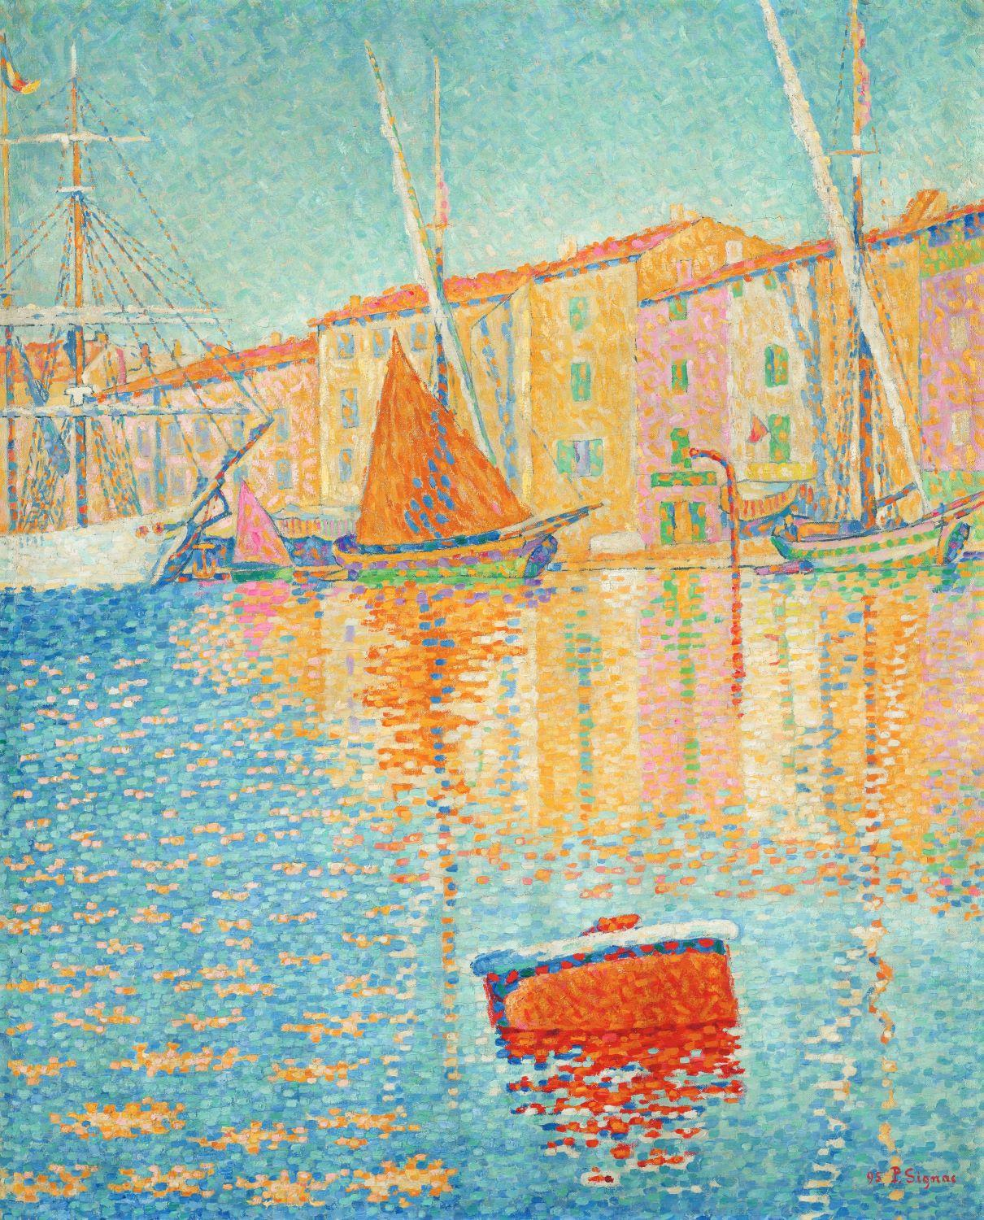
Saint Tropez, The Red Buoy, 1895,
Oil on canvas, 81.2x65.0 cm, Musée d’Orsay, Paris, France https://www.musee-orsay.fr/fr/oeuvres/saint-tropez-la-bouee-rouge-3016

Slide 11
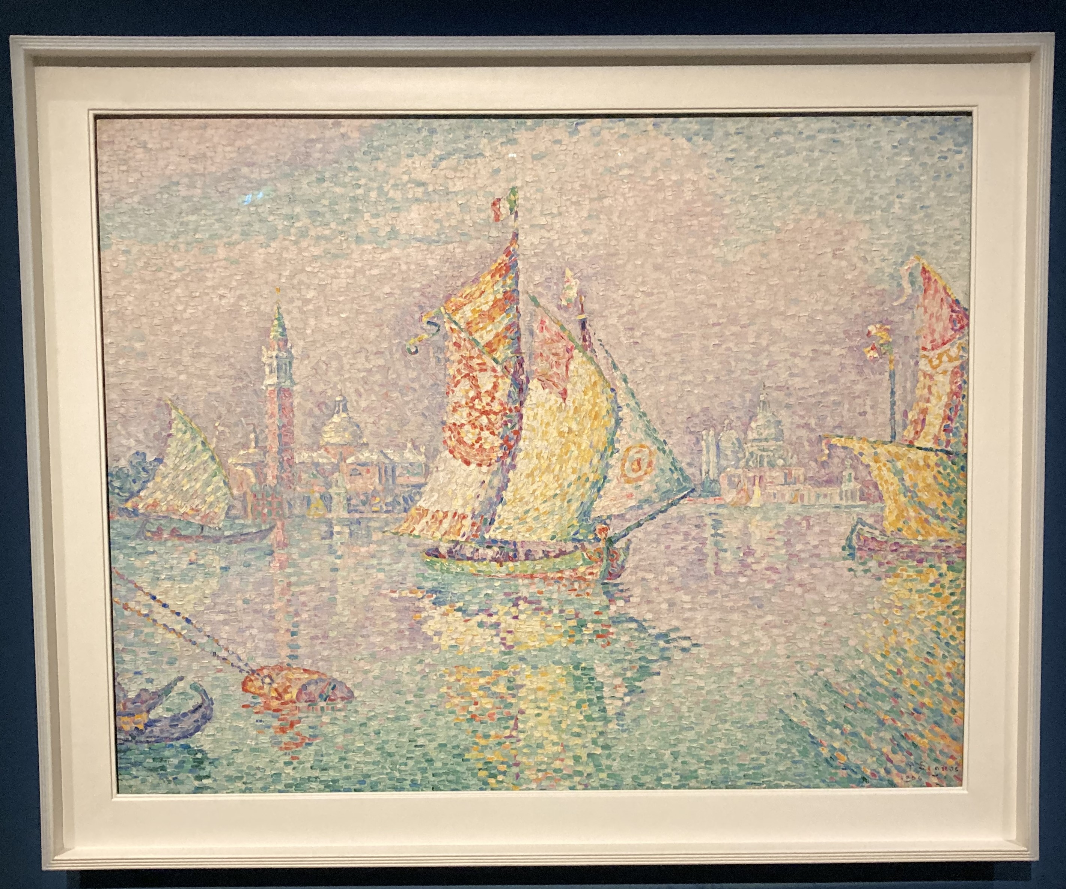
Venice, the Yellow Sail, 1904, Oil on Canvas, 73x92 cm, Centre Pompidou, Paris, France (In deposit to the Museum of Fine Arts and Archeology of Besançon since 1972) - Photo Credit: Amalia Spiliakou, Neo-Impressionism in the Colours of the Mediterranean Exhibition (10.01 - 07.04.2024), February 2024

Slide 12
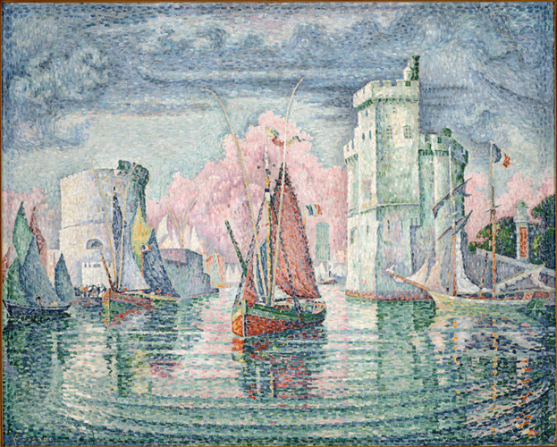
Entrance to the port of La Rochelle, 1921, Oil on canvas, 130.5x162.0 cm, Musée d’Orsay, Pris, France https://www.musee-orsay.fr/fr/oeuvres/entree-du-port-de-la-rochelle-7994

Slide 13
The End

